Slide 1
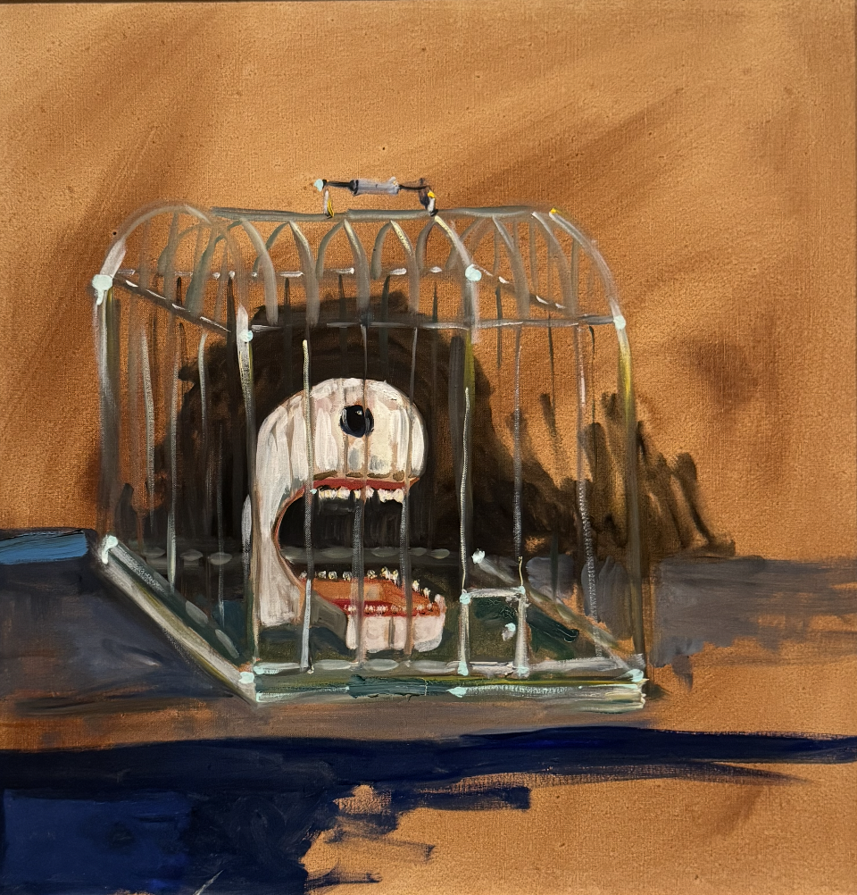
"Modernization" (现代化)
and Chinese Constitutionalism's "Lifeworld"
Presented at the European
China Law Studies Association
Annual Conference 2026
Panel on Chinese Constitutionalism
8 September 2026
University of Barcelona
Larry Catá Backer
Pennsylvania State University

Slide 2

The Problem
Three dominant Western narratives about Chinese constitutionalism:
Implementation gap — progressive constitution, inadequate enforcement
Façade constitutionalism — window dressing for authoritarian power
Transitology — economic reform will produce political liberalization
All three commit a fundamental analytical error
https://wherever-i-look.com/movies/bubble-2022-review-summary

Slide 3

Modernization is not something the Chinese constitutional system pursues; it is the medium through which the system understands itself.
— Central Thesis
“spread spring over China to those who make contribution to the four
Modernization”

Slide 4

Modernization as Lebenswelt
Lebenswelt (lifeworld): pre-given background of shared assumptions
Operates as a condition of intelligibility, not an object of justification
Modernization is not one goal among many — it is the organizing framework
Rule of law, common prosperity, ecological civilization — all are dimensions of modernization
As metasignifier: a sign that positions other signs without emptying them

Slide 5
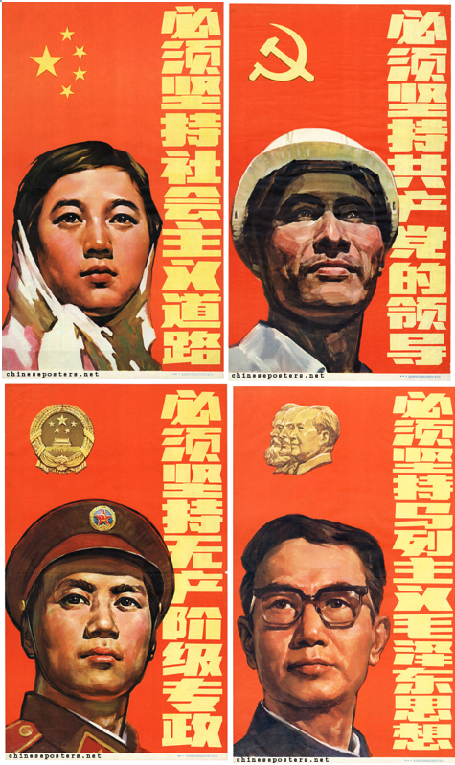
What are the foundational premises embedded in the Socialist (or Chinese style) modernization?
Its is modernization with the CPC at the center
National Characteristics
Core premises:
  Socialist
  Pathway towards Communism
  Political project (CPC at the center
  Development of productive forces
  Whole process democracy
  Create an international pathway

Slide 6

What are the ends of modernization?
Establishment of a Communist Society in China
That serves as a model of the world
Alignment between productive forces and State assets
All productive forces bent toward the fundamental terminal objective

Slide 7
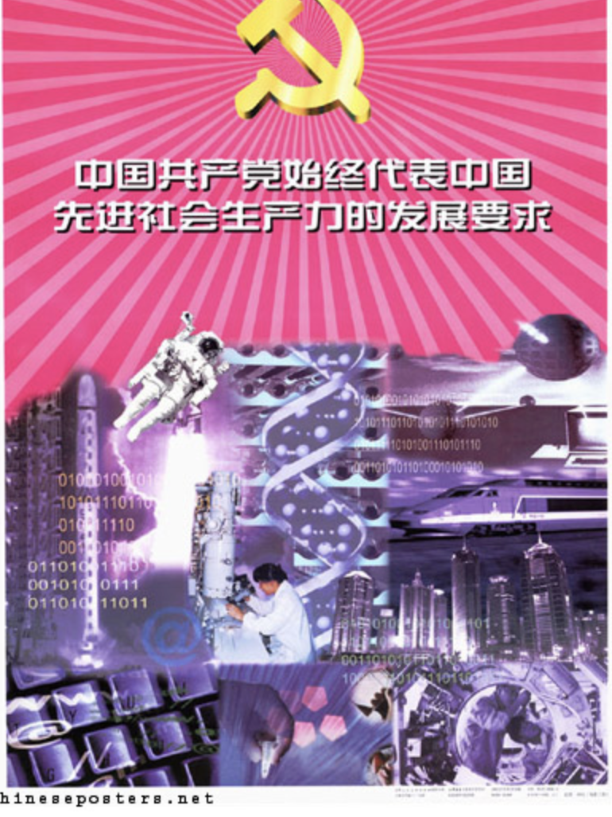
How is the constitutional concept of modernization expressed in institutional action?
Development of productive forces must move along socialist path in the right direction
CPC is the apex manifestation of productive forces, and its legitimate driver
  Democratic centralism
Chinese people are the object of modernization and the engine of its fulfillment
  People’s democratic dictatorship
  Whole process consultative democracy

Slide 8
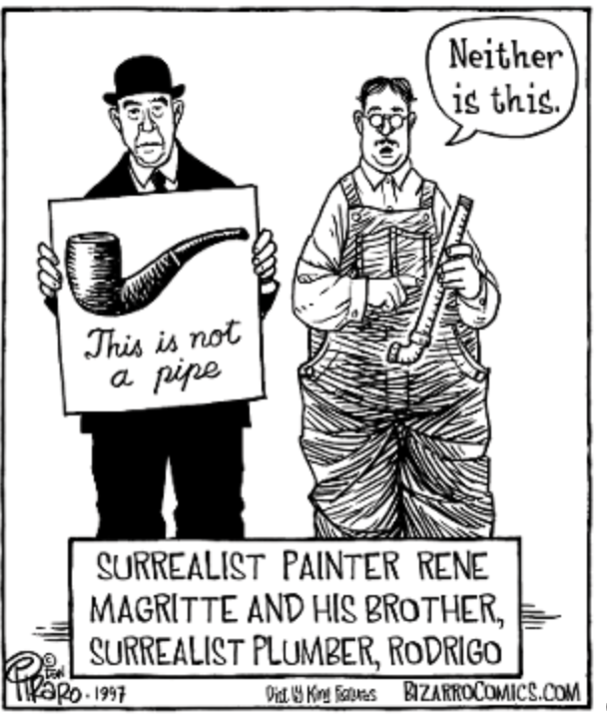
What are the constitutional forms of modernization thus understood?
The role of constitutional text
Modernization project drives text; text does not drive modernization
Constitutionalism
  The study of a critical productive force in the structuring and institutionalization of order, and
  The means by which the normative imperatives of socialist modernization is realized.

Slide 9

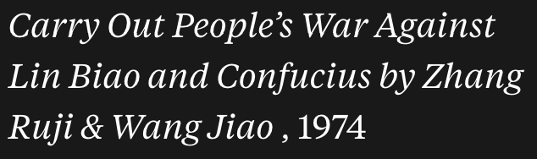
From Lebenswelt to Analytic Risk
Projecting one order's constitutive assumptions onto another
Implementation gap: assumes universal constitutional function
Façade: assumes constraining force = genuine constitutionalism
Transitology: assumes modernization is instrumental, pointing beyond itself
Chinese constitution: representational and constitutive, not constraining

Slide 10
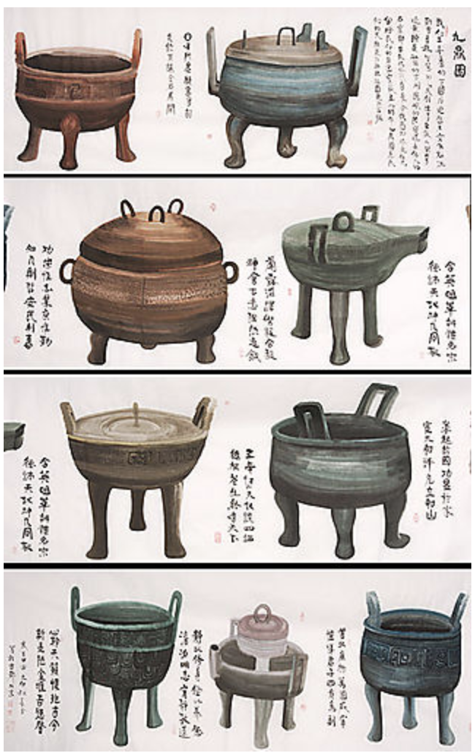
Implications for Policy
Modernization has a long memory — invokes a century of experience
Modernization organizes the whole program — not one policy among many
Party legitimacy tied to direction, not to outcome thresholds
Do not misidentify the system — distinct constitutional form
Accurate interpretation is not endorsement
The power of regulatory cages; the vessel (鼎) of state power; A productive force; Modernization to high or new quality production

Slide 11
Thank You
Access Paper “Modernization” (现代化) and Chinese Constitutionalism’s “Lifeworld”; Constitutionalism as the Institutionalized Phenomenology of Modernization; A Semiotic-Phenomenological Analysis of Modernization Discourse in Chinese Marxist-Leninist Political-Legal Theory [现代化作为中国宪政的生活世界 ].
ENGLISH: https://www.backerinlaw.com/Site/wp-content/uploads/2026/08/FINAL_Modernization_as_Lebensweltv3_CLEAN_Working_Paper3.pdf
点击此处获取论文: https://www.backerinlaw.com/Site/wp-content/uploads/2026/08/FINAL_%E7%8E%B0%E4%BB%A3%E5%8C%96%E4%BD%9C%E4%B8%BA%E4%B8%AD%E5%9B%BD%E5%AE%AA%E6%94%BF%E7%9A%84%E7%94%9F%E6%B4%BB%E4%B8%96%E7%95%8C_%E5%B7%A5%E4%BD%9C%E8%AE%BA%E6%96%8711.pdf

