Slide 1
LECTURE Seven
Comparative AI Governance
How the U.S., EU, China, and UN construct AI as different governance objects.
Larry Cata Backer – (白 轲)
W. Richard and Mary Eshelman Faculty Scholar; Professor of Law and International Affairs
Lecture Six - Comparative AI Governance
1

Slide 2
Core Thesis
AI governance systems sound similar but allocate authority differently.
THESIS
AI governance is not one global project. It is a field of competing political rationalities.
Shared vocabulary: safe, secure, trustworthy, beneficial AI
Different objects: innovation market, risk system, strategic infrastructure, global concern
Key dispute: who governs, when governance occurs, and whose values dominate
Lecture Six - Comparative AI Governance
2

Slide 3
Comparative Frame
The same technology becomes four different governance objects.
United States
Innovation market
Strategic asset
AI GOVERNANCE
European Union
Risk-bearing system
Legal market object
China
Strategic productive force
Development-security infrastructure
United Nations
Global coordination site
Norms and capacity-building
Lecture Six - Comparative AI Governance
3

Slide 4
Shared Themes Across Systems
Vocabulary converges even when institutions diverge.
Safety
Risk management, product safety, social order, human rights
Security
Cybersecurity, national security, compute, chips, infrastructure
Transparency
Disclosures, documentation, filing, scientific assessment
Accountability
Responsibility across providers, deployers, platforms, users
Innovation
No major system wants to stop AI development
Data
Training data, privacy, copyright, sovereignty, cross-border flows
Infrastructure
From models to compute, cloud, energy, and supply chains
Key Idea: the dispute is not whether AI matters; the dispute is the institutional design for governing it.
Lecture Six - Comparative AI Governance
4

Slide 5
Alignment versus Divergence
Agreement at the level of language; disagreement at the level of institutional design.
Points of Alignment
Points of Divergence
AI is transformative
AI creates serious risks
Standards and expertise matter
General-purpose AI complicates responsibility
International cooperation is necessary
Role of the state
Role of Market
Objective of innovation
Timing: ex post, ex ante, continuous oversight
Theory of harm
Source of legitimacy
Authority over platforms and infrastructure
Lecture Six - Comparative AI Governance
5

Slide 6
Fundamental Differences
The models differ most in authority, timing, harm, and legitimacy.
U.S.
Fragmented state + private sector
Often ex post correction
Harm translated into existing law
Legitimacy through innovation
EU
Legal-bureaucratic supervision
Ex ante and lifecycle duties
Risk to safety and rights
Legitimacy through legality and rights
China
Party-state coordination
Continuous administrative oversight
Security, content, public opinion. Legitimacy through development and stability
UN
Multilateral convener
Agenda-setting and norm-making
Global inequality and human rights
Legitimacy through inclusion and universality
Lecture Six - Comparative AI Governance
6

Slide 7
United States Model
Monitored markets plus strategic statecraft.
Strengths
Weaknesses
Innovation capacity and private capital
Flexible existing-law enforcement
Strong standards ecosystem
Geopolitical and infrastructural power
Multiple points of contestation
Fragmented obligations
Reactive enforcement after harm
Heavy dependence on private governance
Uneven rights protection
National-security secrecy and concentration
Lecture Six - Comparative AI Governance
7

Slide 8
European Union Model
Risk-based supervisory governance.
Strengths
Weaknesses
Clear legal architecture
Fundamental-rights orientation
Ex ante governance for high-risk systems
Lifecycle duties: logs, monitoring, incidents
Market influence beyond Europe
Complex classification and compliance
Enforcement capacity must mature
Risk of paper compliance
Slower than technical change
Burdens may favor large firms
Lecture Six - Comparative AI Governance
8

Slide 9
China Model
Development-security governance under party-state coordination.
Strengths
Weaknesses
Treats AI as infrastructure
Administrative speed and coordination
Early focus on recommenders and synthetic media
Integration of data, platforms, security, industry
Clear national development direction
Safety intertwined with political control
Opaque enforcement expectations
Constrained speech and experimentation
Compliance uncertainty
International trust deficits
Lecture Six - Comparative AI Governance
9

Slide 10
United Nations Model
Global coordination, legitimacy, and capacity-building.
Strengths
Weaknesses
Includes countries outside frontier AI ecosystems
Frames AI as a humanity-wide issue
Connects governance to development
Can build shared scientific assessment
Supports interoperability among systems
Limited enforcement power
Geopolitical conflict shapes negotiations
Principles can become abstract
Multilateral processes move slowly
Formal equality does not equal capacity equality
Lecture Six - Comparative AI Governance
10

Slide 11
Central Comparative Tension
Every system balances innovation, rights, security, and control differently.
INNOVATION
CONTROL
GOVERNANCE CHOICE
SECURITY
RIGHTS
No model solves the whole problem: the U.S. sees innovation, the EU sees rights, China sees infrastructure, and the UN sees global legitimacy.
Lecture Six - Comparative AI Governance
11

Slide 12
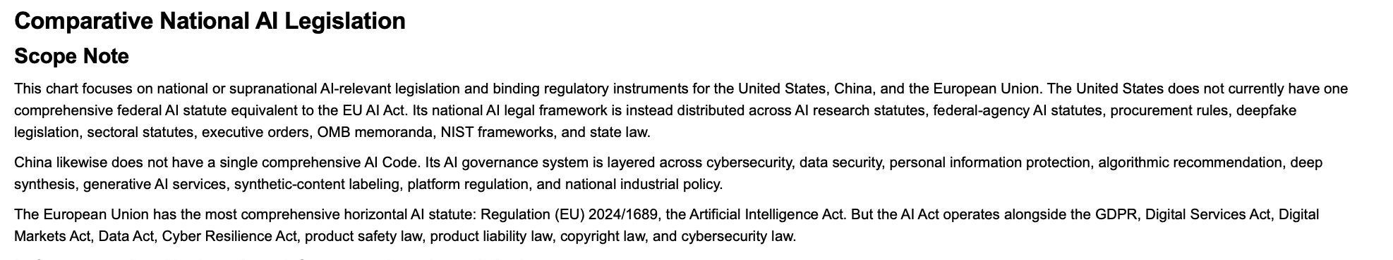
Comparative National Legislation

Slide 13
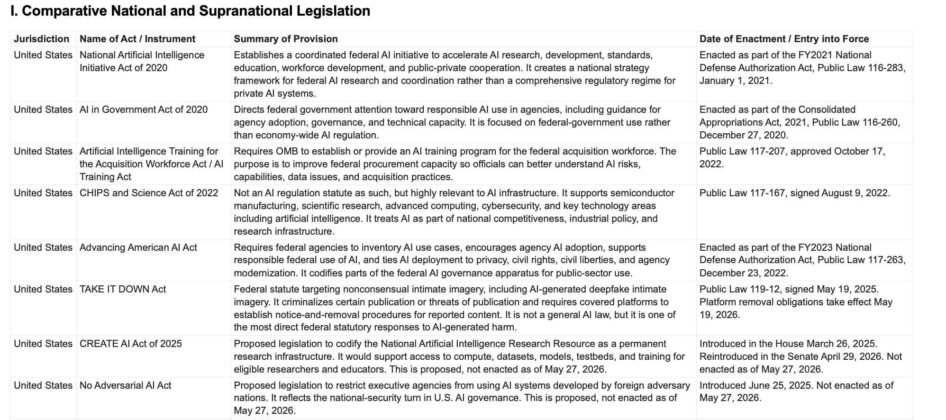
Comparative National Legislation (2)

Slide 14
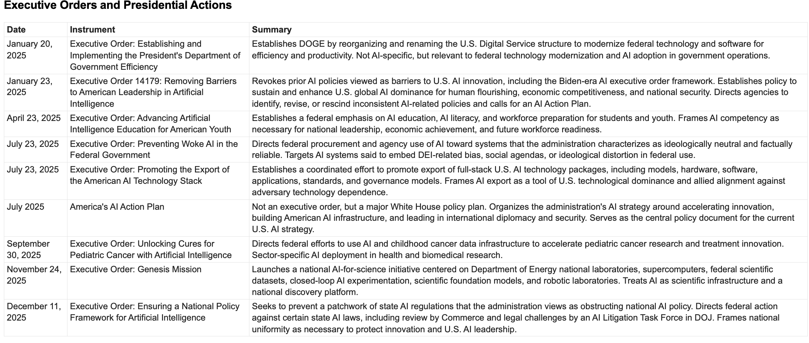
Comparative National Legislation (3)

Slide 15
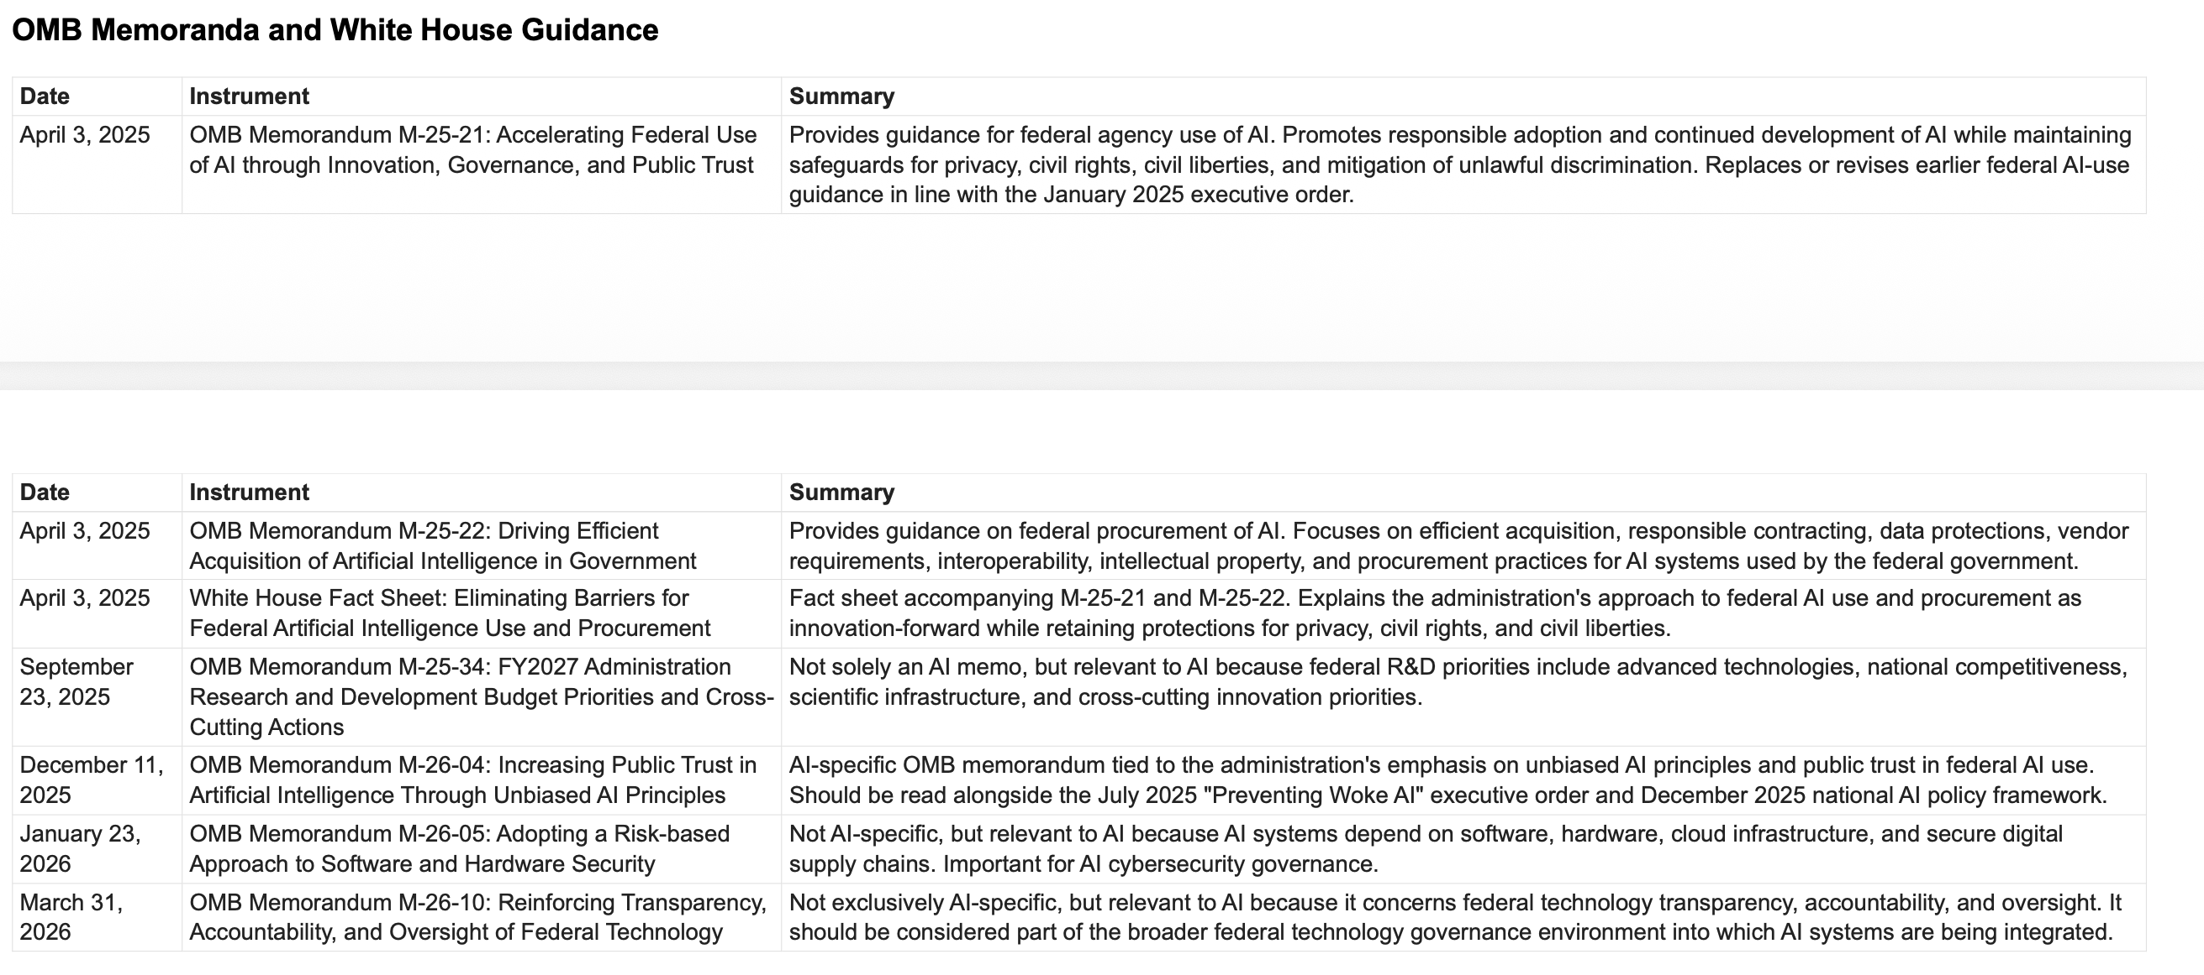
Comparative National Legislation (4)

Slide 16
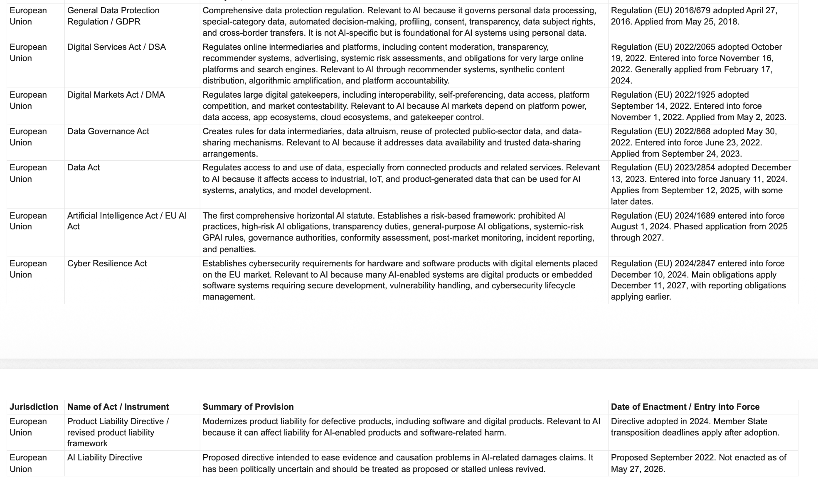
Comparative National Legislation (5)

Slide 17
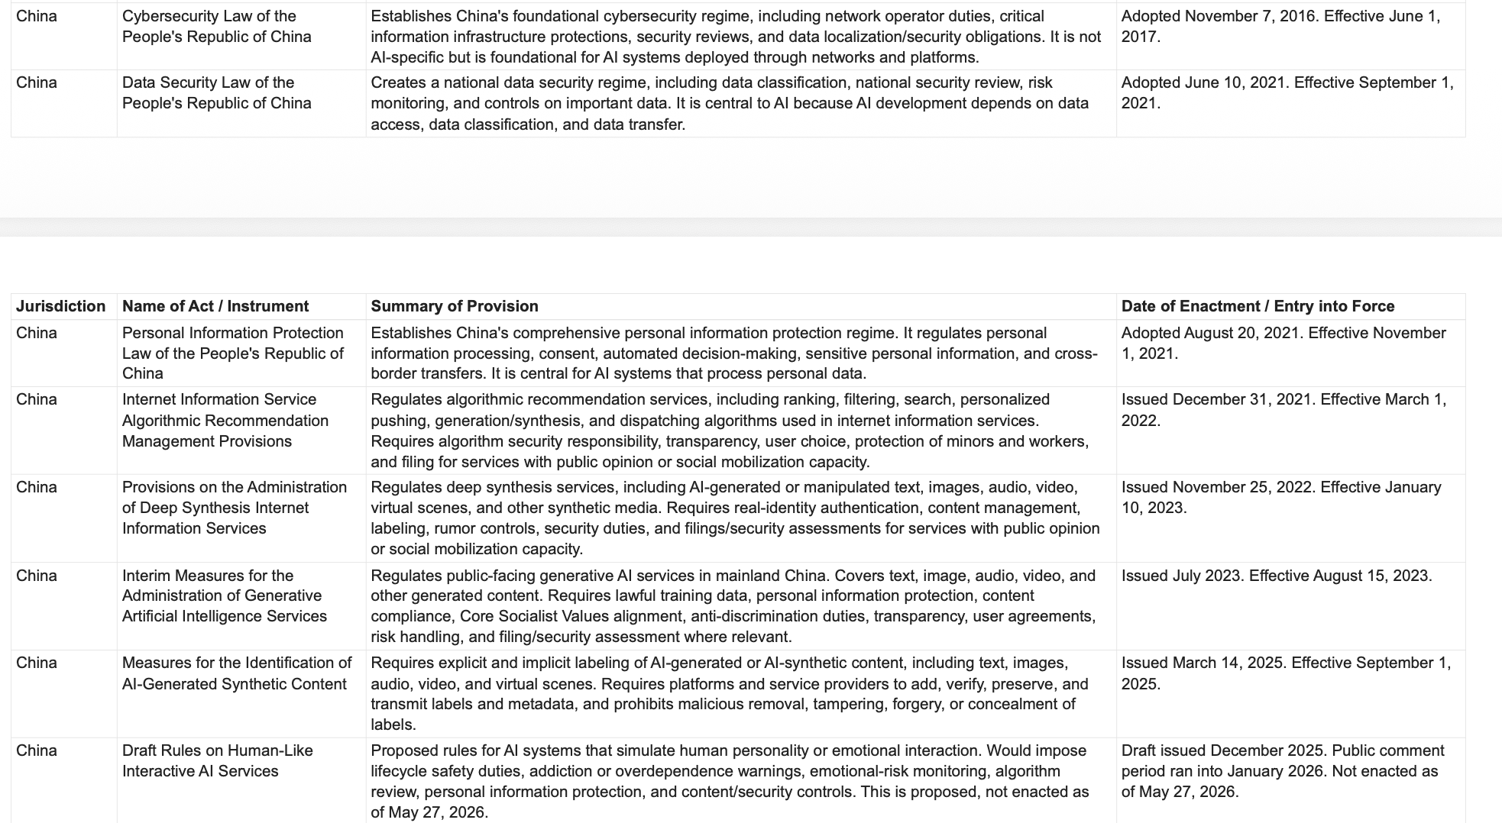
Comparative National Legislation (6)

Slide 18
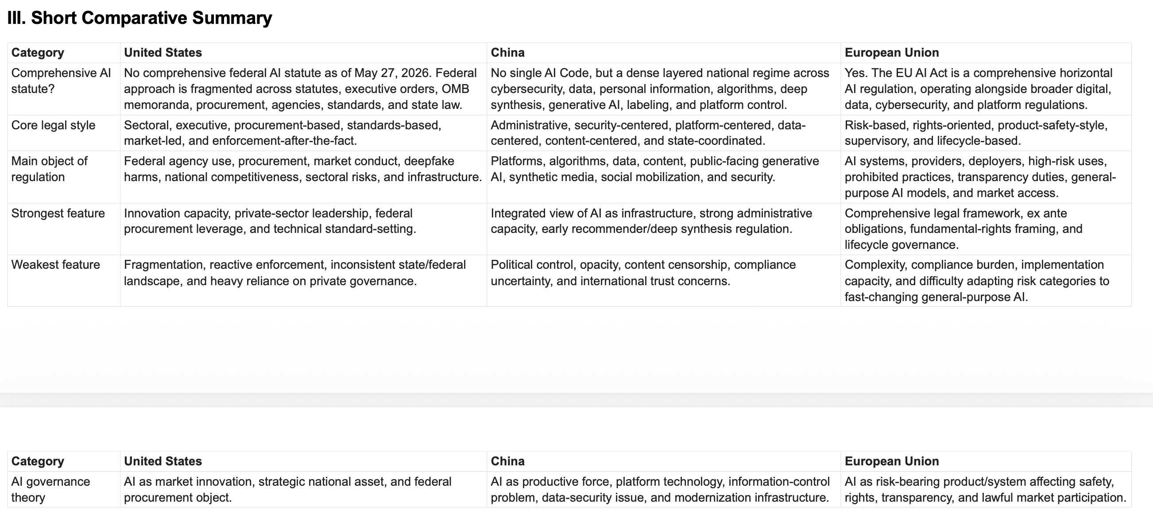
Comparative National Legislation (7)

Slide 19
Regulatory Challenges Today
The object of governance keeps moving.
1. Defining the object
models, systems, platforms, outputs, harms
2. General-purpose AI
upstream duties vs. downstream uses
3. Evaluation
continuous, contextual, adversarial testing
4. Opacity
technical, institutional, and legal explanation
5. Data governance
privacy, copyright, biometric data, borders
The recurring problem: laws designed for defined products and decisions must govern modular, adaptive, distributed systems.
Lecture Six - Comparative AI Governance
12

Slide 20
Regulatory Challenges Today
Responsibility and power are distributed across the AI stack.
6. Liability
many actors can blame one another
7. Regulatory capacity
expertise, compute, audits, staffing
8. Private power
frontier labs, cloud, chips, app ecosystems
9. Open models
transparency and competition vs. misuse
10. Arbitrage
training, hosting, fine-tuning, deployment across borders
Governance must prevent distributed technical systems from becoming responsibility-free institutional systems.
Lecture Six - Comparative AI Governance
13

Slide 21
The Special Case of Risk in C operative AI Regulatory Structures
Responsibility and power are distributed across the AI stack.
6. US
many actors can blame one another
7. EU
EU AI Act: Risk as a function of adverse impacts to rights regimes; innovation secondary
8. China
Principles and framework for AI safety governance: Safety risks assessed as a function of fundamental innovation principle
9. Open models
transparency and competition vs. misuse
10. Arbitrage
training, hosting, fine-tuning, deployment across borders
Governance must prevent distributed technical systems from becoming responsibility-free institutional systems.
Lecture Six - Comparative AI Governance
13

Slide 22
AI Risk/Based Regs in Comparative Perspective-EU
EU

Slide 23
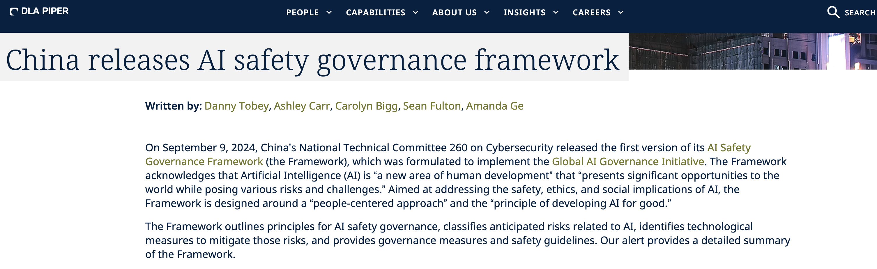
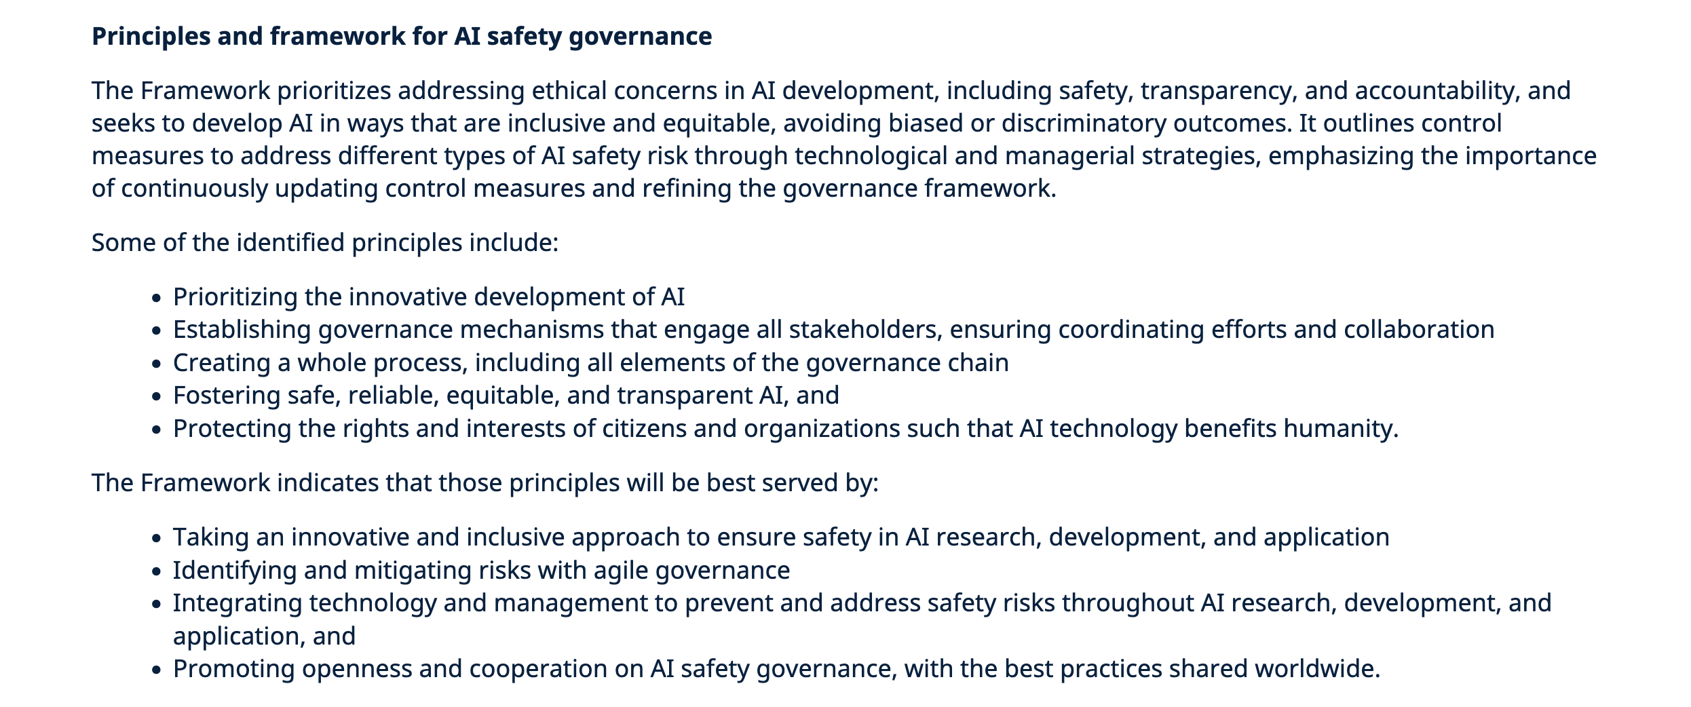
Comparative AI Risk-Based Regs -China (1)

Slide 24
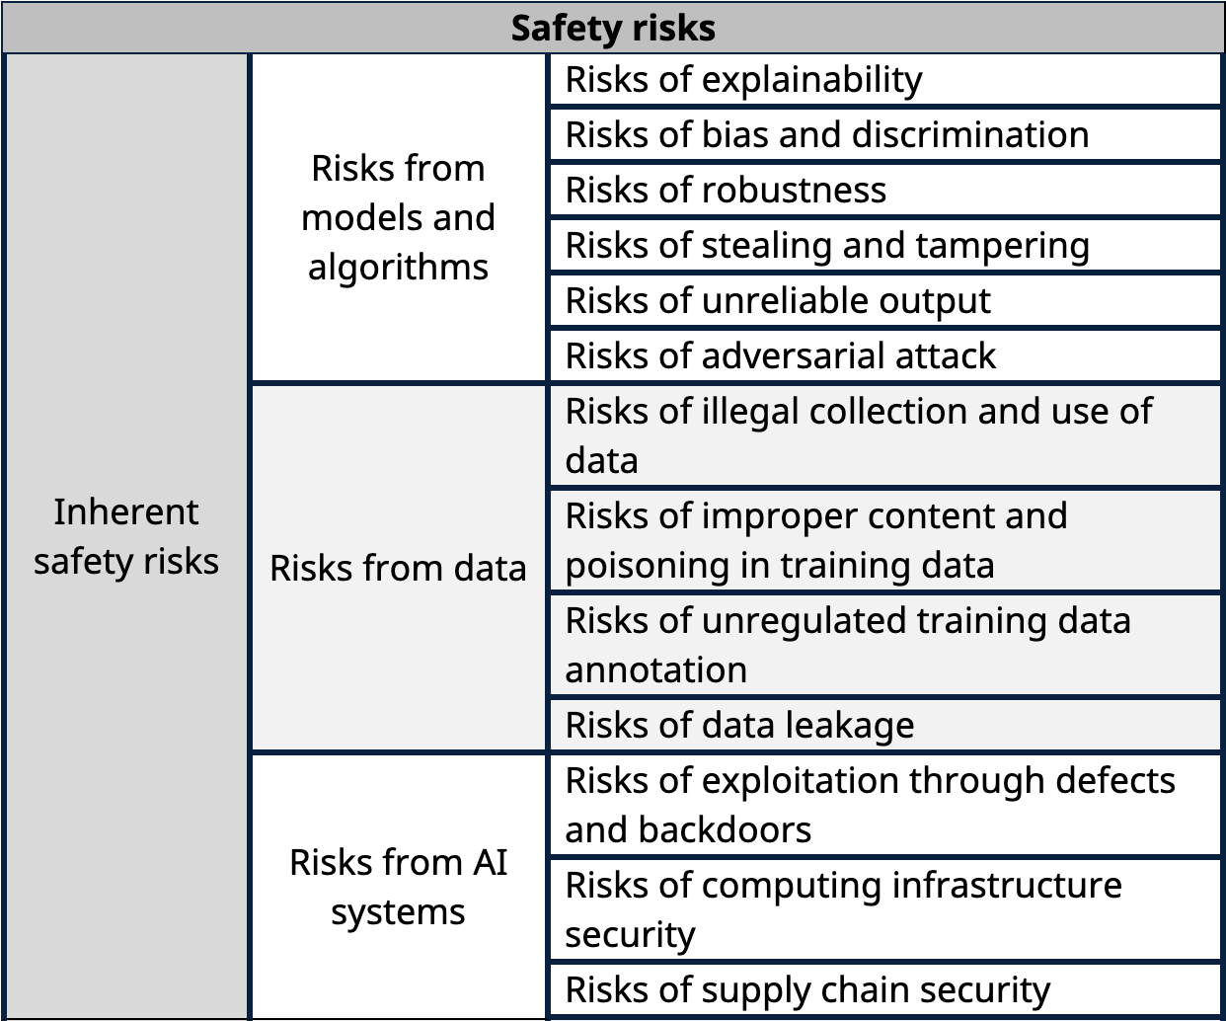
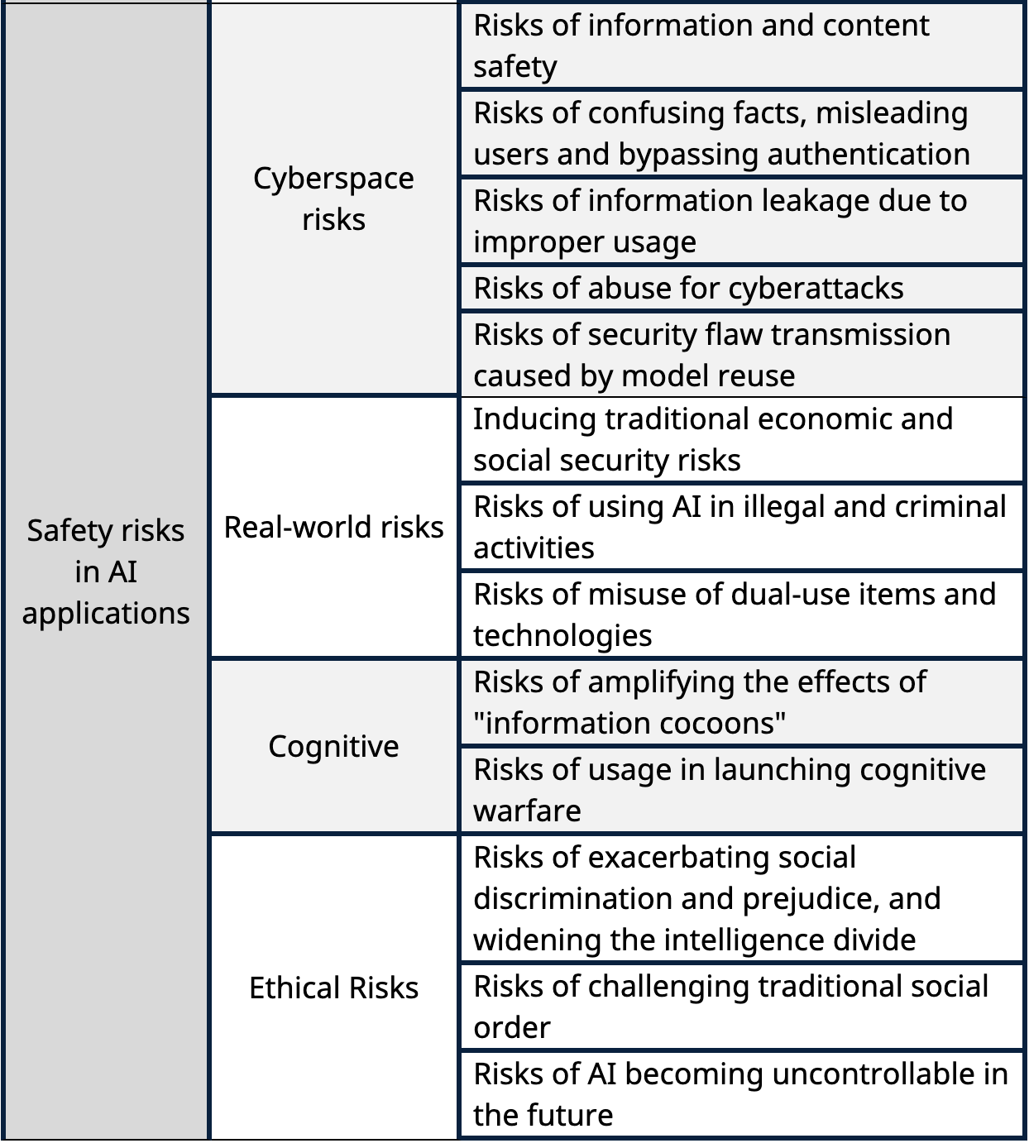
Comparative AI Risk-Based Regs -China (2)

Slide 25
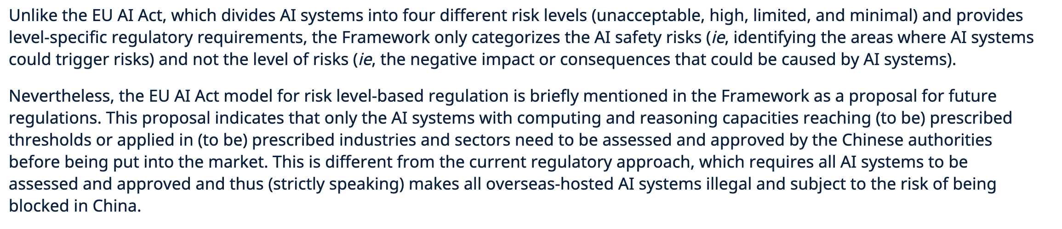
Comparative AI Risk-Based Regs -China (3)

Slide 26
Comparative AI Risk-Based Regs -US (1)

Slide 27
Future Governance Agenda
The next regime must govern technology, institutions, and infrastructure together.
Lifecycle-based
evaluation, monitoring, incident reporting, reassessment
System-based
data, interface, workflow, deployment context
Capacity-sensitive
tools, sandboxes, assistance, global support
Infrastructure-aware
compute, cloud, chips, energy, cybersecurity
Institutionally Accountable
humans and organizations cannot outsource responsibility
Democratically Legitimate
public participation, civil society, affected communities
Globally Equitable
avoid dependency, exclusion, and AI-rich/AI-poor divides
Public-benefit Oriented
medicine, education, accessibility, climate, science
Lecture Six - Comparative AI Governance
15

Slide 28
Closing Takeaway
AI governance is not merely governance of technology.
CLOSING
AI governance is the governance of power as it moves through technology.
The systems share a vocabulary of safe, secure, trustworthy, and beneficial AI.
They diverge in how they allocate authority among markets, rights, states, platforms, and global institutions.
The next challenge is governing AI as infrastructure, not only as models or products.
Lecture Six - Comparative AI Governance
16

