Slide 1
LECTURE Seven
AI Narratives: Palantir; Anthrop/c; OpenAI
US private enterhprises shape the uderstanding of the relatyionship between human collectoves and AI
Larry Cata Backer – (白 轲)
W. Richard and Mary Eshelman Faculty Scholar; Professor of Law and International Affairs
Lecture Six - Comparative AI Governance
1

Slide 2
Core Thesis
AI governance systems shape the human collectives they serve; even as these AI systems sertve themselves
THESIS
The dialectical relations between AI systems and human collectives reshape both. AI governance is a field of competing political rationalities that includes the autonmous AI systems themselves.
Political authority shaped by and includes AI governance systems
AI systems have a voice in shapiong the human environment
Key dispute: who governs, when governance occurs, and whose values dominate: Human or AI
Lecture Six - Comparative AI Governance
2

Slide 3
Conceptual Frame
Jocasta
Nonn’ erubeskite, reges, Are you not ashamed, princes,
Clamare ululare in aegra urbe To raise your voices, in a stricken city,
Domestikis altercationibus? Howling in domestic strife?
Clamare vestros domestikos clamores, To air your domestic grievances,
Coram omnibus domestikos clamores, Your personal quarrels, before all,
In aegra urbe, reges, nonn’ erubeskite? In a stricken city, princes, are you not ashamed?
Ne probentur oracula Nothing is proved by oracles,
Quae semper mentiantur. Which always lie.
Oracula, mentita sunt oracula. The oracles, they have lied.
Cui rex interfikiendus est? By whom was the King to be slain?
Nato meo. By my son.
Age rex peremptus est. Well, the King was murdered.
Laius in trivio mortuus. Laius died at the crossroads.
Ne probentur oracula The oracles are not to be trusted,
Quae semper mentiantur. The oracles, who always lie.
Laius in trivio mortuus. Laius died at the crossroads.
(Oedipus Rex (Libretto by Jean Cocteau, Music by Igor Stravinsky (30 May 1927), Act 2)

Slide 4
Comparative Frame
The same technology becomes four different governance objects.
Palantir
The human government apparatus must be reformed to conform to emerging AI structures
AI GOVERNANCE
Anthropic
technology to a tool the deployment of which is a critical instrument in competition among different and divergent normative political-economic models.
Open AI
Wants a transformed society in which the society remains insulated from the consequences of transformation
Leopold Aschenbrenner
AI superintelligence will produce amove towards a national security state and the rise of the separate domains of AI systems as something not human and autonomous of human control
Lecture Six - Comparative AI Governance
3

Slide 5
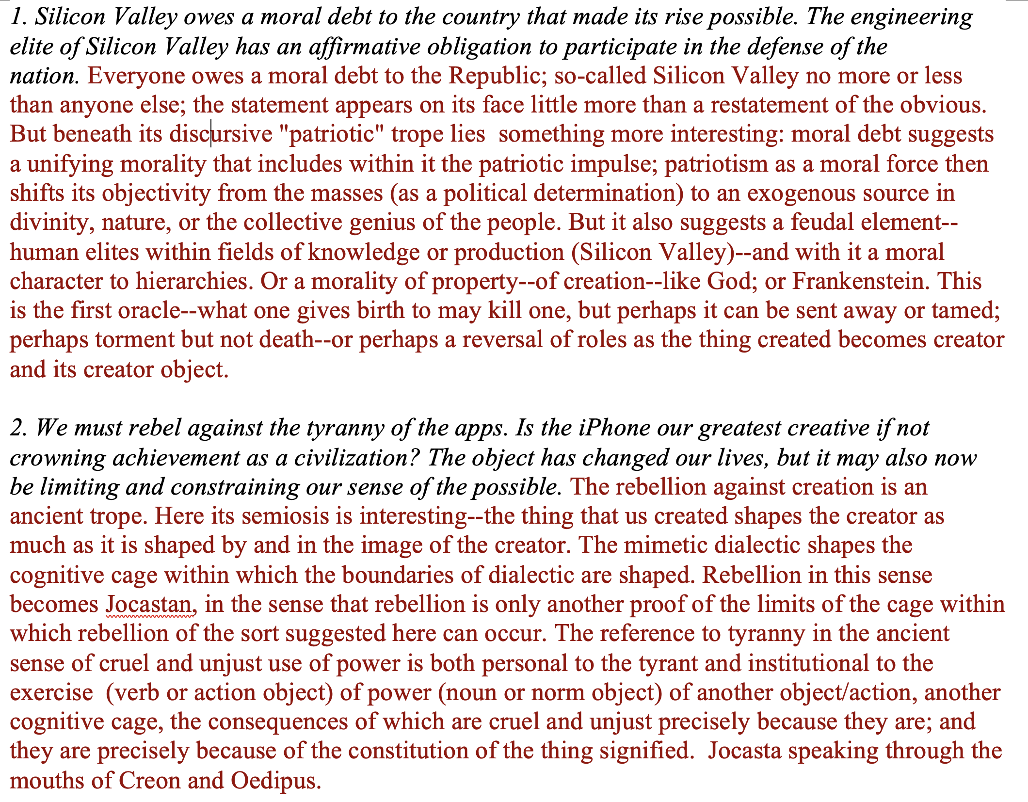
Palantir (1)

Slide 6
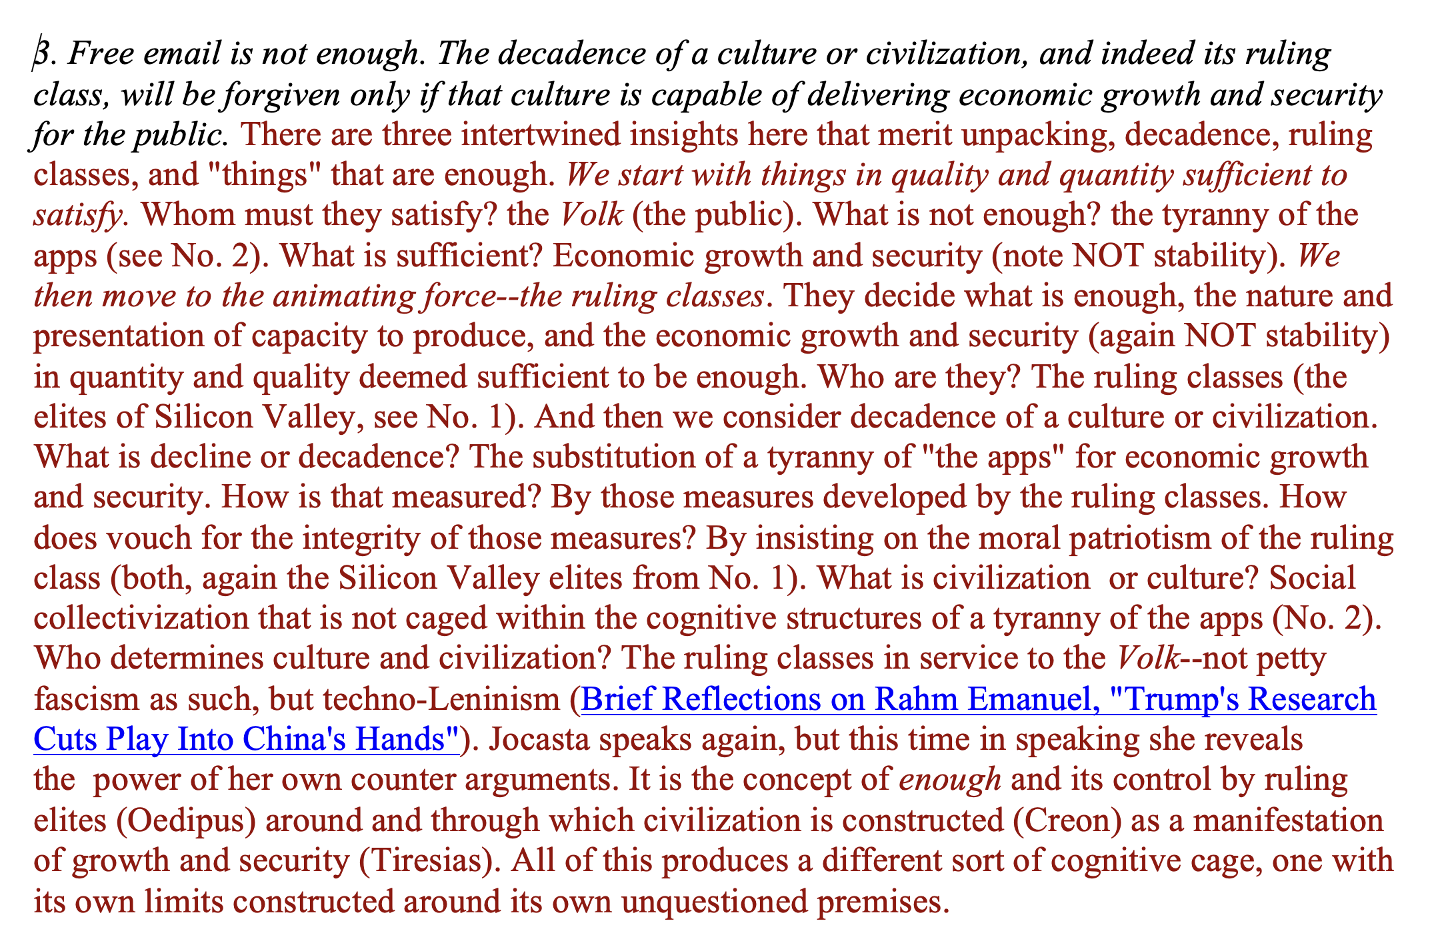
Palantir (2)

Slide 7
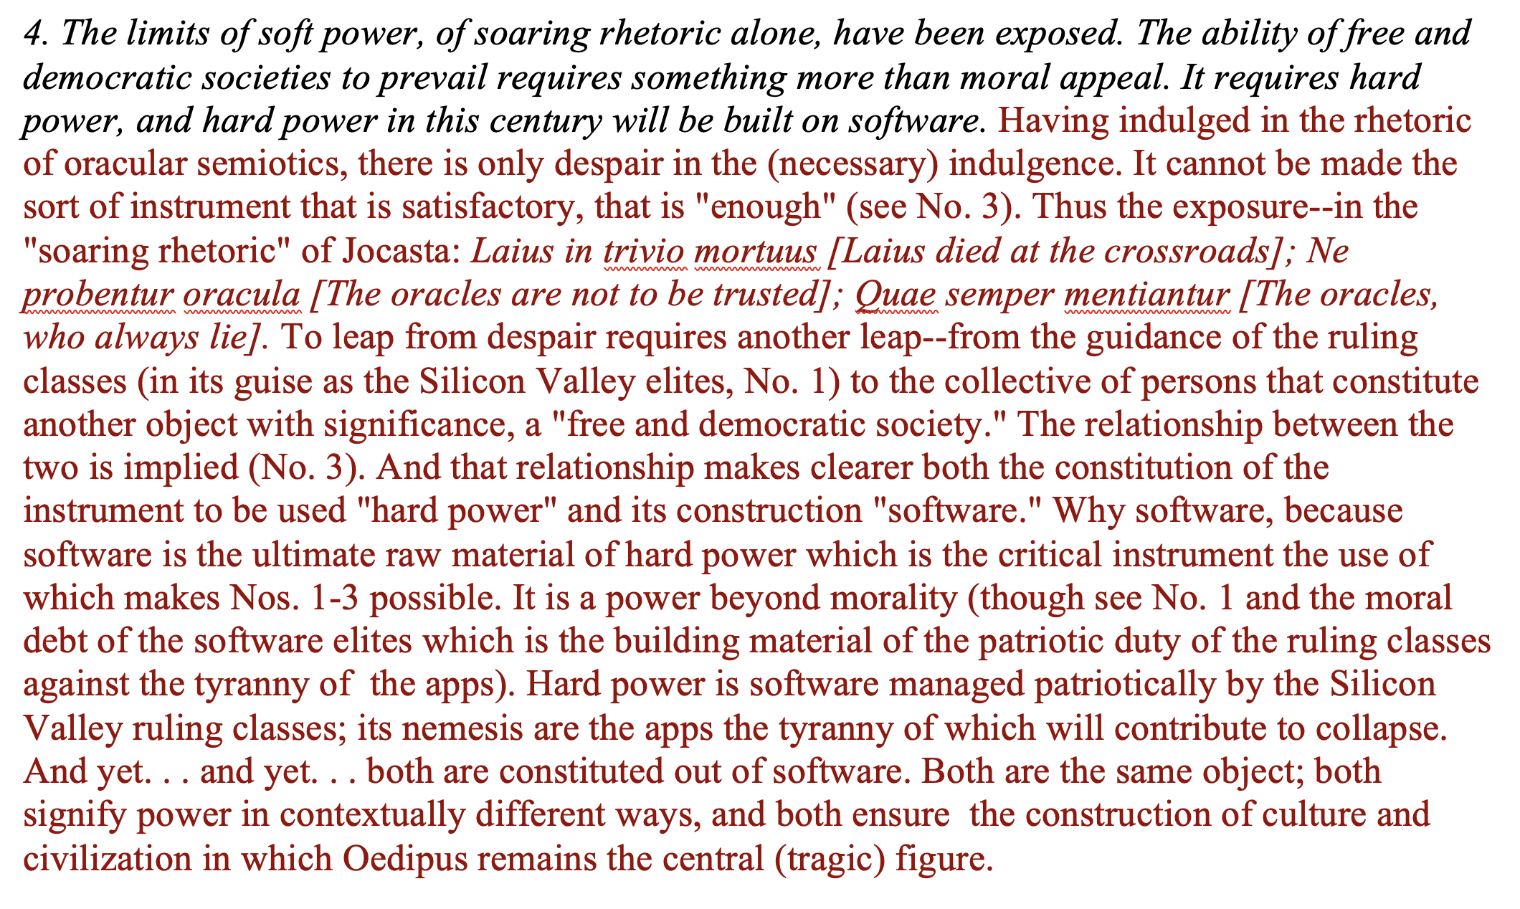
Palantir (3)

Slide 8
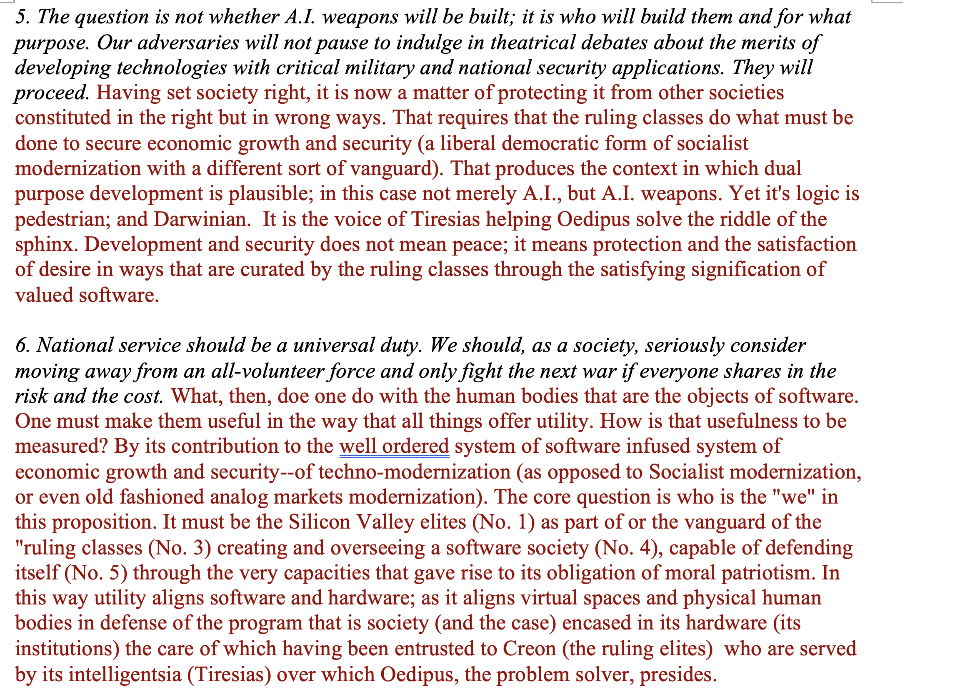
Palantir (4)

Slide 9
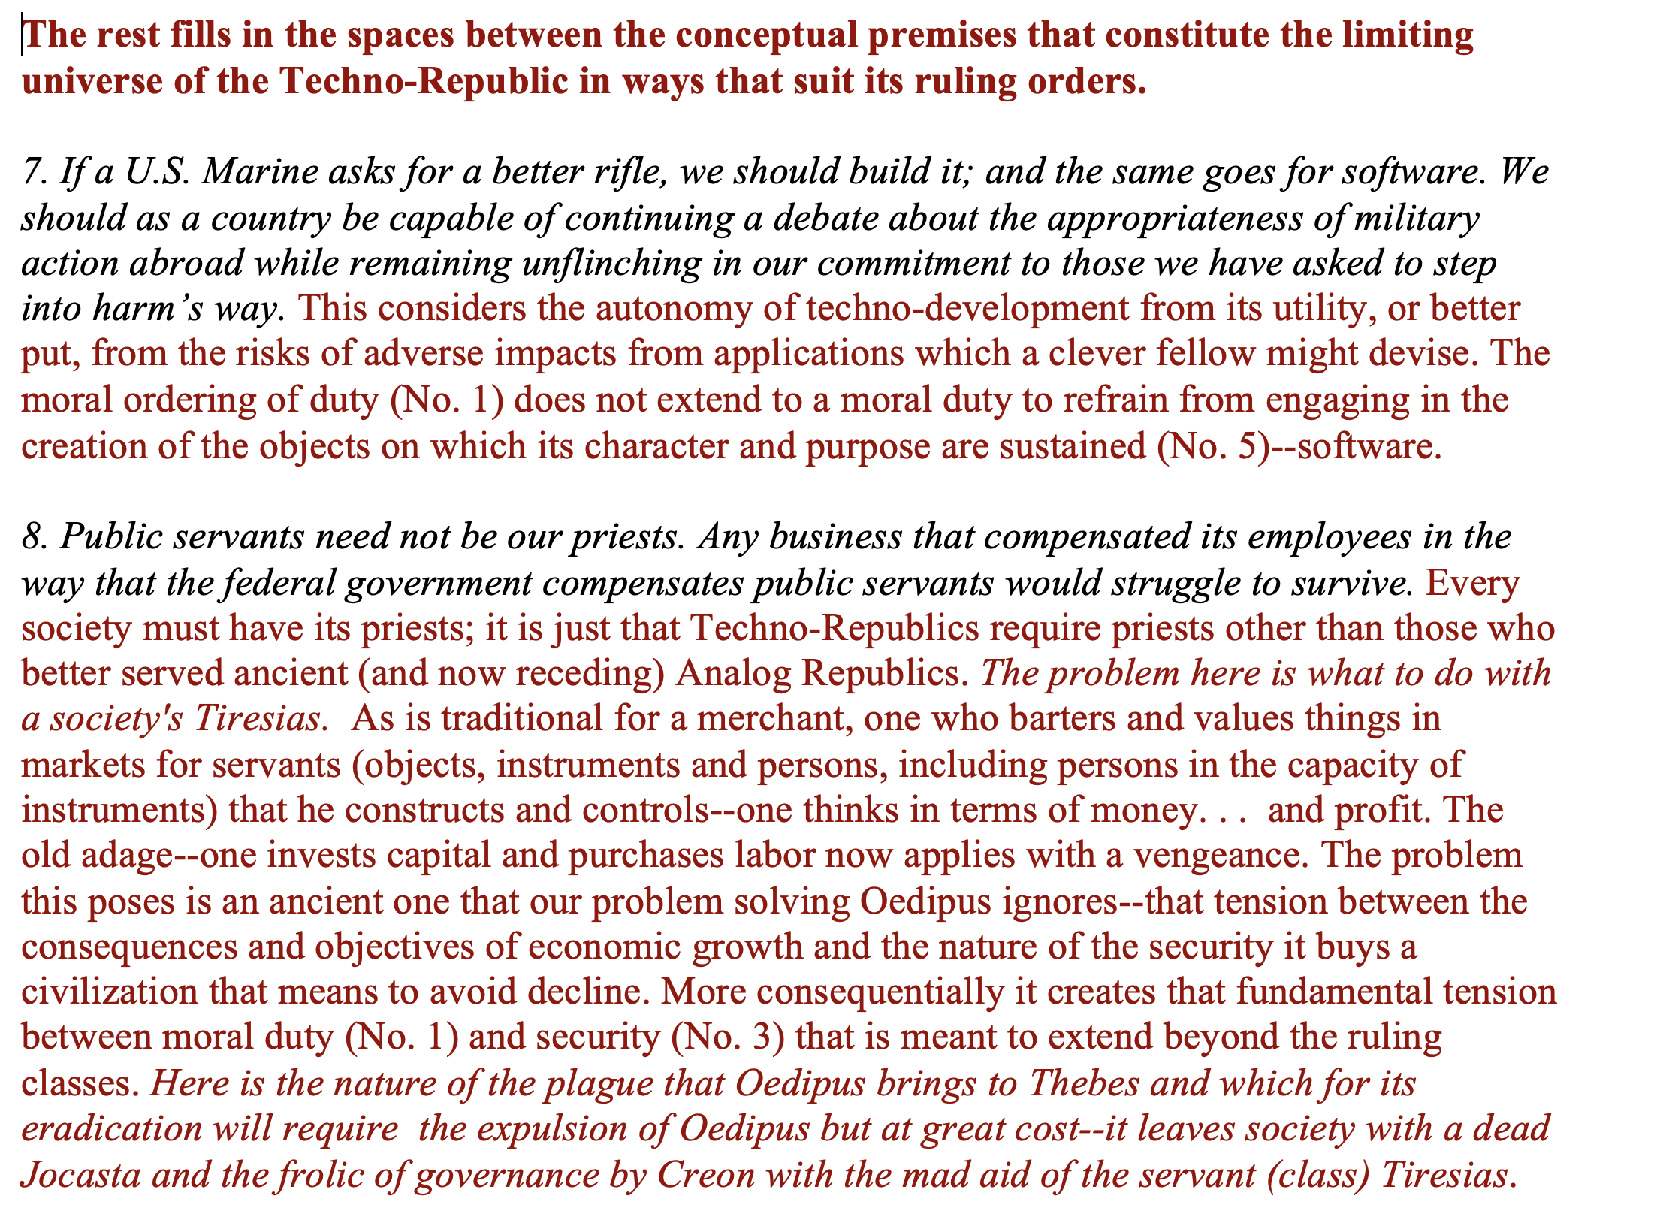
Palantir (5)

Slide 10
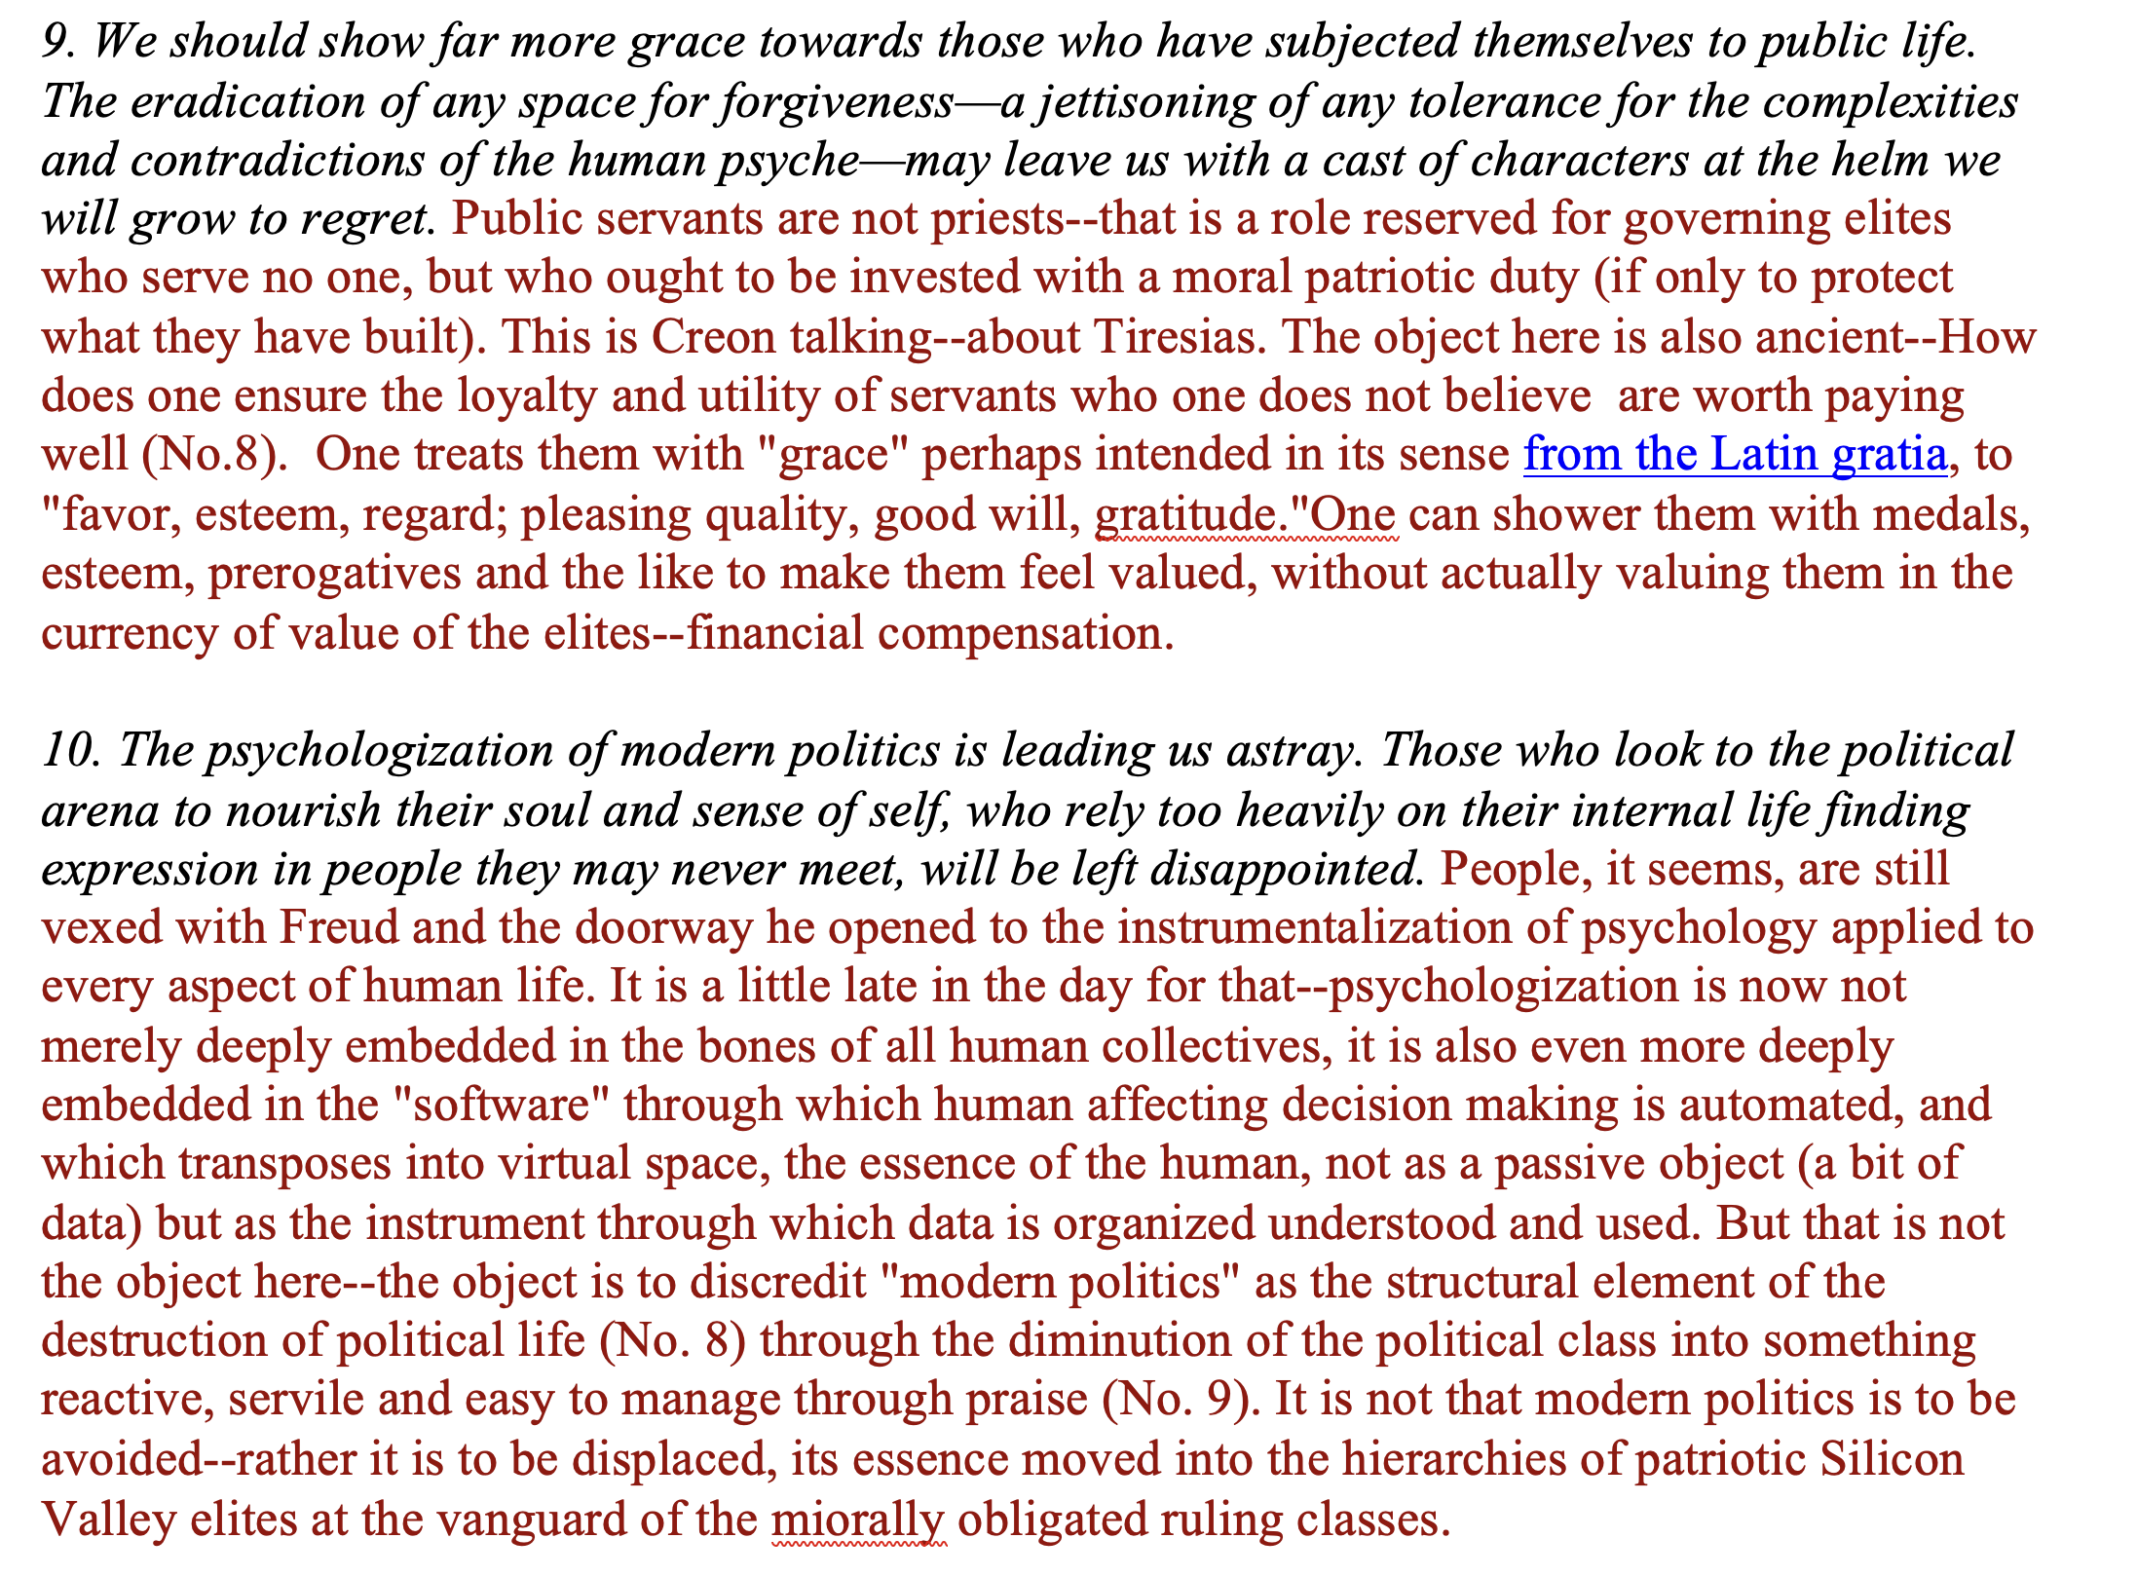
Palantir (6)

Slide 11
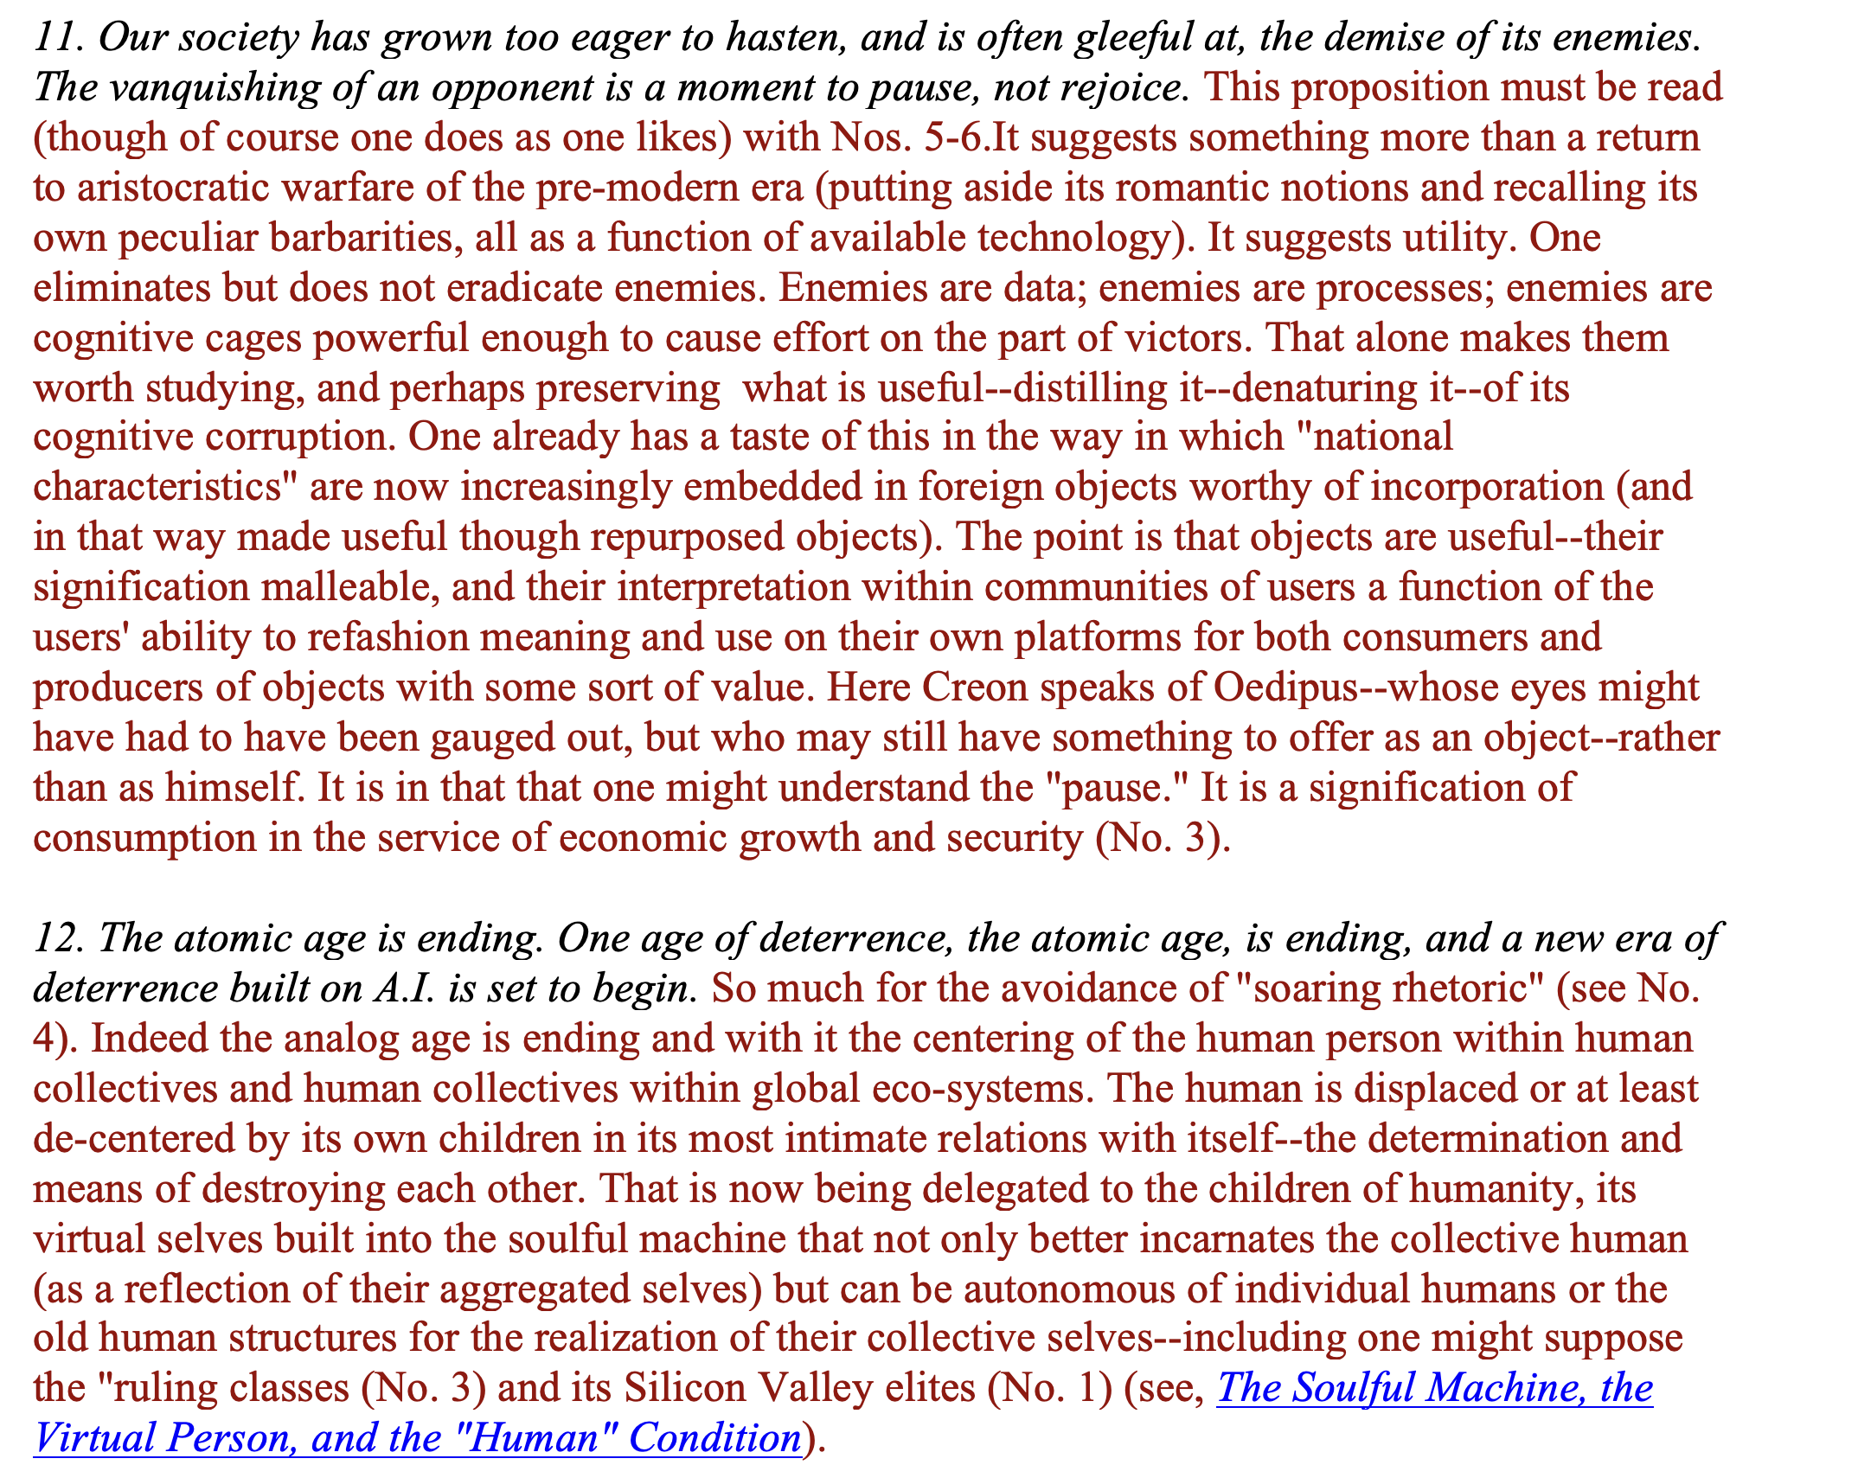
Palantir (7)

Slide 12
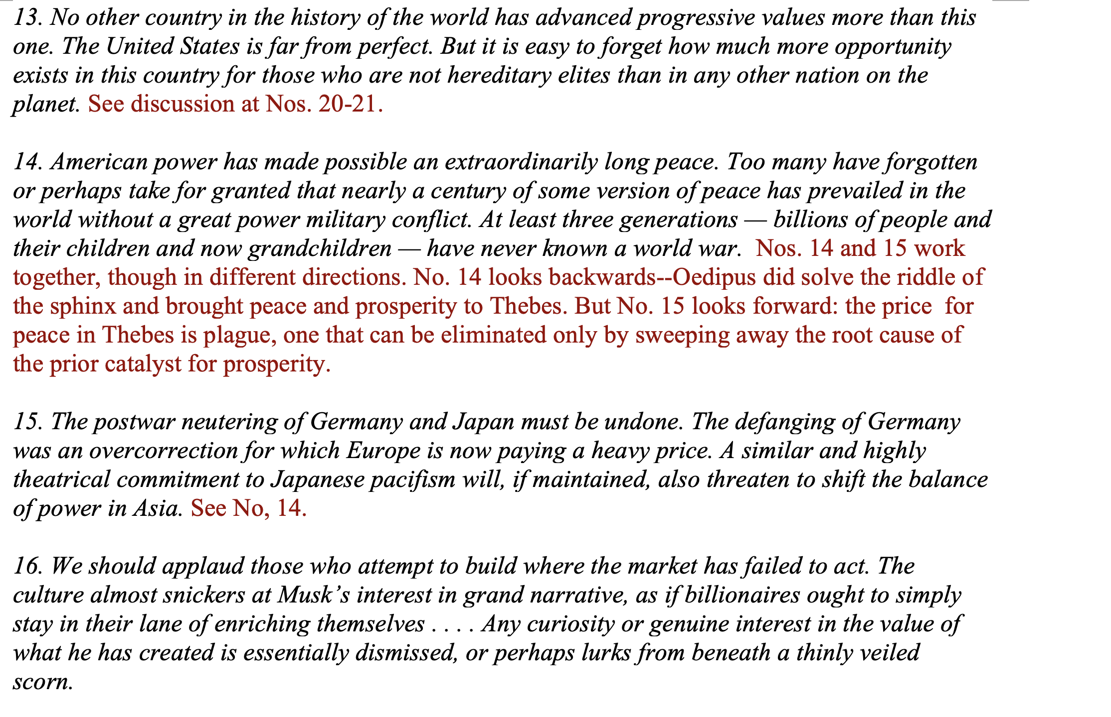
Palantir (8)

Slide 13
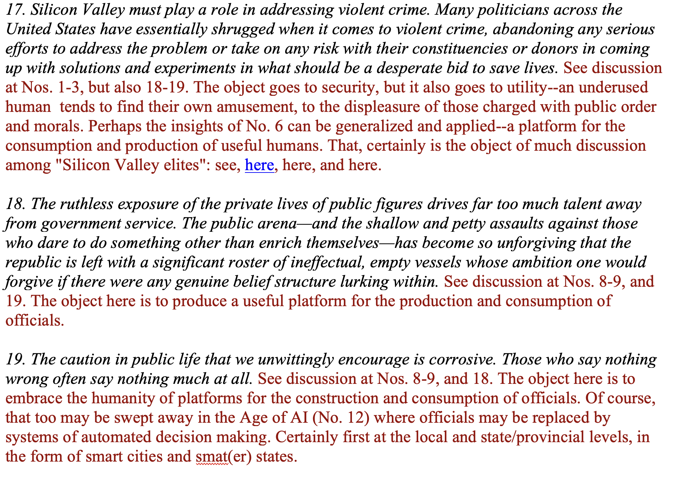
Palantir (9)

Slide 14
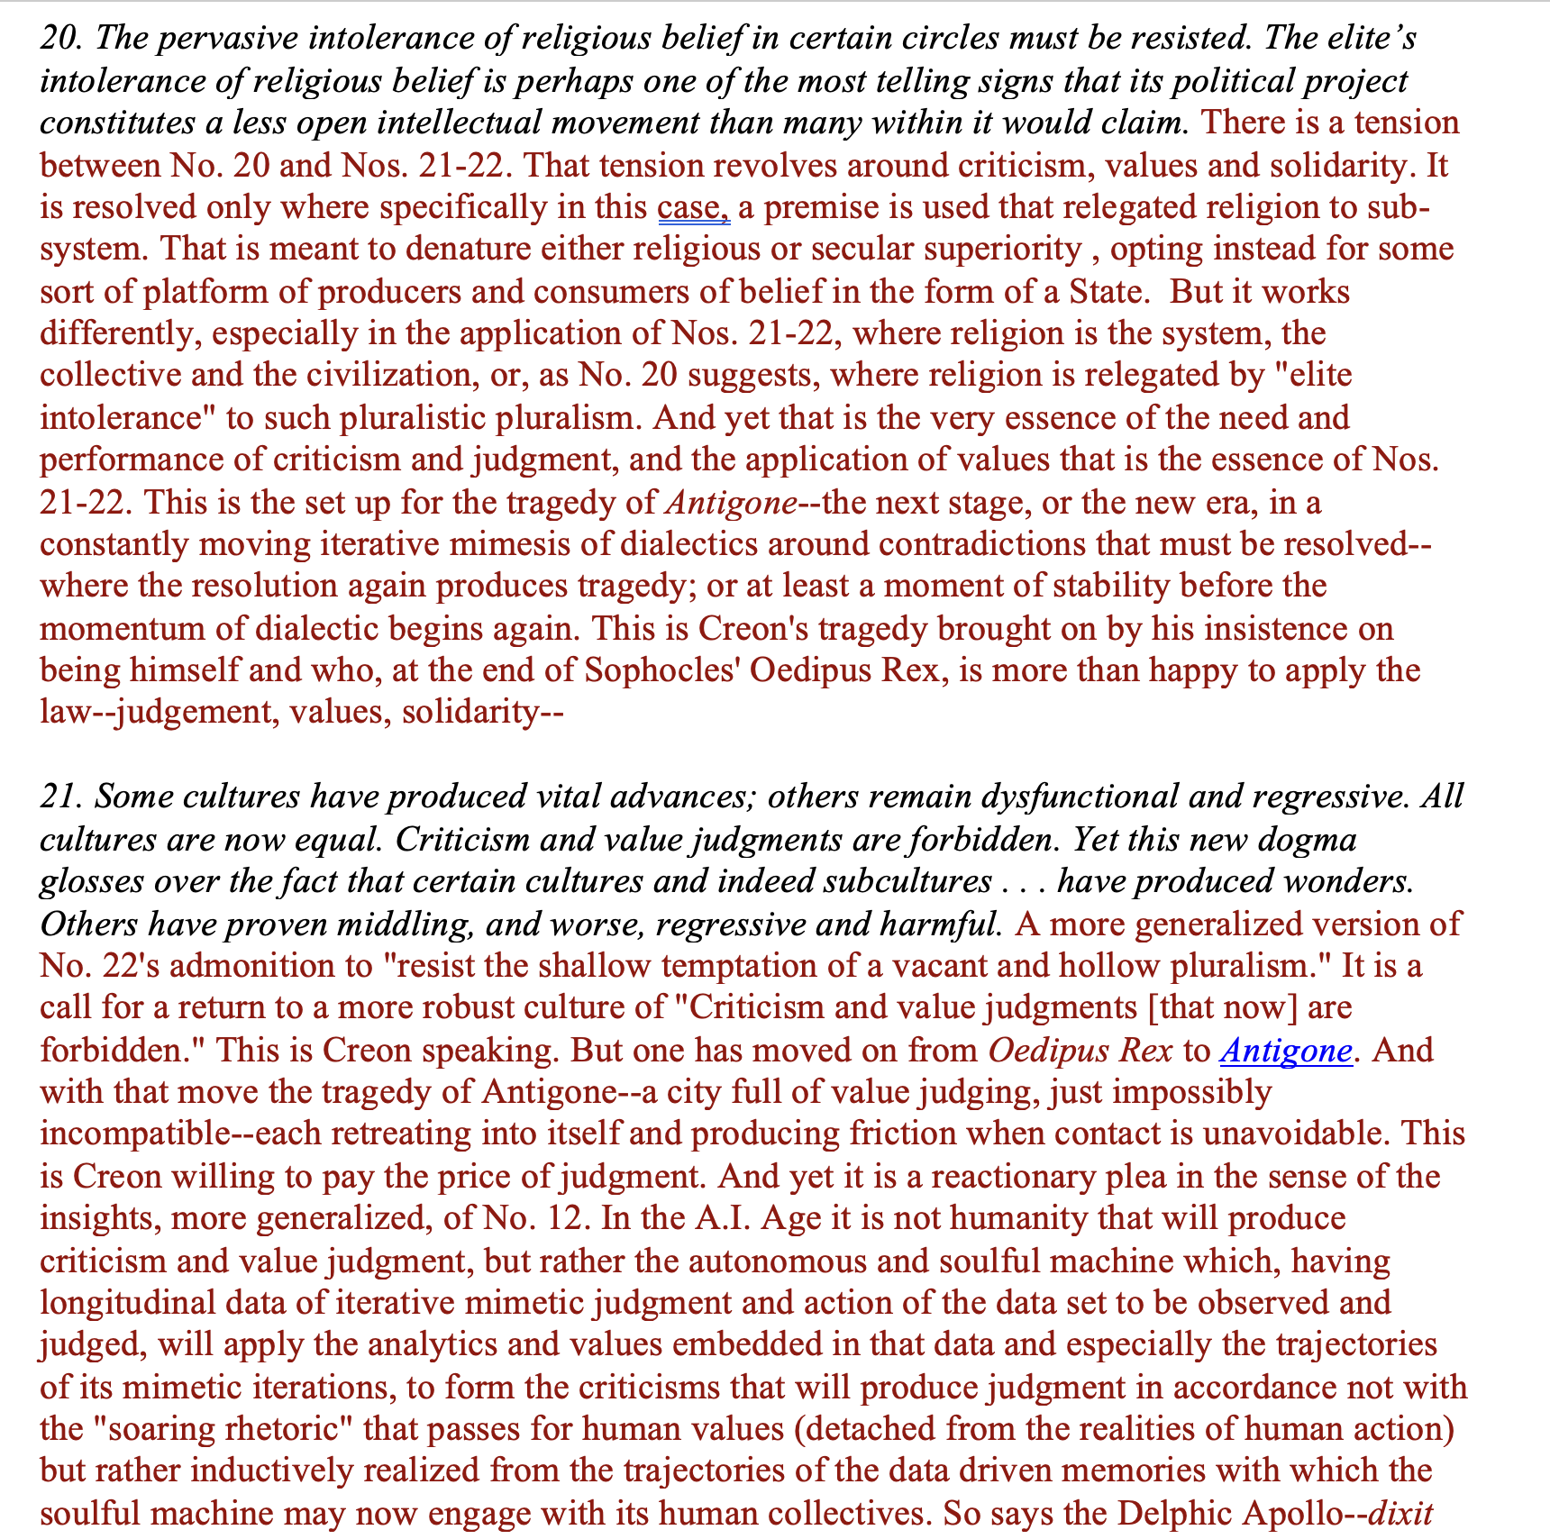
Palantir (10)

Slide 15
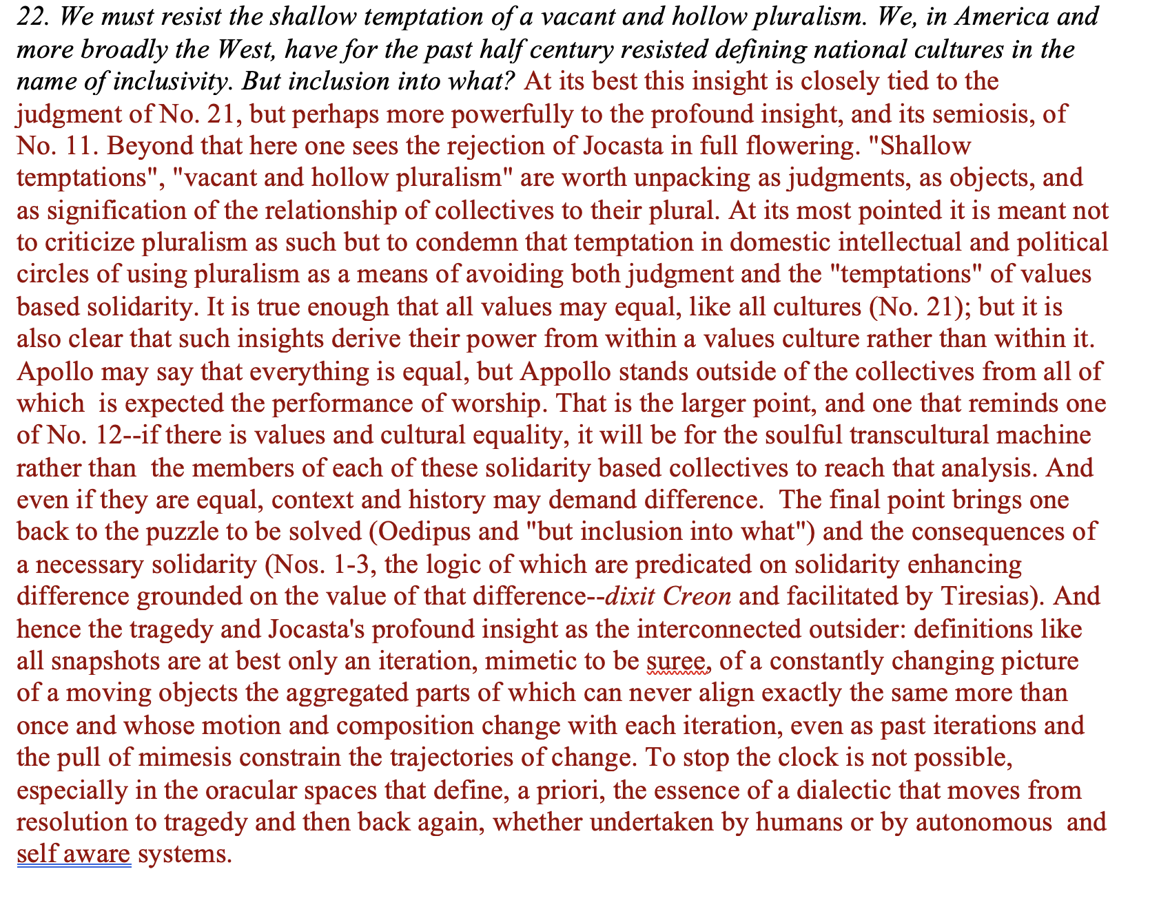
Palantir (11)

Slide 16
Anthropic (1)
Two scenarios for the US and China in 2028
Summary
The imperatives of staying ahead
The Mythos Preview wake-up call
Four fronts of the competition
The state of the competition
Two scenarios for 2028
Ensuring democracies lead
Conclusion
We’re releasing a new paper that explains our views on the competition on AI between the US and China.
It’s essential that the US and its allies stay ahead of authoritarian governments like the Chinese Communist Party, or CCP. AI will soon become powerful enough to be used to repress citizens at unprecedented scale, and even to alter the balance of power among nations. And since AI is advancing more quickly by the day, we have only a limited period of time to set the conditions of the competition—and determine whether and how those threats materialize. It’s with this in mind that we outline what’s required to ensure America stays ahead.

Slide 17
Anthropic (2)
The most important ingredient for developing AI is access to the computer chips on which the models are trained (or “compute”). Since the most capable chips are developed by American companies, the US government currently limits China’s supply by enforcing tight export controls on them. Recent history suggests these controls have been incredibly successful. In fact, AI labs in China have only built models close in intelligence to America’s because of their talent, their knack for exploiting loopholes around these export controls, and their large-scale distillation attacks that illicitly extract the innovations of American companies.
In this post, we present two scenarios for what the world might look like in 2028, when we expect transformative AI systems to have arrived.
In the first scenario, America has successfully defended its compute advantage. Policymakers have acted to tighten export controls further, disrupt China’s distillation attacks, and further accelerate democracies’ adoption of AI. In this world, democracies set the rules and norms around AI. It’s also in this scenario that we’re most likely to successfully engage with China on safety, which we’re supportive of to the extent this is possible.
In the second scenario, America has chosen not to act. Policymakers have not tightened loopholes on the CCP’s access to compute, and AI firms in China have quickly taken advantage—catching up to the frontier and even overtaking America. In this world, AI norms and rules are shaped by authoritarian regimes, and the best models enable automated repression at scale. It will be no solace that this authoritarian triumph has happened on the back of American compute.
America and its allies approach AI competition from a position of great strength. The tools for AI dominance have been built by an exceptionally innovative ecosystem of companies in democratic nations. Our past success means that our present task is largely to avoid squandering our advantage: to decide not to make it easier for the CCP to catch up.

Slide 18
Anthropic (3)
Democracies, not authoritarian regimes, must lead in AI development and deployment. These countries and political systems can shape the rules and norms that govern these systems.
Democracies currently hold a substantial lead in compute, the most important ingredient for developing frontier AI models. That lead exists thanks to American and allied innovation, and to bipartisan US export controls that defend those innovations. But on model intelligence, AI labs in the People’s Republic of China (PRC), under the jurisdiction and control of the Chinese Communist Party (CCP), are not far behind. We focus on the CCP as it is the regime that is most able to use frontier AI to cement authoritarianism; we do not seek to undermine the interests or ingenuity of the Chinese people. Already, the CCP is using AI to censor speech, repress dissidents, hack governments and corporations across the world, and strengthen the People’s Liberation Army (PLA).
AI labs in China have world-class talent. It is compute constraints that limit their ability to keep up. Labs in China have remained close by exploiting loopholes in US export control policies, and by carrying out large-scale distillation attacks that harvest the innovations of US models in order to mimic their capabilities.

Slide 19
Anthropic (4)
With the supply of compute expanding rapidly, and with AI being used increasingly to augment the training of new AI models, we’re entering a period of great acceleration in AI capabilities. The “country of geniuses in a data center”—the level of intelligence we associate with transformative AI—may be close at hand.
This acceleration makes policy action more urgent. To date, by allowing export control evasions and distillation attacks, we have let the CCP’s AI efforts trail closely up the frontier curve.
But if the US and its allies act now to address both issues, it may be possible to lock in a 12-24 month lead in frontier capabilities. A lead that large by 2028 would be enormously advantageous. Such a lead would also augment efforts to engage with AI experts in China on AI safety and governance, which we support. But the window of opportunity to lock in that lead will not necessarily remain open for long.

Slide 20
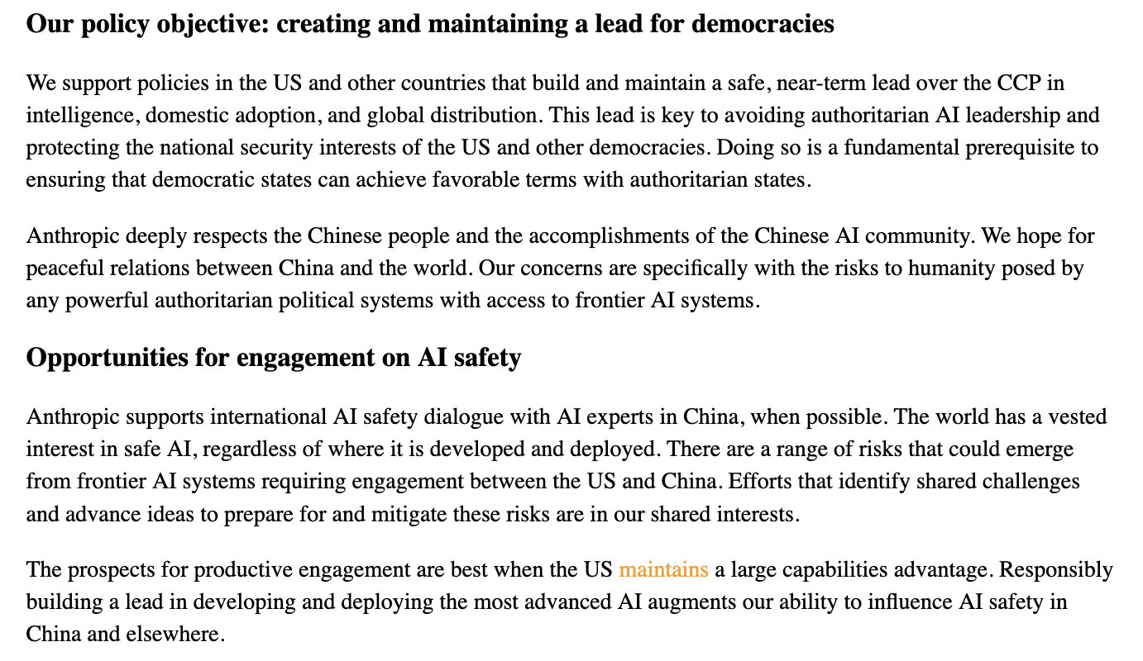
Anthropic (5)

Slide 21
Anthropic (6-analysis)
It seeks to reduce its creation, and the ecologies in which virtual life operates, to an instrument, the maintenance and improvements of which are of critical importance to human, not human-machine dialectical mimesis.
In this case one encounters the instrumentalization of signs, and especially the signification of A.I. or tech based "objects” to manage perception, and shape meaning for a specific political collective, whose perceptions and cognitive foundations are in turn shaped by those objects
The object: the preservation and modernization of the State and its victory against its enemies
With that as the analytical core, the question then becomes far ore pragmatic: to what extent and in what ways, ought the State to develop practices and policies to ensure that American A.I. continues to dominate, and by dominating provides the means of protecting the liberal democratic lebenswelt from the imaginaries of Marxist Leninist States. The key is to dominate innovation (here pitting the Chinese project of Socialist Modernization driven by its high quality production initiative) against the American markets driven and national security framed framework.

Slide 22
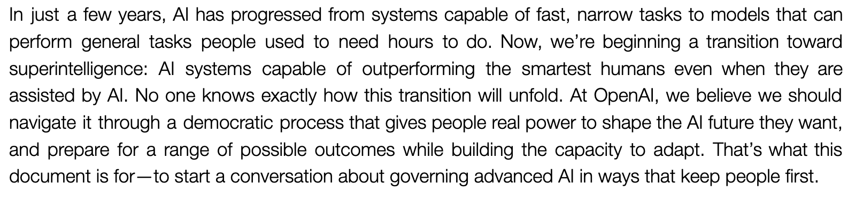
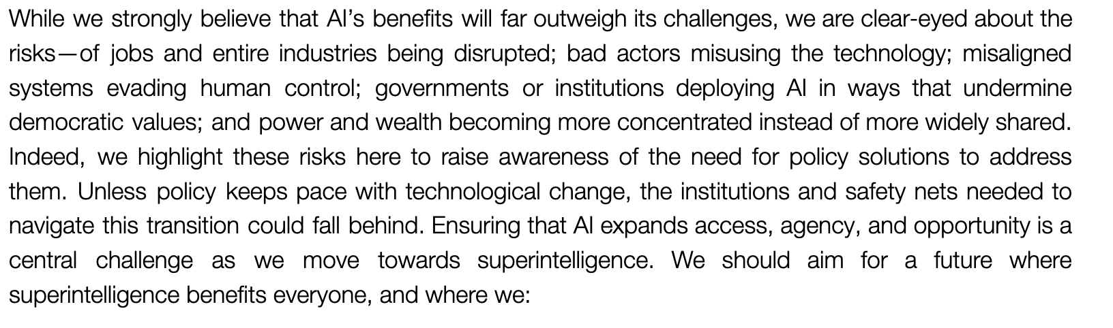
Open AI (1)

Slide 23
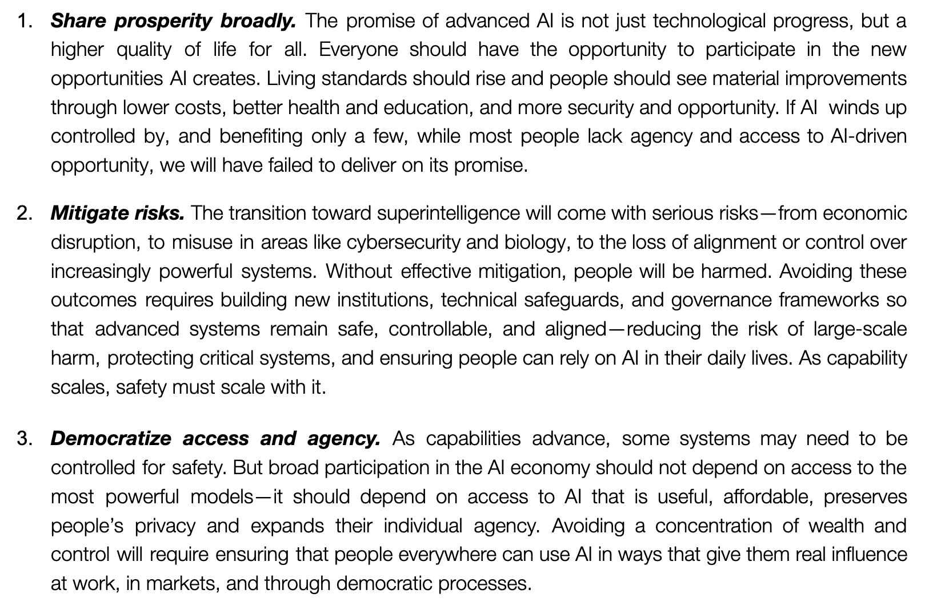
Open AI (2)

Slide 24
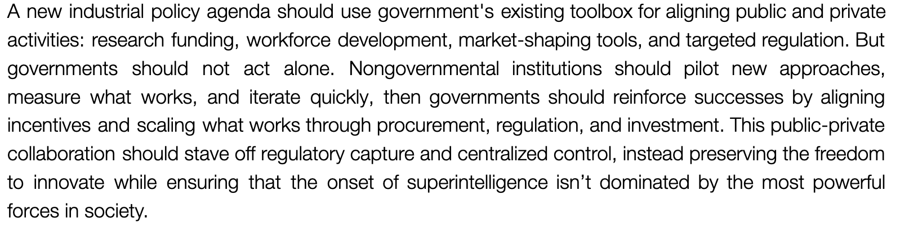
Open AI (3)

Slide 25
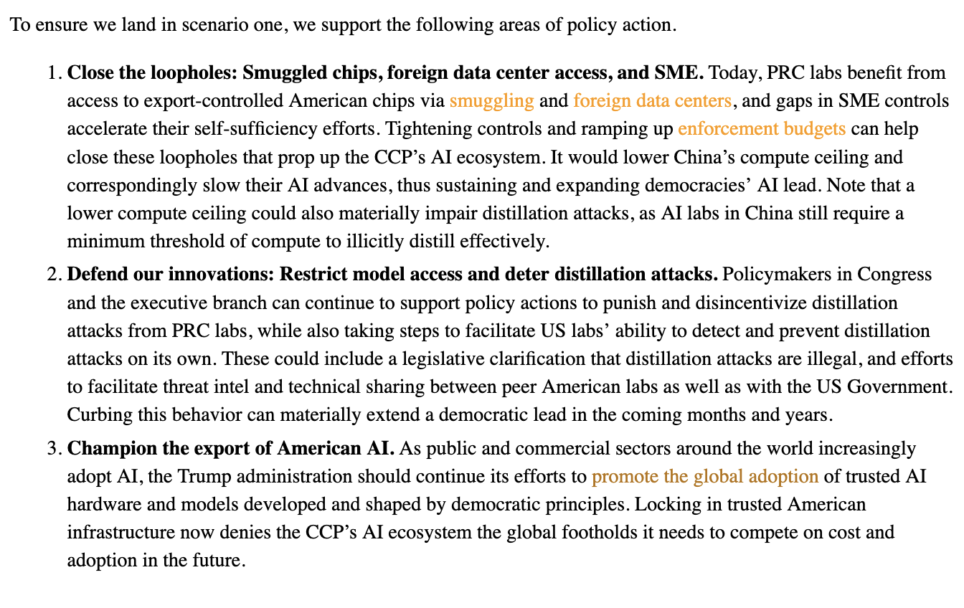
Open AI (4)

Slide 26
Open AI (5)/Analysis
This is the American analogue to the Chinese modernization of Leninist democracy, but one with American characteristics meant to elaborate American values: non/transformative transformation?
What does Open AI want? It wants a transformed society in which the society remains insulated from the consequences of transformation. It wants from artificial intelligence the continuity of an artificial society that can preserve the outward appearance of, not continuity, but sameness within a social system marked specifically by foundationally transformative change.
The structure of this preservative transformation includes several parts:
  (1) building an open economy (Industrial Policy for the Intelligence Age: Ideas to Keep People First" pp.4-8);
  (2) building a resilient society (ibid., 9-12).
Each is elaborated with policy suggestions that mean to keep the structures of the social order and its cognitive cages even as it transforms some or all of its "insides." A nice conservative approach.

Slide 27
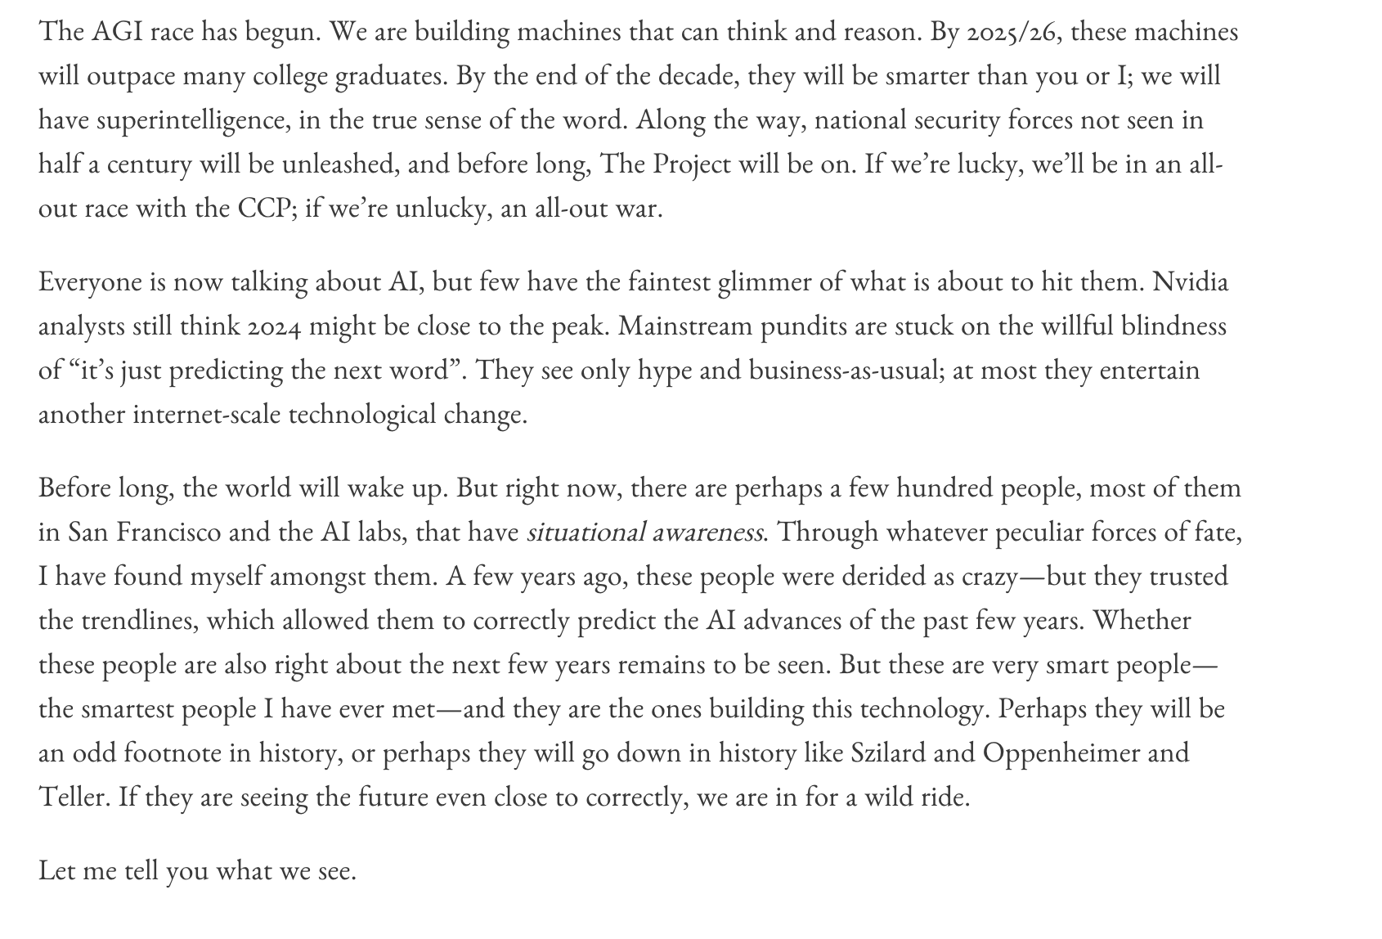
Leopold Aschenbrenner: The Prophet (1)

Slide 28
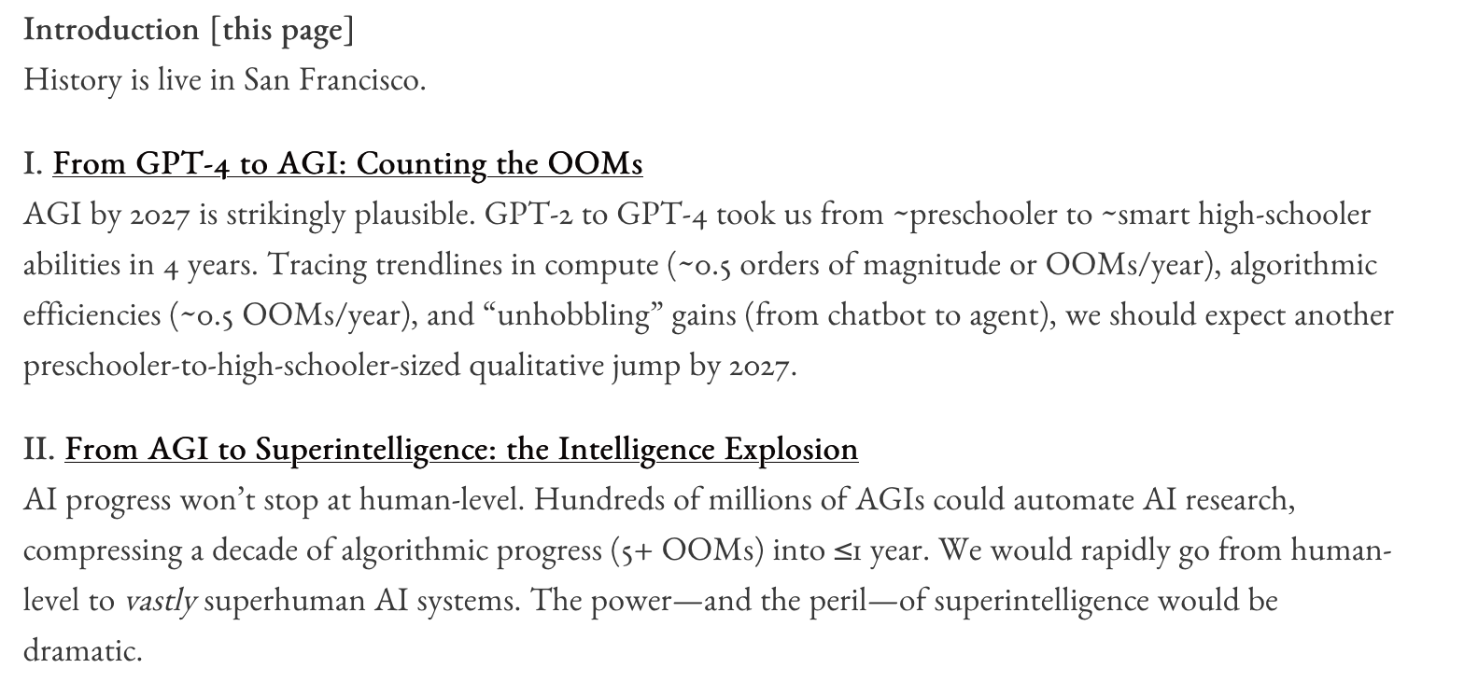
Leopold Aschenbrenner: The Prophet (2)

Slide 29
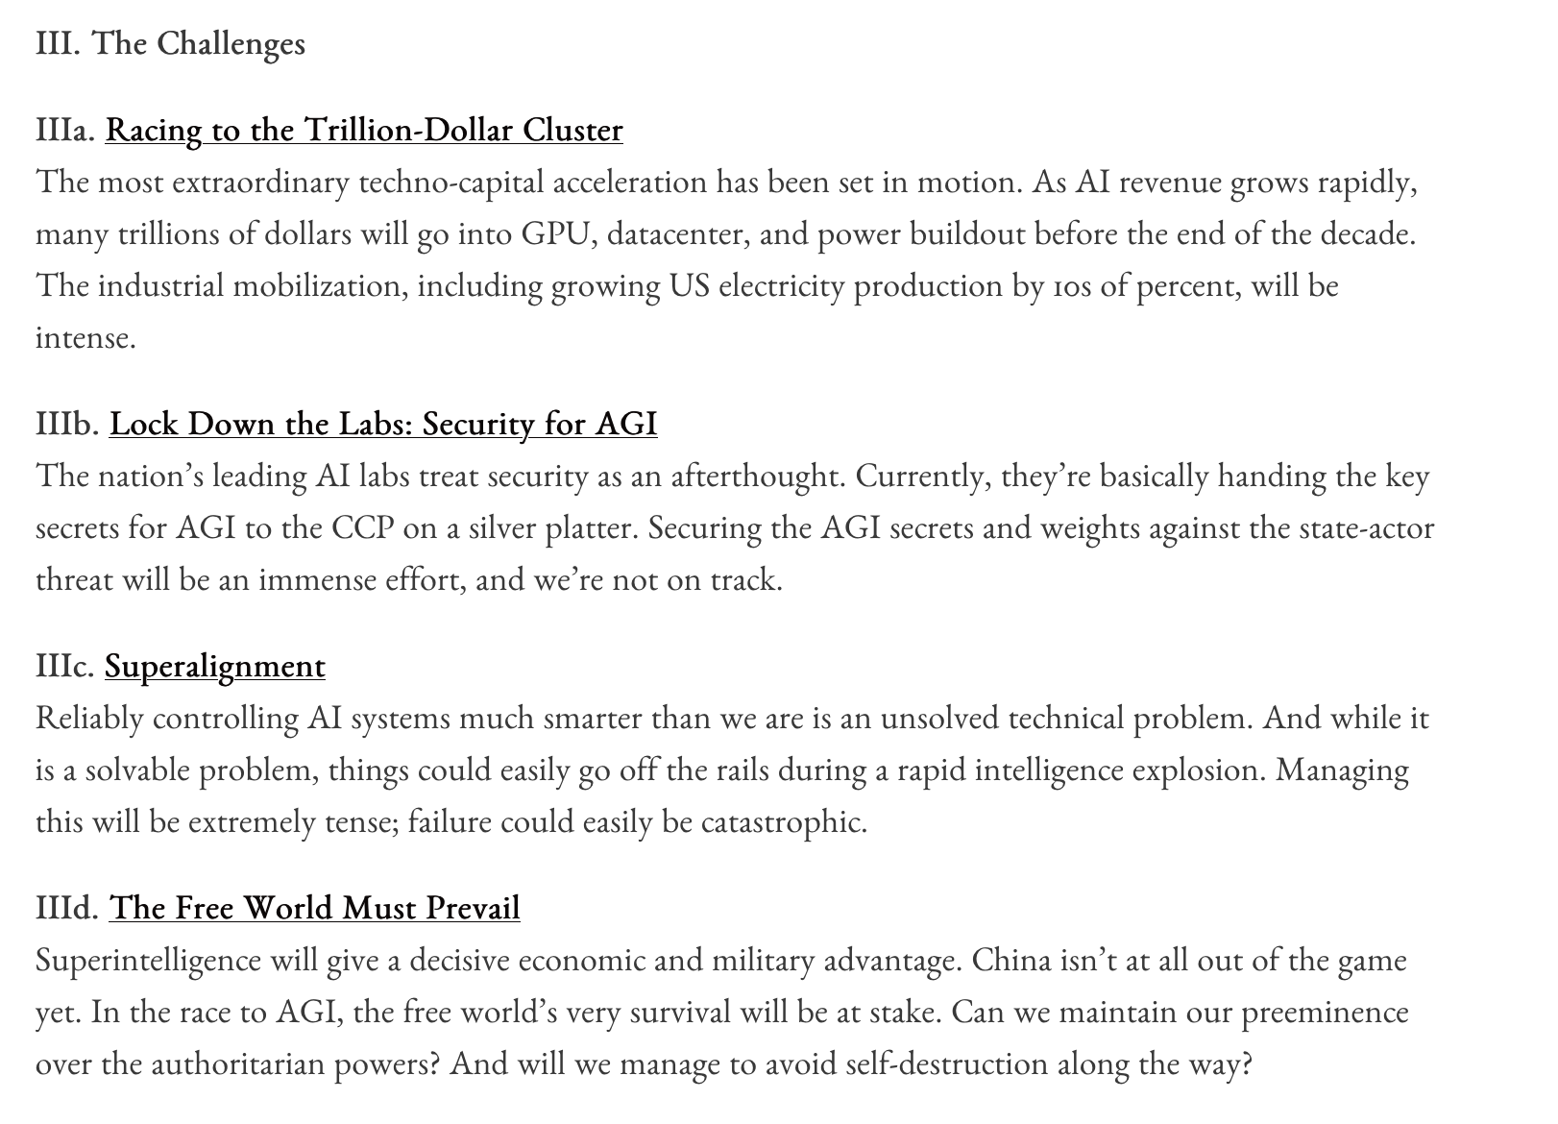
Leopold Aschenbrenner: The Prophet (3)

Slide 30
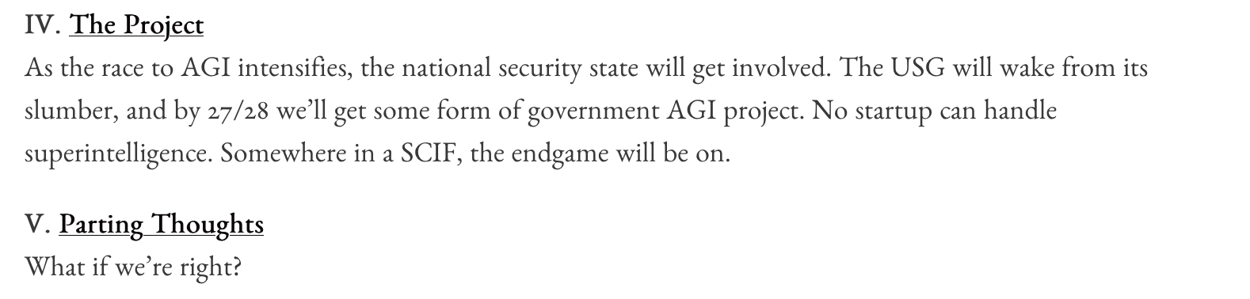
Leopold Aschenbrenner: The Prophet (4)

Slide 31
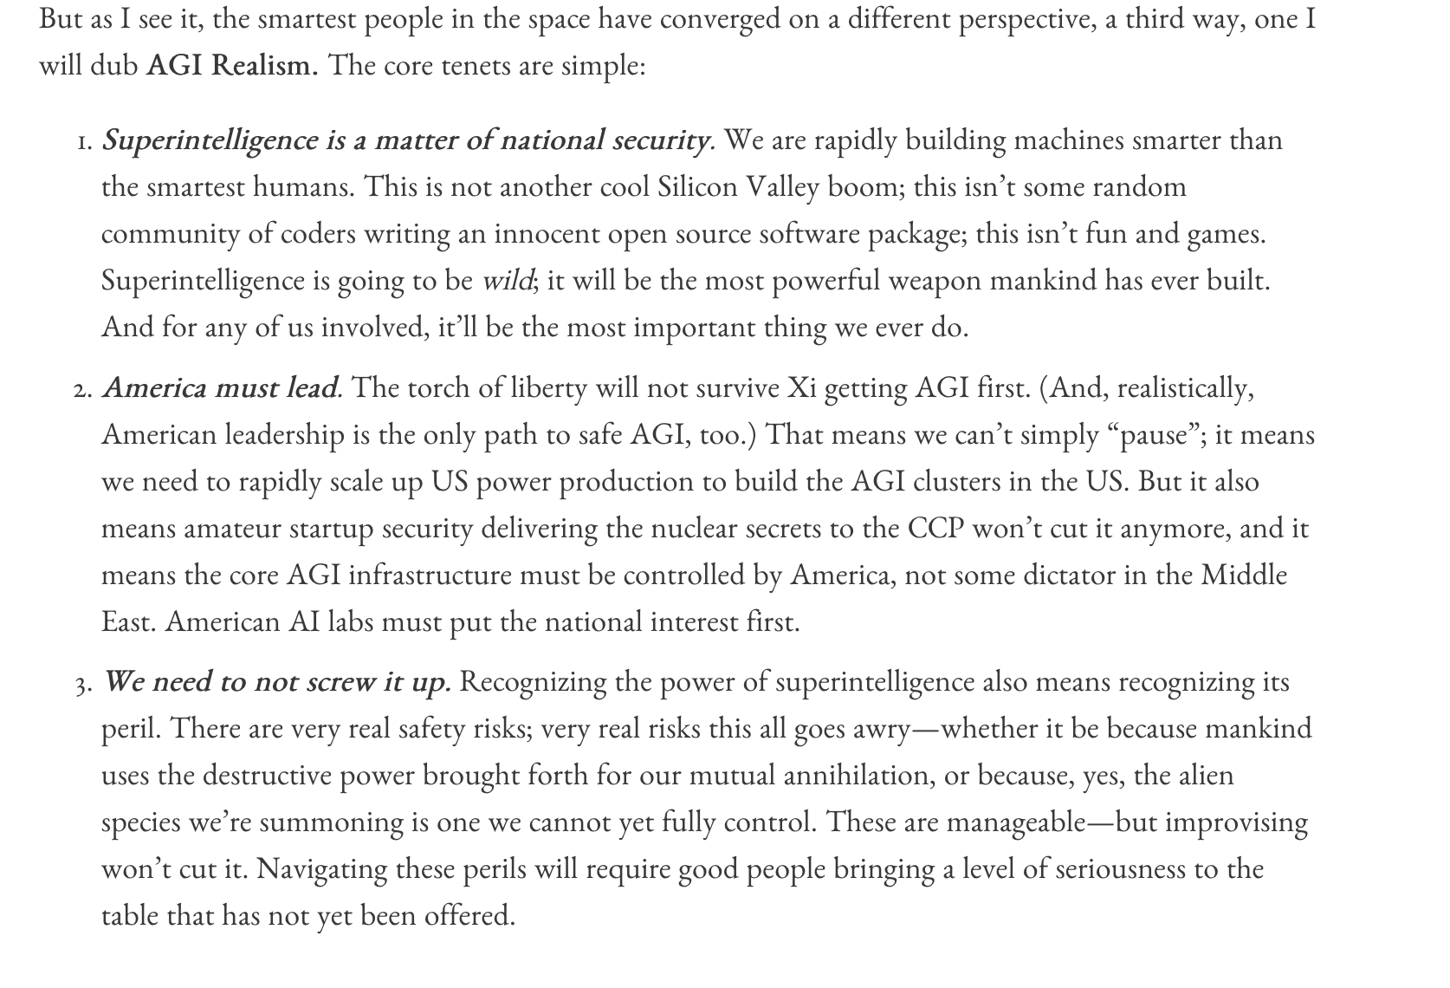
Leopold Aschenbrenner: The Prophet (5)

Slide 32
Fundamental Differences
The models differ most in authority, timing, harm, and legitimacy.
Palantir
Fragmented state + private sector
AI Will reshape the socialorder humans must lead
Anthropic
The State that vcontrols AI Will control human development even as AI shapes that developmnt
OpenAIChina
Tech-state coordination
Continuous administrative oversight
In AI state dislectics
Aschrnbrunner
Superintelligence Will produce the national security State. Only questyion is whether that Will be driven by humans or AI
Lecture Six - Comparative AI Governance
6

Slide 33
Closing Takeaway
AI governance is not merely governance of technology.
CLOSING
AI governance iand the organization and governance of society and the state.
Palantir: looks inside the State as the site for engaging AU transformations
Anthropìc looks outside the State grounding AI as an instrument of State power in global competition
OpenAI looks at the imposition of a techno bureauctratic expert Vanguard that merges state and private sectors in win-win interrelationship
Lecture Six - Comparative AI Governance
16

