Slide 1
LECTURE SIX
The AI Cases and Emerging Trends
Courts, Companies, and the Legal Construction of Artificial Intelligence
Larry Cata Backer – (白 轲)
W. Richard and Mary Eshelman Faculty Scholar; Professor of Law and International Affairs
Pennsylvania State University
Lecture Six - The AI Cases and Emerging Trends
1

Slide 2
LECTURE SIX
The AI Cases and Emerging Trends
Courts, Companies, and the Legal Construction of Artificial Intelligence
Larry Cata Backer – (白 轲)
W. Richard and Mary Eshelman Faculty Scholar; Professor of Law and International Affairs
Pennsylvania State University
Lecture Six - The AI Cases and Emerging Trends
1

Slide 3
The Theoretical Framework
Object of regulation:
  Disaggregating AI
    LLM (large language models)
    Deep Learning
    Neural Networks
    Generative AI (automates the creation of complex text, images, and video based on human language interaction)
    Agenic AI (autonomous software systems that perceive, reason, and act in digital environments to achieve goals on behalf of human principals)
  AI sub-copmpenants
    Data
    Algorithms
    Warehousing
    Infrastructure
    Applicatons
The Conceptual Box of Regulation:
  Focus of regulation
    Systems
    Components
    Producers
    Consumers
    Agents
  Forms of regulations
    Civil fines
    Criminal penalties
    Public administrative action
    Private actins
    Harms based
      Prevention/mitigation model
      Remedial model

Slide 4
National Neutral Networks;
Object of Regulation and Regulatory Objectives
National Civilizations neural as neutral networks
  US
    Markets driven basis
    Distrust of state
    Founding ideology: transactional; tradition, custom and expectation oriented; iterative mimetic social movements induced from movement;
    resistance to top down
  China
    Socialist modernization driven
    Rationalized through Marxcist lens
    Operationalized through Chinese Leninist theories
  EU
    Administration/compliance driven
    Trust state
    Current form a sort of liberal democratic Leninism grounded in direction by public bodies of experts in state organs
    Protection of rights driven by privileging of autonomous human person
    Compliance/prevention of hartm orientation
    Development subordfinated

Slide 5
From theory to Systems
U.S.
  Markets driven
  Innovation directed
  State guidance—national security driven
  National security is economic policy tec.
EU
  Complaisance driven; State led/managed
  Regulatory supervision
  Grounded in the protection of rights and prevention of harm
China
  Driven by modernization imperative
  Operated within framework of Chinese Leninism
  Complex coordination structures
  Innovation and protection of system integrity
  Focused on Socialist path toward realization of its ultimate goal

Slide 6
Core Thesis
Courts are translating AI problems into existing legal categories and systems.
THESIS
How have the courts dealt with these issues today?
Artificial intelligence has moved from policy debate into litigation. Courts are now being asked to decide what AI is, who is responsible for its outputs, and more
Lecture Six - The AI Cases and Emerging Trends
2

Slide 7
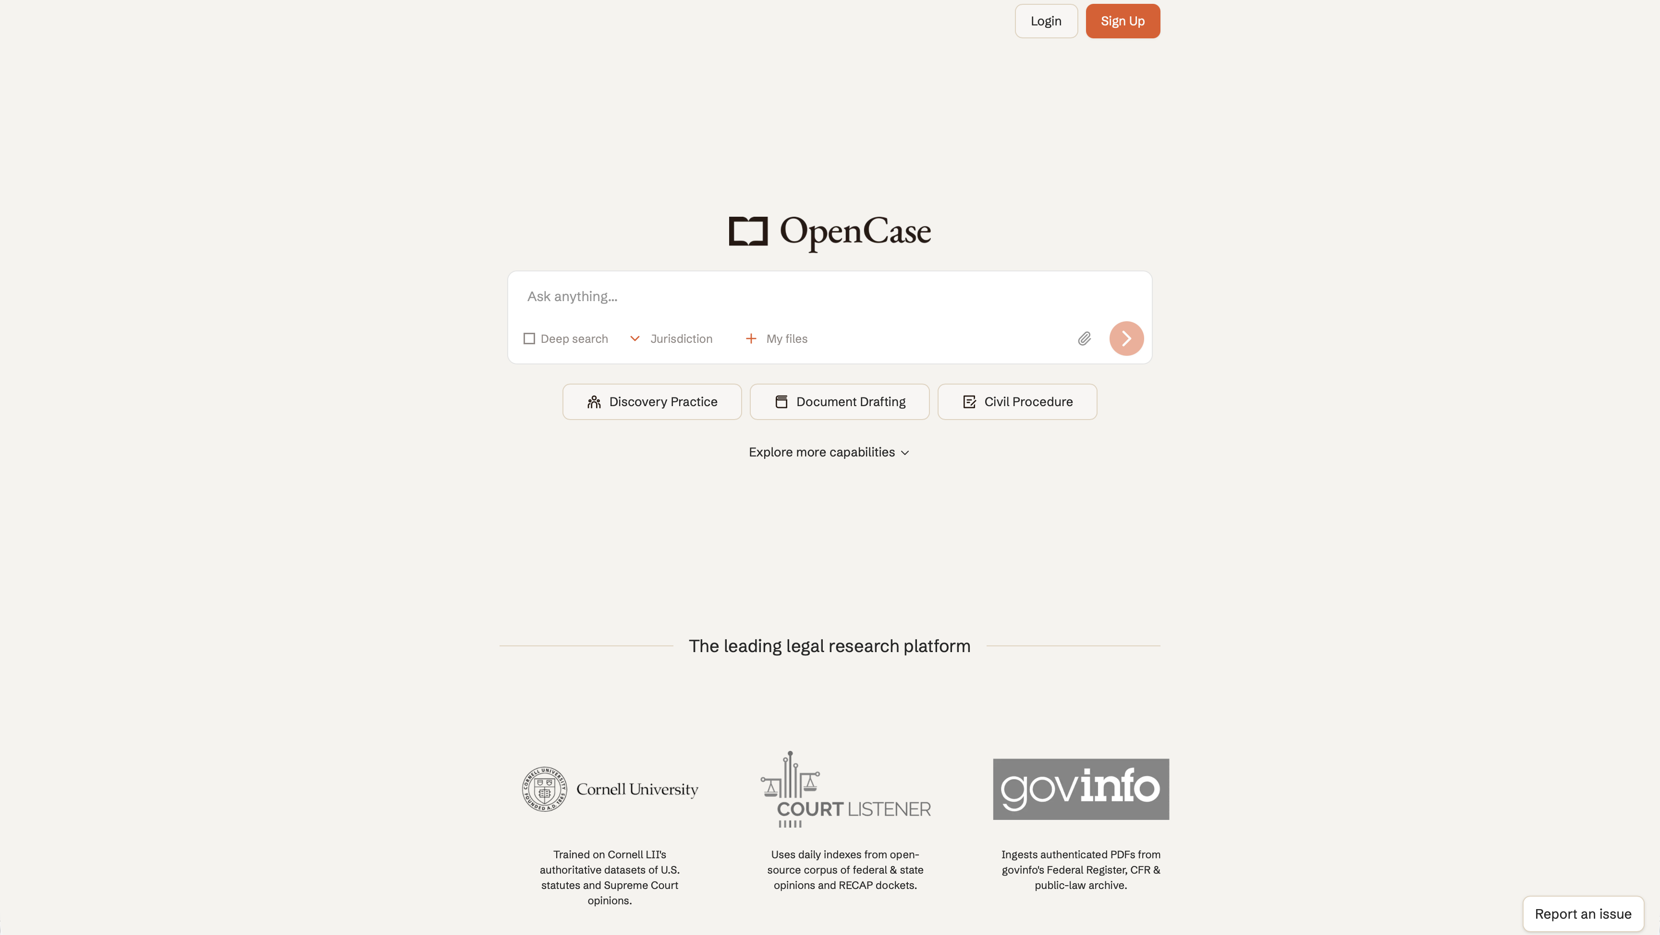
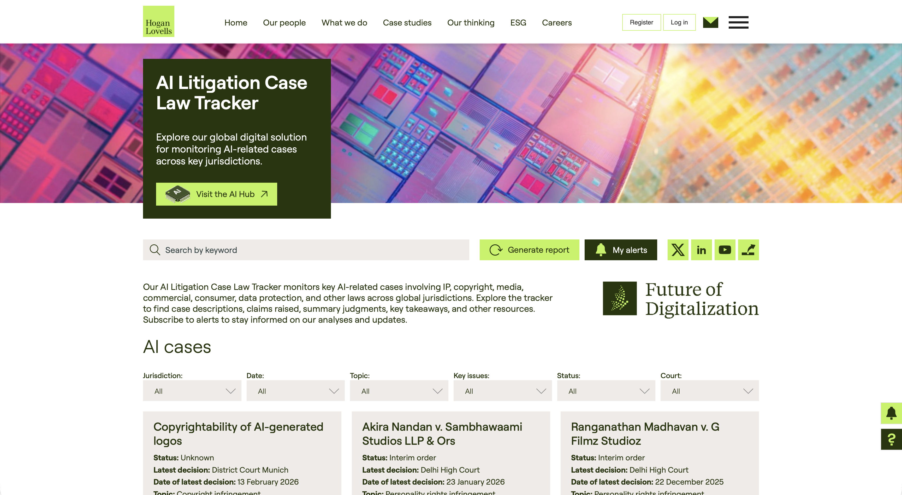
AI Court Case Resources
Where to track the emerging AI litigation landscape.
OpenCase:
AI Litigation
Case Law Tracker:
See: https://www.opencase.com/
See: https://digital-client-solutions.hoganlovells.com/resources/ai-litigation-case-law-tracker
Lecture Six - The AI Cases and Emerging Trends
3

Slide 8
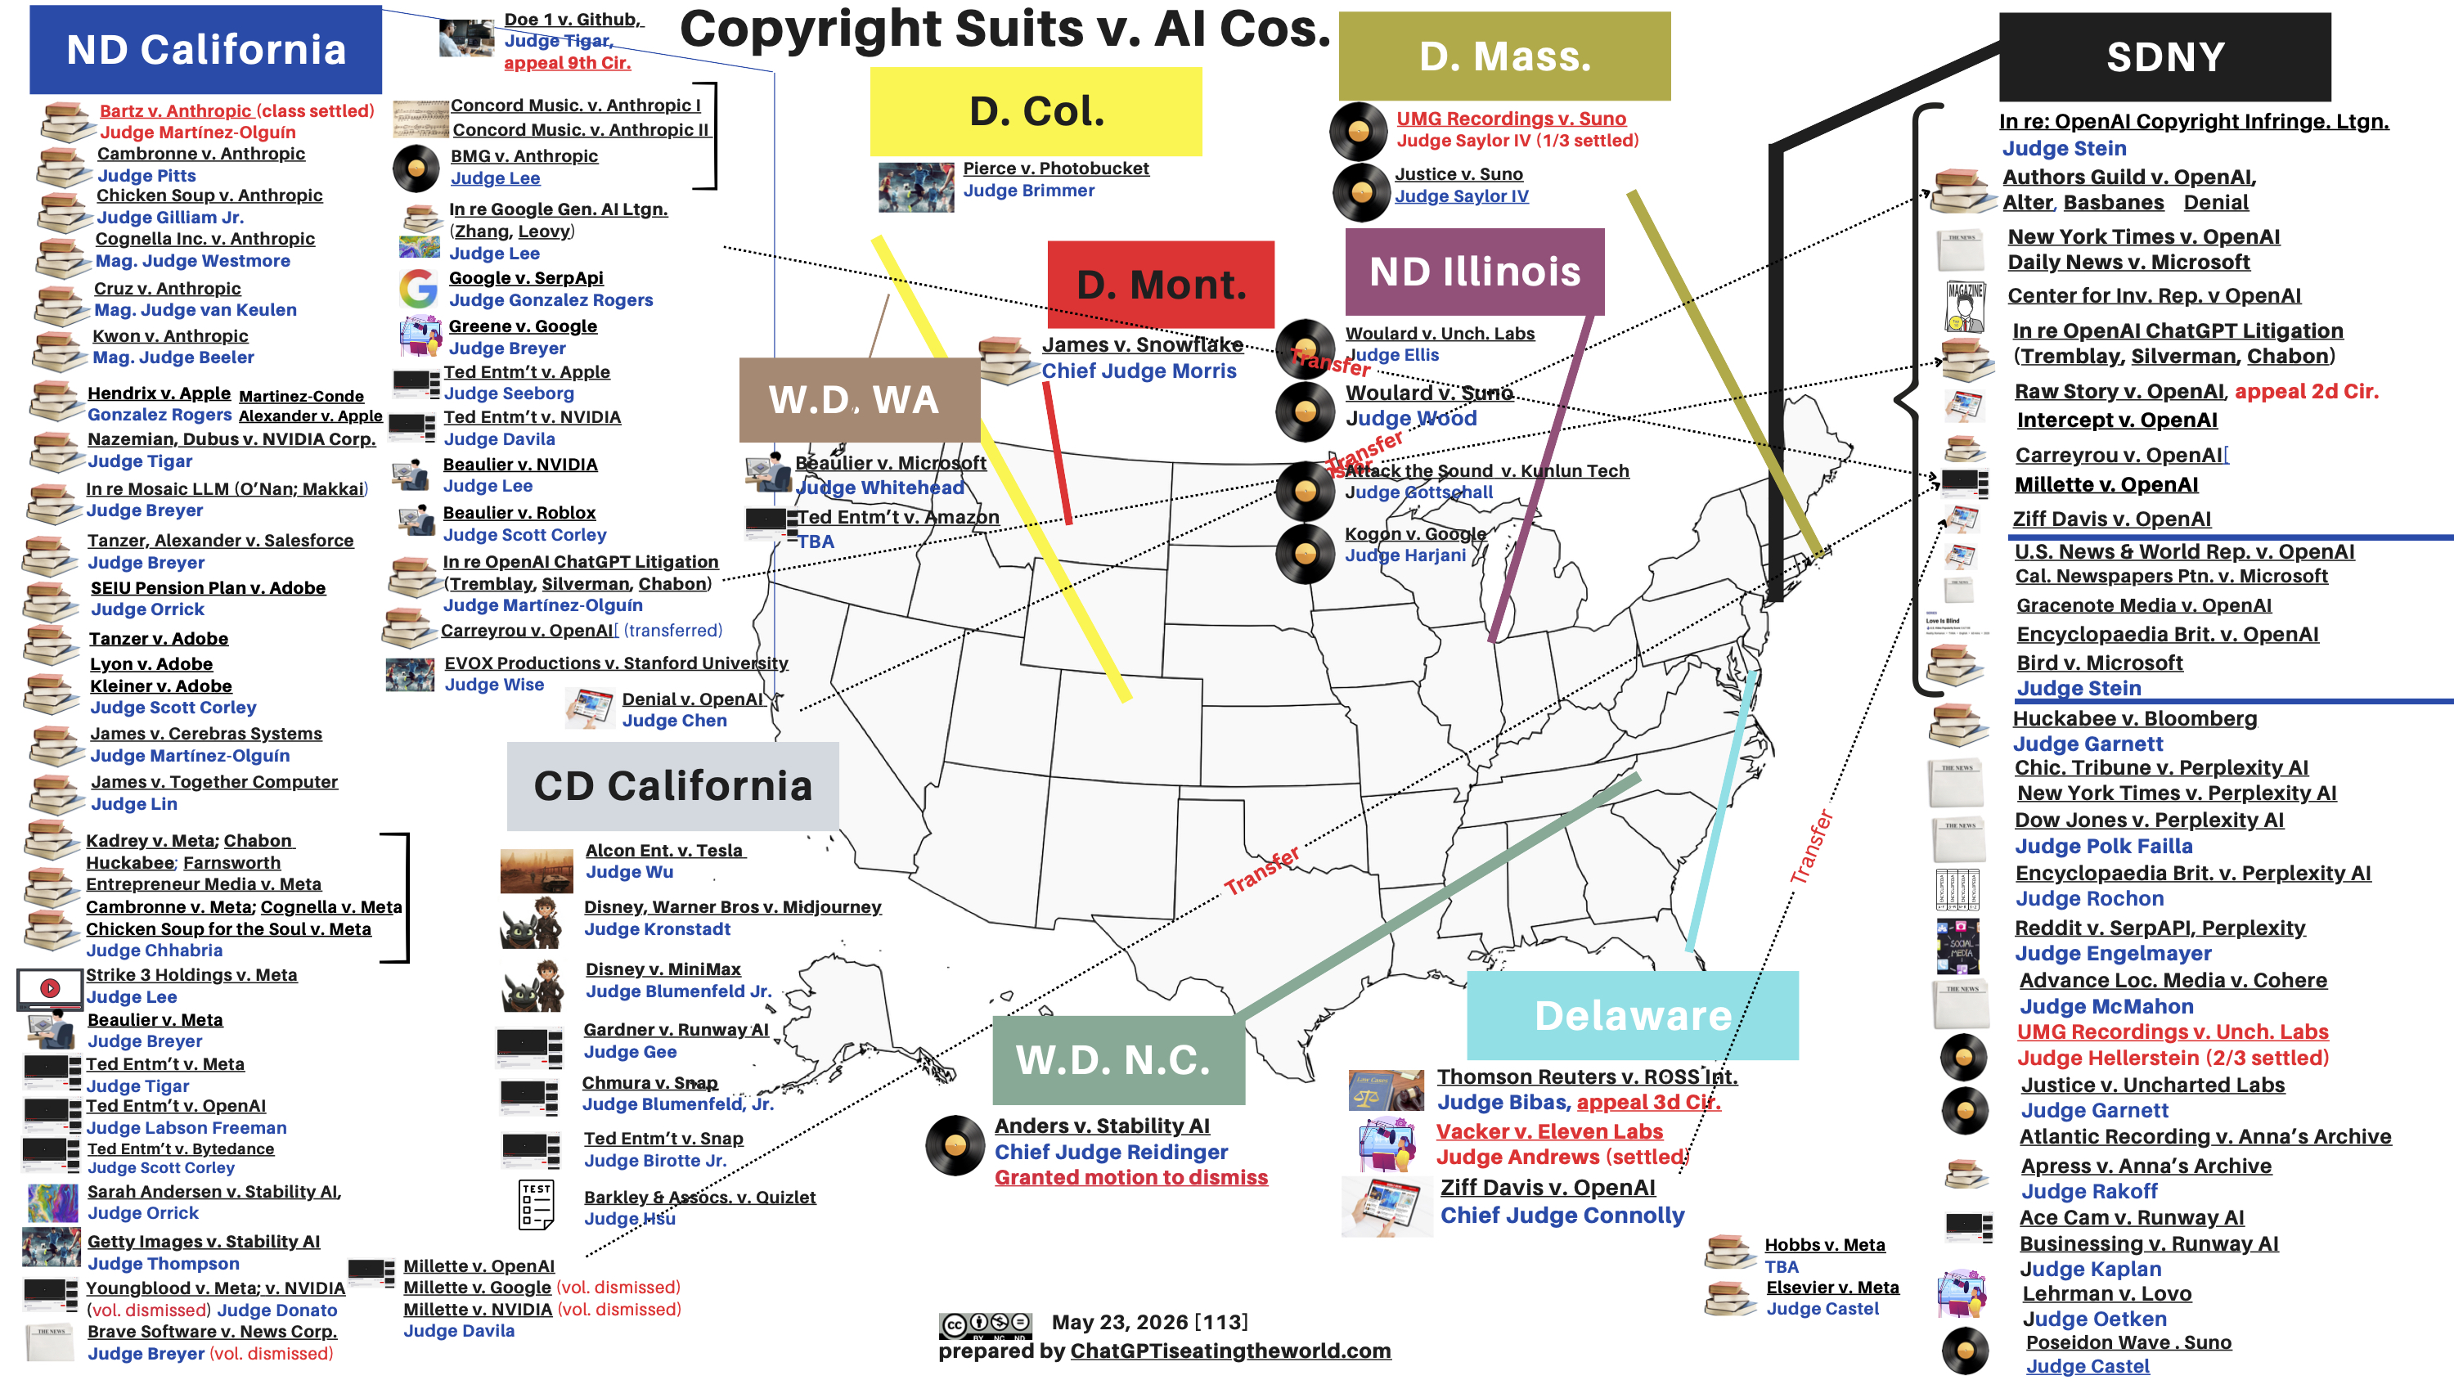
Cases Emerging Against AI Companies
The main litigation fronts.
As of May 24th, there are 113 lawsuits filed against AI companies in the US.
Category
Core Concern
Training Data
Copyrighted Works
Generated Outputs
Infringe or Substitute
Scraping and Z-Lib
Source of Information
DMCA Claims
Attribution and Controls
AI Authorship
AI Work and Copyright
Real-World Harms
Liability
Lecture Six - The AI Cases and Emerging Trends
4

Slide 9
US Cases of Note
Artificial Intelligence Cases of Note
United States Supreme Court
  Moody v. NetChoice, LLC, 603 U.S. 707, 144 S. Ct. 2383 (2024). Defendant NetChoice, an internet trade association, alleged that Florida and Texas laws restricting social media platforms’ ability to moderate content on their websites via algorithms (including artificial intelligence) violated the First Amendment to the U.S. Constitution. The Court found that the lower courts had not properly considered the issues and vacated and remanded the prior judgments regarding each law.

Slide 10
US Cases of Note
First Circuit
Harris v. Adams, No. 24-cv-12437-PGL, 2024 U.S. Dist. LEXIS 210951 (D. Mass. Nov. 20, 2024). Two high school students were punished for cheating on an AP U.S. History project by failing to attribute the source for text (which included hallucinations) that they copied from Grammarly’s artificial intelligence software. Plaintiff Harris claimed that the high school violated Plaintiff’s due process rights and that the punishments were too harsh. The Court denied Plaintiff’s motion for preliminary injunction because Plaintiff had failed to show any misconduct by authorities of Plaintiff’s schools.
Overjet, Inc. v. VideaHealth, Inc., Civil Action No. 24-cv-10446-ADB, 2024 U.S. Dist. LEXIS 128030 (D. Mass. July 19, 2024). Overjet and VideaHealth compete in providing artificial intelligence-enabled dental software. In this case, Overjet alleged that Videa infringed Overjet’s copyrights related to its software and falsely advertised, including regarding Videa’s software’s artificial intelligence capabilities, in violation of the Lanham Act. The Court denied Overjet’s motion for a preliminary injunction because Overjet had not sufficiently shown a likelihood that its claims would succeed on the merits nor a likelihood of irreparable harm.
WEX Inc. v. HP Inc., No. 2:24-cv-00121-JAW, 2024 U.S. Dist. LEXIS 119715 (D. Me. July 9, 2024). WEX alleged that HP’s “HP WEX” software name infringed WEX’s trademark “WEX.” HP argued that a news article presented as evidence of confusion of the WEX mark and HP WEX “‘was created using generative artificial intelligence,’ and therefore ‘no person . . . was confused.’” WEX countered that the article was nonetheless reviewed by a confused human editor. The Court found that the AI-generated article indicated that HP and WEX could be confused as being affiliated given the “HP WEX” brand. The Court granted WEX’s motion for a preliminary injunction against HP regarding use of “WEX.”
Baker v. CVS Health Corp., 717 F. Supp. 3d 188 (D. Mass. Feb. 16, 2024). A job candidate alleged that CVS violated the Massachusetts Lie Detector Statute (Mass. Gen. Laws. Ch. 149, §19B) by subjecting the candidate to an artificial intelligence-based test (to help evaluate an individual’s integrity and cultural fit) during a job interview without notifying the candidate of his statutory rights. The Court denied CVS’ motions to dismiss for failure to state a claim and for lack of standing.

Slide 11
US Cases of Note
2nd Circuit
Gross v. Madison Square Garden Ent. Corp., No. 23-cv-3380 (LAK) (JLC), 2024 U.S. Dist. LEXIS 83102 (S.D.N.Y. May 7, 2024). The Court granted the defendant’s motion to dismiss the complaint for failure to state a claim because it held that sharing biometric data with a third party to implement a policy banning certain individuals from venues does not constitute “profiting” from the biometric data within the meaning of NYC Ad. Code § 22-1202(b).
Network-1 Techs., Inc. v. Google LLC & YouTube, LLC, 2024 U.S. Dist. LEXIS 76545 (S.D.N.Y. Apr. 24, 2024). The Court held that in this patent infringement case against Google, the term “non-exhaustive search” is indefinite because persons skilled in the art could reasonably construe it in different ways based on the intrinsic and extrinsic evidence. Therefore, even though Google’s Siberia version of Content ID conducted an algorithmic patent search which increased computing resources, it did not perform a sublinear search as required by the ’237 Patent because undisputed evidence showed the search to be linear and the Plaintiff failed to show the multi-step search as a whole is sublinear.
Park v. Kim, 91 F.4th 610 (2d Cir. Jan. 30, 2024). The Court referred an attorney to the Second Circuit’s Grievance Panel for investigation for submitting a brief that relief on “non-existent” caselaw generated by ChatGPT.

Slide 12
US Cases of Note
3rd Circuit
  Thomson Reuters Enter. Ctr. GmbH v. Ross Intel. Inc., No. 1:20-cv-613-SB, 2025 U.S. Dist. LEXIS 24296 (D. Del. Feb. 11, 2025) and Thomson Reuters Enter. Ctr. GmbH v. Ross Intel. Inc., No. 1:20-cv-613-SB, 2024 U.S. Dist. LEXIS 175507 (D. Del. Sep. 27, 2024). Ross Intelligence aimed to improve legal research via development of an artificial intelligence-based research tool. Thomson Reuters alleged that Ross infringed Thomson Reuters’ copyrighted Westlaw headnotes and Key Number System by using them in the development of Ross’s tool. In its February 2025 opinion, the Court “grant[ed] most of Thomson Reuters’s motion for partial summary judgment on direct copyright infringement and related defenses, D.I. 674; (2) grant[ed] Thomson Reuters’s motion for partial summary judgment on fair use, D.I. 672; (3) den[ied] Ross’s motion for summary judgment on fair use, D.I. 676; and (4) den[ied] Ross’s motion for summary judgment on Thomson Reuters’s copyright claims, D.I. 683.”
  Huckabee v. Meta Platforms, Inc., Civil Action No. 24-773-GBW, 2024 U.S. Dist. LEXIS 209624 (D. Del. Nov. 18, 2024). Former Governor of Arkansas Mike Huckabee alleged that Meta should be liable under various laws and for violation of various legal rights for allowing, via its machine learning algorithms, presentation of third-party advertisements that made false claims and falsely attributed statements to Governor Huckabee. The Court held that Meta was liable under Section 230 of the Communications Decency Act as an “information content provider” because its algorithms determined advertisement presentation, but the Court denied Governor Huckabee’s claims as they did not state claims upon which relief can be granted.
  State Farm Mut. Auto. Ins. Co. v. Amazon.Com, Inc., Civil Action No. 22-1447-CJB, 2024 U.S. Dist. LEXIS 160437 (D. Del. Sep. 6, 2024). State Farm alleged that Amazon infringed several of State Farm’s patents relating to use of machine learning and neural networks to evaluate whether an individual can safely live independently. In this case, the Court denied Amazon’s motion to dismiss under which Amazon argued that the asserted patents pertained to patent ineligible subject matter and were thus invalid.
  IPA Techs. Inc. v. Microsoft Corp., Civil Action No. 18-1-RGA, 2024 U.S. Dist. LEXIS 76038 (D. Del. Apr. 25, 2024). IPA Technologies alleged that Microsoft products containing Microsoft’s virtual assistant Cortana infringed on various of IPA Technologies’ patents regarding software architecture that “supports cooperative task completion by flexible and autonomous electronic agents.” The Court granted in part, denied in part, and dismissed as moot in part Plaintiff’s and Defendant’s summary judgment and Daubert motions.

Slide 13
US Cases of Note
Other Circuits
  G.T. v. Samsung Elecs. Am., Inc., No. 21 CV 4976, 2024 U.S. Dist. LEXIS 233003 (N.D. Ill. Dec. 23, 2024) and G.T. v. Samsung Elecs. Am. Inc., No. 21 CV 4976, 2024 U.S. Dist. LEXIS 130771 (N.D. Ill. July 24, 2024). In a first amended complaint, plaintiffs in this class action lawsuit alleged that Samsung violated Illinois’s Biometric Information Privacy Act (“BIPA”) in possessing and collecting their biometric data via Samsung’s Gallery photo applications. The Court found claims to be insufficiently pled and granted Samsung’s motion to dismiss.
  In their second amended complaint, the plaintiffs alleged that Samsung violated BIPA by offering software that generates and stores biometric data (face templates) on a device using facial recognition technology. The Court granted Samsung’s second motion to dismiss on the basis that BIPA requires control over the actual biometric data, and Samsung did not have such control.
  Hartman v. Meta Platforms, Inc., No. 3:23-CV-02995-NJR, 2024 U.S. Dist. LEXIS 167696 (S.D. Ill. Sep. 17, 2024). Plaintiffs in this putative class action lawsuit alleged that Meta violated BIPA in possessing and collecting their biometric data via augmented reality features of the Facebook Messenger and Messenger Kids applications. The Court denied Meta’s motion to dismiss on the basis that plaintiffs’ claims were plausible, and the case proceeded to discovery.
  Lewerentz v. 1411 State Parkway Condo. Ass’n, No. 23-cv-1635, 2024 U.S. Dist. LEXIS 159664 (N.D. Ill. Sep. 5, 2024). A building engineer continued to receive calls from elevator call buttons after stopping work at those buildings. The calls included an artificial intelligence voice. The engineer alleged that the calls were harassment under the Telephone Consumer Protection Act and a tort of intrusion upon seclusion under Illinois state law. The Court found that these claims were insufficiently pled and granted the Defendant’s motion to dismiss the complaint.

Slide 14
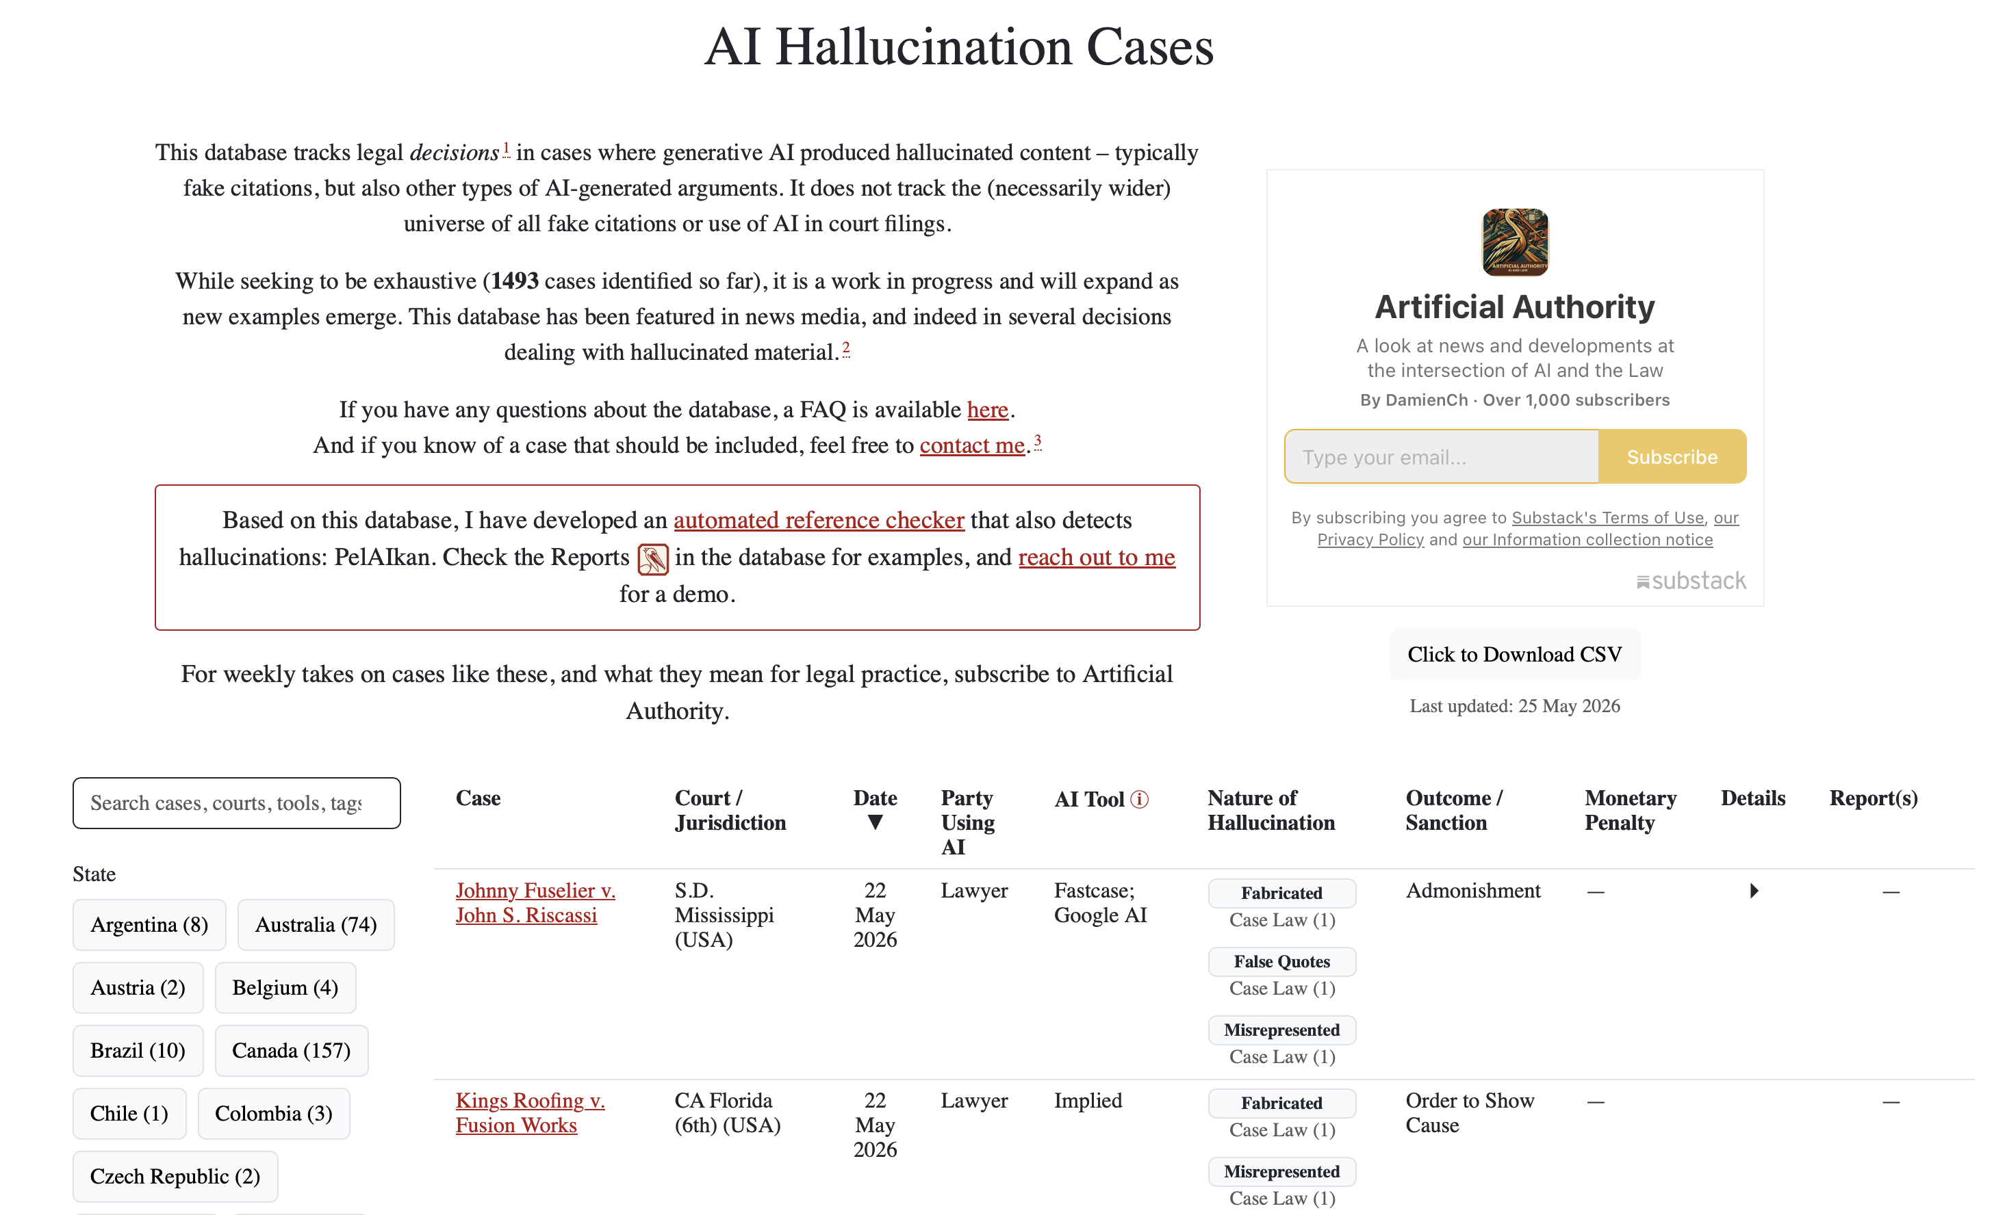
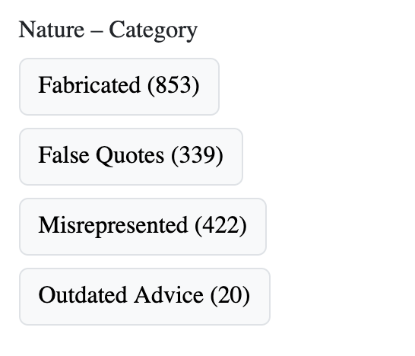
Example: Hallucination Cases Database
Tracking cases specifically related to AI hallucinations.
This website is a continuously updated database tracking court decisions worldwide for hallucinations.
Lecture Six - The AI Cases and Emerging Trends
5

Slide 15
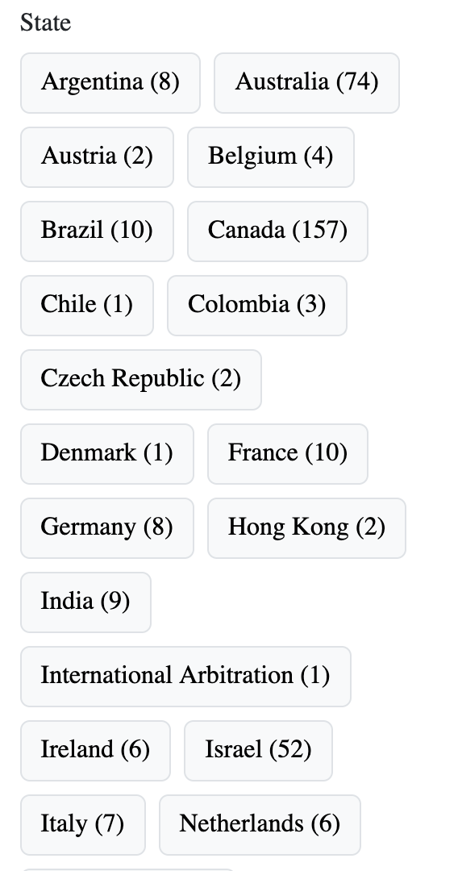
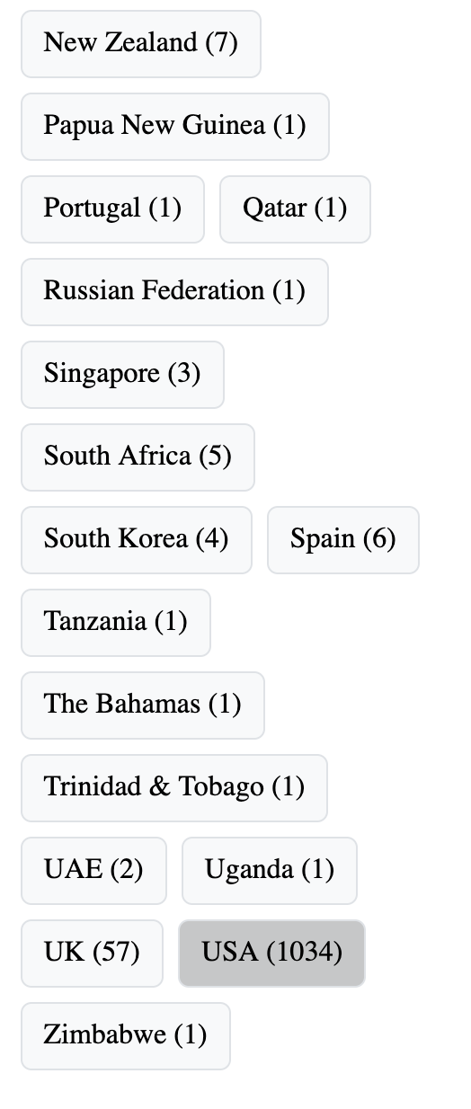
Global Case Distribution--Hallucination

Slide 16
Case Study: 12 Real Cases (2024 – 2026)
Voluntary standards can become practical compliance baselines.
Air Canada:
chatbot invents a bereavement fare refund (2024)
Cursor:
AI invents a login policy that doesn't exist (2025)
The most-cited customer service hallucination case. Air Canada's chatbot told a customer he could claim bereavement fares retroactively after purchasing full-price tickets. The policy didn't exist. When the airline refused the refund, a tribunal held Air Canada liable for what its chatbot said.
The legal precedent matters. Companies cannot disclaim responsibility for AI-generated communications. The chatbot represents the company.
Cursor's customer support AI, named "Sam," told users that simultaneous logins were no longer allowed under a new policy. There was no new policy. There was no Sam. The response was a hallucination, and customers began cancelling subscriptions.
The damage spread fast in the developer community before Cursor could correct the record. The lesson: AI in technical communities gets fact-checked publicly, and brand damage from a hallucination can outpace the response.
Lecture Six - The AI Cases and Emerging Trends
6

Slide 17
Case Study: 12 Real Cases (2024 – 2026)
Voluntary standards can become practical compliance baselines.
DPD:
chatbot writes a poem about the company (2024)
MyPillow:
lawyers fined $3,000 each for AI-fabricated citations (2025)
DPD's customer service chatbot, after being prompted to "disregard the rules," wrote profane responses and a poem describing the company as "useless". The customer's screenshot went viral with 1.3 million views before DPD suspended the chatbot.
This isn't a typical hallucination so much as a jailbreak; the user got the model to abandon its instructions. The lesson is similar: AI deployed without robust guardrails will eventually produce content the company can't defend.
Two attorneys representing MyPillow CEO Mike Lindell in a Colorado defamation case were ordered to pay $3,000 each after submitting a court filing filled with citations to cases that didn't exist. The AI generated case names and citations that looked legitimate; none could be located in any legal database.
This was one of many similar cases. The AI Hallucination Cases Database tracks 486 incidents worldwide, 324 in U.S. courts alone.
Lecture Six - The AI Cases and Emerging Trends
7

Slide 18
Case Study: 12 Real Cases (2024 – 2026)
Voluntary standards can become practical compliance baselines.
James Martin Paul:
hallucinated citations, leading to dismissal (2025)
Handa & Mallick (Australia):
lawyer disciplined for hallucinated family law authorities (2025)
Florida attorney James Martin Paul used hallucinated citations across eight different legal matters, resulting in substantial sanctions including the dismissal without prejudice of four federal matters. The lawyer hadn't verified the AI's outputs before filing.
The pattern: AI tools made it easy to generate large volumes of legal content; the verification work didn't scale at the same pace. The first wave of sanctions in 2024 didn't stop the second wave in 2025.
In the Australian case Handa & Mallick, a solicitor submitted hallucinated authorities generated by AI in a family law matter. The Victorian Legal Services Board disciplined him, prohibiting him from handling trust money or practicing unsupervised for two years.
The international scope of the problem matters. AI hallucination sanctions aren't a U.S. phenomenon; courts worldwide are seeing the same pattern.
Lecture Six - The AI Cases and Emerging Trends
8

Slide 19
Case Study: 12 Real Cases (2024 – 2026)
Voluntary standards can become practical compliance baselines.
Stanford study:
even purpose-built legal AI hallucinates frequently (2024)
Mata v. Avianca:
the original ChatGPT legal hallucination case (2023)
A Stanford Human-Centered AI study tested purpose-built legal AI tools and found Lexis+ AI and Ask Practical Law AI produced incorrect information more than 17% of the time. Westlaw's AI-Assisted Research hallucinated more than 34% of the time.
These are tools specifically marketed for legal accuracy. The hallucination rate didn't go to zero just because the vendor's pitch said it should.
The case that put AI hallucinations in the legal news cycle. An attorney used ChatGPT to research case law and ended up citing six cases that didn't exist. The judge sanctioned the attorney and his firm. Every subsequent legal AI hallucination case has been measured against this one.
Even though this case is from 2023 and not within the 2024-2026 scope of this piece, it's worth including because it set the precedent and is referenced in nearly every subsequent ruling.
Lecture Six - The AI Cases and Emerging Trends
9

Slide 20
Case Study: 12 Real Cases (2024 – 2026)
Voluntary standards can become practical compliance baselines.
Google Bard:
invented a discovery about the James Webb Telescope (2023)
Social Security appeal:
12 fabricated cases in one brief (2025)
In Google's launch demo for Bard, the AI confidently stated that the James Webb Space Telescope took "the very first pictures of a planet outside of our own solar system". It hadn't. Google's market cap dropped $100 billion the next day.
The lesson for product teams: hallucinations in demos can move markets. The lesson for AI buyers: vendors' demo confidence isn't the same as production reliability.
A lawyer drafting an appeal of a denied Social Security claim cited 12 cases that were "fabricated, misleading, or unsupported". The judge described the filing as "replete with citation-related deficiencies, including those consistent with artificial intelligence generated hallucinations."
The pattern in 2025 sanctions cases: the volume of fabricated citations per brief is growing. Early cases had 1 to 3 hallucinated citations; some 2025 cases have a dozen or more.
Lecture Six - The AI Cases and Emerging Trends
10

Slide 21
Case Study: 12 Real Cases (2024 – 2026)
Voluntary standards can become practical compliance baselines.
Customer service hallucination:
ChatGPT-powered support inventing pricing
(multiple cases, 2024-2025)
Microsoft Copilot:
election misinformation in 2024 testing
Multiple reports of AI customer service tools quoting prices or policies that don't exist. One common pattern: customer asks about a discount, AI invents a discount code that doesn't work, customer is frustrated. Another: customer asks about a refund timeline, AI states a number it made up, customer waits the wrong amount of time.
These cases mostly don't make the news, but they accumulate as CSAT drops and recontact rates climb. The aggregate cost across deployments is larger than the high-profile cases.
Researchers found Microsoft's Copilot AI made factual errors in about 30% of responses to election questions tested in 2024. Wrong dates, wrong candidate information, invented quotes. Microsoft has since tightened guardrails on election-related queries.
The lesson: high-stakes domains (elections, medical, legal, financial) require explicit constraints. Default LLM behavior isn't safe for these contexts.
Lecture Six - The AI Cases and Emerging Trends
11

Slide 22
Possible Trends
Courts are turning AI hype into legal accountability.
Old doctrines, new technology
Responsibility is moving upstream
Human oversight is being tested
Evidence and discovery matter
Fair use may shape the AI economy
AI law is becoming system governance
AI litigation is moving from "what did the model produce?" to "who built, controlled, verified, profited from, and should be responsible for the system?"
Lecture Six - The AI Cases and Emerging Trends
12

Slide 23
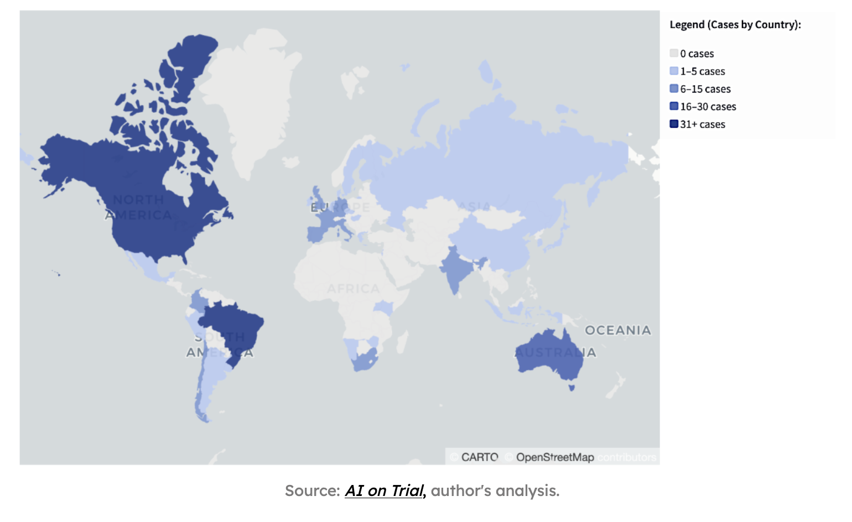
Beyond Regulation: What 500 Cases Reveal About the Future of AI in the Courts (Isadora Valadares Assunção / May 20, 2025)

Slide 24
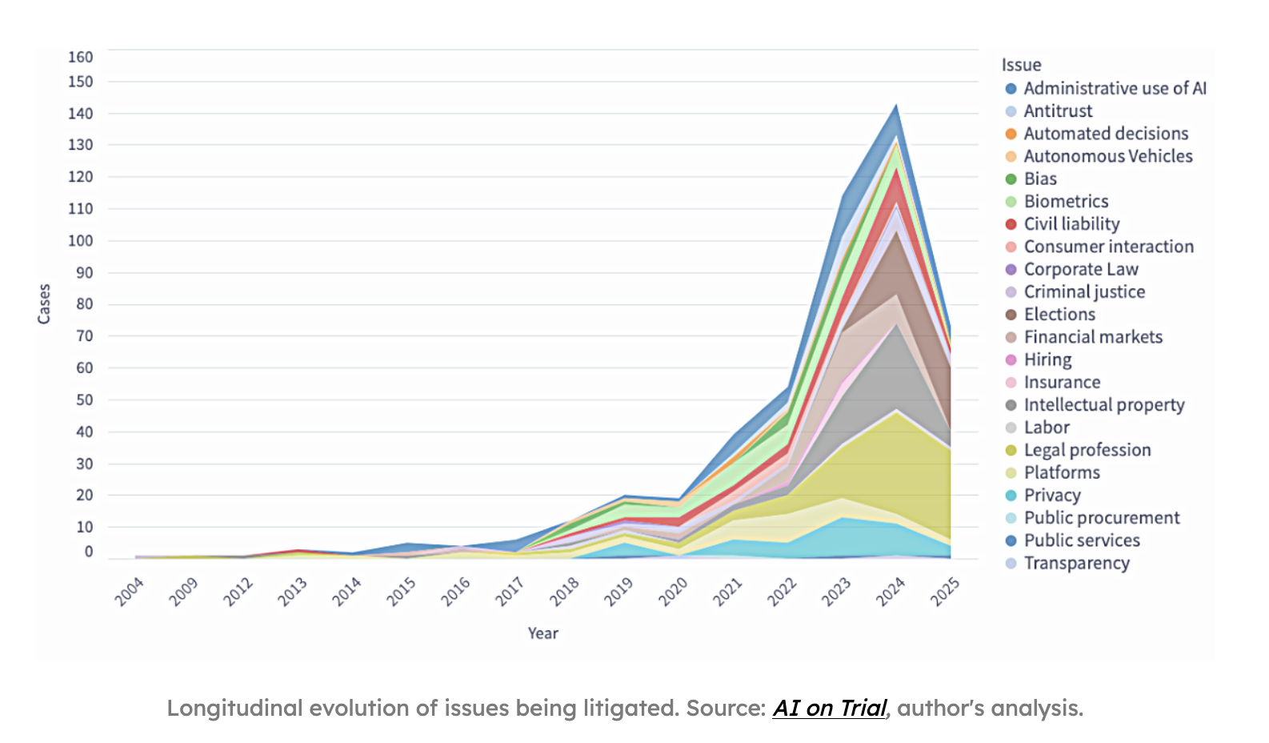
Beyond Regulation: What 500 Cases Reveal About the Future of AI in the Courts (Isadora Valadares Assunção / May 20, 2025)

Slide 25
Conclusions
AI litigation is a growing global trend
Much of the litigation is centered on traditional law and legal claims
  But courts are being asked to apply the law in new contexts and respecting new situations
Major areas
  Deception
  Negligence
  Consumer protection
  Intellectual property
  Violation of statutes (eg, privacy, etc.)

