Slide 1
LECTURE FIVE
The Chinese Approach
Developmental-security governance: rapid AI development under state-centered control.
Larry Cata Backer – ADD YOUR TITLE
Lecture Five - The Chinese Approach
1

Slide 2
Core Thesis
China connects AI governance to socialist modernization and state capacity.
THESIS
China constructs AI as strategic socio-technical infrastructure for socialist modernization.
1. AI is a productive force and a security domain
2. Public-facing AI must remain controllable
3. Platforms become governance intermediaries
4. Governance integrates development, security, data, content, and ideology
Lecture Five - The Chinese Approach
2

Slide 3
Development-Security Dialectic
The whole model moves between acceleration and control.
Develop
Secure
Coordinate
Economic growth, scientific innovation, industrial upgrading, modernization, and competitiveness.
Controllability, legality, social stability, data security, ideological alignment, and national security.
State planning, firms, platforms, local governments, research institutions, and national-security priorities.
Lecture Five - The Chinese Approach
3

Slide 4
Socialist Modernization
AI is not just a private consumer technology.
AI is framed as a strategic technology that can transform production, governance, public services, military affairs, and global competition.
1. Manufacturing, logistics, agriculture, finance, education, healthcare, transport
2. Smart cities, digital government, public administration, social services
3. Surveillance, censorship, predictive governance, and public-order management
Core contrast: productive force under party-state leadership.
Lecture Five - The Chinese Approach
4

Slide 5
Layered Governance Architecture
China does not rely on one AI law; it builds overlapping layers.
Industrial Policy and National AI Strategy
Cybersecurity, data security, and personal information law
Algorithmic recommendation regulation
Deep synthesis regulation
Generative AI measures and ethical review
Filing systems, security assessments, standards, and supervision
Lecture Five - The Chinese Approach
5

Slide 6
Data, Cybersecurity, and Personal Information
Data is both economic resource and security concern.
Data Enables Development
Data Creates Risk
Training data, user data, platform data, public data
AI depends on large-scale data flows
Data-driven modernization supports industrial and public-sector goals
National security and social order concerns
Cross-border transfer and important-data control
Personal information protection and security duties
Lecture Five - The Chinese Approach
6

Slide 7
Algorithmic Recommendation
Recommendation is governance of attention.
In a platform society, whoever controls recommendation controls attention. Whoever controls attention can shape public opinion, culture, consumption, labor, and mobilization.
1. Regulates ranking, selection, pushing, search filtering, scheduling, and decision-making algorithms
2. Requires management systems, data protection, user controls, and filings in sensitive cases
3. Connects algorithms to public opinion, social mobilization, and Core Socialist Values
Lecture Five - The Chinese Approach
7

Slide 8
Deep Synthesis and Generative AI
Synthetic media and public-facing generation are information-governance issues.
Deep Synthesis
Generative AI
Text, image, audio, video, virtual scenes, and deepfakes
Content management, labeling, identity, rumor control, and security assessment
Risk to trust, public order, and information stability
Public-facing services that generate content
Training data legality, IP, personal information, accuracy, transparency, user rights
Content must satisfy state-defined security and value rules
Lecture Five - The Chinese Approach
8

Slide 9
Public Opinion, Mobilization, and Values
The political logic of Chinese AI governance.
Public Opinion
Mobilization
Value Alignment
Systems that shape how people understand events, institutions, and social conditions.
Systems that coordinate attention, collective action, or social participation at scale.
Model behavior and platform design evaluated against Core Socialist Values and state priorities.
Lecture Five - The Chinese Approach
9

Slide 10
Platforms and Industrial Policy
Firms are economic actors and governance actors.
Platform Discipline
Development Policy
Implement state requirements through product design and moderation
File algorithms, label synthetic content, verify users, protect data
Optimize engagement while managing illegal or harmful information
Support research, standards, talent, infrastructure, and domestic capacity
Promote advanced manufacturing, smart cities, digital government, and competitiveness
Balance control with the need to compete globally
Lecture Five - The Chinese Approach
10

Slide 11
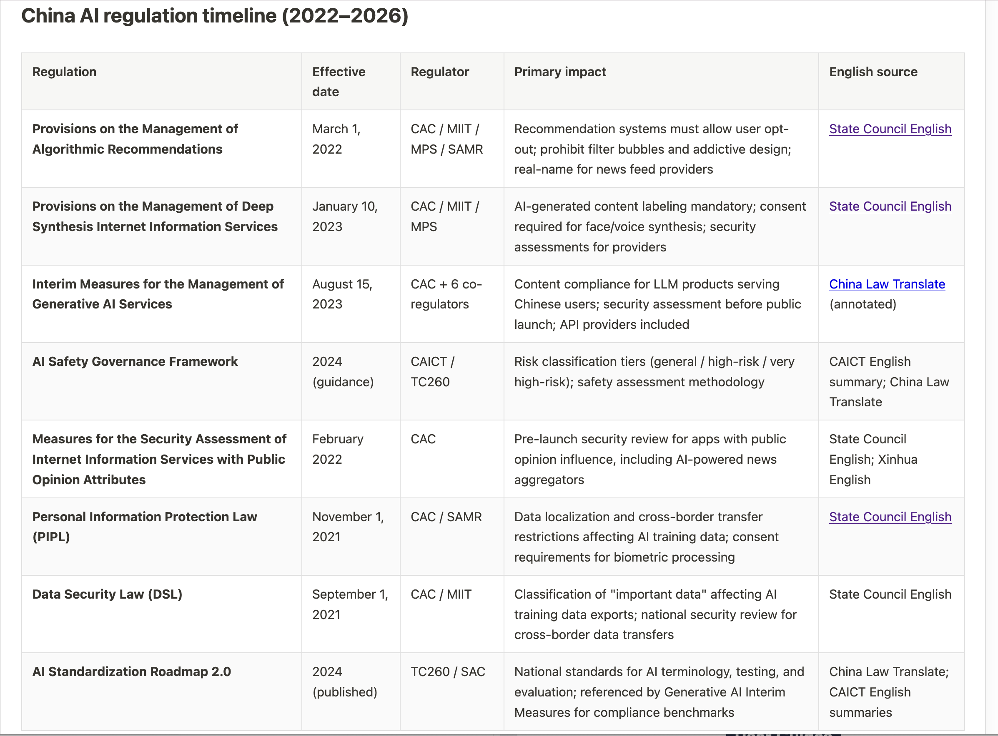
The Regulatory Stack (1) Regulation Timeline for AI Specific Regulation
Coordination, Guidance, Conformity to Fundamental Political Line
Lecture Five - The Chinese Approach
11

Slide 12
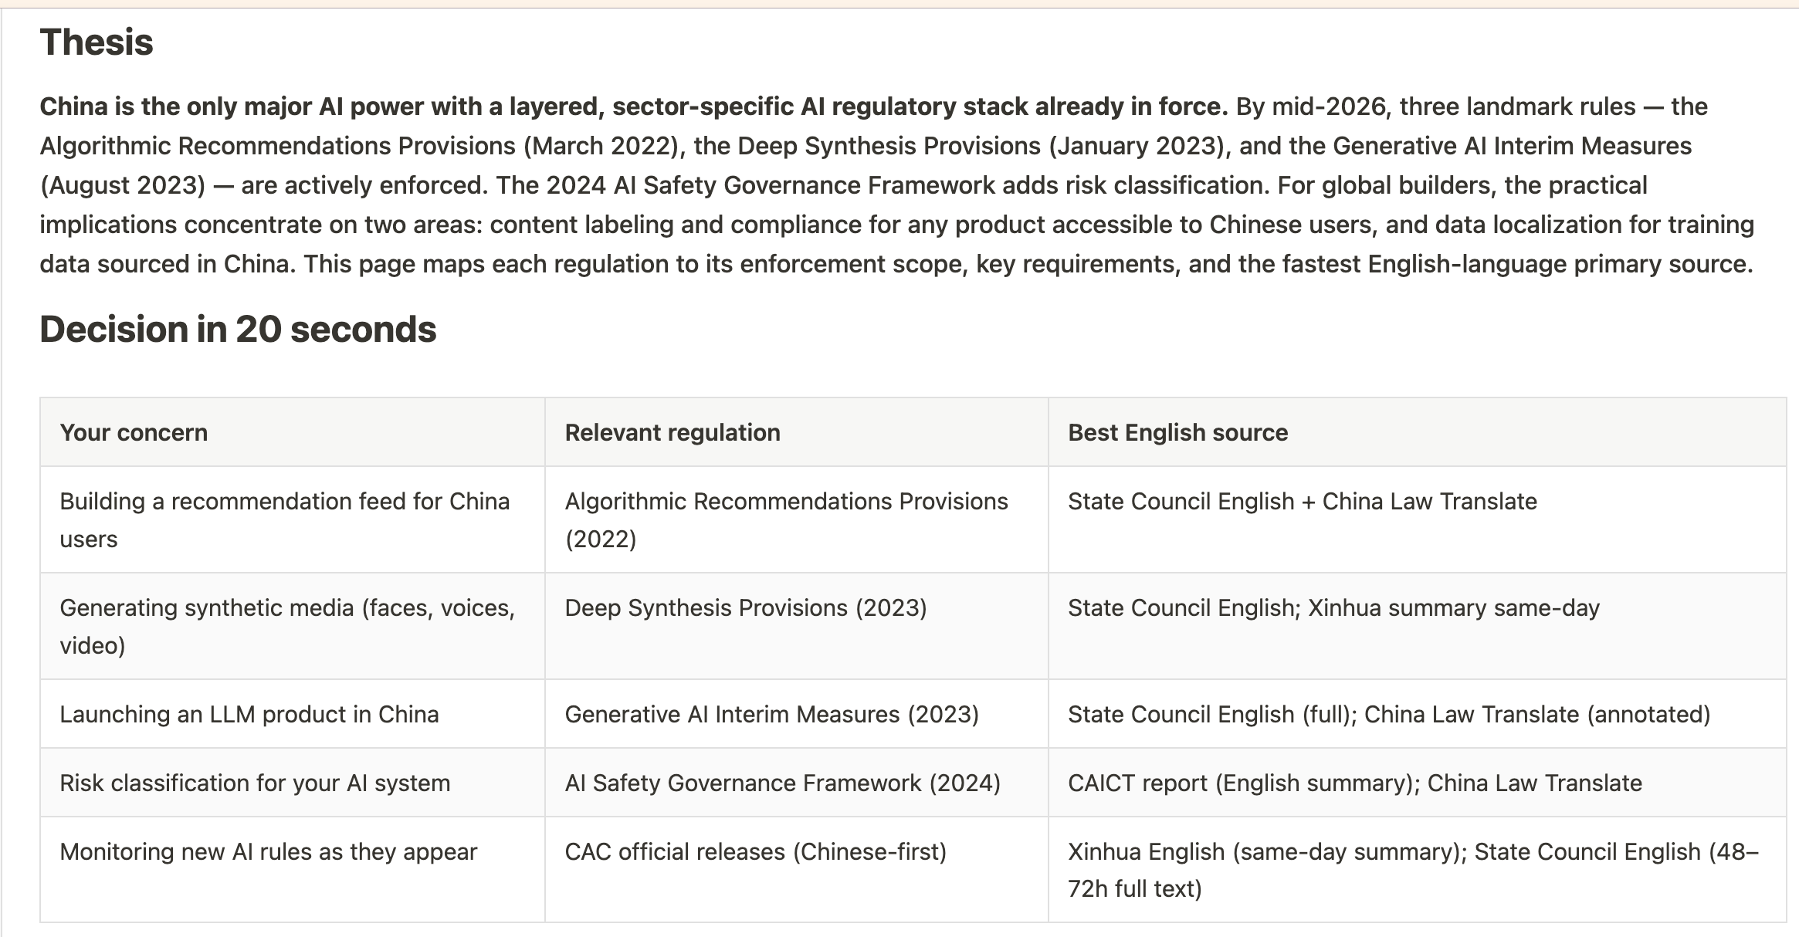
The Regulatory Stack (2)—Coordinating Regulatory Stack
Coordination, Guidance, Conformity to Fundamental Political Line
Lecture Five - The Chinese Approach
11

Slide 13
The Regulatory Stack (3)—Sources
Coordination, Guidance, Conformity to Fundamental Political Line
Lecture Five - The Chinese Approach
11

Slide 14
The Regulatory Stack (4)—The Regulatory Stack Within Legislative Ecologies
Coordination, Guidance, Conformity to Fundamental Political Line
National Security Laws
Anti-Espionage Law
Data Protection Laws
Social Credit Laws
Smart City Regulations
Blocking Regulations
Competition Laws
Land Use
Employment
Lecture Five - The Chinese Approach
11

Slide 15
Global AI Governance Positioning
Sovereignty is the organizing frame.
Internationally, China emphasizes development rights, fairness, multilateralism, opposition to technological hegemony, and respect for sovereignty.
1. Critiques technological blocs and export restrictions
2. Promotes international cooperation while preserving domestic control
3. Competes with U.S. technological leadership and EU trustworthy-AI norms
Lecture Five - The Chinese Approach
11

Slide 16
Strengths and Critiques
Integration creates capacity; control creates accountability problems.
Strengths
Critiques
Recognizes AI as infrastructure
Regulates recommender systems early
Integrates data, cybersecurity, content, platforms, and industrial policy
Strong administrative capacity and speed
Extensive control over speech, content, platforms, and data
Opaque enforcement and limited contestability
Political requirements may constrain innovation
Geopolitical pressure on chips, compute, and research exchange
Lecture Five - The Chinese Approach
12

Slide 17
Comparative Synthesis
The same technology becomes three different legal objects.
United States
European Union
China
AI as innovation market and strategic asset. Monitored through existing law, standards, markets, and national security.
AI as risk-bearing system. Governed through classification, lifecycle duties, rights, and supervision.
AI as strategic infrastructure. Developed for modernization while secured, disciplined, and aligned with state priorities.
Lecture Five - The Chinese Approach
13

