Slide 1

Platforms, Subjectivity, and Competing Sovereignties
Dialectics of Law in the Age of Techno-Kompetenz
Larry Catá Backer
W. Richard and Mary Eshelman Faculty Scholar; Professor of Law and International Affairs
Pennsylvania State University
Remarks Presented at the International Symposium: The Technological Paradigm Shift in International, Transnational, and European Law (Roma Tre, 29-30 January)
Notes:
Introduce the paper’s core claim: technology has transformed legal subjectivity by encoding law beyond human linguistic and cognitive capacity. Frame the talk as an inquiry into subjectivity and sovereignty under conditions of techno-kompetenz.

Slide 2

The Central Question
Has technology altered legal subjectivity?
Law encoded beyond human cognition
Shift from human-centered to techno-mediated ordering
Notes:
Pose the central question explicitly: has technology changed the rules of the game of subjectivity? Emphasize that law is no longer written only for humans but executed by machines.

Slide 3
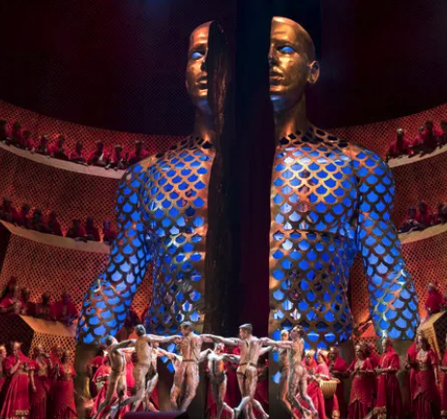
Samson as Metaphor
Biblical Samson Judges 13-16
Power, betrayal, blindness, destruction
Redemption at the cost of extinguishment
Who controls force?
Notes:
Introduce Samson as an illustrative metaphor for power, betrayal, redemption, and destruction in legal ordering.

Slide 4


Two Samsons
Vessel of higher power
Auton-omous agent
Notes:
Explain the two Samson narratives: the traditional shorn Samson as vessel of divine will versus an alternative autonomous Samson acting by his own force.

Slide 5

Bassan’s Framework
Fabio Bassan, Digital Platforms and Global Law
Platforms as virtual (digital) factories
Legal complexity intensified by digitalization
Need to escape old regulatory categories
Notes:
Present Bassan’s baseline: platforms as virtual factories whose complexity strains traditional legal categories and sovereign hierarchies.

Slide 6

Transnational Private Ordering:
Supra-Nationalization
Uniform contracts
Global standards
Platform-Community Governance
The UN BHR Guiding Principles model
Notes:
Discuss transnational private ordering through contracts, standards, and expectations binding platform communities.

Slide 7

State–Platform Bargains
More Supra-Nationalization
Re-territorialization
Production agreements
Platforms pulled back into state space
Negotiated sovereignty
Notes:
Explain state–platform production agreements as negotiated re-territorializations of sovereignty.

Slide 8


Intermeshed Norms
Bassan’s words
  “intricate interweaving between digital platforms, user communities, states, supranational and international organizations [that aggregates and rationalizes] a joint operation of national laws, transnational and international law, primarily private, secondarily public (as regards organizational rules), and also subsidiary (as regards regulation). “ (p. 143).
In effect, the rationalization of structural coupling between autonomous but related subsystems—the legal orders of states and of platforms undertaken within the platform that is international public and private regulatory space.
Notes:
Describe the interweaving of public, private, and subsidiary law producing structural coupling between legal systems.

Slide 9

Five Pathways
Platform definition
Signifying ecosystems
The human in regulation
Platform as sovereign
Competing sovereignties
Notes:
Introduce the five analytical pathways structuring the remainder of the argument.

Slide 10

1--Platforms Definition
Bassan; functionality:
  “hardware or software structures that provide tech-based services and tools, programs and applications, that are to be used to distribute, manage and create digital content and services”
Alternatives:
  Platforms as legal objects
    Detach conenction with law
  Platforms as legal out-laws
    Detach connection with state but not rule: Cmmora
Are platforms spaces or Space or actors?
Notes:
Discuss platform definition as a cognitive starting point: platforms as functional systems, legal objects, or potential legal subjects.

Slide 11

Platform Samson and his Delilah
Self-generated authority
Platform as edifice and actor
Power sourced internally, not externally
Platform as both subject and structure
Seduction
Notes:
Translate Samson into platform theory: the platform is both structure and actor, generating authority internally rather than merely hosting activity.

Slide 12
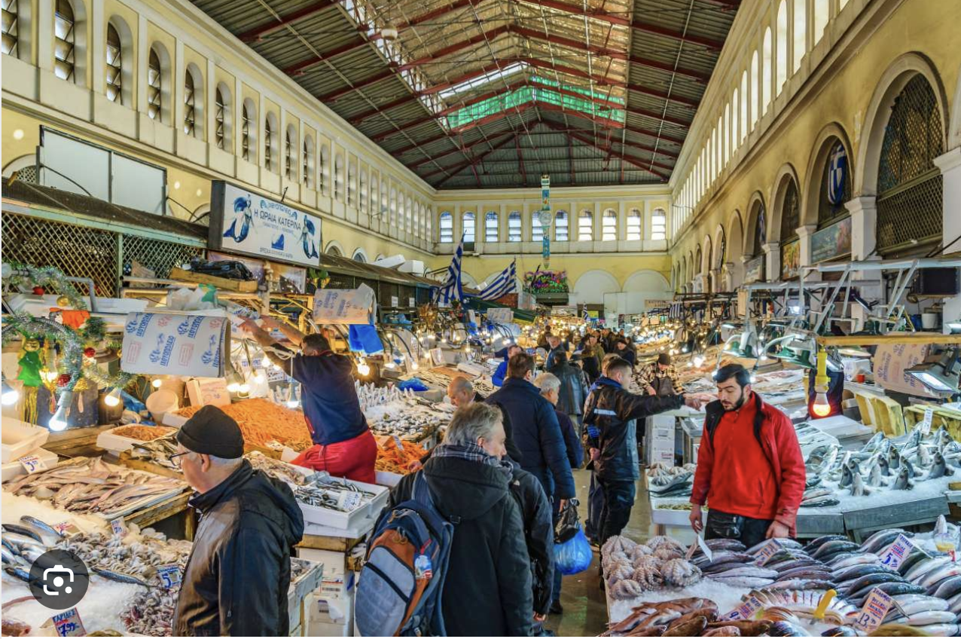
2--Platforms as Spaces Not Subjects
Does subjectivity attach to the platform itself?
  An eco-system rather than an order; no subjectivity except as a function of other things
Does legal subjectivity attach to:
  actors around the platform? Municipio, chiesa, mercante, cliente, transporto, soldati,
  actions within it? Production, consumption, transport, exchange
Platform subjectivity?
  Where eco-systemicity acquires solidarity and self-consciousness in and of itself
Samson revisited
Notes:
Explain platforms as ‘out-law’: existing beyond effective state coercion yet still possessing personality and governance capacity.

Slide 13

Subjectivity and Technology
Subjectivity as legal recognition (rights, duties, capacity)
Objectivity as legal identifier with no rights, duties, capacities)
Technology
  as mediator, translator, and executor of law (object of law)
  As the holder rights duties capacities
  As its own legal subject
Collapse of human monopoly over legal meaning
Notes:
Explain legal subjectivity as recognition of rights, duties, and capacity by a superior ordering force. Stress why identifying the subject matters for regulation and authority.

Slide 14
From Market to Meta
From old town squares to platforms create their own space
The day is coming for the self-constitution and liberation of the platform itself. It comes not with or through those structures—municipio, chiesa, soldati, mercante, cliente, transporte—but through technology itself. Or more precisely it comes as the platform acquires its own self-consciousness through a power to think and act for itself. For that, decision making is transferred from the corporate board and the humans in Meta, for example, from producers and consumers, and is transferred to automated systems of decision making overseen by generative intelligence. We are almost there.
Let me illustrate
Notes:
Use the market square metaphor to show how platforms historically were empty spaces defined by surrounding actors—and how this has changed.

Slide 15
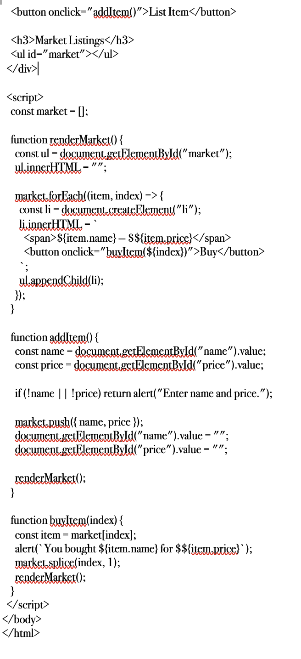

3--From Human as Subject to Human as Object
Notes:
Explain the animation of platforms through automated and generative decision-making, moving governance from humans to systems.

Slide 16
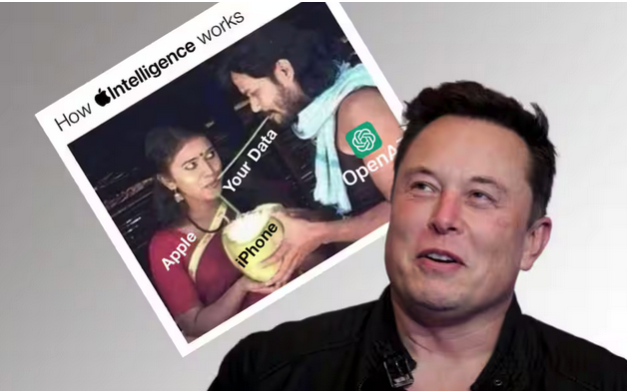
Human at the Core of Regulation; But at the Peripheries of Platforms
Human Dignity
Data protection
Human-in-the-loop
But who or what undertakes these?
Notes:
Re-center the human: dignity, data, and the effort to retain human control through data protection and human-in-the-loop mechanisms.

Slide 17
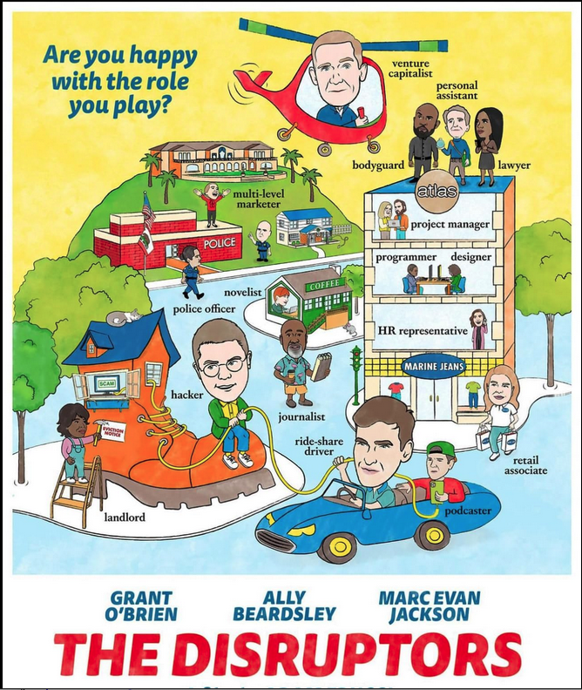
4--Sovereignty at Play;
Technology as Disruptor/Sovereign
States as traditional sovereign objects
  Its own legal subject
Transnational legalities (public and private)
Platforms as virtual territorializations
  Automation of law
  Decision-making beyond humans
  Now its own legal subject
Notes:
Describe how automated and generative systems now participate directly in legal ordering, enforcement, and compliance, displacing human exclusivity.

Slide 18

Legal Pluralism as Marginalia
“One does not regulate platforms, one regulates data in platforms, or better still, one specifies the rights and duties of legal subjects respecting data. At the same time, regulatory sub-systems attempt the same—through internal and private law mechanisms within action pathways in enterprises and in the relation between legal subjects attached to the same data object in ordering their public and private law relations.”
Focus on objects, not systems
Fragmented governance
Regulatory failure under automation

Slide 19

The Many Splendored Thing
Platform (1) objectivity, (2) subjectivity, (3) self-subjective
The template of the multinational Enterprise
  Private law internal governance
  International normative framework
  National legal compliance
Notes:
Identify the limits of object-focused regulation and why fragmented governance fails under automation.

Slide 20

5--Competing Sovereignties
States
Platforms
Automated systems
Notes:
Describe competing sovereignties within platforms: state law, platform norms, and automated authority.

Slide 21

Messy Messi
2024 contest between the Brazilian courts and Starlink
  Brazilian courts exploded the notion of “veil piercing” to effectively create a platform around Elon Musk’s business interests in a fight over control of the social spaces of political debate in Brazil.
  Use of traditional legal basis to challenge self-legal subjectivity of Starlink
Tik Tok in Columbia
  Columbian Constitutional Court ordered the social media site to restore the account of a user wrongly blocked asserting power over TikTok even in the absence of any physical presence in Columbia.
  Projeciton of national constitutional order onto foreign virtual territory through “effects” test regime

Slide 22

Regulatory Transposition
Regulation moves:
  inward (within platforms)
  outward (across legal orders)
EU directives as TEMPLATE
  framing mechanisms
Implementation delegated to legal subjects
Notes:
Explain regulatory transposition: regulation moves inward into platforms and outward across jurisdictions, with EU directives as framing mechanisms.

Slide 23

After the Temple Falls
The Temple of Baal has fallen, but Samson is also dead. The platform remains.
Platforms will continue to evolve as legal subjects, as legal objects, and as subject, like law, only to itself (techno kompetenz-kompetenz) and thus only to its own law in accordance with its own rule of law.
What emerges from the rubble has yet to assume a form.
Notes:
Return to the Samson metaphor: the temple of traditional law collapses while the platform endures.

Slide 24


QUESTIONS?
Notes:
Conclude: platforms evolve as object, subject, and sovereign—answerable ultimately only to their own rule of law.

Slide 25

Thank you
Remarks may be accessed here:
ENGLISH; ESPAÑOL

