Slide 1
Trump’s America: Issues, Conflicts and Future Trajectories
Larry Catá Backer (白 轲) W. Richard and Mary Eshelman Faculty Scholar; Professor of Law and International Affairs
Pennsylvania State University | 239 Lewis Katz Building, University Park, PA 16802 1.814.863.3640 (direct) || lcb11@psu.edu
Presentation for Workshop 14 June 2025

Slide 2
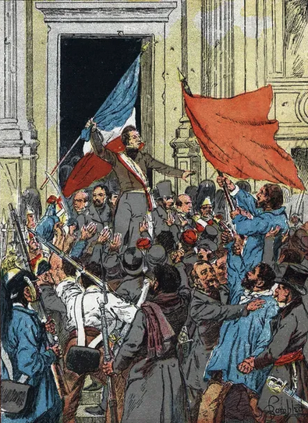
Continuity and Transformations
1. The Path to Trump 45
The perils of complacency
The cluelessness of political elites and their claques
2. Trump 45
The outsider comes inside
Legislative paralysis
The rebirth of the courts as the primary space for politics
Arrogance, and COVID
3. The Political risks of demonization
Insurrection politics
The judicialization of revenge
4. Biden, Democratic Party Fracture and the Return of Trump 47
Biden and the overplaying of the hand of the forces of victory over Trump 1
Who is in control
The disaster of an election campaign; cluelessness Part 2
5. The New Zealot and the Return to a Golden Age
Hitting the ground running
The Executive triumphant
6. Lessons

Slide 3
The Path to Trump 45
“In her own words just two months ago, Clinton described half of Trump’s supporters as ‘deplorables’ who are “racist, sexist, homophobic, xenophobic, Islamophobic”. While Trump himself, condemned by his own words, could be accused of all of these ‘nasties’, it seems that there were enough Americans who were angry enough with ‘business as usual’ to vote for change, even if this made them deplorable in the eyes of Hillary Clinton and the elites.” (What Does Trump’s Win Mean for Trum Voters?)
The perils of complacency
Business as usual (“we experts have everything under control”)
International community complacency suggesting the manageability of elections (and thus their corruption)
The cluelessness of political elites and their claques
The “basket of deplorables”
Polling Hallucinations

Slide 4
Trump 45
The outsider comes inside
Legislative paralysis
The rebirth of the courts as the primary space for politics
Arrogance, and COVID

Slide 5
Democratic Party Fracture 2020-2024 and the Triumph of Trump 47
Biden and the overplaying of the hand of the forces of victory over Trump 1
Scary woke
Managing racial crisis in police killings (George Floyd and its aftermath)
Foot on the gas
Elite re-imagining of the nation through regulation and re-education
Who is in control?
Health issues
The disaster of an election campaign; cluelessness Part 2
The tragedy that was Kamela Harris’s campaign

Slide 6
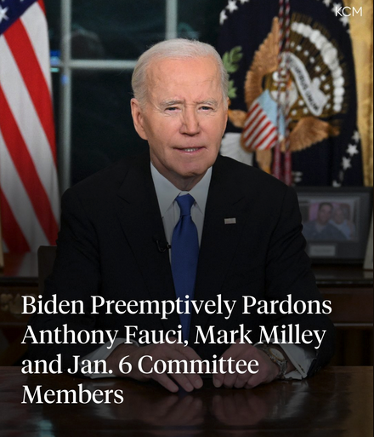
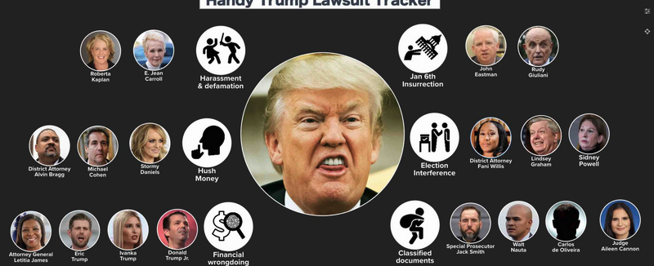
The Political Risks of Demonization
Insurrection politics
The judicialization of revenge

Slide 7
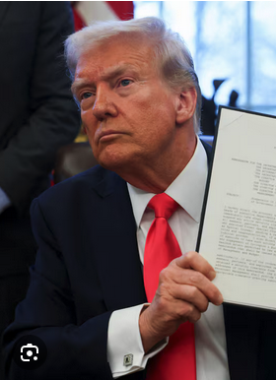
The New Zealot and the Return to a “Golden Age”
Hitting the ground running
The Executive triumphant

Slide 8
The Agenda Triumphant
DEI--racism, racialism, neutrality
Educational Institutions
The deep state
Migration
Lawyers and courts
America First
Climate/Environment
Transactions Culture

Slide 9
Lessons

Slide 10
Revolution or Business as Usual?
Not all disagreement is fascism; or liberal authoritarianism.
Not all fascism comes from the right.
Populations are not objects to be worked on; ignoring the human person and personal wants/needs exacts a high price
Demonization can backfire
Using the courts to punish or destroy political enemies can harm the state more than the target
Tools have no ideological allegiance (E.O.s etc.)
Separation of powers are fragile and easily overstepped (nationwide injunctions)
The politics of the personal can be costly (going after lawyers one despises)
Rule of law is both a sword and a shield in politics
Hermeneutics and process are moving to the center as the basis for interpretive consensus fades and process becomes an impediment.
The fundamental issues of the ordering of liberal democracy are now up for grabs: (regulatory supervision state versus transactional state; managerialism versus markets; to what extent can a population be protected against itself, etc.; development-human rights-traditional values)
Migration and political solidarity
Sovereignty (whose) and national security
O madness! Ye furies ... Despairing Electra. Must I see Idamante in my rival's arms? Ah no, let me follow my brother Orestes into the hollow abyss. Now you will have me for companion in Hades, in eternal woe, in endless lamenting

Slide 11
Questions?

Slide 12
Thank You!
Additional essays on these topics may be accessed at “Law at the End of the Day”
(Trump47 )
Essay; Undesirable Clients; Undesirable Lawyers -The Emerging Structures of Gatekeeping Strategies in the U.S.A” may be accessed from SSRN: https://papers.ssrn.com/sol3/papers.cfm?abstract_id=5286876.

