Slide 1
The Visualization of Text and the Textualization of Image: Factual Narratives in and as Legal Discourse
Larry Catá Backer (白 轲)
W. Richard and Mary Eshelman Faculty Scholar; Professor of Law and International Affairs Pennsylvania State University
Remarks presented at the 25th International Roundtable for the Semiotics of Law (IRSL 2025)Legal Evidence in the Age of Techno-Societies and Visual Jurisprudence
University of Coimbra 9 May 2025

Slide 2
A marvelously Revealing Occurrence
The cultus of “knowing” and the dialectics of the marvelous:
Experienced externally
Internalization—to be filled with wonder
The Occurrence
The essential phenomenology of knowledge as experiencing a “thing”, “event” “process”
The revelation
The solidarity of signification

Slide 3
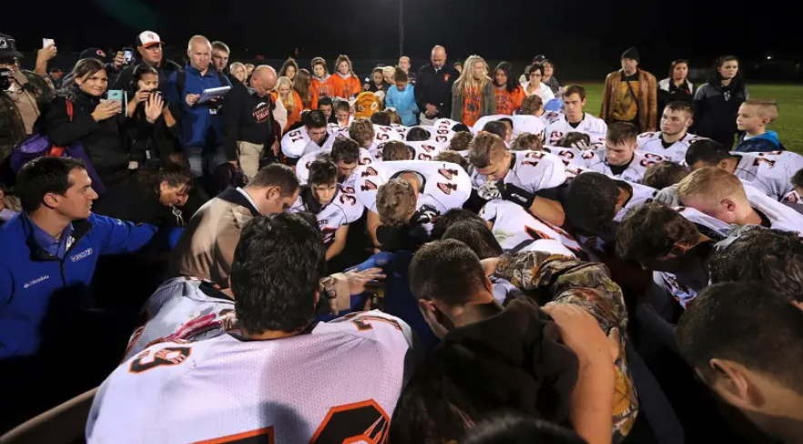
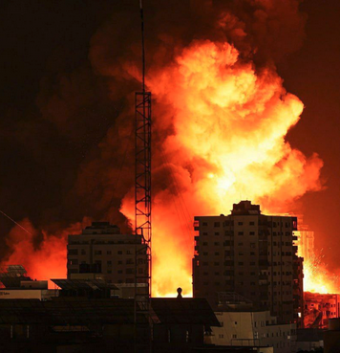
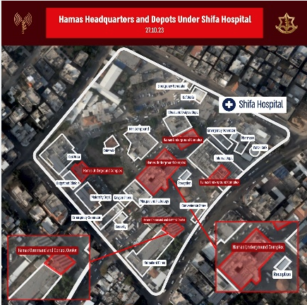
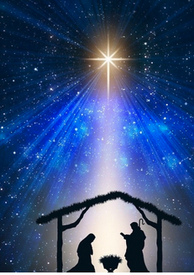
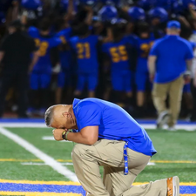
The Guiding Eye

Slide 4
The Mechanics of the Marvelous
The marvelous is such because it is believed to be such, and it is believed to be such through the invocation of an apparatus of belief that guides its witnesses and the audience for these witnesses, into states of cognition that then beg for or can be used to guide action.

Slide 5
The Sun Never Shines on the Same Place Twice
because the preacher was wise, he still taught the people knowledge; yea, he gave good heed, and sought out, and set in order many proverbs. The preacher sought to find out acceptable words: and that which was written was upright, even words of truth.” (Ecc. 12:9-10).
The key here is the connection, at the heart of the semiotic framework, between what is communally acceptable (as an external object that is internalized, the marvel), in in ancient sense form the Latin acceptabilis—as something that is both worthy of acceptance and accepted willingly (Etymology Online).
This, perhaps, is what the authors of Justinian’s Institutes had in mind when they explained that “Justice is the set and constant purpose which gives to every man his due”

Slide 6
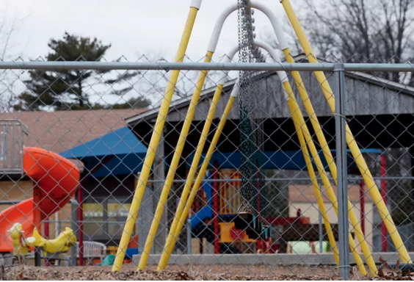
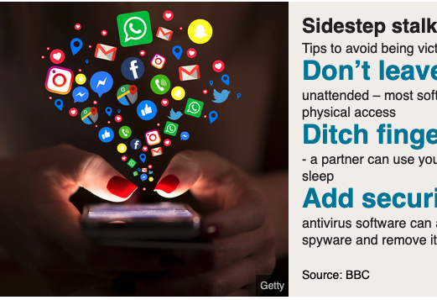
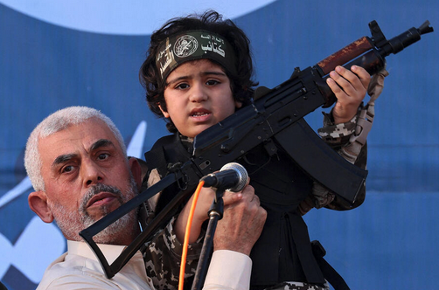
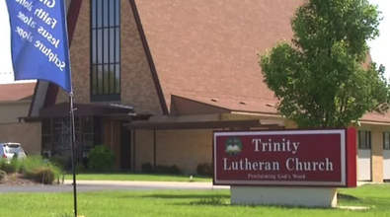
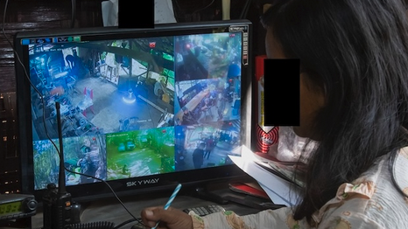
Text-Visualization in Juristic Context
U.S. Religion Clauses Jurisprudence
Gaza and its Genocides
The facilitation of What Displeases

Slide 7
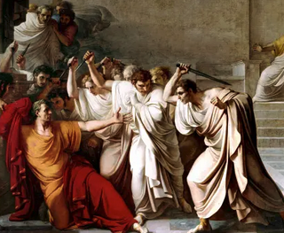
The Bordello of Solidarity
The power of communal sacrifice
The bloody hand of unity
We must all wield the knife

Slide 8
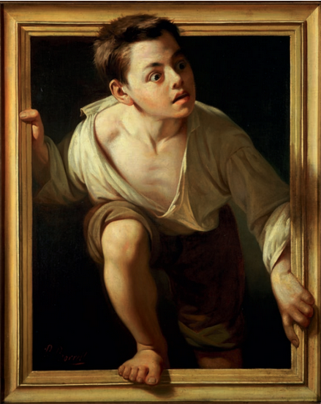
The Image Factory
The first is in the production of large language model data sets form which it is possible to produce an image.
The other is the textualization of images, either as data sets or as the double reduction of a thing or action as an image then reduced to text,
In a third phase these can be digitized and reproduced from data sets in its original or altered forms.

Slide 9
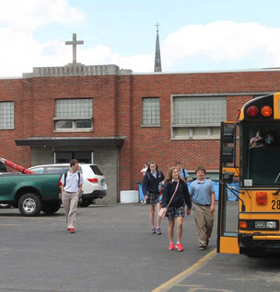
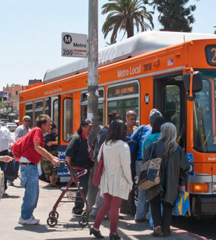
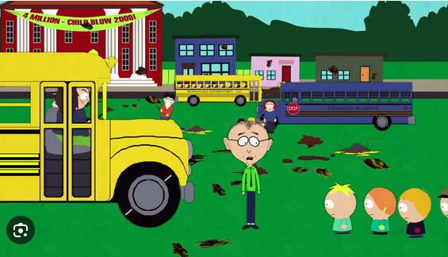
Cropping pictures to Shape Reality
The first is in the production of large language model data sets form which it is possible to produce an image.
The other is the textualization of images, either as data sets or as the double reduction of a thing or action as an image then reduced to text,
In a third phase these can be digitized and reproduced from data sets in its original or altered forms.

Slide 10
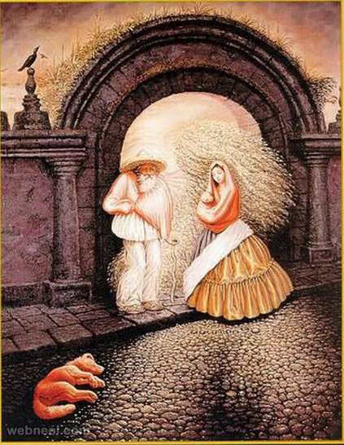
Storytime What if the World is Only Illusion?; What if Illusion Makes the Real?

Slide 11
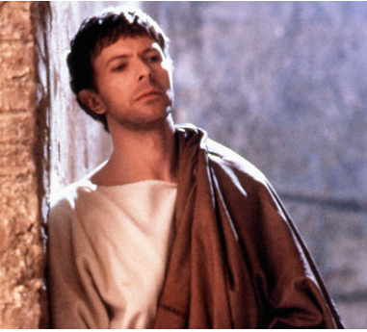
The Last Temptation of Human Rights
Facilitation as acceptable signification
Connecting the dots and the causation matrix
The reality of allocating responsibility

Slide 12
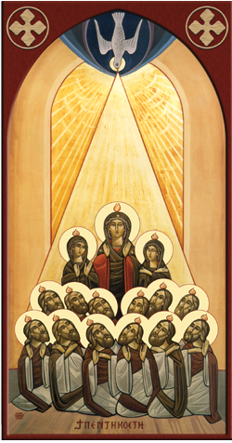
In Search of Logos
And yet beneath these small iterations of a constant drumming of technical functionality lie deeper structures of discipline, and these deeper structures of discipline invoke the expressive power of image made manifest in text. It is the image that moves one—and it is the performance of that imagery in text that drives not just an invocation of regulatory discursive decisional tropes, but also orders the system in which the application of such tropes becomes inevitable.

Slide 13
The Preacher type is indeed in the world, of the world, and the processes through which the world is made manifest. Logos, as Ecclesiastes might have it, is reduced to vanity. But perhaps a necessary one; for vanity expresses the justice to which the Institutes remind us, is our (collective) due expressed in the visualized textualization of what is acceptable to us as just and unjust.

Slide 14
Thank you

