Slide 1
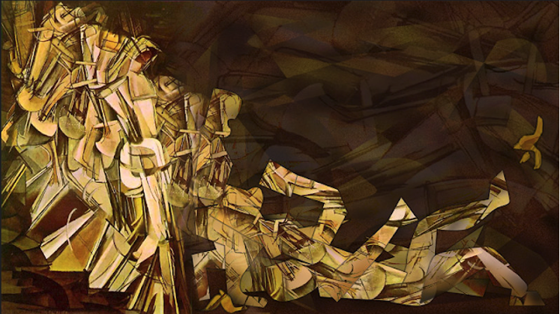
The Future of a Smart Society with Chinese Marxist-Leninist Characteristics:
Reflections on “Opinions on Completing/Improving the Social Credit System” issued by the General Offices of the State Council and the CPCCC
Larry Catá Backer (白 轲)
W. Richard and Mary Eshelman Faculty Scholar; Professor of Law and International Affairs
Pennsylvania State University | 239 Lewis Katz Building, University Park, PA 16802 1.814.863.3640 (direct) || lcb11@psu.edu

Slide 2

外儒内法
Confucianism on the Outside/Legalism on the Inside
中共中央办公厅国务院办公厅关于健全社会信用体系的意见
[Opinions of the General Office of the CPC Central Committee and the General Office of the State Council on Improving the Social Credit System
  First time in over a decade since the last major conceptual writing on social credit and its systems
  Like everything else the Social Credit System requires (socialist) modernization.
  To understand the “Opinions” one must understand post 3rd Plenum Socialist Modernization
Reflect on the “Opinions”
  First Context (Deus ex Machina)
  Then the SIX Opinions (A Shared Future for Mankind)
Suggest broader themes and trajectories: (Structure:外儒内法; and Norms: Trust 信 )

Slide 3
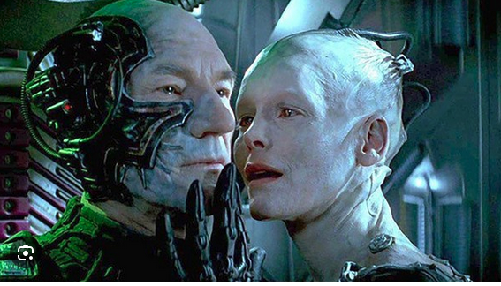
Deus ex Machina

Slide 4

From 2014 to 2025; Is There a Vision Here?
Social Credit
  A concept in search of conception
  A fetish object in which could be poured all fears of transformation in which humans were no longer at the center
  Seamless management with the Party at the center
    But not the Party, its avatar
  A system of systems for the production of the Socialist ideal cadre, worker, artist, person, enterprise, judge etc.

Slide 5

The Fear: A Great Leap Forward Into the Unknown
It was, at its root, the beginning of an effort
  to digitize (eventually, and in its most ambitious versions)
  All of Chinese life and social relations, and then
  to digitalize these social relations through the construction of what might be understood as the hologram of Chinese life in all its respects.
  While similar ambitions were on display outside of China, the core difference was embedded in the difference between Marxist-Leninist and liberal democratic systems.

Slide 6

The Multiplicity of Social Credit Systems
The blowback
  Fracture
  Functional differentiation
  Carving up regulatory power (Silos)
  Detaching various components
    Smart cities
    Implementation
    Delegation
    Techno-Bureaucratization
The coherence problem
  Socialist legality
  Socialist modernization
  Socialist Internationalism

Slide 7

A Shared Future for Mankind

Slide 8

中共中央办公厅国务院办公厅关于健全社会信用体系的意见 [Opinions of the General Office of the CPC Central Committee and the General Office of the State Council on Improving the Social Credit System]
The core object remains the same--trust as the organizing object/characteristic that drives system building.
Its scope and methods now reflect a new and perhaps less ambitious reality grounded in its contribution to socialist modernization
(社会信用制度是市场经济基础制度 [The social credit system is the basic system of the market economy])--an object that also appears in liberal democratic states

Slide 9
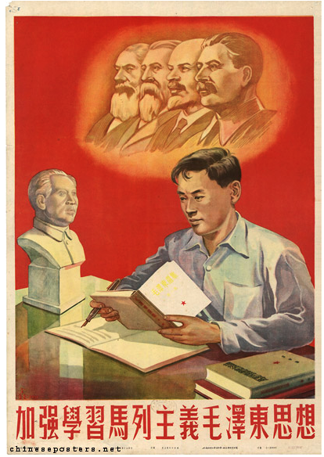
Organization
(1) General Requirements [总体要求];
(2) Build a social credit system covering all types of entities [构建覆盖各类主体的社会信用体系];
(3) Consolidate the data foundation of the social credit system [夯实社会信用体系数据基础];
(4) Improve the trustworthiness incentive and dishonesty punishment mechanism [健全守信激励和失信惩戒机制];
(5) Improve the supervision and governance mechanism based on credit [健全以信用为基础的监管和治理机制];
(6) Improve the marketization and socialization level of the social credit system [提高社会信用体系市场化社会化水平]; and
(7) Strengthen organization and implementation [加强组织实施]. Let's consider each very briefly.

Slide 10

(1) General Requirements
[总体要求]
These situate social credit squarely within the ideological development of Chinese Marxist-Leninism in its New Era,
  Specifically as a manifestation of new and high quality productivity
  at the heart of socialist modernization theory 3rd Plenum of the 20th CPC Congress in July 2024
Risk averse
  Maintain stability
  Risk avoidance development
Regulations for staff and workers -- Warmly love the collective, work hard at economizing, take loving care of public property, participate actively in management
职工守则 -- 热爱集体，勤俭节约，爱护公物，积极参加管理

Slide 11
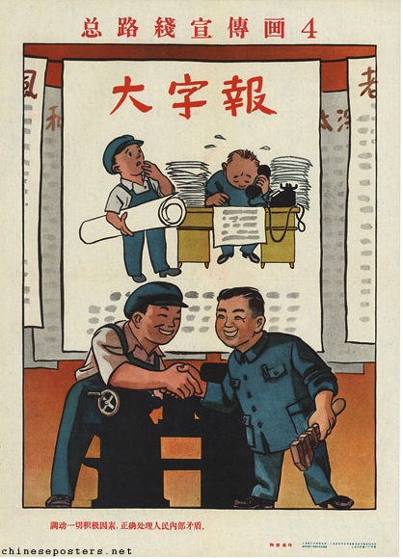
(2) Build a social credit system covering all types of entities [构建覆盖各类主体的社会信用体系]
Comprehensive breadth but cautious fulfillment with people at the center
  (1) Deepen the construction of Government credit;
  (2) Strengthen the credit construction of business entities;
  (3) Accelerate the credit construction of social organizations;
  (4) Promote the credit construction of natural persons in an orderly manner; and
  (5) Comprehensively strengthen the credit construction of the judicial law enforcement system.
Bring every positive factor into play, correctly handle contradictions among the people
总路线宣传画 4 -- 调动一切积极因素，正确处理人民内部矛盾

Slide 12

(3) Consolidate the data foundation of the social credit system [夯实社会信用体系数据基础]
Affirmation of the old SCS core:
  (1) Establish a comprehensive, complete and accurate credit records;
  (2) Strengthen the collection and sharing of credit information;
  (3) Establish a unified public disclosure system for public credit information;
  (4) Promote the open circulation of public credit information in an orderly manner; and (
  5) Strengthen the security protection of credit information.
Struggle to realize the overall assignments of the new era
为实现新时期总任务而奋斗

Slide 13

(4) Improve the trustworthiness incentive and dishonesty punishment mechanism [健全守信激励和失信惩戒机制]
A return to trust and trustworthiness (鱼肥荷香 the fish is fat the lotus is fragrant)
  But its expression and coordination with the project of building a rule of law state has modified the means toward its fulfillment
(1) Strengthening incentives for trustworthy behavior, (2) Carrying out dishonesty punishment in accordance with laws and regulations; and (3) Improving the unified credit repair system

Slide 14

(5) Improve the supervision and governance mechanism based on credit [健全以信用为基础的监管和治理机制]
Preparing the regulatory sausage
  (1) Implement hierarchical and classified supervision based on credit evaluation;
  (2) Establish and improve the credit commitment system;
  (3) Promote the in-depth application of credit reports;
  (4) Strengthen the credit supervision of contract performance such as government signing and guiding the signing of contracts;
  (5) Promote credit empowerment of grassroots governance; and
  (6) Improve the laws, regulations and systems of the social credit system

Slide 15

(6) Improve the marketization and socialization level of the social credit system [提高社会信用体系市场化社会化水平]
A complementary role for private enterprise and the place of Socialist Internationalism
  (1) Vigorously cultivate the credit service market;
  (2) Deepen the promotion of credit financing and credit transactions;
  (3) Strengthen credit construction in the platform economy; and
  (4) Serve high-level opening up
  New Socialist Things are Fine

Slide 16
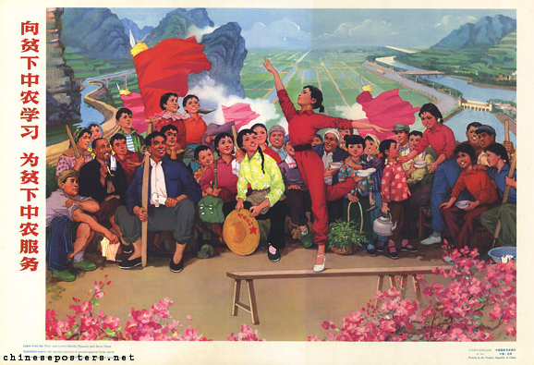
(7) Strengthen organization and implementation [加强组织实施]
section recognizes the state of administrative governance in China,
  Fundamental division, at an operational level, between the Peoples Bank of China on the one hand, and the National Development and Reform Commission on the other.
  Recognizes task of coordinating from the top the activities of lower level actions, regulations, etc. at the provincial and local levels
Learn from the poor and lower-middle peasants and serve them
向贫下中农学习为贫下中农服务

Slide 17


Putting it Together

Slide 18
Where Does this Leave SCS?
serve as a bridge between the operations of an administrative nomenklatura and its caste of bureaucrats and officials, with the overall direction of the CPC.
deployed as a digitalized mechanism for the elaboration of critical dialectics in the operation of the policies developed to propel the nation along the Socialist path
one aspect that a set of techniques that will eventually be as important for the disciplining of the Party as it is for the nation
development of trust in the nation and the CPC, especially through the assessment and data driven mechanisms of SCS may serve China’s international policy objectives
designed to please everyone—legalism on the inside; political doctrine on the outside
furthers the CPC’s role as a cultural leader even within emerging technologies
Mechanism for further developing Chinese productive forces as a new elaboration of the CPC Basic Line through tech

Slide 19

The Bigger Picture
It is not clear what is driving policy
  Is ideology driving function or is SCS driving ideology
  The inherent contradiction of new quality productivity within Marxist-Leninist thery
Fundamental issues unresolved
  What is SCS?
    Regulatory Tool
    Scientific civil actions (punishments/rewards)
  SCS as a subset of larger policies
    Socialist legality
    Socialist modernization
    Organization and management of society
    Digitalization of coordination
The problem of the problem
  SCS reflects conceptual turmoil
  Dissonance:
    between the old humanizing techniques of control and its virtual transformation
  Uncharted pathways and linkages
    Between digitalized regulatory spaces and the human
  Moving Target problem
    SCS is a human and artificial construct over a dynamic process of the movement from the physical to the virtual and from the qualitative and exogenous to the quantitative and endogenous

Slide 20
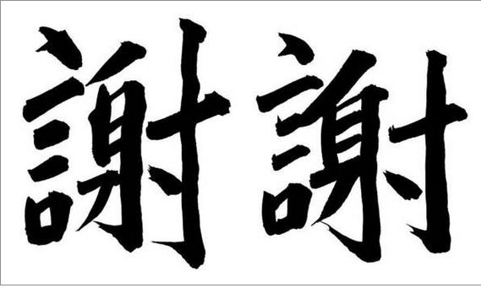
Thank you

