Slide 1
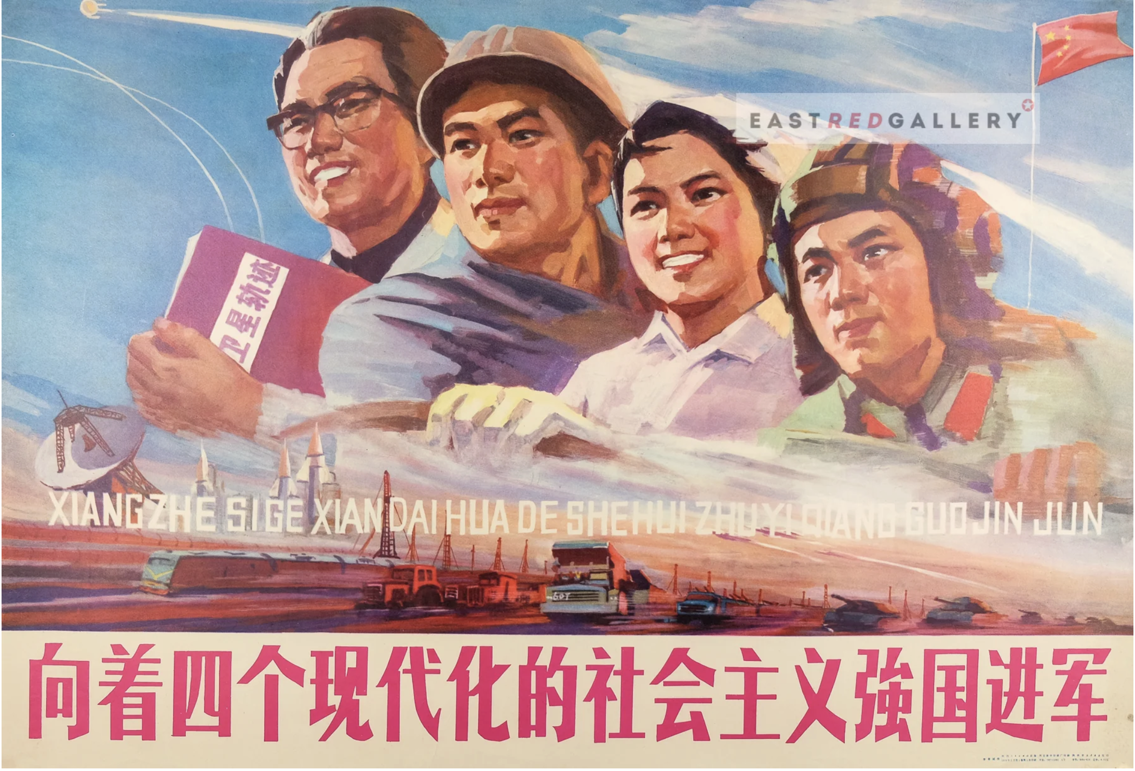
Chinese Constitutionalism as Socialist Modernization
Larry Catá Backer
W. Richard and Mary Eshelman Faculty Scholar; Professor of Law and International Affairs
Remarks presented at the 10th Asian Constitutional Law Forum; University of Hong Kong (10 December 2024)

Slide 2

Constitutional Frames
Text as object
  Text does not say what it means; it means what it does
Revolutionary context and norms
  The cage of regulation
Chinese constitutionalism, has been, is, and will remain, an aspect, a feature, a trait, of imperial, then socialist, and now Chinese style, modernization.
  Modernization represents the apex rationalization of political authority bent to a particular overall purpose and undertaken in a specific form.

Slide 3
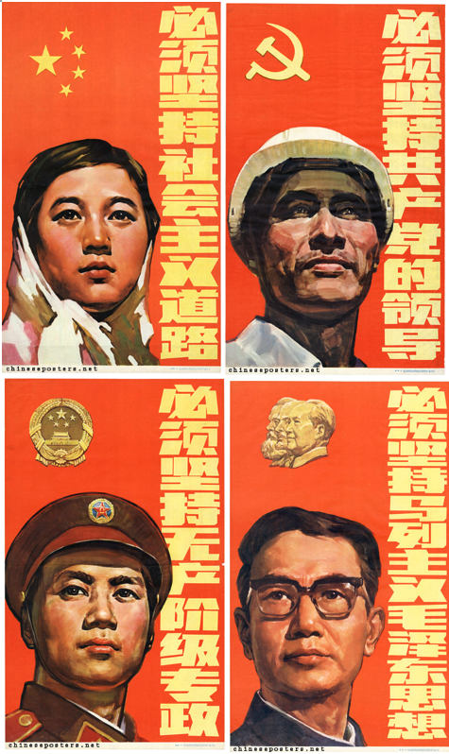
What are the foundational premises embedded in the Socialist (or Chinese style) modernization?
Its is modernization with the CPC at the center
National Characteristics
Core premises:
  Socialist
  Pathway towards Communism
  Political project (CPC at the center
  Development of productive forces
  Whole process democracy
  Create an international pathway

Slide 4
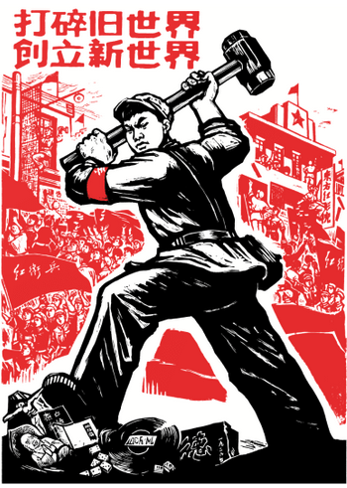
What are the ends of modernization?
Establishment of a Communist Society in China
That serves as a model of the world
Alignment between productive forces and State assets
All productive forces bent toward the fundamental terminal objective

Slide 5
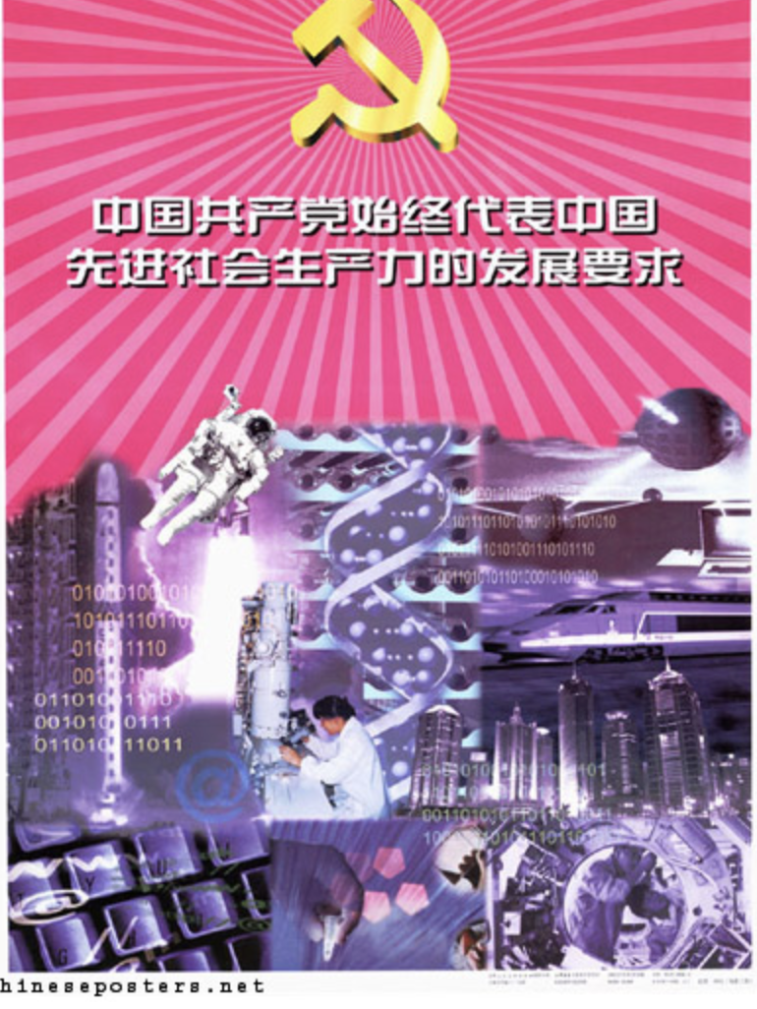
How is the constitutional concept of modernization expressed in institutional action?
Development of productive forces must move along socialist path in the right direction
CPC is the apex manifestation of productive forces, and its legitimate driver
  Democratic centralism
Chinese people are the object of modernization and the engine of its fulfillment
  People’s democratic dictatorship
  Whole process consultative democracy

Slide 6
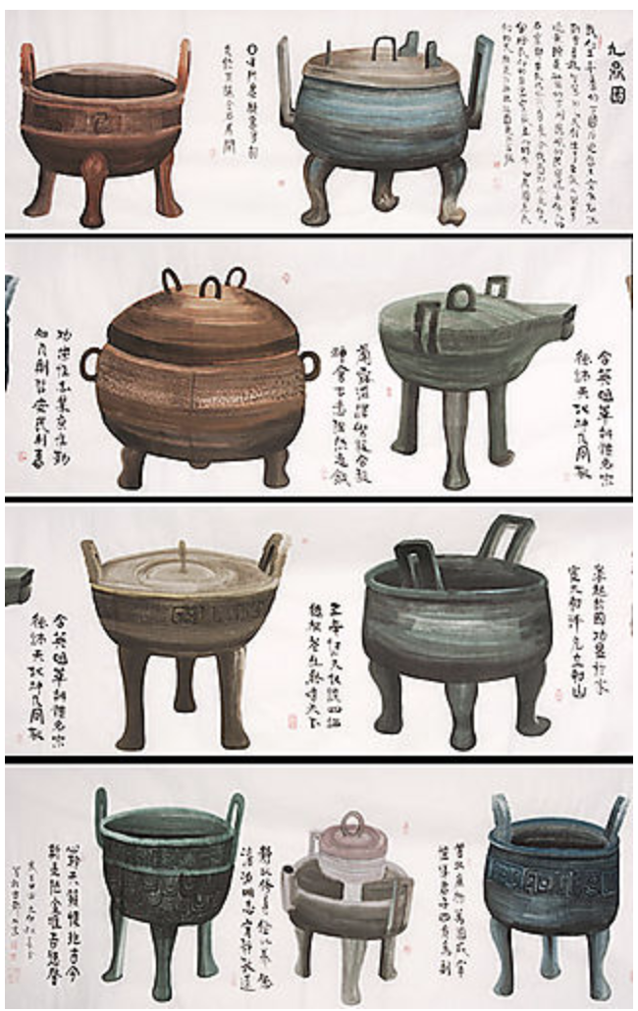
In what form are the means of modernization fundamentally realized ?
The power of regulatory cages
Represent the vessel (鼎) of state power
A productive force
Modernization to high or new quality production

Slide 7
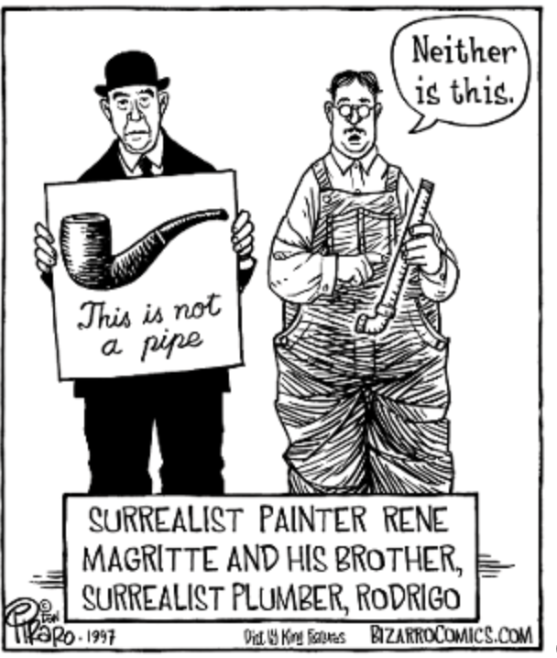
What are the constitutional forms of modernization thus understood?
The role of constitutional text
Modernization project drives text; text does not drive modernization
Constitutionalism
  The study of a critical productive force in the structuring and institutionalization of order, and
  The means by which the normative imperatives of socialist modernization is realized.

Slide 8

What are the dialectics of socialist modernization as a constitutional imperative?
Political and administrative apparatus
Political core and consultative collectives
Accountability
  Self-Revolution
  High quality development
Referent: Modernization
  Principle drives text
  CPC drives principle;
  Principle drives CPC

Slide 9
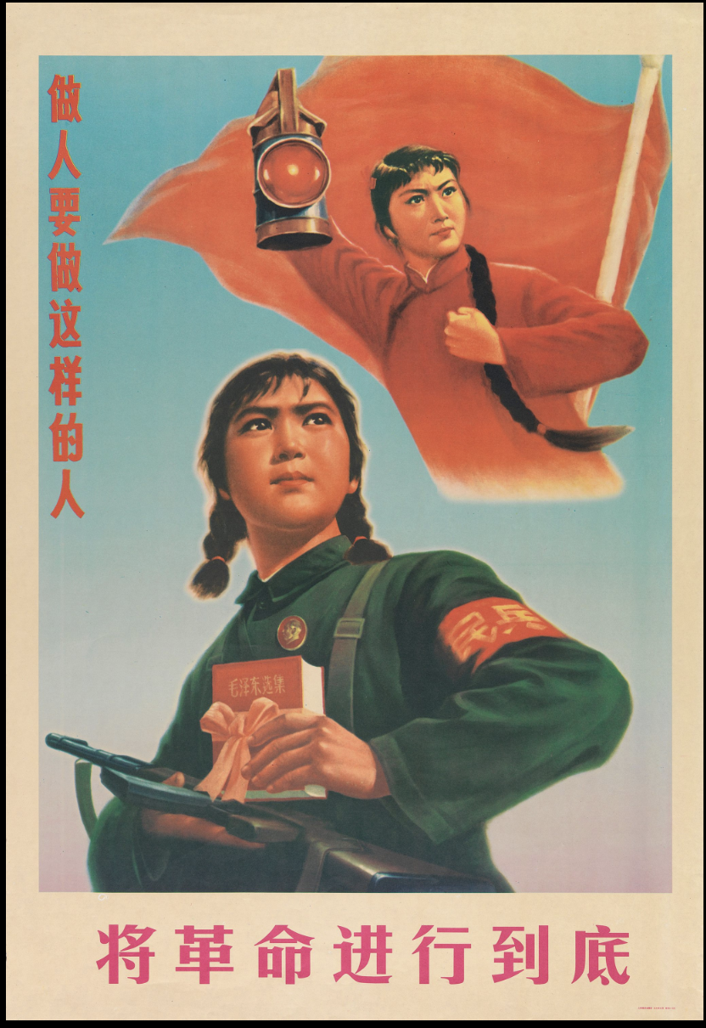
Summary: What does the constitution provide?
Common language
Common point of reference
Normative cages for rationalizing continuous revolutionary impulse
Text platform not to govern but to transform the masses

Slide 10

谢谢
Text of Remarks available online:
  Remarks1.1_ACLF_Backer_12-2024
PPT available online:
  Backer_Remarks_ConstitutionModernization-12-2024

