Slide 1
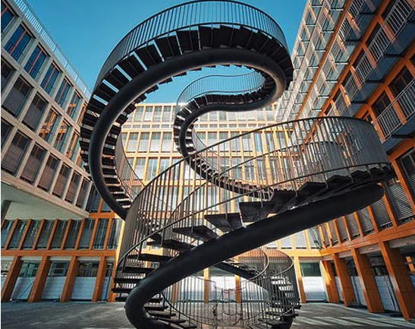
Revolutionary Constitutions and their Constitutionalism: The Internalization of Fear as Process and the Performance of Crisis in the Service of Stability
Remarks delivered at the International Scientific Conference ‘Legal Imaginaries of Crisis and Fear’ 9 November 2024, Sofia Bulgaria
Larry Catá Backer
W. Richard and Mary Eshelman Faculty Scholar; Professor of Law and International Affairs; Pennsylvania State University; 239 Lewis Katz Building; University Park, PA 16802; lcb11@psuedu

Slide 2
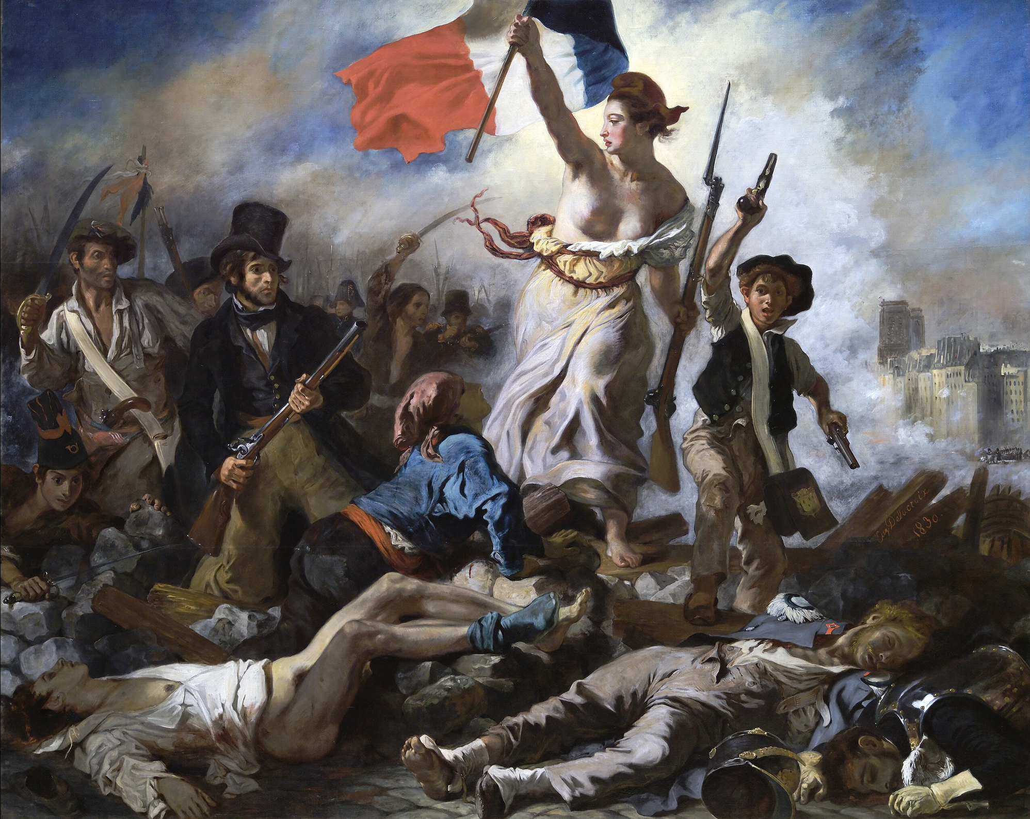
Revolutionary Constitutionalism
The spectrum of fear
Preserving
Progressing
Protecting from Change
Projecting Change
From gubernaculum to gubernaculum

Slide 3
Marching Toward the Constitutional Enterprise
Institutionalize promise of revolution
Internalize the processes of revolutionary passion

Slide 4
Revolutionary Constitution(alism)
Not the end point
A router of revolutionary dialectics
Step through the doorway
What was “inside” is outside
What was “outside” is now inside
Within the constitution everything; Outside the Constitution nothing
A play on Mussolini and Castro maxims

Slide 5
From Router to Pathways
Brief sketch of theoretics
The lens of the American revolutionary experience(ed) in text
The Marxist-Leninist Lens: China and Cuba
The Euro-Internationalist Lens: Kosovo

Slide 6
The Constitutional State of Revolutionary Fear
“Forced to it, forced by dread causes
Sophocles Electra
The etymologies of fear
From fear to terror
The dynamics of Robespierre and people’s democratic dictatorship
Fear of constitutional entropy
The construction of ‘assabiyah

Slide 7
Does a Constitutional Crisis Follow?
Authoritarian constitutionalism
Surveillance and late Capitalism
”Left” and “right” error in Leninist systems
Relevance: The burden of antiquity in Constitutional text
Points of judgment

Slide 8
Constitutional Crisis and its Imaginaries of Fear
Continuous revolution (Mao Zedong)
Permanent revolution (Leon Trotsky)
The Sate itself as a revolutionary instrument
The mutability of the constitution as a function of the dread around which crisis is manifested

Slide 9
Constitutional Rationality
The calm after the revolutionary storm
Detachment
A phenomenology of orthodoxy that is the predicate for the re-enactment of revolutionary ressentiment (in the Nietzschean sense)

Slide 10
Observing Constitutions From their Rear-Ends
Mythos of objectivity as Emoticon
As the container of the revolutionary impulse (preserve/transform)
As the basis for constitutional containment
As the basis for constitutional shattering

Slide 11
Constitutional Reliquaries
Preserve emotional explosion
Rationalization of dialectics in the service of orthodoxy
Protection of orthodoxy through post-revolutionary priesthoods
Objectivity of Resolution
Signified in Constitutional document
Given meaning through structured dialectics

Slide 12
The Examples
U.S.
Cuba
China
Kosovo

Slide 13
The Circle is Now Complete
From crisis of ideology
To crisis of reason
To Crisis as a perpetual loop
Outside to inside to outside
Repetitive performativity

Slide 14
Summing it Up
Constitutions are not a rational exercise
Messy and violent
An object of transposition
Caging revolutions in constitutions
Caging constitutions within revolution

Slide 15
Questions?

Slide 16
Thanks
Text of Remarks may be accessed here: Backer_Remarks_RevolutionaryConstitutions
[https://www.backerinlaw.com/Site/wp-content/uploads/2024/11/Backer_Remarks_RevolutionaryConstitutions.pdf]
Text of essay may be accessed here: [https://www.backerinlaw.com/Site/wp-content/uploads/2024/11/Backer_EmotiveSemiotics_Draft_v2.0.pdf]

