Slide 1
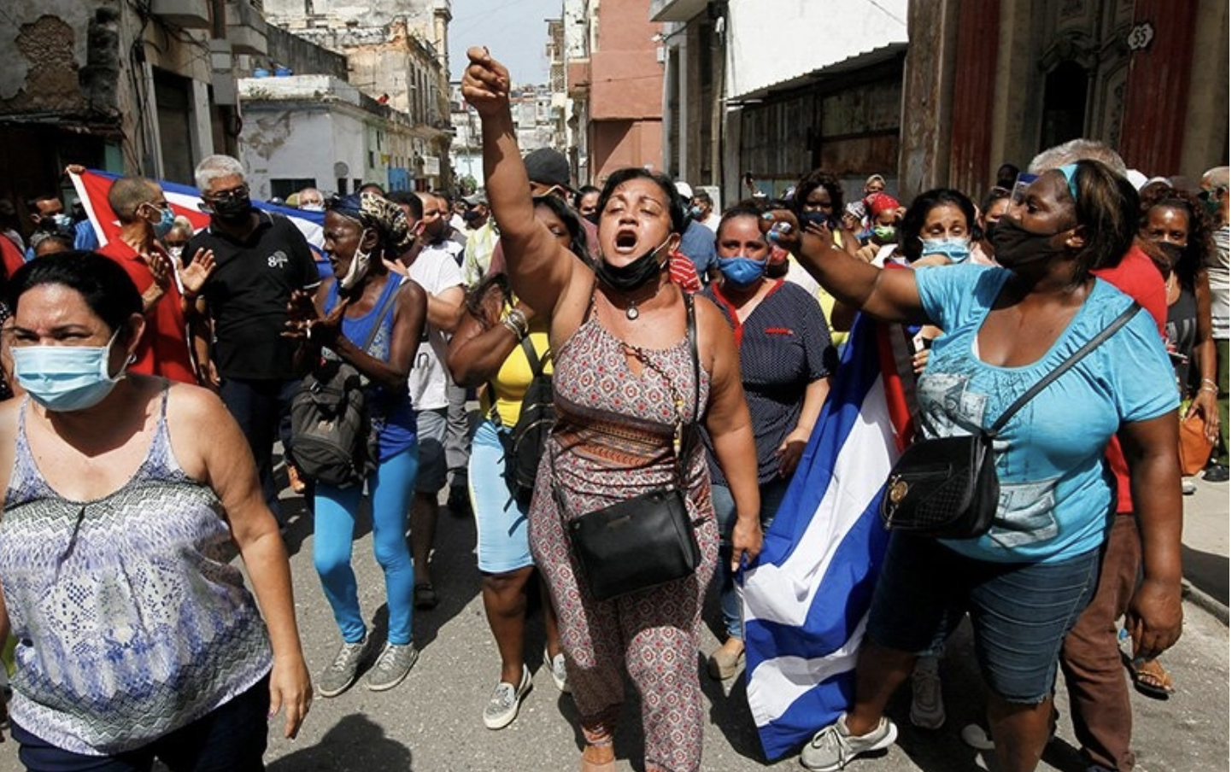
Cuba and the Constitution of a Stable State of Misery:
Ideology, Economic Policy, and Popular Discipline
Larry Catá Backer
W. Richard and Mary Eshelman Faculty Scholar; Professor of Law and International Affairs
Pennsylvania State University
Paper presented for the panel, Social and Cultural Consequences of Cuba’s Economic Path?, 2024 Annual Conference of the Association for the study of the Cuban Economy (Miami, FL 19 October 20204)
https://en.elmensajerorochester.com/news/christian-group-calls-for-free-election-amid-rare-protests-in-cuba/

Slide 2

Questions
Might it be possible to describe the current state of Cuba as an effort to perfect a stable state of misery?
Can one better understand the core premises of its political-economic model as pointing to the perfection of administrative apparatus that oversees this state of misery?
Can what to outsiders appears to be a state of wretchedness be instead understood from the inside
  as the fulfillment of a vision of social relations that relies for its ordering on maintaining just enough wretchedness to divert popular attention from the political (and its ruling apparatus) to the business of surviving;
  as a set of social relations en el que lo principal es resolver (in which the principal objective is to solve, to fix, or to overcome the immediate challenges of finding enough to eat and to live well enough)?
And might that stability of misery be a condition that suits the rest of the world, which contributes to the maintenance of this implementation of the moral judgments embedded in the Cuban political-economic model?

Slide 3
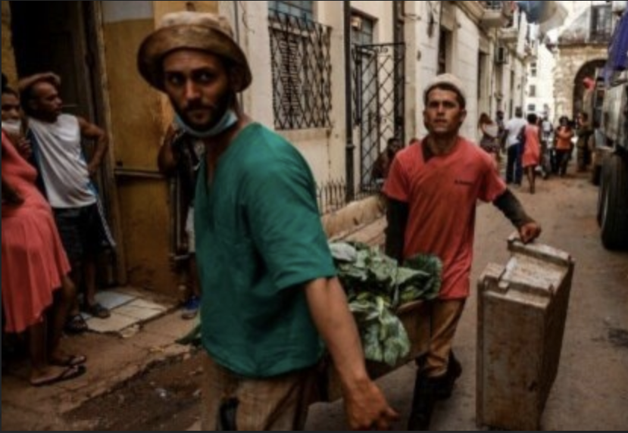
Pathways to Answers
The first, the ideological element, considers the way that that morality of consumerism and its articulation in globalization;
The second looks to the political-economic element; transposing ideology into institutional structures and the complicity of friends and enemies abroad
The third considers the dialectics of protest and the utility of the unofficial economy as the accountability and disciplinary element of misery
https://www.martinoticias.com/a/los-cubanos-enfrentan-la-peor-recesi%C3%B3n-econ%C3%B3mica-en-30-a%C3%B1os-revela-informe-onu/329449.html

Slide 4
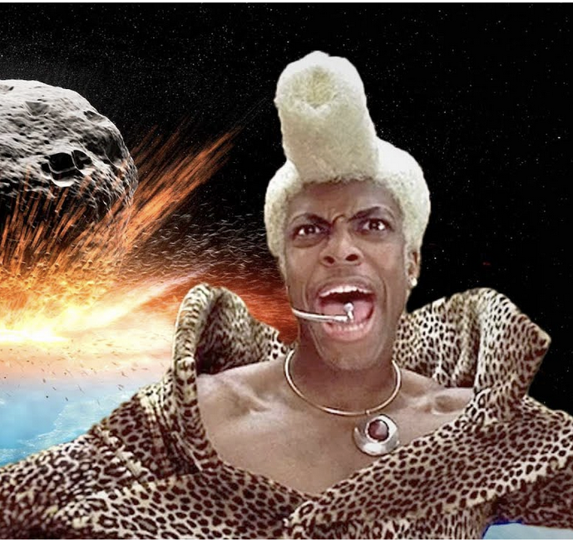
The Vignettes
2. The Ideological Element
  2.1 Vignette 1: Fidel’s Refrigerators.
  2.2. Vignette 2: The State Ideology in the Shadow of Consumption and Globalization.
  2.3 Vignette 3: Fidel’s “Children” and the Institutionalization of Ideologies of Misery.
3. The Political-Economic Element
  3.1 Vignette 4: The Phoenix of Stability From out of Disaster
  3.2 Vignette 5: The Governance of Misery
  3.3 Vignette 6: Welcome to the Hunger Games and Global Lenders
  3.4 Vignette 7: The Hunger Games Part 2—The Spy-Friends Edition.
  3.5 Vignette 8: The Hunger Games Part 3—The ‘You’ve Got a Friend in Me’ Edition
4. Popular explosion as the Disciplinary Factor
  4.1 Vignette 9: The Edges of Misery and the Misery of the Edges--11 July 2021
  4.2. Vignette 10; Even Protests can be a Leninist Instrument.
  4.3 Vignette 11: The Toleration of the Intolerable and the Search for a Stable State.
  4.4. Vignette 12: The Swingling Pendulum.
https://thatjoescott.com/2024/07/01/how-the-fifth-element-really-ended-according-to-science/

Slide 5
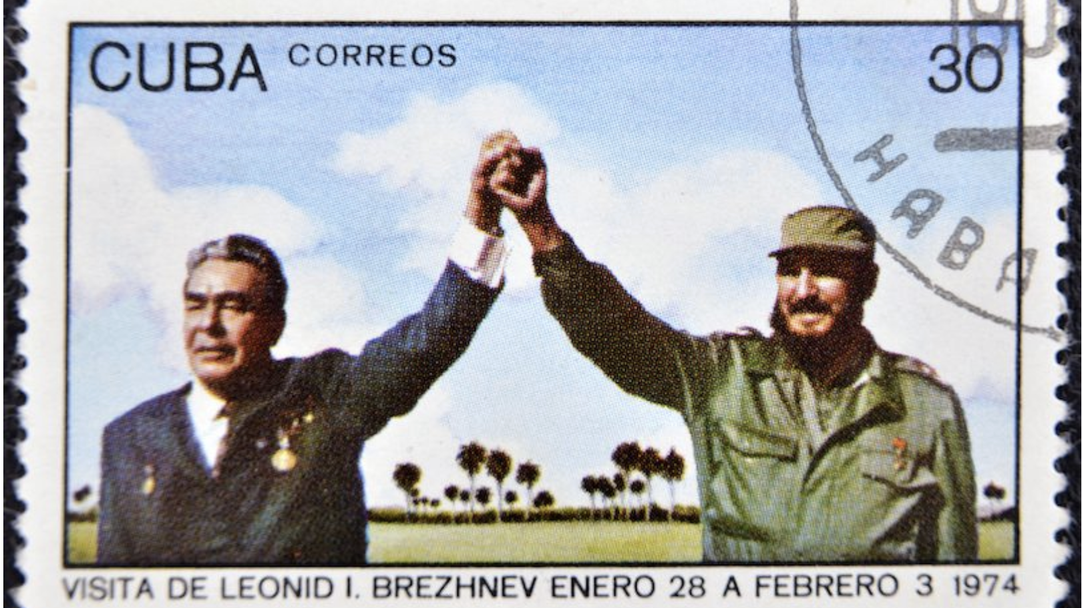
The Ideological Element

Slide 6
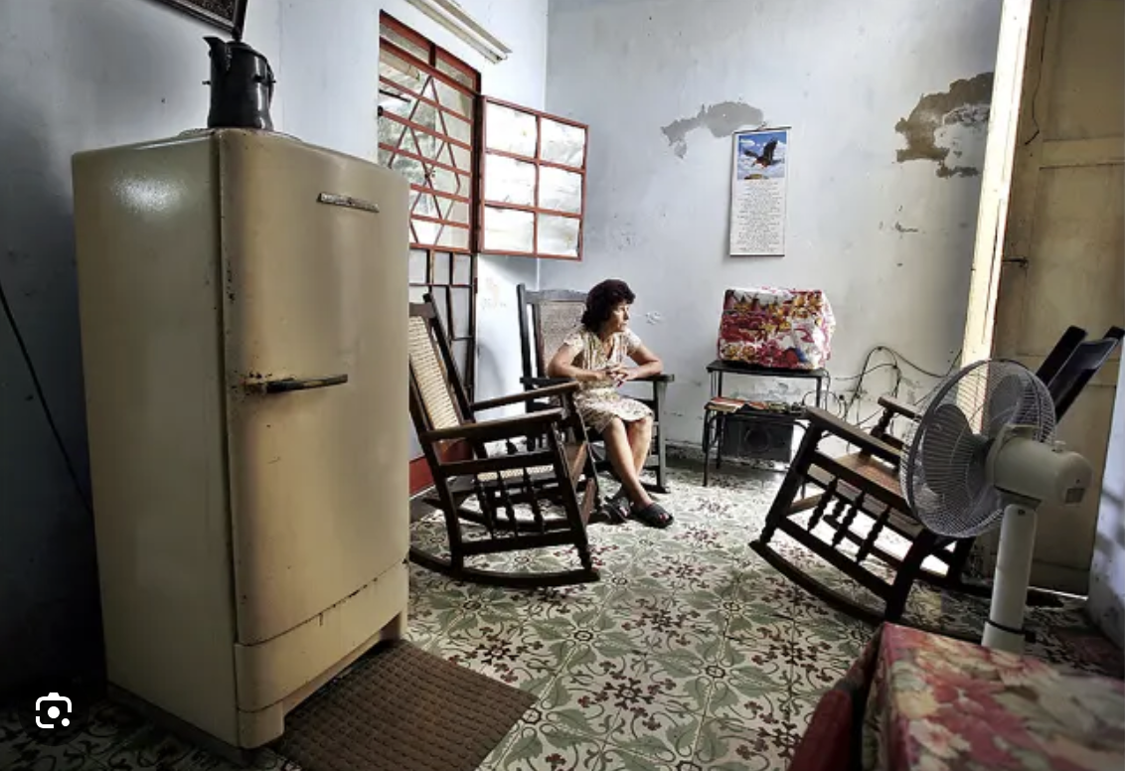
Consumerism, Globalization, Abstracted Solidarity
  2.1 Vignette 1: Fidel’s Refrigerators.
    The morality of consumerism
  2.2. Vignette 2: The State Ideology in the Shadow of Consumption and Globalization.
    Overproduction, overconsumption, and the economics of equality
  2.3 Vignette 3: Fidel’s “Children” and the Institutionalization of Ideologies of Misery.
    The bureaucratization of equality within a messy environment

Slide 7
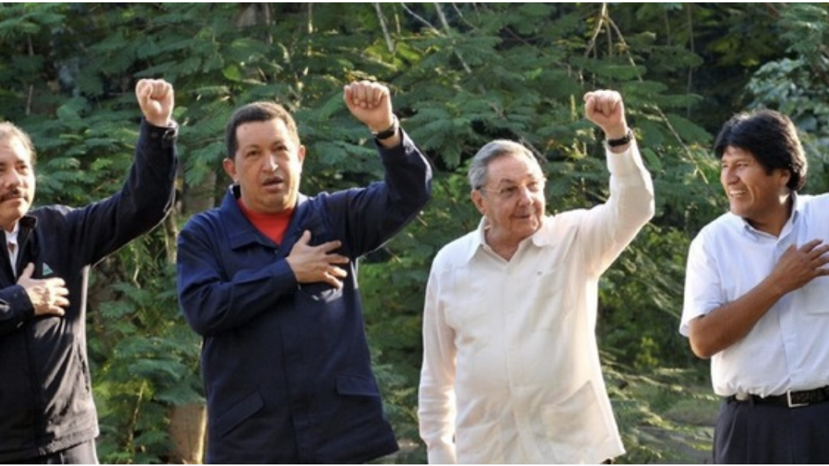
The Political-Economic Element

Slide 8

The Institutional Structures of Misery and Its International Framework
  3.1 Vignette 4: The Phoenix of Stability From out of Disaster
    The shifting ideal and the disjunction of ideal and realities of economic policy
  3.2 Vignette 5: The Governance of Misery
    Equality principles and the economics of avoiding collapse
  3.3 Vignette 6: Welcome to the Hunger Games and Global Lenders
    The complicity of foreign lenders—the Pars Club
  3.4 Vignette 7: The Hunger Games Part 2—The Spy-Friends Edition.
    Leveraging value: Cuba for sale and the quid pro quo of subsidy
  3.5 Vignette 8: The Hunger Games Part 3—The ‘You’ve Got a Friend in Me’ Edition
    Subsidies and the friends keeping Cuba on a short leash

Slide 9
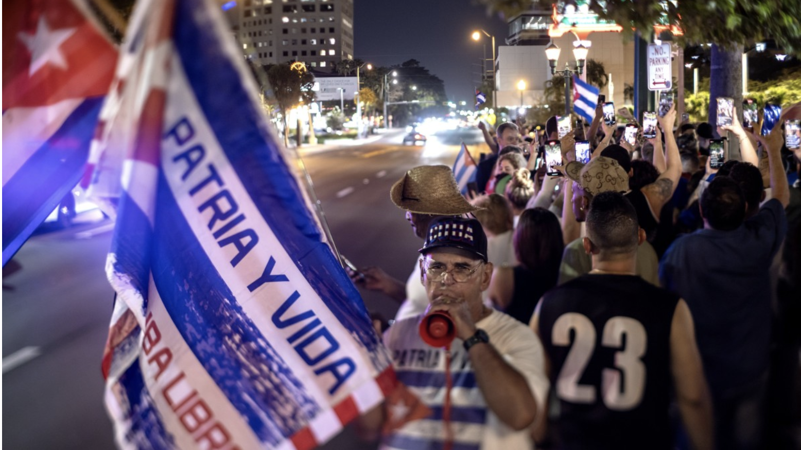
The Dialectics of Protest

Slide 10
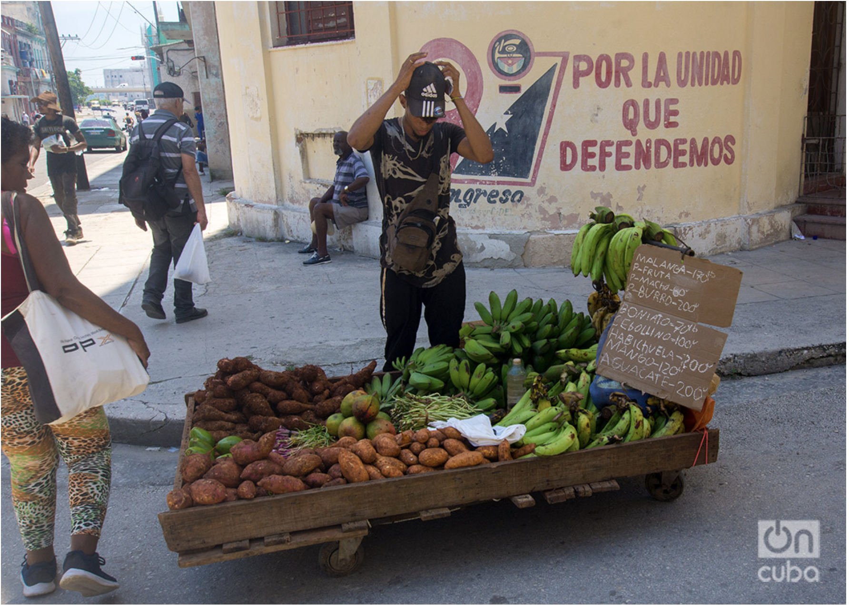
Mass Dialectics in the Economy and on the Streets
  4.1 Vignette 9: The Edges of Misery and the Misery of the Edges--11 July 2021
    The power of the masses to move administrative practice
    But not state ideology
  4.2. Vignette 10; Even Protests can be a Leninist Instrument.
    Lumpenproletariat protests as a Leninist mechanism
  4.3 Vignette 11: The Toleration of the Intolerable and the Search for a Stable State.
    Transitory complementary of the official non-state sector
  4.4. Vignette 12: The Swingling Pendulum.
    The realities of the unofficial market, corruption and escape hatches

Slide 11
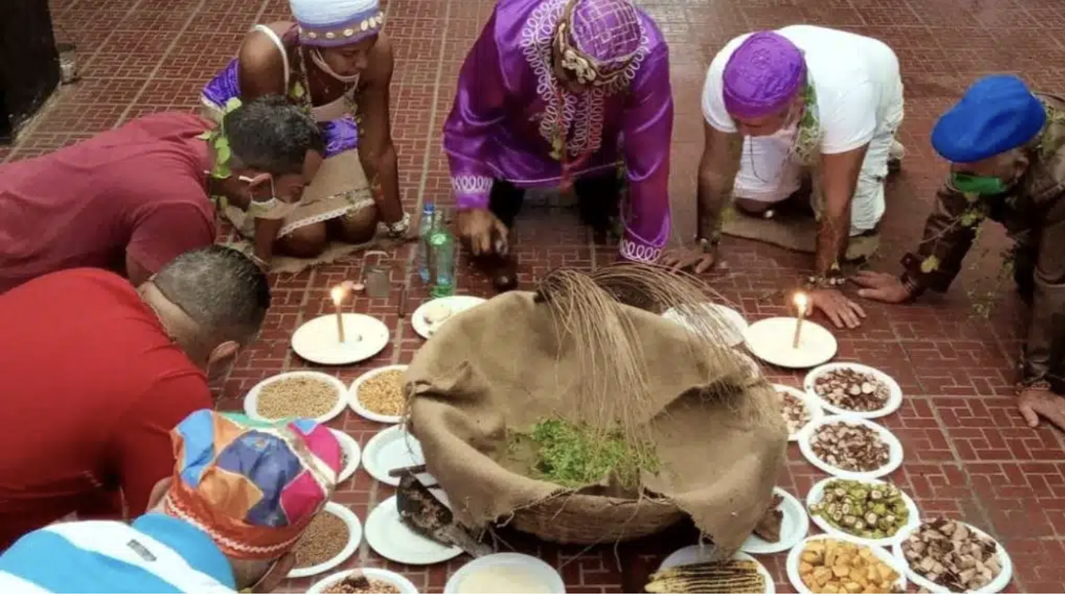
Prognostications: Is There a System Here? Is it Stable?

Slide 12
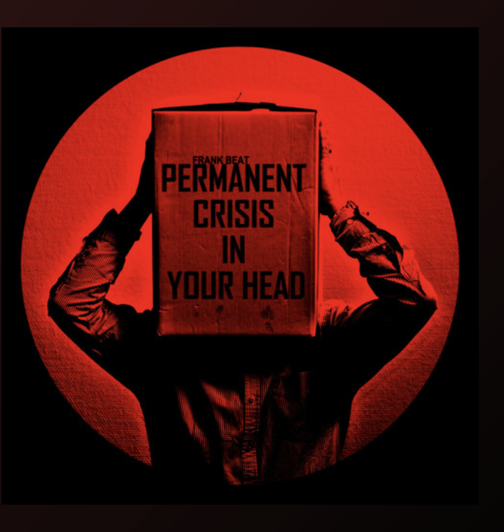
The Dynamic Stability of Misery: A Theory of sorts?
The Core Objective:
  Society of workers whose needs are met; not prosperity
  Economic activity is the means to make that possible
  External conditions make that goal difficult; the current object is to protective preservation of the framework (8th PCC Congress)
The Moral State
  The morality of consumerism and materialism
  Mass and sovereign equality as the measures
  Markets are the enemy
The State of Permanent Crisis
  Transpositions of moral ideology to the Leninist apparatus
  The Internationalization of Subsidies
  Migration as subsidy
The Cuban Mass Line
  The Streets: Popular protest
  The Economy: Non-state sector and unofficial economy

Slide 13

Questions/Prequntas/Comentarios?

Slide 14
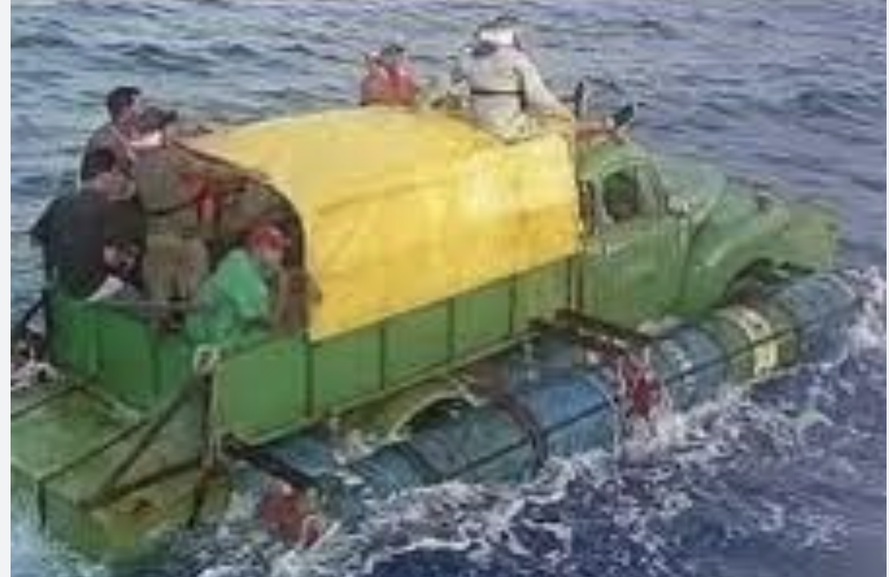
¡Gracias!
The paper, Cuba—The Art and Theory of a Stable State of Misery: Ideology, Economic Policy, and Popular Discipline." may be accessed HERE:
https://papers.ssrn.com/sol3/papers.cfm?abstract_id=4991337

