Slide 1
Cuban Socialist Democracy 2.1—Revolutionary Leninist Constitutionalism With Cuban Characteristics: Popular Participation and Engagement from Lineamientos Through Cuba’s 2019 Constitution, to Contemporary Administrative Techno-Bureaucratization
Larry Catá Backer
Coalition for Peace & Ethics and Pennsylvania State University (lcb911@me.com)
Prepared for Lecture at Barry University Andreas School of Law 24 June 2024

Slide 2
A Part of the Larger Project of Project of Leninist Constitutionalism
Rise of theories of Socialist Democracy
Distinguish these from core principles of liberal democracies
Chinese Model emerges after 19th Chinese Communist Party Congress
Cuban (Caribbean) Model emerges after 7th PCC Congress
Other variations
Hybrid: Venezuela
Dynastic: N. Korea
Aristo-Administrative: Vietnam

Slide 3
The Initial Problem: Possibility of Aligning Popular Participation in a Vanguardist State With Constitutional Ambitions
Core premises of a theory of Cuban (Caribbean) Socialist Democracy?
Who are the “masses”
Relationship between the masses (populace) the state and the vanguard party (a patriotic front?)
“Within the revolution everything; outside the revolution, nothing
The question, then, is what is the Revolution and who decides
Modalities of democratic participation
Voting
Engagement/consultation
Initiation and control
Caribbean Socialist Democracy in the 2019 Constitutional Reform project and thereafter
Engagement vs Voting
Dissent (11 July 2021 Protests and beyond)
Alignment with constitutional governance—Masses; Vanguard; State apparatus?
Nature of representation of the masses
(1) by the Vanguard party;
(2) in the work of the state apparatus; and
(3) in mass organizations this be applied elsewhere

Slide 4
First Stage The Revolutionary Government 1959-76

Slide 5
The Initial Problem: Possibility of Aligning Popular Participation in a Vanguardist State With Constitutional Ambitions
First Stage—The Revolutionary Government 1959-76
Seeking ways to connect their authority, authenticated through military victory, to (mass) popular affirmation
Why?
Second Stage—Institutionalizing the Revolutionary Government
The Revolutionary Government now transformed (metastasized?) into the concept of the Revolution itself.
In need of a political ideology that mirrored its self conception
Vanguardism (in the form of Soviet Marxist-Leninism)
Institutionalized a generation of leadership that remained immobile
Third Stage—Toward a New Era
Institutionalizing a Vanguardist State without form the “dead hand” of the Histórico” period
Draw on first two stages to present a remodeled system suitable for the “New Era” of historical development (parallel Chinese intellectual currents)
Combine popular affirmation with mass engagement through institutional structures of “poder popular”

Slide 6
Popular Participation—First Wave 1960-62
2 Sep. 1960
First Havana Declaration 2 September 1960
Popular affirmation of action by revolutionary government
Mass physical gathering of the people in a space
Affirm actions taken; but no initiation of action
Revolutionary Government determines when or if to convene
11 Feb. 1962
Second Havana Declaration 11 Feb 1962
Who are the people who can assert sovereign authority?
Class based; class struggle basis for inclusion
But not nationality based: includes other Latin Americans

Slide 7
Cautions: Popular Affirmation
These might be viewed as “agit-prop”
Propaganda to manage masses internally; effectively abandoned after 1962 except propaganda effect
Projection of images of democracy that are meant to target influential Western intellectuals and the popular press
The “Havana Effect”
The device is anachronistic in the sense that it gives the Capital disproportionate weight
Danger of conflation with bourgeoise mechanisms where the Revolutionary government was looking for something distinctive
The Representation Effect
Who are these people?
Logistical nightmare (can’t gather the “people” even in a large square in Havana).
The role of the Committees for the Defense of the Revolution and other mass organizations
Discussion; What Discussion?
The focus is on affirmation
The disciplinary power of the mob to silence dissent
Flattens discussion; No effort to theorize much less consider Vanguard obligations respecting these “affirmations”

Slide 8
Second Stage— Institutionalizing the Revolutionary Government

Slide 9
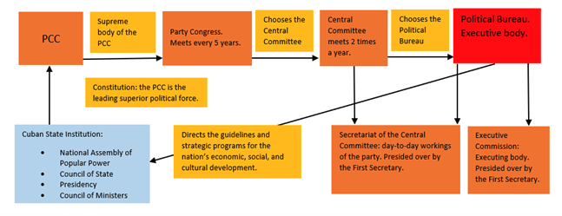
The Institutionalized Organization of Revolutionary Power
Chart credit Cuba Study Group

Slide 10
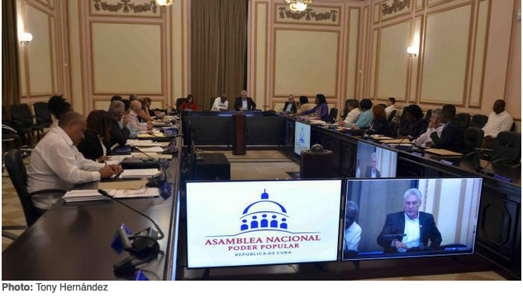
The Ruling Administrative Apparatus
The Council of State (Consejo de Estado)
31-member body
Elected by the National Assembly of People's Power.
Exercises most legislative power between sessions of the National Assembly of People's Power, subject to its approval.
Can call the NAPP into session between its scheduled twice-yearly sessions.
The Council of Ministers (Consejo de ministros)
Supreme executive and administrative body constituting the highest levels of the administrative apparatus of the State.
Includes: the President, the First Vice President and the five Vice Presidents of the Council of State, the Secretary of the Executive Committee, the heads of the national ministries, and other members as established by law.
The Executive Committee is a smaller body, consisting of the President and Vice Presidents of the Council of State, the Secretary and those ministers chosen by the President. The Council of Ministers is responsible for the implementation of policy agreements authorized by the National Assembly of People’s Power.

Slide 11
Template—1975 1st PCC Congress and 1976 Constitution
Party leadership develops core documents to institutionalize government and party structures
Develop core ideological documents
Develop draft of a new constitution that reflects ideological changes
Popular commentary
Review comments and modify
Constitution subject to popular affirmation and vote.

Slide 12
Cautions: A New Role for Affirmation
Transposition of Soviet model
also transposed the weaknesses of Stalinist glosses on Leninist theory; esp. cults of personality
Wide gap between theory and the realities of government;
evisceration of Leninist theory even as applied to the Vanguard
The evisceration of “mass participation” through representative organs
even by the standards of Leninist theory
The problem of representation remained unsolved in theory or practice
The result was either systemic corruption or/and functional delegitimization
How to distinguish “socialist” from “capitalist” elections
Capitalist elections were criticized as serving as a means through which those in control could put in their own “clients”
But where the vanguard both put its members up for election, and where sometimes only one person stood for a position, it was hard to see the difference
The difference was explained on a sort of “best person” theory AND election as AFFIRMATION
A new role for public affirmation—From Mass Approval of Actions to Affirmation of Choices for Representation
Single candidate and Party member candidates for representatives of the “people” (masses, proletariat) justified on principle of elections as affirmation of choices made by the vanguard rather than of contests between individuals.

Slide 13
Third Stage— Toward a New Era of Socialist Consultative Democracy 2.0

Slide 14
The Long Arc of Development in Cuba
6th PCC Congress
Lineamientos
Development of a Cuban “Reform and Opening Up” Line
7th PCC Congress
Conceptualization of the political and economic model
Revision of the Lineamientos
Development of a revised approach to central planning (Year 2030 Plan)
The Project of Constitutional Reform 2017-2019
Reflect the changes in the PCC basic line
Reflect new focus on model citizen and model worker
Focus on efficient reconstitution of state organs

Slide 15
The Next Wave 2011
PCC Initial draft
Popular consultation
Revised Draft
PCC Approval at 6th PCC Congress
Reform and Opening Up
Objective to develop Guidelines (Lineamientos) for reform
No real engagement with theoretical model of the state
Interactive process; use local organizations Committees for the Defense of the Revolution etc.

Slide 16
Reaction and Retrenchment: The Reconceptualization of the political and Economic Model 2016
Follow the template of the 1st PCC Congress and the Lineamientos
Much more tightly controlled process of engagement
Selected mass organizations
No general mass involvement
Return to the Political Model of 1976
Party at the center
Rule by Law applied through administrative discretion
Shadows: the US and strategic opportunism

Slide 17
The 2017-2019 Process of Constitutional Reform
Transposing Conceptualización into the state constitution
PPC Committee
Asamblea Nacional
Popular Commentary
Revision by Asamblea
Plebiscite

Slide 18
The Problem of Voting
The meaning of affirmation in plebiscites
Plebiscites and the political work of the vanguard
The scope of the duty of the vanguard in the face of “no” votes
A role for a Caribbean version of the Chinese “Mass Line” principle?
The Ideology of counting
Who is included in the voting masses
A variant of the Maoist problem of excluding counter-revolutionary forces, etc.
The Contradiction of “popular power” in which dissident (unreformed) voices are excluded

Slide 19
The Problem of Engagement
Formal versus informal structures
Party and State managed consultation may produce results that do not serve either the vanguard or the state apparatus
Moving out of the 20th century
Committees for the Defense of the Revolution in the “New Era”
Tech and consultation remain at a nascent stage
The management of intellectuals and the non-state sector
The problem of foreign interference
The filtering effect of consultation
The role of the diaspora community
The role of the conveners for determining what gets summarized, how it is summarized and what is reported to the organs of Party-State power responsible for modification
A role for informal consultation
Already appearing at the margins of debate
Tolerated even within State supported websites

Slide 20
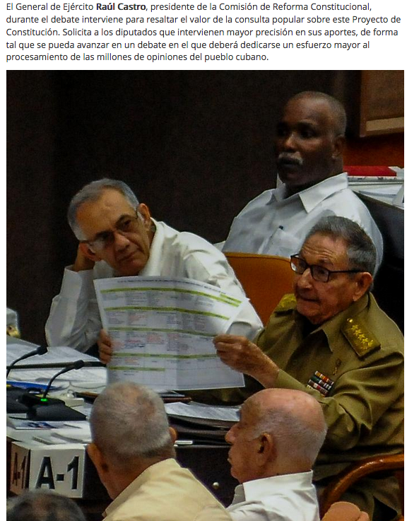
The Problem of Representation of “Popular Power”
The role of the Asambleas de poder popular
Legislative or affirmation body?
Policy or mechanics of implementation
Politics in implementation?
Delegation and deference to regional and local groups
Not clear how the delegation will work in fact
The problem of coherence
Vertical: up the chain of asambleas
Horizontal: Between the Asambleas and the Nomenklatura
Inter-systemic: Between the State and Party apparatus
Space for Non-Party members
Is the Chinese United Front a model?

Slide 21
The Fourth Stage: Challenges and Constraints in the Era of the Orisha Oya Post-COVID

Slide 22
Mass Response of 11 July 2021 and Thereafter:
Move to Democracy;
Maoist Rectification From Below; or
Institutionalization of a Tolerable State of Misery?
The stability of strategic economic misery wrapped up on narrative excuses that suit the ruling global elites operating through their respective State apparatus.

Slide 23
An Iconoclast Perspective: Analysis and Engagement With “Acerca de las protestas en Cuba del 11 de julio,” Comunistas Blog (English version here)
1. The protests did not include significant counter-revolutionary elements—they expressed mass opinion in a classical Marxist sense
2. The protests have diminished the political legitimacy of the state apparatus but not the power of the PCC
3. The protests originated in working class neighborhoods, which from a Marxist perspective suggest a contradiction between the policies of the vanguard and their realization in class struggle terms which weakens the legitimacy of the vanguard
4. The protests may not represent majority popular opinion; at the same time their manifestation suggest a mass vanguard that invites (internal or external) rectification on the part of the ruling vanguard party if it is to retain its legitimacy.
5. Notable by its absence were socialist slogans—this suggests a contradiction—action on the street by the masses suggest the manifestation of class struggle while that movement did not appear to embrace classical articulations of Marxist class struggle—the language has changed and with it perhaps the underlying ideology.
6. This represents a minority of workers allied with a minority of the intellectuals; but again, the nature of a vanguard is to be a leading force not a majority force. Intellectual/worker vanguards suggest the diminution of the political vanguard as the undisputed leading social and intellectual force, which also requires rectification within the Party and in the state.
7. The lumpenproletariat played a decisive role; that ought to worry a vanguard that continues to embrace the fundamental contradiction of class struggle as the basic foundation of the Party’s work.
8. The “Black Hand” of foreign interference once the protests started cannot be underestimated adds complexity. The foreign element might have sought to hijack the process of mass engagement with a vanguard that has lost its way.
9. Violence was integral to the protests. And that forced the hand of the state to meet violence with violence. Yet Lenin reminds us that revolutionary violence is an essential element for exposing the weakness of an opponent and the key to the triumph of the vanguard.

Slide 24
The Consequences From a Leninist Perspective
A significant public attack on the legitimacy of the vanguard: Failure of ideological response
Exposure of the gulf between the authority of the vanguard and its legitimacy; the legitimacy of the stability of misery
Emergence of alternative vanguard voices (artists, bloggers, intellectuals)
Failure to meet responsibility to the proletariat; gap between theory, governance and contemporary conditions
Challenge comes from below
May be articulated by the intellectuals
Hijacked by foreigners and diaspora actors
But its force, from a Leninist perspective, is centered on the core collective form which a vanguard derives its legitimacy
Pix credit here Reuters 2024

Slide 25
Cuba: La Dueña del Cementerio
Decision point for the vanguard
Alignment of ideology with the historical conditions of the rimes
The relevance of the project of Marxism and Leninism to the masses
Fundamental contradiction of modern Leninist parties: the gap between the vanguard and the needs of the masses
This will be measured by the material conditions of the masses
The post-1980s model of Cuba will have to be revisited.
A fortress impregnable by foreigners but willing to project itself politically and economically outward through the state is likely to have to re re visited.
For the short term, however, the distance between the forms of governance and its objectives grow.
Oya, La Virgen de la Candelaria, the ruling orisha 2024

Slide 26
Thanks
Further reading:
Larry Catá Backer, Cuba’s Caribbean Marxism: Essays on Ideology, Government, Society, and Economy in the Post Fidel Castro Era (Little Sir Press, 2018).
Larry Catá Backer, Flora Sapio, and James Korman, “Popular Participation in the Constitution of the Illiberal State--An Empirical Study of Popular Engagement and Constitutional Reform in Cuba and the Contours of Cuban Socialist Democracy 2.0” (2020) 34(1) Emory International Law Journal 183.
Larry Catá Backer and Flora Sapio, “Popular Consultation and Referendum in the Making of Contemporary Cuban Socialist Democracy Practice and Constitutional Theory” (2020) 27(1) University of Miami International & Comparative Law Review 37.

