Slide 1
You Can’t Stop the “Signal”: From the Past to the Future of Digitally Mediated Sustainability Due Diligence
Larry Catá Backer (白 轲) W. Richard and Mary Eshelman Faculty Scholar; Professor of Law and International Affairs
Pennsylvania State University | 239 Lewis Katz Building, University Park, PA 16802
Asser Institute: Center for International and European Law & University of Amsterdam Law School-
[Spring Academy] Technologies of sustainability due diligence: Digital tools and global value chain regulations
8 April 2024

Slide 2
The Flow of the Remarks
1. Ordering Concepts
2. From Corporate Social Responsibility to Sustainability Due Diligence.
3. From the Technologies of Monitoring, Accountability, and Assessments to Big Data Descriptive, Predictive and Generative Analytics.
4. The Conjunction of Sustainability Due Diligence and Big Data Analytics: The Environment of Social Relations
5. The Conjunction of Sustainability Due Diligence and Big Data Analytics: Mediating Operating Systems
6. The Revolution is Coming

Slide 3
I. Ordering Concepts 1: The Signal/Flow
[Mr. Universe:] “There is no news. There's the truth of the signal. What I see. And, there's the puppet theater--the Parliament jesters foist on the somnambulant public. . . Can't stop the signal. . . Everything goes somewhere, and I go everywhere.”
(Script, Serenity, 2005)
Static, deductive, top down (from principle/norm to action)
freezing the past to project onto the future
Law-rule systems
Dynamic, inductive, iterative, bottom-up (from action to principle to action to principle)
Historical flows from out of the past into a/several future(s)
Virtual, simulated and rule-dialectical systems

Slide 4
Ordering Concepts 2: Router/Platforms
On one side one encounters the modalities, expectations, practices, constitution, and legalities built around the development of productive forces in collective social relations.
More specifically, one focuses on the larger social collectives organized around the exploitation of labor through capital to produce and consume objects of value.
Most specifically, the focus is on efforts to manage these forces against norm ideals through “diligence” systems.
On the other one engages with virtual simulacra of the behaviors of productive forces in collective social relations.
Technology in-itself and as an object-instrument and a consumable in the production of something of value to humans and human society.
More specifically data fed digital and virtual systems for descriptive, predictive and generative analytics

Slide 5
Ordering Concepts 3: The Diligence and Tech Lebenswelt-Imaginaries
Contextualization of diligence and tech platform systems within larger systemic transformation of governance
Governmentalization of public sphere
Reconceptualization of the role and purpose of economic activity
Encountering, exploiting, and taming collective virtual selves

Slide 6
The Principal “Take Aways”
Three fundamental characteristics of (1) the role of technology in the evolution and application of sustainability due diligence systems, and (2) the role of sustainability due diligence in the evolution and shaping of tech.
(1) The interactive and dialectical processes of these operating systems are incompatible in the sense that one system is analog (“diligence”) and the other is digital (big-data tech) system; two-way bridges are necessary to effect productive inter-penetration.
(2) Those two-way bridges are built on the trajectories of macro changes to the core premises and operations of collective social relations; these are creating points of convergence in norms and expectations of social sub-systems—big-data tech and economic behavior expressed through signification of ”diligence.”
(3) The dissonance produced by the interpenetration of analog (“diligence”) and digital (big-data tech) platforms produces a dynamic environment in which every instance of application affects the system and its applications; digitally mediated diligence becomes a site of plural inter-subjectivity.

Slide 7
II. The Enterprise of Due Diligence

Slide 8
Contemporary History
Blending of two streams:
Disclosure in securities markets from the 1930s (public law)
Risk minimization in caveat emptor environments (private law)
Crossing the blood-Brain barrier
UN Guiding Principles
HRDD as a private function grounded in public compliance under UNGP 2nd Pillar (Protect-Respect-Remedy)
Inspiration from Environmental due diligence
Prevent, mitigate, remedy shifted character of duty from negative to positive
Recombination as sustainability due diligence
Amalgamation of environmental, sustainability, and climate rights with and as human rights after 2015.
Generalized duty to investigate within compliance and risk reduction principles

Slide 9
Modern Forms of Diligence
In its modern forms, sustainability due diligence takes one of two forms—
one essentially private law based, and markets driven with a compliance overlay;
the other public law based and driven by the imperative to align public policy goals of the state with the behavior expectations and outputs of markets and the institutions that operate in them.
The private forms of structuring due diligence have largely been developed for the market
UNGP
The public forms of structuring due diligence have largely been a European (and to a lesser extent a Chinese Leninist) project
SC3D

Slide 10
Markets-Based Diligence Systems: UNGP
Policy Commitment
Diligence Framework
Purpose:
to “identify, prevent, mitigate, and account for” the way in which an enterprise addresses adverse human rights impacts
(1) assessing impacts;
(2) integrating and acting on findings;
(3) tracking responses; and
(4) communicating how impacts are addressed
Mediating and Routing Principles
Prevent-mitigate-remedy
Severity
Direct vs Indirect causation
Leverage

Slide 11
Public Law Based Diligence Systems: SC3D
Built around the conceptual framework for such systems developed by the Organization for Economic Cooperation and Development (OECD).
Six critical steps:
(1) integrating due diligence into policies and management systems;
(2) Identifying and addressing adverse human rights and environmental impacts;
(3) Preventing, ceasing or minimizing actual and potential adverse human rights impacts;
(4) Monitoring and assessing the effectiveness of measures;
(5) Communicating; and
(6) Providing remediation. Action and impact is to be ordered around concepts of severity and immediacy. And the system privileges prevention (risk aversion principles) rather than compensatory principles.
System of administrative oversight
With incentive and penalty features
Limited direct reach
Cram down principle for indirect adoption

Slide 12
III. Compliance Tech and Compliant Technologies: The Marriage of Tech and Diligence

Slide 13
Mutual Advantage--Bridging
Mapping
Upstream/downstream supply chains
Product lifecycles
Detect and assess
Sustainability risks and impacts
Model and predict
Activity as a function of risk
Monitoring
Minimize compliance risk across platforms
Quality control
Mr. Universe weds his Companion Bot
2023 report, The Potential of Big Data Technologies for the Human Rights and Environmental Due Diligence Process

Slide 14
Mutual Risks—Blowing Things Up
Risks
Effectiveness
Coding
Data garbage
Conceptual framework
Objectives
Alignment of OS
Amplifying bias
Coding a system of privileging bias
Suppressing taboo bias
Knowing the difference between the two
Tech itself an adverse impact
Privacy
Manipulation (only humans should manipulate each other)
Effect on environment through consumption of resources
2023 report, The Potential of Big Data Technologies for the Human Rights and Environmental Due Diligence Process

Slide 15
EU Artificial Intelligence Act
EU-AIA core objectives:
(1) ensuring that AI systems placed on the Union market and used are safe and respect existing law on fundamental rights and Union values;
(2) ensuring legal certainty to facilitate investment and innovation in AI;
(3) enhancing governance and effective enforcement of existing law on fundamental rights and safety requirements applicable to AI systems;
(4) facilitating the development of a single market for lawful, safe and trustworthy AI applications and prevent market fragmentation
What is suppressed:
(1) biometric categorization systems that use sensitive characteristics (e.g. political, religious, philosophical beliefs, sexual orientation, race);
(2) untargeted scraping of facial images from the internet or CCTV footage to create facial recognition databases;
(3) emotion recognition in the workplace and educational institutions;
(4) social scoring based on social behavior or personal characteristics;
(5) AI systems that manipulate human behavior to circumvent their free will; and
(6) AI used to exploit the vulnerabilities of people (due to their age, disability, social or economic situation).

Slide 16
Systemic Elasticities
Exceptions, limitations, interpretation
Competition/convergence from other AI regulatory regimes
Rise of “unofficial” markets
Bridging rule text and coded application

Slide 17
IV. The Conjunction of Sustainability Due Diligence and Big Data Analytics: The Environment of Social Relations

Slide 18
Pathways and Trajectories
(1) General trend within liberal democratic political orders to deepen the scope of the governmentalization of the private transnational sphere through multinational enterprises.
(2) Collateral effects of this process of governmentalization--of transforming the multinational enterprise from an economic organ to an organ through which state power may be applied directly
(3) The double role now assigned to private economic actors.
Instruments of economic activity representing large numbers of aggregated productive forces-
Private sector administrative organ of the state
(4) Acceleration of rise in markets for regulation
(5) Operating system obsolescence
Static statutes; dynamic operations

Slide 19
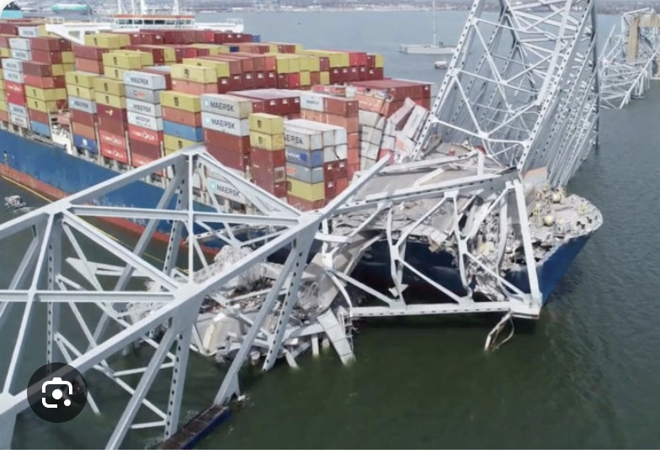
V. The Conjunction of Sustainability Due Diligence and Big Data Analytics: Mediating Operating Systems

Slide 20
Challenge
Corporate operations, corporate compliance, and the techno-bureaucracies that tend to both, are essentially still analog institutional forms.
Big data descriptive, predictive and generative processes and their products are digital and virtual.

Slide 21
Challenge Types
Translation across operating systems
Cross-recognition of OS “being”
Processing data and recognizing and organizing it as knowledge
Management and control

Slide 22
Is the Diligence-Tech Revolution Coming?

Slide 23
The Dialectics of the Diligence-Tech Revolution
A society reveals itself most clearly when it consciously confronts something threatening. That revelation becomes acute when the threat also constitutes a temptation that is irresistible.
Reactionary/traditionalist reflex
Keep things as they are
Exploit but control
Revolutionary reflex
Exploit
Instrument of collateral changes

Slide 24
Thanks
Contact me at lcb11[AT]psu.edu
Text of Remarks may be accessed here:[https://www.backerinlaw.com/Site/wp-content/uploads/2024/04/Backer_Remarks_v1-2_CantStopSignal.pdf]

