Slide 1

Human Rights Due Diligence in the UNGPs
Larry Catá Backer
W. Richard and Mary Eshelman Faculty Scholar; Professor of Law and International Affairs
Pennsylvania State University
239 Lewis Katz Building
University Park, PA 16802
Prepared for Workshop: The current state and future trajectories of human rights due diligence laws: New Legal Norms on Human Rights Due Diligence (6 September 2023; virtual)

Slide 2

Problemmatique of the UNGP
Alignments
  Public administrative apparatus and markets institutions
Coordination
  States and enterprises
Transpositions
  Value in economic relations
  Duty in social relations

Slide 3

UNGP 3 Pillar Structure
State duty to protect
  Grounded in public law grounded in national constitutional law and state obligations under international law; structured within systems of administrative and judicial oversight
Corporate responsibility to respect
  Grounded in markets and private law guided by international norms and legal compliance principles;
Remedial pillar
  Grounded in the critical role of state based judicial mechanism within a constellation of administrative, legislative or other appropriate mechanisms.

Slide 4

Where and How Does Human Rights Due Diligence Fit Into the UNGP Framework?
Consider the aligning structures of the UNGP as a whole
  General principles
  “End of the beginning” narratives
Examine the core structural regulatory framework for the three pillars
  Regulatory silos
  Risk cabins
Consider the interlinkages
  Structural
  Regulatory

Slide 5
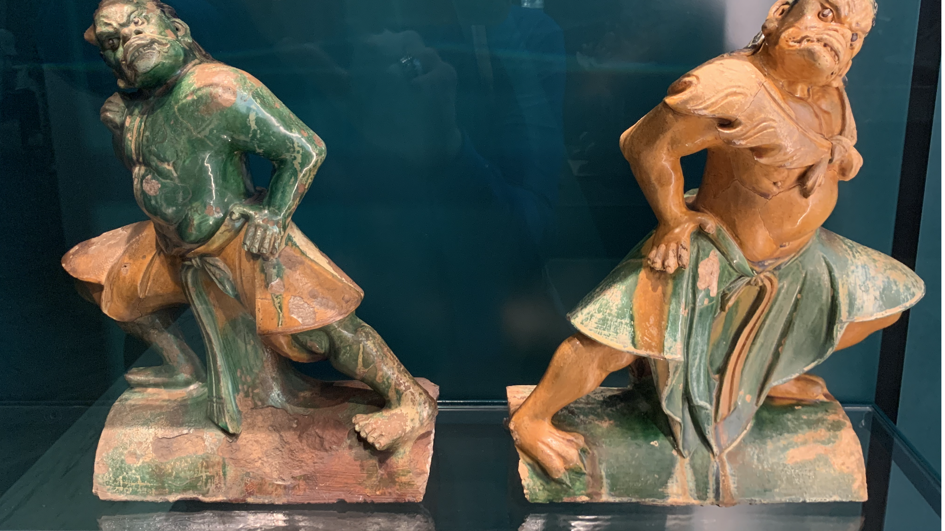
Crossing the Streams/Fording the River

Slide 6

Due Diligence and Risk
Generally: “a process or effort to collect and analyze information before making a decision.”
Risk mitigation (against a liability standard)
  Legal Risk
  Business Risk
  Financial Risk
  Compliance Risk
  Political Risk
Due Care
  All phases of economic activity
  Internal/external
  Costing/impacts

Slide 7

UNGP as Aligned Parallel Risk-Reg Structures
Reading Pillars 1-2-3 as interlinked interpenetrating institutional frameworks
  Structural coupling among functionally differentiated institutional actors that together constitute the aggregated sum of human social relations
Due diligence Runs through this
  Pillar 1
    Macro regulation; coordination; and guidance function within territories
    Supra coordination through international institutions and private actors
  Pillar 2
    Micro regulation; coordination; and guidance function within the territories of global production
    Supra coordination through transnational alignments with NGOs, IOs, and states
  Pillar 3
    State coordinated systems of interlocking remedial mechanisms (judicial, administrative, data-based accountability)

Slide 8

The Framing Ideology
Prevent-Mitigate-Remedy
  Transposing public administrative culture sensibilities or embedding accountability and avoiding free riding
    Governing risk and value in business decision making (administrative and process-centered)
      endogenous
    Imposing conduct rules and interdictions (traditional norms and command-prosecution-centered)
      exogenous.

Slide 9

HRDD Mediating Between Prevention-Mitigation-Remedy
Central Contradiction between Markets and Management
  Markets based bottom-up decisions and centrally planned or guided top-down choices;
    Issue of line drawing
    Focus on post facto compensation
    Longer term—mitigation
    Prevention—longest term and in the public realm
  The ideology and construction of profit (public and private) as the foundational rationalizing premise
  Management compliance based with state as te critical shareholder
  Centralizing or privatizing standards and standard setting functions.
    State based public versus private and 3rd party
      Tolerance of markets for private standards
        Eg NGO and for-profit institutions
      Or markets for national public standards
        Eg German mHRDD
  The ideology of compliance and public profit (value to the political collective)
    Compliance as a norms based “golden share”

Slide 10
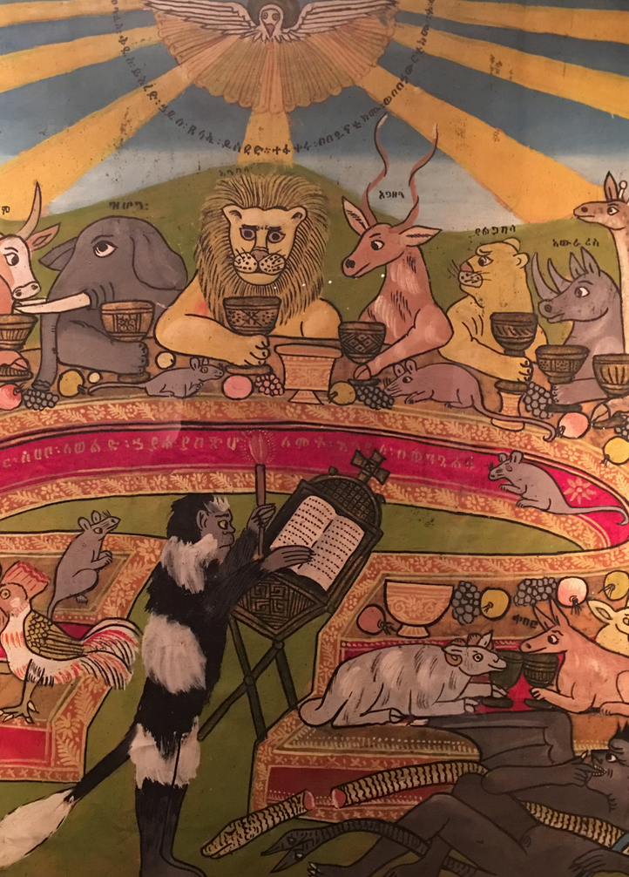
From Principled Pragmatism to HRDD
Principled pragmatism
  “an unflinching commitment to the principle of strengthening the promotion and protection of human rights as it relates to businesses, coupled with a pragmatic attachment to what works best in creating change where it matters most—in the daily lives of people.” (Ruggie 2006 Report; ¶81)
“[C]ompanies are constrained not only by legal standards but also by social norms and moral considerations . . . Each has standards” (Ibid., ¶ 70)
“[T]he State duty to protect against non-State abuses is part of the very foundation of the international human rights regime. The duty requires States to play a key role in regulating and adjudicating abuse by business enterprises or risk breaching their international obligations” (Ruggie 2007 Report ¶ 18)

Slide 11
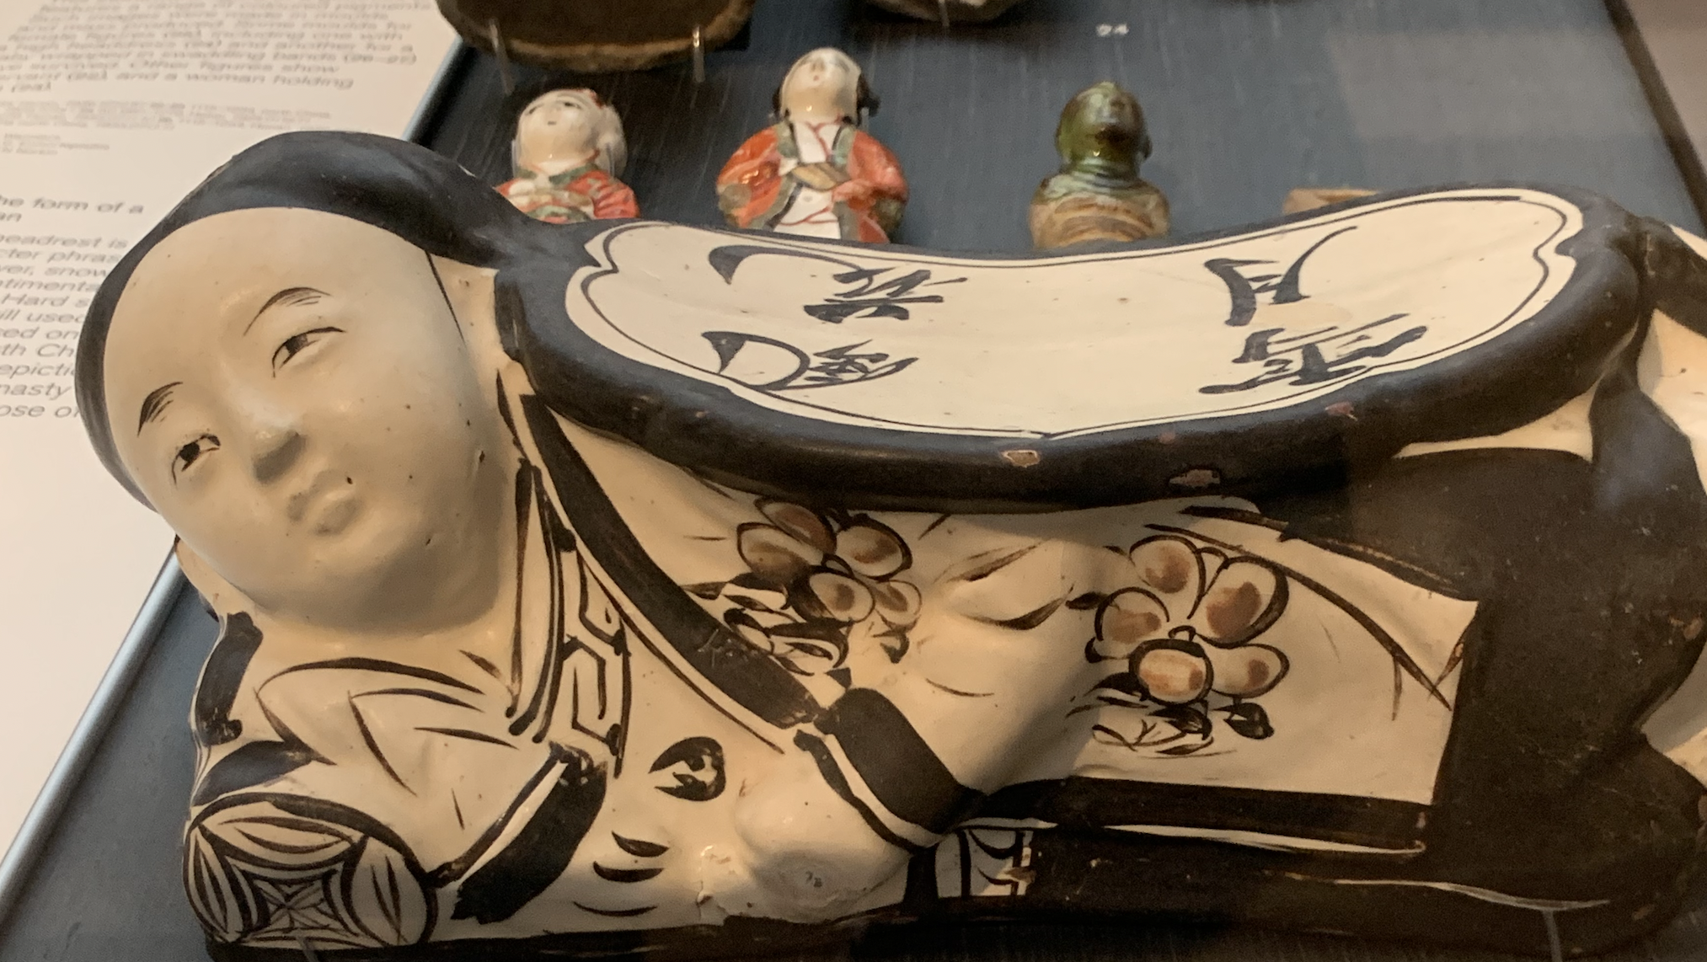
From Goal to Structure

Slide 12

Chapeaus--The UNGP General Principles
Apply to all States and to all business enterprises, both transnational and others, regardless of their size, sector, location, ownership and structure.
Should be understood as a coherent whole and should be read, individually and collectively, in terms of their objective of enhancing standards and practices with regard to business and human rights so as to achieve tangible results for affected individuals and communities, and thereby also contributing to a socially sustainable globalization.
Should NOT be read as creating new international
law obligations, or as limiting or undermining any legal obligations a State may have undertaken or be subject to under international law with regard to human rights.
Should be implemented in a non-discriminatory manner.
Grounded in recognition of:
  (a) States’ existing obligations to respect, protect and fulfil human rights and fundamental freedoms;
  (b) The role of business enterprises as specialized organs of society performing specialized functions, required to comply with all applicable laws and to
  respect human rights;
  (c) The need for rights and obligations to be matched to appropriate and effective remedies when breached.

Slide 13

The Hard Shell of the 1st Pillar
The 1st Pillar framed around primacy of international law WITHIN STATE OPERATIONS
    Hard Law that penetrates (the UNGP itself etc.)
    Hard law that does not penetrate (International Law binding on states)
    Soft Law that Guides and affects outward behaviors: (UNGPs)
Transposition Mechanics:
  From international law to National Rights in law
  Alignment of (1) internal compliance regimes, (2) political pressure, and (3) alignments of state external commitments against internal rights structures
    Capacity.
    Compliance (administrative oversight)
    Political and Compliance Risks
    Oversight Risk
    Complicity/Collusion
    The Normative politics of human rights

Slide 14

Masks of Complexity
The 2nd Pillar framed around primacy of international norms WITHIN OPERATIONS
    Soft law; hard norms (the UNGP itself etc.)
    Hard law; soft norms (International Law binding on states)
    Law from remedies: widening the portal to remedial organs for individuals (judge made regulation through deep webs of interconnected decision-making)
Transposition Mechanics:
  Primacy argument is not strictly a matter of public law
  Alignment of (1) compliance regimes, (2) market pressure, and (3) private law
    The framing is built into the operations of economic collectives that are themselves, in some respects, a nexus of contracts and control relationships.
    MARKETS: International norms: Soft on the outside (with respect to states); hard on the inside of production chain management(with respect to private law)
    STATES: From contract to compliance: hard on the outside (regulation); soft n the inside (through data and disclosure-based disclosure regimes.
    INDIVIDUALS: the rise of human rights and sustainability torts.
Danza del Diablo; Ciudad de Panamá

Slide 15

Consequences
Spillover
  Into the state’s 1st Pillar duty
  Legalization of 2nd Pillar itself
    Through international legally binding instruments
    National Law
Transpositions
  From HRDD to mHRDD
  Embedded in ESG

Slide 16

The Challenges
Narrow view of the “legal”
  Regulation: soft and hard
  Non-regulatory measures: (1) administrative discretionary guidance subject to regulatory objectives; (2) markets guidance based on consumption
  The new frontier: automated and machine based nudging regulation
Silo approaches to regulation-management
Zero Sum-ism
  Oppositions
    between state and market
    between national and international
    Between the territories of production and of politics
  The problem of profit
  The fear of valuation and tensons between tort and administrative approaches to remedies
The risks
  Return to the governance gaps pre-2011
  The rise of the state and regulatory fracture (commodification of law in production)
  The development of zones beyond regulatory reach
  Coherence issues

Slide 17

Conversations between the Harder 1st and Softer 2nd Pillar

Slide 18
Duty Versus Responsibility
Pillar 1--UNGP 1; 2
  “States must protect against human rights abuse within their territory and/or jurisdiction”
    WHAT: “requires taking appropriate steps to prevent, investigate, punish and redress such abuse
    HOW: “through effective policies, legislation, regulations and adjudication” (UNGP 1)
  COMPLIANCE: “States should set out clearly the expectation that all business enterprises domiciled in their territory and/or jurisdiction respect human rights throughout their operations.” (UNGP 2)
Pillar 2--UNGP 11; 12; 14
  “Business enterprises should respect human rights.” (UNGP 11)
    WHAT: “This means that they should avoid infringing on the human rights of others and”
    HOW: “Should address adverse human rights impacts with which they are involved.”
  The responsibility to respect human rights requires that business enterprises (UNGP 12):
    (a) Avoid causing or contributing to adverse human rights impacts through their own activities.
    (b) Seek to prevent or mitigate adverse human rights impacts that are directly linked to their operations, products or services by their business relationships, even if they have not contributed to those impacts.
  The responsibility of business enterprises to respect human rights applies to all enterprises regardless of their size, sector, operational context, ownership and structure (UNGP 14):
    May affect means through which enterprises meet that responsibility

Slide 19
Hard & Soft Legal Foundations
Pillar 1—UNGP 3; 4
  States should:
    (a) Enforce laws that are aimed at, or have the effect of, requiring business enterprises to respect human rights, and periodically to assess the adequacy of such laws and address any gaps;
    * * *
    (d) Encourage, and where appropriate require, business enterprises to communicate how they address their human rights impact (UNGP 3)
  States should take additional steps to protect against human rights abuses by business enterprises that are owned or controlled by the State, or that receive substantial support and services from State agencies such as export credit agencies and official investment insurance or guarantee agencies, including, where appropriate, by requiring human rights due diligence.
Pillar 2—UNGP 11
  internationally recognized human rights – understood, at a minimum, as those expressed in the
    International Bill of Human Rights and
    The principles concerning fundamental rights set out in the International labour Organization’s Declaration on Fundamental Principles and Rights at Work

Slide 20
POLICY OPERATIONLIZATION
PILLAR 1—UNGP 3; 5
States should:
  * * *
  (b) Ensure that other laws and policies governing the creation and ongoing operation of business enterprises, such as corporate law, do not constrain but enable business respect for human rights;
  (c) Provide effective guidance to business enterprises on how to respect human rights throughout their operations;
  (d) Encourage, and where appropriate require, business enterprises to communicate how they address their human rights impact (UNGP 3)
States should exercise adequate oversight in order to meet their international human rights obligations when they contract with, or legislate for, business enterprises to provide services that may impact upon the enjoyment of human rights.
PILLAR 2—UNGP 15
Business enterprises should have in place policies and processes appropriate to their size and circumstances, including:
  a) A policy commitment to meet their responsibility to respect human
  rights;
  (b) A human rights due diligence process to identify, prevent, mitigate
  and account for how they address their impacts on human rights;
  (c) Processes to enable the remediation of any adverse human rights
  impacts they cause or to which they contribute

Slide 21
The Soft Law of Policy Coherence
Pillar 1—UNGP 6; 8; 9
  PUBLIC LAW: States should ensure that governmental departments, agencies and other State-based institutions that shape business practices are aware of and observe the State’s human rights obligations when fulfilling
  their respective mandates, including by providing them with relevant information, training and support. (UBGP 8)
  PRIVATE LAW: States should promote respect for human rights by business enterprises with which they conduct commercial transactions. (UNGP 6)
  INTER-STATE POLICY: States should maintain adequate domestic policy space to meet their human rights obligations when pursuing business-related policy objectives with other States or business enterprises, for instance through investment treaties or contracts. (UNGP 9)
Pillar 2—UNGP 15; 16
  In order to meet their . . . enterprises should have in place policies and processes . . . , including:
    (a) A policy commitment to meet their responsibility to respect human rights;
    (b) A human rights due diligence process to identify, prevent, mitigate and account for how they address their impacts on human rights;
    (c) Processes to enable the remediation of any adverse human rights impacts they cause or to which they contribute
  As the basis for embedding their responsibility to respect human rights, business enterprises should express their commitment to meet this responsibility through a statement of policy that:
    (a) Is approved at the most senior level of the business enterprise;
    (b) Is informed by relevant internal and/or external expertise;
    (c) Stipulates the enterprise’s human rights expectations of personnel, business partners and other parties directly linked to its operations, products or services;
    (d) Is publicly available and communicated internally and externally to all personnel, business partners and other relevant parties;
    (e) Is reflected in operational policies and procedures necessary to embed it throughout the business enterprise.

Slide 22
The Hard & Soft Law of Diligence
Pillar 1 UNGP 7; 9; 10 (Heighted Diligence and Compliance)
  STATE TO STATE: States should maintain adequate domestic policy space to meet their human rights obligations when pursuing business-related policy
  objectives with other States or business enterprises, for instance through investment treaties or contracts. (UNGP 9)
  STATE BUSINESS NEXUS: States should promote respect for human rights by business enterprises with which they conduct commercial transactions. (UNGP 6)
Pillar 2—UNGP 17-22 (HRDD)
  In order to identify (UNGP 18), prevent, mitigate (UNGP 19) and account (UNGP 20) for how they address their adverse human rights impacts, business enterprises should carry out human rights due diligence. The process should include assessing actual and potential human rights impacts (UNGP 21), integrating and acting upon the findings, tracking responses, and communicating how impacts are addressed. Human rights due diligence:
    (a) Should cover adverse human rights impacts that the business enterprise may cause or contribute to through its own activities, or which may be directly linked to its operations, products or services
    by its business relationships;
    (b) Will vary in complexity with the size of the business enterprise, the risk of severe human rights impacts, and the nature and context of its operations;
    (c) Should be ongoing, recognizing that the human rights risks may change over time as the business enterprise’s operations and operating context evolve

Slide 23
The Law of Soft Interventions in Production
Pillar 1—UNGP 7; 10
RULES BASED MULTILATERALISM (the” common reference point” principle): States, when acting as members of multilateral institutions that deal with business-related issues, should:
  (a) Seek to ensure that those institutions neither restrain the ability of their member States to meet their duty to protect nor hinder business enterprises from respecting human rights;
  (b) Encourage those institutions, within their respective mandates and capacities, to promote business respect for human rights and,where requested, to help States meet their duty to protect against human rights abuse by business enterprises, including through technical assistance, capacity-building and awareness-raising;
  (c) Draw on these Guiding Principles to promote shared understanding and advance international cooperation in the management of business and human rights challenges.(UNGP 10)
CONFLICT ZONES: Because the risk of gross human rights abuses is heightened in conflict-affected areas, States should help ensure that business enterprises operating in those contexts are not involved with such abuses, including by:
  (a) Engaging at the earliest stage possible with business enterprises to help them identify, prevent and mitigate the human rights-related risks of their activities and business relationships;
  (b) Providing adequate assistance to business enterprises to assess and address the heightened risks of abuses, paying special attention to both gender-based and sexual violence;
  (c) Denying access to public support and services for a business enterprise that is involved with gross human rights abuses and refuses to cooperate in addressing the situation;
  (d) Ensuring that their current policies, legislation, regulations and enforcement measures are effective in addressing the risk of business involvement in gross human rights abuse. [UNGP 7 (ESG)]
Pillar 2—UNGP 23; 24
NUDGING AND COMPLIANCE: 23. In all contexts, business enterprises should:
  (a) Comply with all applicable laws and respect internationally recognized human rights, wherever they operate;
  (b) Seek ways to honour the principles of internationally recognized human rights when faced with conflicting requirements;
  (c) Treat the risk of causing or contributing to gross human rights abuses as a legal compliance issue wherever they operate. (UNGP 23)
RISK ALLOCATION, PRIORITIZATION; BALANCING: Where it is necessary to prioritize actions to address actual and potential adverse human rights impacts, business enterprises should first seek to prevent and mitigate those that are most severe or where delayed response would make them irremediable. (UBGP 24)

Slide 24

Soft and Hard Remedial Measures

Slide 25
Semi-Firm: Compliance and Remediation
Pillar 1—UNGP 25, 27
  As part of their duty to protect against business-related human rights abuse, States must take appropriate steps to ensure, through judicial, administrative, legislative or other appropriate means, that when such abuses occur within their territory and/or jurisdiction those affected have access to effective remedy. (UNGP 25)
  States should provide effective and appropriate non-judicial grievance mechanisms, alongside judicial mechanisms, as part of a comprehensive State-based system for the remedy of business-related human rights abuse. (UNGP 27)
Pillar 2—UNGP 22, 29
  Where business enterprises identify that they have caused or contributed to adverse impacts, they should provide for or cooperate in their remediation through legitimate processes (UNGP 22)
  Business enterprises should establish or participate in effective operational-level grievance mechanisms for individuals and communities who may be adversely impacted (UNGP 29)
  Industry, multi-stakeholder and other collaborative initiatives that are based on respect for human rights-related standards should ensure that effective grievance mechanisms are available (UNGP 30)

Slide 26

Remedial Variegation
Administrative
  Protect systemic integrity
  Compliance and accountability oriented
  Institutionally focused
    Punitive: civil fines , criminal etc.
    Solidarity building: capacity building, guidance etc.
Breach Oriented
  Compensatory
    human rights and sustainability torts with individual and measurable effects
    Post facto
  Injunctive
    Ex ante
    Prevent harmful acts
    Ties back to compliance and supervision
UNGP suggests interweaving of both tracks
  Folds back to Pillars 1-2

Slide 27
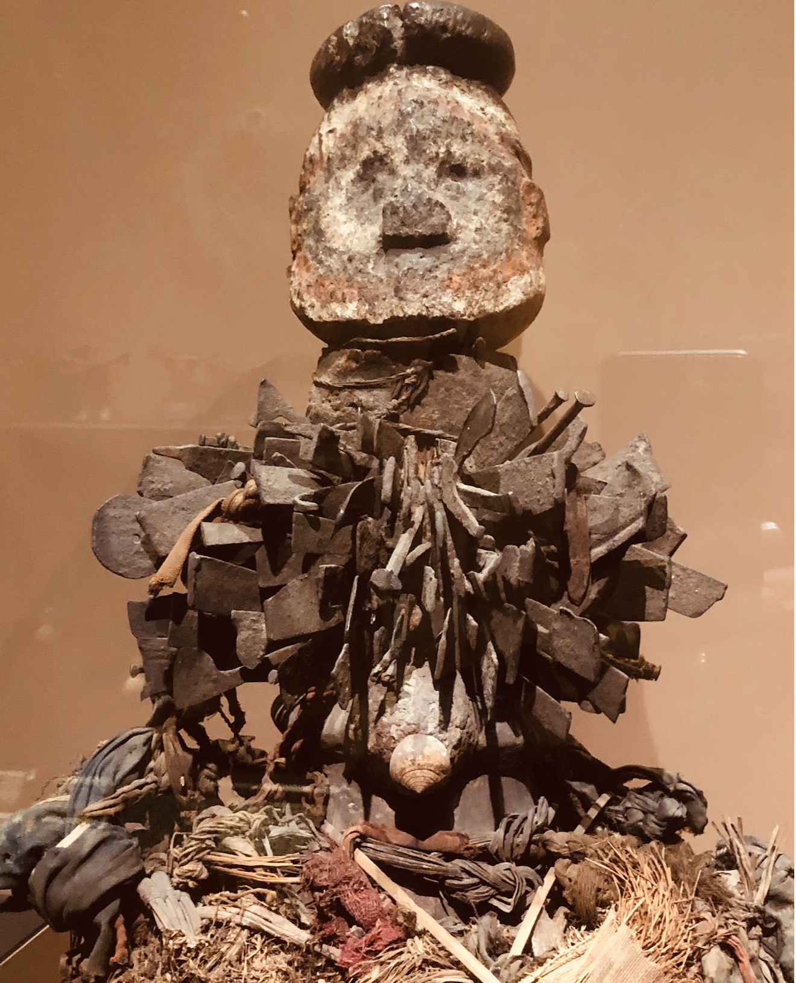
Interweaving Hard and Soft Law—
The Soft Edges of the Hard Law of mHRDD

Slide 28

What is Going on Here?
There are no clear divisions:
    between hard and soft OR
    between public and private law
    Between regulatory and admirative (compliance; guidance; accountability) measures
All 3 pillars are built on interaction between
    national, international, public and private law,
    together with administrative guidance and broad discretionary authority to meet objectives
The UNGP as a framework for legal inter-penetration
    Vertical (internal and external):
      Optimality through structural coupling and core functional autonomy
    Horizontal (internal and external):
      Encourages polycentric transnational (legal) ordering

Slide 29
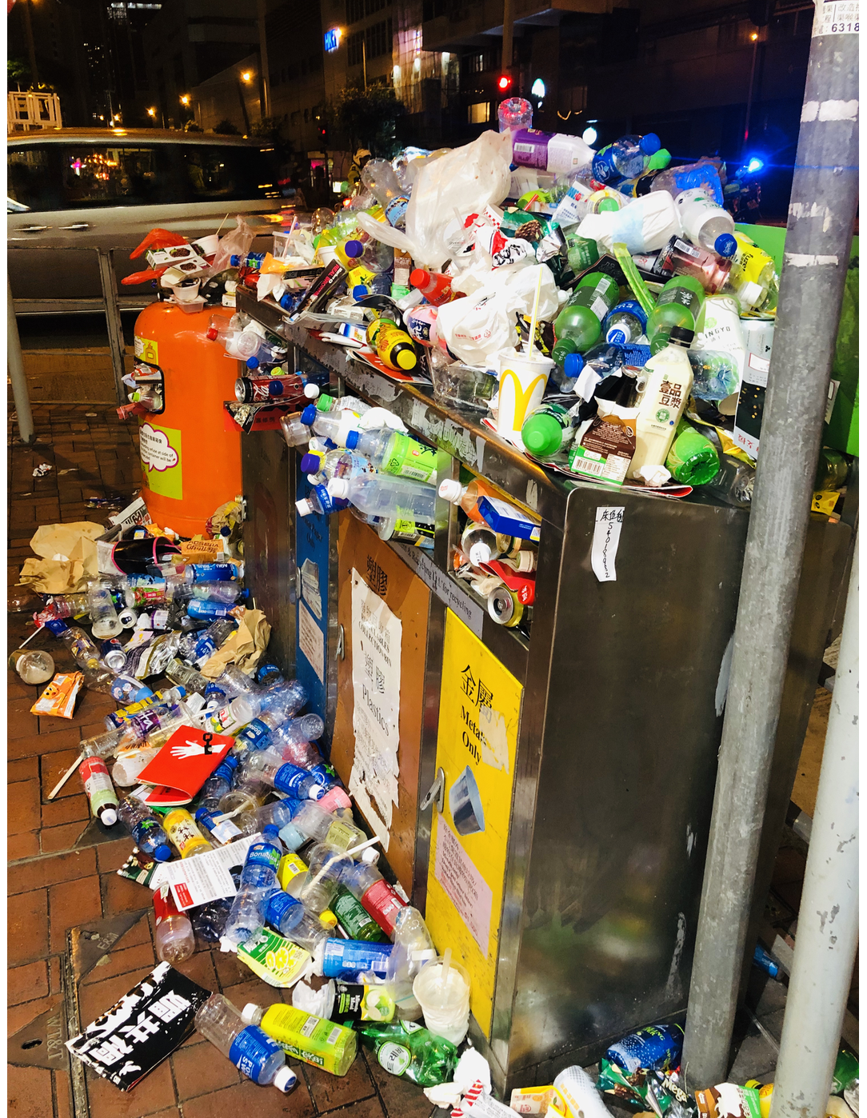
Interpenetrations
1st Pillar Administrative Legalities
  Create Norms
  Capacity building
  Coordination upwards and downward
2nd Pillar Enterprise Operationalization
  Create systems
  Effective operation
  Quality control and reporting
3rd Pillar Civil-Juridical Disciplines
  Civil penalties (system integrity)
  Rights vindication (ex ante; post facto)

Slide 30

Questions/Discussion

Slide 31
Thanks!

