Slide 1
The Just Transitions of Risk—Human Rights, Sustainability and the ESG Wars
Larry Catá Backer (白 轲)
W. Richard and Mary Eshelman Faculty Scholar Professor of Law and International Affairs; Pennsylvania State University
Presentation at Just Transitions and International Law Conference
7-8 September 2023
University of Dundee, Scotland, 13 February 2023

Slide 2
ESG as Object; Method; and Fetish
Objective
To consider the discursive and operational complexities of ESG
Normative battlefields of
principles of finance,
valuation,
risk, and
corporate purpose
Discursive Framing
ESG as objectification of risk
ESG as methods of valuation
ESG as Fetish
Transforming corporate purpose through valuation
Transforming the system of markets based and profits fueled first principles of organizing collective economic activity

Slide 3
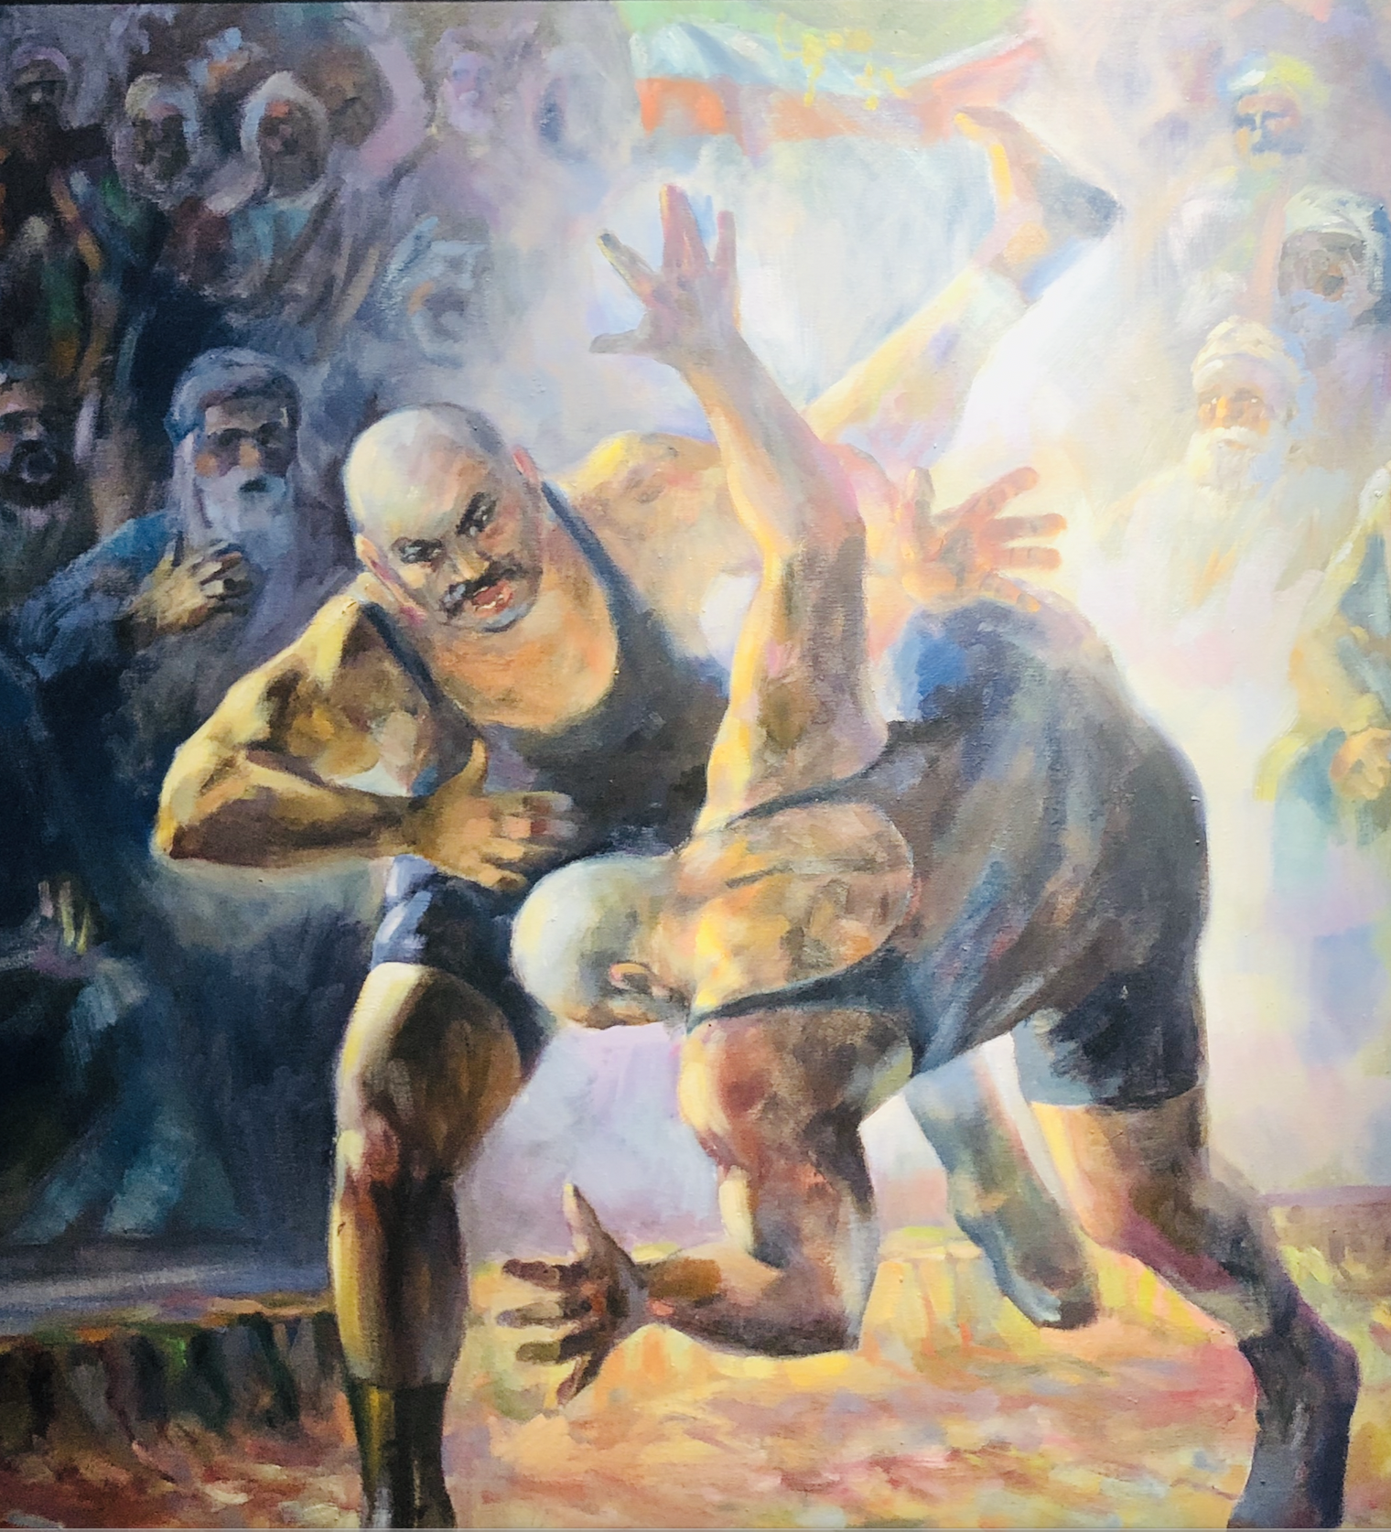
What’s the Fuss?
Risk or Impact?
ESG has evolved
from a means of broadening risk assessment
into a tool for alignment with normative agendas around the shape and operation of economic activity (impacts)
The ideologies embedded in ESG have sparked strong reaction
An attack on markets and primacy of profit principle?
A refinement of compliance principles?
More realistic risk-pricing model to enhance profit based economic activity?
The fight for the control of the narrative of ESG and its use
Highly contested
In the US it has now migrated to the courts

Slide 4
Risk, Valuation, and Responsibility

Slide 5
In the Beginning
Current Framing: 2004 UN Report; Who Cares Wins (focus on financial market actros)
“The institutions endorsing this report are convinced that in a more globalised, interconnected and competitive world the way that environmental, social and corporate governance issues are managed is part of companies’ overall management quality needed to compete successfully. Companies that perform better with regard to these issues can increase shareholder value by, for example, properly managing risks, anticipating regulatory action or accessing new markets, while at the same time contributing to the sustainable development of the societies in which they operate. Moreover, these issues can have a strong impact on reputation and brands, an increasingly important part of company value.”

Slide 6
Brief Background: ESG
Assessing finance risk (and thus cost of capital) in private markets
Possibilities:
a decision-making device for internal operations and choice and manner of engaging in transactions
Operational framing
Expression of prevent-mitigate-remedy (Risk) principles
risk framing
Means of operationalizing sustainability and human rights measures in economic activity
Objectives framing
Human versus bio-diversity centered
System framing
Development versus individual centered
Stakeholder privileging framing

Slide 7
How is it Used?
Investment and reporting
Grounded in specific objectives relevant to time, space and place
Indirect regulatory effect:
Companies conform to ESG expectations to remain in their investment universe
“According to an industry report from US SIF Foundation, investors held $17.1 trillion in assets chosen according to ESG principles in 2020, up from $12 trillion just two years earlier.1 ESG-specific mutual funds and ETFs also reached a record $400 billion in AUM in 2021, up 33% from the year before. . .” (Investopedia)
RATINGS: “100 Best ESG Companies 2021”

Slide 8
The E-S-G in ESG
Environmental
Ecologies/Environment/
SDGs/Climate policies
Bio-diversity; Climate change
Social
Human rights
Societal and workplace focused
SDGs (internal/external stakeholders)
Health and safety
Governance
Capacity (systems)
Compliance
Transparency
Internal governance (Board diversity; executive pay; corruption)

Slide 9
Coherence Challenges
Definitions
Methods of Assessments
Quality of data
Applications
Scalability
Comparability
Liability-consequences
Pix CFA Institute

Slide 10
Regulatory Challenges
Regulatory competition
EU
(e.g. Corporate Sustainability Reporting Directive (CSRD) (5 January 2023 and its European Sustainability Reporting Standards (ESRS) to be developed by the EFRAG, a "private association established in 2001 with the encouragement of the European Commission to serve the public interest "; and also the Non-Financial Reporting Directive (NFRD)).
Global Reporting Initiative (GRI)
Mullti-stakeholder standards
Sustainability Accounting Standards Board (SASB)
identify the subset of environmental, social and governance issues most relevant to financial performance and enterprise value for 77 industries.
Incompatible standards
Competition
Complementarity
Global ESG Disclosure Standards for Investment Products Handbook (including review of 125 regulations, principles, codes, standards, guides, reports, white papers, methodologies, classifications, labels, assessment tools, and questionnaires).
Pix Credit GRI (here)

Slide 11
External Risk—Rating Investment
Rating investment
Transpose SWF practice
Include in investment universe
Means of adjusting costing of capital
Eg Trillium Asset Management
“No go” companies (private prisons, etc.)
Ratings based positive criteria
Focus on identification judged against an ideal
Legal compliance
Reduce business and social risk
Fidelity International
Fidelity International

Slide 12
External Risk—Compliance
From identifying risk to using risk assessment to further normative aims (from passive to active)
Risk identification produces judgment for action
SWF Model—active shareholding to induce internal changes, or divestment
From hard to soft law compliance
Standards as a goal
Articulated through Int’l soft law instruments
EU Regulation
US Permissive use and disclosure

Slide 13
Beyond Finance—ESG and Operational Impacts Assessments

Slide 14
Internal Corporate Operations
Risk Assessment
Risk as action triggers (the effects of risk)
Risk based surveillance, monitoring, and reporting

Slide 15
Internal Tool: Project Risk
ESG risk factors for project
Risk mitigation strategies
What does mitigation mean?
Balancing
Financial objectives
Social objectives
Political objectives (SOEs and Private entities)
Issue prioritization among
Prevention
Mitigation
Remedy

Slide 16
Internal Tool: Operational (Systemic) Risk
Compliance and Reporting regimes
Identification of risk markers
Contextual analysis
Risk
Avoidance or correction
Effect on Valuing or costing operations
Governmentalization of the enterprise
Are all entities SOEs now?
State Owned Versus State Controlled entities
Risk.net

Slide 17
Internal Tool: Global Production Chain Risks
Hardening of markets driven guidance through soft law regimes
Complicity as risk
Complicity in or of what?
Balancing and prioritizing risk
PRI

Slide 18
ESG and the Great Capitalist Revolution

Slide 19
Does ESG Have an Ideology
There is a suggestion that ESG is economics not ideology
Yet that misses the point
Economics is itself an expression of ideology
Providing the foundational principles and assumptions on which its lens can develop self referencing rationalization
ESG is a vessel
For risk assessed against objectives
For impact assessed against ideal states
Contests over ideology is reflected in current debate
Traditional financial objectives centered on firm
Liberal democratic social objectives grounded on human rights/environment
Marxist-Leninist/Developing States objectives based on development, security, and sustainability

Slide 20
From Purpose to Ideology; From Ideology to Fetish
Purpose:
Operations: Risk measuring device for specific contingencies in production of goods and services(company centered);
Impacts: measuring risk toward specific normative ends; guiding the conduct of economic activity through impacts assessments (community or externally centered)
Ideology
Privileging markets (micro) decision making and individual autonomy through transactions (level playing field, true costing, transparency)
Privileging Administrative compliance structure that views markets as a tool of public policy
Fetish
ESG as sloganeering for re-imagining collective ideology of economic production
Form of projecting these ideologies within systems
Piecemeal revolution; using the system against itself
Viktor Deni (1920), “either death to capitalism, or death under the foot of capitalism” Pix Credit here

Slide 21
ESG and the “New Capitalism”: A Fetish Object
Wrapped in a sloganeering of a re-imagined “capitalism” fashionable among propertied elites and their staffs
Davos Manifesto 2020: The Universal Purpose of a Company in the Fourth Industrial Revolution.
“A company is more than an economic unit generating wealth. It fulfils human and societal aspirations as part of the broader social system. Performance must be measured not only on the return to shareholders, but also on how it achieves its environmental, social and good governance objectives.” (Manifesto § B).
22 Core metrics; 34 aspirational metrics

Slide 22
From Law and Mores to the Law of Mores
Marxist-Leninist Systems
Public; State directed
Aligned to the core objectives of the vanguard party and its basic line
Embedded within the current stage of history and its principal contradiction
Today: Core Socialist Values; Development, Stability
Liberal-Democratic
Private; Directed through finance hierarchies
Embedded within the private sector of public administrative structures
Today “social justice” and “sustainability”

Slide 23
Contradictions of Risk
Compliance oriented risk
Administrative risk: The primary purpose of business is to comply with mandatory obligations (prevent-mitigate-prevent) and achieve public purposes
VERSUS
Business risk: primary purpose is micro—enhancing entity value as a going concern; based on balancing gain net of costs of remedying harms (return net of compensation for unavoidable harm as a function of return)
Objectives oriented risk
M-L and post colonial: privileging development and anti-poverty measures
Liberal democratic privileging rights-based individual and communal harm prevention

Slide 24
From Contradiction and Incoherence to Resistance
Risk as battleground
Proxy for business purpose and the role of economic activity in human political organization
What s Profit and for whose benefit
Identifying fields of battle
Mandatory disclosures
Mandatory action given conclusions
Access to markets
Cost of production
Cost of capital

Slide 25
Summing Up: ESG as Platforms—Producers and Consumers
Consumers
Financial managers
Public agencies
NGOs
Producers
Ratings agencies
Enterprises
NGOs
What is produced/consumed
Assessing finance risk (and thus cost of capital) in private markets
Decision-making device for internal operations and choice and manner of engaging in transactions
An expression of prevent-mitigate-remedy (Risk) principles
Means of operationalizing sustainability and human rights measures in economic activity
Human versus bio-diversity centered
Development versus individual centered

Slide 26
Questions?

Slide 27
Thanks!

