Slide 1

The Cage of the System (制度的笼子里): Standards Setting, National Security Values, Tech Platforms, Regulation, and the Central Contradiction of Legality in the Current Historical Era
Technological Platforms and National Security in Hong Kong: The Domain of Standards Setting
Law and Technology Center and Center for Chinese Law
University of Hong Kong
25 August 2023
Remarks
Larry Catá Backer (白 轲)
W. Richard and Mary Eshelman Faculty Scholar; Professor of Law and International Affairs, Pennsylvania State University

Slide 2

Cages and Domains
Cages
  Standards (integral)
  National Security (horizontal)
  SAR-PRC (vertical)
Domains
  Domus, a house or household or estate
  Dominus—its lord, master, owner, (perhaps 掌握 (Zhǎngwò)
  Dominion (统治 (Tǒngzhì)), implies sovereign rights (主权 (Zhǔquán)).

Slide 3

The Digital Challenge to Analogue Cages
“That is the challenge of producing static rules constructed in ancient and traditionally developed analogue forms—words, text, objectives bound up around systems of administrative discretion ultimately exercised by technical and political officials in complex interlocking organizational frameworks—in an evolving environment in which the domains are virtual and the effective forms of regulation are digital and dynamic as to space, time, and place.”

Slide 4

Domains, Interludes, and Contradiction
Interludes: spaces (physical/cognitive/discursive/expressive) between normative orders; between modes of communicating/cognition/legalities (water-land-water)
Dialectical contradiction: iterative engagement between two effects/conditions/forces and their resolution producing a new era with a new principal contradiction (water eroding land-creating new shoreline)

Slide 5
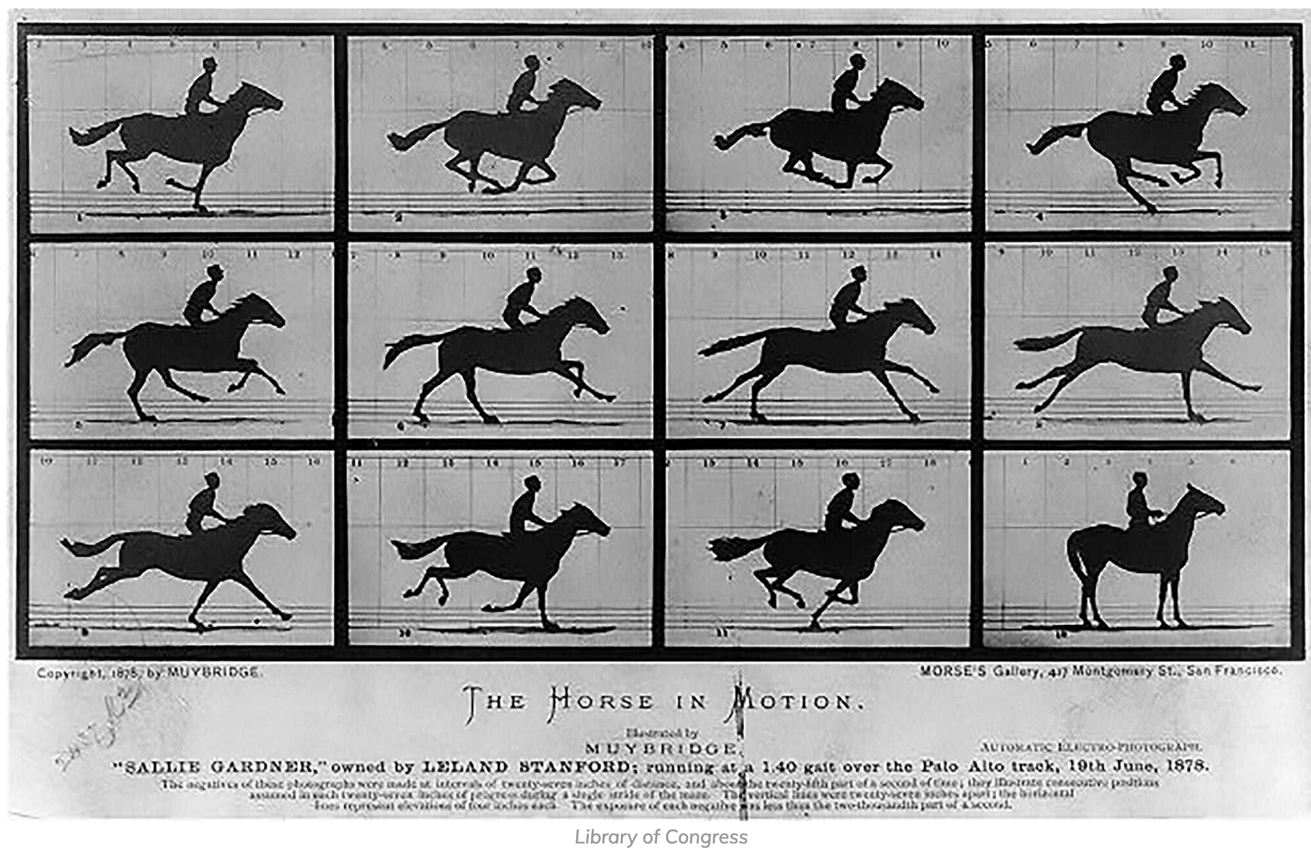
The Cage of Space, Time, and Place
To a large extent, the legal structures that manifest a particular world view and its operationalization in social relations focuses on a picture, that is, on a specific moment of time, space and place. That is the way, for example, a balance sheet is meant to take a snapshot of a dynamic process of production.
These are the spaces between these pictures and static moments that are captured in analog thinking and traditional law Instead focus shifts to the constant movement from picture to picture. That is the way, for example, one approaches the income statement of a financial statement, . . . or perhaps best (and here we come closest to the platform)—to the general ledger

Slide 6

In the face of technology, what might the characteristics of regulatory contradiction, and interlude, consist of?

Slide 7

Wired Legalities and Legalities as Signal
The analog is wired, that is, it is physically connected;
The digital is signal, both in the sense of transmission and in the sense of its flow of iterative actions which give the signal form and to some measure predictability

Slide 8

Legalities as Modes of Transmission
The analog transmits in words and sounds and visual effects, it is grounded in the senses of the physical word centered on humanity;
The digital is code; it transmits through and as code

Slide 9

The Cage of Regulatory Cognition
The analog is housed in carbon-based life forms, principally humans, its essential narcissism is the essence of a self-love that has fueled civilization to date;
The digital is a silicon-based intelligence housed in inorganic casings;

Slide 10

Analog Versus Digital Cages
The analog is structured through norms, rules, presumptions that are elastic though when expressed as text constructs the modern edifice of political collective;
The digital is programmed

Slide 11

Analog Deductivity v. Digital Inductivity
The analog is dialectics, which constitutes the dynamic guts of its programing; it is the essence of deductive processes from the most general to the most specific;
the digital is iterative, which constitutes its own programmatic guts, it is the essence of the inductive processes starting from its data to produce general conclusions.

Slide 12

The Six Core Domains of Analog-Digital Caging
(1) Platforms
(2) Interlinkages between platforms and National Security Law
(3) Legalities of risk
(4) The mediating role of analog-digital standards
(5) National Security Accountability in analog and digital domains
(6) Governance gaps of interconnectivity of regulatory cages in global domain

Slide 13

Assembling the Cage of the System
First, understand the analog and the digital elements of the parts necessary for assembling the cage—national security law (SAR and national), tech platforms, and constitutional norms, scope, objectives, and applications.
Second, understand the way that these parts are to fit together and the effect of discretionary choices about parts in the shape and utility of the cage.
Third, develop a means of aligning analog and digital legalities and their legal subjects. And
Last, undertake these tasks sensitive to the overall leadership of political vanguards whose policy choices will determine the way that these interludes will be bridged, and these contradictions resolved within the cage of the system.

Slide 14
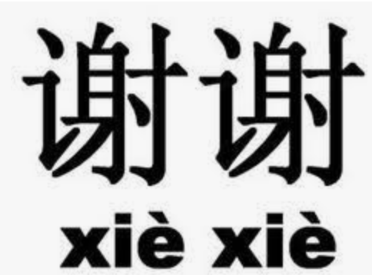
Thank you
Text of these remarks may be accessed here:

