Slide 1
The Semiotics of Democracy and Ideologies of Meaning in Constitutional Orders
Larry Catá Backer W. Richard and Mary Eshelman Faculty Scholar; Professor of Law and International Affairs
Pennsylvania State University
Presented at
Workshop “Wagner-Linhares”
23rd International Roundtables for the Semiotics of Law
Rome, Italy 24 May 2023

Slide 2
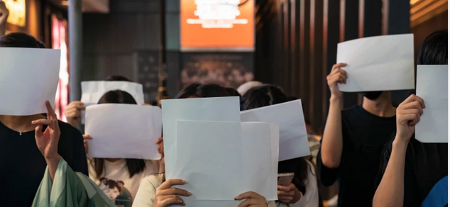
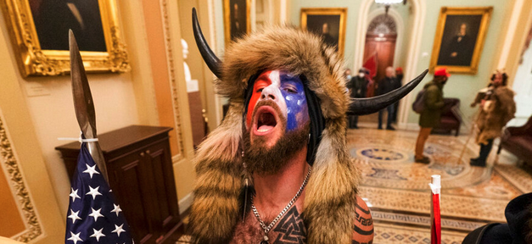
Democracy is in Crisis
The symptoms of that crisis might be found on the streets and in the public institutions of Brasilia, Brussels, Beijing, and Washington.
Its signification may be performed by the masses and their shepherding elites in actions like the 6 January 2020 events and then the Commission inquest
the COVID Lockdown protests in China; but its fundamental character is semiotic

Slide 3
The Democratic Mirror Cracks
Democracy is a language of signification
of collective social relations,
formally expressed in national constitutional orders
within the framing of constitutional internationalism.
Its fundamental signification
the weaving of a conceptual framework within which such expression is constrained,
is expressed in and expresses the semiotically rich language of ideology.
Here the democratic mirror cracks.
Out flew the web and floated wide— The mirror crack'd from side to side; "The curse is come upon me," cried The Lady of Shalott. (Tennyson, The Lady of Shalott (1842))
The ideal has fractured
The weaving is no more;
The signifier--the Lady of Shalott--dies
And in death signifies what remains ↘️

Slide 4
Gladiatorial Contests in the Coliseum of Democratic Semiosis Among Imperial Orders of Signification
Once the mirror cracks the shards become weapons
Democratic ideology as a site for signification of a democratic order.
Looking at some of the shards:
Examination of one of the principal points of fracture
That between the contemporary development of a semiotics of liberal democratic democracy, and that of Marxist-Leninism.
Then sketch the consequences of semiotic fracture on other systems of signification:
human rights, rule of law, the mutual inter-relationship between the individual, state and society, and the nature and character of a rules based international order

Slide 5
Semiotic Building Blocks

Slide 6
The Semiotic Shards of the Democratic Crisis
Dēmokratia/ dēmagōgos
Δῆμος (demos)
People
Κρᾰ́τος/κρᾰτῐ́ᾱ (kratos; kratia)
Strength, power/rule, power of
ᾰ̓γωγός (agōgos)
Leader, guide
Counter Forms
Monarkhia/ Autokrateia
Μόνος (Monos)/ αὐτός (auto)
Alone/self
ἄρχειν (Arkhein)/)/ ἄρχων (Archon) /Κρᾰ́τος/κρᾰτῐ́ᾱ (kratos; kratia)
Rule/to be first/strength, power-rule; power of
Aristokratia
Άριστος (Aristos)
The best/noblest
Κρᾰ́τος/κρᾰτῐ́ᾱ (kratos; kratia)
Strength, power/rule, power of
Oleksandr Balbyshev. Shards

Slide 7
A Closer Look at Some Shard Piles
Demos
Everyone/Patriots/Citizens/Wealthy/Poor/Men/etc.
-Kratia
Direct/Indirect/Through a priesthood of the best, the noblest/Elected; appointed
-Agogos
Guidance: people or law/Ideal or custom/Mandatory or voluntary
Permutations and Combinations of –kratia (κρᾰτῐ́ᾱ) as common thread
Solidarity
Autonomous individual at the center
Autonomous collective at the center
Ordering Objectives
Preserve and protect customs and traditions
Perfect the autonomous individual or collective

Slide 8
The Semiotic Empire of Liberal Democracy

Slide 9
Ideology of Exogenous Democracy
Political parties exist within liberal democracy organized through a government apparatus which exercises political authority;
Parties exist as exogenous to the exercise of political authority vested in state organs.
Political parties contribute to the peopling of representative state organs
Elections as the highest expression of exogenous democracy
Law—protects integrity of elections
Governance—the marketplace of ideas

Slide 10
The Signification of Voting and its Rituals
“The right to vote, to have your vote counted, is the threshold of democracy and liberty everywhere in the world. And with it, anything is possible. Without it, in my view, nothing is possible.”
(Remarks by President Biden at the Summit for Democracy Virtual Plenary on Democracy Delivering on Global Challenges)
The individual at the center of the rituals of democracy
Democracy as the theater within which the rituals of delegation can be performed.
1943 general elections Italy

Slide 11
From Voting to Values
“The great strength of democracy is that it gives us all the tools we need for self-government and self-improvement. And I’m proud to stand with all of you to defend those fundamental values we all share: justice, the rule of law, free speech, assembly, freedom of the press, freedom of religion, and our core belief in the interest of human rights for every single individual in the world.”
(Remarks by President Biden at the Summit for Democracy Virtual Plenary on Democracy Delivering on Global Challenges).
One might better understand liberal democracy theory as the effort to normalize a theory of political organization from out of the principal manifestation of human (individual) rights in the form and from out of the sensibilities of the International Covenant for Civil and Political Rights (operationalized with local and historically current characteristics).

Slide 12
From Values (Signification) to Objectification (Projects)
“Inter alia, the Declaration affirms the endorsing parties’ political commitments to:
--Protect human rights, media freedom, and rule of law;--Ensure accountability for human rights violations and abuses;--Support people, including in Ukraine, who stand for freedom and reject aggression;--Combat all forms of discrimination and exclusion, including by strengthening women’s rights;--Prevent and combat corruption;--Advance technology that works for, and not against democracy;--Defend against transnational threats, including foreign malign influence and foreign information manipulation;--Support free and fair elections; and --Address global challenges, including sustainable development, climate change, global health, and food security. “
(Media Note Summit for Democracy Declaration).

Slide 13
From Objectification to the Liberal Democratic International
Rules Based International Order and the Pax Americana post 1945
G-7 Communiqué (May 2023) Proffers the managed market
"upholding and reinforcing the free and open international order based on the rule of law, respecting the UN Charter to the benefit of countries, large and small"(Ibid.).
Divided roughly into three parts: (1) principles and shared values; (2) operational objectives; (3) operational policy drivers.
Shared values and principles are built around the concept of the rules based multilateral trading system.
That in turn, is grounded in the centrality of markets, and markets express the space where individuals may exercise a substantial measure of individual autonomy in their social relations. Included in the shared values are universal human rights, gender equality and human dignity and a free and open internal order that rejects territorial expansion by force.
Operational objectives include a longer list that are meant to protect the global trading order, foster management of migration, advance climate change mitigation programs, drive the management of AI, accelerate the achievement of the Sustainable Development Goals, and manage global health regimes (including moves toward universal health coverage).
Operational policy drivers
include support for Ukraine, advancing disarmament and non-proliferation strategies, diversifying and deepening economic relations, including with competitor empires, drive green energy transition, promote food security, and jump start its own grand infrastructure program.

Slide 14
The Semiotic Empire of Marxist-Leninism: Chinese Whole Process Democracy

Slide 15
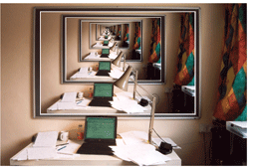
$$Ideology of Endogenous Democracy$$
Marxist-Leninist collectives, the vanguard party, as the leadership core of organized political authority, exists as the organization of political authority itself, which is then administered through state organs and contributing collective organizations; political collectives exist as endogenous organs of governance under the leadership of the vanguard.
Political parties serve as recognized organs of consultative governance administered by state institutions
Though both systems use the same term to describe collective political organization, the ideological basis of the meaning of that term could not produce a greater distance in the way in which meaning is embedded in those terms.

Slide 16
《中国的民主 》(China: Democracy That Works)
One starts by defining the people (patriots) who are object and subject of democracy and democratic legitimacy
(people’s democratic dictatorship). One then divides democratic structures into two distinct institutional venues— the first the National People’s Congress system (Democracy within the administrative apparatus); the second the system of political consultation (Democracy for the masses)
Exogenous element
People’s Congress System as democratic practice within the state apparatus
Voting under vanguard guidance
Endogenous element
CPPCC as central organ of mass collective democratic representative consultation within the political apparatus

Slide 17
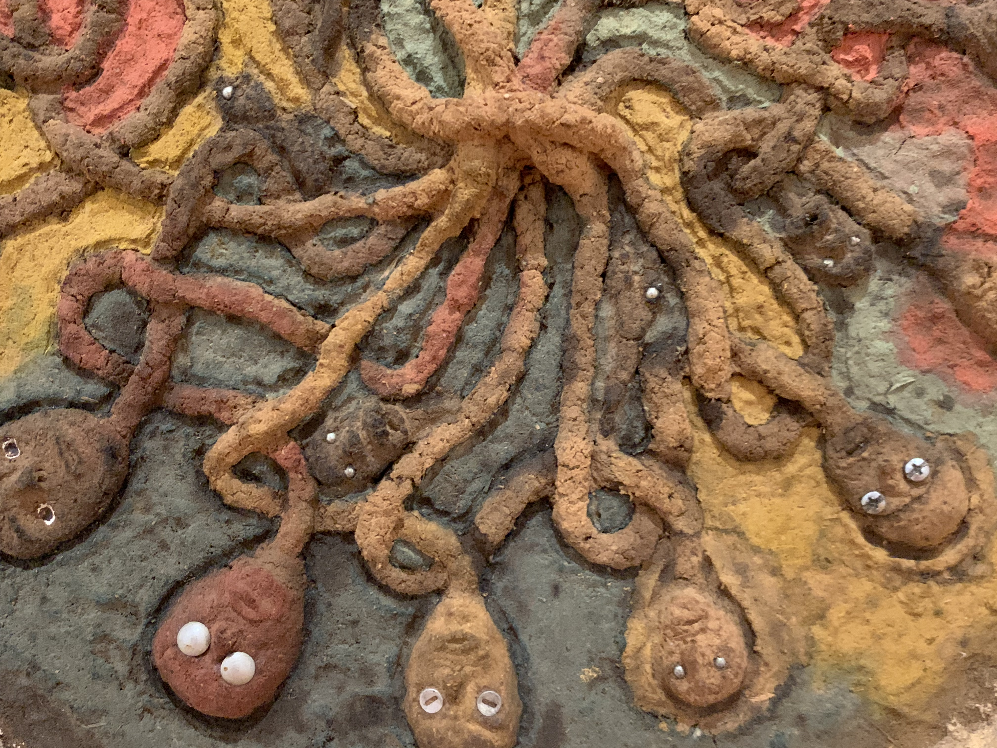
The System
Political collectivization
Institutionalization of political voices of masses
A collective for everything and everyone in a collective
Embedding collectives within structures of consultative democracy
Tight division between leading and consulting
Socialist purity as against liberal democratic corruption
The unique constitution of the Vanguard party
The supra-collective; the embodiment of the leading social forces and
As the holder of stewardship for exercise of political authority in the service of the masses

Slide 18
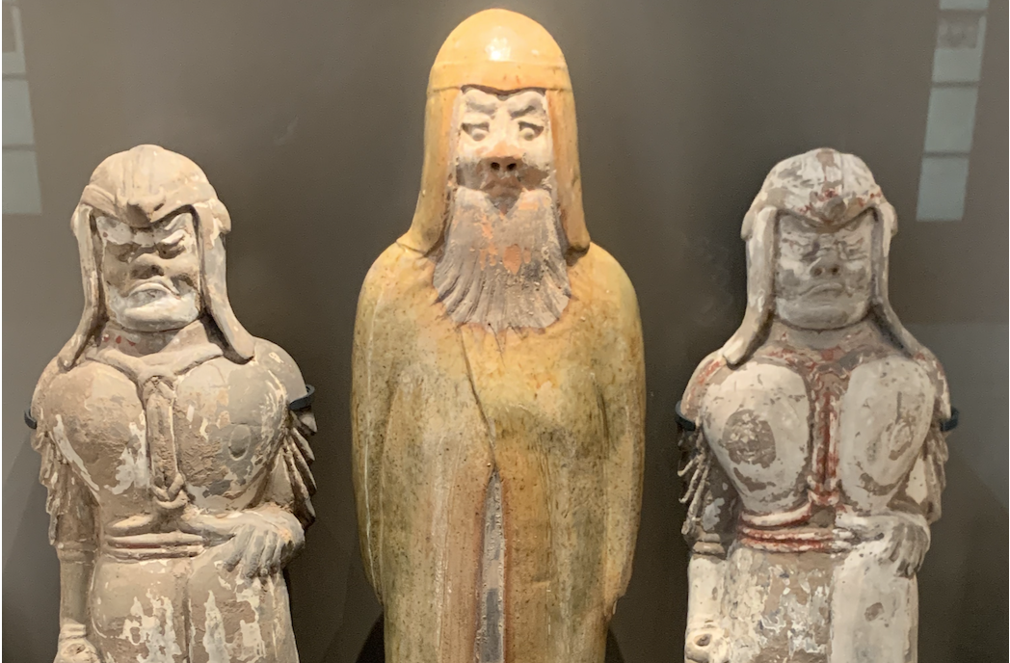
Resolving Two Core Issues of Political Collectivization
Representation: functional differentiation of the masses along lines of recognized mass collectives that in the aggregate represent the entirety of the masses
Nexus point for the implementation of the mass line (群众路线)
Avoid representation gaps
Institutionalization of Consultation: application of the principle of democratic centralism to the institutionalization of the mass line in the relationship between the CPC and mass organizations
Consultation model embeds direct democratic participation and popular representation under the leadership of the CPC; it enhances coordination and consistency; it operationalizes broadly the core principle of people’s democratic dictatorship (人民民主专政) (and the great patriotic campaign)
Supervision function—proper operation of state and monitor individual and administrative lapses
Critical Vessel: Chinese People’s Political Consultative Conference (人民政协)system as central coordinating organ

Slide 19
中国新型政党制度》(China’s New Political Party System)

Slide 21
The Marxist-Leninist (Communist) Democratic International
Belt & Road Initiative
Socialist Human Rights
Collectivization
Vanguardism
Stability and Prosperity with local characteristics
Instrumentalist markets
Managed individual autonomy

Slide 22
Whole Process Democracy in the Shadow of the Liberal Democratic “Other” and “Vice-Versa”

Slide 23
《美国民主情况》 (The State of Democracy in the US)
“Whole-process people’s democracy includes democratic elections, consultations, decision-making, management, and oversight. It integrates process-oriented democracy with results-oriented democracy, procedural democracy with substantive democracy, direct democracy with indirect democracy, and people’s democracy with the will of the state. It is a model of socialist democracy that covers all aspects of the democratic process and all sectors of society. It is true and high quality democracy that works.”
“But what happens in some western countries are quite on the contrary. If the people are awakened only to cast a vote but become dormant afterwards, that is no true democracy. If the people are offered great hopes during electoral campaigning but have no say afterwards, that is no true democracy. If the people are offered fulsome promises during electoral canvassing but are left empty-handed afterwards, that is no true democracy.”
“Whole-process People’s Democracy Is A High Quality Democracy,” Chargé d’Affaires Wang Xining (Chinese Embassy in Australia); 2021-12-11 15:18

Slide 24
The Comparative Critique
The comparison, measuring exercise, is built around three core propositions.
（一）制度痼疾积重难返; (1) The system's chronic defects are difficult to overcome
（二）民主实践乱象丛生; (2) the practice of democracy is chaotic
（三）输出所谓民主产生恶果 (3) exporting the so-called democracy produces evil results.
Bringing the language of class struggle back to the comparative analysis.
Class struggle is still the primary contradiction in the US;
Political parties are incapable of comprehensive representation;
Politics is an expression of capitalist production (quid pro quo operation
Domination by social and financial elite (the liberal democratic vanguard)
Adversarial rather than consensus building system

Slide 25
And from the Other Side
“China’s transformation is due to the talent, the ingenuity, the hard work of the Chinese people. It was also made possible by the stability and opportunity that the international order provides. Arguably, no country on Earth has benefited more from that than China.”
“But rather than using its power to reinforce and revitalize the laws, the agreements, the principles, the institutions that enabled its success so that other countries can benefit from them, too, Beijing is undermining them. Under President Xi, the ruling Chinese Communist Party has become more repressive at home and more aggressive abroad.”
“We see that in how Beijing has perfected mass surveillance within China and exported that technology to more than 80 countries; how its advancing unlawful maritime claims in the South China Sea, undermining peace and security, freedom of navigation, and commerce; how it’s circumventing or breaking trade rules, harming workers and companies in the United States but also around the world; and how it purports to champion sovereignty and territorial integrity while standing with governments that brazenly violate them.”
Antony Blinken, “The Administration’s Approach to the People’s Republic of China” ()26 May 2022)

Slide 26
Democracy’s Semiotic Nightmare

Slide 27
Nightmares of Representation Liberal Democratic /Marxist-Leninist Democracies
The Contradictions of Representation as a Function of Ideology /Marxist-Leninist Democracy
A form of Aristokratia
Rule by the noblest elected by “the people”
A form of oligarkhia
Rule by the few (oligos (few, small, little)
A form of anarkhia
Without a leader
A form of dēmagōgos (δημᾰγωγός)
A blended type
Presidential autocrat
Legislative aristocracy
Courts guardians of polity (demos)

Slide 28
Semiotic Lifeworlds
The meaning and performance of elections,
Affirmation of vanguard choice
Key autonomous individual political act
The meaning and performance of consultation
Decision-making through collectivization of social groups
Post-election structural element; marketplace of politics
The nature of civil and political rights,
Dependent on achieving ESC Rights
Essential to the realization of ESC Rights
The nature of economic, social and political rights
Essential for achieving CP Rights
Dependent on achieving CP Rights
Human rights
Collective development and security
Maximizing individual expression and participation in social and economic relations
Internationalism
Coordination around shared objectives
Convergence around values

Slide 29
What Comes Next?

Slide 30
The Fractured Imaginary and Abstracted Terrains
From discrimination as a basis of social relations to social justice as a rejection of the semiotics of consequential difference as a baseline
Negotiating borderlands of solidarity?
The production of the ideal person the ideal collective
The instrumental role of custom and tradition (whose?)
The new universalism (object-signs)
Global collectivism (Marxist-Leninist imaginaries updated)
Social Justice and equality as apotheosis of the autonomous individual (liberal democracy)

Slide 31
Questions?

Slide 32
Thanks!

