Slide 1
Chinese State-Owned Companies: Congruence and Dissonance in Outbound Investment
Larry Catá Backer (白 轲)
W. Richard and Mary Eshelman Faculty Scholar Professor of Law and International Affairs; Pennsylvania State University
Presentation at Oxford University China Law Center, (Oxford, England) 16 February 2023

Slide 2
Original Sins
The Chinese state-owned enterprise (CSOE) as an anomaly
Dissonance with liberal democratic internationalism
Especially visible in areas business and human rights
Anomaly Effects
Human Rights (1) public law-national versus international law/norms; (2) private law-liberal democratic versus Socialist approaches
Development of principles conduct-based both human and environmental rights system
The Stakes
Control of narratives of business, risk and the way that human rights and sustainability are embedded within it.

Slide 3
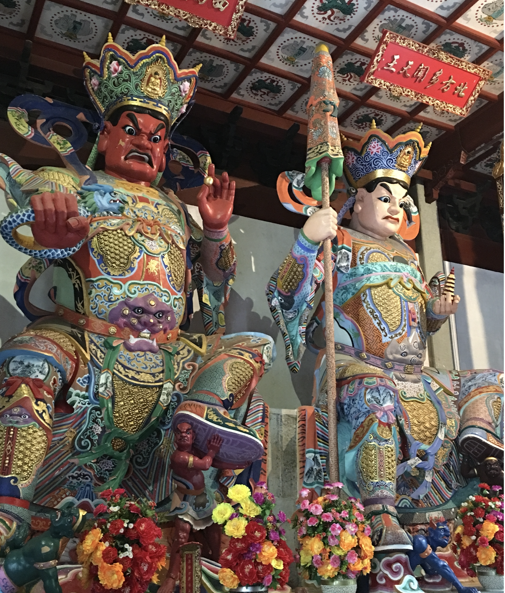
Gods Eating Gods– OR – A Clash of Titans
This essay considers disjunctions where CSOEs are used as vehicles for the projection of Chinese economic activity (and values) beyond its borders
--situates the CSOE within the political ideology of its home state.
--formal structures for CSOE surveillance by state organs that operationalize the guiding ideology
--Outward Projection of that model through the Belt & Road Initiative
--Consequences when systems clash
--WHERE IS THE DIFFERENCE:
Operational versus investment decisions

Slide 4
Post-1945 Structures; Post-1980s Deal
Normative Convergence model
Facilitated through mechanism of UN system and related iOS and increasingly comprehensive web of international (state collective) law/norms
Effectuated through ideologically aligned International Financial Institutions
Operationalized by Interconnection
Free movement of goods, capital, investment
Managed movement of peoples
Driven by Markets
Underscored the primacy of personal autonomy of natural and legal persons
Economic activity essentially privatized; safeguarded by public (collective) policy/law

Slide 5
The State in Markets Driven Globalization
Dual role; two ways
Enlightenment Great Clockmaker
Ideological commitment o protecting the structure and integrity of markets
Ideological commitment to vision of integration/convergence from the bottom up
Open borders with increasingly narrowed exceptions
National security
Cultural identity
Consumer protection
Sovereign protection on state to state sovereign relations
Sovereign as a private entity when engaged in market activities
As investor
As owner or operator of enterprises

Slide 6
Enterprises in States and Global Markets
The market as platform
Consumers and producers of anything of economic value
Core principle of equality—”level playing field”
Cheating
State aids
Anti-competitive private gangs
Equality
National Treatment for foreign entities
Respect for local law BUT pressure for local law to conform to global converging expectations (ideologies)

Slide 7
States as Enterprises—The ‘Other’ Deal
A great wall between state sovereign and economic activity
Sovereign regulatory and political activity confined to governmental and public spaces
Economic activity organized in and through special purpose instrumentalities-the state owned or controlled enterprise (SOE); sovereign wealth fund (SWF) etc..
SOEs/SWFs
To be operated like a private enterprise (OECD principles of SOE Governance)
Primarily economic or financial objectives aligned with those of private firms
Disclosure and transparency to ensure compliance for shareholders, host states, and markets
Consequences
Sovereign activities protected under principles of Sovereign Immunity
Conforming Sovereign economic activity would be permitted global access like private firms (equal treatment)

Slide 8
The Chinese Challenge to Global Orthodoxy
Ideology
Control through regulation and supervision
Economic objectives realized through politics;
Political objectives realized through economics

Slide 9
The Ideology of the State
Core political objective:
To establish a communist society in China.
To that end, a Chinese socialist system was established “governed by a people’s democratic dictatorship.” Xianfa, art. 1 (1982 as amended)
The Socialist system incorporates two key fundamental Leninist principles.
The first is that “leadership by the Communist Party of China is the determining feature of socialism with Chinese characteristics.” (Xianfa art. 1)
The second is that both the CPC and state institutions “shall practice democratic centralism.” (Xianfa art. 3; V.I. )
CSOEs
Instrument for the operationalization of the Socialist system within the ordering of Chinese Marxist-Leninism as expressed through law and implemented under the leadership of the vanguard CPC Xianfa art.1 (1982) (China).
Intermediate step in the realization of core political objective of the state through socialist modernization

Slide 10
The Socialist Market Economy
The grounding principle is the commitment of “socialist public ownership of the means of production.” (Xinfa art. 6)
The exercise of public ownership, direct or indirect, has been subject to consideration development since 1949,
Also constitutionally protected space for a non-state economic sector over which the state exercises oversight and regulation in furtherance of the operation of “the socialist market economy.” (Xianfa art. 11)
In the development of the socialist market economy, the “state sector of the economy. . . shall be the leading force in the economy. The state shall ensure the consolidation and development of the state sector of the economy.”

Slide 11
The CPC
Recent trends suggest that the principle of strict operational detachment between CSOE, state, and Party has been rejected in favor of substantial interlinking among the three institutions—with the CPC at the center.
“Party building will be improved across the board in Party and state offices and will be advanced in public institutions. We will make sure that Party leadership in SOEs and financial firms is strengthened in the process of their improvements to corporate governance.”
Model: formal operational detachment, but effective personal interlinking forming a dense web of control-supervisory relationships, rather than a clean jurisdictionally structured system.
In addition to party building within CSOEs, focus on CPC involvement in micro-decision making within the enterprise.
For example to “strengthen the supervision and management of key positions and important personnel in state-owned enterprises, especially the top leaders, and highlight the supervision of project bidding, restructuring, property rights changes and transactions.”
This intertwining affects both the domestic and foreign operations of a CSOE. The interlinking, as a key policy principle, was further elaborated in 2022. The focus is on data driven high quality development in line with political objectives that can be assessed against an indicator system.

Slide 12
The CSOE
CSOEs: vessels for the realization of socialist modernization
under the direction of the state and
subject to the overall leadership of the CPC. SOAEL, supra, art. 1 (“This Law is enacted for the purpose of safeguarding the basic economic system of China,.”)
Productive assets (capital) are organized as a juridical person under a special law of making related sets of assets productive.
FOCUS: Management and profit
The legal personality of CSOEs is includes “the rights to possess, use, benefit from and dispose of their movables
While they act autonomously, they also must “accept the administration and supervision” (art. 17)
This division of authority—operational in the CSOE (management and profit) and supervisory in SASAC (objectives, assessment, and approvals)
State-owned companies (other than enterprises) may be formed under the Company Law of the People’s Republic of China and subject to its internal governance rules
Several of which focus exclusively on state-owned enterprises operating in corporate form, whether or not wholly owned by the state.
State managerial and guidance structures, rather than the intra-corporate governance, of CSOEs, that give these enterprises their unique character, and that separate them from the normative framework built into the OECD-SOE.

Slide 13
The Role of the SOE Within that State Order
SASAC serves as the administrative and supervisory organ designated for ensuring that the leadership and guidance of the CPC,
Articulated in rules, policies, objectives, and plans
Actualized through the appropriate state organs,
Operationalized through CSOEs as the instruments rationalizing national productive forces.
The CSOE is then to pursue those objectives through markets in ways that reduce risk to assets and objectives and maximizes financial and political gains.

Slide 14
The Pattern
Autonomy-Supervisions-Objectives:
(1) Grounding ideology,
(2) political leadership of the CPC,
(3) development of policy and articulation of rule, plans and objectives (through whole process democracy and state administrative and legislative organs),
(4) the downward iteration of this pattern as between SASAC and CSOEs.
Lastly, the markets driven environment in which CSOEs operate is understood differently in Marxist-Leninist theory.
In liberal democracy markets are spaces for non-public activity, and the space where individual autonomy can be exercised subject to the protection of the integrity of markets (and its normative foundations) by public authorities.
In Marxist-Leninism, markets are instruments of state policy necessary to move a society through its development stages.

Slide 15
OUTWARD BOUND
Consequences for state liability
Consequences for human rights and sustainability frameworks
Reactions
The emerging reality in Latin America and Europe

Slide 16
Supervision: 2017 NDRC Guiding Opinions on Overseas Investment Direction
Rationalizes supervision of overseas investment and policy goals.
Part of overseas investment standardization process
Reduce overseas investment risk while taking full advantage of investment opportunities.
Reinforces core principle: separation of supervisory from operational decision-making.
STATE ORGANS: Supervision and guidance of CSOEs,
CSOEs: make independent decisions under guidance and responsible for their own profits and losses; and assume their own risk”
Decentralization OF RISK TAKING AND RISK GUIDANCE,
RISK GUIDANCE INVESTMENT DECISION:
focused on encouraging development and constraining it through the circulation of black lists of discouraged investment.
RISK TAKING GUIDANCE: enterprises are to be guided to risk assessment
based on local conditions in the host country,
Cultivation of good relations with local officials
Creating “good economic and social benefits, and promote mutual benefit and win-win cooperation.”
Basis
Strategy of prevention (坚持防范风险), coordination of host relations with home state national economic and diplomatic strategies,
legal compliance, under the active supervision of state organs
The idea is to coordinate—and intertwine, micro -investment decisions of CSOEs, with the macro strategies for enhancing the comprehensive strategy for outward projection of Chinese economic, social, cultural, and political-ideological power-influence.

Slide 17
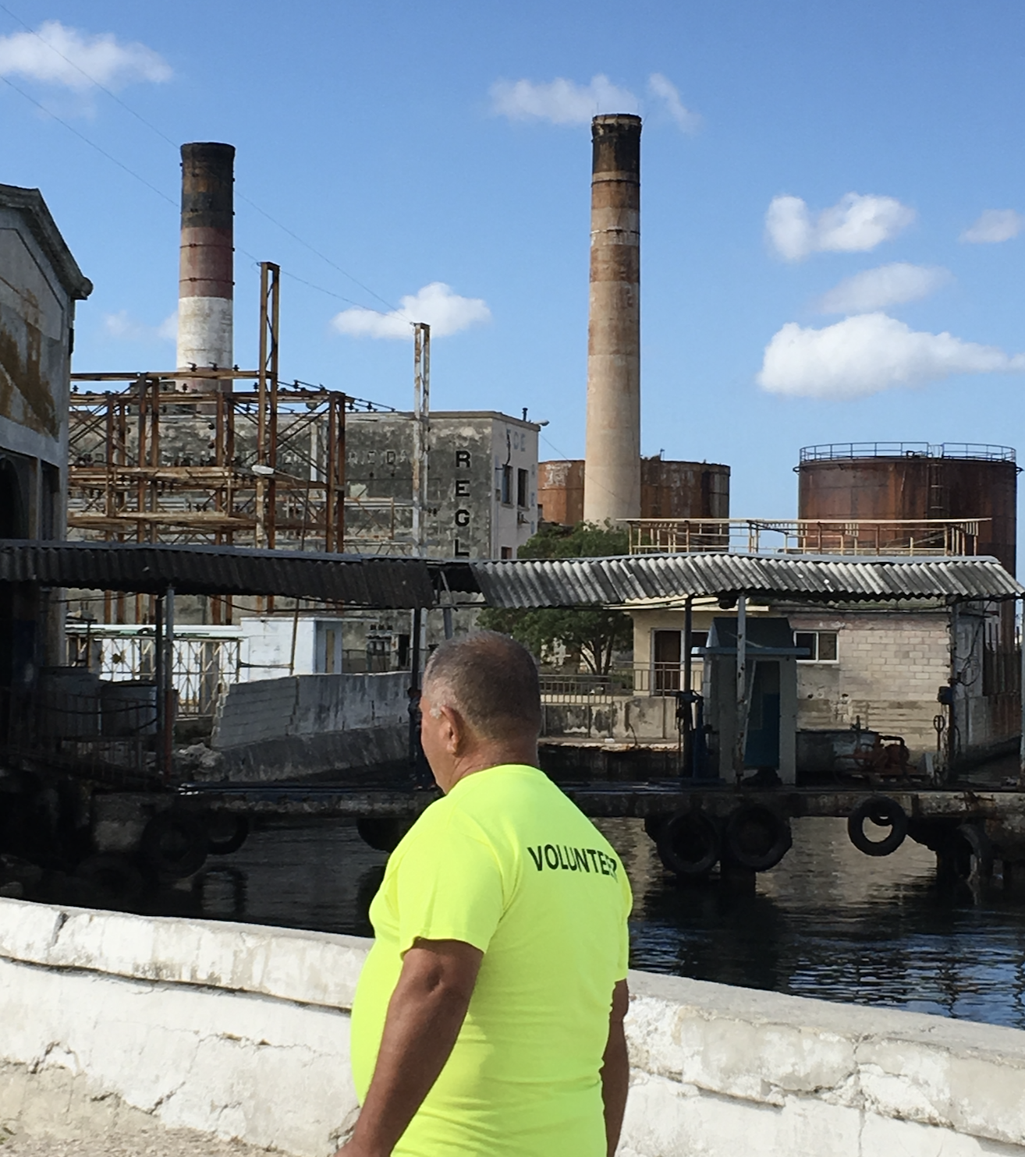
Supervision: Measures for Supervision of Overseas Investment 2017
Framework for supervisory discretionary decision making respecting CSOEs.
CSOE tasks:
Establishment of overseas investment management systems,
Basic principles under which they are developed and operated,
Specifics of which are specified, centered around the core elements of compliance, risk based decision making and the focus on the state directed objectives of outbound operations. (art. 6).
SASAC tasks:
Establishment and enforcement of negative investment lists,
Oversight of CSOE investment management systems,
Integration of party and state presence in CSOE internal management and operations,
CSOE operational compliance with thrust of national five year development strategies, and special rules for overseas projects in the negative investment lists.

Slide 18
Supervision: Measures for Supervision of Overseas Investment 2017
Risk Management Strategies
Drive investment and are managed at the enterprise, state, and Party levels.
CSOEs are encouraged to act responsibly with a sensitivity to local context.
In that respect they are required to “actively fulfill social responsibilities, and focus on cross-border investment, cultural integration, and the creation of a good external environment. Ibid., art. 9.

Slide 19
The Vessel: Belt & Road Initiative
“As a collaborative endeavor, the Belt and Road Initiative has been welcomed by the international community both as a public good and a cooperation platform. China has become a major trading partner for more than 140 countries and regions, it leads the world in total volume of trade in goods, and it is a major destination for global investment and a leading country in outbound investment. Through these efforts, we have advanced a broader agenda of opening up across more areas and in greater depth.”
(Xi Jinping, Report to the 20th CPC Congress (2022), p. 8)

Slide 20
What is BRI?
Framework through which China and its vanguard, the Chinese Communist Party, rationalizes its trade, security, cultural, and political policies
Operationalized through all sectors (economic, political, cultural, etc.)
Grounded in the primacy of development, stability, and prosperity
Principle that then informs the development of Socialist Human Rights
Structurally, BRI can be understood as sourced in a comprehensive blending of four foundational pillars:
(1) legal;
(2) security;
(3) culture ; and
(4) infrastructure development .
Chinese alternative to the functioning of globalization

Slide 21
Socialist Human Rights--Foundations
Break from the arc of convergence based human rights development after the 1980s.
Rupture points build on the old 1970s divide between the Soviet and American camps,
but now embedded within globalization,
and the territorialization of global production.
Undertaken in the service of the task of overcoming the principal contemporary contradiction. In contemporary China the central contradiction--”
What we now face is the contradiction between unbalanced and inadequate development and the people's ever-growing needs for a better life,"
To overcome this principal contradiction, the vanguard must develop and governmentalize a series of policies that better distribute the fruits of prosperity and stability.
That challenge itself is focused on the forward movement along the "socialist path"--that is on a path that is meant, eventually, to come closer to the establishment of a communist society in China

Slide 22
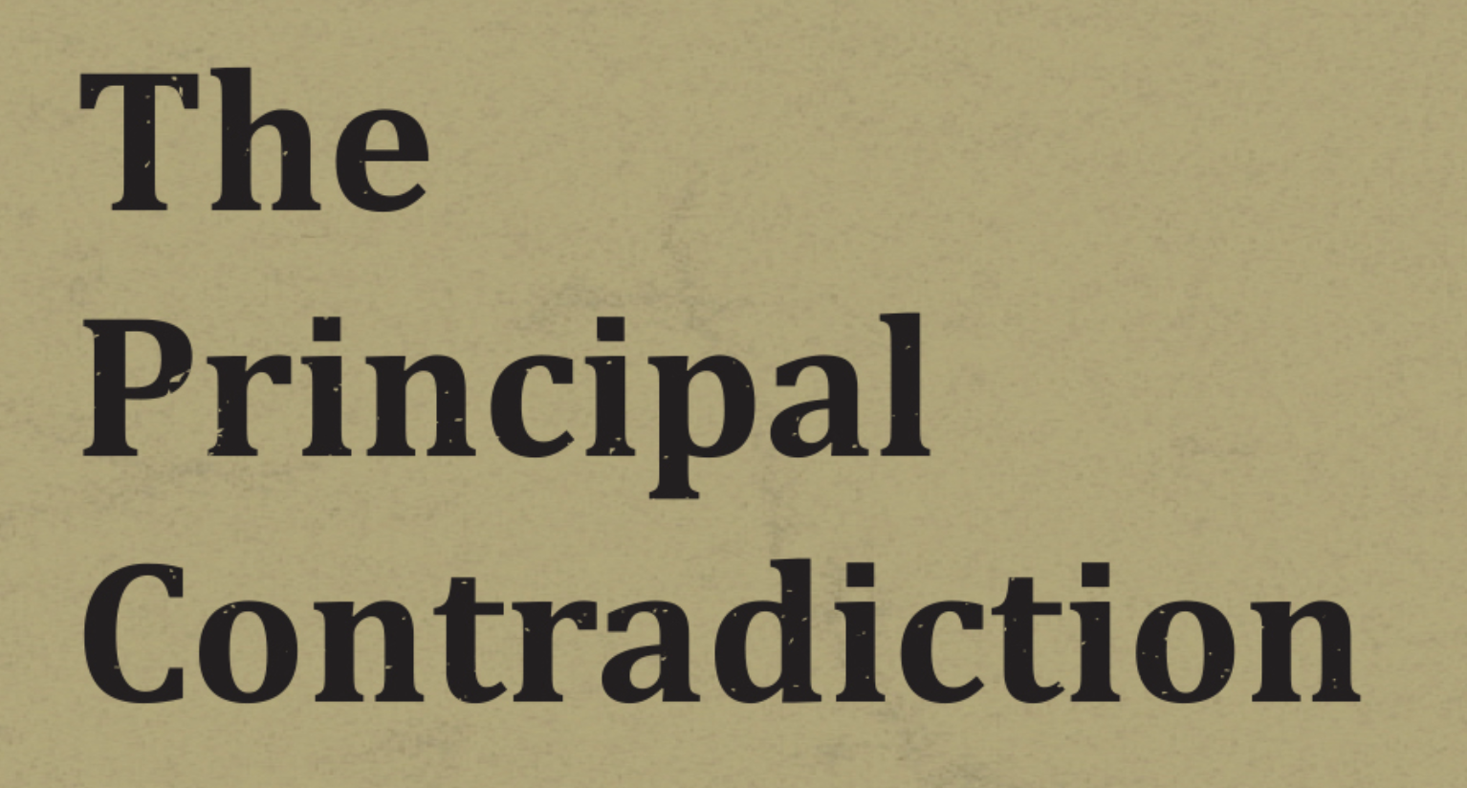
Socialist Human Rights: Core Objectives
Socialist modernization (rights cannot be realized except in and through collective prosperity—the richer the better)
Working through contemporary principal contradiction
From class struggle (1949-1978); to socialist modernization (1978-2016); to balance “between unbalanced and inadequate development and the people's ever-growing needs for a better life” (2016-)
To that end the development of productive forces globally to enhance Chinese core political responsibility to the nation becomes important
Its articulation can serve multiple interests.
Win-Win strategy
Hub ad spoke model of BRI

Slide 23
Socialist Human Rights: Contemporary Policy
Chinese New Era conceptual universe, collective development comes first.
Chinese human rights combines the theory of Reform and Opening Up with Socialist Modernization (development of productive forces) and extension of modernization to social and cultural spheres.
Security is next.
These are related to the discourse of stability and prosperity Principles.
These require an engagement in political work
Refocuses from productivity and development of the economic resources of the nation, to a development of the cultural and social position of the community within that productive culture.
Chinese Patriotic Campaigns; and then of the policy projects of advancing values and shared culture.

Slide 24
2008 SASAC Guidelines to the State-owned Enterprises Directly Under the Central Government on Fulfilling Corporate Social Responsibilities
Aligns CSR
With the political line of the CPC,
Then with the social requirements that are reflected in the implementation of that line,
And then with the fulfillment of sustainable development goals.
Aligns with CSOE conceptual orientation as partitioned state assets assigned contributing toward Chinese socialist modernization; Realized:
Compliance
Profitability
Product Quality and Service
Resource conservation and Environmentalism
Tech Innovation
Production Safety Issues
Labor Rights
Philanthropy/Social Aid Projects

Slide 25
The CSOE Human Rights Bottom Line
THE CORE:
Development, risk mitigation, compliance, state aligned philanthropy, and some worker protection.
MORE PERIPHERAL ROLE:
Human rights grounded in autonomy of individuals, and expressive rights—civil and political rights—beyond those that are mandated through law.
INTERNATIONAL LAW (and norms) play negligible formal role
Other than to the extent they are incorporated into the risk parameters of engagement in a foreign jurisdiction.
International law may be of some concern, but that would be received only in the context of supervisory governance.
Disjunctions apparent in the way in which CSOEs interact with the local environments.

Slide 26
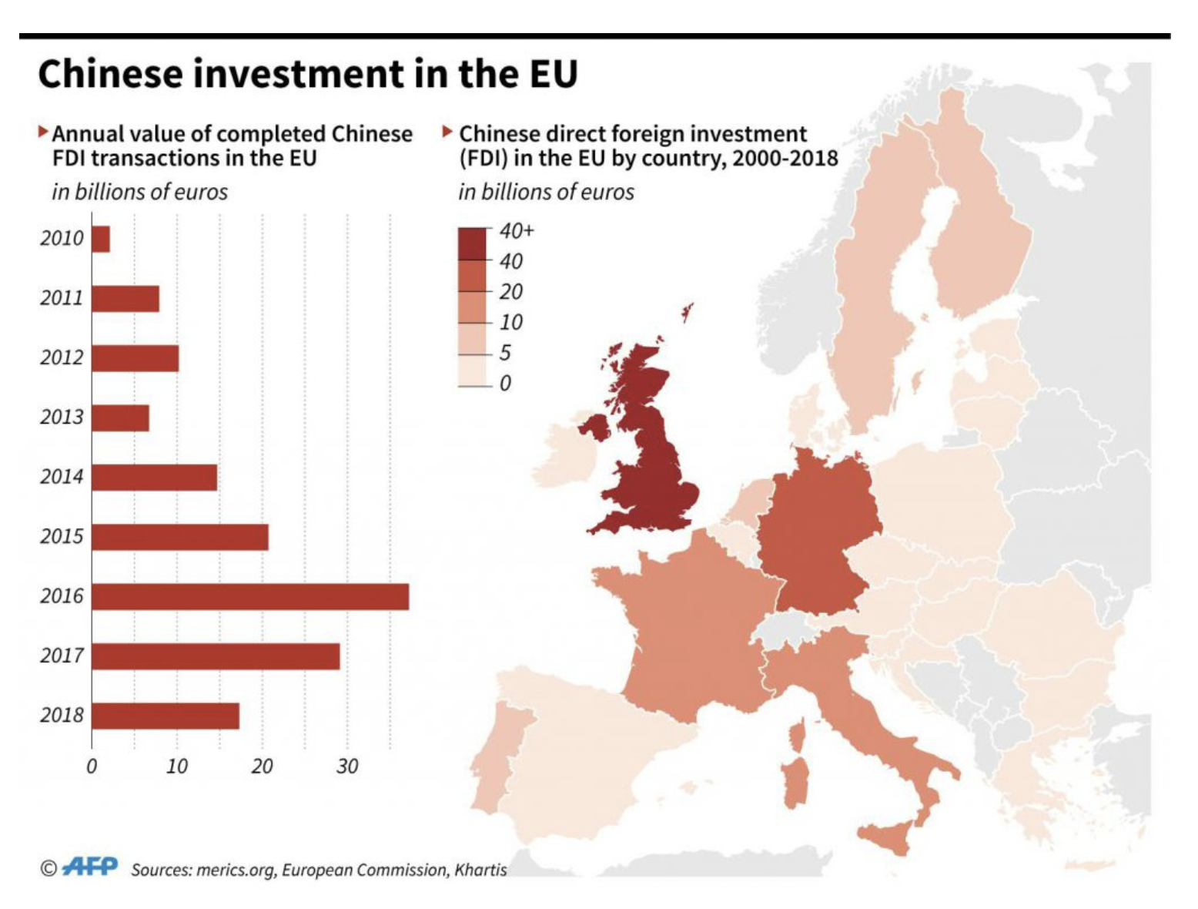
CSOEs: Latin America and Europe
Environmental options
Remedial versus prevention
Security
Tech sector (Huawei)
Property ownership near sensitive facilities
CSOE investment in local enterprises
Cooperation
Spying
CPC discipline in host states
Exploitation: BRI Hub and Spoke and plantation economies
Human Rights
Sanctions regimes
Blacklists
Risk assessment
Food security

Slide 27
Operational Convergence
CSOE risk analysis
Steers outbound activity to t(1) hose places and (2) within those economic fields
That minimize risk (as that may be evaluated).
Operationalizes the Chinese policy of “win-win” internationalism
Through projects of compliance-based localization of practices, including human rights.
Problem od (mis)alignment:
Expectations of host state stakeholders and CSOE managers.
A function of risk tolerances—and expectations about preferences for prevention versus mitigation or remedy
FUNCTION OF differing calculus of home and host state actors around the calculus of activity that have human rights and environmental degradation effects

Slide 28
Operational Versus Investment RISKS/IMPACTS

Slide 29
Operational Disjunctions and Translations: FIDH 2022 Report
60 civil society organizations evaluated 26 Chinese projects in nine Latin American countries, (New report examines rights violations by Chinese business activities in Latin America 23 March 2022)
There are at least 20 Chinese companies involved in the projects analyzed, with the most significant ones by sector being as follows:
Mining: Railway Construction Company (CRCC); Tongling Nonferrous Metals Groups Holding Company; and China International Trust and Investment Corporation (CITIC)
Hydroelectricity: Sinohydro Corporation Limited and the consortium between China International Water & Electric Corporation (CWE) and China Three Gorges Corporation (CTG)
Hydrocarbons: the three projects are the responsibility of China National Petroleum Corporation (CNPC) and China Petrochemical Corporation (SINOPEC)
Other infrastructure projects: China Communications Construction Company (CCCC)
All of these companies have a greater incidence in impacts on rights related to the environment and indigenous peoples.
Funders with the greatest amount of investment are the Industrial and Commercial Bank of China (8 projects), Export-Import Bank of China (7), China Development Bank (7), and Bank of China (5).

Slide 30
FIDH Violation Classifications (Report 2-3)
There were violations of the right to live in a healthy environment and environmental harms in 24 cases.
All of the extractive and infrastructure projects affect fragile ecosystems, generating intergenerational impacts by transforming the territory and social, economic, and symbolic relations developed by communities. Irregularities were confirmed in the environmental impact studies: the lack of prior studies, conflicts of interest in the approvals, and improper modifications after approval.
In at least 18 cases there were violations of the rights to participation and free, prior, and informed consultation.
Confirmation was obtained of the lack of prior consultation; significant deficiencies in its development resulting from the provision of incomplete or modified information; the use of language different from the one used by the communities; processes to fragment the communities; and the lack of guarantees of compliance with the will expressed in the consultations held.
In at least half of the cases there were violations of the rights to land, territory, and adequate housing.
Furthermore, in eight of them there were forced displacements that linked practices such as pressure to acquire lands, inadequate compensation, disproportionate use of the police and violence against the civilian population, restrictions to the freedom of movement, and even the emergence of irregular ‘grupos de choque’ [clash groups].

Slide 31
FIDH Violation Classifications 2
In at least 10 cases there were violations to fundamental civil and political rights, [including] violations of the rights to life, integrity, freedom, and free assembly, primarily in mining projects.
The significant amount of societal conflict has even led to scenes of violence and the loss of environmental defenders’ lives. In addition, the intimidation of opponents has become common practice in their territories, including with participation from irregular surveillance groups, and the judicial system has been utilized to pursue opponents.
There were violations of individual and collective labor rights in nine cases.
The projects have impacted the world of work in the impacted communities and the weak institutions in each country have contributed to deepening the effects on labor rights. In some cases, joining a labor union has been prohibited and criminalized through the application of practices of persecution, firings, delayed pay, censure, and failure to renew labor contracts. In the most extreme of cases, the inadequate management of labor risks has led to the loss of life of some workers, primarily in the mining sector.
COVID-19 context and the right to health.
The lack of biosecurity measures and inadequate practices in the labor milieu of some projects that could lead to increased contagion and mortality were denounced during the pandemic. Improper pressures to increase the length of the workday and [force workers to] sign documents exempting the companies from responsibility were also denounced.

Slide 32
Investment Decisions and Operations
(Social) Potential gross violations of Human Rights
Myanmar
Internal operations with global effects (Xinjiang)
Labor rights (including forced labor)
(Environmental) Potential environmental harms
Investment in coal, petroleum
Traditional medicine and bio-diversity
Wood and old growth forests
Governance
Lending traps
Food security
Data Harvesting and AI based investing (Tik Tok controversy)
Response
National security (BORDER CLOSING-Huawei))
Investment universe (Norway SWF)

Slide 33
Concluding Thoughts: The Role of Risk
For Marxist-Leninist systems risk is driven by development and legal compliance risk.
Focus
Not on the value of production as a function of human rights or sustainability,
but rather the risks/costs of human rights as a function of value added of specific activities measured by (1) contribution to advancing socialist modernization,(2) international relations, and(3) the political objectives of home (China) and host (other) states.
In that environment, the automatic preference (and valuation skewing) is not toward or from prevention (and its risk parameters) but on the weighing of the cost and benefit of prevent, or mitigation or remedy strategies as a function of the value of the project itself.
That is incompatible with non-M-L frameworks
A source of Conflict in Chinese CSOE outbound investment
Manifests in different ways:
In operations: remedy over prevention as a function of value of activity.
In investment decisions: Political objectives first
When that is added to the challenge of the use of CSOEs as political instruments in private markets, conflict is inevitable
The rest follows.

Slide 34
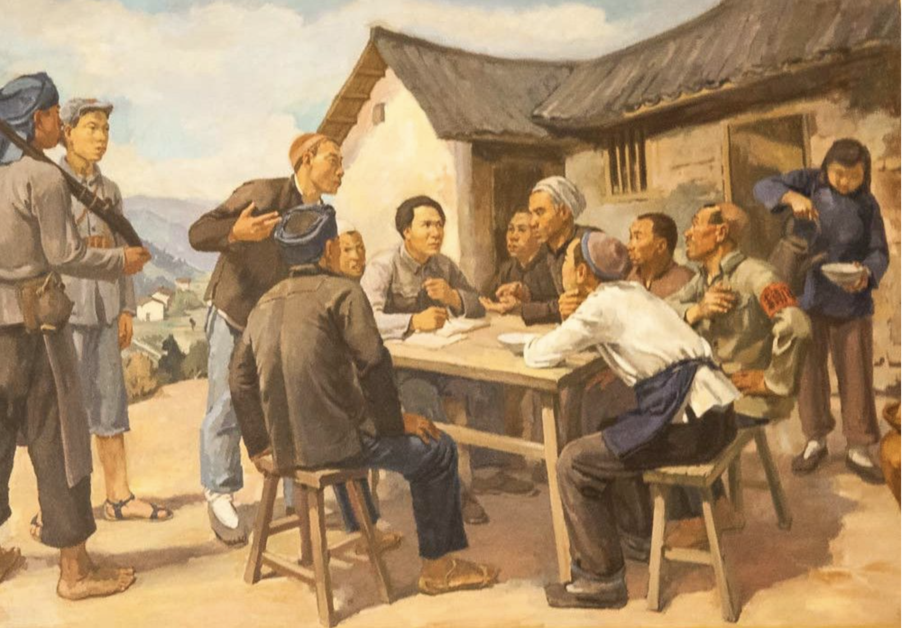
Questions?

Slide 35
Thanks!

