Slide 1
Climate Impacts, Labor Rights, and Pathways to Remedy
Larry Catá Backer
Pennsylvania State University
Workshop: Weather and Work: How Climate Change Relates to Workers' Rights"/Mëtéo et Travail: Comment le Changement climatique se rapporte aux droits des travailleurs
Osgoode Hall, York University, Toronto, Canada 8 December 2022

Slide 2
The Problem: Climate Change; Climate Action
The global temperature has already risen 1.1ºC above the pre-industrial level, with glaciers melting and the sea level rising. Impacts of climate change also includes flooding and drought, displacing millions of people, sinking them into poverty and hunger, denying them access to basic services, such as health and education, expanding inequalities, stifling economic growth and even causing conflict. By 2030, an estimated 700 million people will be at risk of displacement by drought alone.
Taking urgent action to combat climate change and its devastating impacts is therefore an imperative to save lives and livelihood, and key to making the 2030 Agenda for Sustainable Development and its 17 Goals – the blueprint for a better future – a reality. (SDG 13)

Slide 3
Climate in the Anthropocene
Foundational lens of Climate objectives
Baselines:
Climate without humans
All human activity in the environment is a net negative
De-centering humans
Climate with humans from a pre-industrial baseline
Industrialization as a net negative
Centering ideal basis of human embedding
Climate as a dynamic interaction with expectation of degradation, loss, and renewal
Stewardship model in which “climate” is one variable
Centering the human

Slide 4
The Focus on Labor
Climate change has an impact on all areas of economic global production
Privileging Capital:
Much of the focus has been on the use of productive forces to meet the challenge of climate
Accounting for Labor
Impacts n labor require substantial focus
Everything from the calculation of the value of labor and labor sustainability
Multiple lenses-human rights, productivity, social, economic, cultural, and political stability
Labor welfare as a principal objective (developing states and Marxist-Leninist states)
Focus of this presentation is on the possible sources of accountability and basis for remedy for labor in global (and national) production
The effect of the objectives lens on movement toward rights construction and remedy

Slide 5
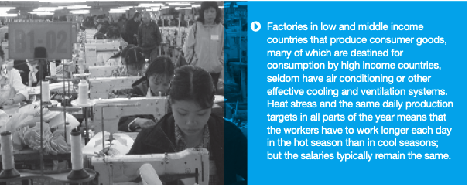
Labor Contributing to and Affected by Climate Degrading Practices
“As detailed in the report: “When it is too hot, people work less effectively out-of-doors, in factories, the office or on the move due to diminished ability for physical exertion and for completing mental tasks. Heat extremes also increase accident risk and expose people to serious heat-related health risks including heat stroke, severe dehydration and exhaustion, while a body temperature above 40.6º Celsius is life-threatening.” (Climate Change and Labour)
Business consume labor in ways that instrumentalize workers as contributors to climate degrading practices

Slide 6
Sources of Accountability: National Law
Fiduciary Duty
Duty to enterprise; value enhancing in the form of duty of care (monitoring); and perhaps good faith duty in the operation of the enterprise within its accountability ecologies (but rights asserted only by shareholders)
Disclosure Regimes
Securities Laws; Consumer Protection; Compliance Systems; Human Rights Due Diligence
Environmental Legislation
Impact statements; Species Protection Regimes; Clean Environment Legislation

Slide 7
Sources of Authority: Int’l Hard & Soft Law
Resolution on the inclusion of a safe and healthy working environment in the ILO’s framework of fundamental principles and rights at work (10 June 2022)
UN Guiding Principles for Business and Human Rights (2011) ¶ 12
OECD Guidelines for Multinational Enterprises (2011) ¶ VI (Environment); and ¶ V (Employment and Industrial Relations)
Paris Accords and related constellation of norms

Slide 8
Hardening Soft Law in Enterprise Private Law: Possibilities
ESG in Supplier Codes of Conduct
Model ESG and Climate clauses in contracts
Chancery Lane Project Climate Clauses but for labor
Compliance oriented Reporting

Slide 9
Constraints: Structural
State duty under international law may create no direct rights for labor and no direct duty for non-state actors
The problem of international soft law in UNGP 1st Pillar and OECD GME
Private law regimes may create no rights in labor
Limits of 3rd party beneficiary rules
Jurisdictional limits
Asset partitioning in the structuring of global production
The problem of virtue signaling and greenwashing
Governance gaps
Regulatory lag times
Regulatory silos
Jurisdictional silos
The problem of virtue signaling and greenwashing

Slide 10
Constraints: Remedial
Proving Damages
Identify damage
Measurement
The problem of Causation
Tracing issues where employer contributed
Distilling direct effect
Joint and several liability
The problem of identification and valuation
Valuing costs (and benefits) of climate affecting action
Connection with financial reporting
Quantifying climate related disclosure
Metrics and analytics at an early stage of development
Labor focus necessary
The problem of collective remedy for collective breaches
Remedial frameworks not developed to reflect the realities of climate-based breaches
Remedial Fora in their infancy
State based Non-Judicial For a
Non State Based Non-Judicial mechanisms
The Scientific Case for Climate Liability and Loss and Damage Claims (Lawfare 11-2022)

Slide 11
Lost in the Shuffle: Labor Instrumentalization Rights and Climate Degradation
State duty and corporate responsibility to reduce the use of labor as a vehicle to climate degradation
Read this into ILO Conventions, UNGP, or OECD GME?
Administrative law and compliance issues
Civil and criminal penalties
Breach of duty (Shareholder litigation)
Labor right to refuse to follow rules or directions that directly or indirectly degrade environment
Development of labor collective protections
Piggyback on developing right to refuse unsafe work
Needs substantial development to be effective

Slide 12
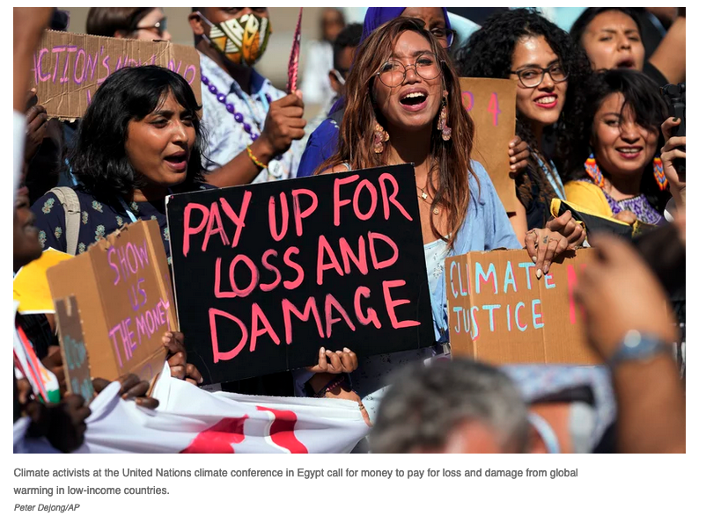
Possible Future Trajectories
Trajectories
Labor autonomy as agents for compliance within economic entities (work refusals etc.)
Heightened compliance-based cultures
The rise of measurement and valuation (costing climate degradation in financial statements; teasing cost of contribution to degradation)
Rethinking principles of causation and damages in tort
Rethinking scope of jurisdiction and rights to enforce and seek damages (right to bring actions, scope of remedial toolkits)
Reducing the barrier of sovereign immunity and the litigation of public positive duties
Reparations (states); Workers Comp regimes (individuals)
Cautions
Protecting democratic principles in the exercise of public authority
The problems of delegation and governmentalization of private sector
The inefficiencies of a judicial mechanisms
Measurement bias and integrity
Accountability for analytics
Transposability; coordination and national context
Fairness in allocating both protection and responsibility and sensitivity to traditionally vulnerable groups
Opt outs and waivers (traditional rights; cultural imperatives etc.)

Slide 13
Questions?

Slide 14
Thanks!

