Slide 1
From 11 July 2021 to Hurricane Ian in 2022: The Transformation of Mass Protests in Cuba and its Consequences
Larry Catá Backer (白 轲) W. Richard and Mary Eshelman Faculty Scholar; Professor of Law and International Affairs
Pennsylvania State University
Journal of Law & International Affairs
Speaker Series
25 October 2022
Katz Building Room 114

Slide 2
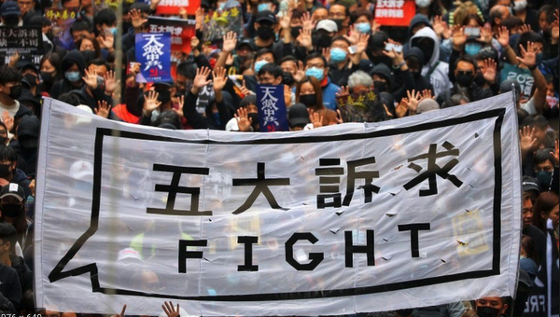
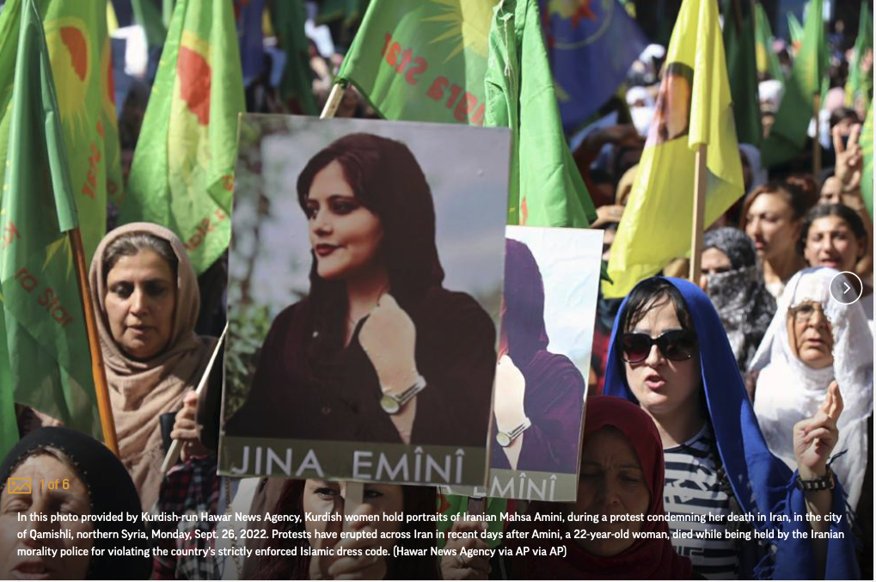
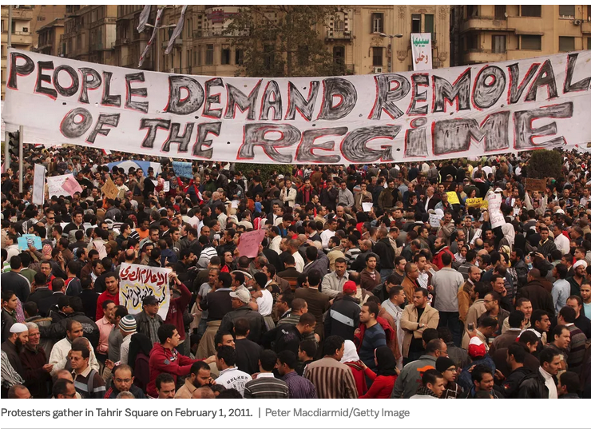
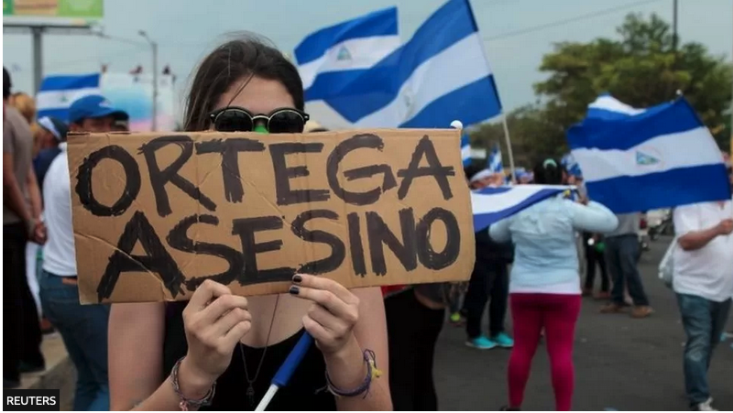
Popular Protests, Legality

Slide 3
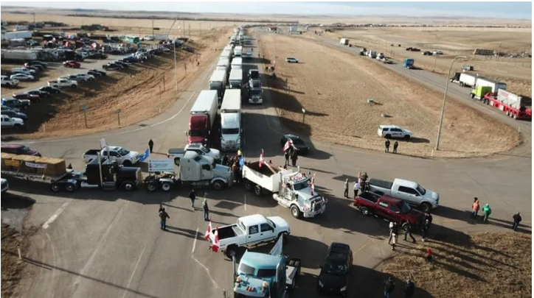
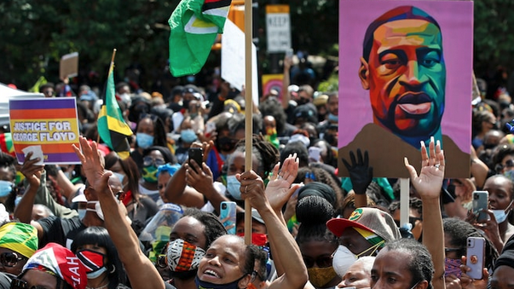
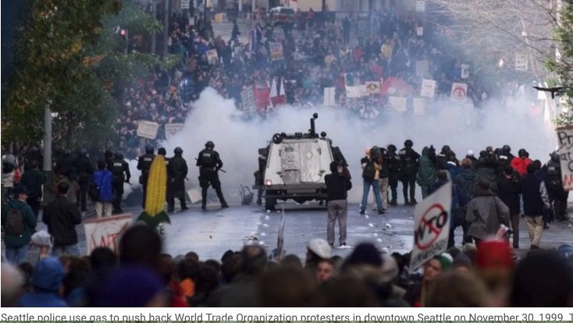
Legitimacy

Slide 4
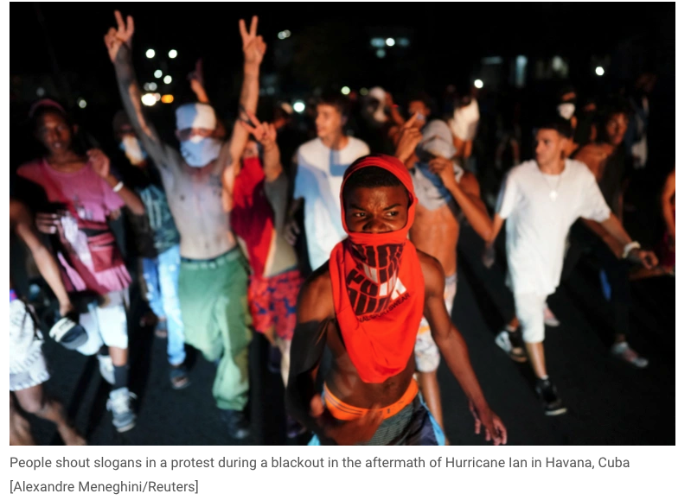
Two Protests
At the end of September 2022 Hurricane Ian plunged much of Cuba into darkness as the national electrical supply was compromised.
Days later, without power restoration, mass protests erupted all over Cuba. This time the police and security services did not respond in the same way.
While internet services were cut for a while,
Luis Antonio Torres, the head of the Communist Party in Cuba was widely quoted as saying ""I believe that protesting is a right, but only when those responsible are not doing their jobs,” though he noted these protests might not rise to that level.
On 11 July 2021 mass protests erupted across the country in ways that had not been seen since the success of what became the Marxist-Leninist revolution of 1 January 1959.
The protests represented an important challenge to the inertia that had characterized Cuban Marxist Leninism since the start of the 21st century.
It was forcefully suppressed.

Slide 5
Roadmap
This presentation considers the ramifications of potentially radical transformation protest Cuba.
Weaves together a number of critical stands that now produce an effort to accept and internalize at least a limited role for popular protests, while suppressing the rest.
Interlinkages between
the move to popular consultation and referenda in Cuba,
the 11 July protests, and
the reshaping of the cultures of protests in 2022.
The implications
For the United States and the Cuban diaspora, the changes point to the eventual triumph of some form of liberal democracy in Cuba;
For the Cuban establishment, the changes point to a much needed reform of the political system.
For Constitutional ordering : It is that collision between the development of Party and mass expectations translated into political action that reveals the great fissures and challenges that face Party, State, and mass collectives in Cuba after 2021.

Slide 6
Cuba Legal Historical Background
Before 1492—Taino rule through caciques
1492-1898 Spanish colony
1898.1901 Military occupation
1901-1934 Teller/Platt Amendment (US interventions: 1906, 1912, 1917, 1920)
1934-1959 Good Neighbor policy
1959 -1976 Military dictatorship
1976-present establishment of a Marxist-Leninist form of government
2008 Reform and Opening Up
2017 Reaction 7th Party Congress
2021 Retrenchment 8th Congress
2021 Explosion

Slide 7
State Generated Mass Action
1st Havana Declaration 1960
Rejected condemnation by OAS Treaty the alliance of Cuba with PRC and USSR
Popular acclamation
2nd Havana Declaration 1962
Popular acclamation of masses whether Cuban or not
The duty of revolutionaries is to make revolution

Slide 8
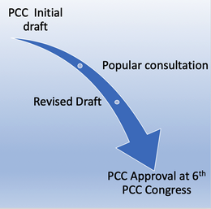
From Mass Consultation to Popular Referendum
Lineamientos (2008)
Constitutional Amendment (2019)
New Family Law (2022)
Partial consultations
PCC political documents

Slide 9
Suppression of All Other Mass Manifestations
Benito Mussolini 1939
. . . for the Fascist, everything is in the State, and nothing human or spiritual exists, much less has value, outside the State. In this sense Fascism is totalitarian, and the Fascist State, the synthesis and unity of all values, interprets, develops and gives strength to the whole life of the people. (“The Doctrine of Fascism)
Fidel Castro 1961 Speech to Intellectuals
This means that within the Revolution, everything goes; against the Revolution, nothing. Nothing against the Revolution, because the Revolution has its rights also, and the first right of the Revolution is the right to exist, and no one can stand against the right of the Revolution to be and to exist, No one can rightfully claim a right against the Revolution. Since it takes in the interests of the people and Signifies the interests of the entire nation.

Slide 10
Reform and Counter-Revolution 1997-2017

Slide 11
Survival and the 5th Congress (1997)
Allá los chinos debaten sobre lo que deben hacer; nosotros respetamos sus ideas y sus puntos de vista, es otro país. Ellos están tratando de hacerse su traje a la medida, y nosotros estamos haciéndonos nuestro traje a nuestra medida (APLAUSOS) y defendemos ese derecho. ¿Qué derecho tiene el imperialismo a decirnos cómo tenemos que vestirnos nosotros y cómo debe ser el traje? Eso lo decidimos nosotros; pero tiene que ser un buen traje. (Fidel Castro, Remarks delivered at the 5th Congress)
There, the Chinese debate what they should do; we respect their ideas and their points of view, it is another country. They are trying to tailor their suit to their own measure, and we are tailoring our suit to ours (applause) and we defend that right. What right does imperialism have to tell us how we should dress ourselves and what that outfit should look? We decide that; but it must be a good outfit.
More energetic embrace of a contextually distinct Caribbean Marxism;
Reaffirmation of classical Soviet Leninism.
The state as the monopoly capitalist
Globalization and global markets as venues of neo-imperialism
Resolución económica: a reaffirmation of central planning, of a strictly managed private sector, and of the supplemental and complementary nature of the non-state sector.
The ideal eventually is to return a point where private economic activity may be eliminated as the state moves closer to an idealized communist society

Slide 12
The Revolution of the 6th PCC Congress (2011)
Transitional moment
Lineamientos: slow and steady reform
Admission that it is time to move forward with reform
The Achilles heel: rationalizing the ideological basis for reform
Avoid Chinese model (though Raúl and FAR were sympathetic carried over from 5th Congress)
Suspicion of markets
Private sector expansion viewed as a temporary experiment subject to modification as circumstances required
Managed self sufficiency
Always under the control of the state and its apparatus
Limit: When it contradicted the fundamental line of Cuban “socialism”
The forward thrust of the draft Lineamientos blunted but not stopped.
Opens door to global consensus that Cuba is “moving forward”
Though that term had very different significance depending on who was using the term
Delayed reaction: Great victory the Cuba-EU framework: Political Dialogue and Cooperation Agreement (PDCA)

Slide 13
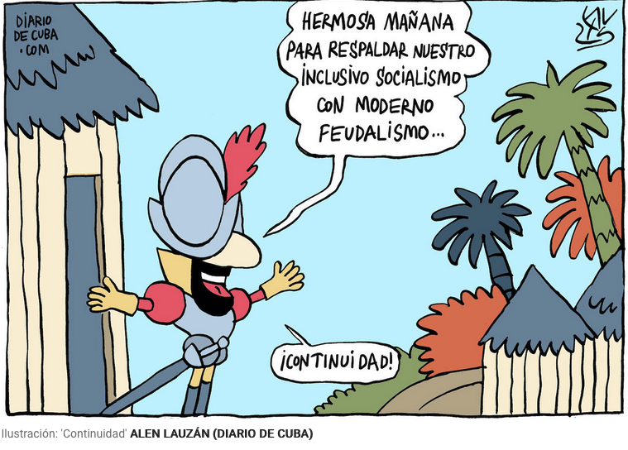
The Counter-Revolution of the 7th PCC Congress
Reaction from the “Left”
From Lineamientos to the Concepualizacón del Modelo Político Económico.
Back to the 5th PCC Congress but now elaborated in a more rational way.
Plan Nacional de Desarrollo Económico y Social 2030 de Cuba
Plan Económico 2030
Six Guiding Themes: 1. Gobierno eficaz y socialista e integración social; 2. Transformación productiva e inserción internacional; 3. Infraestructura; 4. Potencial humano, ciencia, tecnología e innovación; 5. Recursos naturales y medio ambiente; 6. Desarrollo humano, justicia y equidad
Return to the rationalization of planning as a substitute for markets and markets as a supplementary mechanisms for micro allocations in a tightly controlled non-state sector.
An engagement with the political ramifications of Us-Cuba opening up?

Slide 14
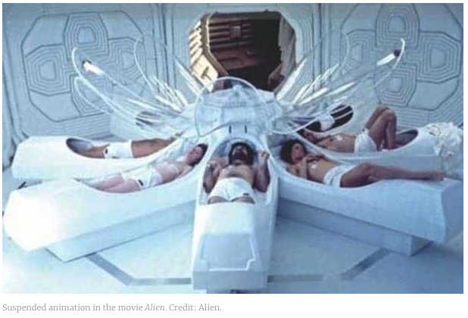
The 8th Congress and Stasis
Protectionism and an ideological inward turning detached from the realities on the ground. These include
substantial refocusing on the institutional integrity of the Party itself,
the development of new parameters that would permit more flexible delegation of economic authority in very closely controlled retail sector of the economy,
a managed opening of the wholesale and agricultural sector, and a slow movement
Rejection of Markets Marxism (the China Model) and market-based reform (the Lain American techno-progressive model)
Intensification of the construction of a rationalized effort to further develop a Caribbean Marxist Model, under conditions of crisis, though
Not clever enough to substitute predictive analytics and modelling for markets (though that might come—ironically led by the West)

Slide 15
From the Self-Reflection of the 8th Congress to the Explosion of the Masses
The documents and proceedings of the 8th Party Congress suggest the culmination of an arc of development that races back at least to the 5th PCC Congress
Reactionary (embedding of left error)
Self-Reflexive in the sense of a focus on party building and solidarity (pulling back to themes from the mid 1970s) .
The popular manifestations of 11 July suggest the disconnect between the work of the vanguard and the reality of the masses (fear of right error)
And it suggests the possibility of a Hong Kong analogy
The protests will drive the state more deeply into defensive conservative ideological development
A period of reward and rectification will follow
But the situation will remain fluid with the state in control

Slide 16
Unraveling and explosion
San Isidro Movement (2018)
Rejection of 1961 Understanding when the state attempted its recodification (Decree 349)
Bloggers
Critics versus dissidents
Reversal of US-Cuba Normalization
Restrictive policies of US
Tourism and trade
COVID
A fragile economy goes into free fall

Slide 17
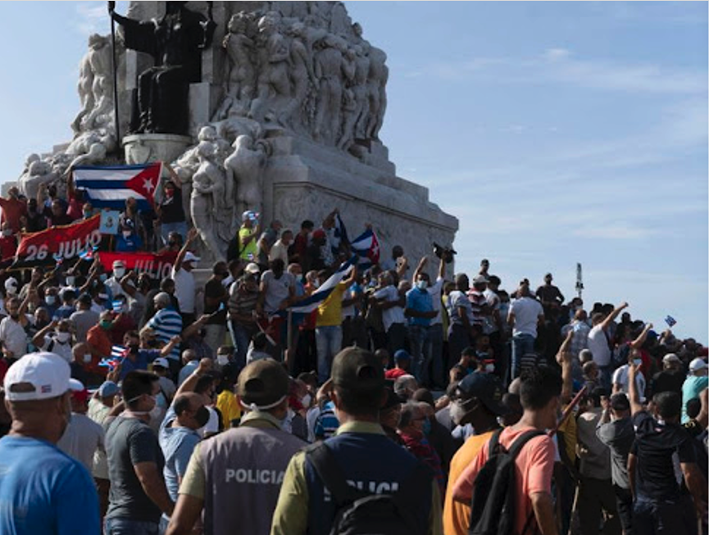
Mass Response of 11 July 2021: Move to Democracy or Maoist Rectification From Below?

Slide 18
A Different Kind of Protest
1. The protests erupted all over Cuba. But from the first it was clear that part of the object of the protests was to project its power not just to state authorities (and the vanguard party) but outward to the global community.
2. The protests build on a number of normative strands, the spark that ignites this normative explosion is grounded in the inability of the state and its apparatus to sufficiently satisfy the masses of its ability to fulfill its own duties to them.
3. The core of leadership denounced the protests as hooliganism and as the projection of foreign power and influence into the nation.
4. Cuban Diaspora leaders in the U.S. (starting with the major of Miami) began calling for the intervention of the US, militarily as necessary, to overthrow the government
5. The Biden Administration, through a State Department spokesperson and the US Embassy in Cuba delivered an initial response that paralleled in many respects the US response to the protests in Hong Kong
6. Great powers will continue to argue that prosperity is the ultimate objective and a necessary consequence either attainable only through a privileging of of stability (Marxist Leninist states) or of the exercise of peaceful protests (the liberal democratic states).
7- State apparatus is exploiting the "violence" caveat to American "concern." Rumors have been circulating of Cuban state personnel disguising themselves as protestors but armed with clubs, and intent on causing chaos and violence--chaos and violence that the state can then use to justify the use of force to restore stability and peace

Slide 19
The Consequences From a Leninist Perspective
A significant public attack on the legitimacy of the vanguard
Exposure of the gulf between the authority of the vanguard and its legitimacy
Emergence of alternative vanguard voices (artists, bloggers, intellectuals)
Failure to meet responsibility to the proletariat
Challenge comes from below
May be articulated by the intellectuals
Hijacked by foreigners and diaspora actors
But its force, from a Leninist perspective, is centered on the core collective form which a vanguard derives its legitimacy
Failure of ideological response
Crisis of vanguard legitimacy
Th vanguard Party looks inward and to the past, the party
Failure of responsibility
Crisis of ideology
Gap between theory and the historical conditions of the collective
Left error
Bureaucratism
Rectification from below?

Slide 20
An Iconoclast Perspective: Analysis and Engagement With “Acerca de las protestas en Cuba del 11 de julio,” Comunistas Blog (English version here)
1. The protests did not include significant counter-revolutionary elements—they expressed mass opinion in a classical Marxist sense
2. The protests have diminished the political legitimacy of the state apparatus
3. The protests originated in working class neighborhoods, which from a Marxist perspective suggest a contradiction between the policies of the vanguard and their realization in class struggle terms which weakens the legitimacy of the vanguard
4. The protests may not represent majority popular opinion; at the same time their manifestation suggest a mass vanguard that suggests a necessary rectification on the part of the ruling vanguard party.
5. Notable by its absence were socialist slogans—this suggests a contradiction—action on the street by the masses suggest the manifestation of class struggle while that movement did not appear to embrace classical articulations of Marxist class struggle—the language has changed and with it perhaps the underlying ideology.
6. This minority of workers allied with a minority of the intellectuals; but again intellectual vanguards suggest the diminution of the vanguard as the undisputed leading social and intellectual force, which also requires rectification within the Party and in the state.
7. The lumpenproletariat played a decisive role; that ought to worry a vanguard that continues to embrace the fundamental contradiction of class struggle as the basic foundation of the Party’s work.
8. The “Black Hand” of foreign interference once the protests started cannot be underestimated. The foreign element might have sought to hijack the process of mass engagement with a vanguard that has lost its way.
9. Violence was integral to the protests. And that forced the hand of the state to meet violence with violence. Yet Lenin reminds us that revolutionary violence is an essential element for exposing the weakness of an opponent and the key to the triumph of the vanguard.

Slide 21
The Response
Illustrates the extent of the current contradiction between the needs of the masses and the working style of the vanguard.
Failure of creative response
An ideology that is centered o history looks to history for contemporary guidance
Result: Problem of false analogies
“Maleconazo”
Mariel
Result: Problem of Transposing Roadmaps
The Hong Kong playbook

Slide 22
Hurricane Ian
The fragility of the infrastructure exposed
Layered on top of failures to respond effectively to the shortages that brought the 11 July protests
National blackout the trigger; taking protests to the leaders in Playa section of Havana
Power blackout cut internet service
“Protesters in Playa were at one point met with several truckloads of security forces, who blocked them from marching down a main boulevard, according to Reuters, although no clashes were reported.” (Aljazeera reporting 1 October 2022)

Slide 23
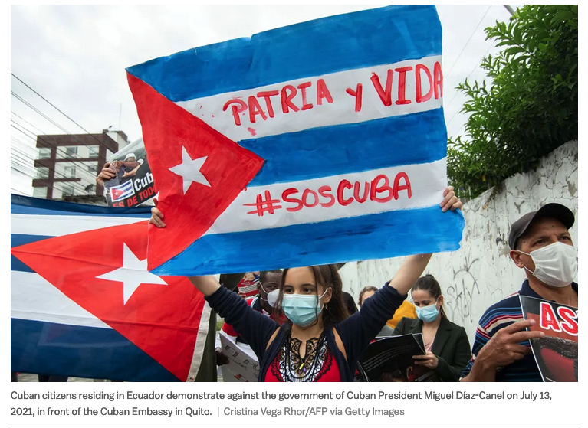
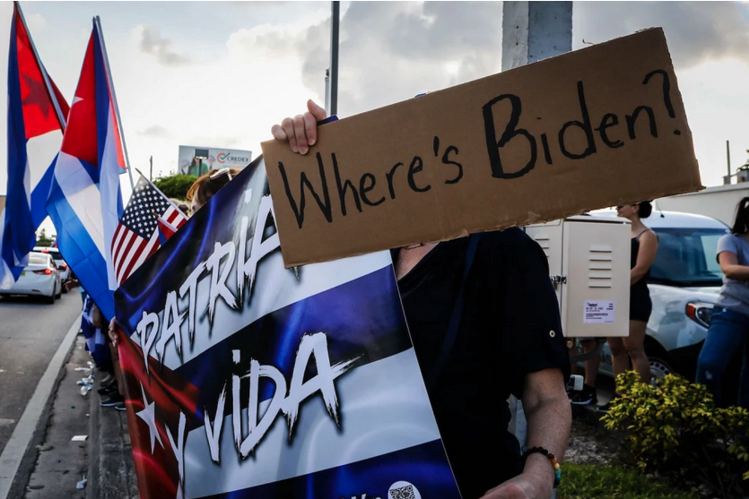
Will the Protests Bring Down the Government?
Yes
The failure of the economic model and the stubborn refusal to move beyond it
The intensification of US sanctions
The aggregate effects of COVID, hurricanes, and infrastructure collapse
Failure of international support (Russia, China, Iran, Venezuela)
Corruption out of control (again)
No charismatic or effective leadership
No
The usefulness of anti-US narratives and patriotic tropes
The division and strategic weakness of the Cuban diaspora
The success of the trope that social media dissidents are paid by the US or the diaspora
Nostalgia
State control of media and media messaging
Effective use of intimidation and repression
FAR intervention
Emigration as a political stress reliever (since the 1960s)
Effectiveness of limited reforms to increase “hope factor”
Key elements remain economically sound

Slide 24
Inertia
En Santiago de Chile, en septiembre de 1973, dias antes del golpe militar, se organizó un desfile en apoyo al gobierno de la Unidad Popular. Entre los que desfilaban, venía un obrero, minero de profesión, con un gran cartel que decía: ESTE GOBIERNO ES UNA MIERDA. El presidente Allende bajó de la tribuna y le increpó por su cartel y el hecho de estar desfilando en su apoyo. Aquel obrero le contestó: ES UNA MIERDA, PERO ES MI GOBIERNO. . .
[In Santiago de Chile, in September 1973, days before the military coup, a parade was organized in support of the Popular Unity government. Among those who paraded, was a worker, a miner by profession, with a large sign that read: THIS GOVERNMENT IS SHIT. President Allende came down from the podium and rebuked him for his poster and the fact that he was marching in support of him. That worker replied: IT'S SHIT, BUT IT'S MY GOVERNMENT. (Domingo Amuchastegui, Gobierno Cubano: ¿Se cae o no se cae? 12 October 2022 )

Slide 25
An Undiscovered Alignment?
Convergence of popular protests and popular participation
A n alignment in need of exploration
Theoretically compatible with Cuban Leninism
But requires abandonment of the 7th Congress Model and its Conceptualizacíion model.

Slide 26
From Violence to Rectification— The Protests and the Hong Kong Playbook
Violence and meaning making
Legitimacy
Permitted Scope of response
Intent (suppression; revolution)
The Narrative War
Discursive emphasis (of the government and the Party)
Discourse “on the ground” by the masses
Projected inward and outward as a tool for framing analysis and managing allies
Sovereignty and Nationalism
Strategic opportunity to blame the US embargo
“Black Hand” of foreign interference
The Changing Character of Imperialism
Legitimacy of “regime change” rationales
Imperialism in globalization—the imperialism of ideas and ideologies
But that implicated both the project of Liberal democratic and Communist internationalism
The Sanctions Reactions
The deeper embedding of Global Magnitsky from outside
The ascendancy of the Maoist notion of the difference between patriots and ithers who must be monitored
Democracy for democrats; dictatorship for everyone else

Slide 27
Questions?

Slide 28
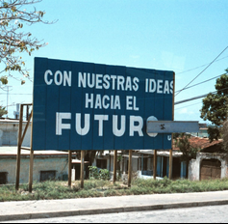
Thank You
Further reading:
Larry C. Backer, Flora Sapio & James Korman, Popular Participation in the Constitution of the Illiberal State--An Empirical Study of Popular Engagement and Constitutional Reform in Cuba and the Contours of Cuban Socialist Democracy 2.0, 34 Emory Int'l L. Rev. 183 (2020). Available at: https://scholarlycommons.law.emory.edu/eilr/vol34/iss1/1
Larry Catá Backer and Flora Sapio, Popular Consultation and Referendum in the Making of Contemporary Cuban Socialist Democracy Practice and Constitutional Theory, 27 U. Miami Int’l & Comp. L. Rev. 37 (2020) Available at: https://repository.law.miami.edu/umiclr/vol27/iss1/4

