Slide 1
Linking People to Governing Institutions: 《中国新型政党制度》 (China‘s New Political Party System), 全过程民主 (Whole Process Democracy), and Leninist Political Parties Within Socialist Constitutional Democracy
Larry Catá Backer
(白 轲)
W. Richard and Mary Eshelman Faculty Scholar Professor of Law and International Affairs; Pennsylvania State University | 239 Lewis Katz Building, University Park, PA 16802 1.814.863.3640 (direct) || lcb11@psu.edu
Workshop: Political Parties and Constitutions in Asia
St Hughes College, Oxford 23 Sept 2022

Slide 2
Fei Qian飛 箝 (Captivate-Capture)
A person who aims to enhance his power and capacity reaches afar to draw talents close to him. . . As for those who cannot be captivated with words . . ., invite them and encumber them with responsibilities. Or encumber them with responsibilities first and then reveal their weaknesses; or reveal their weaknesses first and then encumber them with responsibilities.
Guiguzi: China’s First Treatise on Rhetoric (Hui Wu, trans; Southern Illinois University Press, 2016) (Captivate-Capture (Fei Qian飛 箝; Book II.5.2, p 56, 57-58)
What ‘captivates’ is the possibility of representative participation in political and administrative organs endogenously and exogenously.
What ‘captures’ is the institutional framework that is then constructed around these allocations of responsibilities organized around the people’s democratic dictatorship and democratic centralism that is self-reflexive and self-disciplining.

Slide 3
九鼎 (Jiǔ Dǐng) (Nine Tripods of State Power)
Genesis of project:
Study of the development of a theory of political parties in New Era thought
九鼎 (Jiǔ Dǐng): the offering and its ritualized spaces; Leninist political parties as offering within the CPC-State-CPPCC. Activation--
全过程民主 (Whole Process Democracy),
Socialist Consultative Democracy, and
《中国新型政党制度》 (China's New Political Party System)”
Meeting challenge of the contradiction of mass line democracy and people’s democratic dictatorship: CONSULTATION
Political Collectives $⇄$ Collectivization of Politics
Political collectives as avatars for the masses
Relationship between the leadership role of leading social forces and political collectives
Institutionalization through CPPCC system
Attenuated LINK to NCP system: ELECTION
Election system based on CPC guidance

Slide 4
Ordering Principles

Slide 5
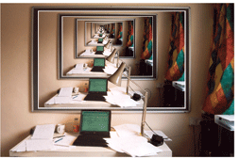
$$∰Ideology of Endogenous Democracy$$
Liberal Democracy: Political parties exist within liberal democracy organized through a government apparatus which exercises political authority; parties exist as exogenous to the exercise of political authority vested in state organs.
Political parties contribute to the peopling of representative state organs
Marxist-Leninist collectives, the vanguard party, as the leadership core of organized political authority, exists as the organization of political authority itself, which is then administered through state organs and contributing collective organizations; political collectives exist as endogenous organs of governance under the leadership of the vanguard.
Political parties serve as recognized organs of consultative governance administered by state institutions
Though both systems use the same term to describe collective political organization, the ideological basis of the meaning of that term could not produce a greater distance in the way in which meaning is embedded in those terms.

Slide 6
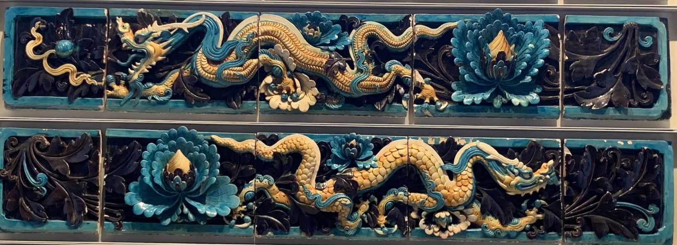
Overcoming Contradiction
Goal: Elaboration of a theory of political collectives within the larger framework of the development of Marxist-Leninists principles
The hypothesis:
‘The emerging theory of Leninist political parties contributes to the development of a coherent theory of endogenous socialist constitutional democracy.’
Subsidiary hypothesis: at least conceptually, the transformation of the ‘mass line’ principle into ‘whole process democracy’ provides a basis within Leninist political theory to link the people to their state institutions through the structuring of a system of well-managed mass political organizations under the leadership of the vanguard.
The object of this system
Enhance consultation under a system in which the vanguard drives the policy discussion, frames the implementation agenda, and controls the development of the guiding ideology. That rationalized system of 全过程民主 (Whole Process People’s Democracy) can then be stripped of liberal democratic values and practices and better align with the principles of Chinese Marxist Leninism.

Slide 7
Foundations

Slide 8
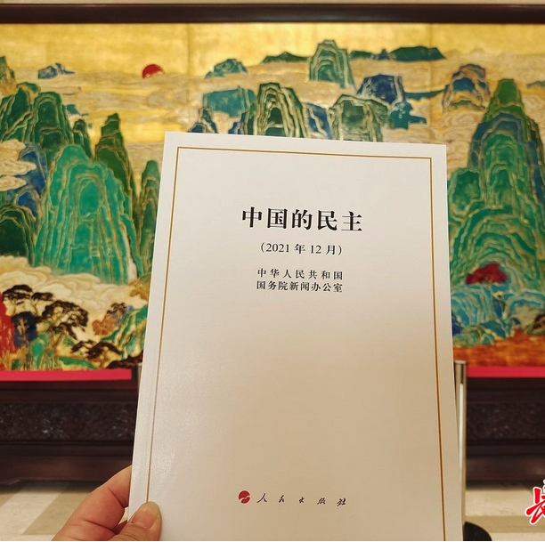
3 Key State Council White Papers
《中国新型政党制度》(China's New Political Party System)
sketched out the current structures of the Chinese system of multi-party cooperation and political consultation under the leadership of the apex vanguard (Communist) party
《中国的民主 》(China: Democracy That Works)
elaborates a theory and discourse of “whole process people’s democracy” [全过程人民民主]
《美国民主情况》(The State of Democracy in the United States); 5 December 2021)
“aims to expose the deficiencies and abuse of democracy in the US as well as the harm of its exporting such democracy.”

Slide 9
Putting the Pieces Together

Slide 10
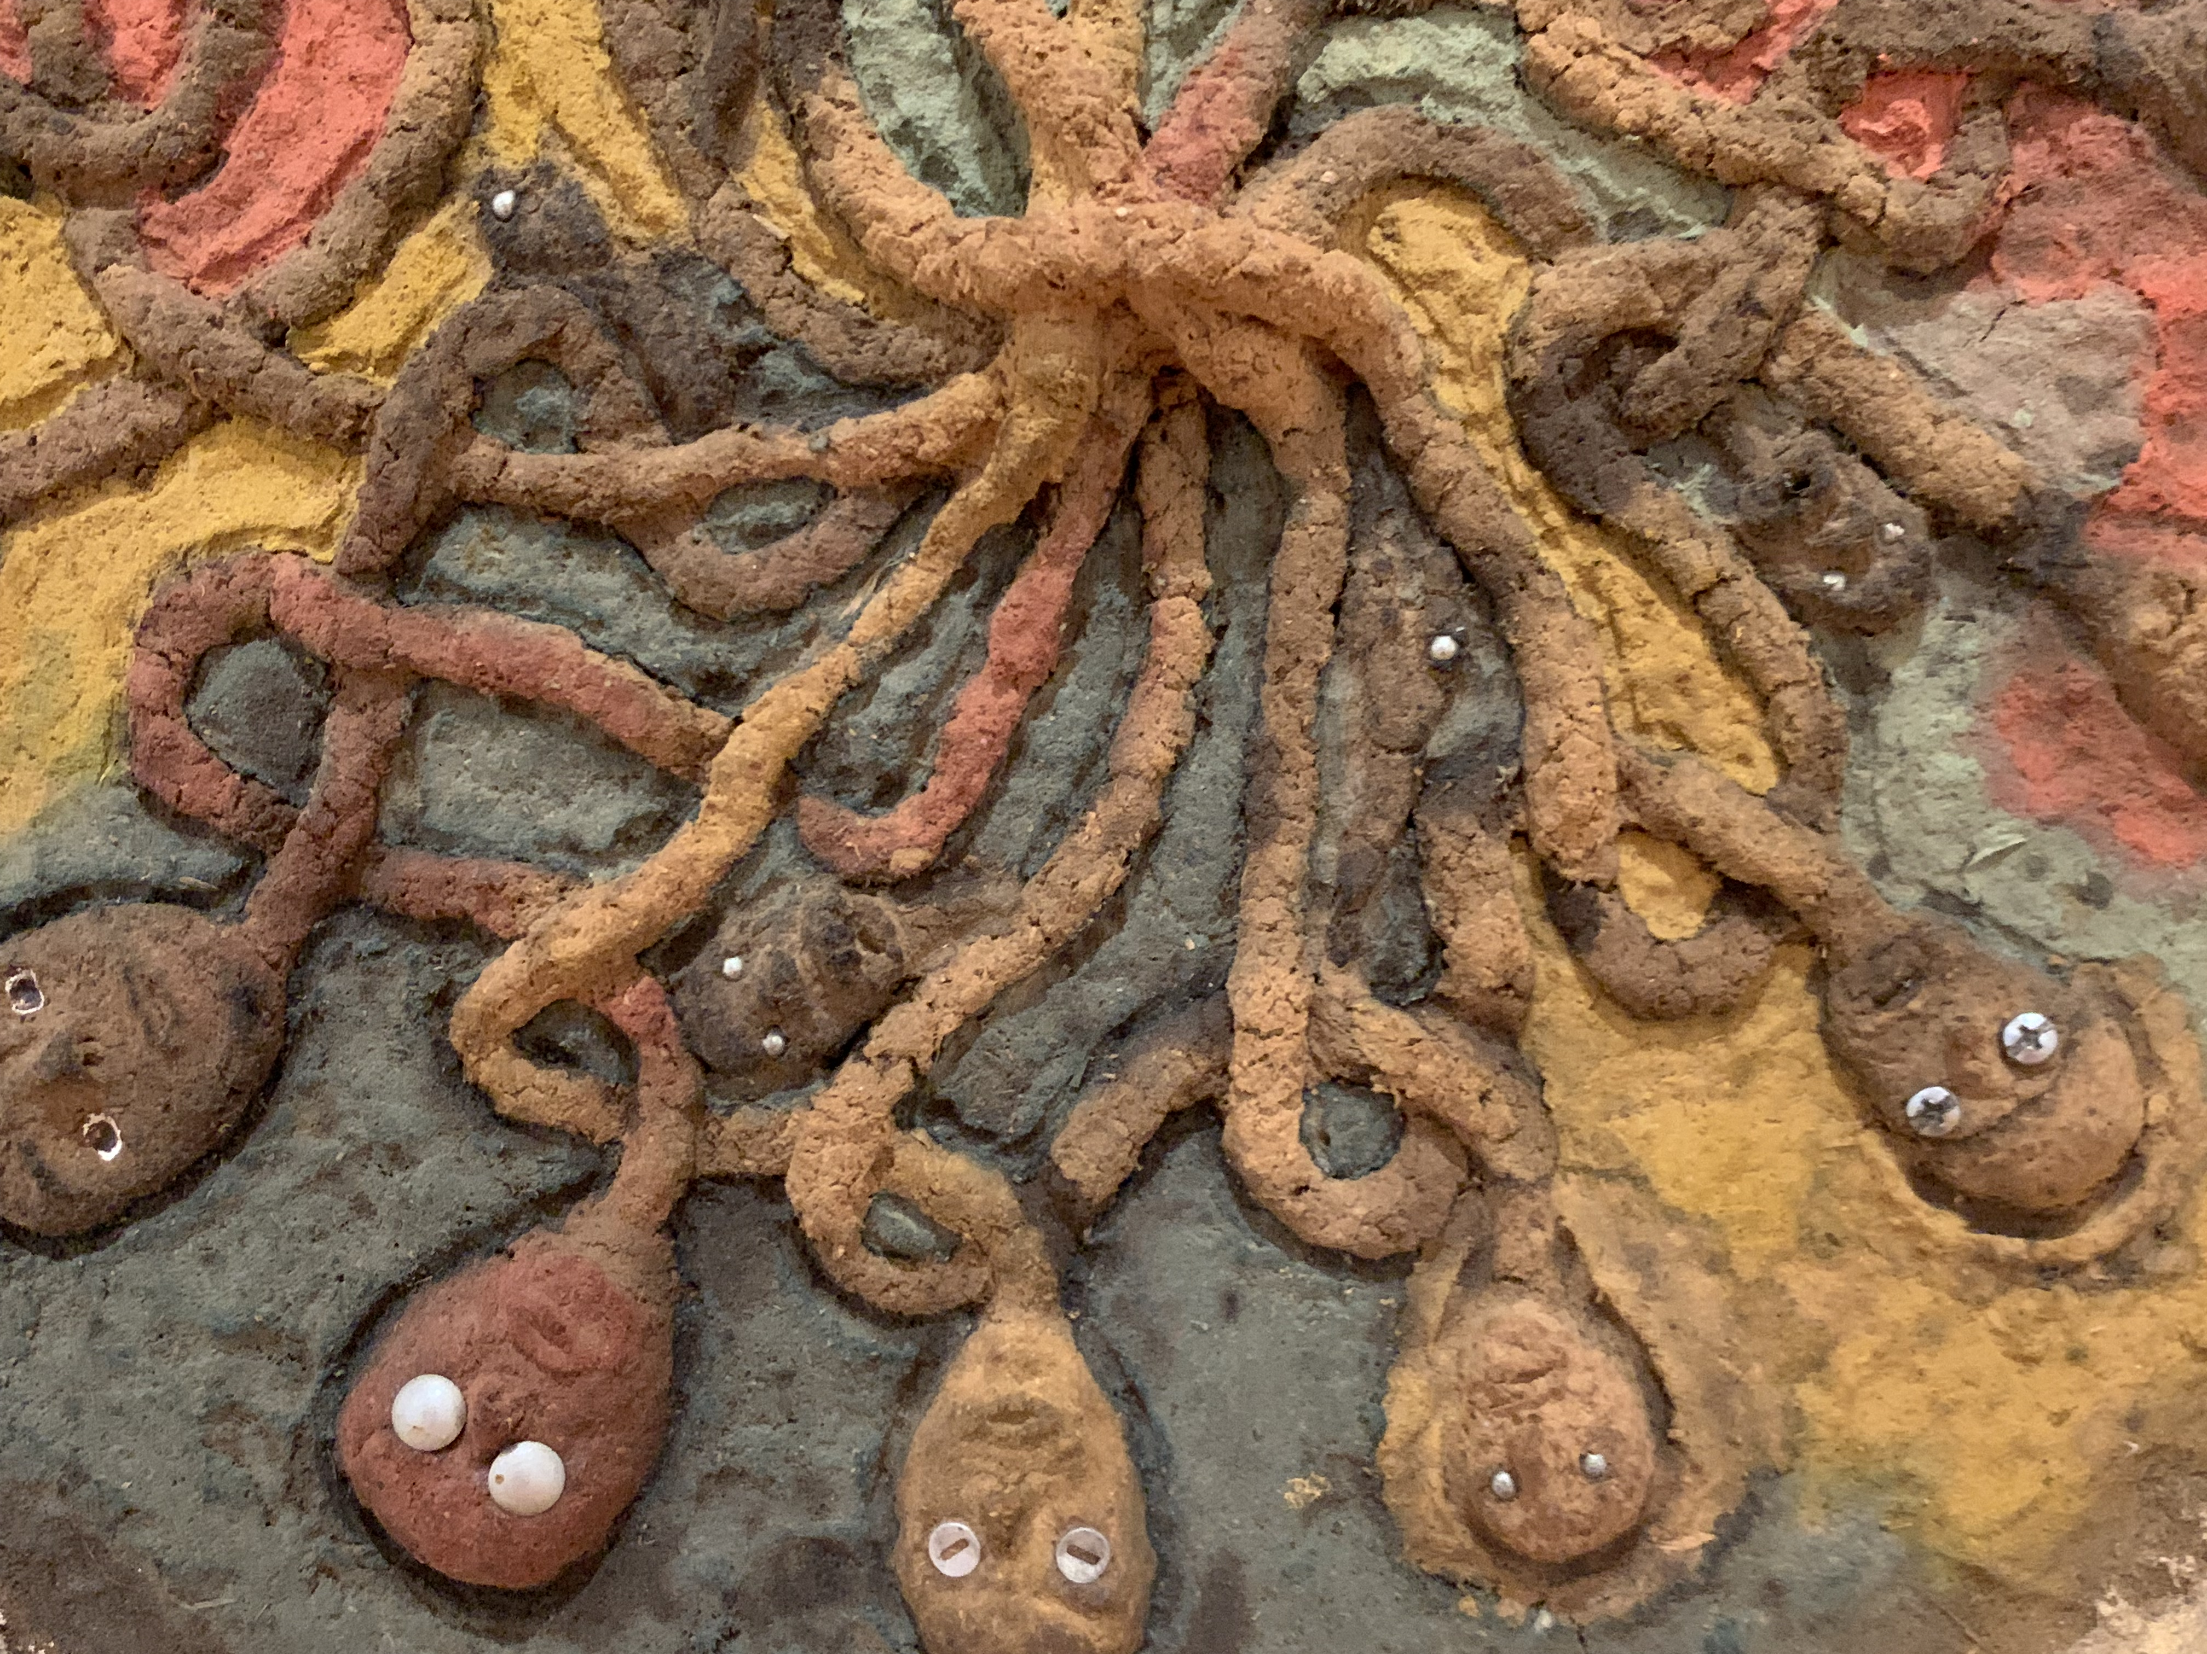
The System
Political collectivization
Institutionalization of political voices of masses
Embedding collectives within structures of consultative democracy
Tight division between leading and consulting
Socialist purity as against liberal democratic corruption
The unique constitution of the Vanguard party
as the embodiment of the leading social forces and
As the holder of stewardship for exercise of political authority in the service of the masses

Slide 11
《中国新型政党制度》(China's New Political Party System)
Elaboration of CPC Basic Line and principles in CPC Constitution’s General Summary or Program (总纲)
Updating old United Front political party system into a New Era Leninist system of consultative democracy.
Political collectives are given autonomy to operate as nodes of engagement
Political parties, then, are:
(1) collective mass representative political organizations
(2) mass organizations legitimated by their history, their patriotic activities, and their role in the revolution
But only within the overall structures of Chinese Leninism in which the CPC remains at the center.
(3) Realizes institutionalization of mechanics of CPC leadership as the apex vanguard patriotic revolutionary party.
(4) In the aggregate represent all of the people

Slide 12
Advantages of the “new political party system” (§4)
First, the consultation model better expresses mass line participatory democracy under the leadership of a Leninist vanguard.
“The organic unity of cooperation, consultation, and supervision is an important form of realization of the people's mastery of the country and an important institutional carrier of socialist consultative democracy.”
Second, the multi-party consultation system best expresses popular representation.
That representation extends to a broad category of what in the liberal democratic West would be understood as identity-based groupings.
It is also meant to soften tyrannies of majorities or minorities mediated by the apex vanguard party.
Third, the new party system enhances coordination and consistency.
Step toward the greater efficiency under the guidance of the apex party through the refinement of a consensus-based system.
Consensus is guided by the principles of democratic centralism and limits of the people’s democratic dictatorship.
Rationalize political decision-making beneath the level of sovereign decision-making.
Lastly, political parties are meant to enhance the primary political objectives of stability and prosperity.
To that end, the political party system is understood to replace “confrontation and struggle with cooperation and negotiation,
Overcomes the drawbacks of frequent political regime changes caused by mutual conflict between parties, and can effectively resolve conflicts and maintain harmony and stability.” Ibid.

Slide 13
Vanguard Party Versus Political Party
The Chinese Communist Party leads the Chinese people of all ethnic groups. It is the vessel of political authority within which political collectives can effectively function to consult on the CPC’s policy and implementation strategies
The socialist system is the fundamental system of the People’s Republic of China. Leadership by the CPC is the defining feature of socialism with Chinese characteristics. It is prohibited for any organization or individual to damage the Socialist system.
Principles of democratic centralism are deployed in arranging the vertical power relationships with the CPC at the apex and representative mass political organizations as guided participating organs.
“The Communist Party of China is in a leading and ruling position. . . The leadership of the Communist Party of China over the democratic parties and persons without party affiliation is mainly political leadership, that is, the leadership of political principles, political directions, and major principles and policies.” (Section 3)

Slide 14
《中国的民主 》(China: Democracy That Works)
One starts by defining the people (patriots) who are object and subject of democracy and democratic legitimacy
(people’s democratic dictatorship). One then divides democratic structures into two distinct institutional venues— the first the National People’s Congress system and Democracy within the administrative apparatus; the second the system of political consultation and democracy for the masses
Endogenous element
CPPCC as central organ of mass collective democratic representative consultation within the political apparatus
Exogenous element
People’s Congress System as democratic practice within the state apparatus
Fei Qian飛 箝

Slide 15
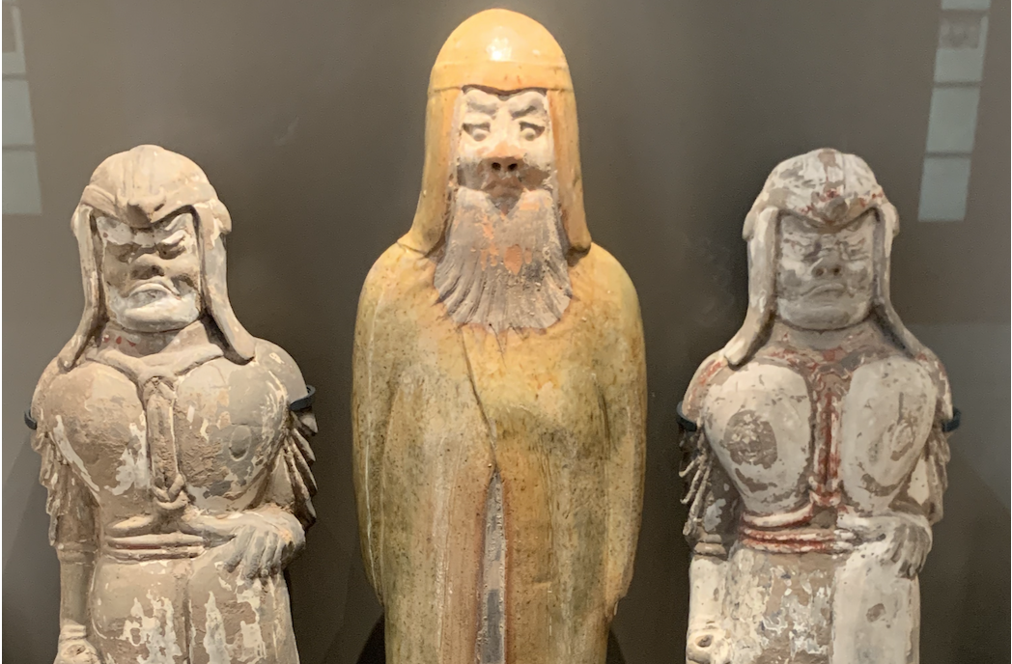
Resolving Two Core Issues of Political Collectivization
Representation: functional differentiation of the masses along lines of recognized mass collectives that in the aggregate represent the entirety of the masses
Nexus point for the implementation of the mass line (群众路线)
Avoid representation gaps
Institutionalization of Consultation: application of the principle of democratic centralism to the institutionalization of the mass line in the relationship between the CPC and mass organizations
Consultation model embeds direct democratic participation and popular representation under the leadership of the CPC; it enhances coordination and consistency; it operationalizes broadly the core principle of people’s democratic dictatorship (人民民主专政) (and the great patriotic campaign)
Supervision function—proper operation of state and monitor individual and administrative lapses
Critical Vessel: Chinese People’s Political Consultative Conference (人民政协)system as central coordinating organ

Slide 16
Whole Process Democracy in the Shadow of the Liberal Democratic “Other”

Slide 17
《美国民主情况》 (The State of Democracy in the US)
By listing facts, figures, and the opinions of relevant institutions, personalities, and experts from various countries, the shortcomings of the American democratic system are exposed, the chaos of American domestic democratic practice analyzed and the harm of exporting democracy to the outside world explained, to the ends that the United States will improve its own democratic system and practice and change its course abroad.
通过列举事实、数字和各国相关机构、人士及专家观点，梳理美国民主制度的弊端，分析美国国内民主实践的乱象和对外输出民主的危害，以期美国完善自身民主制度和实践，对外改弦易辙。

Slide 18
《美国民主情况》(The State of Democracy in the US)
Measuring the ideal
“8 Cans”习近平 民主应该什么样？习近平这样说 [Xi Jinping, “What Should Democracy Be?”, supra (2014 )
To judge whether a country is democratic, it is important to see (1) whether its people run their own country. In addition to voting rights, it is important to see (2) whether people have the rights to extensive participation. It is important to see (3) what promises are made in an election campaign and, more importantly, (4) how many of those promises are honored afterwards. It is important to see (5) what political procedures and rules are instituted by a country’s systems and laws and, more importantly, (6) whether these systems and laws are truly executed. It is important to see (7) whether the rules and procedures governing the exercise of power are democratic and, more importantly, (8) whether power is truly put under the oversight and checks of the people.
[一个行之有效的民主制度不仅要有完整的制度程序，而且要有完整的参与实践，能够做到过程民主和成果民主、程序民主和实质民主、直接民主和间接民主、人民民主和国家意志的相统一。如果人民只有在投票时被唤醒、投票后就进入休眠期，只有竞选时聆听天花乱坠的口号、竞选后就毫无发言权，只有拉票时受宠、选举后就被冷落，这样的民主绝不是真正的民主。一个国家是不是民主，应该由这个国家的人民来评判，而不是由外部少数人来指手画脚。

Slide 19
The Comparative Critique
The comparison, measuring exercise, is built around three core propositions.
（一）制度痼疾积重难返; (1) The system's chronic defects are difficult to overcome
（二）民主实践乱象丛生; (2) the practice of democracy is chaotic
（三）输出所谓民主产生恶果 (3) exporting the so-called democracy produces evil results.
Bringing the language of class struggle back to the comparative analysis.
Class struggle is still the primary contradiction in the US;
Political parties are incapable of comprehensive representation;
Politics is an expression of capitalist production (quid pro quo operation
Domination by social and financial elite (the liberal democratic vanguard)
Adversarial rather than consensus building system

Slide 20
Exporting Democracy
Liberal Democratic practices export class struggle
Promotes a false Vanguard
Furthers the idea of diffuse political authority that fractures the masses
Produces the dangerous idea of autonomous markets markets as regulatory space (bottom up leadership)
Incapable to producing success elsewhere; intensifies conflict
Whole Process Democratic Alternative Through BRI
Rhetorically, what ‘captivates’ potentially receptive foreign states is the success of the system (something foregrounded in the White Papers).
What ‘captures’ attention is the flexibility in adding national characteristics to the whole process framework.

Slide 21
Drawing Conclusions

Slide 22
Political Parties and the Rationalization of Socialist Democracy as Fei Qian飛 箝 (Captivate-Capture)
The problem of political collectives presents a contradiction
How does one organize political collectivization that aligns with the core Leninist principle of party leadership?
How does one avoid the trap of liberal democratic political parties while using the same language (eg political parties)
The resolution of that contradiction appears requires the strategic rationalization of core Chinese Leninist theory
Development of the mass line as (1)a foundation for the organization of political collectives that represent all national forces and (2) to shape the consultative character of its role
Normalize and universalize democratic centralism as the mechanism for rationalizing hierarchy
Develop people's democratic dictatorship to distinguish the role of the vanguard CPC as the space within which political collectivization may exist legitimately
And an endogenous democracy theory
Rationalizes political space and the construction of parties
Acquires form by distinguish endogenous socialist from liberal democratic (exogenous) democracy.

Slide 23
Questions?

Slide 24
Thank You -- 谢谢

