Slide 1
The Imaginaries of Regulatory Spaces in an Age of Administrative Discretion: Social Credit ‘in’ or ‘as’ the Cage of Regulation of Socialist Legality
Larry Catá Backer (白 轲) W. Richard and Mary Eshelman Faculty Scholar; Professor of Law and International Affairs; Pennsylvania State University | 239 Lewis Katz Building, University Park, PA 16802 1.814.863.3640 (direct) || lcb11@psu.edu

Slide 2
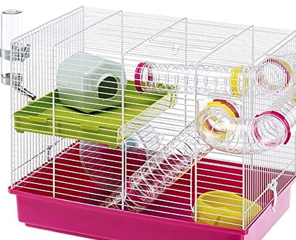
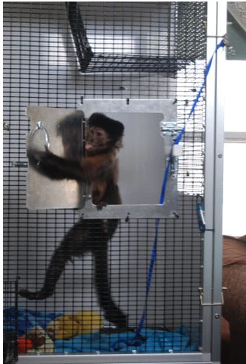
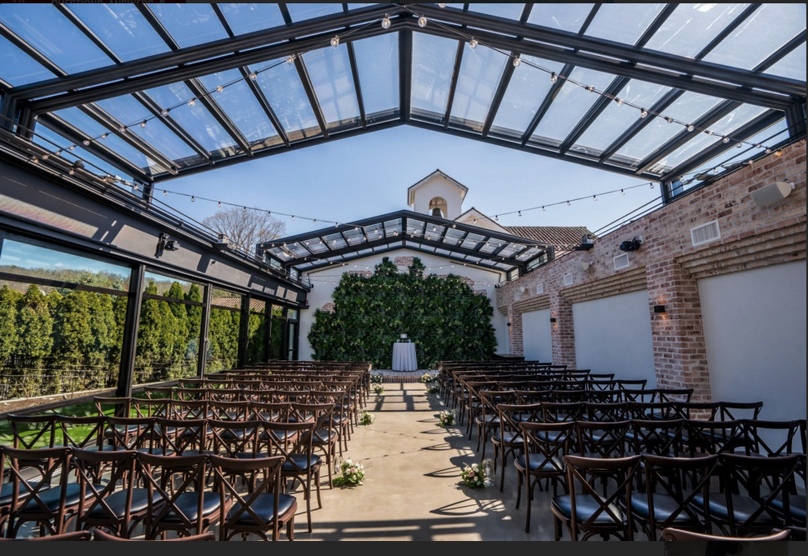
Cages as Hollow Spaces
Ambiguities
--Perspective—from the inside or the outside
--Keep something in or keep something out
--Escape hatches
--Cages within cages

Slide 3
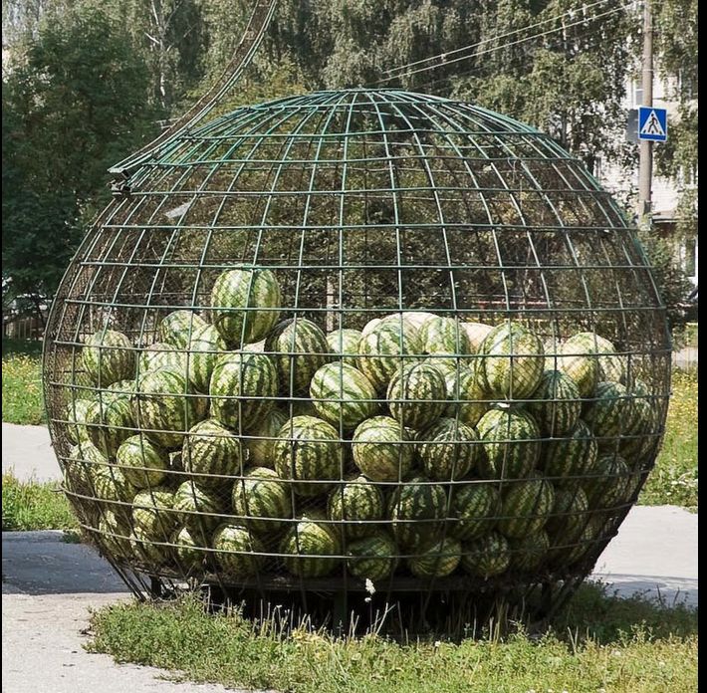
Roadmap
I will explore the way this cage imagery defines both the project of legalization in China
More specifically, of its manifestation as, in and through the construction and operation of the social credit system (SCS) of China.
SCS, is caged within something wider and more powerful: the cage of socialist legality.
And thus the research question in what ways are social credit systems embedded into the conceptualization, and implementation of socialist legality.

Slide 4
The Semiotics of Social Credit

Slide 5
SCS as Object
Formal constitution of SCS Legality:
An information aggregation and sharing service where social credit platforms are developed to aggregate credit information, in the style of an API (application programming interface).
A regulatory enforcement instrument with the object of facilitating compliance.
A project of legalization of, or better put of legalization around, the projects of information aggregation and regulatory enforcement
This is where much of the formal work of objectifying SCS within the cage of regulation occurs
Legalizing mechanics (data protection, list production and use, guidelines for use, etc.)
Coordinating producers and consumers of SCS
With thanks to Jamie Horsley for this

Slide 6
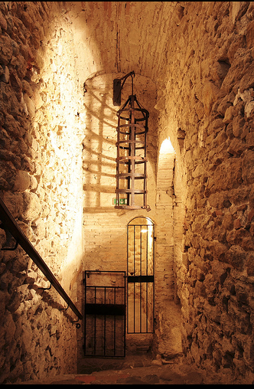
SCS as Interlinkages
Detach the mechanics of SCS from its legalization through or by state organs
Centering the technologies of data driven governance
The Rationalization of the techniques of nudging
Dataificaiton and modeling
SCS as the science of reductionism and essentialization
This is the face of the private ratings and ranking systems and of their interface with formal SCS le¡galities

Slide 7
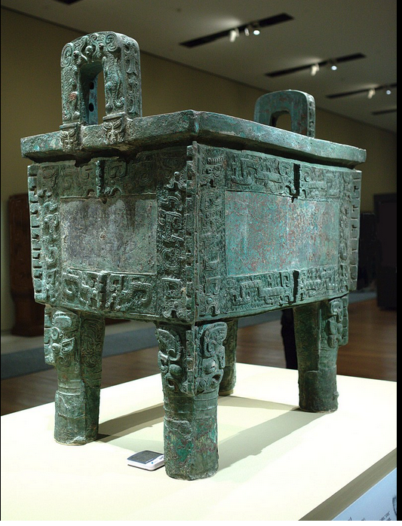
SCS as Ideology
Moral/cultural project
Trustworthiness
Core socialist values
Mechanisms for measuring and assessing
Political project
Perfecting socialist legality
A rectification project for law: stripping away ideological detritus of liberal democracy
The cage of regulation (笼子里) may actually be a representation of the vessel of state power (鼎)—the vanguard--within which everything exists.
The Houmuwu Ding is the largest piece of bronze work found from the ancient world so far. It was made in the late Shang dynasty at Anyang.

Slide 8
The Cage of Regulation and Regulation Caged

Slide 9
SCS Within the Cage of Socialist Legality
Purification
Purging/cleaning up the contradictions imported through the Era of Reform and Opening Up
Developing modalities of legality unblemished by liberal democratic ideologies, principles and operating styles
The Socialist Path
Articulation of mass line policies
Quantification of the guiding principles of People’s Democratic Dictatorship
Legalization of Self-Criticism (检讨jiǎntǎo)
Quantitative self reflection guided by the core of leadership
Realization of an all-around socialist collective

Slide 10
Socialist Legality Within the Cage of SCS
Convergence of three fundamental trajectories of socialist legality
Objectives based legality:
Law commands results (eg, wholesome food) or
Law describes an ideal state (eg, trustworthiness)
Realized through complex systems of exercises of administrative discretion
Officials exercise quasi-judicial, administrative and regulatory authority
These are assessed against commands and ideal state baselines
Objectives and discretion guided under vanguard leadership
Source of normative legitimacy of socialist legality
Socialist legality as an expression of vanguard fundamental political line
SCS as a mechanics of socialist legality
Quantifiable guidance and disciplinary mechanism
A means of (1) modeling objectives based legality; (2) caging exercises of administrative discretion; and (3) coordinating and rationalizing comprehensive state management system
Socialist legality expressed as quality control.

Slide 11
Cages Within Cages

Slide 12
SCS and the Rectification of 全过程民主 Whole Process Democracy
Socialist legality attached to but not within the state
The realm of popularized credit histories operated through private entities
Modalities of nudging drawn from individual behaviors
The cage of regulation here focuses inward
Integrity/trustworthiness of SCS
Data protection
Robustness: (1) analytics and algorithms; (2) information sharing integrity
Different cages:
Where the formal objectification of SCS focuses on administration and coordination
Rectification focuses on the internal integrity of the systems themselves

Slide 13
Whole Process Democracy and Social Credit Platforms
Consultation as data production and consumption
The quantification of the administration of the mass line through platforms
That data production and consumption (consultation) can be used to measure both the quality of outreach and the quality of input through consultative organs
Example:
Monitor the consultation process
Monitor the quality of received information
Monitor feedback
Points of Monitoring
People giving information
Members of political collectives
Operations of the institutions

Slide 14
Whole Process Democracy Through Social Credit Mechanisms? Objectives
Ratings of Representative Organs
As against an ideal or objectives
Quality control
Information
Producing data for consumption in whole process democracy
Coordination or consolidation of data harvesting
Disciplinary Tool for Individuals
Quality of performance; solidarity enhancing measures
Adherence to Vanguard leadership expectations
Monitoring
Training, effectiveness measures
Coordination
Between political and administrative apparatus
Management of systems of punishments and rewards
Integration into current systems

Slide 15
Whole Process Democracy and Anti-Corruption/National Security Measures
Objectives: (1) integrity, (2) accountability, (3) quality control, (4) outreach, and (5) capacity building.
Disciplining and monitoring
Individuals in their representative capacity
Representative organs in their institutional capacities
Tied to Internal Discipline
Coordination and quantification of monitoring
Coordinating corruption and anti-patriotic measures
Solidarity building through education campaigns
Measure effectiveness
Measure effectiveness of coordination

Slide 16
Whole Process Democracy and Coordination of Punishments and Rewards Systems
Refinement of Patriotic Campaigns:
rights to participate in consultation dependent on appropriate behaviors and credit scores
Monitoring of quality of inputs affects personal Social Credit Score
Add participation measures to Social Credit scoring
“To the people” monitoring
Review quality of popular interaction
Budget rewards and punishment for meeting goals

Slide 17
From Whole Process Democracy to AI Assisted Predictive Governance
Endogenous democratic systems require substantial interactive capability
Social credit systems start to get at the problem of input and output in large capacity systems
It serves to manage and protect the integrity of sub-routine systems (mass organizations, administrative organs)
Effective tool for coordination and management by the core of leadership
If whole process democracy is the theory; then digitalized social credit techniques might serve as an important integrity enhancing tool
When combined with predictive analytics, modeling, and reward/punishment algorithms, an AI assisted whole process democracy may be feasible in the way that AI assisted modeling can simulate markets:
九鼎 (Jiǔ Dǐng) now become digital, simulated, and AI assisted platforms

Slide 18
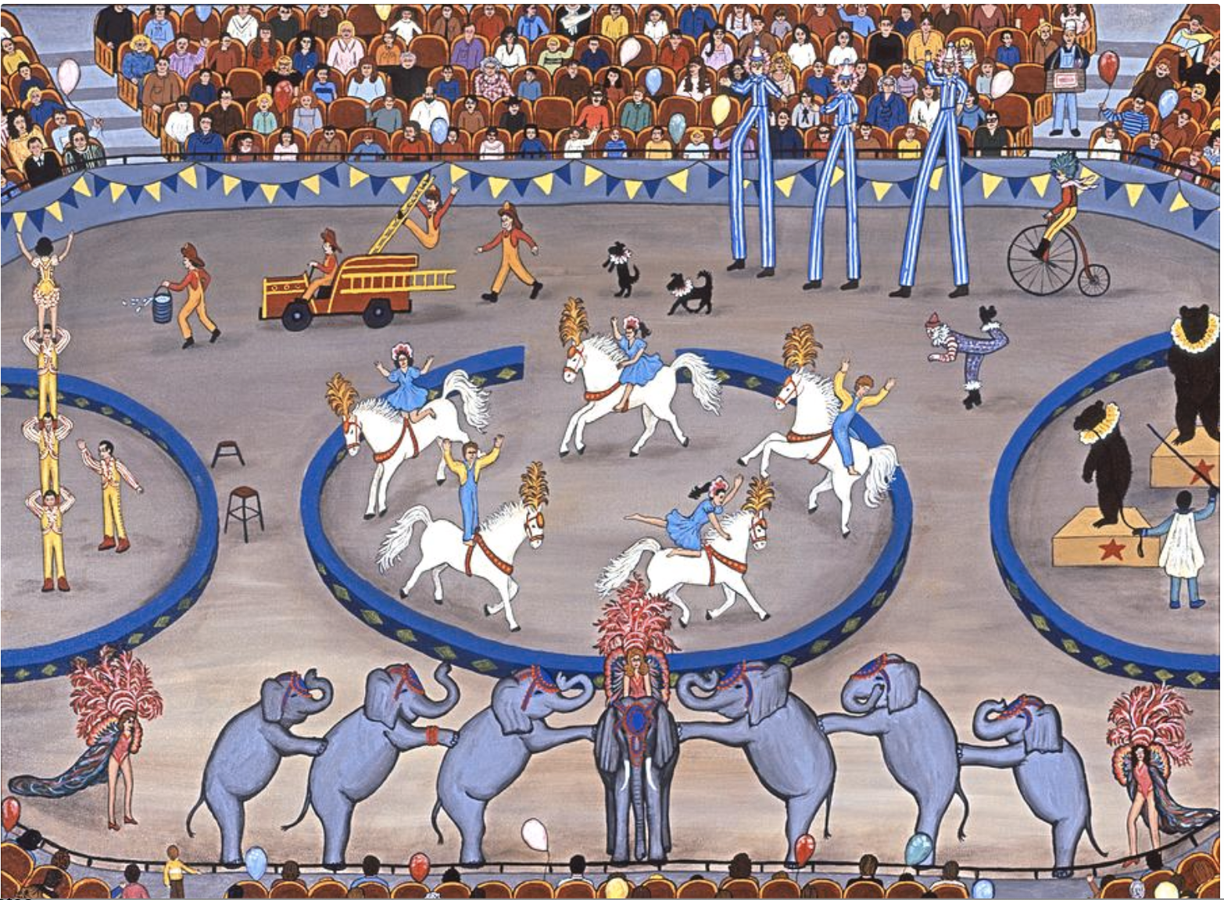
Summing Up SCS in the Cage of its Imaginaries
Not a singular event or project
Inter-governmental project
platform
Represents an alternative and potential socialist approach to
Legality
Governance, and
Language
Points away from institutionalism (bricks and mortar government) toward the simulated state (virtual, smart city type government)
Is rationalized in 3 keys: (1) object; (2) network; (3) ideology.
Constructs a dynamic relationship between cage and caged in which law and administrative decision-making (quantified through SCS) become each other’s cage

Slide 19
QUESTIONS?

Slide 20
谢谢 Thanks

