Slide 1
Hong Kong Between Sovereignties, Autonomies, and Self-Determination
Larry Catá Backer
Pennsylvania State University
Rage, Reckoning & Remedy: 7th Global Meeting on Law & Society
Panels on: Law, Resistance, & Authoritarianism; Jointly Sponsored by CRN01, ALSA, CRN33, & IRC
15 July 2022

Slide 2
Genesis of the Project
The book critically examines the conflict of words between Hong Kong protesters, the Chinese central and local authorities, and important elements of the international community.
This decisive discursive contest paralleled the fighting for control of the streets and that pitted protesters and the international community that supported them against the central authorities of China and Hong Kong local authorities.
Derives from book, Hong Kong Between ‘One Country’ and ‘Two Systems’: Essays From the Year that Transformed the Hong Kong Special Administrative Region (2019-2020) (Little Sir Press, 2021)

Slide 3
The Three Faces of ‘One Country’ Two Systems’
Drawn from the emergence of three distinctive approaches to sovereign governance (and their implications) that played a role in the narrative battles around the Hong Kong protests of 2019-2020.
Internal sovereign partitioning under or within a superior national constitutional order
External sovereign partitioning under or within international law or norms
Shared sovereign partitioning based on indigenous self-determination.

Slide 4
The Hong Kong Context
9 June 2019 protests triggered by the Extradition Bill but reflecting festering issues
June 2019-May 2020 increasingly aggressive engagement between protesters, local and central authorities, and the international community
February 2020 COVID changes the context of protests and state response
June 2020 enactment of National Security and National Anthem Laws and the triumph of the central authorities
U.S. augments sanctions regimes; UK opens door to migrants
Election Law revised

Slide 5
At the Center: ‘One Country, Two Systems’ Principle
1985 Sino-British Joint Declaration (中英联合声明) (“JD”)
Blueprint for the return of Hong Kong to China.
Interpretation disputed
Chinese position:
Hong Kong Autonomy consigned to discretion of the Chinese central authorities guided by the JD as an initial matter
Autonomy grounded in economic policy and rights
UK position:
HK Autonomy guaranteed in form and duration by the terms of the JD
International instrument constrained domestic discretion at least until 2047
Autonomy grounded in civil and political rights

Slide 6
Sovereignty at the Center after 2019

Slide 7
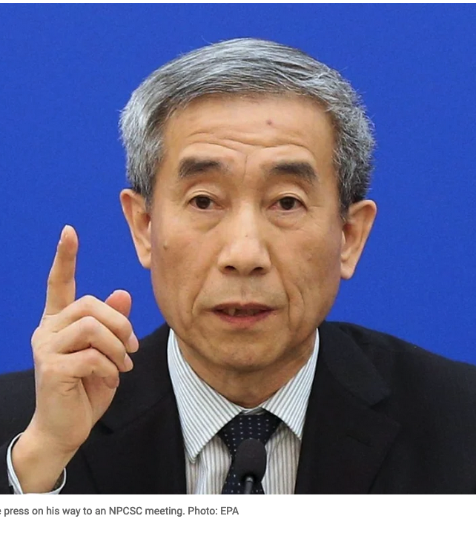
China: ‘One Country’ Over ‘Two Systems’
Alignment of territorial sovereignty with effective control of political life:
key issue what is the system over which autonomy is possible?
Autonomy
Is a discretionary decision constrained only by the constitutional order of the state
Must be consonant with the national political-economic order
Autonomy grounded in economics (markets) but not political order
Limits
Avoids separatism
Purely internal matter
Deng Xiaoping ‘Patriots ruling Hong Kong’
Objective:
Pearl River Delta integration

Slide 8
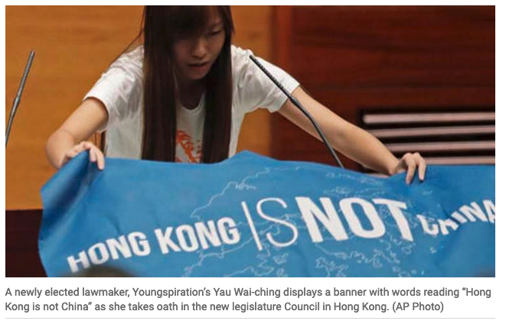
Protestors: ‘Two Systems’ over ‘One Country’
Hong Kong autonomy is inherent in the formula for reunification
Respect for the evolving separate customs and traditions of HK people must not be inhibited
The baseline for that autonomy is memorialized in the JD but is not necessarily bound by its terms
international law and the protection of minorities and minority development acts autonomously;
Indigenization of Hong Kong people with resonance to norms for the protection of indigenous rights
international community has a responsibility to protect the rights of HK people under international law.

Slide 9
‘Two Systems’ and ‘One Country’ Under International Normative Order
Variation 1
Chinese territorial and ultimate sovereignty recognized
China elected to waive operational sovereignty as the price for reunification through peaceful means
That “contract” was embodied in the JD which serves as a constraint on the power of the domestic Chinese constitutional order
international order has the authority to intervene to ensure Chinese compliance with its international obligations under the JD
Ends in 2047
Variation 2
Chinese territorial and ultimate sovereignty recognized
Operational sovereignty constrained by international law, principles and norms, including the principle of self-determination
Hong Kong’s political autonomy and constitutional order is internationalized and left to the HK people to decide
That autonomy guaranteed under international law
Autonomy is measured by distance between HK and PRC approaches to civil and political rights

Slide 10
The Different Conceptions of Sovereign Ordering in the Hong Kong Context
Sovereign division within the discretion of the territorial sovereign (the position of the Chinese central authorities)
Sovereign division as a matter of international derogation (the US/UK position)
Autonomy of sovereign governance from ultimate territorial sovereignty subject to protection under international principles of self-determination (not independence but internationally protected autonomous development (the position of part of the HK protester community).

Slide 11
Consequences: Internally Administered Autonomy Within Sovereignty
Patriotic campaigns
National Flag and National Anthem Statutes
Wall of separation to keep out “black hand” of foreign interference
Legalization of political discipline through National Security Law
Empowerment of NCP
Guidance on Basic Law and the Contours of autonomy
Defensive internationalism
Post colonial and neo-imperial narratives
Aggressive Counter-measures: Fact Sheet: U.S. Interference in Hong Kong Affairs and Support for Anti-China, Destabilizing Forces (021/09/24

Slide 12
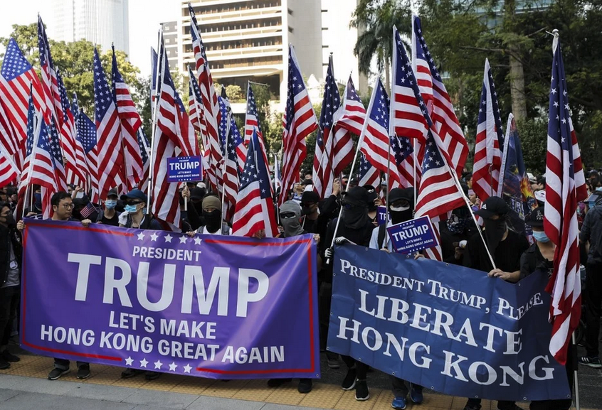
Consequences: Internationalist and Divisible Sovereignty
Inter-governmentalism
Multilateralism
IGO action
Targeted sanctions
Global Magnitsky regimes
Contests over primacy: (1) collective prosperity and stability (China) VERSUS (2) liberal democratic political rights (Int’l Community)
Alignment with bilateral and Multilateral relations
US-China trade relations
5th and 6th generation warfare
Lawfare
Application of “soft law” and Private Law regimes (human rights, development, etc.)
UNGP
OECD NCP actions
Consequences
Sovereignty in Ukraine
Dependencies in global production chains

Slide 13
Thanks
Please consider ordering the book:
More information about the book including video interviews covering each essay and some free sample chapters may be found at the Book webpage at Little Sir Press:
https://www.thecpe.org/little-sir-press-a-self-publishing-collective/little-sir-press-bookstore/hong-kong-between-one-country-and-two-systems-essays-from-the-year-that-transformed-the-hong-kong-special-administrative-region-june-2019-june-2020/

