Slide 1

Facilitating Energy Transition: A Human Rights and Soft Law Perspective
2nd Energy Transition Colloquium
West Virginia University, Rockefeller School of Policy and Politics, Dept. of Public Administration
Paolo D. Farah, Conference Chair
West Virginia University 16-17 June 2022
Larry Catá Backer
W. Richard and Mary Eshelman Faculty Scholar Professor of Law and International Affairs
Acting University Ombudsperson (from October 2021) University Ombudsperson Elect
Pennsylvania State University | 239 Lewis Katz Building, University Park, PA 16802

Slide 2
Questions
Do human rights provide a useful lens for framing energy transition challenges?
  Human rights provides the basis for measuring and valuing both the basis of energy consumption and the costs of transition by reference principally to human welfare
Is it necessary to rely solely on traditional forms and cultures of law to navigate transition?
  Is the issue of energy transition a challenge that also decenters law and legal mechanisms; is the nature of the challenge measurable and quantitative or conceptual and qualitative?
  Data based platform governance and new modalities of managing people, processes, and activities
Is it possible to invert the analysis of energy transition?
  from its principal focus on objectives (e.g., climate change) as the goal, evidenced through markers of bio-diversity and the environment measured in its value to human productivity apart from those systems,
  to an analysis that focuses on bio-diversity and stable environment as the goal of energy transition, the evidence through climate change mitigating measures and measured in its value to human sustainability within those systems?

Slide 3

Energy Transition in the Shadow of Climate Change: Goals and Pathways as Ambiguous Binary Relations
Climate Change is the object and human rights is the pathway
  The law is one centered on the human and their “rights”
  The state of those rights is to be preserved through “climactic effects” on human rights
Human Rights is the object and changes to climate is the pathway
  The law is one centered on identification and management of climate changing behaviors
  The state of the climate is of interest only to the extent that it has a legally cognizable effect on current interpretation of the “rights” of humans; the human and the environment are viewed as inhabiting different spheres
Sustainability is the objective, the pathways to which are through climate and human rights
  The law de-centers the human; focus on managing human behavior within ecologies of living things
  Accountability is grounded in and the science of climate data baselines;
  predictive analytics and monitoring with penalties and incentives structure programs of behavior normalization aligned with climate objectives baselines
  Energy transition is a mediating set of measures to align human and environment

Slide 4

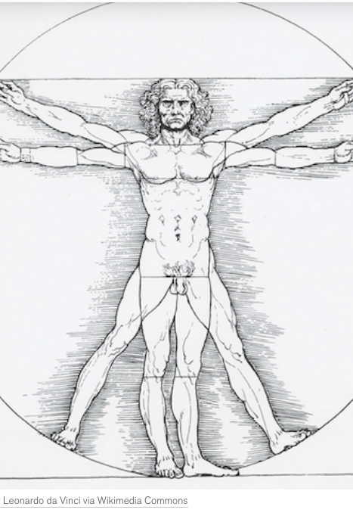
The Current State of Energy Transition Through the Lens of Climate
Human centered
Grounded in exogenous positive law in the form of command
Increasingly aligned with two political pathways:
  Centrally managed planned administrative-bureaucratic structures (the state at the apex)
  Coordinated judicial interventions (dispute resolution with broad regulatory effect)
Climate as a consequential object or measuring stick
  Of consequence because and only to the extent of its impact on the organization and production of human good (as that is valued and measured form generation to generation)
Energy transition is understood as a technical matter with economic consequences rather than as a normative challenge

Slide 5

Energy Transition is the object and human rights is the pathway—A Matter of Cause and Effect
A useful lens: Report of the Special Rapporteur John Knox “on the human rights obligations relating to climate change” (A/HRC31/52 (2016)
  Centering the edifice of human rights
  Constrained within the analytic framework of “effects on” humans (including human collectives)
    Report ¶¶23-32
  What is protected is not climate or the environment, but the human condition, damage the cause of which is change to climate—as a matter of law AND norm.
    Report ¶¶33- 49

Slide 6

The Legal Structure of Consequences for a Human Centered Focus on Energy Transition Triggered by Climate Change
Procedural Obligations (¶¶50-61):
  Assessing and providing information
  Facilitating participation (liberal democratic; elites/aristocratic; sages/Marxist-Leninist?)
Remedial Obligations (¶¶62-64)
  The issue of ‘effectiveness’
  State based and judicial (Query OHCHR ARP project on remedial heterogeneity in the context of human rights-based wrongs)
  “ which might include monetary compensation and injunctive relief, for violations of the right of free expression in connection with climate-related projects” (¶ 63)
Substantive Obligations (¶¶65-80)
  Top down—internationalist supremacy
  Bottom up—Nationalist primacy? (“States have discretion to strike a balance between environmental protection and other societal goals, such as economic development and the promotion of other human rights.”)
  Indigeneities and vulnerabilities—the issue of agency (¶¶81 et seq)

Slide 7

Energy Transition Nudging ThroughThe State of Climate Change as Human Rights:
Litigation at the national and international level
  Strategies/ Judicial Law-Standard Making
  Causation
  Social-Normative effect
Lawmaking/Regulations/Systemic measures
  Substantive objectives
    Hard and soft law
    National-regional-international
  Administrative—State managed Private Law
    EU: Corporate Sustainability due diligence measures Initiative (directive proposal 2022)
    Supply Chain Due Diligence measures (Europe)
☛Markets based
--UNGP/OECD Guidelines (NCP)
--The Prospects for an International Instrument
--German Federal Ministry of Labor and Social Affairs:
Supply Chain Conference--Sustainable value chains –
Success factors for an internationally accepted
binding standard
--IGWG process since 2014
--Framework Treaty?

Slide 8
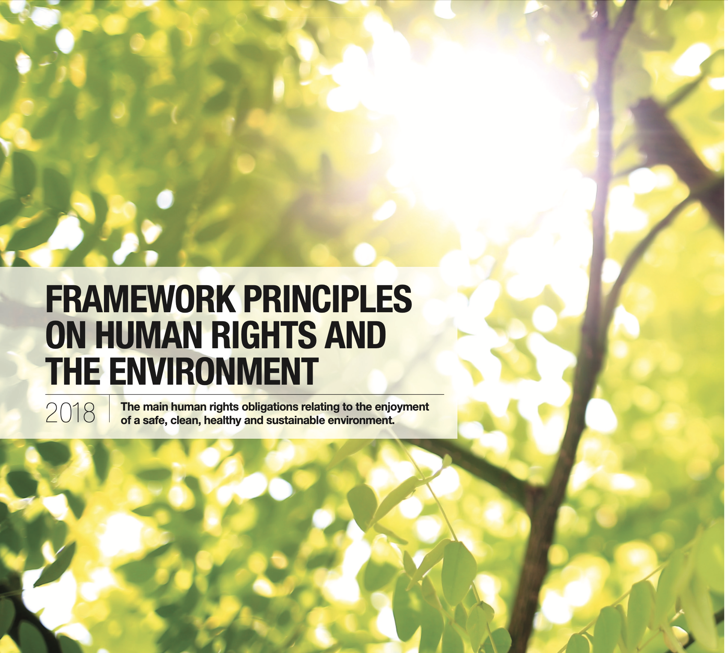
The Sum of all Things?

Slide 9
Apex Expressions: Framework principles on human rights and the environment
8. To avoid undertaking or authorizing actions with environmental impacts that interfere with the full enjoyment of human rights, States should require the prior assessment of the possible environmental impacts of proposed projects and policies, including their potential effects on the enjoyment of human rights.
9. States should provide for and facilitate public participation in decision- making related to the environment, and take the views of the public into account in the decision-making process.
10. States should provide for access to effective remedies for violations of human rights and domestic laws relating to the environment.
11. States should establish and maintain substantive environmental standards that are non-discriminatory, non-retrogressive and otherwise respect, protect and fulfil human rights.
12. States should ensure the effective enforcement of their environmental standards against public and private actors.
13. States should cooperate with each other to establish, maintain and enforce effective international legal frameworks in order to prevent, reduce and remedy transboundary and global environmental harm that interferes with the full enjoyment of human rights.
14. States should take additional measures to protect the rights of those who are most vulnerable to, or at particular risk from, environmental harm, taking into account their needs, risks and capacities.
1. States should ensure a safe, clean, healthy and sustainable environment in order to respect, protect and fulfil human rights.
2. States should respect, protect and fulfil human rights in order to ensure a safe, clean, healthy and sustainable environment.
3. States should prohibit discrimination and ensure equal and effective protection against discrimination in relation to the enjoyment of a safe, clean, healthy and sustainable environment.
4. States should provide a safe and enabling environment in which individuals, groups and organs of society that work on human rights or environmental issues can operate free from threats, harassment, intimidation and violence.
5. States should respect and protect the rights to freedom of expression, association and peaceful assembly in relation to environmental matters.
6. States should provide for education and public awareness on environmental matters.
7. States should provide public access to environmental information by collecting and disseminating information and by providing affordable, effective and timely access to information to any person upon request.

Slide 10

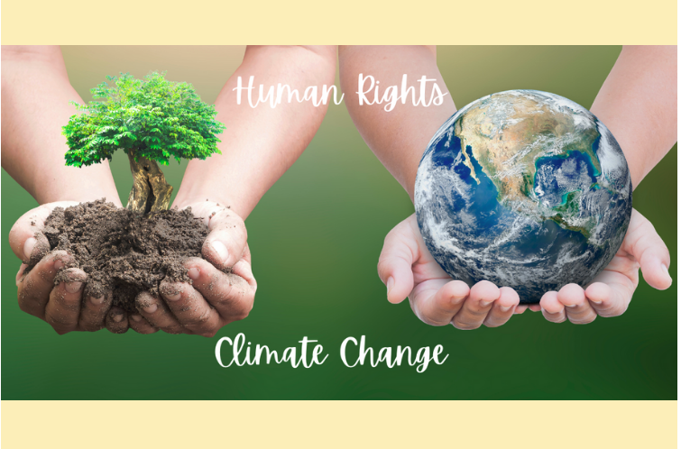
The Object of Protection?
Human Rights
  Climate and sustainability a function of “rights”
  “Rights” are a function of the valuation by humans and human collectives of the world around them
  “Rights” are objects legitimated through the exogenous acts of states, of courts, and of administrative and other institutional bodies
  Detachment of “rights” as inherent in the human collective from the “autonomy” and “agency” of the individual
  Climate is a consequential measure of the human in and on Earth
Climate
  Human Rights the means by which changes to climate is measured
  Climate has no “rights”; it is the welfare producing complex of exogenous physical relations on which human rights are dependent
  Climate is protected in itself—but only in relation to its value to the human
  Bio-diversity as a measure not in itself but in its relation to the human as the center of value.
  The human as “Good Shepard”

Slide 11

The Role of Energy Transition
Where? To What Ends?
Managing climate change but preserving the current levels of development?
Equalizing access to post petroleum energy (North-South; rich-poor, etc.)?
Development and transition—the unequal pace of transition issue?
The ideology of energy: nuclear energy at the center?
The costs of transition on bio-diversity (e.g., wind power killing migrating birds, etc.) versus social benefit to humans?

Slide 12

Climate; Transition, and the Post Anthropocene
The human within in global ecologies
  The triumph of the endogenous
  Requires reorienting traditional human exogenous relation to the world around them
Climate as the expression of the equilibrium functioning of that embedding
focuses on bio-diversity and environment as the goal
  the evidence of which is measured through climate change mitigating measures

Slide 13

Pathways to the Post-Anthropocene
The law de-centers the human; focus on managing human behavior within ecologies of living things
Accountability is grounded in and the science of climate data baselines;
predictive analytics and monitoring with penalties and incentives structure programs of behavior normalization aligned with climate objectives baselines
The objectification of the human and human collectives
And now the question of power and power relations transformed but not eliminated
Machine Rule? Social Credit?
The triumph of bio-politics

Slide 14
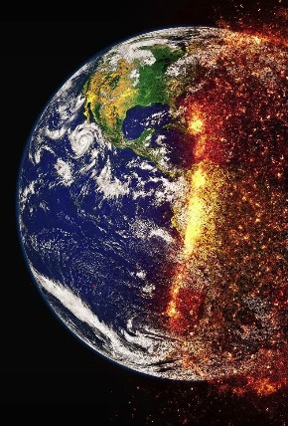
Summing Up
Substantial recent measures suggest the shape and trajectories of efforts to protect the environment especially with respect to the effects of human oriented hyper changes to climate. Transition might play a mediating role.
Those measures are deeply embedded in a set of premises that themselves tend to work against climate equilibrium states
  Human centered—The earth as object separate from the human
  Exogenous measures
  Cause and effect as a function of human values
Characteristics
  Remedial—damages; injunction
  Administrative—precautionary principle (prevent-mitigate-remedy)
  Tension between ex ante and post facto approaches
  Tension in the organization of power and power relations:
    Administrative VS judicial
    State VS International
    Public VS private
Climate remains the object and effectively de-centered
  Yet reform and reframing produces its own contradictions

Slide 15

Thank you!
“Sustainability, like pollen, is very much in the air north of the Equator. It is sticky and meant to fertilize just the right receptacle to produce from this connection those fruits or encapsulations that can be consumed by others the seeds of which, then excreted, or unconsumed and rotting can fall to earth, in either case giving rise to new life. . . . The curation choices are made [or which are made] in the hopes of successful fertilization leading to the production of fruit that, consumed by the great state actors attracting these pollinators, might then be "processed" into new regulatory Lebenswelt “.

