Slide 1
‘The Flower of Democracy Blooms Brilliantly in China’ [中国的民主之花绚丽绽放]: The Chinese Communist Party and the Chinese Constitutional Order
Larry Catá Backer, (白 轲) W. Richard and Mary Eshelman Faculty Scholar Professor of Law and International Affairs Pennsylvania State University
Prepared for Conference:
Constitutional Law of Greater China
9-10 December 2021
Oxford Programme in Asian Laws

Slide 2
The Ugly Duckling of Constitutionalism
The constitutionalism of liberal democratic orders
start from the premise that all sovereign power is vested in a government
authority is ordered and constrained by a constitutional document,
vested in a government suitable for the times but loyal to its core normative premise (about which there is consensus).
What happens when a constitutional order starts from a different set of premises?
Authority, legitimacy, transitory nature

Slide 3
A Different Starting Place for Chinese Constitutionalism
delegation of sovereign authority from the people to its leading forces constituted as a vanguard party
administrative authority is realized through state organs and principles of endogamous democracy
At all levels: accept the leadership of the Party and its guidance in the governance of the nation.
Shaping Scope of (internal) Debate:
nature and scope of exercise of CPC political authority
The nature and scope of limits on the exercise of CPC discretionary authority
This contribution: examines the Chinese constitutional system within the parameters of its own political assumptions.
Constituting documents
With the CPC at the center

Slide 4
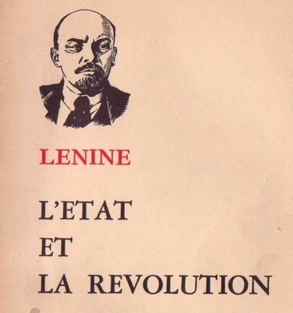
Leninist Constitutionalism: State and Party Autonomous and Entwined
State Constitution Preamble; Constitution,
affirms, in legal form, the achievements of the struggles of the Chinese people
sets out the fundamental system and task of the state.
treated as the fundamental standard of conduct
expresses the cause of building socialism under the leadership of the vanguard CPC
Develops mechanisms for democratic engagement under CPC guidance
Implementation (art. 1)
People’s democratic dictatorship
Socialist character of system
“Leadership by the Communist Party of China is the defining feature of socialism with Chinese characteristics.”
Constitutional Integrity (art 2)
“The organs through which the people exercise state power are the National People’s Congress and the local people’s congresses at all levels.”
Apply principle of democratic centralism (as legal methodology)

Slide 5
E Pluribus Unum: Article 5, the State, and the CPC
The People’s Republic of China shall
practice law-based governance and
build a socialist state under the rule of law.
The state shall safeguard the unity and sanctity of the socialist legal system.
No law, administrative regulation or local regulation shall be in conflict with the Constitution.
All state organs and armed forces, all political parties and social organizations, and all enterprises and public institutions must abide by the Constitution and the law. Accountability must be enforced for all acts that violate the Constitution or laws.
No organization or individual shall have any privilege beyond the Constitution or the law.
* * * * * * * *
Recall here: constitutionalization of people’s democratic dictatorship (art. 1)
Recall here that “building a socialist state” (art. 1) may not be damaged by any organization or individual.
Recall as well (art 1) “Leadership by the CPC is the defining feature of socialism “

Slide 6
Operational Principles
the state (and its organs) is charged with safeguarding “the unity and sanctity of the socialist system”
This necessarily includes safeguarding the paramount leadership role of the CPC as the essential feature of socialism with Chinese characteristics.
no exercise of authority by or through the state organs “shall be in conflict with the Constitution.”
encompasses the usual supremacy provisions of constitutional documents generally
But first responsibility of of constitutional legalism is to avoid damaging the socialist system
Key element of that responsibility: the leadership of the CPC.
all state organs and other collective organizations (including the CPC itself) are bound by the State Constitution and its legitimately enacted laws. (Art. 5).
prohibits extending any “privilege beyond the Constitution or the law” to any individual or organization, including the CPC itself (Cage of rules).
But CPC is the master of the socialist path guided by ruling ideology and rationalized through its own rules

Slide 7
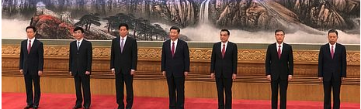
Situating the CPC within and Beyond the State Apparatus
State Council's White Paper: China: Democracy That Works on 4 December 2021 (original: 中国的民主): endogenous democracy under leadership of CPC bounded by principles of democratic dictatorship
If CPC falls outside the reach of the State Constitution, then the CPC is itself incapable of developing and abiding by its own rule system in its leadership role.
If CPC is itself bound by the State Constitution, then the socialist system which the State Constitution expresses but does not constitute if left without a vanguard, which is the essence of Leninist constitutionalism.
to challenge the CPC’s authority to exercise its leadership of the socialist system itself by suggesting it incapable of binding itself to its own rules would appear to produce a substantial damage to the socialism itself.

Slide 8
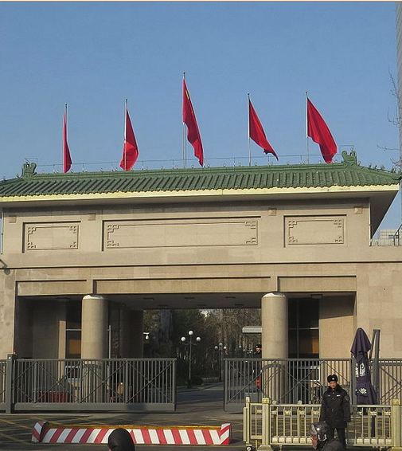
Constituting the Vanguard as Polity: The CPC Constitution
If the highest political authority in China is vested in or proceeds from the socialist system, one which may be affirmed (but not contained) in legal form, then one must look elsewhere for the articulation of those vessels within which it is either contained, held, or expressed.
CPC constitution memorialization of the normative essence of the socialist system and the institution of the CPC as its steward.
Vanguardism
Leading social force as long as they remain true to basic normative constraints of socialism
Ultimate fiduciary; normative basis guided by theory and duty to work toward vanguard objective
Core objective:
Lead nation to establishment of a communist society
Historical process: identifying and overcoming historical contradictions
Form
Vanguard solidarity and institutional coherence: core-collective principle
Development of a responsive basic line
Intra-party discipline (democratic centralism as a political methodology)
Historical Dialectic
While they are bounded by socialism, they are also the masters of the path socialism takes toward its objective through the iterative process of overcoming the challenges of contradiction.

Slide 9
Summary
What emerges from these provisions is the affirmation, in legal form, of the supremacy of socialism, and the socialist path,
under the leadership of the CPC as the expression and exercise of supreme sovereign authority in China
that supreme sovereign authority is exercised in legal form through a hierarchy of rules and through a similarly constituted hierarchy of state organs,
the purpose of which is to provide a rules-based expression and implementation of the principles of state socialism with Chinese characteristics to which all national and political organs are bound.
Yet that is a major constitutional concession that expresses the essence of constitutionalism in China--that the sovereign authority and its normative framework are themselves bound by their own rules

Slide 10
Constitutions and Vanguards to an End
The ends of Chinese constitutionalism:
the establishment of a communist society for the nation
Thanks

