Slide 1
The Algorithmic Law of Business and Human Rights: Constructing a Private Transnational Law of Ratings, Social Credit, and Accountability Measures
Larry Catá Backer and Matthew McQuilla
Penn State University
Prepared for Algorithmic Law and Society Symposium
HEC Paris & Ecole Polytechnique
1-3 December 2021

Slide 2
Synopsis
Examines the rise of algorithmic systems in the context of business and human rights.
Systems of data driven governance (and social credit type) systems
Exam the landscape of such algorithmic private legal systems as it has developed to date by considering the extent to which a rating or algorithmic system has been emerging around recent national efforts to combat human trafficking through so-called Modern Slavery and Supply Chain Due Diligence legal regimes and international norms.
Section 1 Context for framing algorithmic law.
Algorithmic law at the nexus point of a number of critical contemporary trends.
Section 2: Contemporary Application through Ratings Systems.
Focus on the development and use of modern slavery and forced labor ratings systems
Section 3 Ramifications for liberal democratic orders and the constitution of law.
Among the more relevant are those tied to issues of privacy, of the integrity of data, and on transparency.

Slide 3
The Temptations of Algorithmic Law For Regulating the Human Rights Effects of Economic Activity
The Challenge: filling governance gaps
Failure of state system in the face of global production
Failure of traditional administrative-bureaucratic system administered through law
Failure of direct transposition of administrative-bureaucratic model into enterprises overseeing global production
Traditional response: ineffective
Governmentalization of private sector
Privatization of governmental sector
Hardening of International soft law regimes through private law
Market as drivers (narrative control over factors of consumption and finance)

Slide 4
From Governance Gaps to Algorithmic Management
Normative principles of enterprise law and operations limited incorporation of human rights and sustainability absent direct compulsion
Direct compulsion was in turn limited by the territorial principle of domestic legal orders
Soft law measures have not filed the gap to the satisfaction of influence drivers
International hard law effort failures mimicking the failures of the human rights project as a legal normative project
Fracture as well on the meaning and objectives of law
Operational gaps: Traditional legal mechanisms detached from systems of discretion based administrative behavior management through law
Markets have been deployed as an administrative tool through development of compliance-oriented systems mimicking law
Result: emergence of transnational private law based managerial systems of enterprise self-regulation grounded in compliance and based on prevention, mitigation, and remediation principles
Move from law based to data based (compliance and accountability grounded) systems of managing behaviors

Slide 5
Hints of Movement from Law to Algorithm: Western Markets Embedded Rating Systems
Ratings systems serve as a useful entry point for the examination of emerging structures of algorithmic law and governance
Ratings Systems are Not Rocket Science (and that is a problem)
A set of normative ideals that can be reduced to a set of measurable inputs.
Relevant data that can be identified and harvested.
Measurement of relevant data against the ideal as extracted from application of norms that provide basis of measurement
Progress: measurement against the performance of other entities.
On that basis normatively infused judgments can be attached to the measures (eg “excellent”, “good” “fair” unacceptable” performance).

Slide 6
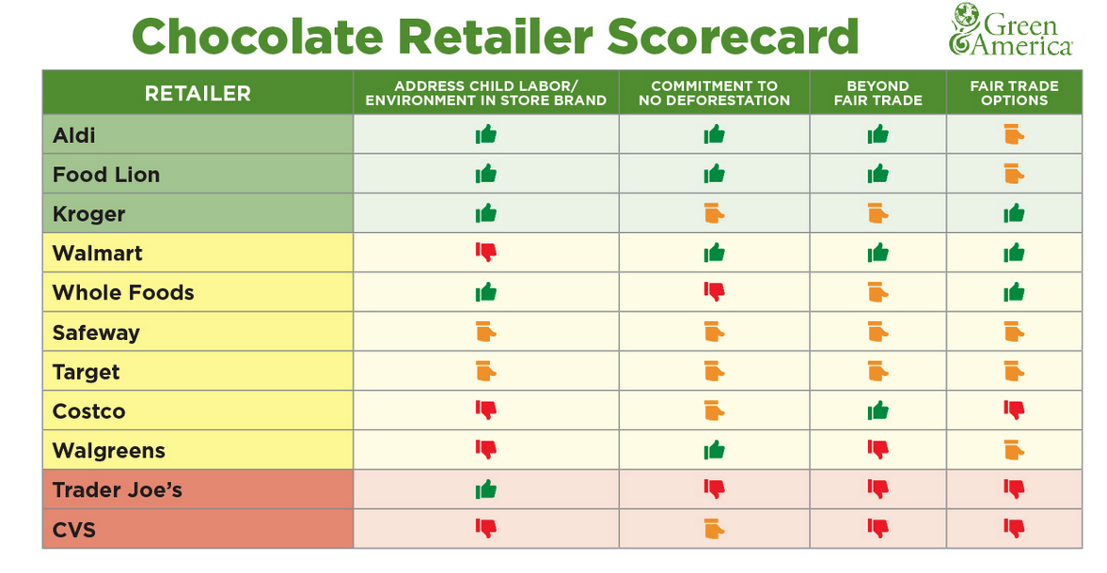
Examination of Systems
Business and Human Rights Resource Centre FTSE 100- 2018
Know The Chain KTRC-2018
Green America 2019 Chocolate Scorecard

Slide 7
Key Characteristics
No consensus on normative starting point; or end points
Translation of norms to measurable categories varies
Increasing specialization; platform as a nexus point for rationalizing process
Data collection, analytics undertaken by different partners
Networked production including financing, production, distribution elements
Platforms as mediums of consumption and production of ratings
Data, analytics, algorithmic judgment as property

Slide 8
From Ratings to System
Interlinkages: Ratings Systems as Points of Governance Convergence
Between public, private, NGO and economic collectives
Among ratings systems
Division of labor
Algorithm system functionality divided among interlinked participating organizations
Centrality of Markets
Space within which ratings-based regulation may be implemented
Projection of state and private governance in markets through the mechanics of measurable ratings
Competition among ratings systems
Convergence of norms within liberal democratic and Marxist-Leninist territories

Slide 9
The New Frontiers
Relationship between law and ratings systems
Relation between rule and norm;
irrelevance or challenge to traditional premises of democratic gvernance and organization
Algorithmic law uses action to define principle; traditional law uses principle to define acts
Law as constituting element of algorithmic systems (which/whose?)
Data and Enforcement
Traditional law operates post-facto: Law to Acts to Enforcement to Remedy
Algorithmic law operates in real time: Acts to Judgment to Action
Issues of data protection, integrity, and privacy (eg who can use what, who has responsibility for robustness of data)
Systemic Integrity and Accountability
System auditing (markets, states)
Transparency (analytics as proprietary etc.)
Who/what is audited?
Accountability of system as created/as applied

Slide 10
From “Here” to “Where”?
The rise of algorithmic law is both descriptive (judgments, punishments/rewards) and predictive (the prevention principle).
It deepens the transformation of governance from coercion and command to management grounded in principles of prevention-mitigation-remediation where role of government is as a site for accountability and the platform for organizing normative orthodoxy.
INTERNAL Challenges:
Refining and deepening the construction and application of data-based systems of measures-based management of behavior and the efficient quantification of norms. CONSTRUCTION AND OVERSIGHT ISSUES
EXTERNAL Challenges:
Embedding compliance based external rules systems within domestic legal orders—moving away from the sensibilities of qualitative command to quantitative and predictive judgment

Slide 11
Thanks!

