Slide 1
Robert Cover and International Law--Narrative Nudges and Nomadic Nomos
Larry Catá Backer (白 轲)
W. Richard and Mary Eshelman Faculty Scholar Professor of Law and International Affairs, Pennsylvania State University
Prepared for the Conference,
The Life and Work of Robert M. Cover, Touro Law Center, 4-5 October 2021

Slide 2
Of Narrative, Nomos, and Bridges
“A legal tradition is hence part and parcel of a complex normative world. The tradition includes not only a corpus juris, but also a language and a mythos - narratives in which the corpus juris is located by those whose wills act upon it. These myths establish the paradigms for behavior. “
Robert M. Cover, Foreword: Nomos and Narrative, Harvard Law Review 97:4-68 (1983)]
“I have argued not only that the nature of law is a bridge to the future, but also that each community builds its bridges with the materials of sacred narrative that take as their subject much more than what is commonly conceived as the ‘legal’.”
Robert M. Cover, The Folktales of Justice: Tales of Jurisdiction," 14(2) Capital University Law Review 179-204, 182 (1985)

Slide 3
Cover Within the Ecologies of Ouroboros
Nomoi:
expectations, habits,
Narrative:
dominion stories; boundary stories; origin stories, stories of collectivity, agency, authority and the ceremonials of creation—the identification of Eden and its functioning.
The Bridge:
temporal, territorial, abstract—from “here” to “there” . . . .and back again
The Sacral:
the imprimatur of legitimacy; the sacred oil; nihil obstat and the constitution of the priesthood (vanguard, elite, aristocracy, coders)

Slide 4
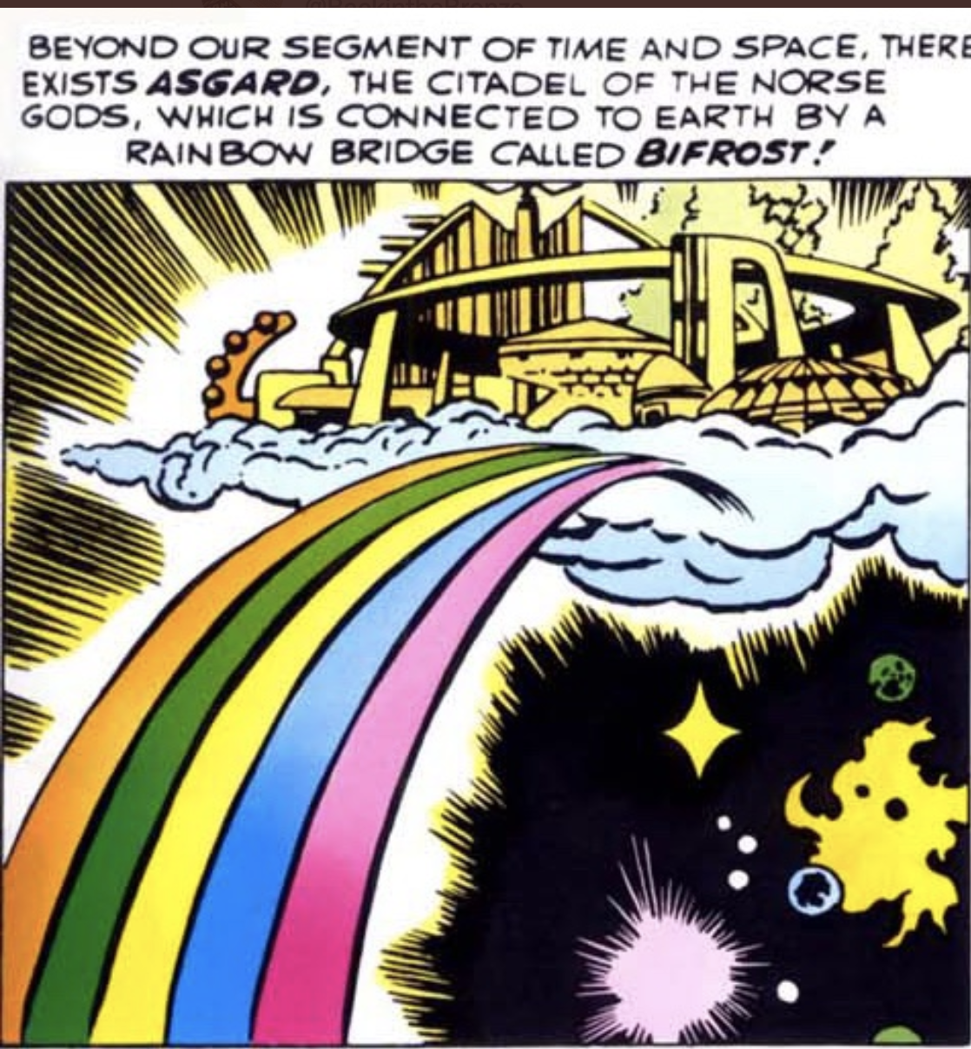
Crossing the Rainbow Bridge From Here to. . .
International law as animal husbandry
The private law of public law
The public law of private law
From Nomos to Data-Analytics
From Data to Platform as Narrative and Nomos

Slide 5
International Law as Animal Husbandry
Nomos:
Legalization of inter-state relations
Judicialization of dispute resolution
Supra-nationalization of meta-narratives
Objects: (1) Stability and prosperity; (2) Unity in diversity; (3) Convergence and consensus
A Führerprinzip embedded within the genius of collective principle; the collective‘s word is above all written law.
Narrative Taboo
Harming the wealth of nations:
Reducing the value of populations, and wealth creating structures
Mechanics:
Contracts between states
Constitutionalization of international organs
Husbanding resources for collective welfare maximization

Slide 6
The Private Law of Public Law
Nomos: Law as contract; as the terms of loan agreements; public policy as corporate governance
Narrative: The apotheosis of the collective and the de-territorialization of nomic communities.
The bridge: From the “here” of human activity, to the “there” of comprehensive projections of public power subordinated to meta-collective principles.
The sacral: The primacy of the market as the apex space for political expression

Slide 7
The Public Law of Private Law
Nomos: private law as the expression of public objectives; the state recedes as a source of a law that operates between states (private law as the solution to transnational governance gaps).
Narrative: the stories of responsible business conduct and corporate social responsibility, the reconstruction of the economic sphere as the primary space for the management of human relations and the conduct of aggregated actors. The evolution of the passive individual now stripped of agency displaced into aggregated actors (states, enterprises, NGOs etc.). The apotheosis of the victim as a legal-moral-cultural category.
The Bridge: The enterprise as public organ with private objectives from the “here” (focus on profit) to a “there” focus on the private law articulation of public policy.
The sacral: The primacy of international human right; soon the displacement the human at the center of law and their replacement by principles of the human embedded in their environment.

Slide 8
From Nomos to the Narratives of Data-Analytics
Nomos: Quantifiable measures against an ideal; the rating, algorithms and the construction of systems of rewards and punishment for deviations from the ideal. Measurability, compliance, accountability become the mechanisms of law making.
Narrative: Creation stories--the evolution and character of the ideal and the4 organization of collectives around ideal--the ideal worker, debtor, health advancing body. The legitimation of the disaggregation of the individual into an aggregation of statistics and their reconstitution as failed efforts toward perfection.
The Bridge: From qualitative to quantitative dominion. From the language of command to that of judgment. From the exogenous enforcer to the internalization of punishment and reward. The bridge crosses as well from the dominion of the lawyer, the politician, the policymaker, to the coder, the statistician, the modeler and the realm of predictive analytics.
The sacral: This is the world of Abraham’s bargaining with God over the fate of Sodom. But it is also the realm of Pharaoh’s dream. The realm of data. Gen 18:16-33. The allocation of authority between the Divine and the collective is telling.
Gen. 41:1-57. This is a sacred predictive analytics--but a small step from the interpretation of dreams to the prediction of action from big data analysis of comprehensive data driven aggregated patterns of behavior reduced to meaningful data points.

Slide 9
From Data to Platform
Nomos: Rewards and punishments interconnected by networked platforms. From law to shared spaces where users and producers meet for the purpose of exchange. The quid-pro-quo--those who contribute data to platforms can use the aggregated data in platforms for analytics.
Narrative: The apotheosis of the exogenous. Judgment is now detached from the judged even as the constitution of that judgment is assembled from the contribution of the thing judged of its data.
The Bridge: Users, producers and coordinators and the bridge itself becomes the destination. Here and there are the same place. Nomos and narrative collapse into each other.
The Sacral: The Archive. The dominion of the coordinator reigning over the iterative interactions of users and producers.

Slide 10
Summing Up
The subject is whatever constitutes itself (Lyotard, “The Earth had no Roads to Begin With,” Postmodern Fabes (1993))
“There is no more hope for meaning. And without a doubt that is a good thing: meaning is mortal. But that on which it has imposed its ephemeral reign, what it hoped to liquidate in order to impose the reign of the Enlightenment, that is, the appearance that they are immortal, invulnerable to the nihilism of meaning or of nonmeaning itself. This is where seduction begins. (Jean Baudrillard, Simulacra and Simulation, p. 164 (1981))

Slide 11
Thanks

