Slide 1

Conceptualizing the Emerging Structure of Transnational Governance in the Age of Divided Sovereignty:
The Hong Kong SAR 2019-2020
Larry Catá Backer
Pennsylvania State University
15th Annual Meeting of the European China Law Studies Association
Panel on: New Actors and Dynamics in Transnational Law: Moving Borders and Changing Concepts of Borders, Demos, and Territory
26 September 2021

Slide 2
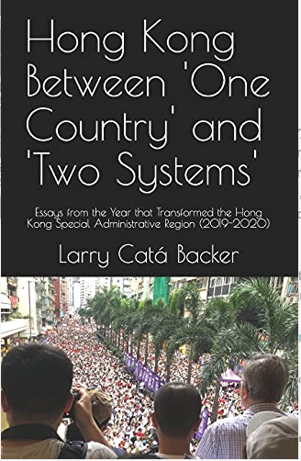
Genesis of the Project
The book critically examines the conflict of words between Hong Kong protesters, the Chinese central and local authorities, and important elements of the international community.
This decisive discursive contest paralleled the fighting for control of the streets and that pitted protesters and the international community that supported them against the central authorities of China and Hong Kong local authorities.
Derives from book, Hong Kong Between ‘One Country’ and ‘Two Systems’: Essays From the Year that Transformed the Hong Kong Special Administrative Region (2019-2020) (Little Sir Press, 2021)

Slide 3

The Three Faces of ‘One Country’ Two Systems’
Drawn from the emergence of three distinctive approaches to sovereign governance (and their implications) that played a role in the narrative battles around the Hong Kong protests of 2019-2020.
  Internal sovereign partitioning under or within a superior national constitutional order
  External sovereign partitioning under or within international law or norms
  Shared sovereign partitioning.

Slide 4

The Hong Kong Context
9 June 2019 protests triggered by the Extradition Bill but reflecting festering issues
June 2019-May 2020 increasingly aggressive engagement between protesters, local and central authorities, and the international community
February 2020 COVID changes the context of protests and state response
June 2020 enactment of National Security and National Anthem Laws and the triumph of the central authorities

Slide 5
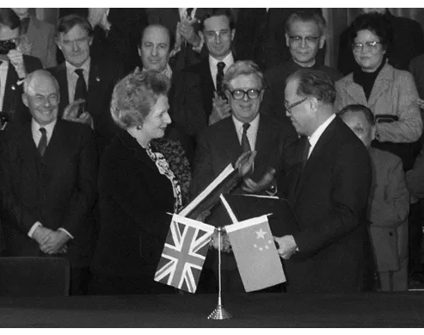
At the Center: ‘One Country, Two Systems’ Principle
1985 Sino-British Joint Declaration (中英联合声明) (“JD”)
  Blueprint for the return of Hong Kong to China.
  Interpretation disputed
Chinese position:
  Hong Kong Autotomy consigned to discretion of the Chinese central authorities guided by the JD as an initial matter
UK position:
  HK Autonomy guaranteed in form and duration by the terms of the JD
  International instrument constrained domestic discretion at least until 2047

Slide 6

Sovereignty at the Center after 2019

Slide 7
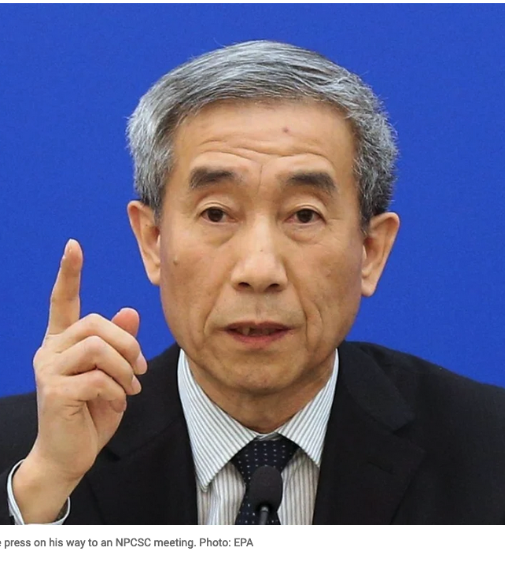
China: ‘One Country? Over ‘Two Systems’
Alignment of territorial sovereignty with effective control of political life
Autonomy
  Is a discretionary decision constrained only by the constitutional order of the state
  Must be consonant with the national political-economic order
Limits
  Avoids separatism
  Purely internal matter

Slide 8
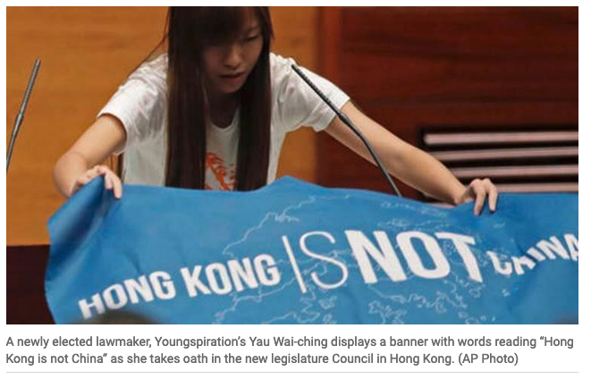
Protestors: ‘Two Systems’ over ‘One Country’
Hong Kong autonomy is inherent in the formula for reunification
Respect for the evolving separate customs and traditions of HK people must not be inhibited
The baseline for that autonomy is memorialized in the JD but is not necessarily bound by its terms
international law and the protection of minorities and minority development acts autonomously
international community has a responsibility to protect the rights of HK people under international law.

Slide 9

‘Two Systems’ and ‘One Country’ Within International Normative Order
Variation 1
  Chinese territorial and ultimate sovereignty recognized
  China elected to waive operational sovereignty as the price for reunification through peaceful means
  That “contract” was embodied in the JD which serves as a constraint on the power of the domestic Chinese constitutional order
  international order has the authority to intervene to ensure Chinese compliance with its international obligations under the JD
  Ends in 2047
Variation 2
  Chinese territorial and ultimate sovereignty recognized
  Operational sovereignty constrained by international law, principles and norms, including the principle of self-determination
  Hong Kong’s political autonomy and constitutional order is internationalized and left to the HK people to decide
  That autonomy guaranteed under international law

Slide 10
The Different Conceptions of Sovereign Ordering in the Hong Kong Context
Sovereign division within the discretion of the territorial sovereign (the position of the Chinese central authorities)
Sovereign division as a matter of international derogation (the US/UK position)
Autonomy of sovereign governance from ultimate territorial sovereignty subject to protection under international principles of self-determination (not independence but internationally protected autonomous development (the position of part of the HK protester community).

Slide 11
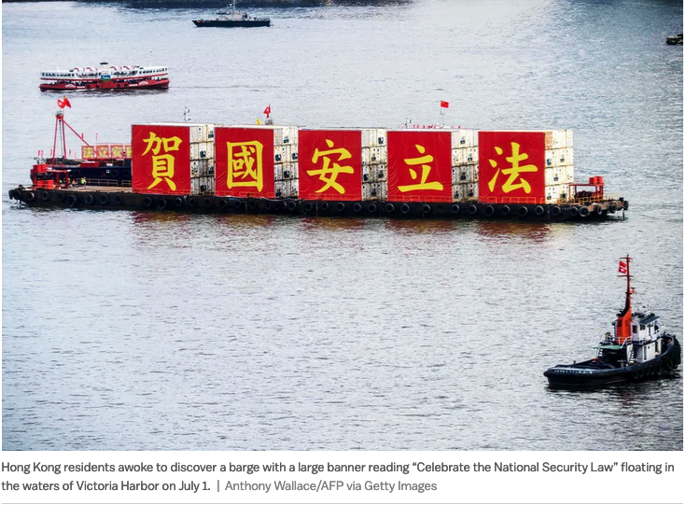
Consequences:
Internally Administered autonomy within sovereignty
  Patriotic campaigns
    National Flag and National Anthem Statutes
  Wall of separation to keep out “black hand” of foreign interference
    Legalization of political discipline through National Security Law
  Empowerment of NCP
    Guidance on Basic Law and the Contours of autonomy
  Defensive internationalism
    Post colonial and neo-imperial narratives
    Aggressive Counter-measures: Fact Sheet: U.S. Interference in Hong Kong Affairs and Support for Anti-China, Destabilizing Forces (021/09/24

Slide 12
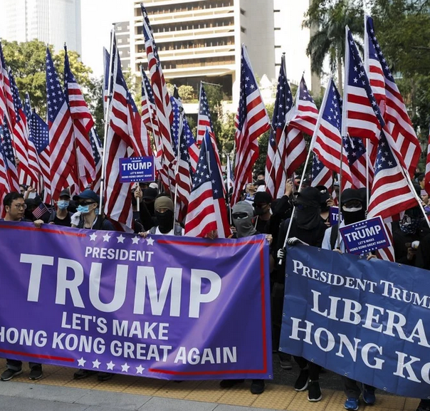
Consequences:
Internationalist and Divisible Sovereignty
  Inter-governmentalism
    Multilateralism
    IGO action
  Targeted sanctions
    Global Magnitsky regimes
  Alignment with bilateral and Multilateral relations
    US-China trade relations
    5th and 6th generation warfare
    Lawfare
  Application of “soft law” and Private Law regimes (human rights, development, etc.)
    UNGP
    OECD NCP actions

Slide 13

Thanks
Please consider ordering the book:
More information about the book including video interviews covering each essay and some free sample chapters may be found at the Book webpage at Little Sir Press:
  https://www.thecpe.org/little-sir-press-a-self-publishing-collective/little-sir-press-bookstore/hong-kong-between-one-country-and-two-systems-essays-from-the-year-that-transformed-the-hong-kong-special-administrative-region-june-2019-june-2020/

