Slide 1
Trust Platforms: The Digitalization of Corporate Governance and the Transformation of Trust in Polycentric Space
Larry Catá Backer, Pennsylvania State University
Presented 31 August 2021

Slide 2
Trust and its Discursive Skeleton
Trust as a Relational concept
Reliance by the person or institution extending trust (faith)
Fidelity of the object of trust to principles and expectations (worthiness)
Signaling Trust as a Relational Concept
To be worthy of trust requires performance of acts of fidelity to legitimating values
Veracity, integrity, conformity to normative expectations or other authenticating virtues
Mutual embrace of shared values and signaling that those values would govern the actions of givers and receivers of trust
Performance of Trust and Signaling
Half century of transformation

Slide 3
Problem: The Transformation of Trust in the Age of the Digital
Personal ✑ institutional
Character ✑ Datified actions
Presumptions ✑ assessment
Unitary cultural expectations ✑ Fractured rule compliance
Internal ✑ External and Networked

Slide 4
Thesis
The shift from trust in persons or institutions to trust in assessment has been facilitated by accountability technologies and digitalization
Digitalization has inverted the traditional relationship between the trust and its objects,
Trust is becoming a function of trust in the mechanics by which trust is measured;
Compliance and accountability has fractured both the mechanics and the standards used to gauge and measure trust
Platforms become the mechanisms by which this ecology of trust and trust producing, and trust consuming communities may be interlinked.

Slide 5
Fourteen Propositions
(1) The premises on which trust is manifested have drifted from a qualitative character-based presumption to one based on principle that trust must be evidenced before it may be deduced.
From the principles of Graham v. Allis Chalmers to that of Stone v. Ritter in the context of Delaware fiduciary duty law
(2) Evidencing trust requires quantitative measures and a structure for its production, assessment and consequences that aligns accountability and trustworthiness.
(3) Datafication is the necessary mechanics for the efficient harvesting and organization of measurable objects.
(4) Datafied quantitative measures requires “quality control” (accountability). Compliance is a function of the need for objective external and verifiable accountability measured against an ideal; that it compliance serves as the conceptual vessel within which trust and accountability may be produced and utilized.
(5) Digitalization provides the context in which compliance and quantification can be aligned.

Slide 6
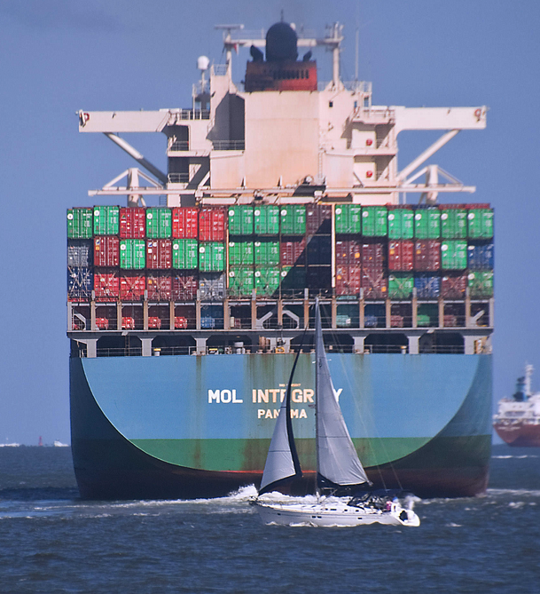
From Governance to Platforms
(6) Digitalized datafication can be made most efficient by detaching its processes and analytics from data sources and the object of compliance.
(7) Multiple consumers and producers of data and analytics create an ecology of accountability, compliance and datafied analytics that can no longer be efficiently maintained by single actor/ producer- consumers.
(8) That ecology is driven in part through markets for assessment standards and capacity for data harvesting and analytics and the proliferation of sometimes functionally differentiated markers for trust.
(9) Where can all of this activity be housed within and outside of the enterprise? Platforms serve as a potentially powerful end product structure of this trajectory.
(10) Platforms permit a rational detachment of the process of trust from the enterprises for which trust is generated; platforms provide a space within which the ecologies of trust may operate by detaching data from its generators, and assessment from the control by those who seek trust.

Slide 7
From Trust in Enterprises to Trust Platforms
(11) Through platforms, trust as a commodity that can be packaged and repacked for consumption in markets for trust the consumers of which are as varied as the standards used to produce it.
(12) These trust platforms serve as markets for data and analytics and their supporting normative bases.
--Ppermit the application of multiple regulatory or standards systems against which governance behaviors and accountability measures can be evaluated.
(13) Trust platforms serve to rationalize the space where polycentric standards and regulatory mechanisms can interact with the multiple communities that produce and consume the platform content.
(14) The resulting ecologies of corporate governance then produce interlinking of communities of users and consumers (boards, officers, stakeholders, public and private regulators) that in the aggregate transform trust into a product of these processes that then itself can be assessed by its ability to manage risk.

Slide 8
Managing Anarchy/Avoiding Chaos: The Platform
Trustworthiness an exogenous enterprise
Plural norm producers
Plural methodologies of assessing trust/rating trustworthiness
Dynamic group of trust assessment consumers and producers
Highly contextual and a function of relationship
Distinct platforms for communities of users
Inter-locking platforms where each serves as consumers and producers of data and analytics that contributes to the production of trust objects (ratings, assessments, etc.)

Slide 9
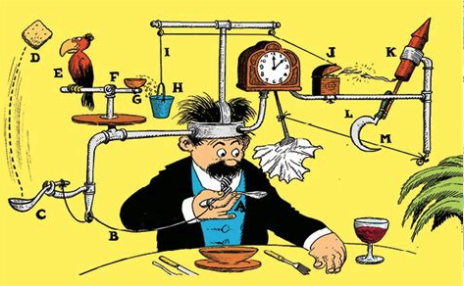
The Future
Trust in enterprises, then, become a function of trust in trust accountability systems.
What had started as an enterprise of character closely aligning individuals to their positions, became the enterprise of measuring performance and of holding performers to account.
What had been a moral presumption became a quantifiable aggregate of judgment grounded in measurement and assessed against values (and thus assessed also valued).
Trust is no longer something generated from within but assessed from outside.
That assessment varies among assessing communities with different values and different functionally differentiated objectives.
It is around this that Trust Platforms will drive trust as commodity, mechanics, and normative framework

Slide 10
Thanks
Discussion Draft may be accessed: https://papers.ssrn.com/sol3/papers.cfm?abstract_id=3895425

