Slide 1
Discussion of Aaron A. Dhir: “Black Star Line, Inc.: Race in the Historical Life of the Corporation”
Larry Catá Backer
W. Richard and Mary Eshelman Faculty Scholar Professor of Law and International Affairs Pennsylvania State University
Business and Human Rights Workshop Series
University of Connecticut Human Rights Institute
19 February 2021

Slide 2
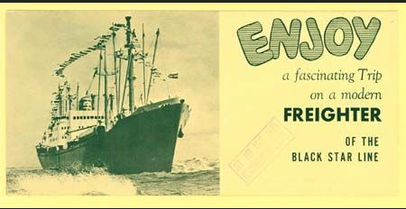
The Mechanics of the Aggregation of Power
Is there an economic value to politics and racial solidarity?
How is that valued as against the economic value of ideological solidarity?
Is the state the only corporation within which political values may be organized?

Slide 3
Framing Points
The abusive discretion of the state in the public sphere
The abusive discretion of influencers (academics, race elites) in the societal sphere
The interlinkages between natural and juridical personality
Garvey has been ghosted by elites
His project as been detached from the mainstream consensus of “proper” economic behavior in corporate form
The object, as Aaron Dhir nicely frames his introduction, is racial and political and the object to unpack both within the orthodoxies of corporate law and principles. These merit further elaboration:
Garvey as a sacrifice to advance the now orthodox integrationist ideology forged from the 1960s
Garvey as the demon prince of separation, and its Implicates for the distinction between integrationist and desegregationist projects

Slide 4
The Historical Context: A Triple Shock to the State and its Governing Ideology
Three simultaneous challenges:
Black nationalism expressed through radically racial conservative corporatism
Socialist and Marxist Labor internationalism driven by “proletariat” and foreigners expressed through labor and revolutionary internationalist movements
Women’s emancipation—the right to vote, the effective right to control property, and liberation from male domination becomes irresistible
Is it possible to consider one without considering the others
WEB DuBois reflects some of this complexity
J Edgar Hoover and the reactionary state apparatus another
The establishment of the ILO as a taming counter force
Within this broader context, Dhir considers one critical aspect and offers a critically necessary analytical perspective:
Corporation as a racialized body
Race as a corporate body
The utility of racial capitalism literature as a useful reflection of the phenomenon
Thesis:
Corporation as a site for the performance of anti-colonialism
Corporation as a form of subaltern resistance
Implicit in this approach
The relevance of the connection between capitalism and the corporation, the body corporate as an economic, societal or political space
The autonomy of bodies corporate within the realms of global production and through them, their relation to the state

Slide 5
Critique of the Critique
The Critique of the Critique:
The issue of agency
A desegregationist approach
The issue of politics
The corporate purpose approach
The issue of economics
A conflation of the ‘capitalist’ with the ‘corporate’
The Critique: When it doubt cast doubt on the mechanics of aggregation
Pathologizing the corporation from the ‘conventional’ and ‘radical’ political (Western) left and when ‘foreign’ the right
The politics of the therapeutic (deviance has always been buttressed by the science of hysteria)
The ‘monster’ model of enterprises (Brandeis’s famous ‘discourse’ in Liggett, one much beloved by the Western political left).
Ghosting, the modus operandi of the legal academy (history written out of the legal history of the corporation)
Engagement with critique:
Is it useful to disaggregate, to detach, the corporate from the capitalist? Corporate Leninism is as potent, the development mercantilism of developing states, may be as important for the analysis as the old standby capitalism’
Capitalism is in some ways an obsolete concept in the face of its transformation into ideologies of markets. Capitalism has become an instrument, but not an exclusive one.

Slide 6
Capitalism and Race
Nietzsche’s 4 Great Traps
Inverting cause and effect
False causation
Imaginary causes
The falsity of ‘free’ will.
The constitutive relationship between capitalism and race is the critical element of the analysis
Though situated within the structures of capitalism it has far broader application:
Implicates the foundational contradiction in the constitutive relationship between economic ideologies and race within which capitalism forms a sub-dialogue.
Conflation of capitalism and markets may require further interrogation; it is not clear the terms are or ought to be interchangeable.
An analytical Supplement:
1. The relationship between systems of production and ideologies of subordination (race, gender, class, religion, caste).
2. It is within this broader construct that the interconnections between ideologies of racial subordination, its expression through capitalism, and its manifestation in corporate form might be enriched.
3. Effectively the analytical value of inversion.

Slide 7
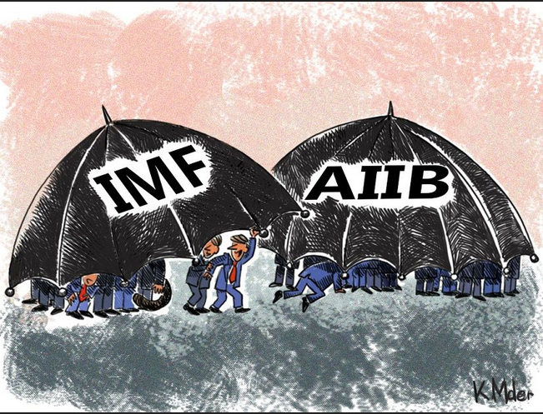
The Multi-Directionality of Racial Capitalism
Garvey’s approach
(“not solely about wealth generation,” infrastructure based, connectivity project, aligning and coordinating black production chains)
Modern expression:
China’s Belt & Road Initiative.
Infrastructure projects align with the Chinese approach in structuring the Asian Infrastructure Investment Bank system (AIIB)
There is much to the insight that racial capitalism in the West provides a normative structure but leaves open the objectives of that structure
Within that framework, only value enhancement is necessary
But what is value? A moving target (Business and Human rights revaluations; sustainability and climate change)
A semiotic project: (political-cultural) contest among groups for the control of meaning making.
Meaning is up for grans in the early 21st century moving the debate from the national to the transnational spheres
This is precisely where Garvey left it.
Garvey sought to wrest control for a little space within that construct.
It has now moved within
ideologies of global production and
within emerging Marxist Leninist approaches to aggregations of “productive forces” under the leadership of a vanguard

Slide 8
Garvey: Ahead of His Time
Race(ism) as markets
The territoriality of the African Diaspora
The construction of globalized interlinkages based on the management of production
The extra economic ideological construction of the corporate body within or through ‘race’
From Garvey to Malcolm X to Sowell to Thomas
Variations on radical conservatism?
The state as a dependency trap
The corporation (or the power to aggregate capital) to te rescue?
One can “disdain money” (WEB DuBois) but not necessary what it can buy

Slide 9
Fatalities and Alternatives
Fatalities
Mercantilism within a capitalistic enterprise
The model to avoid was the East India Company and yet that was all there was.
Alternatives:
Benefit corporations
Is Marxism an alternative o just a variation on the same themes?
Not the Black Star Lines but the “African and Diaspora Infrastructure Investment Bank”
Modern variations: African Sovereign Wealth Funds

Slide 10
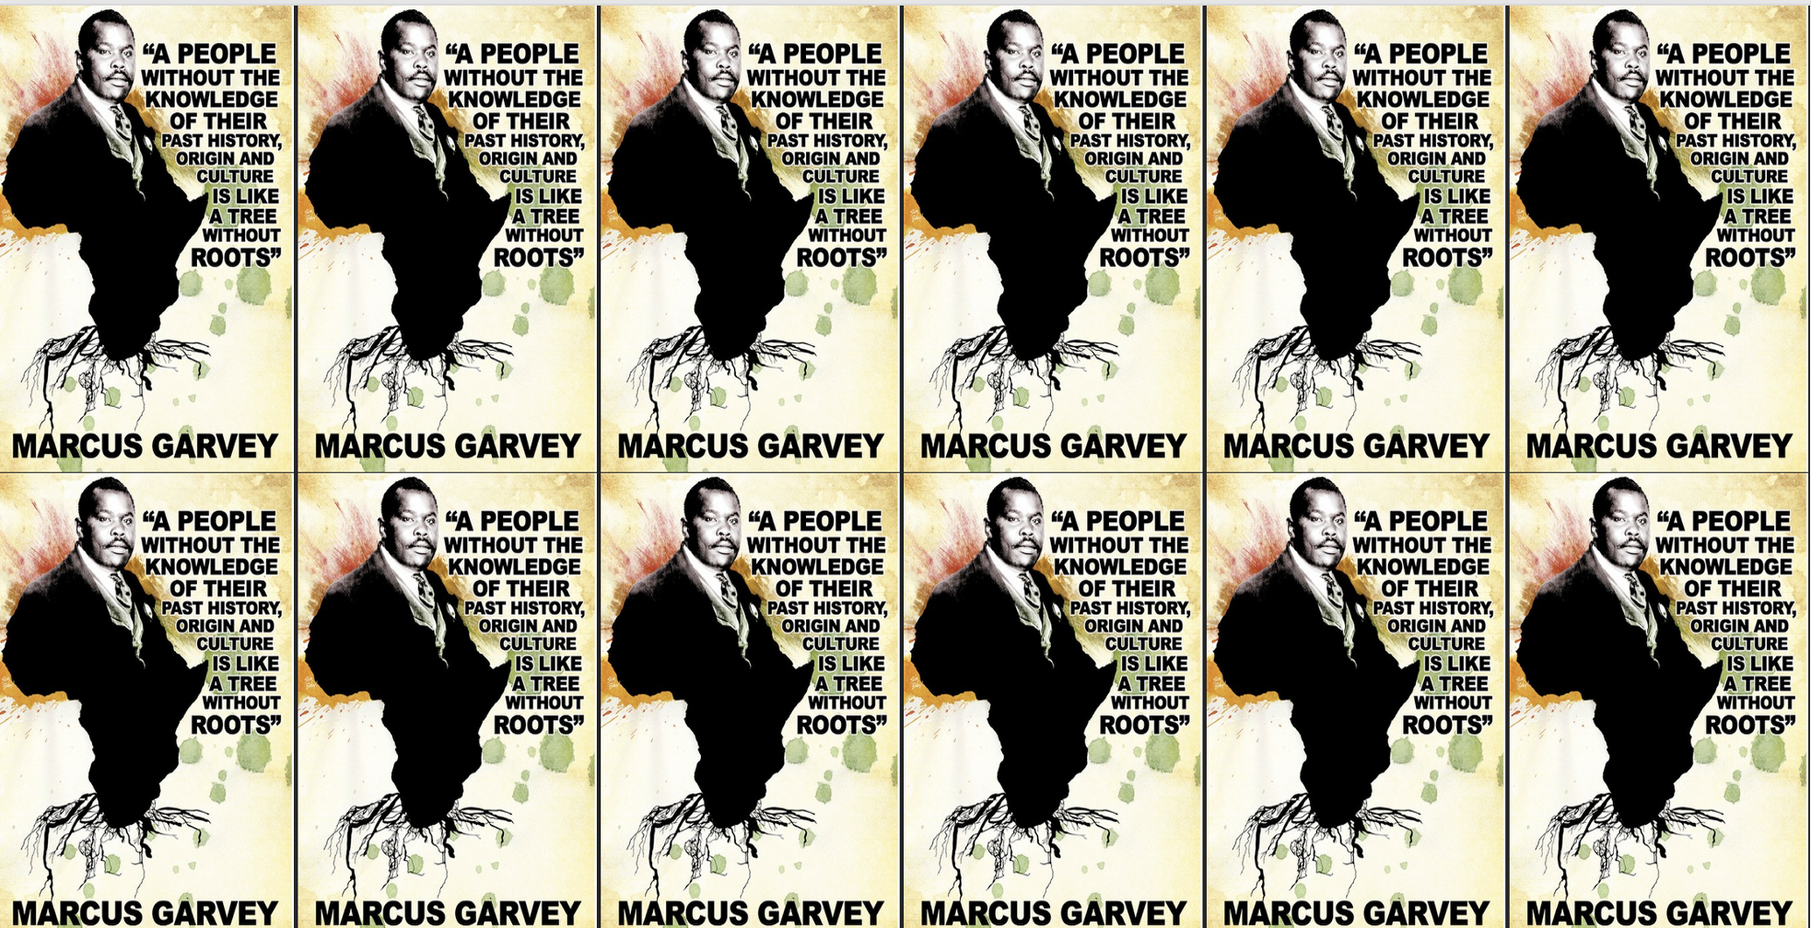
Garvey: Points to a Future Mired in the Past
Thanks!

