Slide 1
Transparency, Good Governance at the African End of China's Silk Road—Challenges and Opportunities
Larry Catá Backer
W. Richard and Mary Eshelman Faculty Scholar Professor of Law and International Affairs; Pennsylvania State University
Conference: BRI in Africa: Governing the Issues of Debt, Dispute Resolution, and Transparency
Panel on Transparency and Good Governance 24 February 2021

Slide 2
Reciprocal Concerns
China: corruption and instability
Protect investment
Enhance production chains
Produce all around approach to integrated relations within its hub and spoke economic-political model
Produce prosperity and stability throughout the chains
Africa: Dependency and fracture
Protect sovereignty (with a nod to Ian Taylor’s “In a Fix”
Enhance internal controls of macro-economic policies
Capacity Building
Build structures of African unity

Slide 3
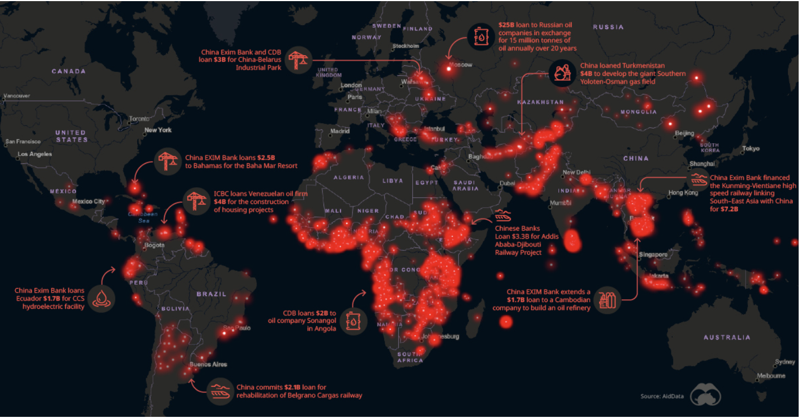
The Challenges at the Ends of the Silk Roads
Opacity
Capacity
Fracture
Inequality
Stability
Prosperity
Pix Credit: Technical Politics (8 Jan 2020)

Slide 4
Focus
Start with global approaches to two key drivers
Transparency
Good governance
Then Consider BRI
Its constitution
How it may be situated within these transparency-good governance frameworks
Last consider both BRI and Transparency-Governance form a more African perspective
Aspirational suggested approaches
Mediating between China and the West

Slide 5
Good Governance and Transparency
Source:
GOOD GOVERNANCE

Slide 6
Good Governance as Ideology
Focused on the State:
“There are many competing views on what the term ‘good governance’ should mean, but most donors argue that it should include some (if not all) of these: [1] increased public accountability and transparency; [2] respect for and strengthening of the rule of law and [3] anti-corruption measures; [4]democratization, decentralization and local government reform; [5] increased civil-society participation in development; and [5] respect for human rights and the environment.” (Good Governance and the World Bank (Vivien Collingwood (ed); p. 4).
The Private Sector as derivative and invisible
Good governance distinguished from responsible business conduct; but business has a responsibility to respect and promote good governance in weak and fragile states and in conflict zones.

Slide 7
Good Governance Converges as Applied Ideology
This ideology does align precisely with that of the Chinese vanguard party and the framework of the BRI?
--Collective rights based
--Focused on enhancement of key principles: prosperity and stability
--Understands the manifestation of democracy and the substance international obligations from the perspective of its own “New Era” political-economic model as manifested through BRI
--The private sector and markets as an instrument for the operationalization of core objectives (first moderately prosperous leading eventually to establishment of communist society).
--Good governance is understood as the general manifestation of the working style of the vanguard and its manifestation in the collectives under its guidance.
Good governance is an expression of the correct approach to the development of productive forces and to the approach to meeting the challenges of the current contradiction facing society

Slide 8
Transparency
As an element of good governance
Strong interlinkages with (1) integrity of political processes; (2) With anti-corruption measures; (3) With the efficiency of governance
Tied to human rights and sustainability-based initiatives
Mechanics align as well with cultures of compliance and accountability
But Contradiction:
While transparency is a useful mechanism for the internal operations of states
Does it apply with the same vigor to relations between states?
Or between states and International Organizations (pubic or private)?
Is transparency an Ideological Concept?
Its specific application may be shaped by the objectives tasked (markets versus regulatory control frameworks);
Is transparency an instrument of political ideology?
Of economic ideology?

Slide 9
Convergence in Methodologies
From from the World Bank (Good Governance and the World Bank ):
--Change developing countries from within
--Hybridity; alignments between state and market forces
--Not just technical but political, social, and cultural
Convergence in Methodologies
--This convergence presents the core of the challenges and opportunities from the African side of BRI
--Is BRI a path towards a different sort of good governance and transparency that better works for African states and society?
--Or is BRI merely the current manifestation of the same expression of power relations but in an ideological variation better suited to the political economic model of the new apex authority?

Slide 10
International Standards and Regional Organizations
UN Guiding Principles for Business and Human Rights
Human Rights due diligence compliance model
Separate state duty to protect , and corporate responsibility to respect human rights
OECD
Guidelines for Multinational Enterprises
Principles of Corporate Governance and for State Owned Enterprises
Principles of Responsible Investment
Sustainability Development Goals
Including Climate change and bio-diversity measures
African Regional Associations
African Court of Human and People’s Rights
The African Continental Free Trade Area (AfCFTA) (entered into force 2019)

Slide 11
From Good Governance Government to Trade Governance: China’s Silk Road

Slide 12
What is BRI
BRI represents the framework through which China and its vanguard, the Chinese Communist Party, rationalizes its trade, security, cultural, and political policies.
That rationalization seeks a framework for the seamless and coherent connection between China’s internal and external relations.
Serves:
As the outward expression of the core of the Basic Line of the Chinese Communist Party as the leadership collective of the nation,
As the current manifestation of that Basic Line as the principles of the “New Era” theory developed by the current leadership core of the Chinese State and its Communist Party collective, which along with the elements of the United Front, represents the collective of the Chinese nation.

Slide 13
BRI as a Societal and Moral Project
Represents the outward expression of the 12 Core Socialist Values (Xi Jinping: “Core Socialist Values represent the contemporary Chinese spirit and are a crystallization of the values shared by all Chinese people.”)
National values of "prosperity", "democracy", "civility" and "harmony";
Social values of "freedom", "equality", "justice" and the "rule of law";
Individual values of "patriotism", "dedication", "integrity" and "friendship"
Represents the implementation of the 12 CSV through the Five Principles of Peaceful Coexistence:
mutual respect for sovereignty and territorial integrity,
mutual non-aggression,
equality and mutual benefit,
To understand the BRI, it is first necessary to understand
The central role of Marxism in the construction of Chinese political-economy.
The Central role of Leninism in the organization of implementation methods
And the core principles of Marxist-Leninism as the basis for the interpretation of core political-moral concepts
non-interference in each other's internal affairs,
peaceful coexistence.

Slide 14
Outbound Cooperation in Key Areas
policy coordination,
facilities connectivity,
integrated transport infrastructure construction,
connectivity in energy infrastructure,
communication infrastructure,
investment and trade cooperation,
enhanced customs cooperation,
mutual recognition and coordination of standard setting,
the development of a united front in the context of developing policy within the global trade community,
coordinated trade innovation,
investment facilitation,
cooperation in agriculture, forestry and animal husbandry,
Cooperation in development of renewable energy sources.
Cooperation in coal, oil, gas, metal minerals and other conventional energy sources

Slide 15
Four Foundations of BRI
Legal
Security
Culture
Infrastructure development

Slide 16
BRI as a Legal Construct
Formal Mechanisms
Aggregation of an increasing number of bi-lateral and multi-lateral trade, friendship, and cooperation agreements between foreign states and China
No current uniformity on agreement forms
Informal mechanisms.
Prominent among them are Memoranda of Understanding among China and her BRI partners.
Most are not transparent; additional agreements not subject to scrutiny or oversight
Oversight
In China by the Leading Group for advancing the Development of One Belt One Road, formed in 2014.
Its steering committee reports directly into the State Council of the People's Republic of China.
Externally, China’s BRI partners have under the leadership of China, undertaken a set of informal structures aimed at coordination.

Slide 17
Security Arrangement
BRI is connected to the Shanghai Cooperation Organization.
But the Shanghai Cooperation Organization is merely meant to be one of many mechanisms that enhance multilateral security cooperation, including cyber operaitons.
BRI also connected to expanding Chinese military presence in key outposts along the “Silk Road”
These entities tend to layer the policies, principles and objectives more broadly conceived in BRI but targeted to the specific context for which they were created.

Slide 18
Bringing People Closer Together
People to people exchanges with the objective of enhancing BRI economic and political cooperation.
These have included since 2015“cultural and academic exchanges, personnel exchanges and cooperation, media cooperation, youth and women exchanges and volunteer services, so as to win public support for deepening bilateral and multilateral cooperation.”
Measures designed to enhance intra-BRI tourism
Leverage trade, infrastructure, and cultural interaction
Scientific and technical cooperation.
These include the development of joint research centers. It also includes integration of programs in aid of economic development, including entrepreneurship and the like.
Mechanisms for enhanced political communication.
The objects of these projects include political parties, legislative bodies sister city programs and the like.

Slide 19
Infrastructure Projects
Conceptual framework around which the core objective of enhancing regional connectivity and development may be furthered.
It consists of a series of evolving mechanisms for developing and financing infrastructure projects.
But infrastructure projects are merely to be understood as the necessary first stage of the larger project of bringing like-minded groups of states together by solving the world’s infrastructure gap.
Such activity is also internationalized within the Asia Investment and Infrastructure Bank (AIIB)—which connects the infrastructure to the finance gap.
Solving those gaps is a step toward greater security, trade, and people to people connectivity from China through its BRI partners.
Initial focus has been infrastructure investment, education, construction materials, railway and highway, automobile, real estate, power grid, and iron and steel. Post COVID pandemic will also include medical equipment and pharma.

Slide 20
BRI and Empire and the Long Arc of History
One perspective of the arc that informs transparency and good government
Marcus Garvey and the Black Star Line
Effort to develop a global production and societal chain that incorporated elements of security, culture, people to people exchanges thwarted by US authorities in the early 1920s
The Colonialism Model
Harnessing production chains for the benefit fo the metropolis along with political control and societal assimilation
The Development Model
Socialist and self sufficiency model (control technocratic model)
Followed by integrated markets driven (managed through loan conditionalities and trade agreements)
The BRI Model
A hub and spoke model with China at the center
Africa a number of spokes tied together or just aligned by reason of territory
The reflexive impulse
Distrust; extract what one can from an exploitative relationship
Aligns with Fidel Castro’s notions of global production as the new veil behind which unequal relations and exploitation can be naturalized

Slide 21
The Way Forward for Transparency and Governance:
Breaking the cycle
Requires strong confidence and trust building measures
Requires active measures on both sides

Slide 22
On the Chinese Side
Applying the Five Principles of Peaceful Coexistence as a means of project due diligence and make that transparent (at least to the participants.
mutual respect for sovereignty and territorial integrity,
mutual non-aggression,
non-interference in each other's internal affairs,
equality and mutual benefit,
peaceful coexistence.
Develop strong socialist approaches to international soft law instruments
Eg a develop Socialist Human Rights Due Diligence for operational and finance projects
EG, capacity building tied to the core values of BRI and AIIB (prosperity and stability) applied with sensitivity to national characteristics

Slide 23
On the Chinese Side: Socialist Capacity Building
· Inherent in BRI is the notion of a “community of shared future for mankind” (Xi Jinping Report to 19th CPC Congress)
· Both AIIB and BRI facilities may produce mechanisms for socialist version of the good governance capacity building of the IFIs and the OECD.
·This has yet to be developed.
·Role for the United Front organs and Communist Party organs embedded in SOEs and other economic institutions
·Transparency and reporting is crucial for assessment and coordination of policy

Slide 24
On the African Side: Cultivating Macro and Micro Governance
Macro governance
Focuses on the state and public organs
Focuses on rule fo law and corruption
Focuses on aligning policy and macro-economic objectives
Accountability
Micro governance
Focuses on the firms and their internal governance
Focus on conformity to international standards
Focus on compliance and accountability
Focus on knowledge transfer and alignment of markets with state objectives

Slide 25
On the African Side: Soft Law Instrumentalism
Human Rights and sustainability good governance through International Soft Law Instruments
Baseline standards of conduct
Basis for assessment
Useful for capacity building and technology transfer
Write Human Rights Due Diligence into contracts
Delegate operationalization from state to private organs
Remedial Mechanisms: host state judicial or non judicial state-based remedies financed by the investor
Use the BRI or OECD mechanism for dispute resolution
but by reference to host state standards

Slide 26
On the African Side: Leverage Regionalism
There is bargaining power in collective organizations;
utilizing the African Union and the many other regional organizations might improve capacity and engagement with the Belt & Road
The untested value of the African Continental Free Trade Area (AfCFTA)
Use collective organizations as a platform
for the advancement of exogenous good governance (the maintenance of a stable and orderly government run in accordance with law)
For promoting endogenous governance in the operation of enterprises
For capacity building
This might be financed by the host state as part of the BRI strategies
Enhance security and people to people exchanges
Enhance transparency and accessibility as political accountability and anti-corruption measures
BRI MOUs
BRI Treaties and contracts

Slide 27
On the African Side : Master Planning Infrastructure
The Bet and Road must be understood as a two-way street
Aligning projects, and project synergies produces maximum value
Here using and building on the capacity of AIIB and the Chinese side appropriately can be useful
Focus on regional projects

Slide 28
On the African Side: Tech Transfer
Technology transfer should be at the forefront
Host state workers; mandatory training
Home state workers temporary stay long enough to train
Know how transfer; invest in education and training programs
For enterprise and administrative employees
An upside for China—they manage the training to align with the principles of their political-economic model
Apply principles of Reform and Opening Up to the development of national economies through BRUI engagement

Slide 29
On the African Side: Projecting Up the Chain of Global Production
The resource trap as a production chain trap
Insist on investment in industries that process resources for export.
Avoid exporting resources , emphasize exportation of more finished (and higher value added) goods.
Example: Avoid exporting soy; export tofu; avoid exporting rare earths inside they be processed in the host state in which they are extracted.
Consider provisions that require observation of home state operations of host state partners.
Information and data sharing
Here there is a sensitivity to the new Chinese cyber-security laws, but principles of mutuality may be used as a leverage where Chinese home state enterprises may require data from host state. .

Slide 30
Summing Up
Good governance and transparency
Core concepts
Ideologically embedded
BRI
Hub and spoke model of production chain management
With China at the center
All around project with social, cultural, and political alignments with core principles of CPC Basic Line
BRI, Good Governance and Transparency in Africa
From the Chinese side: capacity building and the construction of socialist approaches to governance and transparency to further principles of prosperity and stability
From the African side: leveraging international soft law, regional integration, coordinated approaches to infrastructure, tech transfer, and leveraging resources to move up the production chain.

Slide 31
Thanks; Contact me at lcb911[AT]me.com

