Slide 1
Entangling the Legalities of Utopia New Terrains of Entanglement among Traditional and Data Driven Governance
Larry Catá Backer; Penn State University
Prepared for the Conference: Multiple Legalities: Conflict and Entanglement in the Global Legal Order
Panel on “Invisible Drivers Behind Formal Law”

Slide 2
From invisible to Visible Driver From Behind to Beyond Formal Law
Two sets of legalities; both alike in dignity. . . Both alike in
ideologies of control
languages for incarnating intangible objectives
elites who drive development and control the application of legalities
camps arrogantly assuming that the other is inevitably “invisible” or “behind” the other
Their couplings redefine the rationalization of entanglements among the expanded universe of plural legalities
“Two households, both alike in dignity, In fair Verona, where we lay our scene, From ancient grudge break to new mutiny, Where civil blood makes civil hands unclean.”

Slide 3
Traditional Scope of examination
Entanglement itself entangled in the ideologies and pretensions of the state; leaving the scraps to entangle within the gaps left between and beyond the state

Slide 4
The Battle Hymn of the Republic of Laws
That also implicates the central question that continues to elude consensus—is traditional law “special” in the sense that it is the measure, the gold standard, against which the character, function, authority and legitimacy of other legalities are measured or (in some versions) into which such legalities will inevitably, must inevitably, be expressed.

Slide 5
The Masks of God
The last several centuries, however, have seen both Marxist-Leninist systems and liberal-democratic ideologies embraced the core premise that neither the individual nor society may be left to their own devices.
Instead, the perfection of the system requires the state to nudge individuals and societal organizations toward perfection the contours of which are defined by politics and enforced by both a legal-administrative apparatus, and societal collectives to which administrative-governance authority has been delegated.

Slide 6
The Gods Unmasked
The methods for managing the application of the expression of that perfection principle, though, have been revolutionized in the last several decades through the miracle of technology.
It is in that process of the expression of the regulatory power of perfection through data-based systems of rewards and punishments, of ratings, of compliance and accountability that one encounters emerging social credit systems.

Slide 7
Social Credit Legalities
A. Within liberal democratic political orders, social credit systems take a variety of forms built primarily around rating and accountability systems to implement legislative objectives or as a means of assessing compliance
B. Within Marxist-Leninist political orders, social credit systems have been developed as a broad range of assessment, ratings and disciplinary programs coordinated through the state and designed to further an integrated set of public objectives for the perfection of the individual, the social order, production, and the operations of the state under the guidance of the vanguard (communist) party.

Slide 8
In the Ring: Traditional Versus Social Credit Legalities
Traditional legalities (whether the conventional law of states, international law, norm making, and the regulatory expressions of other institutions with rulemaking authority) are essentially qualitative in nature.
Social Credit Systems (whether in the form of ratings, assessment, monitoring, conformity or other variations, and whether or not coupled with rewards and punishments, or coordinated, through platforms or on a bilateral basis, with other systems) are essentially quantitative.

Slide 9
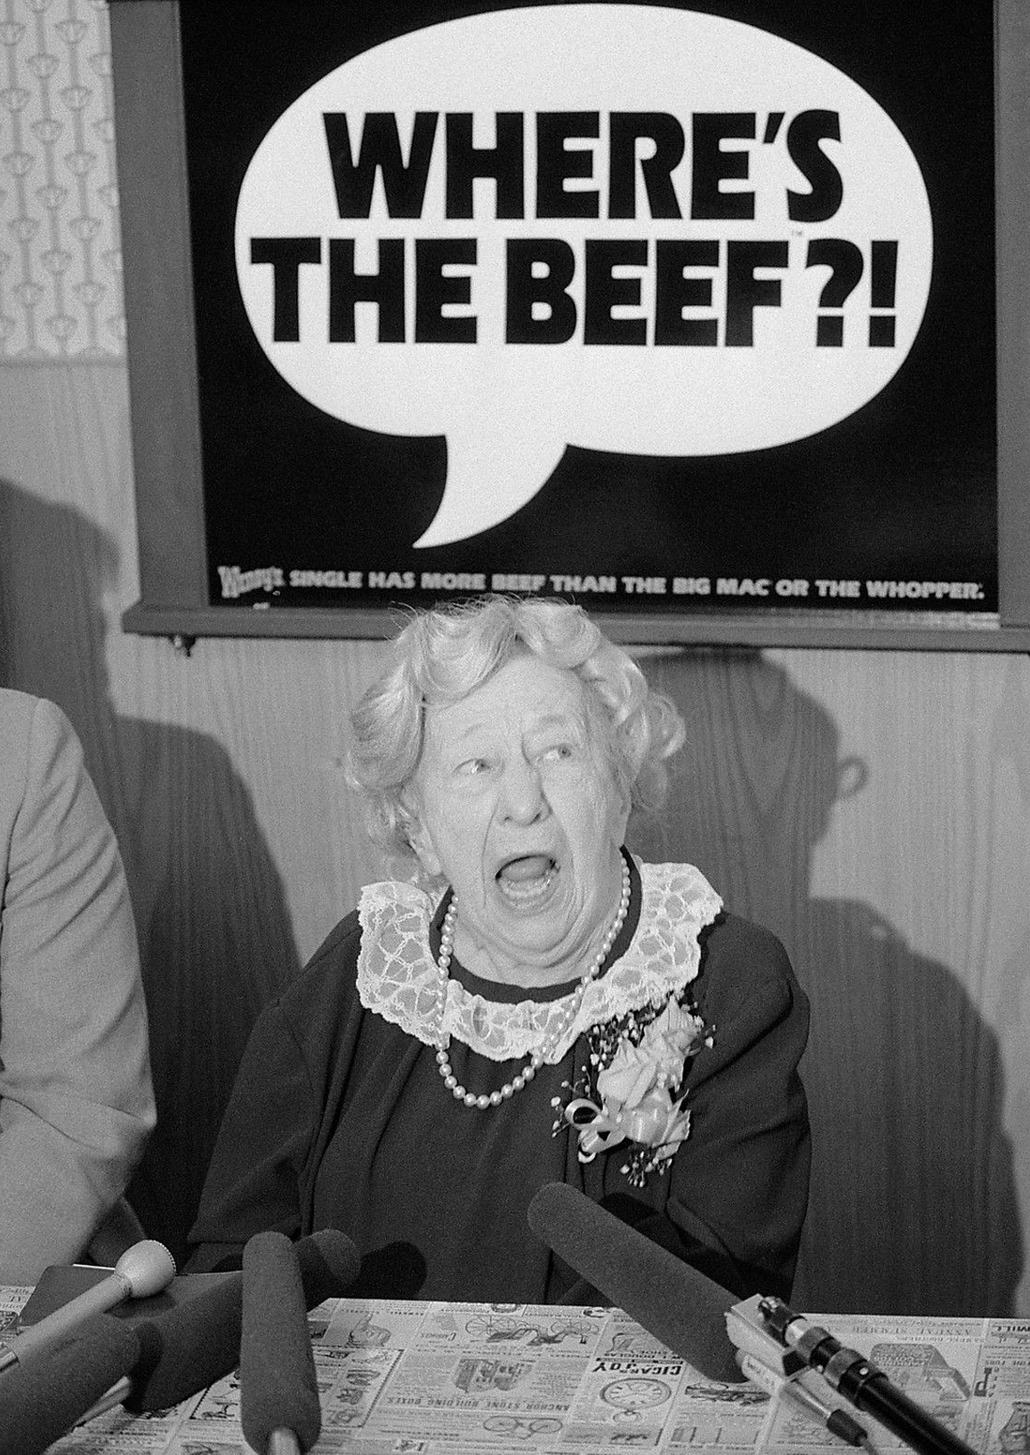
Where is the Beef?
But what emerges even from this cursory description of the legalities of conventional and data driven legalities is the almost naturalness of their entanglement.

Slide 10
Symbiotic Entanglements
In both cases, law becomes the instruction manual for the operation of social ordering through data driven analytics. But sometimes data driven analytics becomes the basis for ordering reality through which law is made and enforced.

Slide 11
Clarity
The recent controversy over the inclusion of questions about citizenship on the U.S. census provides a case in point.
Another important point of entanglement centers on the scope and principles through which data may be harvested.
Entanglement of a different sort occurs with traditional credit and health rating systems.
The use of simulations in making policy inverts the usual trajectories of entanglement. Here law itself becomes a function of predictive analytics, which in turn if a function of the legal basis for the harvesting and use of personal data.
Smoking campaigns are well known.
The use of human rights due diligence systems in the development of the internal governance of multinational enterprises

Slide 12
And there it is. . . .
Rationalizing entanglement
Functional differentiation among systems
Symbiosis
The marriage of two classes of regulatory elites
In the service of accountability of law and of the legality of accountability
Ideology will drive the expression of entanglement
Advancing the objective of perfection

Slide 13
Thanks

