Slide 1
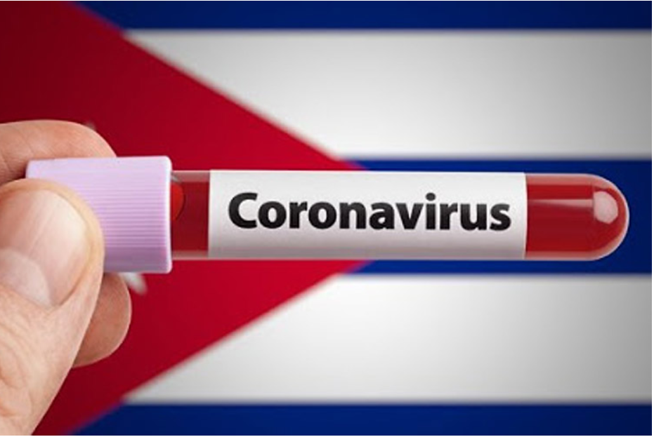
“Cuba’s Response to COVID-19 and the Consequences for Cuba of the Pandemic”
Larry Catá-Backer (Pennsylvania State University)
Yuri Gonzalez Hernandez (Havana)
ASSA Virtual Conference
3 January 2021

Slide 2
Context
Most attention focused on great powers and great tragedies
Viewed in the popular press and by certain states as a test for the legitimacy and strength of a political system
The battles for policy supremacy between economics and health policy
Policy shaped by need to preserve health of entire population
Policy shaped by the need for a viable economic system to continue to function
Much less attention paid to the developing world
Exception—sensationalism in tragedy (Central and South America)
Exception—where a government that is unpopular in the United States does “badly” in its response (Brazil)

Slide 3
Cuba: A Unique Case Study
Has many of the characteristics of a developing states
But also shares some of the characteristics and sensibilities of a developed state
The conflict with the United States adds greater interest
The issue of medical internationalism exposes quite strong ideological rifts between Marxist Leninist and Western Liberal Democratic sensibilities
The tensions between seeking to help and protecting populations is substantially exposed
The interactions of economic and health policy and their tensions are highlighted
The specific effect of placement downstream in pathways of economic production produces dependencies that then affect health policy and capabilities

Slide 4
Overview—History of Pandemic
The infection vectors
Tourism—European visitors right before the European flareup
Diaspora—Cubans traveling back and forth from countries immediately before flare ups in host states
Internationalism--Cuban doctors and other medical staff abroad
Humanitarianism—the sage of the cruise ships allowed to dock in Cuba
Consequences
Closing borders; border corridors for tourists; limited reopening
Developing treatments—and vaccines
Keeping the country running in the face of shortages
Reducing incidence of mortality and disease severity
Difficulties of maintaining disease reduction strategies
Maintaining social control

Slide 5
Focus on Key Issues: Tourism
Core challenge
Tourism is a critical element of economy
Economic development for 2030
Expansion of non-State sector
Tourism was the key vector for the introduction of disease
Pandemic dried up sources of tourist flows
Reduced investment by foreign companies
Response
Encouraging local tourism
Difficult to make up the difference
Diaspora Cubans effectively cut off
Collateral effects (restaurants, tour operators, difficult to manage)
From July 2020 effort to establish tourist safe zones, where tourists would be transported to 1 of 5 quarantined all inclusive resorts

Slide 6
Cuban Medical Internationalism
Has been controversial for years
Has proven effective during Pandemic
Cuban doctors sent worldwide
Special focus on Italy for example—well received
But the program has been controversial
Critics charge that it amounts to forced labor
Returning doctors have been a source of COVID-19 (e.g. recently from Venezuela)
Medical internationalism puts a potential strain on state’s ability to deal with local COVID infections

Slide 7
Medical Technologies
Advances in medical tech has also been a core area of development under 2030 Plan
COVID accelerated and redirected medical research
Deepened partnerships with China and European states
Recycling and repurposing drugs in development
Some success; but locked out of vaccine race?
Has been used strategically: in some cases less of an attempt to monetize drug treatment regimes than to use it for middle and long-term political advantage.

Slide 8
Challenges
Sanitation
Hard to encourage hand washing where water scarcity is an issue
State incapable of meeting that challenge in the short term
Potential to increase susceptibility
Food
Condition of Cuban people waiting in long lines for food and other needs well publicized
Highlights inefficiency of internal state planned distribution networks
Highlights difficulties of Cuban access to goods where they are cash strapped
Potential to increase susceptibility
Economic Reform
The pressures of COVID response has induced state t return to some of the measures of the “Special Period”: Dollarization relaxation of central planning, expansion of areas let to private sector, etc.
Hard to plan—might be revoked as soon as crisis passes
Food security issues highlighted
Will the non-state sector expand with less oversight going forward? Non-state sector VERSUS informal sector poses its own problems
Impacts health care and productive economic capacity

Slide 9
The 2021 Current Outlook; Tourism
Pressure on tourism
Reporting from Miami Herald 30 December 2020; Link HERE):
Cut down on the number of travelers allowed into the island from the U.S. Mexico, Panama, Bahamas, Haiti and the Dominican Republic
Method: Cut don flights to Cuba
Lucrative European and Canadian connections left intact.
The American Factor:
“President-elect Joe Biden’s team plans to bring the U.S. closer to normalized relations with Cuba, reversing many of the sanctions and regulations imposed during the Trump administration, according to people familiar with the matter. That strategy includes reducing restrictions on travel, investment and remittances.” (Bloomberg Reporting 15 December 2020)
The rise of COVID-19 travel insurance extended in some cases to Cuba (e.g., complementary insurance for Iberostar guest 15 December2020)

Slide 10
The Current Outlook;
The (Mis) Use of Criminal Penalties to Meet COVID-19 Challenges
Enforce Criminal Penalties
Cuba’s penal code says a citizen can be jailed for as long as a year and fined up to 300 pesos for the crime of “propagation of epidemics,” although fines of up to 3,000 pesos have been reported during the coronavirus pandemic.
Use of Criminal Law against political opponents
“On November 26, 2020, Cuban security forces detained 14 government critics in Havana after alleging that one of them had violated Covid-19 rules by failing to re-take a test for the coronavirus. The detentions follow a series of cases in which security officers and prosecutors have targeted dissidents, arresting or charging them with “spreading an epidemic,” and imposing fines for alleged violations of Covid-19-related restrictions.” (Human Rights Watch 7 December 2020).
X Factor:
San Isidro Movement (SIM) artist’s collective, hunger strike and protests
Compare to George Floyd Protests in the US during pandemic
Government arrests sparked larger protests; still unresolved

Slide 11
The Current Outlook: Vaccine Politics
Report from Brazilian sources 1 January 2021:
Cuba to get vaccines through Iran
Iran to purchase vaccines from 3rd party states (unidentified)
23 December 2020 TeleSur Report: "Cuba's vaccine candidate Soberana 02 began Phase II of Clinical Trials this week, making it the first Latin American vaccine against Covid-19 to advance to this stage following positive preliminary results in the first phase." ()
Indigenous Vaccine Development

Slide 12
The Current Outlook: Other Treatments
The consequences of the Winter COVID-19 Surge
  Reported at the end of December 229 new cases; almost 1500 active; 10 critical.
    Mixed results of current approaches to COVID-19
      Positive: prevention and intervention methods, close monitoring
      Negative: lack of resources, difficulties of maintaining health protocols continues in light of food scarcity, hygiene etc.
  Other treatment options:
    “During a meeting with scientists, President Miguel Díaz-Canel learned about the positive impact of the use of Nasaferon (nasal version of Interferon alpha 2-b) in health personnel on the red line and in nursing homes, for which he indicated to extend its application to other vulnerable groups.” (Prensa Latina23 December 2020)
  Joint Ventures:
    14 December Notice in Tass: “Russia and Cuba may carry out joint research and testing of drugs that can be used to treat COVID-19 patients, Russian First Deputy Health Minister Igor Kagramanyan said on Monday.”

Slide 13
Conclusion
Cuba has been among the states better able to meet the challenges of the pandemic inters of infection and mortality rates
But being an island has not proven to be a positive means of avoiding pandemic in an age of globalization; not clear there is planning for managing future similar crsies.
Pandemic has substantially affected economic planning: internally opening the economy in ways rejected by the 7th PCC Congress in 2017; Externally mixed—bad for tourism, better for medical advances and medical internationalism
Has exposed the weaknesses of the state: sanitation, food security, and responsiveness.

Slide 14
Thanks!
Contact authors at lcb911[å†]me.com

