Slide 1
From the Belt and Road Initiative to Social Credit Systems: Tech and Business Relations Between the US and China
Prepared for
Global China Connection Penn State Chapter Industry Expert Series
Larry Catá Backer
W. Richard and Mary Eshelman Faculty Scholar Professor of Law and International Affairs Pennsylvania State University

Slide 2
The US China Tech-Business Environment: 2016 Baseline
2016 Baseline; Arriving at the Point of Contemporary Conflict
Trade liberalization continued
Continued US pressure of Chinese SOEs;
Insistence on access to local markets
But also trade competition:
Trans Pacific Partnership versus Belt and Road Initiative
And the worries
Internationalization of the yuan
Chinese Big Data and AI Initiative
Protection of trademarks
Unfair business practices and WTO actions
Belt and Road Initiative
Alternative global financing through Asia Investment and Infrastructure Bank (AIIB)

Slide 3
The US ChinaTech-Business Environment: On the Cusp of the Biden Administration
From Competition to conflict
Strategic Tariffs on the US side
Strategic prohibition of goods importation on the Chinese side
From integration to de-coupling
Urging diversification of supply chains
Chinese move to two markets environment (development of internal markets decoupled from external exports driven markets)
From penetration of markets to inward turning
America First; Belt and Road Initiative
Coupling trade with ideology and security arrangements
The role of tech in election interference and in destabilization through hacking and penetration of closed data environments
Human rights and politics
Xinjiang
Hong Kong
The business of data
Tech spying
Moves to protect domestic data harvesting from export
The continuing issues
Protection of intellectual property
Integrity of markets and the subsidization of state banks and enterprises

Slide 4
Focus for Today
Questions:
How did we get to this state and
What might explain the complexities of moving toward resolution?
Concentrate on three issues
Fundamental differences in political and economic ideology
Communist internationalism versus liberal democratic universalism
The development of distinct trade empires
Belt and Road Initiative versus America First as the forms of post-Global Empire
The tech that fuels this new environment
Social Credit systems and the transformation of law and management in China
Data driven compliance oriented markets based governance systems elsewhere
And business caught in the middle

Slide 5
Tech, Markets, and Social Control
Tech in the service of the national political-economic model
Is government a tech driven industry?
Is tech innovation driving institutional change in the field of governance?
Does tech serve as a tool of or the means of international relations?
How do tech and markets provide the necessary platform for furthering the objectives of the state to create a system of economic control and frame economic relations with ideological characteristics that contributes to the progress of the nation toward its realization of some sort of cultural-political ideal?
Are governments now in the business of data management and exploitation? Has this been delegated in the West or in China? To what effect?

Slide 6
The Chinese Political-Economic Model
Political theory of Chinese Party State
Party as polity
State as administrative apparatus
Working Style (Mao Zedong 1945 On Coalition Government):
"four obediences" (四个服从):
subordinate the individual to the organization, the minority to the majority, the lower to the higher level and the membership to the Central Committee. The unity of all factors of social production
in the service of the core objective and responsibility of the advanced forces of the vanguard:
the eventual establishment of a communist society in China
Strong interconnections between state, private, civil, religious and other mass organizations
“Within the revolution everything; outside of it nothing”

Slide 7
The Tasks of the Leadership Core
Function of Politics:
Moral Project (the construction of the ideal person in the ideal society)
The Party at the Center (the ideal requires a helmsman and navigator)
Everything else is a tool or a means to ward the attainment of the fundamental objective
Tech, markets, culture, etc. are the expression of and the means through which the advanced social forces move the nation toward its ideal.
The process “scientific” in the sense that is is rationalized and can be measured against the idea (truth from facts—facts in the service of truth).
The Stages of Historical Development and the core contradictions
That objective is to be undertaken in stages (Marxist progressivism toward the ideal)
Each stage requires a distinct contextually relevant political line
Core contradictions reflect principal challenges for the Leadership core in each stage of development
Class struggle (Mao Zedong)
Development of productive forces (Deng Xiaoping – Hu Jintao)
Balance between unbalanced and inadequate development and the people’s need for a better life (Xi Jinping)

Slide 8
The Key Drivers in the “New Era”
Chinese Marxist Leninist ideology in the “New Era” moves beyond” Reform and Opening Up” in the elaboration of its political-economic model.
China must develop its own systems free of foreign ideological baggage.
That fundamental premise has driven the movement toward everything from the articulation of Socialist core values (社会主义核心价值观) as well as Socialist approaches to law, governance, markets and international relations.
Tech plays a critical role in that forward movement

Slide 9
From Government to Trade Governance: China’s Silk Road

Slide 10
What is BRI
BRI represents the framework through which China and its vanguard, the Chinese Communist Party, rationalizes its trade, security, cultural, and political policies.
That rationalization seeks a framework for the seamless and coherent connection between China’s internal and external relations.
Serves
As the outward expression of the core of the Basic Line of the Chinese Communist Party as the leadership collective of the nation,
As the current manifestation of that Basic Line as the principles of the “New Era” theory developed by the current leadership core of the Chinese State and its Communist Party collective, which along with the elements of the United Front, represents the collective of the Chinese nation.

Slide 11
BRI as a Societal and Moral Project
Represents the outward expression of the 12 Core Socialist Values (Xi Jinping: “Core Socialist Values represent the contemporary Chinese spirit and are a crystallization of the values shared by all Chinese people.”)
National values of "prosperity", "democracy", "civility" and "harmony";
Social values of "freedom", "equality", "justice" and the "rule of law";
Individual values of "patriotism", "dedication", "integrity" and "friendship"
Represents the implementation of the 12 CSV through the Five Principles of Peaceful Coexistence:
mutual respect for sovereignty and territorial integrity,
mutual non-aggression,
equality and mutual benefit,
To understand the BRI, it is first necessary to understand
The central role of Marxism in the construction of Chinese political-economy.
The Central role of Leninism in the organization of implementation methods
And the core principles of Marxist-Leninism as the basis for the interpretation of core political-moral concepts
non-interference in each other's internal affairs,
peaceful coexistence.

Slide 12
Outbound Cooperation in Key Areas
policy coordination,
facilities connectivity,
integrated transport infrastructure construction,
connectivity in energy infrastructure,
communication infrastructure,
investment and trade cooperation,
enhanced customs cooperation,
mutual recognition and coordination of standard setting,
the development of a united front in the context of developing policy within the global trade community,
coordinated trade innovation,
investment facilitation,
cooperation in agriculture, forestry and animal husbandry,
Cooperation in development of renewable energy sources.
Cooperation in coal, oil, gas, metal minerals and other conventional energy sources

Slide 13
Four Foundations of BRI
Legal
Security
Culture
Infrastructure development

Slide 14
BRI as a Legal Construct
Formal Mechanisms
Aggregation of an increasing number of bi-lateral and multi-lateral trade, friendship, and cooperation agreements between foreign states and China
No current uniformity on agreement forms
Informal mechanisms.
Prominent among them are Memoranda of Understanding among China and her BRI partners.
Most are not transparent
Oversight
In China by the Leading Group for advancing the Development of One Belt One Road, formed in 2014.
Its steering committee reports directly into the State Council of the People's Republic of China.
Externally, China’s BRI partners have under the leadership of China, undertaken a set of informal structures aimed at coordination.

Slide 15
Security Arrangement
BRI is connected to the Shanghai Cooperation Organization.
But the Shanghai Cooperation Organization is merely meant to be one of many mechanisms that enhance multilateral cooperation.
BRI also connected to expanding Chinese military presence in key outposts along the “Silk Road”
These entities tend to layer the policies, principles and objectives more broadly conceived in BRI but targeted to the specific context for which they were created.

Slide 16
Bringing People Closer Together
People to people exchanges with the objective of enhancing BRI economic and political cooperation.
These have included since 2015“cultural and academic exchanges, personnel exchanges and cooperation, media cooperation, youth and women exchanges and volunteer services, so as to win public support for deepening bilateral and multilateral cooperation.”
Measures designed to enhance intra-BRI tourism
Leverage trade, infrastructure, and cultural interaction
Scientific and technical cooperation.
These include the development of joint research centers. It also includes integration of programs in aid of economic development, including entrepreneurship and the like.
Mechanisms for enhanced political communication.
The objects of these projects include political parties, legislative bodies sister city programs and the like.

Slide 17
Infrastructure Projects
Conceptual framework around which the core objective of enhancing regional connectivity and development may be furthered.
It consists of a series of evolving mechanisms for developing and financing infrastructure projects.
But infrastructure projects are merely to be understood as the necessary first stage of the larger project of bringing like-minded groups of states together by solving the world’s infrastructure gap.
Such activity is also internationalized within the Asia Investment and Infrastructure Bank (AIIB)—which connects the infrastructure to the finance gap.
Solving those gaps is a step toward greater security, trade, and people to people connectivity from China through its BRI partners.
Initial focus has been infrastructure investment, education, construction materials, railway and highway, automobile, real estate, power grid, and iron and steel. Post COVID pandemic will also include medical equipment and pharma.

Slide 18
Social Credit Systems
data driven means of implementing rules-based systems of rewards and punishments that further state objectives under the guidance of the vanguard Communist Party.
eventually are meant to change the character of a socialist rule of law framework and with it the locus of regulatory authority from regulators to those responsible for developing behavior-based ratings.
dependent on two critical elements;
the first is data identification and generation, and
the second is in its organization and use by relevant governance actors (businesses, state organs, and the like).

Slide 19
Social Credit as Expression of New Era Ideology
Part of top-down strategy for confronting challenges of current era under the core leadership of the CPC
Coordinated by the Central Leading Small Group for Comprehensively Deepening Reforms with Xi Jinping at its core. Top down strategies for driving change (顶层设计 (Dǐngcéng shèjì))
Entwined with Chinese Leninism and vanguard organization (from professional revolutionaries (Lenin) to professional managers (Xi) of economic, social, cultural, and political life under the leadership of the CPC. A new (tech centered) nomenklatura?
Constrained by its own ideology and responsibilities in each era
Deeply embedded in several projects
Socialist Culture (integrity and values)
Socialist Individual (the ideal worker and citizen)
Socialist Collective (the ideal society, expression of highest cultural aspirations)
Socialist Government (the ideal cadre, judge and functionary as a function of the correct work style)
Socialist economic activity (trustworthiness; directed toward political objectives under the leadership of the vanguard)
Chinese characteristics:
Suggests that such a thing can be distilled (data driven)
What can be distilled can be managed (system of rewards and punishments)
What can be managed can be managed toward perfection (predictive and scientific deployment of tools of Socialist rule of law, jurisprudential and data driven)

Slide 20
CSC in the Shadow of Lists
New Era regulatory mechanism and Socialist Law
A complex system of rewards and punishment
Founded on data driven scoring
Scoring is based on ratings
Ratings are based on data driven assessments
Assessments are grounded in measurement against a set of norms and objectives for behavior
Norms reflect the values and objectives to be advanced
Traditional law the expression of the CPC Basic Line as administrative objectives and accountability measures
Translating political objectives to its essence and then reduced to measurable actions that can then be monitored and assessed
Is law becoming merely instructions for coding? Is coding the new language of administrative regulation?
At its heart, SCS is a data driven moral system
Created to steer culture and practices towards ideal (integrity, etc.)
Foundation in the 12 core Socialist values
Fidelity to the leadership of the Vanguard Party
Inward Face:
(1) Social harmony
(2) Meet challenge of current contradiction
Outward face: United Front against enemies

Slide 21
From Social Credit to Platform Governance

Slide 22
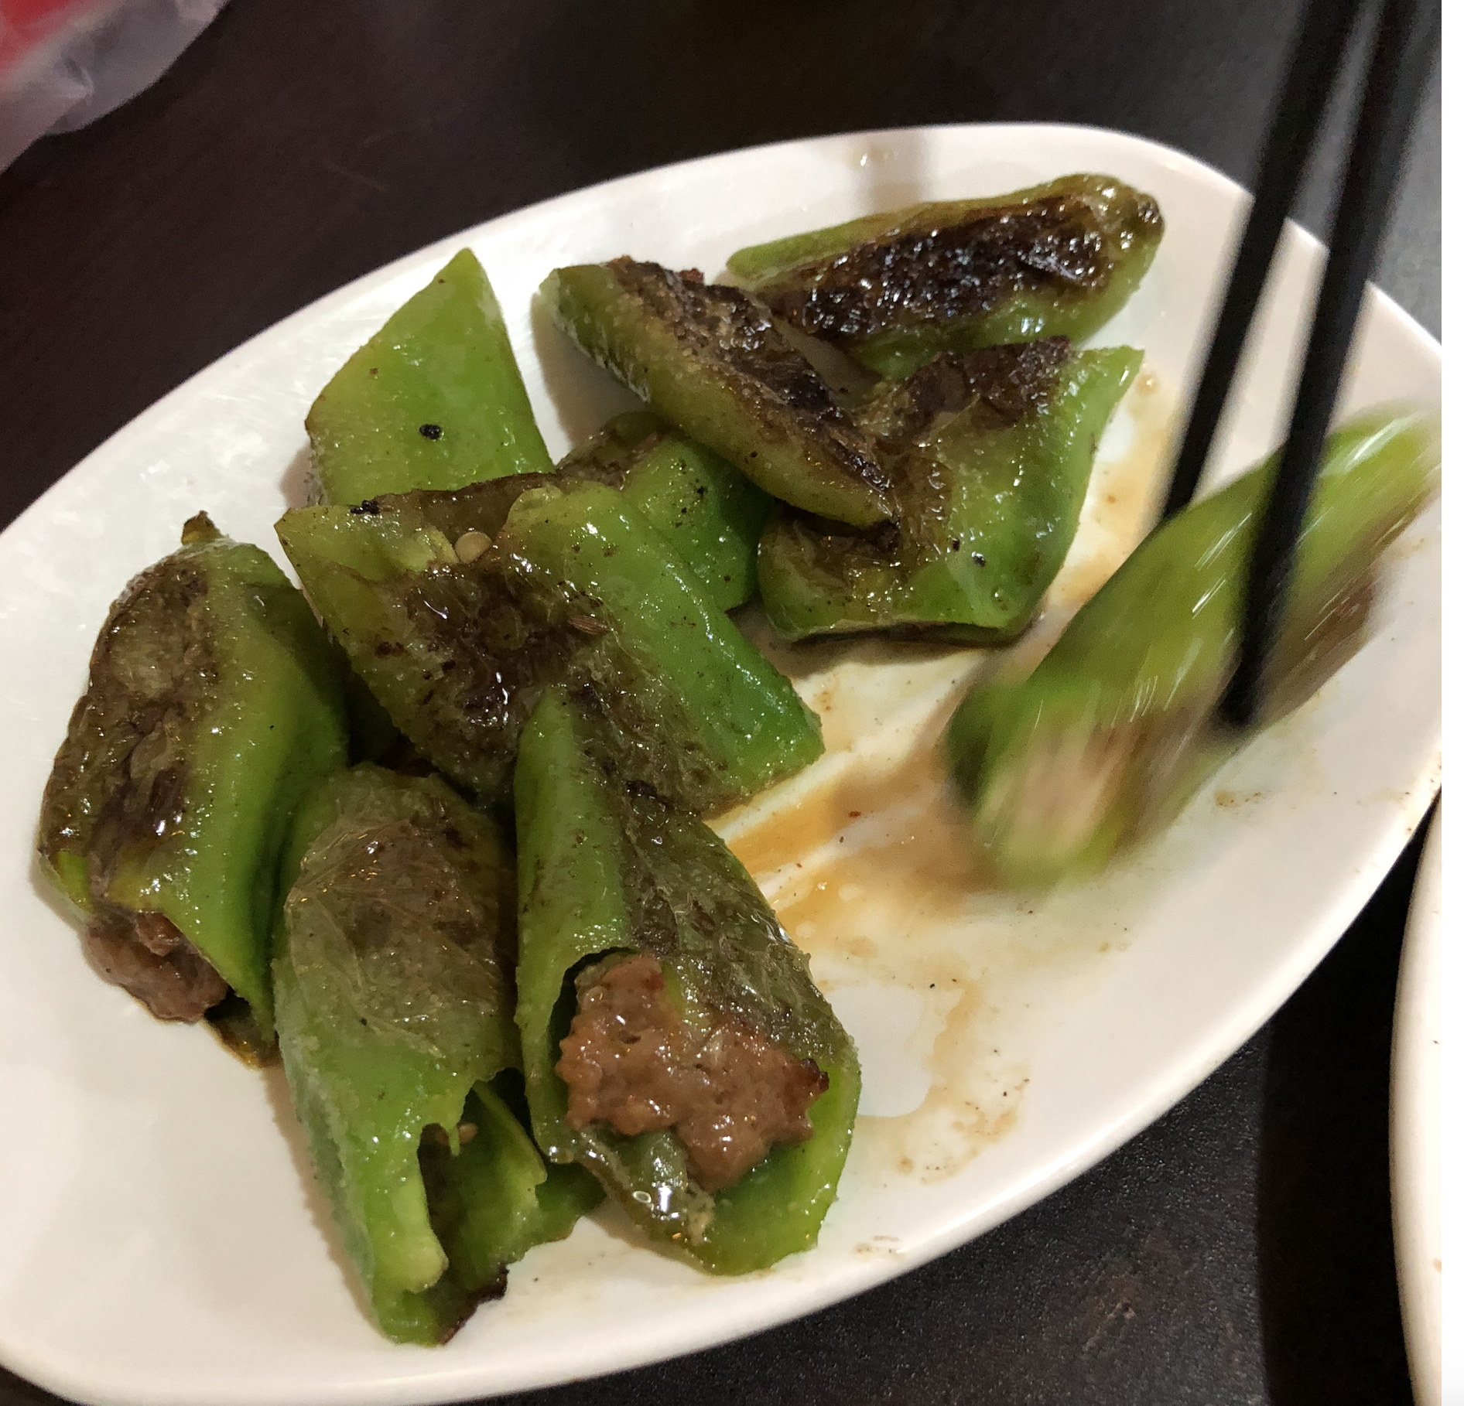
Platforms: Managed (Curated)Networks of Users and Resources
Networks of users and resources
Scalable, divisible
Self-managed or managed from the outside (by a greater platform sometimes)
Create communities (of users for interact)
Create markets (for exchanges of things (tangible and intangible)
CONTRAST “linear institutions” (E.g., Multinational Enterprises or even the state) which create and control inventory (regulation, enforcement, tangible and intangible goods and services ) through interlinkages of control or ownership
CONTRAST Data warehouses—location where a specific kind of goods (data) is stored for retrieval or access
PLATFORMS are spaces for trading, access, utilization, not the “means of production” but the “means of connection” (Platform Business Model – Definition | What is it? | Explanation)
E.g., Amazon, eBay, Instagram, YouTube, WhatsApp, Waze, Uber, Lyft, Airbnb, Pinterest, Square, Social Finance, GitHub, Kickstarter, ZocDoc
E.g., Alibaba, Tencent, Baidu, and Rakuten (Japanese e-commerce)
Even a personal computer is a platform (hardware-the computer), software (operating system), as a foundation to support software and applications

Slide 23
The Universe of Social Credit Platforms: Social Media
Top 10 Chinese Social Media: Table of Contents
WeChat: Not Just the Chinese Facebook Read Now
Sina Weibo: Twitter of China Read Now
Tencent QQ: Popular Instant Messaging App Read Now
Tencent Video: The King of Online Video in China Read Now
Xiao Hong Shu (Little Red Book): Where Community Meets Cross-Border E-Commerce Read Now
Douban: Lifestyle Discussion Platform Read Now
Zhihu: The Quora of China Read Now
Meituan – Dianping: The Chinese Versions of Yelp Read Now
Toutiao: The Hottest News & Information & Entertainment Platform Read Now
DouYin (TikTok): The Short-video App Taking the World By Storm Read Now
Runner Ups for the Top 10 Chinese Social Media Platforms! (2020 Update)
Momo: Tinder of China Read Now
Meitu: From the Creators of Meipai Read Now
Kuaishou: The Short-video Platform For Life in China Outside Tier 1 Cities Read Now
Youku Tudou: The Former Youtube of China Read Now
Baidu Tieba: A Search Engine Forum Read Now

Slide 24
The Universe of Social Media Platforms: Tracking Apps
DIDI(Didi Chuxing Tech Co. 滴滴出行)
App-based transportation services, including taxi hailing, private car hailing, social ride-sharing and bike sharing; on-demand delivery services; and automobile services, including sales, leasing, financing, maintenance, fleet operation, electric vehicle charging and co-development of vehicles with automakers
“Didi to hire 1,000 Communist Party comrades to improve safety:Recruits will serve as 'role models' on customer service team, company says” Nikkei Asia (19 Oct 2018).
Since 2015, DiDi has invested in Grab, Lyft, Ola, Uber, 99, Bolt (Taxify) and Careem.
Vertically integrated services: Financial services (eg car insurance); food delivery services; auto leasing and trading services (platform hybrid)
The DIDI Platform
DIDI Research Institute—AI tech to aid its business model; Labs in Beijing and Mountain View California
DiDi Cloud Platform: integrate data to produce predictive analytics of people and traffic flows for example
Smart Transport Initiative (networked platforms; public-private): use data to optimize traffic flow: joint work for example with Beijing Capital International Airport Public Security Bureau Traffic Detachment;

Slide 25
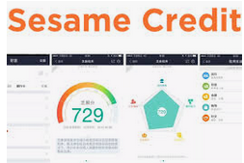
The Universe of Social Credit Platforms: Financial Credit Scoring
Sesame Credit
Develop score based on financial transactions and other factors
Serve as a platform for merging social and financial scoring based on data generated form transactions effected through the platform.
Purchase data serves as proxy for conformity to expected social norms (too much liquor, quality of books purchased, gaming, etc.)
Greenfield, A. (2018, February 14). “China’s dystopian tech could be contagious”.
Ant Group consolidated consumer finance project (August 2020)
Nanyang Commercial Bank, China TransInfo Technology Corp. and Contemporary Amperex Technology Co.
platform would be incorporated in Chongqing.
Coordination with Alipay payments app and money market funds and provides credit scoring

Slide 26
The Universe of Social Credit Platforms: Reputation Tracking
Honest (Credibility) Shanghai APP(诚信上海)
check the reputations of local businesses, using figures provided by Shanghai’s local government offices, such as the tax and food and drug administrations. For example, the app contains credit ratings for companies involved in international trade, as well as lists of restaurants from different districts with accompanying emoticons to indicate their level of hygiene.
一网通办，一网通管 [Yīwǎngtōng bàn, yīwǎngtōng guǎn” One Net Office; One Net Administration]
Move from APP to platform
One Net Office: citizens can take care of all of their activities through one portal
One Net Administration: standardization of administrative services through the platform (unified internet government service portal
Big Data Center to be built as data warehouse and platform大数据中心 (上海)
Two Wings fly together “两翼”齐飞支撑“Strategy
"Internet + government services" and "Internet + supervision" “互联网+政务服务”和“互联网+监管”(generally HERE; HERE)

Slide 27
The Universe of Social Credit Platforms: Platforms of Data and Value Generating Platforms
Platforms for database coordination
Early Effort “Golden Shied Project”
Hoffman, S. (2017). “Managing the state: Social credit, surveillance and the CCP’s plan for China”
Centralized data infrastructures for data collection, mining, and analysis
Platforms for Data Aggregation
From Data mining and analytics to punishment and reward
Blacklists and redlists

Slide 28
Platform Governance
An enhanced method for the expression of New Era “democratic Centralism” grounded in the New Working Stye of the CPC
Principle: the Party at the Center (democratize life within the Party but only under centralized guidance)
Practice: social credit as real time rectification and guided mass line
System: platform codifying the system as a disciplinary tool
Practice: Social Credit as a means of creating and naturalizing the narrative of the current contradiction and its implementation
Social Credit as digital rectification
Normalizing the 1942 Yan’an Rectification (延安整风运动) model for the New Era
A working style for the masses (Cheng, Yinghong. Creating the "New Man": From Enlightenment Ideals to Socialist Realities, University of Hawaii Press, 2009).
System: platforms as the system within which rectification becomes embedded as a constant state
The Platform as the Party’s Tech version of the Central Commission for Discipline Inspection, but for the masses
Automated and coordinated process of guiding the masses and the state to the next era of historical development.

Slide 29
Points of Conflict
Ideology
Leninist
Markets and tech are instruments to meet the responsibilities of the vanguard political authority
Liberal democratic
Markets and tech express and drive choice that may be managed but not controlled by the state
Global Trade
BRI Model
Built on a hub and spoke structure and designed to advance national interests
Trade as an instrument of politics
Markets Globalization Model
Built on an ideal of transparent trading and free movement that enhances individual welfare
Trade as an instrument of wealth building and influence
Tech
Who does tech serve?
The state, the individual, business?
The role and use of surveillance, of accountability, and of analytics
These reflect ideological preferences and the conflicts internal to the society
Yet both appear to target either social control or the behavior and expectations of stakeholders.
Data Regulation
Cybersecurity Law; General Data Protection Regulation; Personal Data Protection Regulations (out 2020)
Consent and protection rules are also a means of collecting data for the state on business prsctices
Localization and data fiefdoms

Slide 30
A Look to the Future
Tech and business will remain high priority issues
Will have significant collateral effects as they become more closely ties to issues of security arrangements and peace
The ethics of big data and the use of data and analytics (descriptive, predictive, and managerial) will remain highly contested
The ideological differences will intensify international contests for control of global baseline narrative
The way these conflicts will manifest will depend on the vision and calculations of the incoming Biden Administration; those of the current Chinese Administration are clear enough

Slide 31
Thanks!

