Slide 1
Platform Governance: Chinese Social Credit and Socialist Digital Markets
Larry Catá Backer
W. Richard and Mary Eshelman Faculty Scholar Professor of Law and International Affairs, Pennsylvania State University | 239 Lewis Katz Building, University Park, PA 16802 1.814.863.3640 (direct) || lcb11@psu.edu
Prepared for Virtual Workshop “Governance and Emerging Technological Change in China” Institute of East Asian Studies, University of Duisburg-Essen, Germany November 19-20, 2020

Slide 2
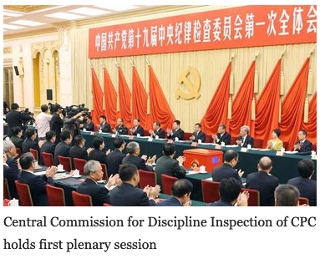
Building the Political Technopole
“We will work faster . . . promote further integration of the internet, big data, and artificial intelligence with the real economy, and foster new growth areas and drivers of growth in . . . human capital services.”
Xi Jinping, Secure a Decisive Victory in Building a Moderately Prosperous Society in All Respects and Strive for the Great Success of Socialism with Chinese Characteristics for a New Era, Report to the 19th CPC Congress 2017, p. 26

Slide 3
We will accelerate development of the crime prevention and control system, combat and punish in accordance with law all illegal and criminal activities such as pornography, gambling, drug abuse, gang violence, kidnapping, and fraud, and protect people’s personal rights, property rights, and right to dignity. We will improve the system of public psychological services, and cultivate self-esteem, self-confidence, rationality, composure, and optimism among our people. We will strengthen the system for community governance, shift the focus of social governance to the community level, leverage the role of social organizations, and see that government’s governance efforts on the one hand and society’s self- regulation and residents’ self-governance on the other reinforce each other.
(Xi Jinping, Secure a Decisive Victory in Building a Moderately Prosperous Society in All Respects and Strive for the Great Success of Socialism with Chinese Characteristics for a New Era, Report to the 19th CPC Congress 2017, pp. 43-44 (emphasis added))

Slide 4
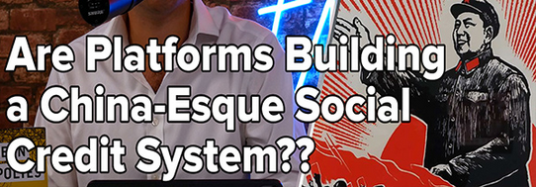

Slide 5
Tech, Markets, and Social Control
Tech in the service of the national political-economic model
Is government a tech driven industry?
Is tech innovation driving institutional change in the field of governance?
Can markets serve as a tool of governance?
Can the evolving relationship between markets and state management suggest a parallel evolution in the evolution of governance?
How do tech and markets provide the necessary platform for furthering the objectives of the state to create a system of social control with Chinese characteristics that contributes to the progress of the nation toward its realization of the ideal the realization of which its leading forces have been tasked?
Can platforms serve as a substitute for markets?

Slide 6
Organization of presentation
Start with foundations:
The Chinese political-economic model
Then look to objectives:
the construction of the ideal person, the ideal society and the ideal economic-political system through social credit systems through social credit systems
In that context consider the use of tech to attain this objective
From Social Credit to platform governance
The role of tech in data driven governance
A look to the future
Law-tech with Chinese characteristics
Emergence of “Platform Governance” model

Slide 7
The Chinese Political-Economic Model
Political theory of Chinese Party State
Party as polity
State as administrative apparatus
Working Style (Mao Zedong 1945 On Coalition Government):
"four obediences" (四个服从):
subordinate the individual to the organization, the minority to the majority, the lower to the higher level and the membership to the Central Committee. The unity of all factors of social production
in the service of the core objective and responsibility of the advanced forces of the vanguard:
the eventual establishment of a communist society in China
Strong interconnections between state, private, civil, religious and other mass organizations
“Within the revolution everything; outside of it nothing”

Slide 8
The Tasks of the Leadership Core
Function of Politics:
Moral Project (the construction of the ideal person in the ideal society)
The Party at the Center (the ideal requires a helmsman and navigator)
Everything else is a tool or a means to ward the attainment of the fundamental objective
Tech, markets, culture, etc. are the expression of and the means through which the advanced social forces move the nation toward its ideal.
The process “scientific” in the sense that is is rationalized and can be measured against the idea (truth from facts—facts in the service of truth).
The Stages of Historical Development and the core contradictions
That objective is to be undertaken in stages (Marxist progressivism toward the ideal)
Each stage requires a distinct contextually relevant political line
Core contradictions reflect principal challenges for the Leadership core in each stage of development
Class struggle (Mao Zedong)
Development of productive forces (Deng Xiaoping – Hu Jintao)
Balance between unbalanced and inadequate development and the people’s need for a better life (Xi Jinping)

Slide 9
The Key Drivers in the “New Era”
Chinese Marxist Leninist ideology in the “New Era” moves beyond” Reform and Opening Up” in the elaboration of its political-economic model.
China must develop its own systems free of foreign ideological baggage.
That fundamental premise has driven the movement toward everything from the articulation of Socialist core values (社会主义核心价值观) as well as Socialist approaches to law, governance, markets and international relations.
Tech plays a critical role in that forward movement

Slide 10
Social Credit Systems
data driven means of implementing rules-based systems of rewards and punishments that further state objectives under the guidance of the vanguard Communist Party.
eventually are meant to change the character of a socialist rule of law framework and with it the locus of regulatory authority from regulators to those responsible for developing behavior-based ratings.
dependent on two critical elements;
the first is data identification and generation, and
the second is in its organization and use by relevant governance actors (businesses, state organs, and the like).

Slide 11
“New Era” Governance With Chinese Characteristics
2014 announcement of plans to develop a Chinese Social Credit System; met with criticism in the West;
Appeared to play into Western fears of local data driven governance dystopias operated by private institutions
Social Credit might be understood itself as a governance platform of administrative platforms of the political, economic, and societal sectors
--Social and cultural project around integrity and accountability
--The Party and the State Apparatus at the center
--Building coordinated and coherent systems of rewards and punishments toward “Era-Specific” tangible goals .
Genesis: State Council Notice concerning Issuance of the Planning Outline for the Construction of a Social Credit System (2014-2020)
社会信用体系建设规划纲要

Slide 12
Social Credit as Expression of New Era Ideology
Part of top-down strategy for confronting challenges of current era under the core leadership of the CPC
Coordinated by the Central Leading Small Group for Comprehensively Deepening Reforms with Xi Jinping at its core. Top down strategies for driving change (顶层设计 (Dǐngcéng shèjì))
Entwined with Chinese Leninism and vanguard organization (from professional revolutionaries (Lenin) to professional managers (Xi) of economic, social, cultural, and political life under the leadership of the CPC. A new (tech centered) nomenklatura?
Constrained by its own ideology and responsibilities in each era
Deeply embedded in several projects
Socialist Culture (integrity and values)
Socialist Individual (the ideal worker and citizen)
Socialist Collective (the ideal society, expression of highest cultural aspirations)
Socialist Government (the ideal cadre, judge and functionary as a function of the correct work style)
Socialist economic activity (trustworthiness; directed toward political objectives under the leadership of the vanguard)
Chinese characteristics:
Suggests that such a thing can be distilled (data driven)
What can be distilled can be managed (system of rewards and punishments)
What can be managed can be managed toward perfection (predictive and scientific deployment of tools of Socialist rule of law, jurisprudential and data driven)

Slide 13
An “All-Around” Focus: Chinese Social Credit Principles
Government promotion, joint construction with society.
“Fully give rein to the organizational, guiding, promoting and demonstration roles of government.”
Completing the legal system, standardizing development.
“Progressively establish and complete credit law and regulation systems and credit standards systems, strengthen credit information management, standardize the development of credit service structures, safeguard the security of credit information, and the rights and interests of information subjects.”
Special Campaigns grounded in sincerity
OBJECTIVE: “persist in correcting unhealthy trends and evil practices of abusing power for personal gain, lying and cheating, forgetting integrity when tempted by gains, benefiting oneself at others’ expense, etc., and establish trends of sectoral sincerity and integrity.” .
Breakthroughs in focus points, strengthen application.
Choose focus areas and model regions to launch credit construction demonstrations. Vigorously spread the socialized application of credit products, stimulate the interaction, exchange, coordination and sharing of credit information, complete combined social credit reward and punishment mechanisms, construct a social credit environment of honesty/integrity, self-discipline, trust-keeping and mutual trust.
It is a project for the development of a national reputation system, assigning a social credit number that reflect a qualitative judgment of relevant data gathered about the subject around which sub-ratings systems will be coordinated.

Slide 14
CSC in the Shadow of Lists
New Era regulatory mechanism and Socialist Law
A complex system of rewards and punishment
Founded on data driven scoring
Scoring is based on ratings
Ratings are based on data driven assessments
Assessments are grounded in measurement against a set of norms and objectives for behavior
Norms reflect the values and objectives to be advanced
Traditional law the expression of the CPC Basic Line as administrative objectives and accountability measures
Translating political objectives to its essence and then reduced to measurable actions that can then be monitored and assessed
Is law becoming merely instructions for coding? Is coding the new language of administrative regulation?
At its heart, SCS is a data driven moral system
Created to steer culture and practices towards ideal (integrity, etc.)
Foundation in the 12 core Socialist values
Fidelity to the leadership of the Vanguard Party
Inward Face:
(1) Social harmony
(2) Meet challenge of current contradiction
Outward face: United Front against enemies

Slide 15
Social Credit for Individuals
Premises (there is an App for this: Honest Shanghai—One Net Programs)
individual behavior is subject to a number of core moral principles,
that those principles can be reduced to everyday behaviors,
that those everyday behaviors may be measured against behavior ideals,
once reduced to a score, these summary judgments about a person’s compliance ought to produce effects—privileges and restrictions depending on ranking that they have earned.
These privileges and restrictions need have little direct connection to specific behaviors but are developed through an network of agreements among public and private actors to piece together black lists and red lists that produce incentives toward better behavior and higher scores.
The system is itself cobbled together from a series of national and provincial programs, from public and private data harvesters and a series of MOUs that are meant to nationalize lists and develop a coordinated system of evaluation (based on aggregate data) and consequences based on ranking demining placement on blacklists and redlists.
Consequence: widely circulated stories in the West about people denied express train and air travel, college admission for their children, restrictions on access to credit and visas for travel abroad on the basis of credit scores.
Analytics appears to incorporate actions that would have been weighed differently in the West. .
these measurements may produce accurate assessments of individual compliance with their societal obligations.

Slide 16
The Social Credit List as Regulatory Power
Lists (red, black, white) represent the end-product of a process of data driven analytics
producing a conclusion related to each list
(compliance with court order lists; student misbehavior lists; subway misbehavior lists; community service lists; financial responsibility lists; etc.)
based on the factors weighed
(e.g., spitting, eating, loud music playing etc. on the subway for the subway misbehavior list; timely payment of bills, traffic tickets, utility bills for a financial responsibility list) )
in order to determine whether a threshold quantum of conduct has occurred that merits inclusion on the list.
The end-product of that analytics—the list—then serves as the signal necessary to either encourage or compel other social, political, and economic actors to act (reward or punish) on the basis of inclusion.

Slide 17
From Social Credit to Platform Governance

Slide 18
Platforms: Spaces Where Value is Created Through Facilitation of Exchanges
“Online platforms have some important things in common, including the use of information and communications technologies (ICTs) to facilitate interactions between users, the collection and use of data about those interactions, and network effects. * * * But what are they?
. . . An online platform is a digital service that facilitates interactions between two or more distinct but interdependent users (whether firms or individuals) who interact through the service via the internet.
OECD (2019) An Introduction to Online Platforms and their Role in the Digital Transformation (Paris: OECD)
_________
Online platforms may also
Serve as or as substitutes for markets (sites where people come together to barter (economic, social and cultural objects-behaviors)
Serve as or as substitutes for systems of administrative regulation (that is in lieu of regulation, the platform itself serves as the space where users contribute or consume information generated by other platforms that are directed toward the management of behaviors through precisely defined conduct the records of which serves as the core input-output of the platform.
Platforms impose rules and institutions that reach beyond the pure matching service and shape the functioning of the marketplace and, potentially, the relationship between the various platform sides, e.g. by regulating access to and exclusion from the platform, by regulating the way in which sellers can present their offers, the data and APIs they can access, setting up grading systems, regulating access to information that is generated on the platform, imposing minimum standards... Such rule-setting and ‘market design’ determine the way in which competition takes place [on a platform].”
Crémer, deMontjoye, and Schweitzer (2019) Competition policy for the digital era.Reportfor the European Commission

Slide 19
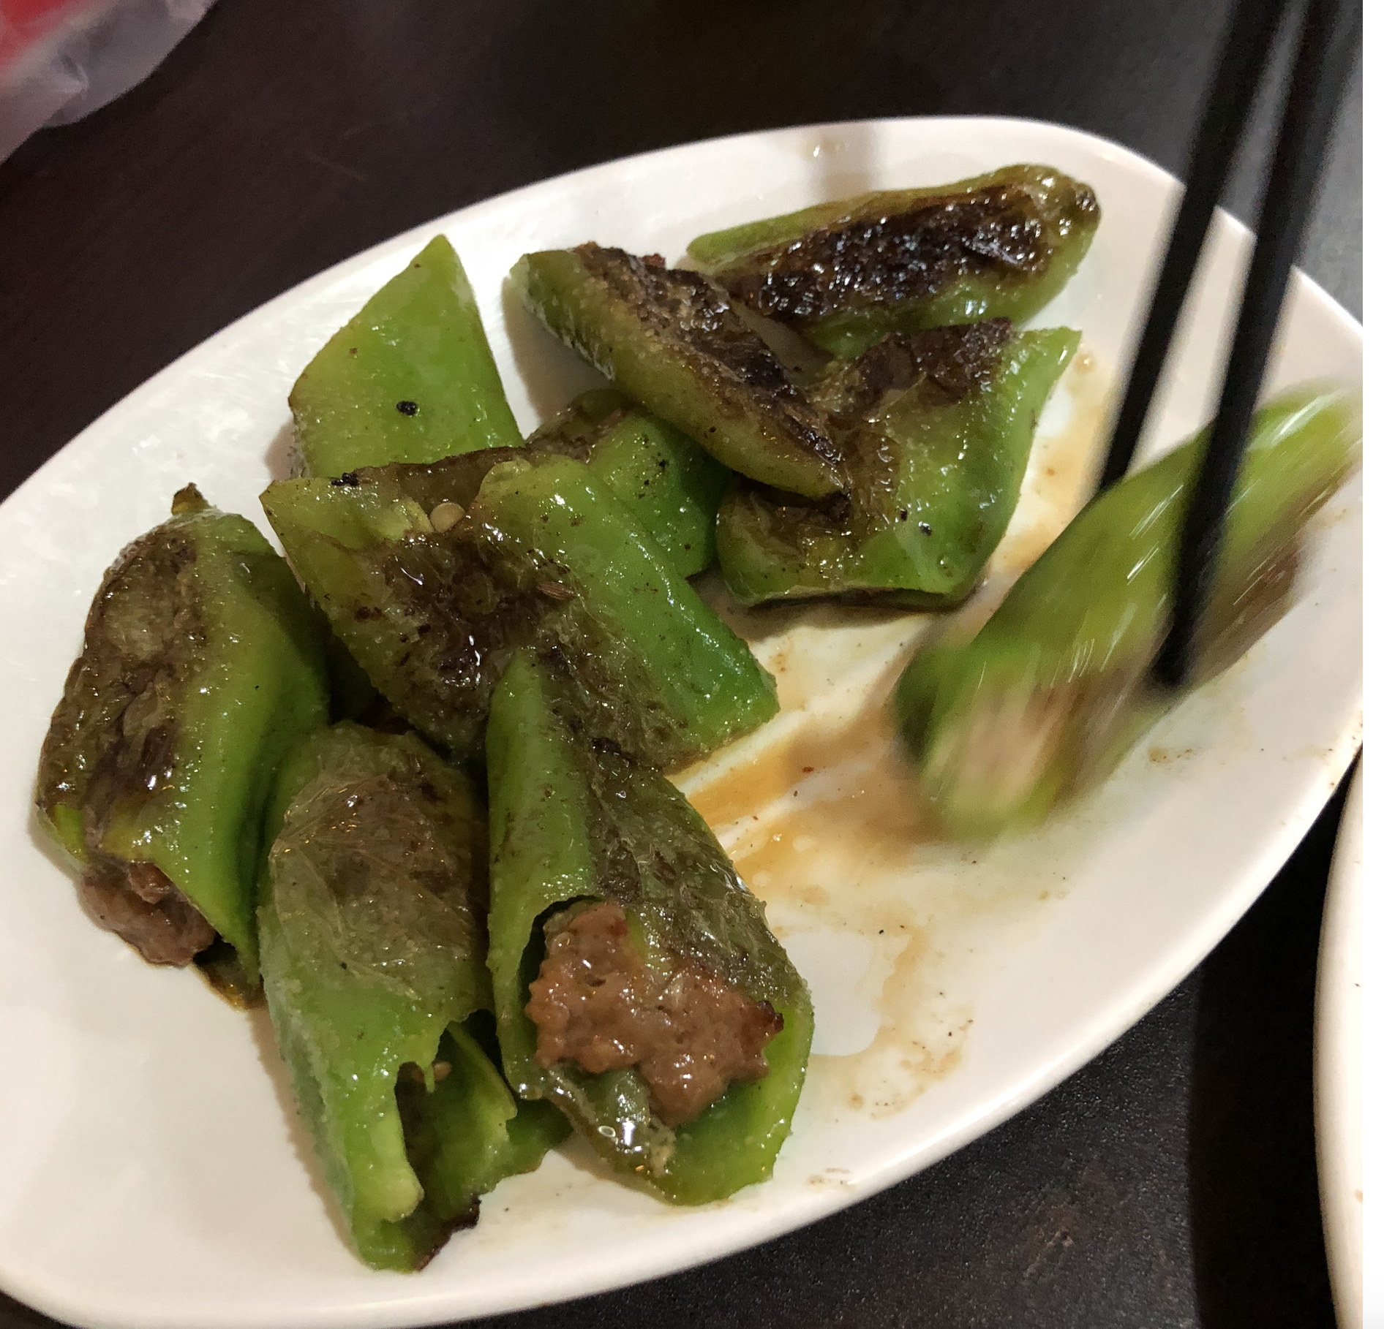
Platforms: Managed (Curated)Networks of Users and Resources
Networks of users and resources
Scalable, divisible
Self-managed or managed from the outside (by a greater platform sometimes)
Create communities (of users for interact)
Create markets (for exchanges of things (tangible and intangible)
CONTRAST “linear institutions” (E.g., Multinational Enterprises or even the state) which create and control inventory (regulation, enforcement, tangible and intangible goods and services ) through interlinkages of control or ownership
CONTRAST Data warehouses—location where a specific kind of goods (data) is stored for retrieval or access
PLATFORMS are spaces for trading, access, utilization, not the “means of production” but the “means of connection” (Platform Business Model – Definition | What is it? | Explanation)
E.g., Amazon, eBay, Instagram, YouTube, WhatsApp, Waze, Uber, Lyft, Airbnb, Pinterest, Square, Social Finance, GitHub, Kickstarter, ZocDoc
E.g., Alibaba, Tencent, Baidu, and Rakuten (Japanese e-commerce)
Even a personal computer is a platform (hardware-the computer), software (operating system), as a foundation to support software and applications

Slide 20
The Role of Platforms
critical role in the implementation of social credit systems in the way that they now occupy a central role in the organization of economic activity through the internet in the West
(e.g., as marketplaces, search engines, social media, creative content outlets, app stores, communications services, payment systems, services).
suggests a paradox that is the subject of examination in this essay:
where in the West the recognition of the power of the platform has produced a discourse aimed at the regulation of platforms (and their private operators), in China, the thrust of policy appears to be first to use platforms as the vehicle for regulation, and second, to align managed markets with managed platforms.
In the process, China appears to be transforming the use and role of platforms both as a governance medium and as a proxy for markets
In this way both tech, and markets-based behaviors becomes central to the project of governance
From rules and judge administered legal norms to ratings and data driven evaluation systems
“play a regulatory role in deciding how to govern the “marketplaces” they create.” Tat-how The, “Platform Governance”2020

Slide 21
The Universe of Social Credit Platforms: Social Media
Top 10 Chinese Social Media: Table of Contents
WeChat: Not Just the Chinese Facebook Read Now
Sina Weibo: Twitter of China Read Now
Tencent QQ: Popular Instant Messaging App Read Now
Tencent Video: The King of Online Video in China Read Now
Xiao Hong Shu (Little Red Book): Where Community Meets Cross-Border E-Commerce Read Now
Douban: Lifestyle Discussion Platform Read Now
Zhihu: The Quora of China Read Now
Meituan – Dianping: The Chinese Versions of Yelp Read Now
Toutiao: The Hottest News & Information & Entertainment Platform Read Now
DouYin (TikTok): The Short-video App Taking the World By Storm Read Now
Runner Ups for the Top 10 Chinese Social Media Platforms! (2020 Update)
Momo: Tinder of China Read Now
Meitu: From the Creators of Meipai Read Now
Kuaishou: The Short-video Platform For Life in China Outside Tier 1 Cities Read Now
Youku Tudou: The Former Youtube of China Read Now
Baidu Tieba: A Search Engine Forum Read Now

Slide 22
The Universe of Social Media Platforms: Tracking Apps
DIDI(Didi Chuxing Tech Co. 滴滴出行)
App-based transportation services, including taxi hailing, private car hailing, social ride-sharing and bike sharing; on-demand delivery services; and automobile services, including sales, leasing, financing, maintenance, fleet operation, electric vehicle charging and co-development of vehicles with automakers
“Didi to hire 1,000 Communist Party comrades to improve safety:Recruits will serve as 'role models' on customer service team, company says” Nikkei Asia (19 Oct 2018).
Since 2015, DiDi has invested in Grab, Lyft, Ola, Uber, 99, Bolt (Taxify) and Careem.
Vertically integrated services: Financial services (eg car insurance); food delivery services; auto leasing and trading services (platform hybrid)
The DIDI Platform
DIDI Research Institute—AI tech to aid its business model; Labs in Beijing and Mountain View California
DiDi Cloud Platform: integrate data to produce predictive analytics of people and traffic flows for example
Smart Transport Initiative (networked platforms; public-private): use data to optimize traffic flow: joint work for example with Beijing Capital International Airport Public Security Bureau Traffic Detachment;

Slide 23
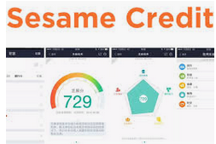
The Universe of Social Credit Platforms: Financial Credit Scoring
Sesame Credit
Develop score based on financial transactions and other factors
Serve as a platform for merging social and financial scoring based on data generated form transactions effected through the platform.
Purchase data serves as proxy for conformity to expected social norms (too much liquor, quality of books purchased, gaming, etc.)
Greenfield, A. (2018, February 14). “China’s dystopian tech could be contagious”.
Ant Group consolidated consumer finance project (August 2020)
Nanyang Commercial Bank, China TransInfo Technology Corp. and Contemporary Amperex Technology Co.
platform would be incorporated in Chongqing.
Coordination with Alipay payments app and money market funds and provides credit scoring

Slide 24
The Universe of Social Credit Platforms: Reputation Tracking
Honest (Credibility) Shanghai APP(诚信上海)
check the reputations of local businesses, using figures provided by Shanghai’s local government offices, such as the tax and food and drug administrations. For example, the app contains credit ratings for companies involved in international trade, as well as lists of restaurants from different districts with accompanying emoticons to indicate their level of hygiene.
一网通办，一网通管 [Yīwǎngtōng bàn, yīwǎngtōng guǎn” One Net Office; One Net Administration]
Move from APP to platform
One Net Office: citizens can take care of all of their activities through one portal
One Net Administration: standardization of administrative services through the platform (unified internet government service portal
Big Data Center to be built as data warehouse and platform大数据中心 (上海)
Two Wings fly together “两翼”齐飞支撑“Strategy
"Internet + government services" and "Internet + supervision" “互联网+政务服务”和“互联网+监管”(generally HERE; HERE)

Slide 25
The Universe of Social Credit Platforms: Platforms of Data and Value Generating Platforms
Platforms for database coordination
Early Effort “Golden Shied Project”
Hoffman, S. (2017). “Managing the state: Social credit, surveillance and the CCP’s plan for China”
Centralized data infrastructures for data collection, mining, and analysis
Platforms for Data Aggregation
From Data mining and analytics to punishment and reward
Blacklists and redlists

Slide 26
As Applied: COVID-19 and Social Credit

Slide 27
The Building of Health Surveillance and Control Systems in China
While an extraordinary range of technology-based COVID-19 proposals and ideas are emerging, as part of COVID-19 response, there are a specific group of biomedical and social control-focused projects requesting large amounts of historically and commercially regulated location data. There are five main categories of problems they strive to address:
1, contact tracing;
2, testing and responder capacity;
3, early warning and surveillance;
4, quarantine and social control; and
5, research and cure.
(Sean MacDonald, “The Digital Response to the Outbreak of COVID-19,” CIGI 30 March 2020
Chinese efforts:
Are meant to try to combine multiple functions. DATA HARVESTING
Personal information: e.g. name, address etc.
Health information: body temperature, present condition, residence or short-term travel to high-risk classified areas, close contact with high-risk individuals.
Travel information: travel/residence for the past 14-30 days
Health Information management department evaluation of health status : health risk level, time of evaluation, reason of evaluation, COVID-19 test results, test time, data source. (Dev Lewis, “CIN #14)
“There is no 1 Health Code for all of China. In reality its hundreds of different codes issued by cities. They have their own names, they look different, and may not even use the same types of data. Essentially ‘HealthCode’ is the catch-all name used to refer to them and where you go to, in either Alipay or Wechat, to find the code for your city.”
Dev Lewis, “CIN #14- Going under the hood of Health QR Codes,” China India Networked 1 June 2020

Slide 28
The Face of Social Credit in the Shadow of Pandemic
Pix Credit: Shining Tan, China’s Novel Health Tracker: Green on Public Health, Red on Data Surveillance; CSIS May 2020

Slide 29
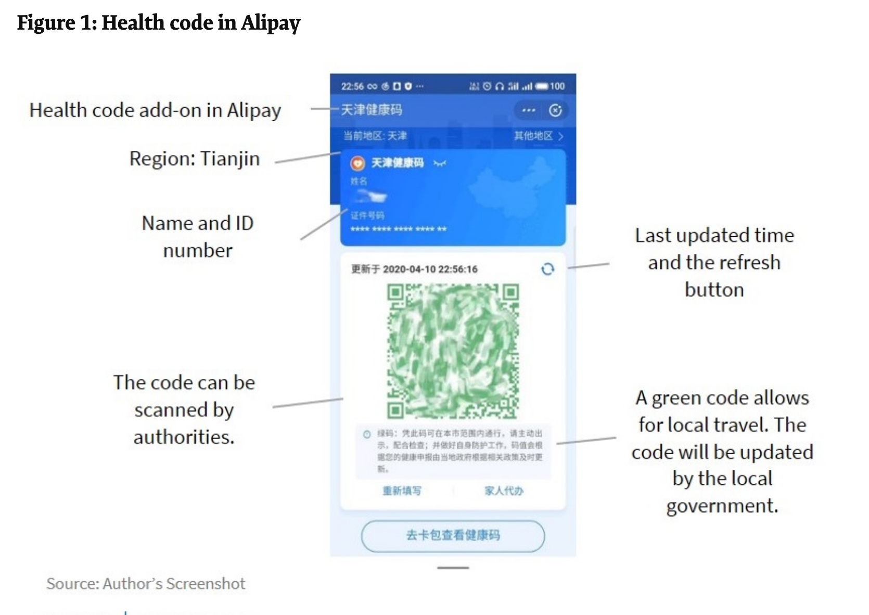
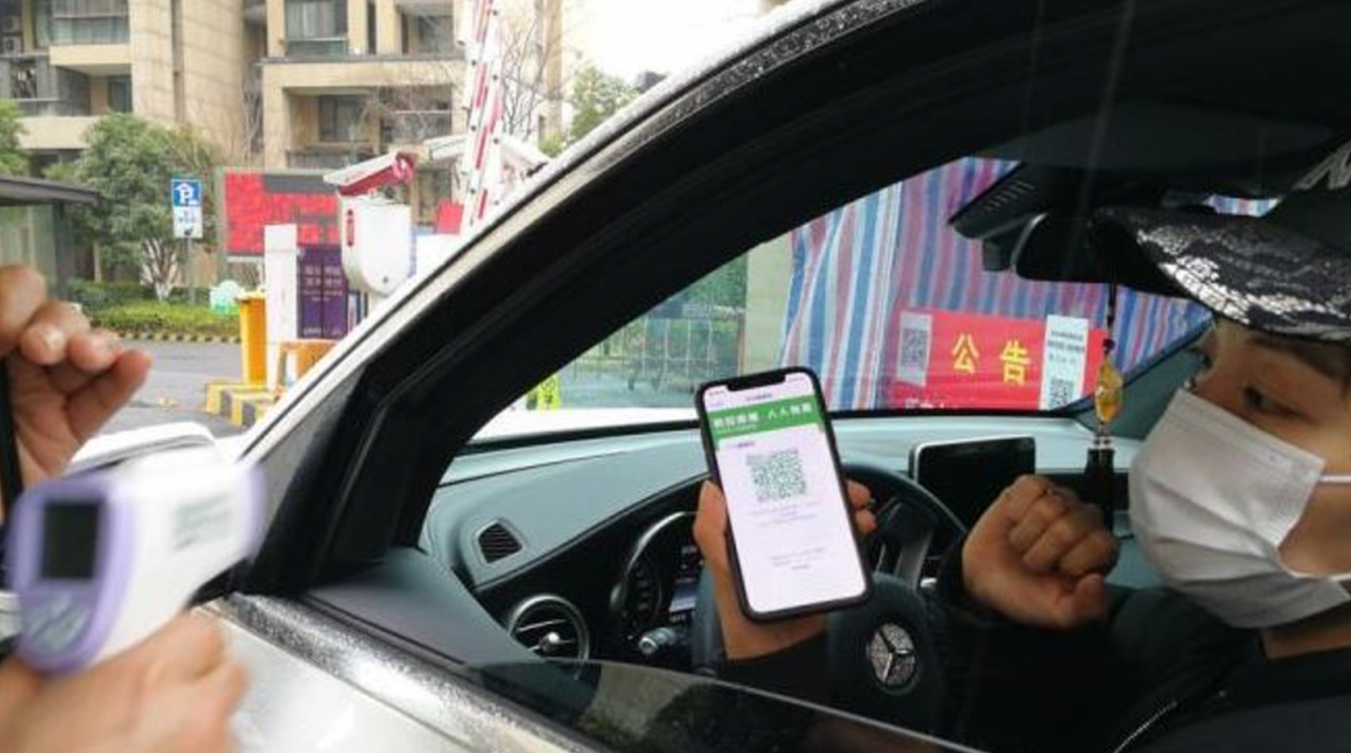
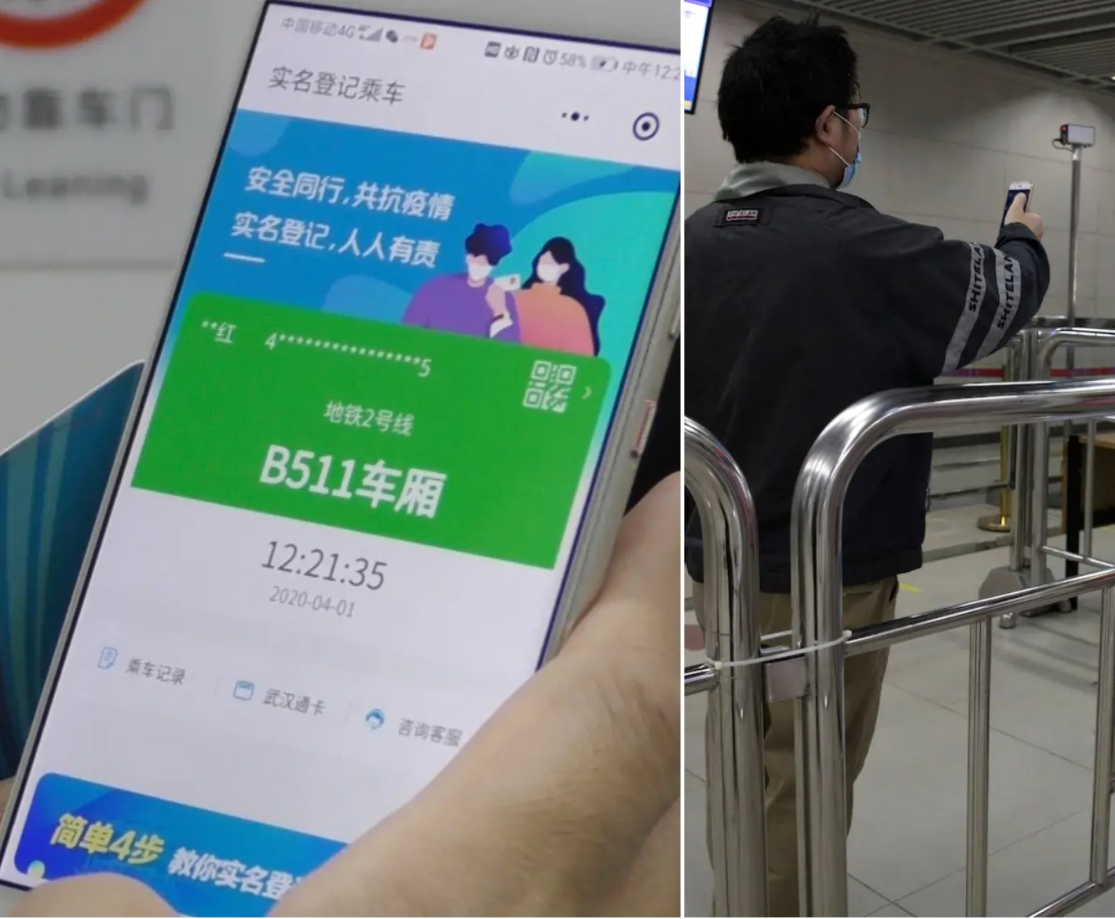

Slide 30
From COVID To Health Management (Hangzhou)
As reported by Chen Du for PingWest (“Drinking, Smoking Affect Your Health Score, Says China's Hangzhou City” (15 May 2020)):
Screenshots of slides from the meeting demonstrate that in the proposed system, residents' workout, lifestyle and living status in general would affect their scores. Walking at least 15,000 steps a day would increase one's score by 5, while getting a good night sleep for at least 7.5 hours can result in an increase of 1.
Meanwhile, lifestyle choices that are considered bad for health but otherwise very common among certain age/gender groups in China, would decrease one's health score. Drinking 200 milliliters of Baijiu, Chinese people's favorite liquor, would cut down one's score by 1.5, while smoking 5 cigarettes a day causes a deduction of 3 points.
But that's not all of it. The system also appears to aggregate scores from employees working for the same company to compile a new score for the company, too. Local media also suggested that the same could be done for all the people in the same apartment complex, or a municipal district.

Slide 31
Making the Scoring System Coherent: Bureaucratization
Inter-institutional coordination of data and analytics.
Lists as mediating agents
Public-Private partnerships
Vertical and horizontal coherence; central discipline
Information gathering, coordination, and sharing

Slide 32
Role of Platforms
Shaun Ee, “We read the technical standards for China’s ‘health code.’ Here’s what we learned,” Technode 10 July 2020: State Council May 2020 Circular

Slide 33
A Look to the Future
From platforms as a system of reward and punishment to system for predictive analytics and progressive intervention
Platforms as models
Predict behaviors
Application to commercial and personal behaviors
Market and culture control devices
Change behaviors before they occur
Change collective behaviors by predicting which measures of rewards and punishments will move mass behaviors in a desired direction.
Platforms as a market of markets
Substitution from traditional hard platforms (shopping, etc.)
Platforms as market disciplinary mechanisms (enterprise social credit)
Platforms as regulatory substitution mechanisms
Compliance and accountability model—rewards and punishments
Centering coder, data harvesting, and analytics
De-centering old regulatory model of post hoc judicial determinations of rule violation

Slide 34
Platform Governance
An enhanced method for the expression of New Era “democratic Centralism” grounded in the New Working Stye of the CPC
Principle: the Party at the Center (democratize life within the Party but only under centralized guidance)
Practice: social credit as real time rectification and guided mass line
System: platform codifying the system as a disciplinary tool
Practice: Social Credit as a means of creating and naturalizing the narrative of the current contradiction and its implementation
Social Credit as digital rectification
Normalizing the 1942 Yan’an Rectification (延安整风运动) model for the New Era
A working style for the masses (Cheng, Yinghong. Creating the "New Man": From Enlightenment Ideals to Socialist Realities, University of Hawaii Press, 2009).
System: platforms as the system within which rectification becomes embedded as a constant state
The Platform as the Party’s Tech version of the Central Commission for Discipline Inspection, but for the masses
Automated and coordinated process of guiding the masses and the state to the next era of historical development.

Slide 35
Points of Tech Transformation
Mechanics/technique merges with regulatory command
The power of data driven governance; empirics as the source and object of management
Language of Coding versus language of rules-rights
Creating networks of data streams
Analytics as the new regulation; platforms as the new markets
The role of the coder, the administrator, and the analyst relative to the government official and the lawyer
Embedding political choices and biases through platforms
The language of data-analytics as socialist rule of law with the Party at the center; Tech Leninism with Chinese characteristics
Dr. Ian Malcolm: Yeah, but your scientists were so preoccupied with whether or not they could, they didn't stop to think if they should.

Slide 36
Thanks!

