Slide 1
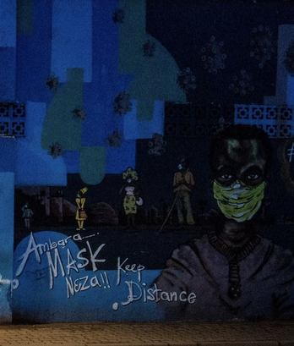
COVID, Control, and Complicity in Rwanda: Human Rights Intersectionality in the Dead Spaces between Legal and Markets Regimes
Larry Catá Backer,
W. Richard and Mary Eshelman Faculty Scholar Professor of Law and International Affairs
Pennsylvania State University
Presentation for Roundtable Sponsored by Penn State Law and School of International Affairs
21 October 2020 (Virtual)

Slide 2
Convergence and Dissonance
The problem
  State institutes measures to meet challenge of COVID
  To implement State must acquire goods and services from foreign enterprises
  COVID measures successful amid allegations of human rights abuses against political enemies of state leaders
The nature of Duty/Responsibility
  State duty to protect human rights (UNGP §§ 1-10)
  Corporate responsibility to respect human rights
  Differences in the measure of accountability of state and corporate conduct
  The concept of complicity as a legal and market driven concept
Consequences: Impunity (the State) and Complicity (the Enterprise)
  State controls risk by their action
  Enterprise bears risk and the obligation to prevent-mitigate-remedy
  Nature of Risk: Market driven (SWFs, lenders, customer) and soft process (OECD NCP, et.) but touch on home state regs (Ex-Im rules, etc.)
What can/must the enterprise do in these circumstances?
  Decision to refuse service (but price may be increased COVID deaths etc.)
  Negotiate state conduct as part of provision of services contract
  Monitoring with penalty-pull out options triggered by Human Rights abuses
  Grievance mechanism
  Enlist assistance of home state

