Slide 1
Chinese Social Credit and Pandemic Larry Catá Backer W. Richard and Mary Eshelman Faculty Scholar Professor of Law and International Affairs Pennsylvania State University
Case Study on Personal Data—Social credit scoring models from China to Silicon Valley
3rd Annual Innovation and Technology Law Conference (all sessions conducted virtually)
2020 Theme-Data Justice: Legal and Policy Issues in Data Collection, Usage, and Ownership
Seattle University School of Law; Friday August 21, 2020

Slide 2
“New Era” Governance With Chinese Characteristics
2014 announcement of plans to develop a Chinese Social Credit System; met with criticism in the West;
Appeared to play into Western fears of local data driven governance dystopias operated by private institutions
Social and cultural project around integrity and accountability
--Understood as a moral project
--As a project to better center the CCP in social and cultural development .
Genesis: State Council Notice concerning Issuance of the Planning Outline for the Construction of a Social Credit System (2014-2020)
社会信用体系建设规划纲要

Slide 3
CSC in the Shadow of Lists
At its heart, SCS is a data driven moral system
Created to steer culture and practices towards ideal (integrity, etc.)
Foundation in the 12 core Socialist values
Fidelity to the leadership of the Vanguard Party
Social harmony
United Frant against enemies
New regulatory mechanism
A complex system of rewards and punishment
Founded on data driven scoring
Scoring is based on ratings
Ratings are based on data driven assessments
Assessments are grounded in measurement against a set of norms and objectives for behavior
SCS relationship with law:
Norms reflect the values and objectives to be advanced
Is law becoming merely instructions for coding?
Is coding the new language of administrative regulation?
Where does that leave traditional law in liberal democratic or Marxist-Leninist States?

Slide 4
An “All-Around” Focus: Chinese Social Credit Principles
Government promotion, joint construction with society.
“Fully give rein to the organizational, guiding, promoting and demonstration roles of government.”
Completing the legal system, standardizing development.
“Progressively establish and complete credit law and regulation systems and credit standards systems, strengthen credit information management, standardize the development of credit service structures, safeguard the security of credit information, and the rights and interests of information subjects.”
Special Campaigns grounded in sincerity
OBJECTIVE: “persist in correcting unhealthy trends and evil practices of abusing power for personal gain, lying and cheating, forgetting integrity when tempted by gains, benefiting oneself at others’ expense, etc., and establish trends of sectoral sincerity and integrity.” .
Breakthroughs in focus points, strengthen application.
Choose focus areas and model regions to launch credit construction demonstrations. Vigorously spread the socialized application of credit products, stimulate the interaction, exchange, coordination and sharing of credit information, complete combined social credit reward and punishment mechanisms, construct a social credit environment of honesty/integrity, self-discipline, trust-keeping and mutual trust.
An example of China’s “top-level design” (顶层设计 (Dǐngcéng shèjì)) approach; coordinated by the Central Leading Small Group for Comprehensively Deepening Reforms
It is a project for the development of a national reputation system, assigning a social credit number that reflect a qualitative judgment of relevant data gathered about the subject.

Slide 5
Social Credit for Individuals
Premises:
individual behavior is subject to a number of core moral principles,
that those principles can be reduced to everyday behaviors,
that those everyday behaviors may be measured against behavior ideals,
once reduced to a score, these summary judgments about a person’s compliance ought to produce effects—privileges and restrictions depending on ranking that they have earned.
These privileges and restrictions need have little direct connection to specific behaviors but are developed through an network of agreements among public and private actors to piece together black lists and red lists that produce incentives toward better behavior and higher scores.
The system is itself cobbled together from a series of national and provincial programs, from public and private data harvesters and a series of MOUs that are meant to nationalize lists and develop a coordinated system of evaluation (based on aggregate data) and consequences based on ranking demining placement on blacklists and redlists.
Consequence: widely circulated stories in the West about people denied express train and air travel, college admission for their children, restrictions on access to credit and visas for travel abroad on the basis of credit scores.
Analytics appears to incorporate actions that would have been weighed differently in the West. .
these measurements may produce accurate assessments of individual compliance with their societal obligations.

Slide 6
The CSC List as Regulatory Power
Lists (red, black, white) represent the end product of a process of data driven analytics
producing a conclusion related to each list
(compliance with court order lists; student misbehavior lists; subway misbehavior lists; community service lists; financial responsibility lists; etc.)
based on the factors weighed
(e.g., spitting, eating, loud music playing etc. on the subway for the subway misbehavior list; timely payment of bills, traffic tickets, utility bills for a financial responsibility list) )
in order to determine whether a threshold quantum of conduct has occurred that merits inclusion on the list.
The end product of that analytics—the list—then serves as the signal necessary to either encourage or compel other social, political, and economic actors to act (reward or punish) on the basis of inclusion.

Slide 7
The Building of Health Surveillance and Control Systems in China
While an extraordinary range of technology-based COVID-19 proposals and ideas are emerging, as part of COVID-19 response, there are a specific group of biomedical and social control-focused projects requesting large amounts of historically and commercially regulated location data. There are five main categories of problems they strive to address:
1, contact tracing;
2, testing and responder capacity;
3, early warning and surveillance;
4, quarantine and social control; and
5, research and cure.
(Sean MacDonald, “The Digital Response to the Outbreak of COVID-19,” CIGI 30 March 2020
Chinese efforts:
Are meant to try to combine multiple functions. DATA HARVESTING
Personal information: e.g. name, address etc.
Health information: body temperature, present condition, residence or short-term travel to high-risk classified areas, close contact with high-risk individuals.
Travel information: travel/residence for the past 14-30 days
Health Information management department evaluation of health status : health risk level, time of evaluation, reason of evaluation, COVID-19 test results, test time, data source. (Dev Lewis, “CIN #14)
“There is no 1 Health Code for all of China. In reality its hundreds of different codes issued by cities. They have their own names, they look different, and may not even use the same types of data. Essentially ‘HealthCode’ is the catch-all name used to refer to them and where you go to, in either Alipay or Wechat, to find the code for your city.”
Dev Lewis, “CIN #14- Going under the hood of Health QR Codes,” China India Networked 1 June 2020

Slide 8
The Face of Social Credit in the Shadow of Pandemic
Pix Credit: Shining Tan, China’s Novel Health Tracker: Green on Public Health, Red on Data Surveillance; CSIS May 2020

Slide 9
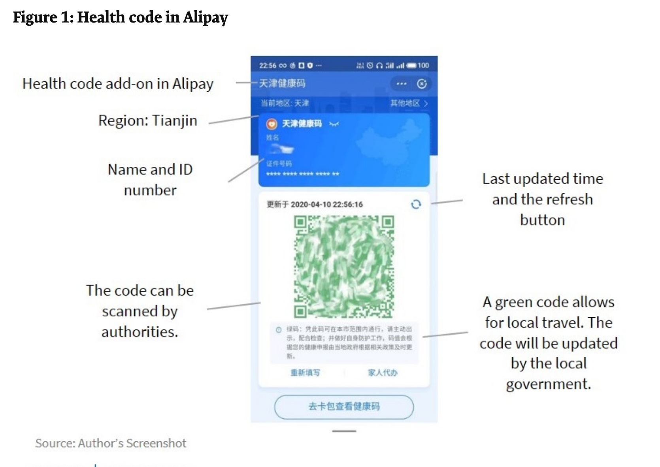
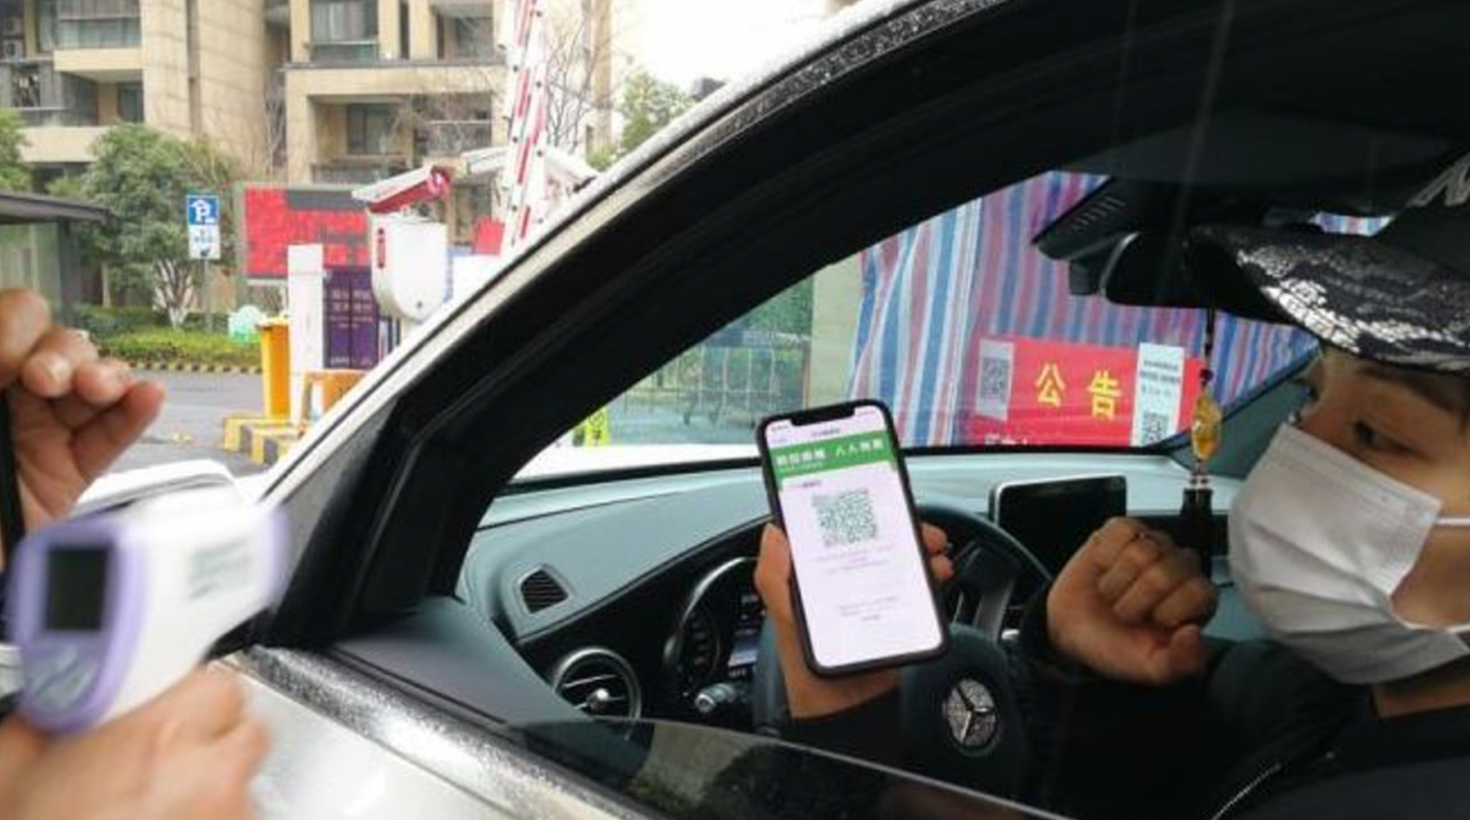
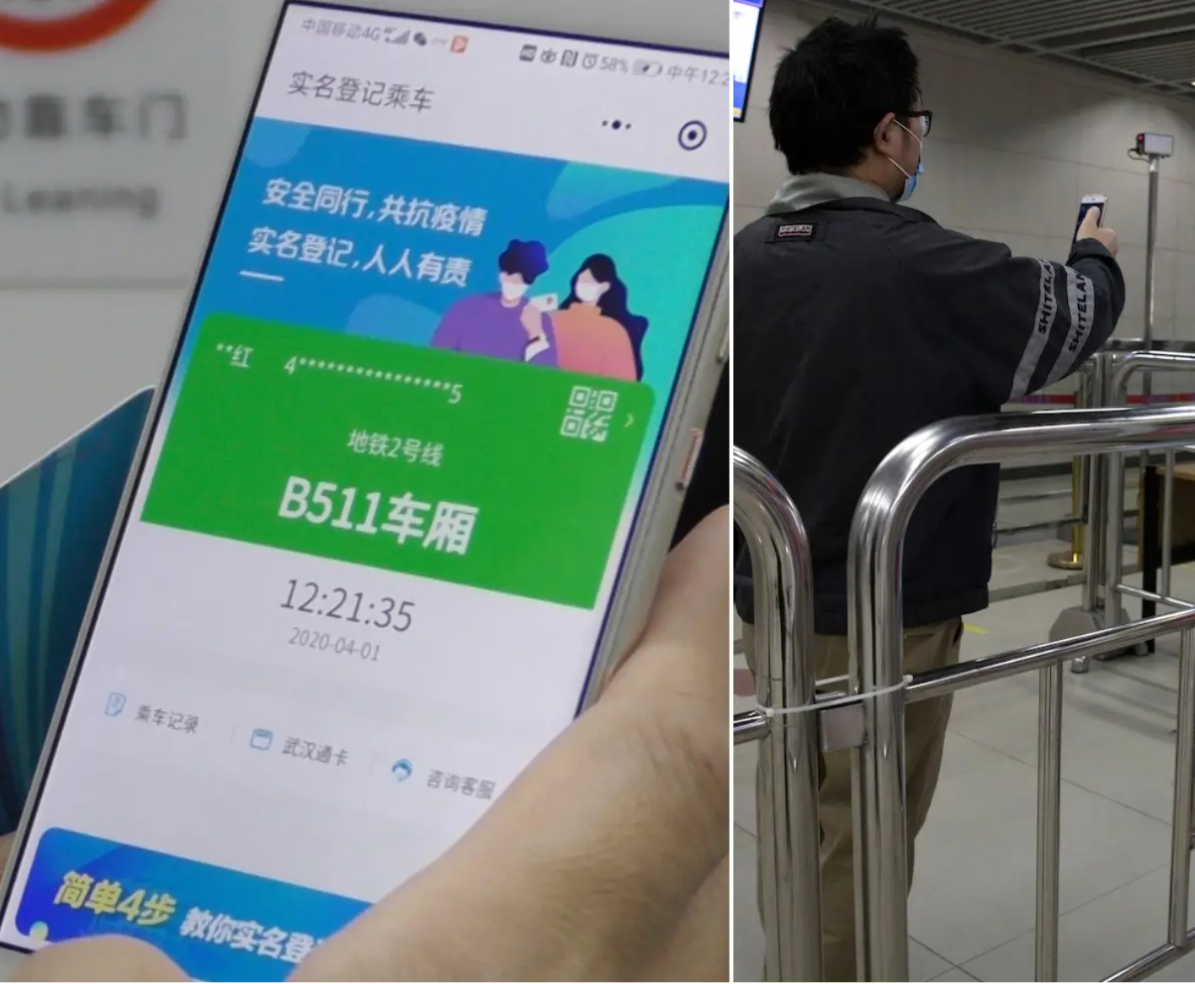

Slide 10
From COVID To Health Management (Hangzhou)
As reported by Chen Du for PingWest (“Drinking, Smoking Affect Your Health Score, Says China's Hangzhou City” (15 May 2020)):
Screenshots of slides from the meeting demonstrate that in the proposed system, residents' workout, lifestyle and living status in general would affect their scores. Walking at least 15,000 steps a day would increase one's score by 5, while getting a good night sleep for at least 7.5 hours can result in an increase of 1.
Meanwhile, lifestyle choices that are considered bad for health but otherwise very common among certain age/gender groups in China, would decrease one's health score. Drinking 200 milliliters of Baijiu, Chinese people's favorite liquor, would cut down one's score by 1.5, while smoking 5 cigarettes a day causes a deduction of 3 points.
But that's not all of it. The system also appears to aggregate scores from employees working for the same company to compile a new score for the company, too. Local media also suggested that the same could be done for all the people in the same apartment complex, or a municipal district.

Slide 11
Making the Scoring System Coherent: Bureaucratization
Inter-institutional coordination of data and analytics.
Lists as mediating agents
Public-Private partnerships
Vertical and horizontal coherence; central discipline
Information gathering, coordination, and sharing

Slide 12
Making the Role of Platforms
Shaun Ee, “We read the technical standards for China’s ‘health code.’ Here’s what we learned,” Technode 10 July 2020: State Council May 2020 Circular

Slide 13
The (Ir)Relevance of the Chinese System to the West
The Issues:
Data Protection (for whom and against whom?)
Data Integrity
Transparency (analytics; algorithms)
Transposability
Accountability
Privacy
The Problems
Issues are heavily contextual
What concerns Chinese politics and law may be of little relevance in the context of liberal democratic states
Example—Different value relationships among political, civil. economic, social, and cultural rights.
Difference in focus of analysis:
China: Stability, prosperity, collective advancement
U.S.: traditional individual rights-based regimes

Slide 14
Points of Convergence
Mechanics/technique
The power of data driven governance
Language of Coding versus language of rights
Creating networks of data streams
Analytics
The role of the coder, the administrator, and the analyst relative to the government official and the lawyer
Embedding political choices and biases
Dr. Ian Malcolm: Yeah, but your scientists were so preoccupied with whether or not they could, they didn't stop to think if they should.

Slide 15
Thanks

