Slide 1

How to Become a Full Time Law Professor
Larry Catá Backer
W. Richard and Mary Eshelman Faculty Scholar Professor of Law and International Affairs Pennsylvania State University
Prepared for Panel 4G: How to Become a Full-Time Law Professor; 4th National People of Color Legal Scholarship Conference
People of Color and the Future of Democracy

Slide 2

Description of Traditional Gateway To Full-Time Law Teaching
Follow the herd
  Conventional and safe
  Risk minimization project
  May require some dissonance between the voices in the head and the stuff that you say and write
Heed the voices in your head
  True to yourself
  Does a tree falling in the woods make a sound if there is no one there to hear it?

Slide 3

From Idea to Action
”How to most effectively prepare to be a candidate for full-time law teaching - especially as a person of color”
  Mentoring
  Know the community (political choices)
  Writing (you are what your write)
  Choosing a field
  Stereotyping (teaching, scholarship, character, expectations)
  The value of an LLM, PhD
  The Value of practice: functional stratification (from practice to clinical positions??)
  VAPS
  Pipeline programs

Slide 4

The Gauntlet
"How and when to apply to full-time positions”
  Your writing is your portfolio
  A research plan extending through tenure helps a lot
  A little teaching doesn’t hurt
  Real answer: There are trajectories and field expectations
  The issue of staleness (too long in practice)
  The issue of mobility

Slide 5
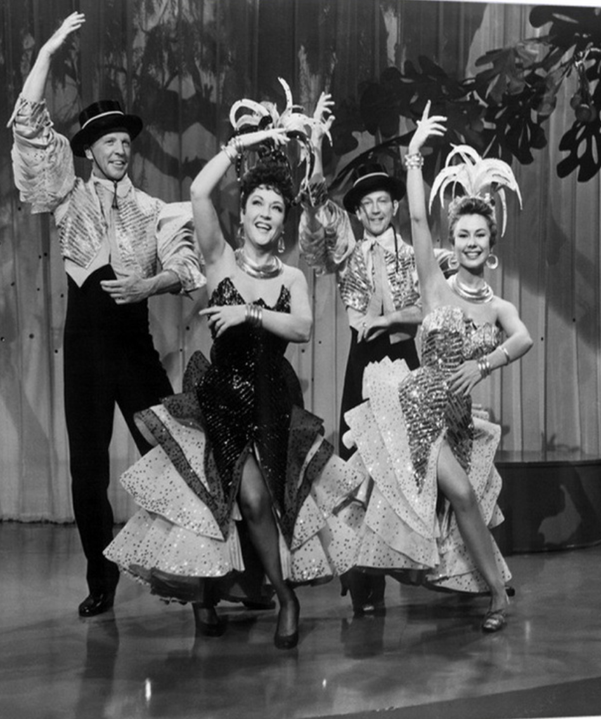
There’s No Business Like Show Business
Success in the AALS "meet/meat market.”
  Appearances
  Selling yourself; enthusiasm matters
  People can tell when you are talking about something you know nothing about
  Be honest but ambiguous
  Be flexible but do not appear clueless
  Making connections
  Serious versus look see
  The problem of padding interview schedules (and the value of minorities for statics)

