Slide 1
Social Credit and Foreign Enterprises Along the Silk Road Larry Catá Backer Remarks prepared for a Lecture Delivered at the Institute for East Asian Studies University of Cologne Cologne, Germany October 10, 2019

Slide 2
From Law to Data Driven Governance
“New Era” Transformative moment: Law
From law as a system of commands
To data driven governance as a set of real time system of privileges and restrictions based on compliance
Transforming the Regulatory environment
Apex states developing core-collective model of trade relationships
Free movement of capital and investment creates regulatory gaps that are filled by governmentalized enterprises
Result
Rise of compliance cultures
De-centering of (most) states
Technology liberates states from reliance on law except as a constitutive element (norms, institutions)

Slide 3
From Chinese Social Credit System to Foreign Enterprise Compliance
Begin from the simplest of starting points:
How is it that one can construct a social credit system?
From there I consider China’s Social Credit system structures in general terms.
Principles
Scope
Modalities
Focus on that part of the social credit system that targets business integrity.
July 2019 publication of the State Administration of Markets on business related Social Credit lists
The 16 July 2019 State Council Guiding Opinion.
Implications for non-Chinese business operating in China and within the BRI sphere of influence.

Slide 4
From Data to “All Around” Data Driven Governance
Pix Credit: Legal Aspects of Data

Slide 5
Data Driven Governance From the Bottom Up Hypothetical: Data Driven Modern Slavery
Assume
general consensus against the practice.
beyond writing laws and regulations, states find it hard to control the practice
Transnational elements of trafficking
Embedded within official and unofficial labor markets.
All businesses are willing to comply with law and are sensitive to stakeholder action
Especially of consumers and
A handful of states have enacted so-called Modern Slavery Laws, or supply chain due diligence laws or Anti-Trafficking disclosure laws,
All of which require some kind of public disclosure.
Companies may be required to disclose additional information
Securities laws, listing requirements, financing agreements.
Voluntary ESG disclosure.

Slide 6
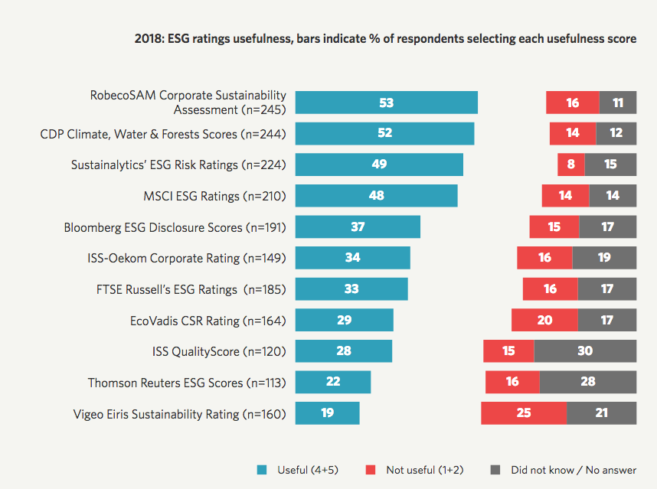
The Protagonist
“Agency” is an NGO with technical capacity and resources
Agency has embraced a set of norms
(1) characteristics of modern slavery,
(2) its connection to human trafficking, its principal effects on women, children and indigenous populations,
(3) its dependency on the willingness of legitimate business entities for its viability, and
(4) its intimate connection with the maintenance of suppressed markets (in this case for people) and money laundering
And Objectives
Embed prevent, mitigate and remedy programs within corporate compliance operations
Measure compliance against our own standards

Slide 7
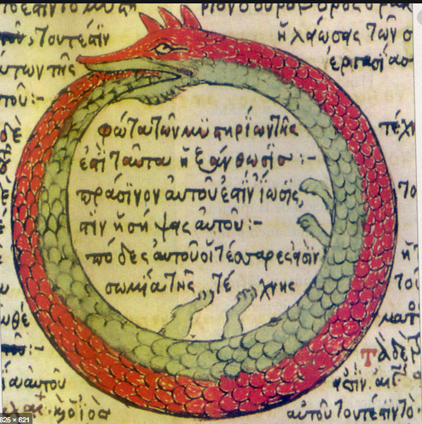
From Data Driven Governance to Rating System
How
Data and data harvesting
Choice depends on norms and objectives of task
Making Data Useful
Analytics
From analytics to assessment
From assessment to Judgment
Effects
People make decisions about relationships with company on the basis of rating
Business conforms behavior to the rating standards
Ouroboros
The standards (and their construction) have regulatory effect
Norms (laws) have constitutive and structural effect
Conflation of normative and implementation mediated by data.

Slide 8
From Rating System to Social Credit
A rating system is not a social credit system; what is missing?
Construction of an institutional structure for imposing consequences on judgments derived from data driven analytic assessments
Object is to develop a coordinated system of interlocking restrictions and privileges (consequences) that flow from rating.
In our hypothetical:
MOUs with other actors (lenders, investors, stock exchanges)
The use of the ratings by the state to impose restrictions or extend privileges base do rating score
Agreement by transport companies to impose restrictions on use of transport by low scoring companies; requirement of sureties and the like

Slide 9
Chinese Social Credit
Pix Credit: Super-Scoring De

Slide 10
Planning With Chinese Characteristics
2014 announcement of plans to develop a Chinese Social Credit System; met with criticism in the West
Social and cultural project around integrity and accountability.
Genesis: State Council Notice concerning Issuance of the Planning Outline for the Construction of a Social Credit System (2014-2020) 社会信用体系建设规划纲要

Slide 11
An All Around Focus: Chinese Social Credit Principles
Government promotion, joint construction with society.
“Fully give rein to the organizational, guiding, promoting and demonstration roles of government.”
Completing the legal system, standardizing development.
“Progressively establish and complete credit law and regulation systems and credit standards systems, strengthen credit information management, standardize the development of credit service structures, safeguard the security of credit information, and the rights and interests of information subjects.”
Special Campaigns grounded in sincerity
OBJECTIVE: “persist in correcting unhealthy trends and evil practices of abusing power for personal gain, lying and cheating, forgetting integrity when tempted by gains, benefiting oneself at others’ expense, etc., and establish trends of sectoral sincerity and integrity.” .
Breakthroughs in focus points, strengthen application.
Choose focus areas and model regions to launch credit construction demonstrations. Vigorously spread the socialized application of credit products, stimulate the interaction, exchange, coordination and sharing of credit information, complete combined social credit reward and punishment mechanisms, construct a social credit environment of honesty/integrity, self-discipline, trust-keeping and mutual trust.
An example of China’s “top-level design” (顶层设计) approach; coordinated by the Central Leading Small Group for Comprehensively Deepening Reforms
It is a project for the development of a national reputation system, assigning a social credit number that reflect a qualitative judgment of relevant data gathered about the subject.

Slide 12
Building the Integrated System
State at the Center
Coordination/ Leadership
Focus on four sectors
Government, commercial activities, social integrity, judicial credibility ¶ II(1)-(4)
Build, Share, Implement
Role of the Chinese Communist Party
Role of the CPPCC (Chinese People's Political Consultative Conference)

Slide 13
Social Credit: System Building Mechanisms
Mechanisms
Incentive structures and punishments for deviations
legal, regulatory and standards systems for credit
standardize credit service markets
Protect the rights and interest of credit information subjects
Special rules for confession and self correction
credit information security management
Build Systems
(1) sectoral credit information systems.
(2) local information systems
(3) credit investigation systems.
(4) uniform credit investigation platforms in the financial sector.
Develop credit information exchange and sharing.
MOUs
Central repositories
Public-Private Partnerships

Slide 14
Social Credit for Individuals
Premises:
individual behavior is subject to a number of core moral principles,
that those principles can be reduced to everyday behaviors,
that those everyday behaviors may be measured against behavior ideals,
once reduced to a score, these summary judgments about a person’s compliance ought to produce effects—privileges and restrictions depending on ranking that they have earned.
These privileges and restrictions need have little direct connection to specific behaviors but are developed through an network of agreements among public and private actors to piece together black lists and red lists that produce incentives toward better behavior and higher scores.
The system is itself cobbled together from a series of national and provincial programs, from public and private data harvesters and a series of MOUs that are meant to nationalize lists and develop a coordinated system of evaluation (based on aggregate data) and consequences based on ranking demining placement on blacklists and redlists.
Consequence: widely circulated stories in the West about people denied express train and air travel, college admission for their children, restrictions on access to credit and visas for travel abroad on the basis of credit scores.
Aanalytics appears to incorporate actions that would have been weighed differently in the West. .
these measurements may produce accurate assessments of individual compliance with their societal obligations.

Slide 15
The Turn Towards Enterprise Social Credit
Pix Credit: CEIBS Releases Index on Chinese Listed Companies’ CSR (2017)

Slide 16
Commercial Activity Affected
Production
Logistics
Finance.
Taxation
Pricing (“clear retail pricing”)
Project construction
Government procurement
Tendering and bidding
Transportation
E-Commerce
Statistics
Services sector (Professionals)
Advertising
Enterprise governance (including CSR)

Slide 17
Government
Social credit as trigger for variety of governmental action:
administrative permission, government procurement, tendering and bidding, labour and employment, social security, scientific research management, cadre promotion and appointment, management and supervision, application for government financial support and other such areas, and foster the development of a credit services market.
Honor government agreements and commitments
Monitor civil servants

Slide 18
The State Council Guidance July 2019
accelerated program of constructing the social credit system for enterprises. It focused on several principal policy areas.
The first was innovation in the connections between enterprises and the credit commitment systems, which in some measure are meant to connect enterprises to data retrieval systems.
This credit commitment system is to be operated by the Chamber of Commerce and Industry, a mass organization under the leadership of the United Front Work Department of the CCP and a constituent organization of the Chinese People’s Consultative Conference (CPCC).
The New York Times recently reported that the scope of data acquisition is quite broad: “court decisions, payroll data, environmental records, copyright violations, even how many employees are members of the Communist Party.”
The second was a plan for integrity education. This appears to focus on providing information to enterprises about the sort of behaviors expected of them.
The third was to expand the application of credit reports. Credit scores will be used to affect “matters of government procurement, bidding, administrative approval, market access, qualification review” and the like according to the Guiding Opinion.
The fourth was to use information gathered to establish list of privileges and restrictions based on rec0rded credit behavior.
Credit tracking is to be undertaken by a number of national, regional, public and private entities, and all coordinated in some way by the state.
Coordination would include a market supervision complaints report hotline and in formation platform.
Companies would be encouraged to voluntarily share additional information with respect to market operations, contract performance, social welfare and other information through a “Credit China” website, or related sites .
Such voluntary disclosures would be considered as part of the credit evaluation.
Under the supervision of the National Development and Reform Commission, an agency under the State Council .
A national credit information sharing platform is meant to aid in the coordination of data harvesting, analytics, assessment and judgment producing a credit score that can then be used to impose restrictions and grant privileges.

Slide 19
National Development and Reform Commission Mandate
System of voluntary disclosure
May count for credit rating
Oversee construction of coordinated system
cross-regional, cross-industry, and cross-disciplinary joint disciplinary mechanisms for untrustworthiness, and fundamentally solve the problems of recurring and easy-to-existence of untrustworthy behavior.”
The object is to have in place a ” joint disciplinary measures is established, which is dynamically updated and disclosed to the public, forming a multi-pronged approach of administrative, market-oriented and industrial disciplinary measures ”
Develop the catalogue of restrictions and discipline.
These include “restricting the issuance of untrustworthy joint disciplinary object stocks, bidding and tendering, applying for financial funds, enjoying tax incentives and other administrative disciplinary measures, restricting access to credit and flying Market-based disciplinary measures such as high-grade trains and seats, as well as industry-based disciplinary measures such as criticism and public condemnation.

Slide 20
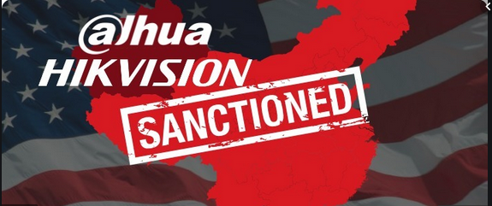
The Expansion of Enterprise Social Credit to Non-Chinese Enterprises
Pic Credit HERE
Pix Credit: Hikvision And Dahua Sanctioned For Human Rights Abuses
Pix Credit: SCMP: China’s social credit system ‘could be used against companies in international trade disputes’

Slide 21
Key Concerns
First the normative basis for constructing and operating the system are not those of Western companies or the states form which they operate.
Indeed, in many respects, they are incompatible with political and economic notions at the heart of Western political and economic organization.
Second, at least as applied to Western companies, the data harvesting may be redolent with ulterior purposes.
These may include everything from tech and business secrets mining, to know how transfers and disguised indirect control of business decisions. Every business decision,
in fact, that may annoy a rating producing agency, might contribute to a lowering of credit scores. This is particularly sensitive in the context of government inspections that are part of the social credit mechanisms for business.
Third, to the extent that local agencies might wish to use the rating system strategically, then differentiated data harvesting and application of privileges and restrictions from credit rating could be used as a disguised protection of local enterprises at the expense of foreign ones.
That has been a problem in certain areas of China even in the absence of social credit. But the system—a product of fracture at the bottom and coordination at the top, could also be used to enhance protection of local interest the way the judicial system sis sometimes said to do the same.
Fourth, in a sense, the principal worry is that that in the absence of a robust social credit system for government, at least government below the level of the central authorities, it is not clear that the integrity principles at the heart of the social credit system, or the robust application of the core socialist values, will actually be embedded in the actions of lower level authorities (public and private) charged with the operation of the business social credit system.
It is just not clear how the system will work.

Slide 22
The Challenges Social Credit May Pose to Non-Chinese Firms
Pix Credit: US blacklists 28 Chinese entities over abuses in Xinjiang

Slide 23
Challenges
First, it is only fair that all enterprises operating on Chinese soil be treated the same.
Second, if, indeed, ratings and assessment will introduce far more intrusive regimes, then non-Chinese companies will have to begin to consider the extent to which they mean their operations to be embedded within China.
Third, Western companies are already quite exposed to data mining.
Fourth, it must be remembered that all such social credit systems, like the domestic legal orders of any states, are primarily deployed as instruments to project the political and normative objectives of those in control of their mechanics.
Fifth, that insight, though, produces powerful consequences. (1) One is that social credit (like our modern slavery hypothetical) will be used as instruments to challenge the values of competitor states. (2) Another is the effect of social credit on operations beyond China.
Sixth, social credit is not limited to the territories of China. The Belt and Road Initiative has extended the scope of the operation of Chinese enterprises to virtually all areas of the world. These companies will have to comply with social credit regimes globally.
Seventh, China is not the only state that can develop social credit.
Eighth, all of this suggests not the weakness but the power of social credit as the next important regulatory mechanism. Compliance, risk management and data driven governance are here to stay.

Slide 24
Summing Up
Chinese Social Credit is in reality neither unique nor uniquely Chinese in its broad outlines. It emerges as part of a broader and deeper cultural dialogue that appears to be transforming the landscape and language of law.
The essence of ratings regimes is the fundamental connection between basic social and political principles and norms, on the one hand, and the construction of systems of data and analytics on the other.
The distinction between Chinese and Western social credit impulses is one of scope and systems of control.
The direct connection between the state and the ratings-social-credit system that is what triggers anxiety in the West; augmented by the modalities through which that exercise of control is manifested.
Social credit regimes, then, are symptomatic rather than generative and are reflected in their application to enterprises.
The challenges posed by these generative differences are likely to shape the nature and extent of Western investment in China and of Chinese investment along the Silk and Maritime Roads.

Slide 25
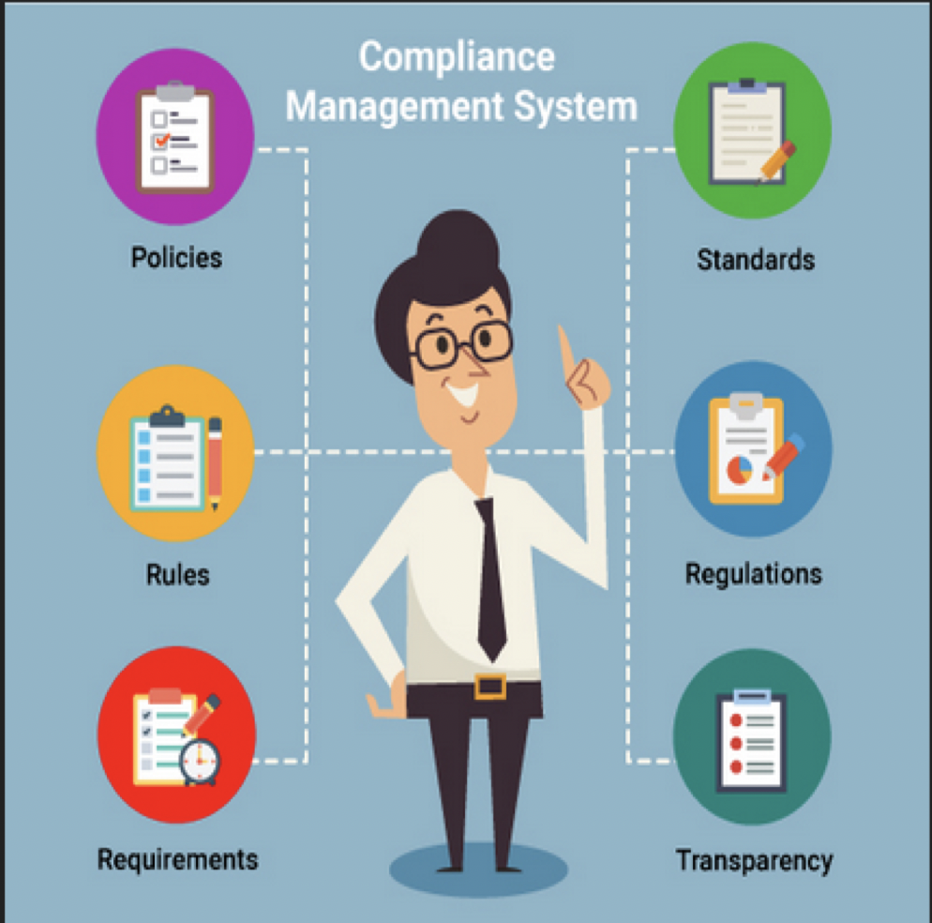
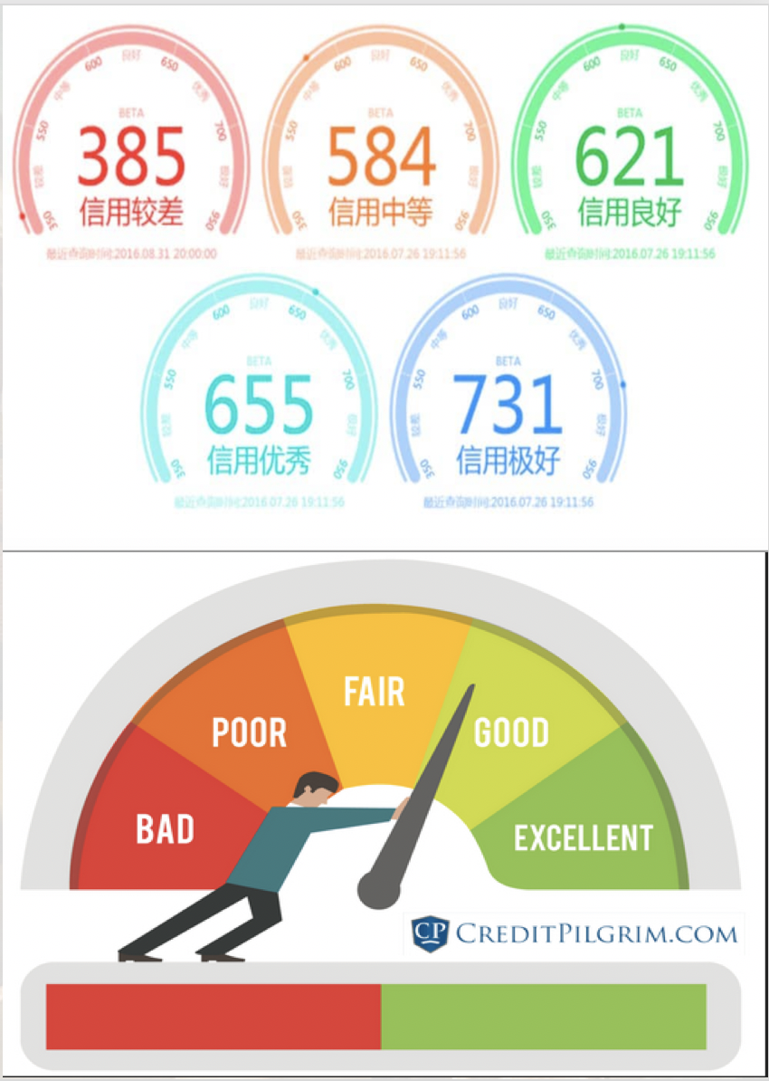
Thanks Please contact me lcb911[at]me.com ____ Short essays: China’s Social Credit System: Data-Driven Governance for a ‘New Era’, Current History 118:209-214 (2019) http://www.currenthistory.com/Backer-CH2019.pdf Blacklists and Social Credit Regimes in China Conference essay; Superscoring (2019) https://www.superscoring.de/wp/wp-content/uploads/2019/09/Cat%C3%A1-Backer_Blacklists-and-Social-Credit-Regimes-in-China.pdf

