Slide 1

The Structures and Ideologies of Social Credit in the U.S.
Larry Catá Backer(白 轲)
W. Richard and Mary Eshelman Faculty Scholar
Professor of Law and International Affairs
Pennsylvania State University
欧美国家信用法治经验及对中国的启示
[Experiences of Credit Law Practices From the U.S. and European Countries and its Implications for China]
首都师范大学 信用立法与信用评估研究中心
Capital Normal University Research Center for Credit Law and Credit Assessment,
April 25, 2018

Slide 2
Introduction
The 2014 announcement of plans to develop a Chinese Social Credit System was met with criticism in the West.
Genesis: State Council Notice concerning Issuance of the Planning Outline for the Construction of a Social Credit System (2014-2020) 社会信用体系建设规划纲要
But also raised many questions worth considering:
Is Social Credit System unique to China?
Are “social credit” systems operating in the West?
What are the differences and similarities?
Do they represent a more universal transformation of the way governments exercise power in the 21st century?
What might be their value and their challenges for society?

Slide 3
What We Will Cover Today
Brief Review of China Social Credit Initiative
Extract its systemic qualities
Understand Scope
Basis for approaching initiatives outside of China
Review of U.S. Initiatives
Does it have systemic qualities
Centrality of Governance, Risk management and Compliance
Emphasis on techniques and operations
End with a brief Comparison
Difficulties of comparison
Extracting useful information

Slide 4
An All Around Focus: Chinese Social Credit Principles
Government promotion, joint construction with society.
Fully give rein to the organizational, guiding, promoting and demonstration roles of government.
Completing the legal system, standardizing development.
Progressively establish and complete credit law and regulation systems and credit standards systems, strengthen credit information management, standardize the development of credit service structures, safeguard the security of credit information, and the rights and interests of information subjects.
Comprehensive planning, graduated implementation.
In view of the long-term nature, systemic nature and complexity of social credit system construction, strengthen top-level design, . . . , plan the overall picture comprehensively, plan systematically, organize implementation in a planned and graduated manner.
Breakthroughs in focus points, strengthen application.
Choose focus areas and model regions to launch credit construction demonstrations. Vigorously spread the socialized application of credit products, stimulate the interaction, exchange, coordination and sharing of credit information, complete combined social credit reward and punishment mechanisms, construct a social credit environment of honesty/integrity, self-discipline, trust-keeping and mutual trust.

Slide 5
Building the Integrated System
State at the Center
Coordination,
Leadership
Focus on four sectors
Government, commercial activities, social integrity, judicial credibility ¶ II(1)-(4)
Build, Share, Implement

Slide 6
Government
Social credit as trigger for variety of governmental action:
administrative permission, government procurement, tendering and bidding, labour and employment, social security, scientific research management, cadre promotion and appointment, management and supervision, application for government financial support and other such areas, and foster the development of a credit services market.
Honor government agreements and commitments
Monitor civil servants

Slide 7
Commercial Activity
Production
Logistics
Finance.
Taxation
Pricing (“clear retail pricing”)
Project construction
Government procurement
Tendering and bidding
Transportation
E-Commerce
Statistics
Services sector (Professionals)
Advertising
Enterprise governance (including CSR)

Slide 8
Social Integrity and Judicial Credibility
(3) Social integrity
Healthcare, birth control, hygiene
“Social Security”; Labor and employment
Education and scientific research
Culture, sports, tourism
Intellectual property rights
Environmental protection
Credit records for natural persons in economic and social life
Internet application and services
(4) Judicial Credibility
Transparency in proceedings
Prosecutorial credibility
´Public Security services credibility
Judicial administrative systems
Law enforcement standardization

Slide 9
Education and Culture
Culture:
  Establish models of appropriate conduct
  launch topical activities concerning sincerity.
    Organize pubic interest activities such as the “Sincerity Activity Week” “Quality Month”
  Special campaigns in focus sectors
    “persist in correcting unhealthy trends and evil practices of abusing power for personal gain, lying and cheating, forgetting integrity when tempted by gains, benefiting oneself at others’ expense, etc., and establish trends of sectoral sincerity and integrity.”
Develop social credit management as a scholarly field
  Research
  training
Education
Tied to construction of Socialist core value system
  Vehicle for socialization of social credit
  “Forcefully launch activities to let universal education and propaganda about credit enter enterprises, enter classrooms, enter communities, enter villages and enter households. ”
Build “moral” classrooms
  Construct parameters for assessing value of classroom instruction in appropriate approaches to social credit and underlying moral principles

Slide 10
Social Credit: Build; Share; Implement
Build
(1) sectoral credit information systems.
(2) local information systems
(3) credit investigation systems.
(4) uniform credit investigation platforms in the financial sector.
Share
Develop credit information exchange and sharing.
Mechanisms
Incentive structures and punishments for deviations
legal, regulatory and standards systems for credit
standardize credit service markets
Protect the rights and interest of credit information subjects
Special rules for confession and self correction
credit information security management

Slide 11

Social Credit in the West
Power through fracture and diffusion
  Governmentalization of the private sphere
  Privatization of the public sphere
  Migration from law and regulation to systems and systems management

Slide 12
Does the West Have a Social Credit System?
There is no social credit system in the West analogous to emerging Chinese model
A Governance, Risk Management, and Compliance (GRC) model
Applied to and by public and private actors; little coordination.
What the West has developed are aggregations of related functions:
surveillance
reporting, including disclosure for accountability (through law)
data collection, markets in data
data repacking and distribution,
Analytics and relational connections between objectives or principles and behaviors
Reward and punishment system (inducement, discipline, social behavior management
Systems of data drive management controls
Systems for identifying and responding to risks affecting objectives of specific parties
System for identifying and meeting legal and social norm requirements

Slide 13
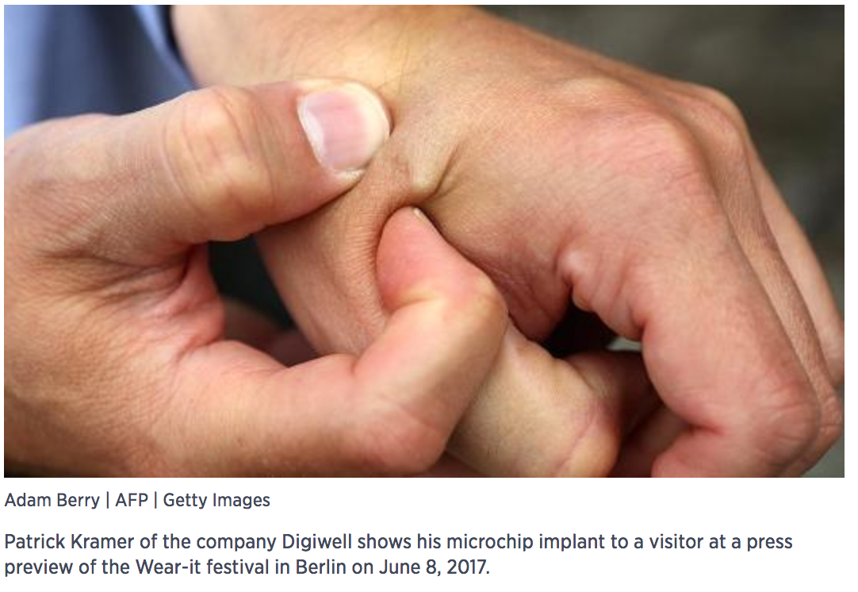
MicroChips in Employees: Three Square Market
Three Square Market will be the first firm in the U.S. to use the device, which was approved by the FDA in 2004, CEO Todd Westby told CNBC on Monday.
"We think it's the right thing to do for advancing innovation just like the driverless car basically did in recent months," he said in an interview with "Closing Bell."
The company, which provides technology for break-room markets or mini-market kiosks, is anticipating over 50 employees to be voluntarily chipped.
Westby said he and his family will be chipped, too.
Installing microchips in employees is 'the right thing to do,' CEO says

Slide 14
“Social Credit” Implications for Chip Implants for Workers
Data Harvesting
Data Analytics
Algorithms pointed toward objectives
System of decision or reward and punishment tied to data

Slide 15
Western Principles for Risk and Compliance Systems
Law Enforcement
Method
Alternative to administrative regulation as a tool of lawmaking
Transparency
Engagement
For governance
Information
For consumer choice
Controlling behavior
Organizations
Individuals
Shaping culture
Health and wellness
Social vices (drinking, sexual activity, etc.)
Accountability
Individuals
Entities
government

Slide 16
A “New Era” Techniques of Governance in the West
It is no longer just a “means” of government but it has become government itself .
Surveillance, understood as an aggregation of techniques, values, judgments and relationships,
Surveillance has leaped the borders of the private and soft law (culture, mores, morals) within which it had been confined.
Law no longer serves its traditional function either as an organic repository of the regulation of a political community or as the positive expression of the will of the political community as legitimately enacted through its representatives in government.

Slide 17
The Industry of Data Harvesting
Techniques
Restaurant “birthday cub”
“Free” internet
Fingerprint or facial recognition to open a mobile phone
Internal Use
Better profile of customers
Reward and punish choices
External use:
Sell to others
Provide to the state

Slide 18
What is Data: The Census Question
Political storm erupted when the government wanted to add a question about citizenship status to census questions.
Citizenship is data but is it more?
Critics fear reduced response rates and inaccurate information
Will affect the distribution of power in Congress
It's no surprise to see census questions shifting with the times, said Margo J. Anderson, a professor of history at the University of Wisconsin, Milwaukee. It was a big deal to ask if someone had a radio in 1930. In 1940, not so much," she said. Citizenship questions were regularly on the census until 1950. In 1960, they were removed from the list.” Lots of questions go off the census when they're not very important anymore," Anderson said. (“Why putting a citizenship question on the census is a big deal”)

Slide 19
Western Approaches to Social Credit Operationalization—Public Sphere
Licensing and review programs
Educational institutions
Professional services (from hairdressers to lawyers)
Data sharing
Child support
Sexual predators
Criminals
Monitoring and disclosure
Securities Law
Basis for funds distribution
Block grants
Revenue sharing for different programs
Regulatory governance (social and CSR disclosure)

Slide 20

From Internet Quizzes to Analytics: Facebook-Cambridge Analytics—Power of Data Driven Algorithms
Before the 2016 election, Cambridge Analytica was an obscure consulting company funded by the family of conservative hedge fund mogul—and Republican political donor—Robert Mercer. But in the weeks after the 2016 election, rumors began to circulate that Cambridge had played a key role in Donald Trump's victory.
Where conventional political advertising uses crude demographic factors like age and ZIP code to target advertising, Cambridge supposedly used a technique called psychographics, which involves building a detailed psychological profile of a user that will allow a campaign to predict exactly what kind of appeal will be most likely to convince any particular voter.
Use of APIs to harvest additional data:
  Application program interface (API) is a set of routines, protocols, and tools for building software applications. An API specifies how software components should interact.
Developing a quiz to harvest Facebook data; use of Facebook profile.
Data feeds predictive algorithms that can be used to shape company action

Slide 21
Western Approaches to Social Credit Operationalization—Private Sphere
Credit rating agencies
Individuals
Enterprises
Governments
News Media
Education institutions (London Time; U.S. News)
Academics; Think Tanks
Impact assessment metrics
Industry sector performance
Enterprise systems
Eugenics
Social media

Slide 22

Managing University Student Clubs
Penn State University applied a set of risk based algorithms to determine that a century old student hiking club could d no longer hike because it was too dangerous.
Students activities a function of risk
Risk assessment subject to changing university risk profiles and objectives
Riskless university and managed risk?

Slide 23
U.S. Rating Agencies as a Form of Social Credit
Credit Rating Agencies
Market for services with a few bog players dominating consumer credit
Also rate business and public credit (Commercial and sovereign lending).
Rating/Ranking systems
U.S. News & World Report and others for university rankings
Other Journals reports for consumables(e.g., “Consumer Reports”).
3rd Party Certification
Groups that offer services by applying their norms and analytics to either rate customers or to certify that they comply with their standards
Legitimation function
E.g. Fair Labor Association and Apple-Foxconn
Subscription or issuer pays models

Slide 24
Rating Agencies as a Form of Applied Social Credit Philosophy?
Comes closest to the shape of the Chinese initiatives
Governance aspects
Meant to manage behaviors
Grounded in data based analytics applied to objectives
Discipline through reward punishment system
But these are detached from the state
Market driven
Objectives are subject to fluctuation grounded in stakeholder desires
Systems are functionally differentiated
No unification even within the same field

Slide 25
Social Credit Challenges: China
Technical Issues
  Data harvesting
  Data retention
  Data integrity
Interpretation Challenges
  Adding meaning to data may be difficult
  Algorithms
  Review mechanism itself a subject of or corrupted by the social credit system in which it is embedded?
System Construction Challenges
  System construction
  Data harvesting and integrity
Management Problems
  Coherence across a vast governmental sphere
  Integration with private social credit offshoots
  How to solve issue of administrative abuse
Political issues
  Integration with political and systems standards outside of China
  Applies especially to Chinese enterprises operating abroad

Slide 26
Social Credit Challenges: US
Management Problems
  Coherence across a vast private and governmental sphere
  No basis for consist integration of private social credit and governmental systems
  How to solve issue of market abuse; extent of governmental oversight unclear
Technical Issues
  Data harvesting
  Data retention
  Data integrity
  The ideological problem of algorithms
Interpretation Challenges
  Adding meaning to data may be difficult
  Algorithms
  Review mechanism itself a subject of or corrupted by the social credit system in which it is embedded?
System Construction Challenges
  System construction: no single standard; quality and scope issues
  Data harvesting and integrity in a fractured system
Political issues
  No real coordination of management of markets for data and data based management systems
  Little protection for data sources and individuals whose information is harvested
  Much regulation is fractured along market segment lines (e.g. credit reporting, social media, etc.)
  Integration with political and systems standards outside of U.S. (e.g., EU and China)
  Coordination with U.S. law (privacy, disclosure, business rules, etc.)

Slide 27
Conclusions
Most of the elements of social credit have already been developed in the West.
Monitoring and reporting
Data harvesting
Algorithms
Reward and Punishment system
The use of these elements is quite distinct
One aims for a comprehensive and integrated system
The other seeks to use techniques and management for Compliance, governance and risk management regimes in markets
And to establish markets for data, data analytics, algorithms and management driven analytics
But the unification of the various elements, and their seamless operation would be a great innovation

Slide 28
Thank You 谢 谢

