Slide 1

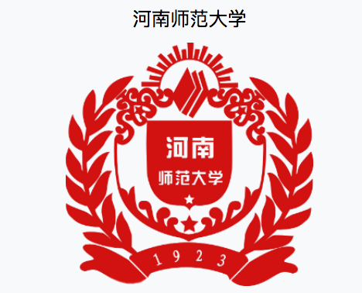
Designing an Ideal OBOR Curriculum for Law Students
Larry Catá Backer (白 轲)
W. Richard and Mary Eshelman Faculty Scholar Professor of Law and International Affairs
Pennsylvania State University | 239 Lewis Katz Building, University Park, PA 16802
Seminar delivered at Henan Normal University 河南师范大学 Law Faculty
Xin Xiang, Henan, PRC, April 23, 2018

Slide 2
OBOR and Education
OBOR and “America First” the two emerging frameworks for trade relations
Both are built on new approaches to relationships among states
And also relations among stake-holders
Both will likely reshape the foundations of globalization
But also produce new challenges
Traditional fields of law, economics, big data and other field
Emerging fields of Soft law and regulatory governance
Universities ought to have a responsibility to better train students
to operate in the new environment
And to better serve national policies
Consider how universities can shape curriculum to meet responsibilities
Challenges of a new curriculum

Slide 3
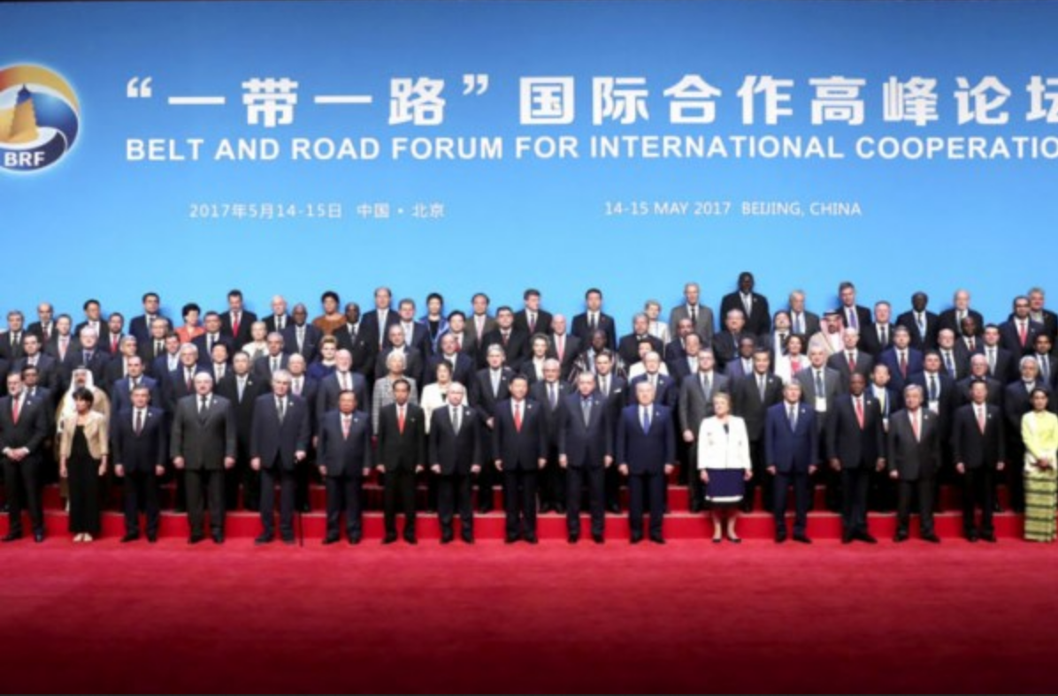
The OBOR Initiative

Slide 4
OBOR Chronology
September 2013
OBOR was first put forward by President Xi in visit to Middle East and SE Asia . At the time he said all the countries along Silk Road will be better off if they could revive a modern version of the old silk road (see President Xi Jinping Delivers Important Speech and Proposes to Build a Silk Road Economic Belt with Central Asian Countries). Even local hosts paid little attention, thinking it was more rhetoric than substantive.
November 2013.
In March 2014,
Premier Li Keqiang, in a report to the National People's Congress called for accelerating Belt and Road construction Development of significance laid down in those reports.
October 2014
Twenty-one Asian countries willing to join the AIIB as founding members signed the Memorandum of Understanding on Establishing AIIB.
March 5, 2015
Premier Li, in his government work report, again highlighted the initiative, saying China will move more quickly to strengthen infrastructure with its neighbors, simplify customs clearance procedures and build international logistics gateways.
2015
announcement of several infrastructure projects (ports, roads, etc.) to build physical structures of OBOR
2016 to present
Sino-CEEF, which was inaugurated by Premier Li Keqiang and his Latvian counterpart Maris Kucinskis in the Latvian capital Riga in November 2016, was set up as a platform for economic cooperation between China and Central and Eastern Europe
Third Plenary Session of the 18th Central Committee of the Communist Party of China there was a formal call for the called for accelerating infrastructure links among neighboring countries and facilitating the Belt and Road initiative

Slide 5
Objectives: Embedding China in World Trade
Strategies
(1) meant to counter what appeared to be trends in World economy;
the West was still in the post financial crisis era that reduced the utility of Western trade systems;
(2) protect against anticipated revival of protectionism in the West
that would create impediments to China's access to global markets and reduce the effectiveness of Western trade systems;
(3) take advantage of the emergence of freer/ more closed global trading system
that would heighten the utility of regional and targeted trading blocks.
(4) fill the void left as the integrity of the post 1945 global economic order
disintegrates as the U.S. began to withdraw from its leadership position because of its own internal politics.
(5) essential to cement China's position in the world economy, if only to protect its own interests
as it transformed from a developing country to one of the G2.

Slide 6
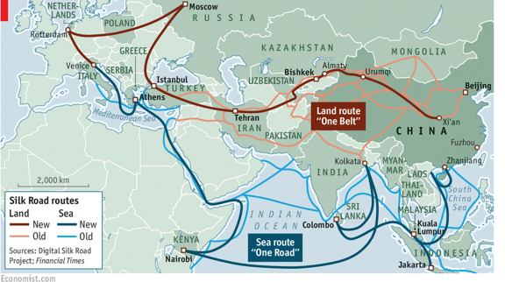
OBOR Routes
OBOR Routes
  (1) silk road economic belt (land based belt to West);
  (2) 21st century maritime economic belt.
  The land route will cover 65 countries in addition to the 2 maritime routes. These are then supported by a large number of interlinked commercial centers along the road.
  Space?
    'Belt and Road’ Space Information Corridor.” (Source)
Source: Our Bulldozers, Our Rules, The Economist

Slide 7
Key Areas of OBOR Policy
G2G Policy Coordination
Infrastructure connectivity
P2P connectivity
B2B connectivity
OBOR Policy Objetives
Cultural Cooperation and educational exchanges
Financial Cooperation
Regional Trade
Meant to represent a coordinated framework of hard and soft power implemented through both public and private channels.
Soft power is bound up in the people to people exchanges.
Most amplified through media coverage are the infrastructure projects and financial cooperation.
Trade, infrastructure, development finance, cultural/societal exchange and security cooperation at the center.

Slide 8
OBOR Out of BITs and Pieces
No OBOR “treaty” or unified legal instrument
(a) a set of coordinated BITs; and
(2) collateral related policies (infrastructure; culture, and education ties)
(3) Military and security coordination
Policy Structures: Internal
New Era socialist modernization
about 50 Chinese state-owned companies have invested in nearly 1,700 OBOR projects since 2013
Internal Funding: state-owned Silk Road Fund, which was officially launched in 2015 with $40 billion of initial capital, and two Chinese policy banks, the China Development Bank and the Export and Import Bank of China.
External:
Principle of mutually beneficial cooperation.
External Financing: (1) Beijing-based Asian Infrastructure Investment Bank (AIIB)—with its registered capital of $100 billion; (2) Shanghai-based New Development Bank (formerly BRICS Development Bank)—with $50 billion starting capital

Slide 9
Two ways of looking OBOR System.
First, Transforming Conventional
As piecemeal multilateralism: partnership arrangement between countries (an aggregation of BITs), yet also bearing some elements of regional economic integration.
As soft multilateralism: b2b and p2p cooperation, education exchanges etc.
As collateral multilateralism: trade dependent on collateral agreements touching on infrastructure, financing and investment (lubricated through RMB internationalization in fact, e.g. all yuan transactions )
Second, OBOR may be treated as sui generis.
First, new model of alliance or association among states grounded in principle and soft power arrangements. Dean Shen Wei (Chinese version of the Marshall Plan) (for commentary along those lines see here).
Second, the focus on "Partnership and Cooperation Agreements (PCSs) (e.g. here generally pp. 389-93) for more comprehensive social and political and cultural vehicle to produce a new version of global governance, a Chinese version of globalization that also advances Chinese national interests.

Slide 10
OBOR Within Chinese Global Engagement Strategies
piggybacking.
China will continue to act responsibility within the current normative trade and investment framework. Piggybacking involves strategic choices to act as a free rider or stakeholder where interests converge. The focus of that activity s--the WTO and IMF (where a policy of reform will also be carried out).
lawfare.
China will engage more aggressively in international fora availing itself of the legalized techniques and procedures long deployed against it and by the traditionally dominant states. Lawfare is a technique for rule making or institution building within the current framework.
bonding.
OBOR is deployed not merely to facilitate trade but to socialize its participants into the new and evolving framework that is to be established around OBOR. Expansive programs for cultural and educational exchanges and similar programs with a social component. A weakness of this approach, the extent that OBOR avoids extensive technical assistance capabilities (augmented by the unwillingness to engage in conditionality lending), China provides a useful space for counter-activity by a still quite potent West.
mixed mutual engagement.
China here follows the path of both leader and of follower as opportunity arises or necessity requires. In that context one can better understand the logic of China's planning respecting its BITs, FTAs, Regional Comprehensive Economic Partnerships (RCEPs) and other measures including those reflecting territorial integrity

Slide 11
OBOR Within Chinese Global Objectives
RMB Internationalization as counter to US Dollar/Euro
Chinese model of global development finance through AIIB style banks as a counterweight to IMF-World Bank Model
Mutually beneficial cooperation as basis for human rights based international standards

Slide 12
What Can Universities Contribute?
Knowledge Production
Analysis
Data Analytics
Preparing Students for Effective Participation

Slide 13
Designing a Curriculum
Planning Issues
Coherence
Technical capacity of teaching staff
Develop robust research focus
Embedded Models
Include OBOR related materials in courses currently offered
Identify and develop courses
Build portable OBOR modules for staff use
Stand Alone Models
Certificate programs
´Concentrations
Degree major
Post Graduate concentration

Slide 14
Challenges
Requires specialized knowledge
Is a nexus of the application of a broad number of traditional fields of study
Contract
International Trade and Investment
Enterprise Law
Etc.
Includes an interdisciplinary element
Law
Finance
Economics
Politics
Etc.
Dynamic area requires constant adjustment
Area of study is itself not fully defined
Poses a problem for training and assessment of staff and students

Slide 15
Thank You --谢 谢

