Slide 1

The Protection of the Rights of Corporations Under U.S. Constitutional Law
Larry Catá Backer
W. Richard and Mary Eshelman Faculty Scholar Professor of Law and International Affairs
Pennsylvania State University
Prepared for Workshop:
East China University of Political Science and Law
Shanghai, PRC
April 27, 2018

Slide 2
The Importance of Corporate Rights Protection
Current Situation
2012 conviction for corruption Algeria
2018 (April) Announce USDOJ investigation for potential violation of Iran sanctions
2016 Corruption investigation Nigeria; 4 subsidiaries placed on Entities list
2016-2017 Norway Sovereign Wealth Fund divestment for corruption
2018 Activated “Denial Order” effective for 7 years for allegedly false statements in audit reports (ban of component sales by US companies relating to IT tech theft and distribution( after notice and opportunity for response .
2017 agrees to pay the U.S. Government $892,360,064 for violation of sanctions law (to settle Bureau of Industry and Security Entity List designation requiring BIS license for US sales to ZTE entities)). “Denial Order” issued and suspended under terms of settlement requiring submission of periodic audit reports on compliance
Current situation
2012 Conviction for corruption in Algeria
2018 (February) US security agencies warn consumers against buying Huawei phones
2012 inconclusive US investigation about Huawei spying after scandal
2014 EU settles investigation of Huawei, ZTE illegal subsidies in EU trade; India investigates Huawei hacking
2016 US Commerce Dept investigation of sales in violation of US sanctions laws

Slide 3
Legal Implications and Issue for Discussion
ZTE and Huawei raise a number of conceptual issues
Can corporations hold rights?
Are corporations entitled to the same rights as natural persons?
Do these rights apply to foreign as well as domestic enterprises?
What is the extent of the protection; can these rights be taken away from corporations by the state?
Whose rights are being protected, those of the enterprise itself or indirectly those of the natural persons (or the state) who are the ultimate owners?

Slide 4
Question for Discussion
If the corporation can hold rights and obligations under law, can it also be subject to the fundamental protections of constitutional Law?
That question has had a long history in the United States
Issue arose almost at the start of the Republic
It remains controversial today
The answer may depend on whether the protection is directed toward the natural persons who own the corporation or directly attached top the enterprise itself

Slide 5
Order of Discussion
Traditional Framework of corporate constitutional protection
Original View
Property based protections
Limitations
Modern
Speech rights
Right Not to be Forced to Speak
Religious Protection Rights
Trends and Conclusion
Constitutional clashes
Clashes between foreign and domestic elements

Slide 6
Conceptual Basis for Protection
Protection of property rights
“And this. ..[is so] because the property of a corporation is in fact the property of the corporators. To deprive the corporation of its property, or to burden it is, in fact, to deprive the corporators of their property or to lessen its value. . . All the guarantees and safeguards of the Constitution for the protection of property possessed by individuals may, therefore, be invoked for the protection of the property of the corporation.” [County of San Mateo v. S. Pac. RR, 13 F,. At 747-48]
Foundation in view of Corporate personality
Corporation as the nexus of contract
Concession: protection of state interest in productive activity
Property in the hands of shareholders
Implicitly reject the possibility that the enterprise autonomously and distinctly holds rights
It is the vessel for the expression of rights of others
Protecting corporate property rights indirectly protects the rights of shareholders

Slide 7
Traditional Debate
Contract Rights
Equal Protection
Due Process
Searches

Slide 8
Traditional Framework; Original View
Trustees of Dartmouth College v. Woodward (17 U.S. (4 Wheat.) 518 (1819).
FACTS: British Crown granted a charter to Dartmouth University; after formation of Republic New Hampshire as successor to the Crown enacted 3 laws amending the Charter. Dartmouth sued to invalidate the legislation. Supreme Court agreed, holding the acts of New Hampshire violated the Contracts Clause of the U.S. Constitution
Set out basic view of the corporation; a concession of the state and the product of contract among private parties.
“A corporation is an artificial being, invisible, intangible, and existing only in the contemplation of law. Being a mere creature of law it possesses only those properties which the charter of its creation confers upon it.”
“Among the most important [objectives for which corporations are created are] immortality, and . . . Individuality; properties by which a perpetual succession of many persons are considered the same and may act as a single individual.”
But such rights could be waived by statute or contract:
Court rejected the idea that the corporation of its own right possessed rights;
but as the corporation was also the product of contract among its stakeholders, those contract rights must be protected by constitutional principles, in this case of contract.
State could amend rules of corporate governance only if they reserved the right to do so in their corporate statutes. Now common practice (“reservation clause”).

Slide 9
Traditional Constitutional Protections
Equal Protection under 14th Amendment
Santa Clara Cty. v. S. Pac. RR, 118 U.S. 394 (1886)
Due Process Under 14th Amendment
Minneapolis & St. Louis Rr v. Beckwith, 129 U.S. 26 (1888)
Protection against unreasonable searches and seizures Under 4th Amendment
Hale v. Henkel, 201 U.S. 43 (1906)
Protection against double jeopardy under 5th Amendment
United States v. Martin Linen Supply Co., 430 U.S. 564, 571-72 (1977)

Slide 10
Limitations: Self-Incrimination
No Protection Against Self Incrimination under 5th Amendment
United States v. White, 322 U.S. 694, 701 (1944)
Since the privilege against self-incrimination is a purely personal one, it cannot be utilized by or on behalf of any organization, such as a corporation. . . .
Moreover, the papers and effects which the privilege protects must be the private property of the person claiming the privilege, or at least in his possession in a purely personal capacity. Boyd v. United States, 116 U.S. 616, 6 S.Ct. 524, 29 L.Ed. 746.
But individuals, when acting as representatives of a collective group, cannot be said to be exercising their personal rights and duties nor to be entitled to their purely personal privileges. Rather they assume the rights, duties and privileges of the artificial entity or association of which they are agents or officers and they are bound by its obligations. In their official capacity, therefore, they have no privilege against self-incrimination. And the official records and documents of the organization that are held by them in a representative rather than in a personal capacity cannot be the subject of the personal privilege against self-incrimination, even though production of the papers might tend to incriminate them personally. Wilson v. United States, 221 U.S. 361

Slide 11
Limitations: Privileges & Immunities
Bank of Augusta v. Earle, 8 U.S. (13 Pet.) 519 (1839)
Corporations not citizens within the meaning of the Privileges and Immunities clause of the U.S. Constitution
States are not required to give extraterritorial effect to or recognize the legal personality of a corporation chartered by another state; but they may acquiesce in the exercise by such corporations of the privileges and immunities granted to natural persons from other states

Slide 12
Limitations on Commercial Conduct
Corporations have limited constitutional protection relating to behavior in the markets and in shaping their economic relations.
Balancing general constitutional rights of individuals against rights of enterprises in marketplace and in relation to regulation by the state.
Right to Refuse Service based on Race:
Constitutional protections against race discrimination higher value than right of business
No religious exemption under Civil Rights Act when BBQ restaurant refused to serve black patrons (Piggie Park, 390 U.S. 400 (1968))
Rejecting claim of religious right to refuse African American students. In the same case (Goldsboro Christian Schools, 461 U.S. 574 (1983)),
Pay discrimination
Application of minimum wage laws in the face of a claim of free exercise of religion (e.g., Tony and Susan Alamo Found. v. Secretary of Labor, 471 U.S. 290 (1985)); Equal Pay EEOC v. Fremont Christian School, 781 F.2d 1362 (9th Cir.1986) Courts have also rejected argument that a educational institution had a right to pay women less because their faith taught that men should be heads of households (Roanoke Valley Christian Schools).
Denial of Service based on Otherwise Legal Private Sexual Conduct
Rejected argument that university had a right to deny admission to students who engaged in, or advocated for, interracial dating and keep its tax exemption(Bob Jones University , 461 U.S. 574 (1983)).

Slide 13
Contemporary Debates
Voluntary Political Speech
Voluntary Commercial Speech
Compelled Speech
Religious Liberty

Slide 14
Voluntary Political Speech
1st National Bank of Boston v. Bellotti, 435 U.S. 765 (1978)
Facts: Court holds unconstitutional a Massachusetts statute that prohibited expenditures by banks and corporations for the purpose of influencing the vote on referendum proposals other than those “materially affecting their property, business or assets.”
Court rejected the argument that the statute was necessary to protect the shareholders from corporate managers; Took the position that the enterprise was autonomous and had governance mechanisms to avoid bad conduct
Grounded in part on the balance of the constitutional right of corporations to protect their property, including as against state policies against the need to protect the integrity of the democratic system; distinguished between lobbying and speech around initiatives and corporate action relating to elections of representatives

Slide 15
Voluntary Political Speech: Campaign Contributions
Citizens United v. Federal Election Commission, 558 U.S.310 (2010)
FACTS: Federal Law prohibited corporations and unions spending for speech defined as “electioneering communication” mentioning a candidate by name). 2008 NGO Citizens United used its money to make and distribute “Hillary: The Movie” critical of Hillary Rodham Clinton, a presidential candidate. Citizens United challenged the law that prohibited them from distributing the movie through video on demand.
Relying on Bellotti, the Court wrote: Corporations have a First Amendment right to speak freely.
Political speech is indispensable in the Republic; the protection of speech protection a higher value irrespective of its source
“When a government uses its full power, including the criminal law, to command where a person may get his or her information or what distrusted source he or she may not hear, it uses censorship to control thought. This is unlawful.”
Based on idea that corporation produce speech distinct from that of its shareholders
BUT what about corporations controlled by foreigners, including foreign governments? That question left open.

Slide 16
Commercial Speech
Central Hudson Gas & Electric Corp. v. Public Service Commission of New York, 447 U.S. 557 (1980)
"commercial speech that is not false or deceptive and does not concern unlawful activities ... may be restricted only in the service of a substantial governmental interest, and only through means that directly advance that interest." Id. at 566
4 part test for analyzing government regulations of commercial speech:
(1) the speech must concern lawful activity and must not be misleading,
(2) the asserted governmental interest must be substantial,
(3) the regulation must directly advance the governmental interest asserted,
(4) the regulation must not be more extensive than is necessary to serve the interest.

Slide 17
Right to Avoid Compelled Speech
Zauderer v. Office of Disciplinary Counsel of Supreme Court of Ohio, 471 U.S. 626, 651 (1985)
FACTS: Ohio bar regulators disciplined Zauderer in part for failing to disclose in an advertisement promoting his contingent-fee services that clients could be liable for litigation costs if they were to lose.
Rational Basis Standard: purely factual, uncontroversial, reasonably related to a legitimate government interest and not unduly burdensome.
“Because the "purely factual and uncontroversial information" Ohio required be included in attorney advertisements was "reasonably related to the State's interest in preventing deception," the advertiser's rights were "adequately protected." Id. at 651”

Slide 18
Does the Conflict Minerals Case Add Anything?
Section 1502(a) of the Dodd-Frank, directed the SEC to promulgate a rule requiring securities issuers to investigate the source and chain of custody of conflict minerals and to make certain disclosures about their findings. 15 U.S.C. 78m(p).
Conflict Minerals Rule, 17 C.F.R. 240.13p-1 requires an issuer to file a report that includes, a description o f the measures taken to exercise due diligence about the source and chain of custody of its conflict minerals and a description of any of its products that have "not been found to be ' DRC conflict free,"'
National Ass 'n of Mfrs. v. SE.C., 800 F.3d 518, 530 (D.C. Cir. 2014) en banc court of appeals determined that requiring a company to make a statement in an SEC filing posted to its website that its products were “not found to be ‘DRC conflict-free.’” Rationale:
Commission had failed to demonstrate that the forced disclosures would materially alleviate the DRC humanitarian crisis
the required disclosures had not been limited to "purely factual and uncontroversial information." Id. at 527­ 530
being required to state that certain products have not been found to be "DRC conflict free," as defined in the statute and rule, effectively "compel[s] an issuer to confess blood on its hands," which interferes with the "exercise of the freedom of speech under the First Amendment." Id. at 530
Neither the U.S. Gov’t nor Amnesty chose to seek cert.

Slide 19
Religious Liberty
Burwell v. Hobby Lobby Stores, Inc., 573 U.S. ___, 134 S.Ct. 2751 (2014)
FACTS: Plaintiff corporations claimed that the mandate in the regulations under the ”ObamaCare” that employers include contraceptive coverage in their health insurance plans violated the Religious Freedom Restoration Act and the Free Exercise Clause of the U.S. Constitution.
Analysis:
RFRA applies to all “persons;”
persons include corporations,
corporations may exercise religion;
corporate decisions about religion are matters of corporate governance
Decision reflects principle that constitutionally protected religious rights may be exercised THROUGH corporations.

Slide 20
Protectable Constitutional Rights: From Process to Substantive Rights
Contract
No state may impair any obligation of contract14th Amendment; Due process
14th Amend. Substantive due process:
some deprivations are so severe that no amount of process is sufficient
14th Amend. Equal protection
(state must treat an individual in the same way as others in similar conditions and circumstances)
Privileges and Immunities
(Const. Art. IV § 2) prevents a state from treating citizens of other states in a discriminatory way
(14th Amend.) (privileges of U.S. citizenship . . Travel etc.)
Freedom of religion, of assembly and of speech
Free exercise of religion plus Religious Freedom Restoration Act
Establishment Clause
Due Process:
every individual is entitled to protection against deprivations of life, liberty or property without due process of law
Speech:
Corporations may exercise speech rights like individuals and may not be compelled to speak except under lawful exceptions where state interest string and precise.

Slide 21
At the Frontiers of Constitutional Protection
Religious Liberty Versus Equal Protection (Gay Cake Case)
Extraterritorial Application of Law (Kiobel)
Huawei and ZTE?

Slide 22

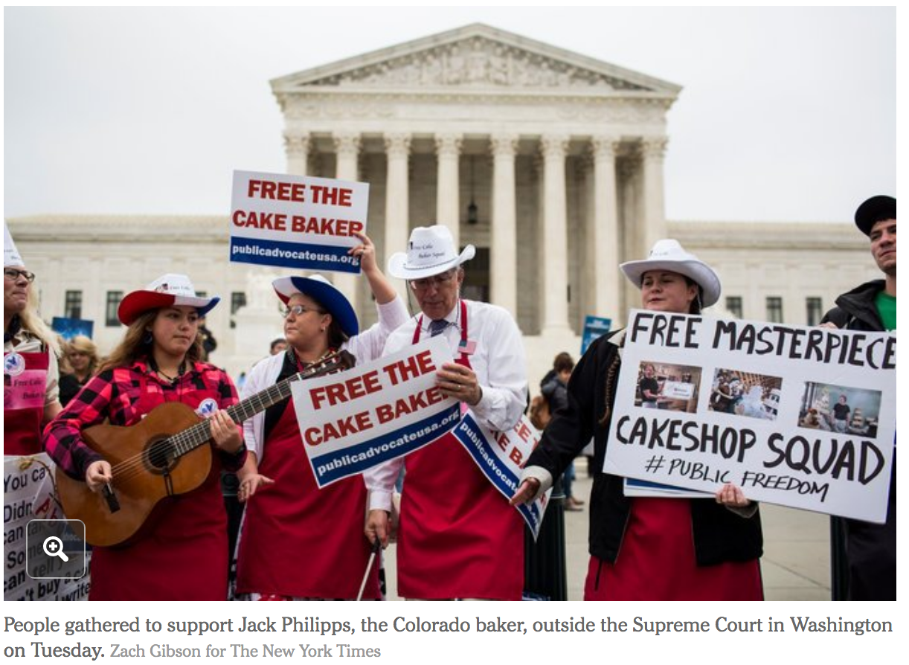
Masterpiece Cakeshop v. Colorado Civil Rights Commission, No. 16-111 ( Gay Cake Case) to bed ecided

Slide 23
Gay Cake Case: Facts
FACTS: 2012, n David Mullins and Charlie Craig visited Mr. Phillips’s bakery, Masterpiece Cakeshop, in Lakewood, Colo.
The couple were going to be married in Massachusetts, and they were looking for a wedding cake for a reception in Colorado.
Mr. Phillips turned them down, saying he would not use his talents to convey a message of support for same-sex marriage as that would clash with his religious faith.
The couple say they were humiliated by Mr. Phillips’s refusal to serve them, and they filed a complaint with Colorado’s civil rights commission.
The Colorado courts and the Colorado Civil Rights Commission found that the bakery's actions violated the state's law barring discrimination.

Slide 24
Gay Cake Case: A Clash of Constitutional Principles
Oberfell case:
marriage between people of the same sex subject to protection under Equal Protection Clause of 14th Amendment
Zauderer
Compelled Speech Cases: does it apply to creat8ve acts commercially sold (artist versus baker versus dancer?)
Hobby Lobby:
people may exercise religious rights through their enterprises.
Right to Refuse service cases:
1960s, Piggie Park, no religious exemption under Civil Rights Act when BBQ restaurant refused to serve black patrons; 1983, Goldsboro Christian Schools of Goldsboro, N.C., rejected claim of religious right to refuse black students. In the same case,
Sex and Race exceptions?:
Bob Jones University of Greenville, S.C., argued it had a right to deny admission to students who engaged in, or advocated for, interracial dating.
Equal pay religious exemption:
1990, Roanoke Valley Christian Schools in Virginia argued that it had a right to pay women less because their faith taught that men should be heads of households.

Slide 25
Application of Law of Nations to Corporations From Kiobel to Jesner
Facts:
Shell Petroleum Development Company of Nigeria, Ltd., operated oil production facilities in Nigeria. Kiobel, a Nigerian national, alleged that they, or their relatives, were killed, tortured, unlawfully detained, deprived of their property, and forced into exile by the Nigerian government and that Shell was complicit with the Nigerian government's human rights abuses.
Questions:
1. Under the Alien Tort Statute, are corporations immune from tort liability for violations of the law of nations, such as torture, extrajudicial executions, or genocide?
2. Does the Alien Tort Statute allow courts to recognize a cause of action for violations of the law of nations occurring within the territory of a sovereign other than the United States?
Results
Presumption against extraterritorial application of U.S. law; for claims about violations of law of nations the claim must touch and concern the United States in some way. Left unanswered the question of corporate liability

Slide 26
Jesner v. Arab Bank
Facts
victims of terrorist attacks that occurred over a 10-year period in Israel, the West Bank and Gaza. They allege that Arab Bank maintained accounts for known terrorists, accepted donations that it knew would be used to fund terrorism, and distributed millions of dollars to families of suicide bombers. They filed lawsuits under the Alien Tort Statute
Issue
Is financing terrorism covered under the law of nations as applied through the ATS (in existence around 1789?
Can Corporations be proper parties to suits under ATS
Arguments
presumption that corporations can be held liable for violations of international law.
there is no specific and widely accepted norm of international law that would allow corporations to be held liable for financing terrorism.
Interference with state relations
Since corporations cannot be jailed international customary law does not extent to corporations; should that apply to civil liability?

Slide 27
Decision 25 April 2018
Tightly connected with interpretation of origins of ATS
1789 original understanding
But not legislative intent
Principles/presumptions
Against extraterritorial application of U.S. law
Against using jurisdictional grants to create substantive rights
Issue for courts
A focus on the standards through which such presumptions might be overcome
That is the way that prior caselaw is now understood
Courts cannot create private rights of action
Because ATS does not specific a private right of action against corporations one cannot be read into the statute
Focus on avoiding foreign entanglements through litigation balanced against giving foreigners some space for litigating a very narrow range of causes in the U.S.
Further analysis here:
Larry Catá Backer, Brief Thoughts on Jesner v. Arab Bank, PLC, 584 U.S. — (2018): The State of Judicial Remedies for Corporate Liability for Human Rights Violations, CPE Working Paper 4/3 (April 2018). Download HERE: Brief Thoughts on Jesner v

Slide 28
How does this affect consideration of ZTE and Huawei?
Due Process
Protection of Property
Self Incrimination
Commercial Regulation Compliance
Others?

Slide 29

Thank You 谢 谢

