Slide 1

Where Neither Corporate Nor International Law Converge: The Multinational Enterprise and Societal Frameworks
Larry Catá Backer (白 轲)
W. Richard and Mary Eshelman Faculty Scholar Professor of Law and International Affairs; Pennsylvania State University
ASIL International Legal Theory Interest Group (ILTIG) Symposium
When Corporate And International Law Meet: Corporate Agency In A Global Context
American Society of International Law, Tillar House; 11 May 2018

Slide 2
Situating the Problem
After over half a century, the structural frameworks of globalization has produced governance gaps and transnational production chains
Much of what is going on in the regulation of CSR and its related aspects (duties, responsibilities and rights) is not happening within the conventional structures of the corporation (enterprise) or law.
The regulatory focus instead is on two constructs, neither of which is recognized fully in law: (1) Multinational corporations (MBCs); and (2) Societal rule making
But the regulation of both of these constructs is made more difficult by the conventional centrality of the corporation and of state based law (domestic and international) with all of its baggage

Slide 3
The Conundrum
The corporation
Juridical person; recognized through application of domestic legal orders
Equivalents (partnerships, LLCs, etc.
Domestic Law
Grounded in statute and administrative regulation
New: social credit and big data management
International Law
Treaties
Treaties creating international bodies with regulatory authority
And the rest: norms, declarations, frameworks, exhortations,. principles, etc.
A witches brew
Organization of economic activity across borders not contained by these forms
territorial limitations of state systems inadequate for regulation
Forms of regulation no longer adequate to meet regulatory objectives
Data driven governance through assessment and accountability mechanisms

Slide 4
Issue
Consider both the MNC and societal regulatory frameworks for governance in the shadow of the corporation and conventional law and on the cusp of data driven managerial regulation
Focus: the MNC as an objective of legal/social regulation
Question: has the legalization of societal space come to its end in the face of data driven governance?
Question: If not the MNC, are regulatory efforts targeting the right object?
Focus: the legalization of societal space, and the emerging governance characteristics of accountability and assessment

Slide 5

What is the Societal Space Within which enterprises operate?

Slide 6
What Makes Rules Societal?
Not binding law of a domestic legal order
Statute(judicial decisions
Regulation
New methodologies (social credit)
Not binding treaty law
Binding states as and to the extent they seek to be bound
Or others seek to bind them (courts, political forces, other states)
Not binding customary law or jus cogens
Global acceptance
Quite contentious
But binding all the same
Because enterprises chose to be bound
Because civil society, investment communities, consumers, and states seek to force enterprises to bind themselves to them

Slide 7
Hard Law in CSR Field
National
National efforts, mostly disclosure oriented,” disclose or explain” approach but extraterritoriality more popular now
Dodd Franck ¶1502Conflict Minerals (2010);
UK Modern Slavery Act (2015)
France: Supply Chain Due Diligence Law (2017) [24 March 2017: Constitutional Council removed the €10 to €30 million civil penalty attached, liability continues to apply when companies default on their duty of vigilance obligations, including failing to publish a vigilance plan or faults in its implementation.]
Australia Modern Slavery Bill (link here)
Traditional legislation around the factors of production and sale of goods and investment
International
None; New comprehensive Business and Human Rights Treaty?
Joint-Hybrid Efforts
Corruption/Bribery; trafficking, etc.
Investment treaties (esp. BITs)
Judicial
Expand fiduciary duty of care (U.K. cases)
Expand veil piercing
Treaty law that affects CSR (Tax, environment, etc.)

Slide 8
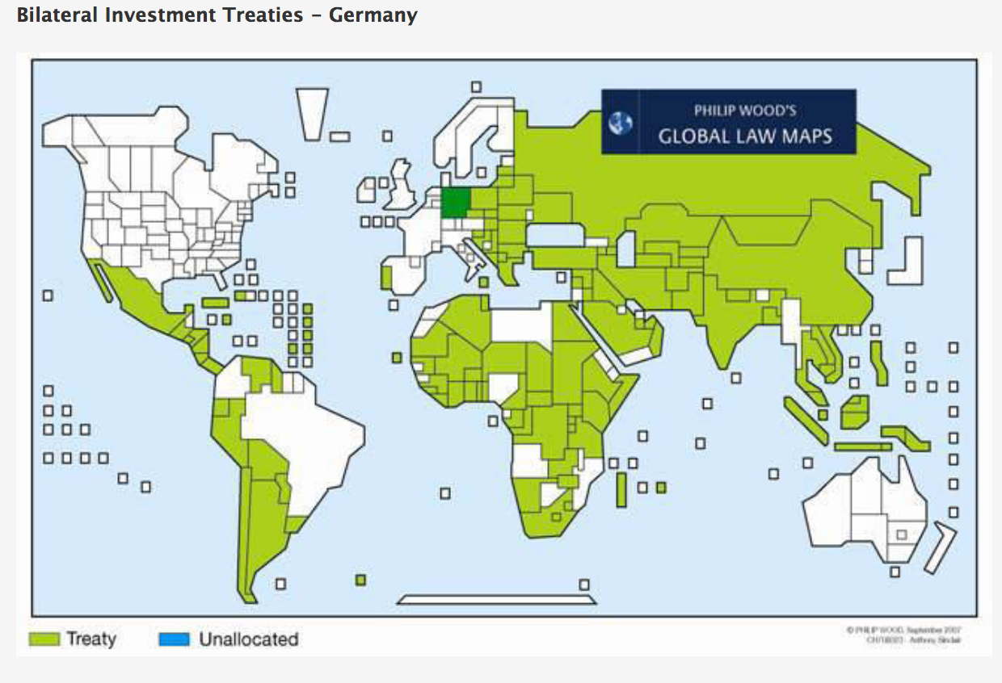
A Leading Edge--BITs with Human Rights Elements?
  --Bilateral Investment Treaties typically deal with investment and investment protection
  --Cuban Bits tend to focus on state prerogatives
  --Most others
  -internationalize national law
  -might discriminate in favor of foreign investors over domestic
  -stabilization provisions protect investment against domestic law
  -focus on expropriation;
  --Possibilities
  -Incorporate HR norms in BIT subject to stabilization protection
  -produce strong enforcement mechanism through arbitration
  -Early Study HERE
  --Requires coherence between HR and trade bureaucracies
Graphic Source (2009)

Slide 9
The Character of the Societal Sphere: From “Social License” to Legalization
Social License
The 2nd Pillar of the UNGP
Consensus on Common Practices and Expectations of Business
The OECD Guidelines for Multinational Enterprises
“Good governance” and Institutional Organization
Corporate constitutionalization and regulatory contracts among MNCs

Slide 10

The Societal Sphere: A Growing Area of Everything Else
Legalization of the societal sphere: Examples
  UN Guiding Principles
  OECD Guidelines for MNEs
  3rd Party Standards (Extractives Specific Guideline; e.g. Extractive Industries Transparency Initiative (EITI))
  MNE internal norms
  Social License for extractives
The next wave:
  Social credit and big data

Slide 11
UNGP
For extractives applies three different ways
State duty
  SOEs
  Development Banks
  SWFs (contentious)
  State controlled banks and other lenders
  IFIs
Corporate responsibility
  Private extractives firms
  Private lenders
  Public lenders operating under commercial activities exemption of sovereign immunity(?)
Remedial
  States through judicial and non judicial public mechanisms
  State based and private systems with option to opt into state system (which state?; against which entity? Under what law?)
  Endorsed by UN Human Rights Council
    Does not create new CSR or HR legal protections
    Polycentric: simultaneous obligations to states and enterprises
  3 part structure
    State duty to protect human rights
      Extends no further than legal obligations of state
      Opens the door to extraterritorial application
    Corporate responsibility to respect human rights
      International bill of human rights
      Human rights due diligence
      Obligation to work around host state restrictions
    Remedial obligations for states and enterprises
      Principally through state
      Also international and private mechanisms

Slide 12
OECD Guidelines for Multinationals
Guidelines: recommendations addressed by governments to MNEs.
  They provide principles and standards of good practice consistent with applicable laws and internationally recognised standards.
  Observance of the Guidelines by enterprises is voluntary and not legally enforceable.
Cover a number of general areas
  transparency/disclosure, human rights, employment/industrial relations, environmental issues, bribery/corruption, consumer protection, technology transfer, anti-competitive schemes, and taxation
  Special toolkit for weak governance zones
    Extractives and weak governance zones HERE
    OECD Due Diligence Guidance: Meaningful Stakeholder Engagement
Complaint procedures through National Contact Points.
  Have been used increasingly in two contexts
    NGOs to advance international normative agenda
    Labor unions to leverage national litigation

Slide 13
3rd Party and Private Standards
GRI (Global Reporting Initiative)
Social, economic and rights based reporting of economic activity
Private-public partnerships
ISO 26000 CSR
EITI (Extractive Industries Transparency Initiative; (2016 Standard)
Private organizations
Certification of compliance with their standards
Monitoring.
Equator Principles

Slide 14
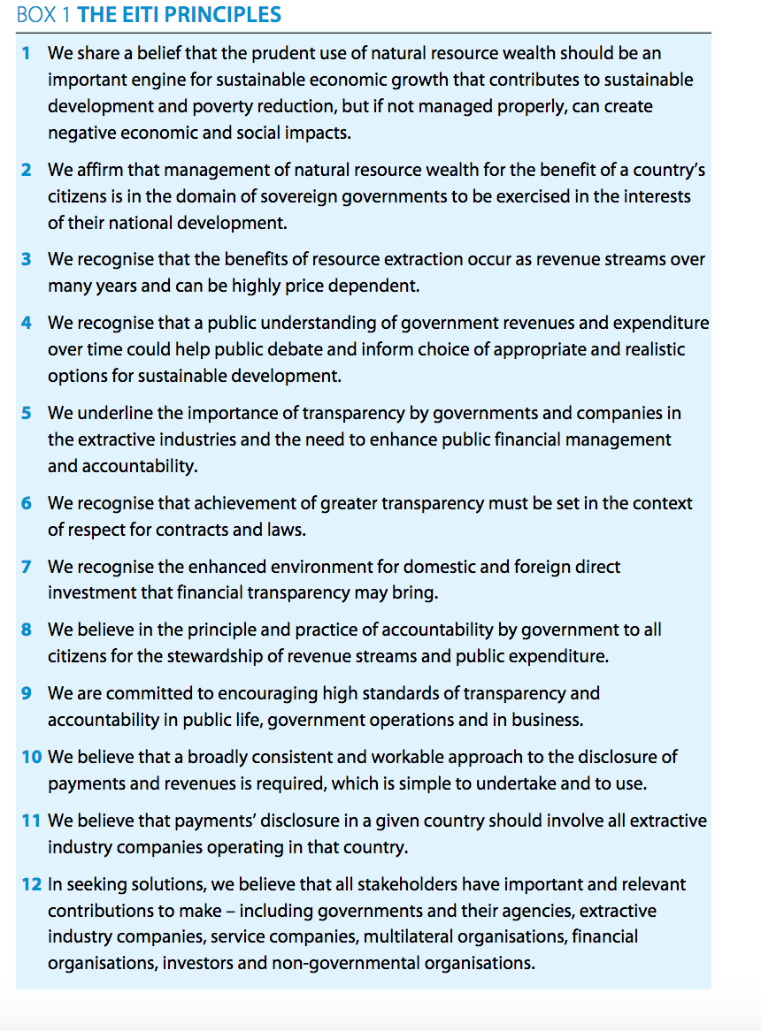
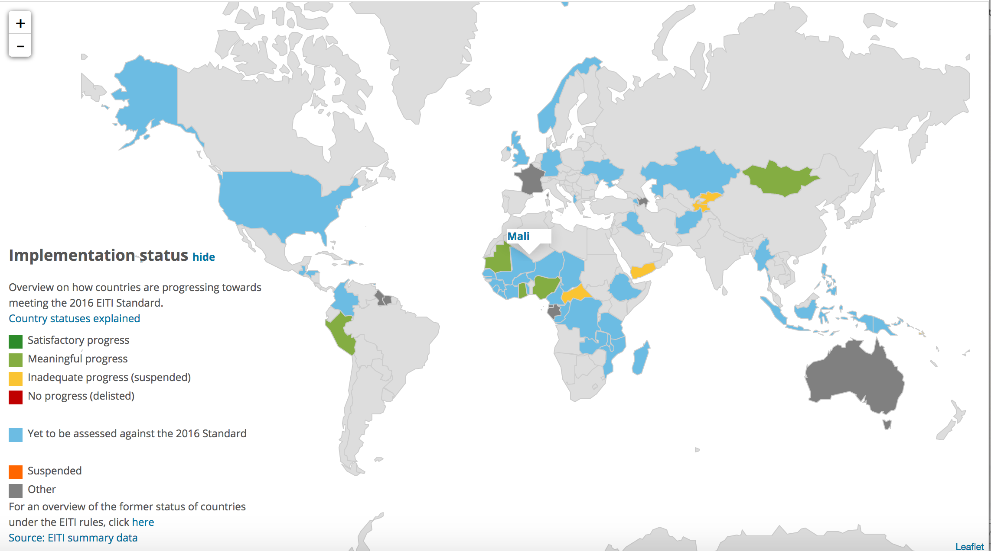
A Work in Progress; Example EITI
Australia and EITI HERE (overview of Australia's Pilot of the Extractive Industries Transparency Initiative within Australia’s resources sector.)
Source: Extractive Industry Transparency Initiative EITI Web Site

Slide 15
Internal MNE Norms and Social License
  Largest MNEs already have harmonized and sometimes complex systems of CSR based control of its supply and production chain throughout their global operations
        Rio Tinto
        Barrick
        TransCanada
    Internal governance norms applied throughout production chain and administered through the MNE itself enforced through contractual and capital arrangements.
      Supply Chain Codes of Conduct
      Codes of Ethics
    Constraints to application: veil piercing rules, contract principles (e.g., 3rd party beneficiary, etc.).
      Recent U.K. cases
      Sustainability cases in the U.S. and Europe
    Indirect enforcement
      Through financial intermediaries
      Public-Private Partnerships (Dutch Banking Sector Accords)

Slide 16

The MNC

Slide 17
As an Object of Regulatory Interest
Entity: Tort Liability
Nexus of operations: Tax
System: Competition law
Production Chain: Disclosure; BHR

Slide 18
From Polycentricity on Regulation to Polycentricity on MNE
MNE regulation moves governance well beyond the well-worn and ultimately unsatisfactory traditional tools of law deployed by and within domestic legal orders.
The misalignment of state and MNE makes such approaches unsuitable to attain goals of regulating MNEs.
Some elements of transnational regulatory structures appear to be moving from the objectification of the MNE as an entity to the management
of its form through interventions in its linkages and connections,
of the production process which is itself the object of MNE function.
In the MNE one encounters entity, connections and linkages, and functionally differentiated production chains.
Each aspect of the MNE is partially and simultaneously by layers of regulatory governance, the effectiveness of which is limited to that portion of the “idea” of the MNE to which it attaches.

Slide 19

The Future: Social Credit

Slide 20
Chinese Social Credit
An example of China’s “top-level design” (顶层设计) approach; coordinated by the Central Leading Small Group for Comprehensively Deepening Reforms.
It is a project for the development of a national reputation system, assigning a social credit number that reflect a qualitative judgment of relevant data gathered about the subject.
will focus on four areas: "sincerity in government affairs" (政务诚信), "commercial sincerity" (商务诚信), "societal sincerity" (社会诚信), and "judicial credibility" (司法公信).

Slide 21
Building the Integrated System: China
State at the Center
Coordination,
Leadership
Focus on four sectors
Government, commercial activities, social integrity, judicial credibility ¶ II(1)-(4)
Build, Share, Implement

Slide 22
Does the West Have a Social Credit System?
There is no social credit system in the West analogous to emerging Chinese model
A Governance, Risk Management, and Compliance (GRC) model
Applied to and by public and private actors; little coordination.
What the West has developed are aggregations of related functions:
surveillance
reporting, including disclosure for accountability (through law)
data collection, markets in data
data repacking and distribution,
Analytics and relational connections between objectives or principles and behaviors
Reward and punishment system (inducement, discipline, social behavior management
Systems of data drive management controls
Systems for identifying and responding to risks affecting objectives of specific parties
System for identifying and meeting legal and social norm requirements

Slide 23
Data Based Regulatory Circles
Compliance regimes
Risk
Risk reduction
Damage control
Data/data analytics

Slide 24
Technical and Normative Challenges to Construction of Social Credit or Ratings Systems
Data
Identification
Data Collection
Algorithm
Assessment
Rating
Effects--
Decision,
Discretion, reward, discipline

Slide 25
What Social Credit Adds to the Regulatory Discussion
Who is regulating: governmentalization of economic sector privatization of the state
Regulatory Tools: policy as data analytics and algorithmic premise
Recharacterization of Data: both a critical factor in production and the key element of managerial politics
From Command and Control to algorithm and Management
What is the division of authority between political and economic institutions? How does this reshape transnational regulation
Does the character of MNE personality (entity, linkages, network, etc.) shape rulemaking?
Accountability as the new constitutionalism grounded in --data and data analytics to regulate both the state and the MNC as autonomous elements of global managerial operating system

Slide 26
Conclusion: Discussion Points Going Forward
The multinational corporation
Entity
System
Production chain
Regulatory Space in the Societal Sphere
What is social space?
Differentiations from law?
A matter of intermeshing at the margins of formal systems?
The Witches Brew
Where MNCs and societal rules meet corporate forms and conventional legal forms and institutions in transnational space
What of data driven governance?
Forms of regulation no longer adequate to meet regulatory objectives
Need to think about new ways to understand MNCs, law, societal governance and their relationships

Slide 27
Challenges
Has the legalization of societal “regulatory” space come to its end in the face of data driven governance?
Has the object of regulation, the MNC, now ceased to exist as a coherent single vessel into which regulatory responsivity can be poured?
Are regulatory initiatives using the rights tools? Are they targeting the right place or object?

Slide 28

Thanks!

