Slide 1
Stress Points and Structural Challenges for the Continued Viability of the University Faculty Senate
Remarks
Luncheon Honoring Past Chairs of the Penn State University Faculty Senate
Larry Catá Backer
W. Richard and Mary Eshelman Faculty Scholar & Professor of Law, Professor of International Affairs 2013-14 Immediate Past Chair University Faculty Senate
Transcript available
http://www.backerinlaw.com/Site/podcasts/speeches-and-remarks/remarks-delivered-at-the-luncheon-honoring-past-chairs-of-the-penn-state-university-faculty-senate/

Slide 2
The Institution Confronts Stress
Is the Senate doing well or has it lost its way
  Docile, remote, elitist?
  Malaise and morale or whining?
  Structural or cultural factors?
Object of Remarks:
  Describe those stress points that may present the greatest challenges for the institutional viability of the University Faculty Senate going forward

Slide 3
Communication
the Senate has yet to master the art of communication with its constituents.
Website not user friendly
Better communication up through the board of trustees than down to unit faculty

Slide 4
Administrative Structure
the Senate’s administrative structure does little to contribute to the autonomy of the elected leadership
  creates incentives to shift effective power from annually replaced elected leaders to a long serving bureaucracy whose interests, beyond self preservation may not be identical to those who they ostensibly serve.

Slide 5
Focus and Emphasis of Work
the Senate has failed to shift its focus and emphasis even as the business of university administration has shifted, and shifted in sometimes dramatic ways, all around it.
  From engagement in policy and rule development to monitoring and assessment
  NGO model

Slide 6
Committee Structures
none of the work of the Senate is made easier by a senate structure that at points does not align with administrative organization.
  Increasing work done through ad hoc committees

Slide 7
Contract Faculty
the Senate has yet to confront the issue of contract faculty and the future of tenure, not in the abstract but as part of the living practices of the institution.
  Senate has failed to be pro-active

Slide 8
Cronyism
two faces of cronyism
  Entrenchment
    Same group of people cycling through committee assignments
  Control from the top of the Senate hierarchy
    Closed door leadership meetings contribute to isolation of leadership and incentives to align interests with administration

Slide 9
Transparency and Retaliation
cronyism has corrupting effects
  Avoidance of transparency and engagement
  Little protection against retaliation especially for contract faculty
No effort to write rights into our terms and conditions of employment
  Reliance only on ambiguous post facto 1st Amendment jurisprudence

Slide 10
Finance Driven Education
even the Senate’s authority over curriculum and its influence in shaping educational programs is being quickly eroded through the transformation of educational policy issues into financial ones.
Finance side of the academic house is taking the lead on changes that affect courses and program quality and delivery.

Slide 11
The “Wellness Program” Example
clear example of the way in which the current structures and cultures of the Senate and its operations tend to constrain, the ability of the Senate to assert an effective leadership role beyond the mass of small ministerial tasks at which it has become quite proficient.
  Example of structural impediments to Senate engagement in shared governance

Slide 12
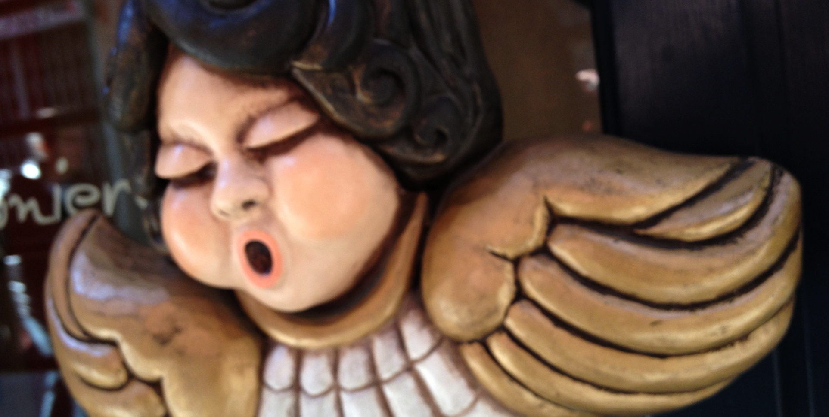
Thanks

