Slide 1

State and Party in the Scientific Development of a Legitimate Rule of Law Constitutional System in China: The Example of Laojiao and Shuanggui
中國憲政法治科學發展過程中黨與國家所發揮的作用： 「勞教」與「雙規」的案例研究
Larry Catá Backer / 白 轲
W. Richard and Mary Eshelman Faculty Scholar & Professor of Law, Professor of International Affairs, Pennsylvania State University. The author may be contacted at lcb911@gmail.com.

Slide 2
Introduction
導言
Two distinctive Chinese disciplinary systems— Laojiao and Shuanggui— are commonly criticized as anti-constitutional and against the rule of law。
Examine the development of constitutional rule of law theory with Chinese characteristics by considering its application in Laojiao and Shuanggui.
「勞教」與「雙規」這兩套中國獨有的紀律這體制普遍被批評為違反憲法並且違背法治精神。
論述中國特色憲政法治體系的發展過程，並透過中國特色憲政法治框架對「勞教」與「雙規」進行分析。

Slide 3
The Basic Outline
論文的基本框架
Brief overview of laojiao and shuanggui.
Current criticisms of laojiao and shuanggui
Review Laojiao and Shuanggui within the context of the Chinese rule of law constitutional order.
Propose ways which the Shuanggui system may benefit from scientific development under China’s rule of law constitutional system.
  「勞教」與「雙規」的簡要概述 。
  勞教與雙規制度所面臨的批評。
  分析「勞教」與「雙規」在中國法治憲政秩序內的運作。
  指出「雙規」制度如何能夠在中國法治憲政體制下受益於科學發展。

Slide 4
*Picture from Jason Lee, Laojiao System to be Phased Out, Beijing Shots, Jan. 21, 2013
Laojiao / 勞教
Laojiao is an administrative detention system, literally translated as “re-education through labor”.
Laojiao received its present name from the 1957 ordinance “Resolution on Approving the Decision of the State Council on the Issue of the Reeducation through Labor ”, which is the principle document providing the “legal basis” for the laojiao system.
Laojiao targets those individuals who have committed “minor offences” that do not amount to criminal liability. It is an compulsory administrative penal system which seeks to “reform and correct” those individuals through forced labor and detention.
「勞動教養」是一種行政處罰體制，簡稱「勞教」。
「勞教」一詞源於1957年全國人大常委會所頒佈的《關於勞動教養問題的決定》，這項決議是目前勞教體制的主要「法律依據」。
「勞教」針對那些犯了「輕微罪行」，但不構成刑事責任的人。這是一種強制性的行政處罰系統，通過強迫勞動和拘留對勞教對象進行「改造」與「糾正」。

Slide 5
*A photograph of Shayang Re-education Through Labor camp in Hubei province, from the archives of the Laogai Museum
Laojiao / 勞教 (cont.)
Public criticism of the laojiao system has been increasing, especially in light of recent cases of abuse of the administrative detention provisions by local officials.
On Jan. 2013, Meng Jianzhu, Secretary of the Central Political and Legal Commission announced during the National Conference that “the re-education through labor system will be terminated by the end of this year upon approval from National People’s Congress Standing Committee”.
On Feb. 2013, Yunnan provincial government announced that Yunnan would no longer approve laojiao cases on grounds of threatening national security, petitioning by causing unrest, and smearing the image of officials.
近年來、有關地方官員濫用政府行政拘留權的事件層出迭見、將勞教這個頗具爭議的懲罰體制再次推向輿論的風口浪尖。
中央政法委書記孟建柱在2013年一月舉行的全國政法工作會議上宣佈，「中央已研究，報請全國人大常委會批准后，今年停止使用勞教制度」。
今年二月，雲南省政府宣佈雲南全省將立刻停止對涉嫌危害國家安全、纏訪鬧訪、醜化領導人等三種行為的勞教審批。

Slide 6
*From CPC Central Commission for Discipline Inspection holds 8th plenum
Shuanggui / 雙規
Shuanggui is commonly understood as a specific procedure for cadre discipline under regulations adopted by the CCP. It is a important instrument to combat corruptions in China.
The term shuanggui, roughly translated as “double designations”, is derived from Article 28, section 3 of the Investigation Regulations for the Discipline Inspection Organs of the CCP, which requires suspected cadres to “answer questions and clarify issues at designated duration and designated place.”
Shuanggui is an intra-Party disciplinary mechanism that only applies to the CCP member. For non-CCP members who work for the governments or state owned enterprises and violates administrative disciplines, the rule of Liangzhi will apply.
「雙規」通常被理解為一套由CCP制定，專門針對涉嫌違紀黨員的特殊調查程序。對於中國而言，雙規是一個重要的反腐工具。
「雙規」一詞來源於《中國共產黨紀律檢查機關案件檢查工作條例》中第二十八條第三款，要求涉嫌違紀黨員「在規定的時間、地點就 案件所涉及的問題作出說明」。
雙規作為一套中共內部的紀律機制，其適用範圍僅局限於中共黨員。《中國行政監察法》中的「兩指」則適用於在政府機關或國有企業工作，涉嫌違紀的中共黨外人員。

Slide 7
Criticisms Against Laojiao and Shuanggui
勞教與雙規制度所面臨的批評
Both laojiao and shuanggui have come under increasing criticism in China as well as in the Western press.
  Laojiao has been widely criticized as irremediably in conflict with both constitutional protections accorded individuals and with a number of general laws adopted by Chinese state administrative organs.
  Though many acknowledge Shuanggui’s function in combat corruptions, it has been criticized as extra-judicial because it is not administered by state judicial organs.
Recently Chinese authorities have indicated an intention to reform or perhaps abolish the laojiao system. There has been no indication of any intention to change the shuanggui system.
中國內外社會輿論对勞教和雙規這兩套制度的批評声音一直不絕於耳。
  勞教在近年來受到了廣泛的批評。勞教體制不僅與中國《憲法》中保護個人權益的條款背道而馳，而且違反了《立法法》、《行政處罰法》等多項法律規定。
  雖然不少學者認同雙規的反腐功能，雙規也被批評為一種繞過國家司法系統的法外懲戒機制。
近來中國官方已經表示有意改革或者取消勞動教養體制。另一方面，目前並無跡象表明雙規系統的改革與去留。

Slide 8
Constitutional Analysis (part 1)
憲法分析
The 1957 Resolution provides that the laojiao system was adopted “In accordance with Article 100 of the Constitution of the People's Republic of China, for the purpose of reforming those idling, law-breaking, discipline-breaching, duty-neglecting but work-capable individuals into self-reliant people of new work ethic.”
Article 100 of the 1954 Constitution stipulates that: “Citizens of the People’s Republic of China must abide by the Constitution and the law, uphold discipline at work, keep public order and respect social ethics.” (Article 100 became Article 53 in the current 1984 Constitution, with almost identical language)
As the laojiao process is without judicial review and completely bypasses state judicial organs , the 1957 Regulation contradicts provisions from both 1957 and 1982 versions of the Chinese Constitution:
Article 89 of the 1954 Constitution provides that: “Freedom of the person of citizens of the People’s Republic of China is inviolable. No citizen may be arrested except by decision of a people’s court or with the sanction of a people’s procuratorate.”
Article 37 from the 1982 Constitution also confirmed the due process requirement found in the 1954 Constitution
Article 53 deals with the duties of the citizens, it does not explicitly provide means for the state to exercise judicial authority.
1957年頒佈的《關於勞動教養問題的決定》声称劳教体制的采用是「根據中華人民共和國憲法第一百條的規定，爲了把遊手好閑、違反法紀、不務正業的有勞動力的人，改造成爲自食其力的新人」。
《54憲法》第一百條規定：中華人民共和國公民必須遵守憲法和法律，遵守勞動紀律，遵守公共秩序，尊重社會公德。【《84憲法》第五十三條傳承了《54憲法》第一百條的內容】
《憲法》第五十三條（54憲法第一百條）僅涉及公民的職責，它並沒有明確國家行使司法的權力。
由於勞教體制缺乏司法審查並且完全繞過國家司法機關，1957年所頒佈的勞教決定既不符合當年《54憲法》中的條款，也違背了當前的《82憲法》。
《54憲法》第八十九條規定： 中華人民共和國公民的人身自由不受侵犯。任何公民，非經人民法院決定或者人民檢察院批准，不受逮捕。
《憲法》第三十七條也規定： 中華人民共和國公民的人身自由不受侵犯。任何公民，非經人民檢察院批准或者決定或者人民法院決定，並由公安機關執行，不受逮捕。禁止非法拘禁和以其他方法非法剝奪或者限制公民的人身自由，禁止非法搜查公民的身體。

Slide 9
Constitutional Analysis (part 2)
憲法分析
Being a revolutionary party, the CCP-led government in its nascent years adopted harsh measures against its political opponents. Those temporary political measures have been institutionalized into two unique disciplinary systems—laojiao and shuanggui.
While both laojiao and shuanggui bypass formal judicial process, shuanggui is a narrowly-applied intra-CCP discipline system that only targets Communist Party cadres.
The laojiao system not only violates constitutional principles, it is also contrary to the CCP's Mass Line.
The “Mass Line” is a founding principle for the CCP, it expresses the need for the Party to stay connected with the general public by both adequately serving and representing the interest of the masses.
The Mass Line mandates the CCP to form a government for the people, through the promulgation of a written constitution.
Laojiao, on the other hand, functions as a pervasive administrative penal system that targets the general public.
Being an extra-judicial penal system that directly targets the masses, the laojiao system contradicts both the Constitution and the Party line of the CCP.
作為一個革命黨，中共在新中國成立后爲了打擊其政敵而採取了一些嚴厲的措施。這些臨時政治措施後來被進一步制度化，從而形成了勞教與雙規這兩個獨特的紀律機制。
雖然雙規與勞教體制都繞過了正規司法程序，雙規作為一個有限的黨內紀律機制僅適用於黨員幹部。
勞動教養體制不僅違反了憲法，它也違背了中共群眾路線
「群眾路線」是中共的根本工作路線、其宗旨為保持黨與群眾的密切聯繫，積極總結群眾的意見，爲了廣大人民的利益去服務群眾。
相比之下，勞教則是一套針對廣大群眾，被廣泛應用的司法外行政處罰體系。
堅持群眾路線意味著中共必須通過頒佈《憲法》來建立一個服務人民的政府。
作為一個針對群眾的司法外行政懲罰體系，勞教不僅違憲，更是違背了中共的根本工作路線。

Slide 10
Constitutional Analysis (part 3)
憲法分析
CCP does not enjoy an extra-constitutional role in Chinese political organization, but it does exist autonomously from the state. State organs, under the constitution that established them and defined their powers, are understood to be required to accept the leadership role of the CCP.
Under the Chinese constitutional order, the CCP is the repository of political power, and the state organs fulfill the administrative function.
Fundamental separation of powers– political (CCP) and administrative (State organs) differ from West, where all power is in state organs and divided into executive, judicial, and legislative functions
Chinese Constitution could be understood as establishing an administrative apparatus under the leadership of the CCP and its multi-party coalition.
The result: government under State Constitution, and the CCP under the Party Constitution.
State Constitution directly binds the government, but does not bind the CCP.
The CCP is bound by its party line and its own Party Constitution.
The State Constitution is an expression of the Party line.
雖然CCP並非在憲法之外，但是在中國的政治秩序中，CCP 不從屬於國家機器。根據《憲法》，中國國家機構必須認同CCP的領導。
中國的分權模式---即中共的政治決策權與政府的行政管理權之間的區分有別於西方的三權分立傳統。
中國《憲法》的功能可以理解為在共產黨為領導的多黨合作框架之下建立的行政管理體制。
在中國的憲政秩序下，中共是政治權利的提供者，政府則是行政管理的機關。
中國政府遵循國家《憲法》，中國共產黨遵循《黨章》
國家《憲法》直接對應的是政府機構，而不是中共
中共受制于其工作路線與《黨章》
《中華人民共和國憲法》本身即為中共工作路線的表達。

Slide 11
Constitutional Analysis (part 4)
憲法分析
The legitimacy of the Shuanggui must be understood within the context of the Chinese Party-state constitutionalism, where both the State and Party constitutions are part of the constitutional order.
Under the Chinese rule of law constitutionalism, shuanggui is a legitimate expression of the CCP’s constitutional power, as long as it is administered properly.
Traditional constitutionalist analysis tends to focus only on the Chinese State Constitution, while the legitimacy of the shuanggui system is found in the Party Constitution and other unwritten constitutional elements.
The leadership role of the CCP over state organs implies the need to discipline Party cadres through the CCP structure.
The state judicial organs have no jurisdiction to discipline Party cadres for the violations of CCP rules under the Chinese separation of powers principle.
中國國家《憲法》和中共《黨章》都是中國憲政秩序的重要組成部份。 雙規的合法性必須通過中國獨有的憲政秩框架來理解。
在中國憲政法制框架下，「雙規」在正確合理使用的前提下並不違反中共的憲法權限。
傳統憲法分析單獨關注中國的國家《憲法》，而雙規機制的合法性則是基於中共《黨章》以及其他不成文憲法要素。
國家機器服從於黨意味著紀律中共黨員幹部需要通過黨組織來完成。
國家司法機構沒有權限紀律中共黨員違反黨紀的行為。

Slide 12
The Operation of the Shuanggui System
雙規機制的運作
Shuanggui operates in accordance with the Investigation Regulations for the Discipline Inspection Organs of the Communist Party of China, adopted by the CCDI in 1994:
Article 1: “…The purpose of this ordinance is to standardize and institutionalize the case examination process. This ordinance is formulated in accordance with the provisions of the Constitution of the Communist Party of China…”
Article 6: “Case examinations shall rely on the Party organizations at all levels to follow the mass line...”
Article 8: “During the examination process, the rights of the Party members…must be guaranteed in accordance with the provisions of the Party Constitution.”
Article 9: “Case examinations should implement a graded management system, where each level shall be responsible for its delegated duties.”
雙規根據1994年中紀委頒佈的《中國共產黨紀律檢查機關案件檢查工作條例》運行
第一條： …為使案件檢查工作規範化、制度化，提高辦案質量和效率，根據中國共產黨章程有關規定，結合案件檢查工作的實踐，制定本條例。
第六條：案件檢查要依靠黨的各級組織，走群眾路線…
第八條：案件檢查中，要切實保障黨員包括被檢查的黨員行使黨章所賦予的各項權利。
第九條：案件檢查實行分級辦理、各負其責的工作制度。

Slide 13
The Operation of the Shuanggui System (cont.)
Case Admission (Art.10)
Preliminary Verification (Art.11-15)
Case-Filing (Art.16-22)
Article 17: Graded case-filing shall be used for disciplinary violations committed by Party members.
Investigation (Art. 23-39)
Article 28 (The Shuanggui Article): The investigation team shall have the right…to demand relevant individuals appear at a designated time and place to provide explanations regarding all aspects of the case;
Article 32: The confirmation of disciplinary violation must be backed by sufficient and compelling evidence. Confession by the party under investigation alone without any supporting evidence is inadequate to confirm the violation.
Hearing Referral (Art.40-44)
Article 37: During the investigation, if it is found that the Party member has breached criminal law in addition to violating Party discipline, the case material of that Party member shall be forwarded to the relevant judicial authority.

Slide 14
雙規機制的運作 (續)
案件受理（第十條）
初步核實（第十一條至第十五條）
立案（第十六條至第十五條）
第十七條：對黨員的違紀問題，實行分級立案。
調查（第二十三條至第三十九條）
第二十八條（「雙規」條款）： 調查組有權按照規定程序...要求有關人員在規定的時間、地點就案件所涉及的問題作出說明
第三十二條：認定錯誤事實須有確實、充分的證據。只有被調查人的交待，而無其他證據或無法查證的，不能認定
移送審理（第四十條至第四十四條）
第三十七条：调查中，若发现违纪党员同时又触犯刑律，应适时将案件材料移送有关司法机关处理。

Slide 15
Inside a Shuanggui Facility*
The gate of the shuanggui facility, you have to pass security check.
Interrogatee’s seat, which is much lower than the interrogator’s position.
The inquiry room, the cameras automatically record all conversions.
The walls are padded to avoid any accidents.
Specially designed windows with protective bars, outside is isolated deserted mountains.
Psychological examination room, equipped with advance instruments.
Command room, equipped with a large multi-display that monitors all activities in the investigation facility.
Interrogator’s seat inside the interrogation room, you can notice there is a camera and a screen;
*The content of this part are retrieved from here (Chinese) and here (English)

Slide 16
中紀委雙規調查設施*
調查場所的入口，進入設施必須通過安檢。
被審人的席位，比審訊官的位置低很多。
「詢問室」，裝有AV設備用於記錄室內所有的談話
牆四周裝有軟墊，以防意外發生
設施內裝有特製的鋼筋加強窗戶，窗外是偏遠山區。
「心理測試室」，配有先進的儀器。
總指揮室，裝有大型複合顯示屏，用於監視整個調查設施
訊問室內審訊官的座位，上面裝有攝像頭和顯示屏。
*The content of this part are retrieved from here (Chinese) and here (English)

Slide 17
Scientific Development of the Operation of Shuanngui
進一步科學發展雙規的運行機制
Managing the Exercise of Discretion by Officials Participating in Shuanggui.
Promote due process, transparency, and other secondary measurements.
Improve the quality of investigation by set up coordinate cooperation mechanism
Separate MOS and CCDI proceedings.
Minimize regulatory incoherence between State and CCP by coordinating Shuanggui with criminal law where appropriate.
Procedures should ensure that all Party Members are equally subject to discipline.
Prevent the Shuanggui system from becoming an instrument for factional political struggles.*
*These issues will be elaborated in the forthcoming article.
加強管理調查人員的自主裁量行使權。
促進正當程序、透明度以及其他輔助方針。
通過成立協調合作機制提高調查質量。
明確區分中紀委與監察部的調查工作。
合理協調刑法與黨內紀律，將黨與國家之間的管理混亂最小化。
進一步確保黨內紀律對全體黨員的公平實施。
嚴防雙規機制淪為宗派間的政治鬥爭工具。*
*以上論點將在下一篇文章中詳細闡述。

Slide 18
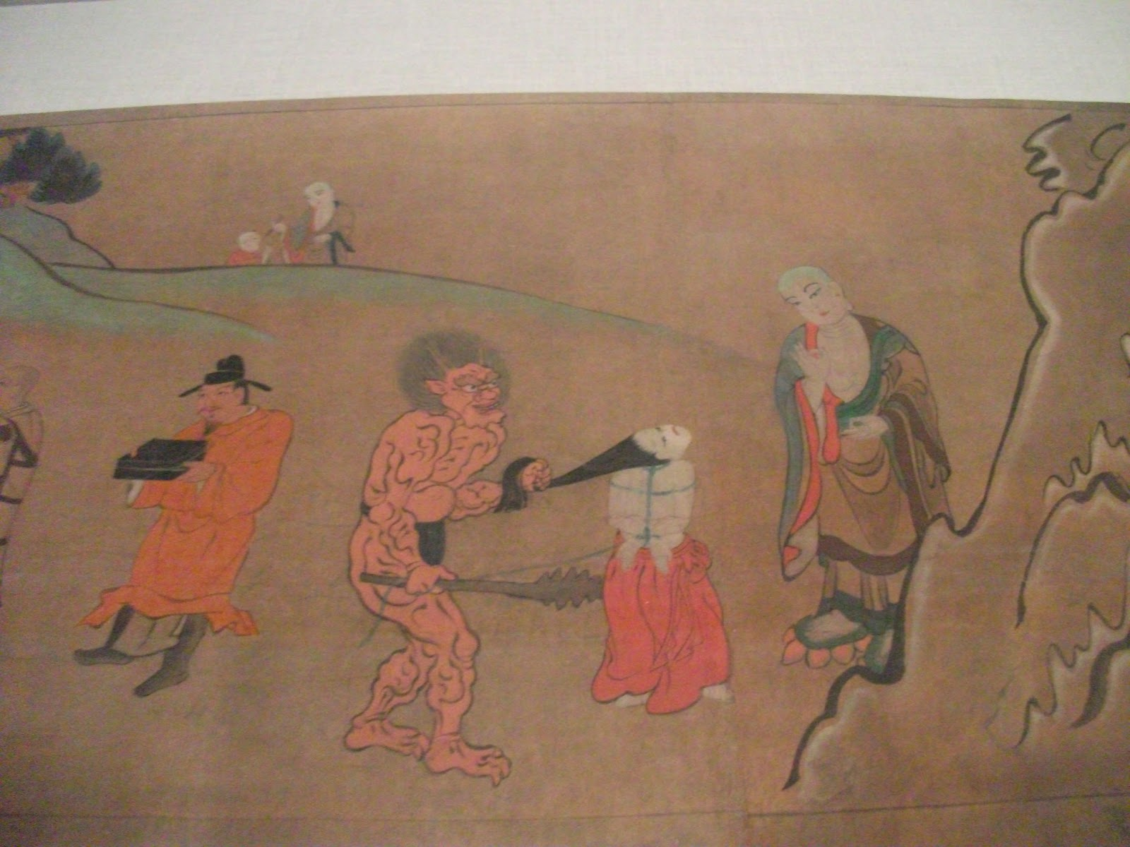
Thank You!
謝謝！
下載論文的完整電子版請用以下鏈接：
白軻、王可任，《中國憲政法治科學發展過程中黨與國家所發揮的作用： 「勞教」與「雙規」的案例研究》
http://papers.ssrn.com/sol3/papers.cfm?abstract_id=2273044
Backer, Larry Catá and Wang, Keren, State and Party in the Scientific Development of a Legitimate Rule of Law Constitutional System in China: the Example of Laojiao and Shuanggui (June 1, 2013). Available at SSRN: http://papers.ssrn.com/sol3/papers.cfm?abstract_id=2273044

