Slide 1

Corporations and the U.S. Constitution: Origin of Rights and Recent Trends
Larry Catá Backer (白 轲)
W. Richard and Mary Eshelman Faculty Scholar Professor of Law and International Affairs
Pennsylvania State University | 239 Lewis Katz Building, University Park, PA 16802 1.814.863.3640 (direct) || lcb11@psu.edu
Seminar: East China University of Politics and Law
Shanghai, China
23 October 2017

Slide 2
Context: Persons and the U.S. Federal Constitutional System
U.S. Constitution
Set up government on basis of delegated powers
Additional Provisions preserving rights to persons
Shared power to establish corporations
State Constitutions
Residuary authority
Includes power to charter corporations
Protections of rights to persons

Slide 3
Personhood
Personhood: Autonomy, the basic holder of rights and duties; The object of society, rules, law, and the basic force of politics
Human beings have personhood
But can bodies corporate be vested with personhood?; Private entities (corporations, other collectives); Public entities (the state, international organizations)
If they can be vested with personhood, is it the same as the personhood of human beings?

Slide 4
Legal Personhood: Bodies Corporate
John Dewey, “The Historic Background of Corporate Legal Personality,” Yale Law Journal, XXXV (6) (April 1926), 655-673 [quoting Maitland, Collected Papers (1911) 307]
“The corporation is (forgive this compound adjective) a right-and-duty-bearing unit.
Not all the legal propositions that are true of a man will be true of a corporation. For example, it can neither marry nor be given in marriage; but in a vast number of cases you can make a legal statement about x and y which will hold good whether these symbols stand for two men or for two corporations, or for a corporation and a man.” [2]
In saying that “person” might legally mean whatever the law makes it mean, I am trying to say that “person” might be used simply as a synonym for a’ right-and-duty-bearing unit.

Slide 5

But What Kind of Personhood?
Three Distinct Models

Slide 6
Theories of Legal Personality for Corporations
Fiction Concession theory
Corporations exist only to the extent permitted by law
Nexus of contracts theory
corporations are collection of contracts between different parties - primarily shareholders.
Corporations as property in the hands of shareholders;
focus on shareholder rather than on enterprise
Autonomy/Aggregation theory
When a group comes together to form an enterprise the resulting body is distinct from any of its members; it is institutionally distinct
Corporations as the government of an economic community
Focus on the enterprise rather than on the shareholder
Corporate form as property controlled by the state
Focus on state economic policy

Slide 7
Question for Discussion
If the corporation can hold rights and obligations under law, can it also be subject to the fundamental protections of constitutional Law?
That question has had a long history in the United States
Issue arose almost at the start of the Republic
It remains controversial today
The issue depends on the extent to which the corporation is viewed as autonomous of its shareholders

Slide 8
Order of Discussion
Traditional Framework of corporate constitutional protection
Original View
Property based protections
Limitations
Modern
Speech rights
Right Not to be Forced to Speak
Religious Protection Rights
Trends and Conclusion

Slide 9
Traditional Framework; Original View
Trustees of Dartmouth College v. Woodward (17 U.S. (4 Wheat.) 518 (1819).
FACTS: British Crown granted a charter to Dartmouth University; after formation of Republic New Hampshire as successor to the Crown enacted 3 laws amending the Charter. Dartmouth sued to invalidate the legislation. Supreme Court agreed, holding the acts of New Hampshire violated the Contracts Clause of the U.S. Constitution
Set out basic view of the corporation; a concession of the state and the product of contract among private parties.
“A corporation is an artificial being, invisible, intangible, and existing only in the contemplation of law. Being a mere creature of law it possesses only those properties which the charter of its creation confers upon it.”
“Among the most important [objectives for which corporations are created are] immortality, and . . . Individuality; properties by which a perpetual succession of many persons are considered the same and may act as a single individual.”
State could amend rules of corporate governance only if they reserved the right to do so in their corporate statutes. Now common practice (“reservation clause”).
Court rejected the idea that the corporation of its own right possessed rights

Slide 10
Traditional Constitutional Protections
Equal Protection under 14th Amendment
Santa Clara Cty. v. S. Pac. RR, 118 U.S. 394 (1886)
Due Process Under 14th Amendment
Minneapolis & St. Louis Rr v. Beckwith, 129 U.S. 26 (1888)
Protection against unreasonable searches and seizures Under 4th Amendment
Hale v. Henkel, 201 U.S. 43 (1906)
Protection against double jeopardy under 5th Amendment
United States v. Martin Linen Supply Co., 430 U.S. 564, 571-72 (1977)

Slide 11
Limitations: Self-Incrimination
No Protection Against Self Incrimination under 5th Amendment
United States v. White, 322 U.S. 694, 701 (1944)
Since the privilege against self-incrimination is a purely personal one, it cannot be utilized by or on behalf of any organization, such as a corporation. . . .
Moreover, the papers and effects which the privilege protects must be the private property of the person claiming the privilege, or at least in his possession in a purely personal capacity. Boyd v. United States, 116 U.S. 616, 6 S.Ct. 524, 29 L.Ed. 746.
But individuals, when acting as representatives of a collective group, cannot be said to be exercising their personal rights and duties nor to be entitled to their purely personal privileges. Rather they assume the rights, duties and privileges of the artificial entity or association of which they are agents or officers and they are bound by its obligations. In their official capacity, therefore, they have no privilege against self-incrimination. And the official records and documents of the organization that are held by them in a representative rather than in a personal capacity cannot be the subject of the personal privilege against self-incrimination, even though production of the papers might tend to incriminate them personally. Wilson v. United States, 221 U.S. 361

Slide 12
Limitations: Privileges & Immunities
Bank of Augusta v. Earle, 8 U.S. (13 Pet.) 519 (1839)
Corporations not citizens within the meaning of the Privileges and Immunities clause of the U.S. Constitution
States are not required to give extraterritorial effect to or recognize the legal personality of a corporation chartered by another state; but they may acquiesce in the exercise by such corporations of the privileges and immunities granted to natural persons form other states

Slide 13
Conceptual Basis for Protection
Protection of property rights
“And this. ..[is so] because the property of a corporation is in fact the property of the corporators. To deprive the corporation of its property, or to burden it is, in fact, to deprive the corporators of their property or to lessen its value. . . All the guarantees and safeguards of the Constitution for the protection of property possessed by individuals may, therefore, be invoked for the proteciton fo the property of the corporation.” [County of San Mateo v. S. Pac. RR, 13 F,. At 747-48]
Foundation in view of Corporate personality
Corporation as the nexus of contract
Concession
Property in the hands of shareholders
Implicitly reject the possibility that the enterprise autonomously and distinctly holds rights
It is the vessel for the expression of rights of others

Slide 14
Contemporary Debates
Voluntary Political Speech
Voluntary Commercial Speech
Compelled Speech
Religious Liberty

Slide 15
Voluntary Political Speech
1st National Bank of Boston v. Bellotti, 435 U.S. 765 (1978)
Facts: Court holds unconstitutional a Massachusetts statute that prohibited expenditures by banks and corporations for the purpose of influencing the vote on referendum proposals other than those “materially affecting their property, business or assets.”
Court rejected the argument that the statute was necessary to protect the shareholders from corporate managers
Took the position that the enterprise was autonomous and had governance mechanisms to avoid bad conduct

Slide 16
Voluntary Political Speech: Campaign Contributions
Citizens United v. Federal Election Commission, 558 U.S.310 (2010).
FACTS: Federal Law prohibited corporations and unions from using their general treasury funds to make independent expenditures for speech defined as “electioneering communication” (any broadcast mentioning a candidate by name). Citizens United, a non profit corporation, with finds form donations used its money to make and distribute a film entitled “Hillary: The Movie” critical of Hillary Rodham Clinton running for president in 2008. Citizens United challenged the law that prohibited them from distributing the movie through video on demand.
Relying on Bellotti, the Court wrote: Corporations have a First Amendment right to speak freely.
Political speech is indispensable in the Republic
“When a government uses its full power, including the criminal law, to command where a person may get his or her information or what distrusted source he or she may not hear, it uses censorship to control thought. This is unlawful.”
Based on idea that corporation produce speech distinct from that of its shareholders
BUT what about corporations controlled by foreigners, including foreign governments? That question left open.

Slide 17
Commercial Speech
Central Hudson Gas & Electric Corp. v. Public Service Commission of New York, 447 U.S. 557 (1980)
"commercial speech that is not false or deceptive and does not concern unlawful activities ... may be restricted only in the service of a substantial governmental interest, and only through means that directly advance that interest." Id. at 566
a four-part test for analyzing government regulations of commercial speech:
(1) the speech must concern lawful activity and must not be misleading,
(2) the asserted governmental interest must be substantial,
(3) the regulation must directly advance the governmental interest asserted,
(4) the regulation must not be more extensive than is necessary to serve the interest.

Slide 18
Right to Avoid Compelled Speech
Zauderer v. Office of Disciplinary Counsel of Supreme Court of Ohio, 471 U.S. 626, 651 (1985)
FACTS: Ohio bar regulators disciplined Zauderer in part for failing to disclose in an advertisement promoting his contingent-fee services that clients could be liable for litigation costs if they were to lose.
Rational Basis Standard: purely factual, uncontroversial, reasonably related to a legitimate government interest and not unduly burdensome.
“Because the "purely factual and uncontroversial information" Ohio required be included in attorney advertisements was "reasonably related to the State's interest in preventing deception," the advertiser's rights were "adequately protected." Id. at 651”

Slide 19
Does the Conflict Minerals Case Add Anything?
Section 1502(a) of the Dodd-Frank, directed the SEC to promulgate a rule requiring securities issuers to investigate the source and chain of custody of conflict minerals and to make certain disclosures about their findings. 15 U.S.C. 78m(p).
Conflict Minerals Rule, 17 C.F.R. 240.13p-1 requires an issuer to file a report that includes, a description o f the measures taken to exercise due diligence about the source and chain of custody of its conflict minerals and a description of any of its products that have "not been found to be ' DRC conflict free,"'
National Ass 'n of Mfrs. v. SE.C., 800 F.3d 518, 530 (D.C. Cir. 2014) en banc court of appeals determined that requiring a company to make a statement in an SEC filing posted to its website that its products were “not found to be ‘DRC conflict-free.’” Rationale:
Commission had failed to demonstrate that the forced disclosures would materially alleviate the humanitarian crisis in the DRC
the required disclosures had not been limited to "purely factual and uncontroversial information." Id. at 527­ 530
being required to state that certain products have not been found to be "DRC conflict free," as defined in the statute and rule, effectively "compel[s] an issuer to confess blood on its hands," which interferes with the "exercise of the freedom of speech under the First Amendment." Id. at 530
Neither the U.S. Gov’t nor Amnesty chose to seek cert.

Slide 20
Religious Liberty
Burwell v. Hobby Lobby Stores, Inc., 573 U.S. ___, 134 S.Ct. 2751 (2014)
FACTS: Plaintiff corporations claimed that the mandate in the regulations under the ”ObamaCare” that employers include contraceptive coverage in their health insurance plans violated the Religious Freedom Restoration Act and the Free Exercise Clause of the U.S. Constitution.
Analysis:
RFRA applies to all “persons;”
persons include corporations,
corporations may exercise religion;
corporate decisions about religion are matters of corporate governance
Decision reflects either the autonomous views of the board or of the controlling shareholders.

Slide 21
Trends
Rights holder:
From fiction concession and state power to the autonomy of enterprises and the substantive rights of shareholders
Source of Rights
From emphasis on process rights to substantive rights protections under Bill of Rights
Contingent Personhood
Contextual adjustment of relations between the state, stakeholders, and enterprise in the face of changing and increasing scope of regulation

Slide 22
Summing Up
With respect to traditional rights:
Based on protection of property
With respect to new constitutional rights
Speech:
Grounded in notion of corporate autonomy; of corporations as generators of speech distinct from that of their stakeholders
Religion:
Grounded in notions of corporation as property in the hands of shareholders or as concession from the state

Slide 23
Protectable Constitutional Rights: From Process to Substantive Rights
Contract
No state may impair any obligation of contract14th Amendment; Due process
14th Amend. Substantive due process:
some deprivations are so severe that no amount of process is sufficient
14th Amend. Equal protection
(state must treat an individual in the same way as others in similar conditions and circumstances)
Privileges and Immunities
(Const. Art. IV § 2) prevents a state from treating citizens of other states in a discriminatory way
(14th Amend.) (privileges of U.S. citizenship . . Travel etc.)
Freedom of religion, of assembly and of speech
Free exercise of religion plus Religious Freedom Restoration Act
Establishment Clause
every individual is entitled to protection against deprivations of life, liberty or property without due process of law

Slide 24
Conclusion
From focus on the internal logic of the corporation
Property protection on behalf of shareholders
Corporation as a space within which rights holders operate
To a focus on the nature of the rights to be protected
Not necessarily for the sake of the corporation but for others
Stakeholders; Society; the polity; religious communities; consumers, etc,.
To a focus on the character of the corporation as an autonomous enterprise capable of the production or expression of rights based conduct
Speech
Religion
Underlying movement is the willingness of the Court to shift from one conception of the corporate personality to another to suit its aims
This is an area of law in which some sort of ordering principle may be useful.

Slide 25
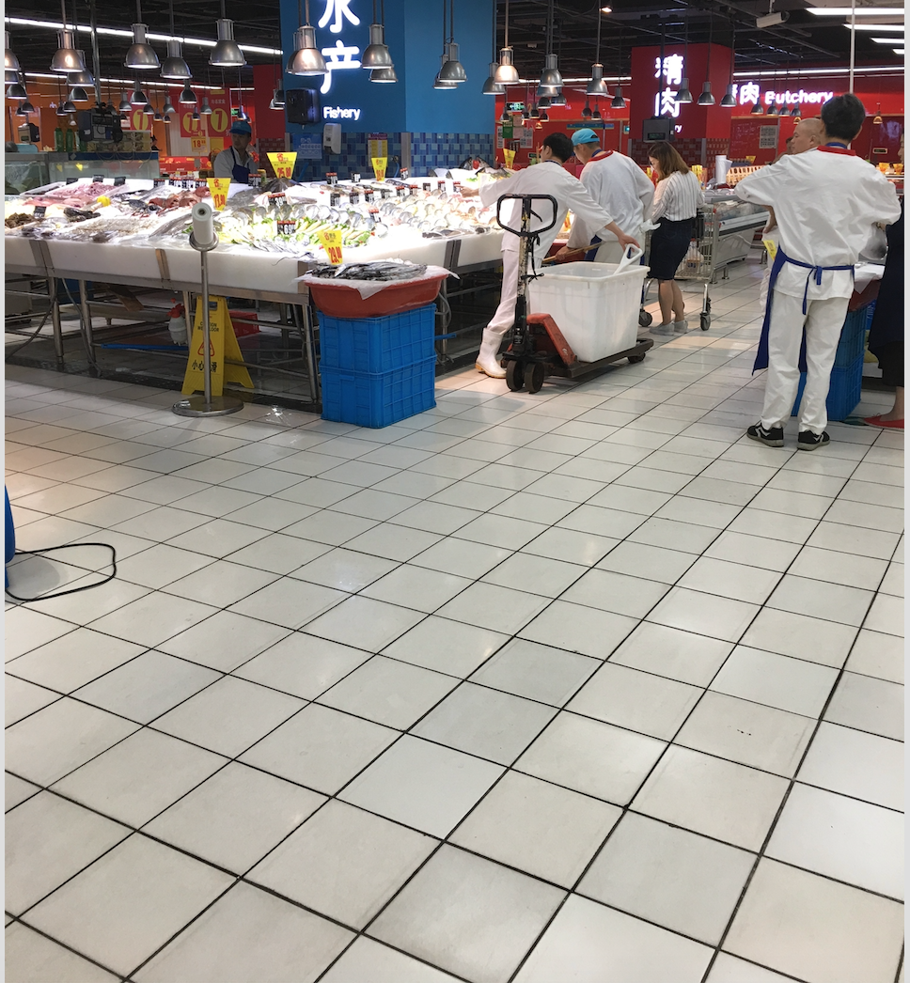
Thanks!

