Slide 1
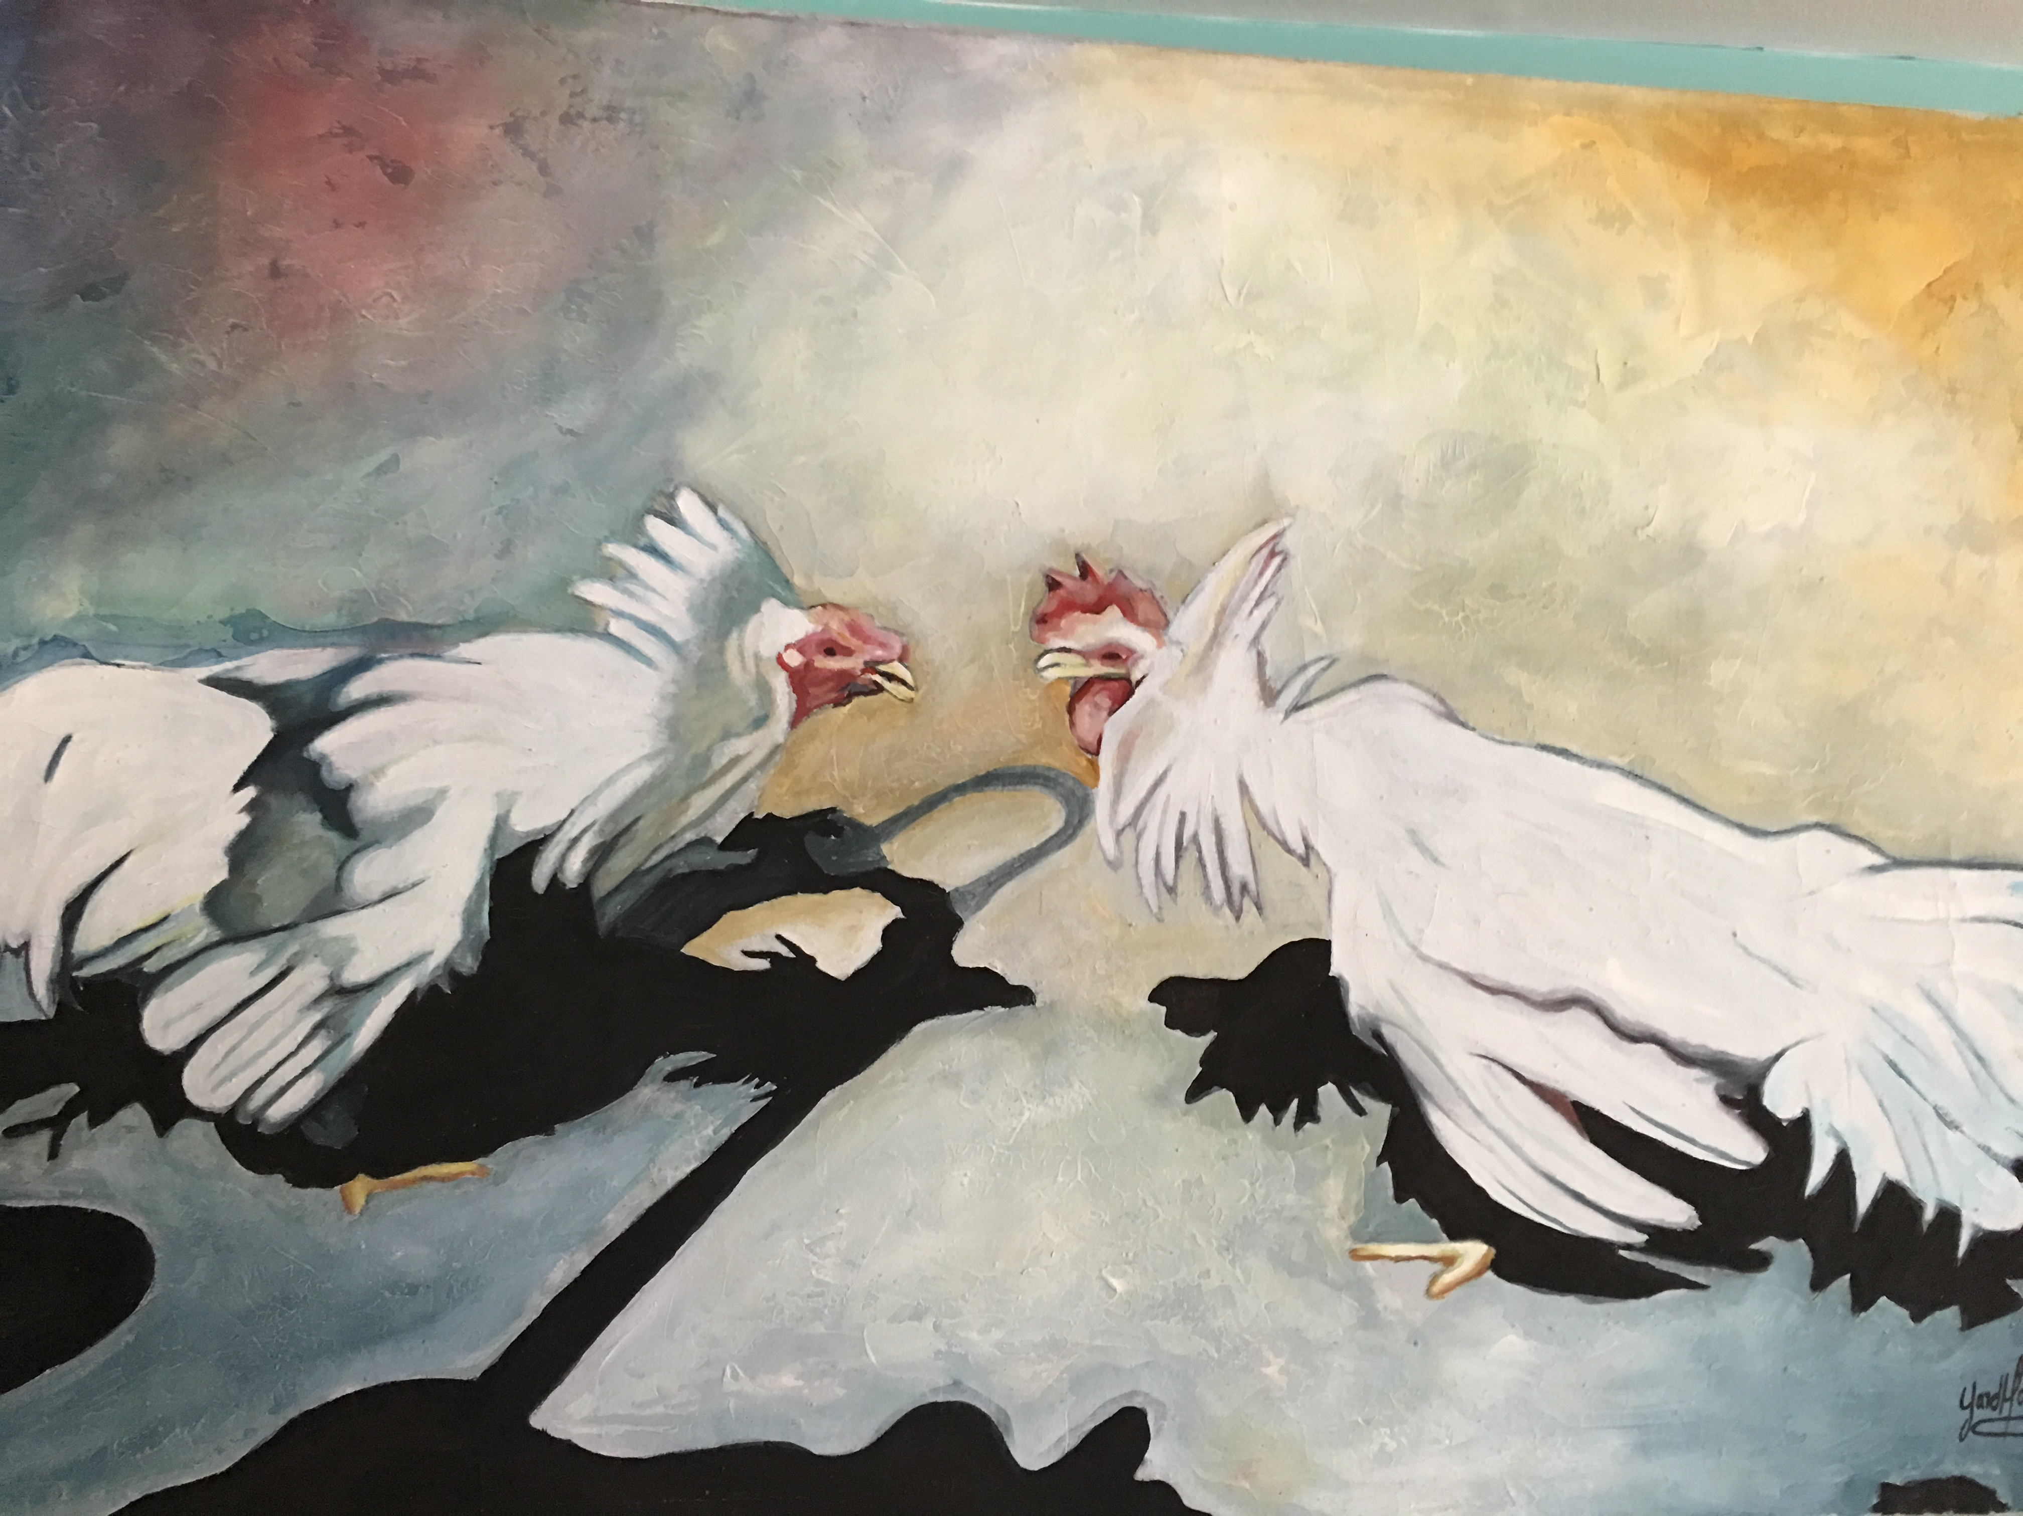
Governance Polycentrism--Hierarchy and Order Without Government in Business and Human Rights Regulation
Seminar for the University of Manchester; Alliance Manchester Business School,
Manchester, UK.
12 October 2017
Larry Catá Backer
W. Richard and Mary Eshelman Faculty Scholar and Professor of Law and International Affairs, Pennsylvania State University
lcb911@gmail.com

Slide 2
Context: Out of Order . . . Anarchy
1940’s. 1970’s: System building From the Rubble of Nationalism
The culmination of the drive toward a global order made up of a community of law-states
The greatest fruit of that drive was globalization
Public (rise of autonomous regulatory public international bodies WTO, Regional Human Rights Courts, etc)
Private (great economic and social organs)
Globalization Turns on the states that fostered it
produce a reality of economic and social interactions beyond the ability of any single political system to control; or even of the international community, given the premises on which it operated
Consequences; whither the ancien regime?
Proliferation of non-state governance orders and “legal” regimens
Crisis of legitimacy (specific and systemic); e.g. democratic deficit and “responsibility” based legalities
Counter-revolution led by states and their allies (and a nostalgia for the simplicities of the old order)

Slide 3
Out of Anarchy, Order?
A new reality:
Collisions of governance orders with overlapping jurisdictions and expanding ambitions
Regime collisions are messy;
Are they marks of institutionalized deviance, an ordered anarchy? Or are they marks not of but (temporary) disequilibrium in search of a steady state or a pathology in need of the therapeutic?
Heterodox Governance regimes can be tamed?
comforting to transpose the premises and habits of law and law-state systems (including its systems of justifications and legitimacy) onto emerging governance regimes

Slide 4
Issue: How to Order Collisions
Purpose of essay:
Impacts on law and business
to consider the issue of collision within the elaboration of governance frameworks touching on the human rights impacts of economic activity by states, enterprises and individuals.
FOCUS: framework of Guiding Principles of Business and Human Rights and OECD Guidelines for MNEs
Three pillar framework (states, enterprises, remedies) frames collisions between states, international organizations, enterprises and civil society in their governance roles in distinct `parts of the transnational sphere
Enforcement through OECD “soft” structures

Slide 5
Thesis
the development of governance regimes for the human rights impacts of economic activity suggests:
the way in which non-legal approaches play a crucial role in the creation of structures within which the collisions of polycentric governance, can be managed (but not ordered),
the necessary character of governance as ἄναρχος,
consequently the way in which law (and its principles of hierarchy and unitary systemicity) plays a less hegemonic role, that is, the way in which law has less to contribute toward the governance problem thus posed.

Slide 6
Roadmap
Part I considers the structures and premises of the emerging governance framework built into the Guiding Principles, and its points of collision with law based systems .
Part II considers the ramifications of collision (fragilities and debilitating trends), and the possibilities for systemic equilibrium by reference to three questions suggested by the thesis:
(1) what may be the role of law for the solution of collision problems, and how does that role relate to non-legal regimes?
(2) what may be the role of non-legal approaches to a solution, and how do they relate to law?; and
(3) what might concrete solutions look like .

Slide 7
Carry Out; Take Away
Analysis Points to
necessity of moving away from state-focused legal paradigms, redolent with hierarchy and order, and
to embrace ἄναρχος, an aggregation of systems without rulers but with an order quite distinct from the late feudalism of the law-state system embedded within it

Slide 8
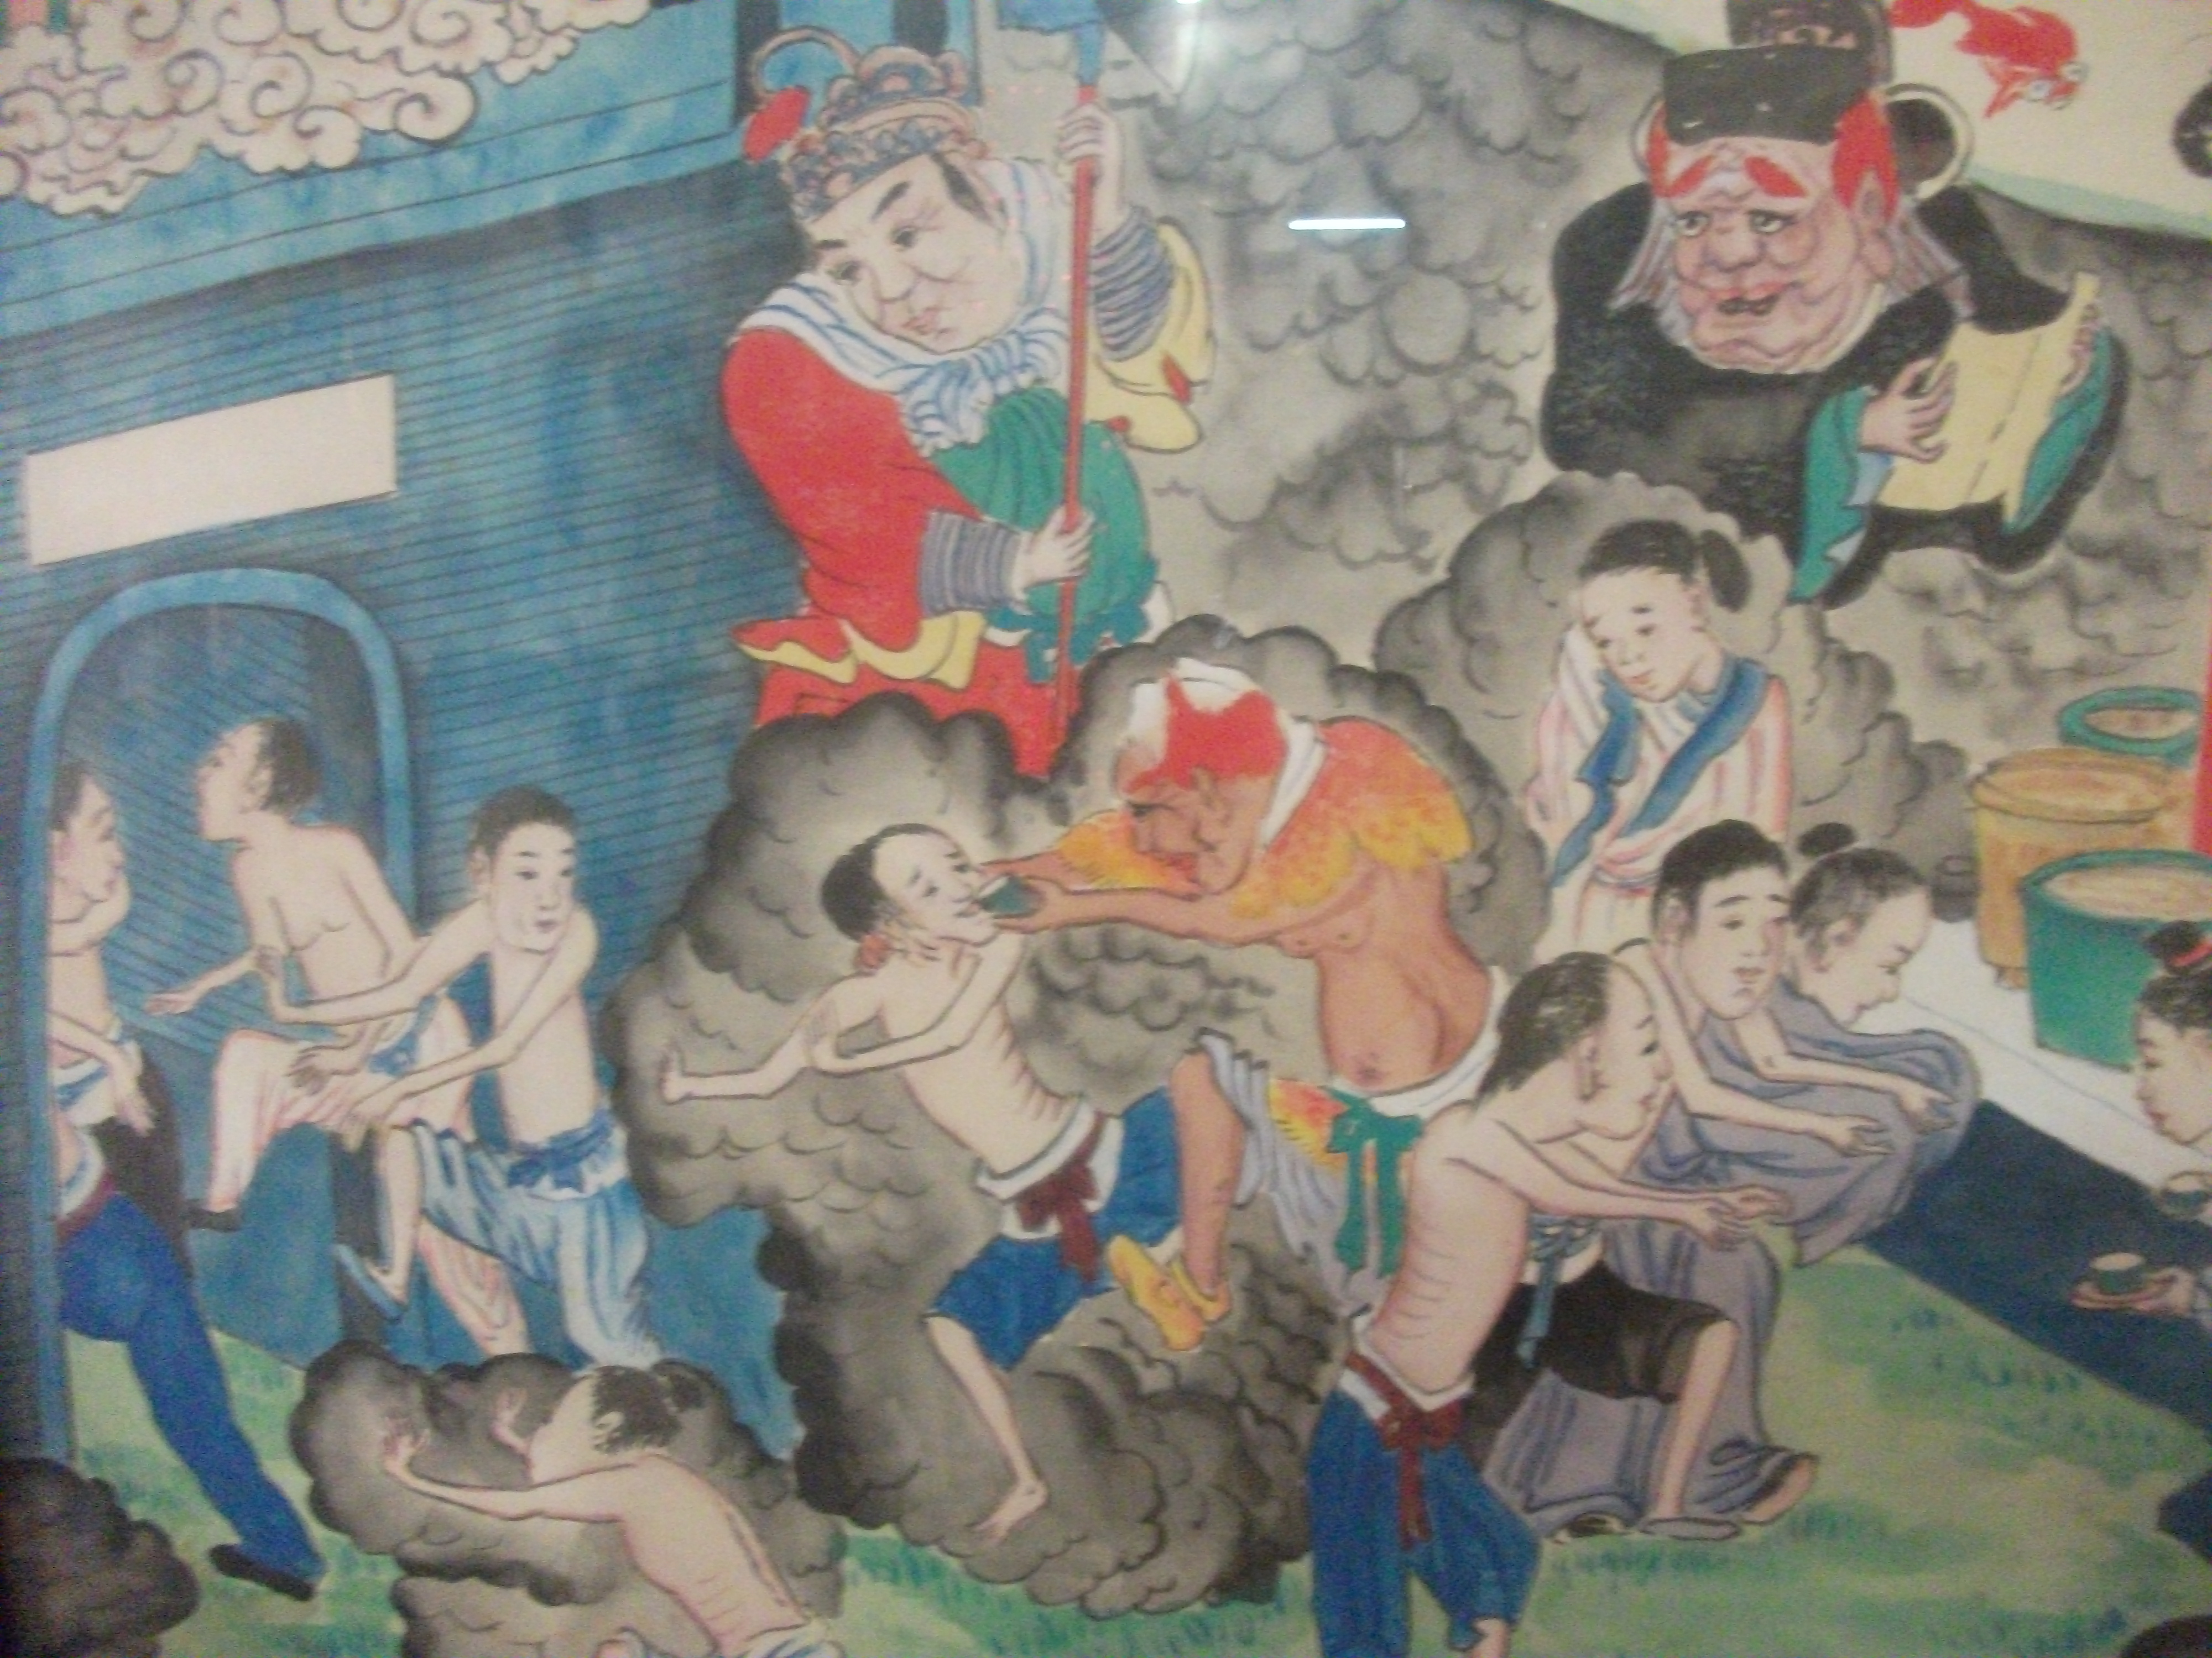
Emerging Governance Framework and Guiding Principles

Slide 9
Human Rights Governance:
An Important Site for Collision
Issues of collisions among heterogeneous governance regimes much in evidence in the context of the adverse human rights consequences of economic activity.
Efforts to mediate collisions between emerging centers of governance that all touch on the human rights impacts of economic activity

Slide 10
Crafting a Self-Referencing Collision Managing Universe: Objectives
capture the essence of the emerging diffusions of governance among distinct political organizations only one group of which are nation-states
Reject traditional approach (the essence of the failed Norms for Transnational Business based) Recognize

Slide 11
Identifying Colliding Spheres
The legal sphere—
based in conventional conceptions of law and its connection to the state and its domestic order
The social sphere—
based in the societally constituted governance organizations (economic enterprises) and the social norms under which it both operates and constitutes
The transnational sphere—
based on the authority of collectives of governance organs (states and non-state actors) to develop rules (international law or transnational social norms)
The incarnate individual
as the object and repository of rights (the remedies problem); avoid abstraction of the objects of these efforts; personal autonomy and data collection/use

Slide 12
Conceptual Framework
establish a framework within which these groups might harmonize their interactions—minimize the friction of their collisions—in the service of a singular objective in three ways
Coherence:
weave together the domestic legal order regimes of states, the societally constituted governance orders of enterprises, and the autonomous multilateral law-norm regimens of international organizations
Coordination:
to intermesh this framework into the internal governance orders of these three groups of regimes
Resolution:
describe a governance space within which remedial projects might be undertaken in the service of the objective

Slide 13
Markets for Management of anarchy
Domestic legal orders;
Civil Society (standards and certification regimes)
Societally constituted MNE governance
International efforts—from failed Norms through Global Compact to Guiding Principles and OECD Guidelines, to Draft BHR Treaty

Slide 14
Managing Collisions of Legal to Societal Norms: Guiding Principles
State duty to protect
International duty embedded in domestic legal order
Each state defines its own relationship to international law Multilateralism
Corporate Responsibility to respect
Defined: International Bill of Rights and ILO Conventions
Includes international law and international norms, grounded in customs and practices
Effectuated through Human Rights Due Diligence
Obligation to provide remedies
State based and non-state based remedial mechanisms
Multilateral non-judicial frameworks encouraged
Coordination between law and policy
U.N. Guiding Principles for Business and Human Rights
Three Pillar framework for elaborating system of human rights consequences of economic activity
No independent enforcement mechanism

Slide 15
Managing Collisions of Legal to Societal Norms: OECD Guidelines
Guidelines: recommendations addressed by governments to MNEs.
They provide principles and standards of good practice consistent with applicable laws and internationally recognised standards.
Observance of the Guidelines by enterprises is voluntary and not legally enforceable.
Cover a number of general areas
transparency/disclosure, human rights, employment/industrial relations, environmental issues, bribery/corruption, consumer protection, technology transfer, anti-competitive schemes, and taxation
Special toolkit for weak governance zones
Extractives and weak governance zones HERE
OECD Due Diligence Guidance: Meaningful Stakeholder Engagement
Complaint procedures through National Contact Points.
Have been used increasingly in two contexts
NGOs to advance international normative agenda
Labor unions to leverage national litigation

Slide 16
Method: Accepting Collision and Anarchy
The SRSG envisioned the creation of a (transnational) space in which the principal actors in the context of the human rights effects of business might align their interests and develop common cultures that is respectful
business imperative to profit (in ways to foster the welfare of its stakeholders including its investors and lenders),
states to govern (in ways that give effect to the democratic will of their respective policies), international organizations (in ways that enhance the elaboration of common norms), and
civil society (in ways that give effect to monitoring and accountability roles).

Slide 17
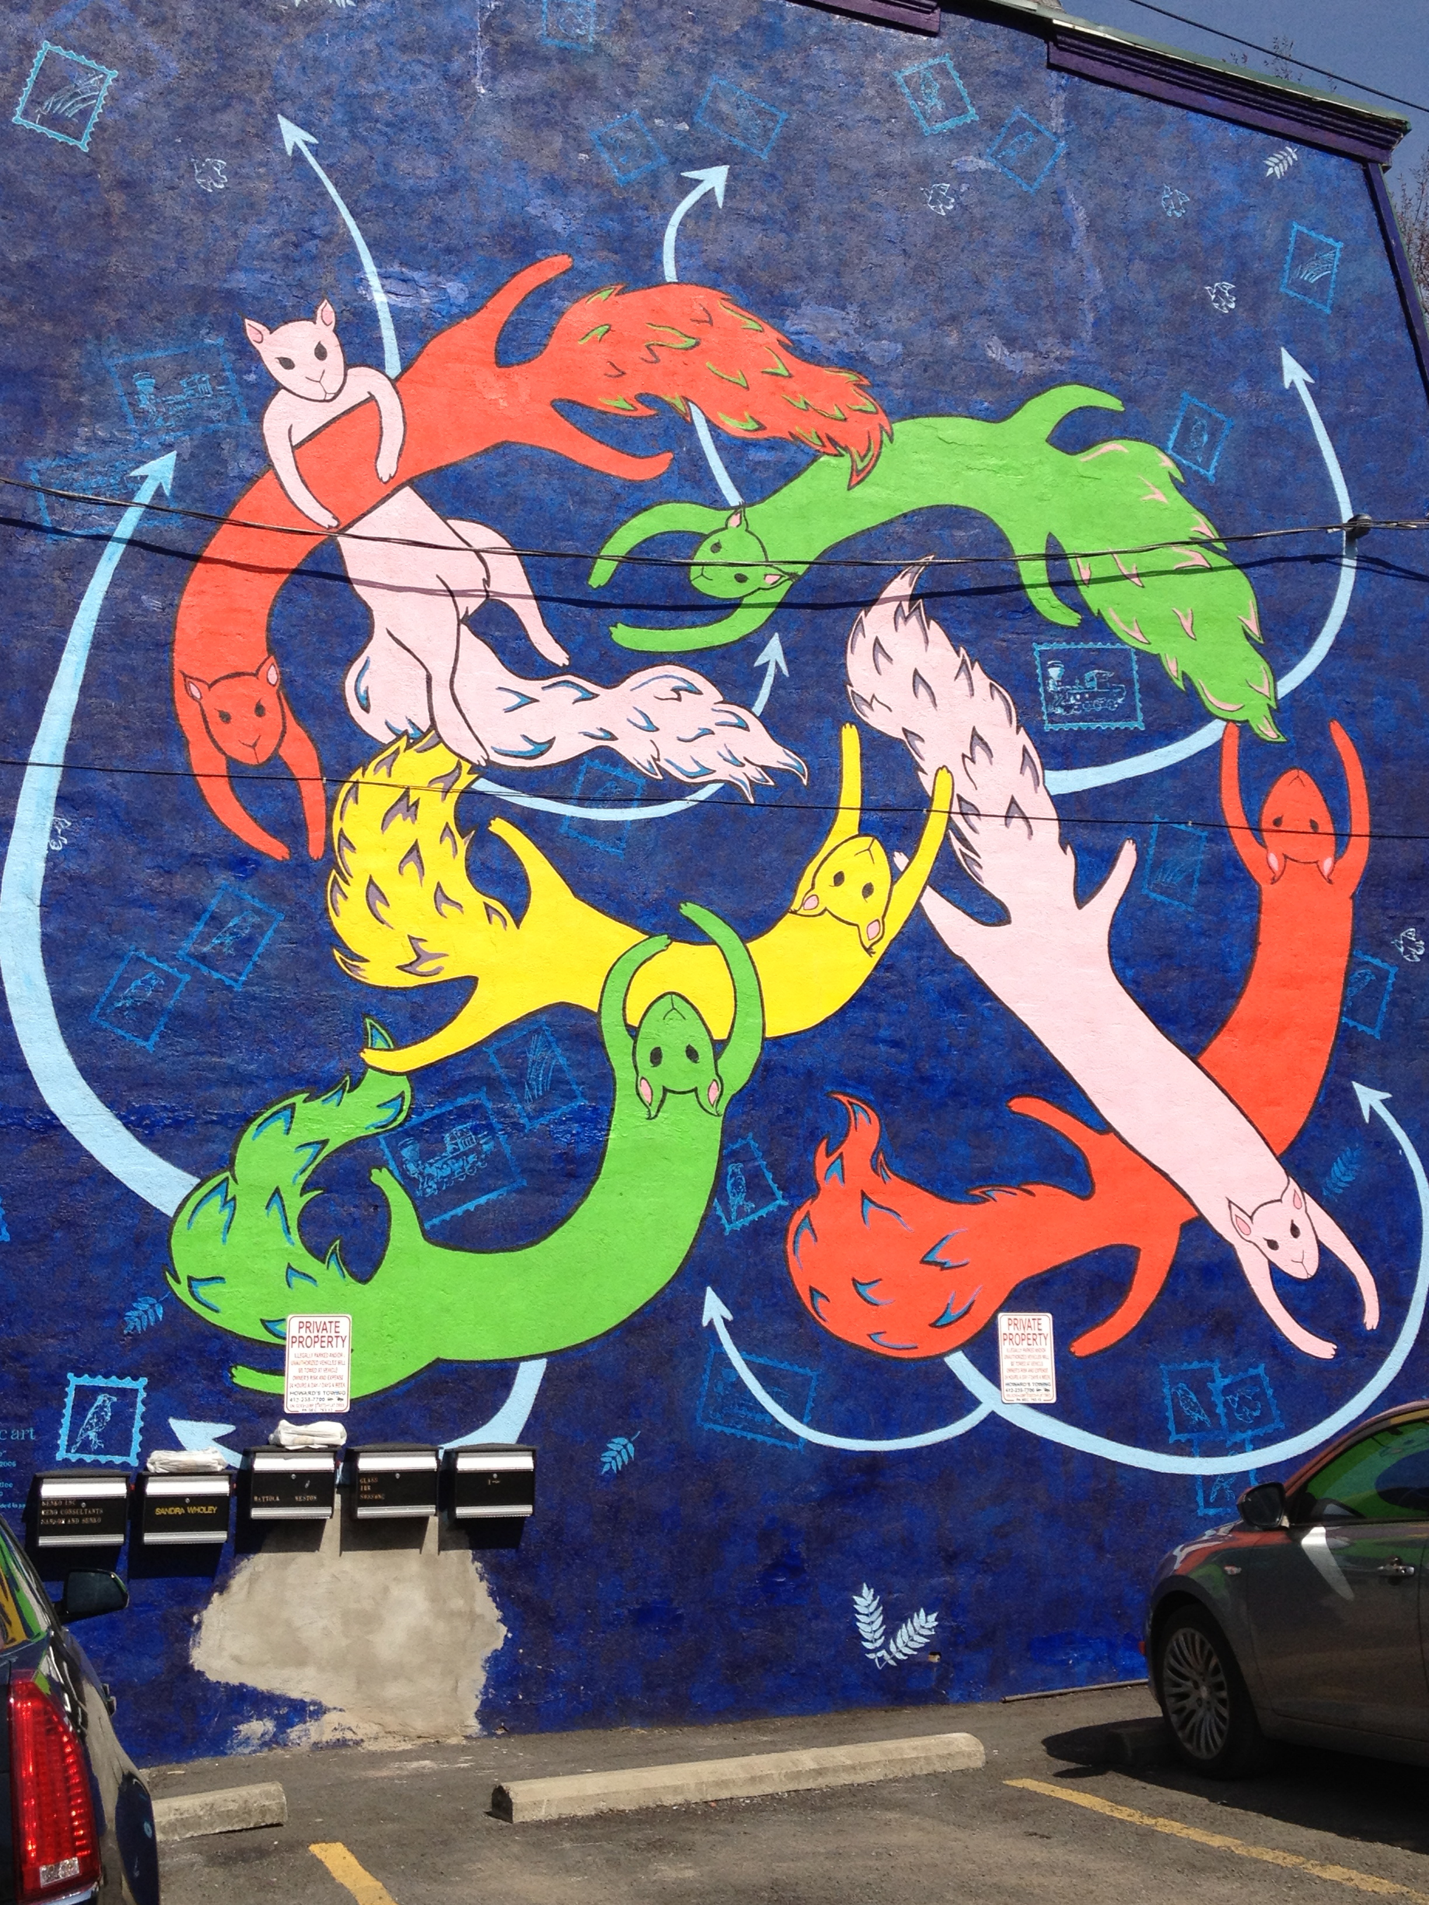
From Out of Disorder. . . .

Slide 18
Realizing Promise of Theory Thru GP System
Provides a common language through which collisions are mediated
Recognizes the autonomy of governance spheres of states and enterprises
Permits fluidity among governance regimes—national, international, contractual, hortatory, legally or societally binding
Hints at superiority of international law as against states and international norms as against societally constituted enterprises
Avoids hyper-rigidity of legal regimes through objectives based functional approach to identifying and mediating consequences of adverse human rights actions effected through a variety of means system
Possibilities are quite fragile.

Slide 19
Fragilities: Fora on Business and Human Rights (2012/13/16/17)
  1st Forum: refocus on the state duty to protect human rights and on traditional/ conventional mechanisms of international law to elaborate a mechanics to that end
  2nd Forum: exposes possibilities of anarchy and disorder
    For states: the focus on extraterritoriality lends itself to the augmentation of the hegemony of those states, some of which tend to be the most skeptical about the GP project
    For businesses: freeing enterprises from the constraints of societally constituted social norms replacing these with a singular obligation to “obey binding law” permits the regulatory fracture within which MNC abuse is strategically compelling.
    Civil society: leaving them to their own devices produces both nihilism and extremism, grounded in principle and passion, that substantially reduces the relevance and effectiveness of civil society efforts except as a power strategy.
      While the interventions of business sought to essentialize the world of governance, and restrict it to its most narrow and traditional jurisdictional bases, civil society interventions sought to fragment discussion to the listing of a litany of highly particularized wrongs in need (and quite rightly to be sure) of redress.
      They also look to law, and thus away form the GP, though either at the national or international level, to avoid or resist human rights obligations as non-legal norms
  5th Forum; the multiple collisions of SOEs and SWFs
    Collision of state duty versus corporate responsibility within the UNGP
    Collision of public power and economic management between law and politics

Slide 20
Debilitating Trends
The first: transformation of the second pillar responsibility to respect human rights (operationalized in part through the GP human rights due diligence mechanics) from a source of privatizing international norms into the culture of corporate activities and the social norm structures of globalized economic activity beyond the state to a mere channel through which the state duty is realized (indirectly) through the corporation.
The second: the emphasis on the state as the center of the GPs might militate in favor of the move toward an adoption of a comprehensive treaty creating an apparatus for specifying (if not remedying) human rights wrongs committed by states and businesses, with little hope of success
The Third: the emphasis on legalization invites the dead end debates about the direct obligations of corporations under international law; a debate that the recognition of the second pillar responsibility to respect was meant in part to make irrelevant.

Slide 21
Consequences of Trends
From force of internalized societal norms to violence of externalized law (imposed from outside)
From societally constituted actors to the class structures and rigidity of the law-state system and its physical borders
From horizontal equality among states to conflict or weak governance zone interventions by states in the name of internationalism but for their interests or those of societally constituted groups acting through them
From the autonomy of international law and norms to its reduction to transnational strategic internationalism as a function of the willingness of a state to incorporate its terms

Slide 22
The Three Questions in Search of Answers: ONE
Which role does the law play for the solution of collision problems?
the GP’s state duty to protect human rights suggest that law both supports impedes solution to collision problems precisely because, by its nature, it invariably seeks to privilege itself over non-law regimes.
Law trips over itself as a manifestation of state power,
But also trips over public international law systems resisting any inversion of legal relationship on which domestic legal orders must give way to an international order construct.

Slide 23
Question 2
How does it relate to non-legal regimes?
the GP’s corporate responsibility to respect offers a more horizontal relationship between law and the societally constituted autonomous regulatory regimes of corporations and other non-state actors.
But that relationship is threatened by the foundational premises of classical law systems.
The logic of these law system premises would seek to subsume societally constituted systems, and the social norms that animate it, within the domestic legal orders of states, or ignore them altogether to the extent they could not be translated into law or harmonized within existing legal norms.

Slide 24
Question 3
What are the non-legal approaches to a solution, and how do they relate to law?
might require independence rather coordination; cooperation rather than the construction of a singular system bounded by law and its idiosyncrasies.
The solution may, indeed, require the rise of a new class of governance facilitator,
something more than a lawyer (bound by the normative cultures of the law-state)
and flexible enough to move between governance cultures.

Slide 25

A Work in Progress

Slide 26
The Big(ger) Picture
The GP-OECD Guidelines framework posits order without hierarchy and the management of collision between three great autonomous governance communities—states, enterprises and public international organizations—whose interactions produce intermeshing around specific normative challenges, but which necessarily resist the hegemony of law.
The resulting framework may not produce unified law, as classically understood, but it may manage ordered interaction among systems in a governance universe without a center (one that in the classical period had been provided by the ideal of “law” and the Rechtsstaat).
But rather than order and the privileging of law, the emerging framework suggests a constitutional framework within which fracture and polycentric co-existence, of short duration, appear to be emerging as the stable state.

Slide 27
Conclusion
First,
law both supports and impedes solution to collision problems precisely because, by its nature, it invariably seeks to privilege itself over non-law regimes.
Second,
the societally constituted autonomous regulatory regimes that, in the absence of the state, can produce increasingly dense networks of jurisprudence with the functional effect of customary law, is threatened by law, which seeks to subsume societally constituted systems, and the social norms that animate it, within the domestic legal orders of states.
Third,
the concrete solution to this collision may well look like the GP-OECD Guidelines framework itself.

Slide 28
Thank You!
Please contact the author for the article on which this presentation is based, Larry Catá Backer, Governance Polycentrism or Regulated Self-Regulation—Rule Systems for Human Rights Impacts of Economic Activity Where National, Private and International Regimes Collide, Contested Collisions: Interdisciplinary Inquiries into Norm Fragmentation in World Society 198-225 (Kerstin Blome, Hannah Franzki, Andreas Fischer-Lescano, Nora Markard and Stefan Oeter, eds., Cambridge University Press, 2016).

