Slide 1
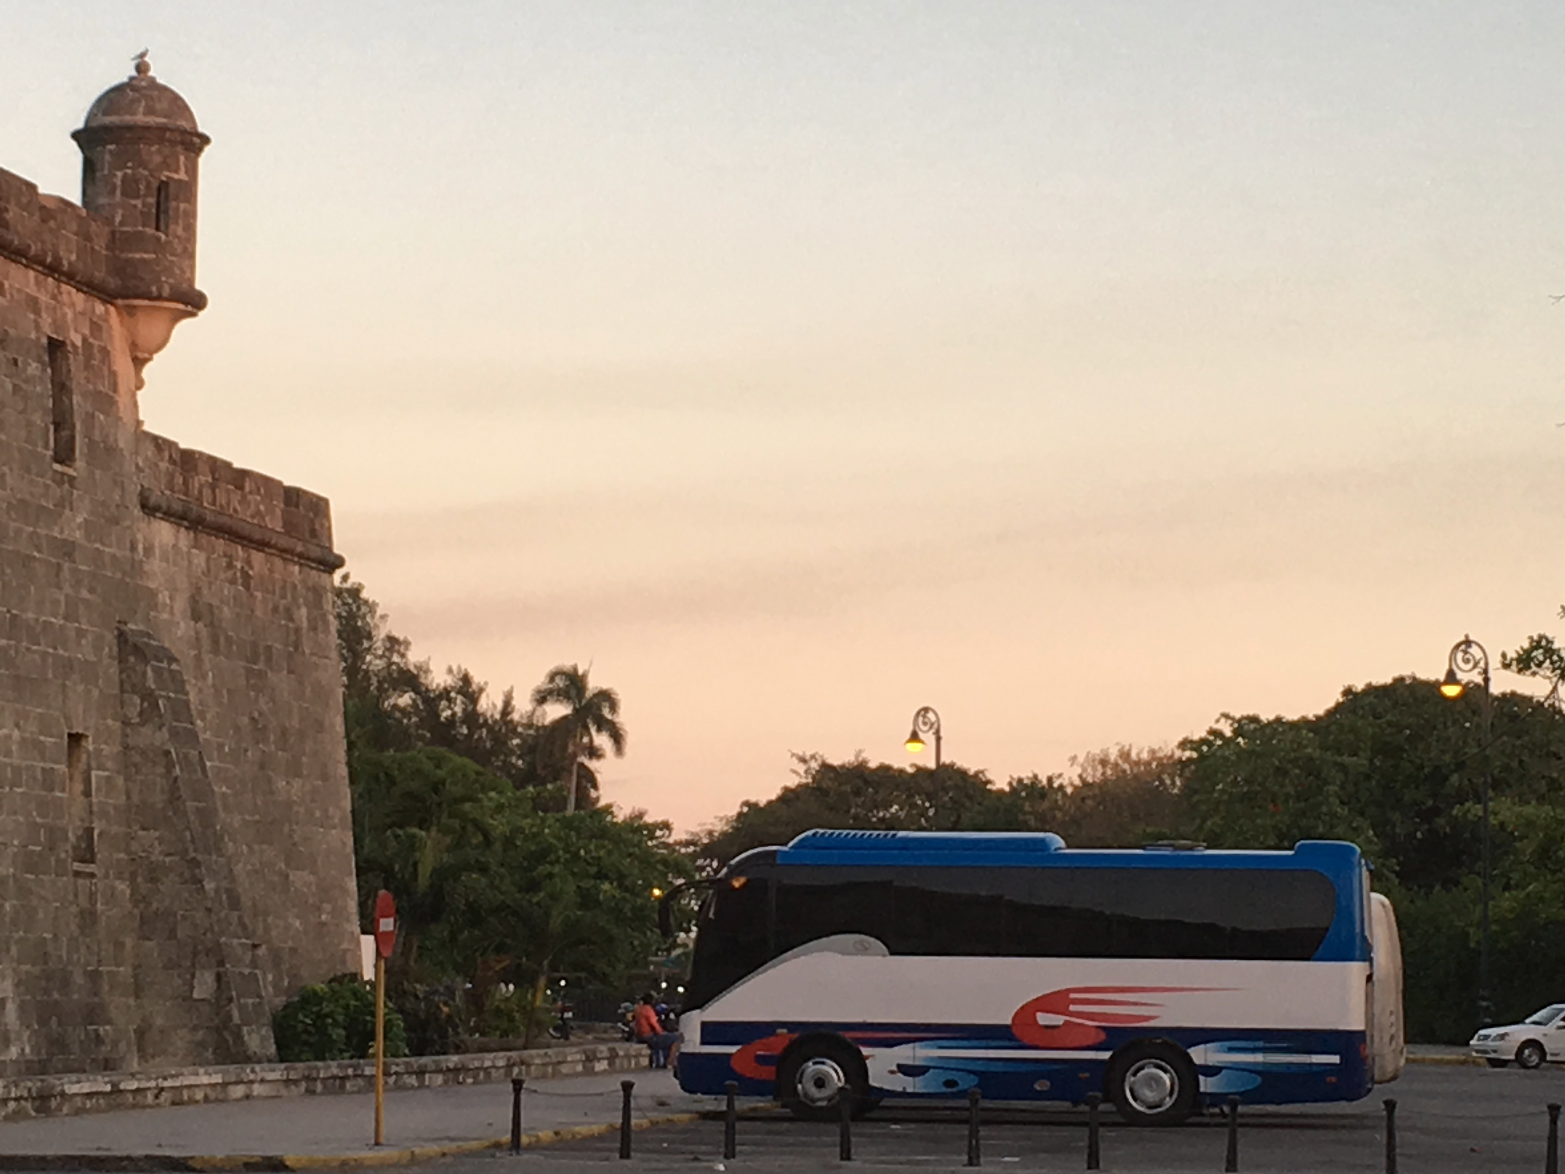
Foreign Investment in Cuba: Law, Policy, and Practicalities
Presenter: Larry Catá Backer,
W. Richard and Mary Eshelman Faculty Scholar; Professor of Law and International Affairs, Penn State Law
Presentation for the
27th Annual Conference Association for the Study of the Cuban Economy
Miami, Florida; 28 July 2017

Slide 2
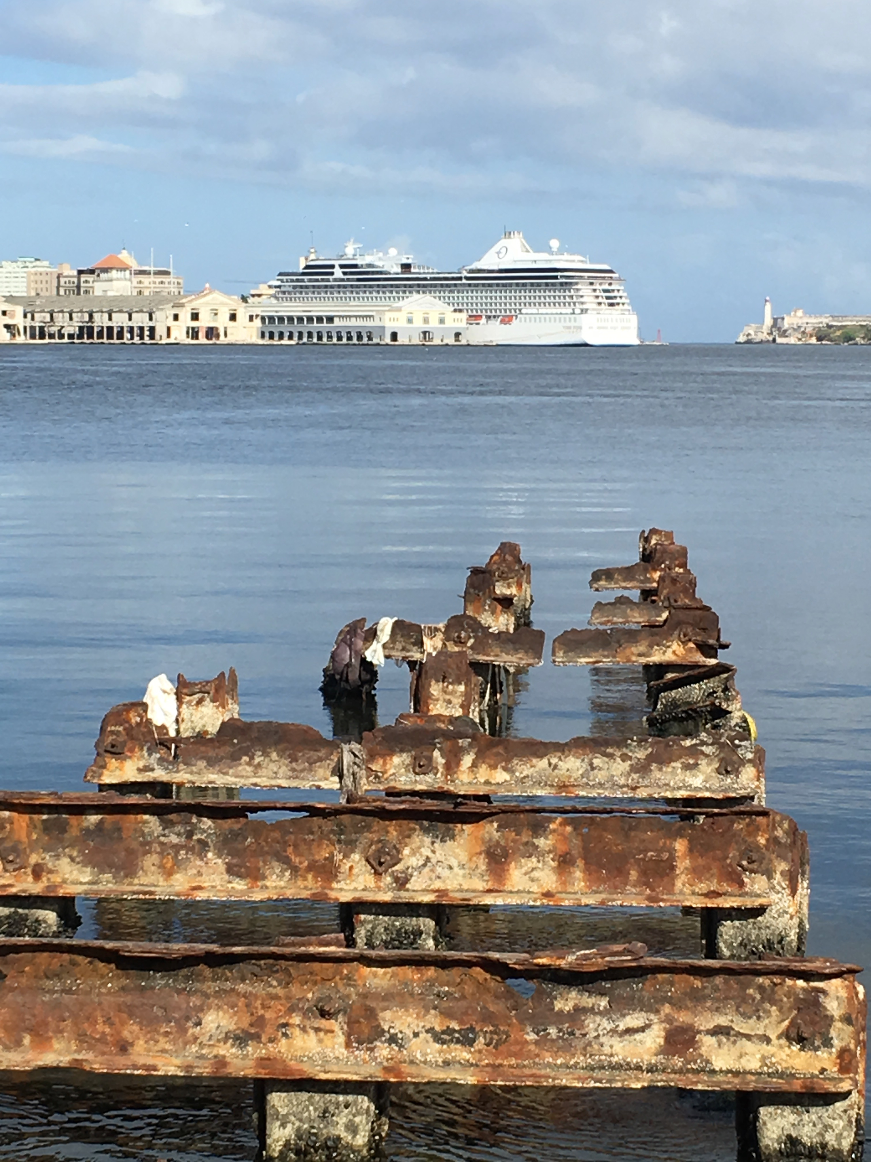
Introduction
Cuba’s 2014 Foreign Investment Law and the dissemination of its annual Portfolio of Opportunities for Foreign Investment are signals that Cuba is open to foreign direct investment.
The U.S. appears to have loosened the sanctions regime it had imposed on Cuba signaling that the U.S. is open to permitting outbound investment.
While Cuba has secured a number of deals, progress on all sides remains slow due to the complexities and uncertainties surrounding legal, policy, liability, and other issues.

Slide 3
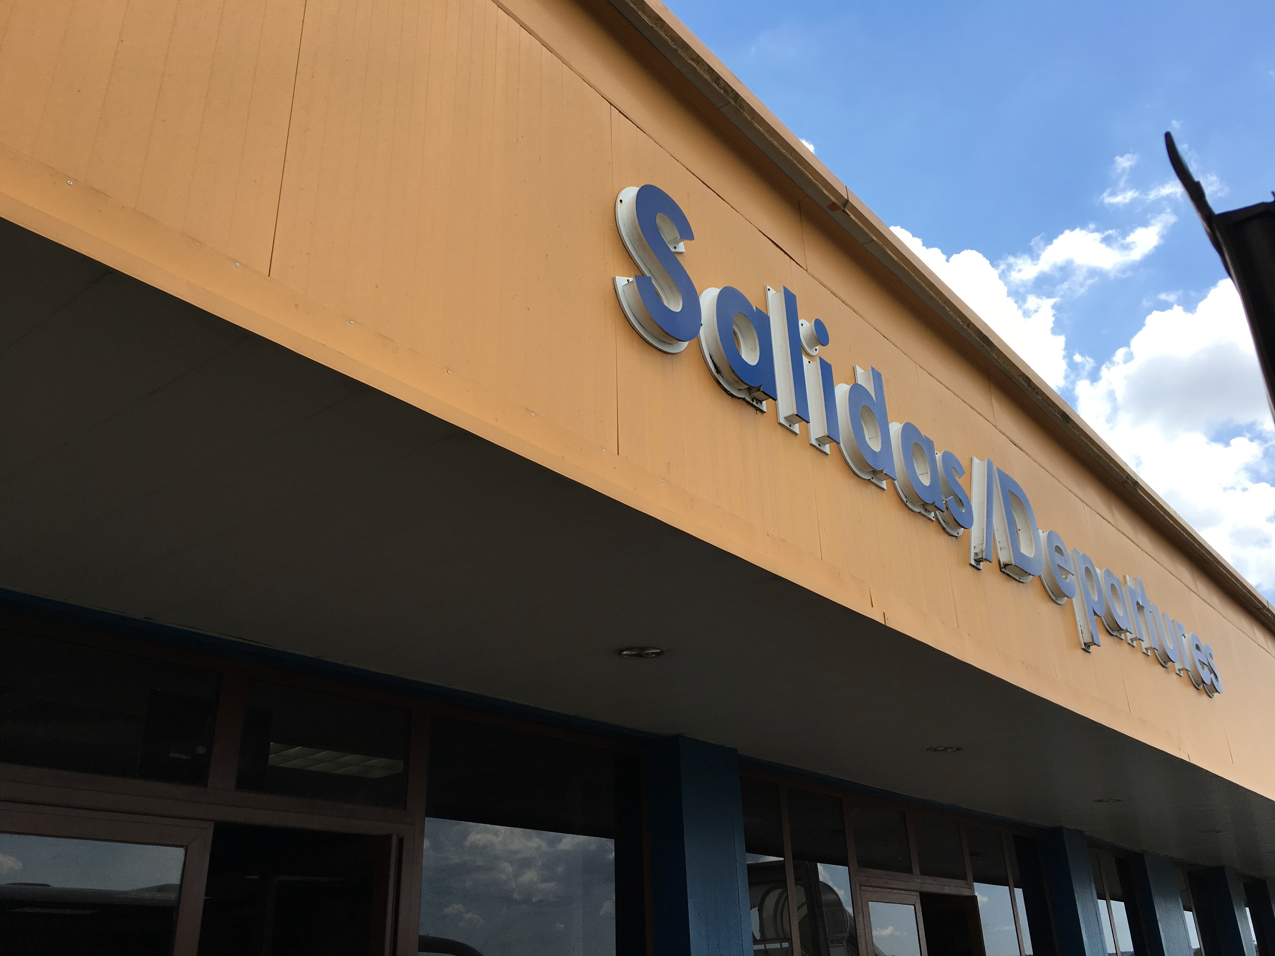
What we Will Cover Today
Context
Legal Sources
  U.S.
  Cuba
The issue of discretion; Corruption
Following a Transaction
  U.S.
  Cuba
Special Economic Zones
The Small Transaction

Slide 4
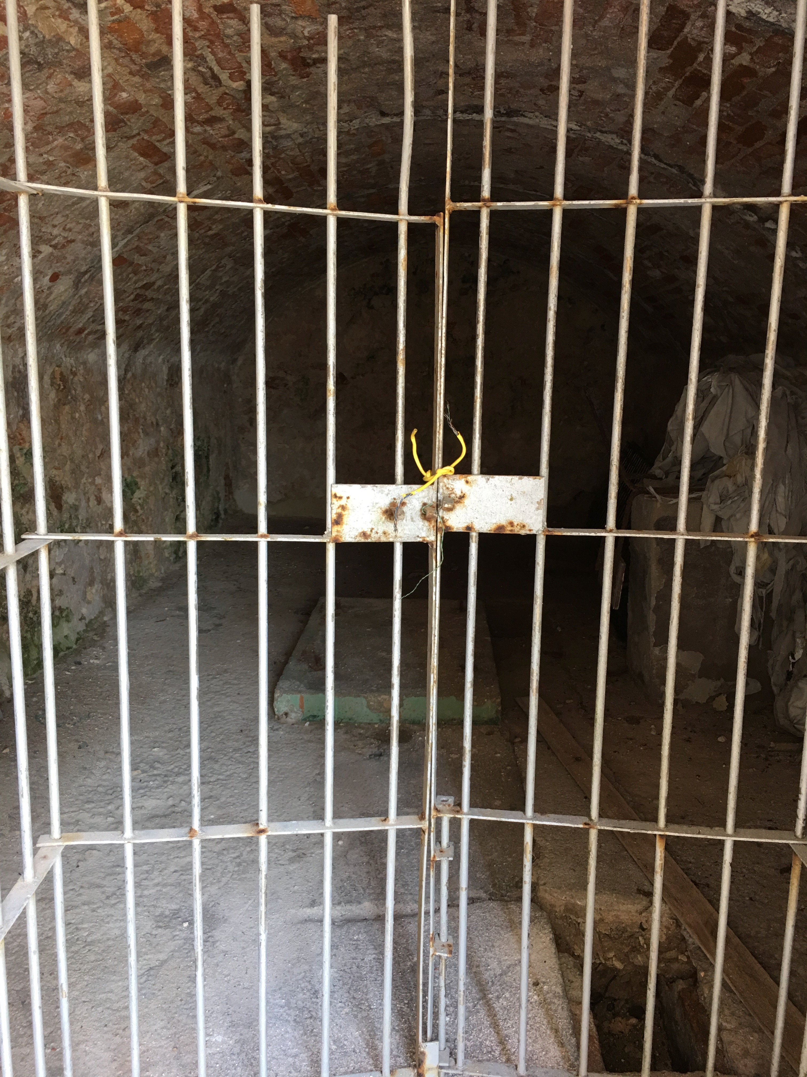
Context
From Revolt to Revolution to sanctions regimes
The cycles of relations 1970s-21st century
  Overtures and reaction
  Sabotage of reconciliation efforts
Moving toward normalization
  Death and transfiguration (changes at the top)
  The power of reaction
    Nomemklaturas in Cuba; Cuban exile power structures
  The power of money (mutually beneficial)
From Normalized relations to normalization
  Economics, societal and political dimensions
  Neither U.S. nor Cuba has split these apart
Creates a unique context for economic activity in globalized markets

Slide 5
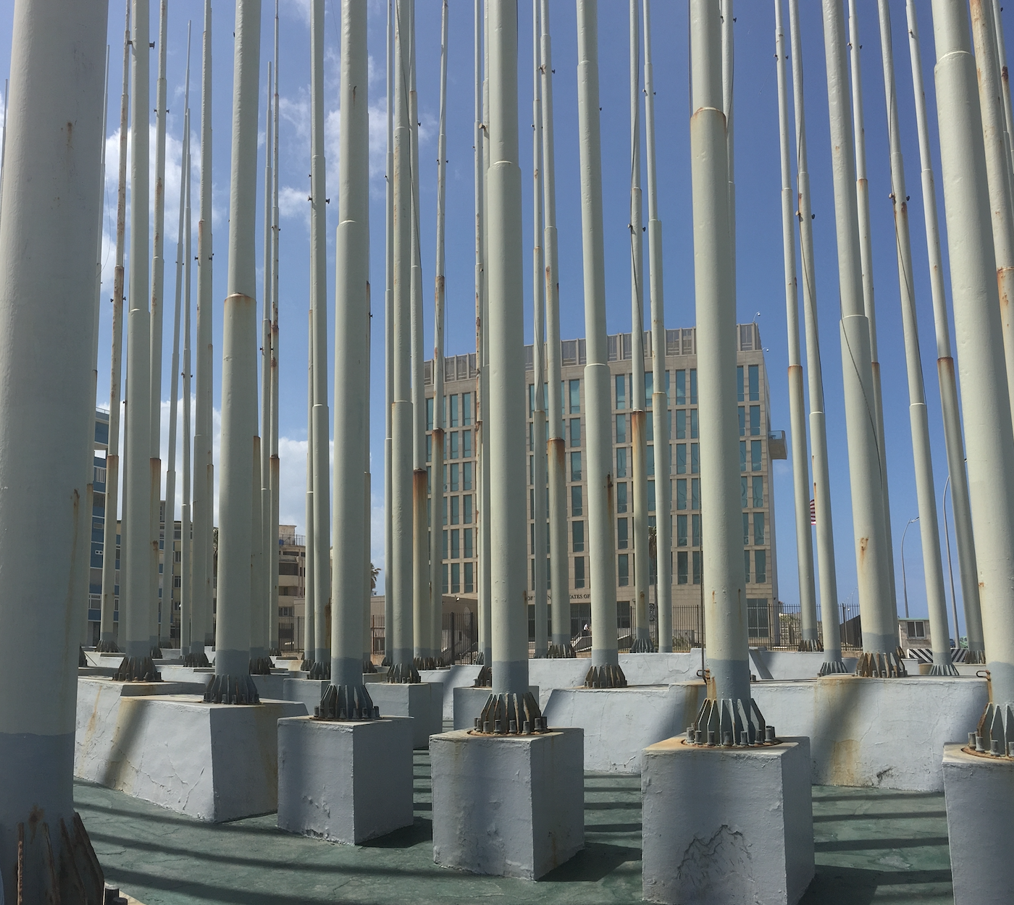
Legal Sources
U.S.
“As required by statute, the United States continues to maintain a trade embargo against Cuba. Only limited categories of items may be exported or reexported to Cuba subject to authorization by Department of Commerce’s Bureau of Industry and Security. These changes implement the policy announced by the President on December 17, 2014, aimed at supporting independent economic activity in Cuba and improving communications by and living conditions for the Cuban people.”
BIS Cuba FAQs II(11).

Slide 6
U.S. Sources
Federal Register Notices
81 FR 71372 ​- October 2016 Amendments to the Cuban Assets Control Regulations
81 FR 13989 - March 2016 Amendments to the Cuban Assets Control Regulations
81 FR 4583- January 2016 Amendments to the Cuban Assets Control Regulations
80 FR 56915 - September 2015 Amendments to the Cuban Assets Control Regulations
80 FR 34053 - Amendment to the Terrorism List Government Sanctions Regulations
80 FR 2291-15 - January 2015 Amendments to the Cuban Assets Control Regulations​​
77 FR 71530-12 - 2012 Amendments to the Cuban Assets Control Regulations​​
76 FR 5072-11 - 2011 Amendments to the Cuban Assets Control Regulations
75 FR 10997-10 - Amendments to authorize certain types of exportation
74 FR 46000-09 - 2009 Amendments to the Cuban Assets Control Regulations​
68 FR 14141-03 - 2003 Amendments to the Cuban Assets Control Regulations
66 FR 36683-01 - Exports of Agricultural Products, Medicines, and Medical Devices to Cuba, Sudan, Libya, and Iran; Cuba Travel-Related Transactions
Trade Sanctions Reform and Export Enhancement Act of 2000 (TSRA), 22 U.S.C. §§ 7201-7211
Antiterrorism and Effective Death Penalty Act of 1996 (AEDPA), 18 U.S.C. § 2332d
Cuban Liberty and Democratic Solidarity (Libertad) Act of 1996, 22 U.S.C. §§ 6021-6091
Cuban Democracy Act of 1992 (CDA), 22 U.S.C. §§ 6001-6010
Sections 5 and 16 of the Trading With the Enemy Act (TWEA), 50 U.S.C. App. §§ 5, 16
Code of Federal Regulations
31 CFR Part 515 - Cuban Assets Control Regulations FAQs
Federal Register Notices
  OFAC publishes a list of individuals and companies owned or controlled by, or acting for or on behalf of, targeted countries. Collectively, such individuals and companies are called "Specially Designated Nationals" or "SDNs." Their assets are blocked and U.S. persons are generally prohibited from dealing with them. CUBA SDN LIST:
Export Administration Regulations (EAR) (15 CFR Parts 730-774) (Commerce Dept: Bureau of Industry and Security) FAQs

Slide 7
It’s All About Licensing
Most export or reexport transactions require general or specific authorizations from both BIS and OFAC. OFAC has issued a general license authorizing all transactions ordinarily incident to the exportation of items from the United States, or the reexportation of 100 percent U.S.-origin items from a third country, to any person in Cuba, provided that the exportation is licensed or otherwise authorized by BIS. (Info HERE)
According to OFAC, “[a] license is an authorization from OFAC to engage in a transaction that otherwise would be prohibited.” (OFAC FAQ)
  A general license authorizes “a particular type of transaction for a class of persons without the need to apply for a license.”
  A specific license “is a written document issued by OFAC to a particular person or entity, authorizing a particular transaction in response to a written license application.”
If the proposed license involves exports, BIS may participate in the process.
Discretionary determinations;
  OFAC broadly states that its licensing determinations are “guided by U.S. foreign policy and national security concerns” and may involve coordination with other federal agencies, including the U.S. Department of State and the U.S. Department of Commerce.¨
License usually takes several weeks to several months to process and may require changes in participants or plans (OFAC Licensing, Background Briefing, March 2013).

Slide 8

And Financing
Since Normalization OFAC restrictions lifted on payment and financing terms for authorized exports and re-exports to Cuba.
  U.S. banks will be authorized to provide financing by third-country or U.S. financial institutions
    letters of credit,
    Advance cash payment,
    sales on an open account.
Exception: Trade in Agricultural products
  limited to cash in advance or
  financing by third-country banks

Slide 9
OFAC
A summary description of each particular embargo or sanctions program may be found in the Sanctions Program and Country Summaries area and in the Regulations by Industry area on OFAC's website.
The text of Legal documents may be found in the Legal Documents area of OFAC's website which contains the text of 31 C.F.R. Chapter V.
U.S. persons must comply with OFAC regulations, including all U.S. citizens and permanent resident aliens regardless of where they are located, all persons and entities within the United States, all U.S. incorporated entities and their foreign branches.
The Office of Foreign Assets Control administers and enforces economic sanctions programs primarily against countries and groups of individuals, such as terrorists and narcotics traffickers. The sanctions can be either comprehensive or selective, using the blocking of assets and trade restrictions to accomplish foreign policy and national security goals.

Slide 10
Bureau of Industry and Security (BIS)
What is the difference between EAR99 and NLR?
EAR99 is a classification for an item. It indicates that a particular item is subject to the Export Administration Regulations (EAR), but not listed with a specific Export Control Classification Number (ECCN) on the Commerce Control List (CCL). While the classification describes the item, the authorization for shipment of that item may change, depending on the transaction.
NLR is the designator of a transaction that stands for the "No License Required" authorization. NLR may be used for either EAR99 items, or items on the CCL that do not require a license for the destination in question, provided no General Prohibitions apply. (US Export Compliance FAQs)
“However, if your proposed export of an EAR99 item is to an embargoed country, to an end-user of concern or in support of a prohibited end-use, you may be required to obtain an export license.” (BIS FAQs).
There are various lists that may be relevant to your export or reexport transaction such as the Denied Persons List and Entity List )Ibid).
“The Bureau of Industry and Security (BIS) implements and enforces the Export Administration Regulations (EAR). The EAR regulate the export and reexport of most commercial items, and some military items. Many items that BIS regulates are referred to as “dual-use” because they have both commercial and military or proliferation applications, but some military items, and purely commercial items without an obvious military use also are subject to the EAR.” (BIS FAQs) ,
Other U.S . Government agencies have export control responsibilities for regulating more specialized exports. . . . OFAC administers and enforces economic and trade sanctions against targeted foreign countries.” (Ibid).
BIS FAQs on CUBA.

Slide 11
BIS Levels of Review
general policy of denial
  There is a general policy of denial for exports and reexports to Cuba of items subject to the Export Administration Regulations (EAR), 15 CFR §746.2(b) including
    for use by state-owned enterprises, agencies, or other organizations of the Cuban government that primarily generate revenue for the state
    items destined to the Cuban military, police, intelligence and security services remain subject to a general policy of denial
EXCEPTIONS:
Case by Case basis 15 CFR §740.2(b)(3)
  Exports to Cuban Government Agencies Meeting the Needs of the People.
    (1) items for construction of facilities for public water
    treatment, electricity or other energy; (2) sports and recreation; (3) agricultural production; (4) food processing; (5) disaster preparedness, relief and response; (6) public health and sanitation; (7) residential construction and renovation; (8) public transportation; (9)wholesale and retail distribution for domestic consumption by the Cuban people; and (10) artistic endeavors.
General Policy of Approval 15 CFR §740.2(b)(1) and (2)
  (1) medicines subject to exceptions; (2) Environmental protection items: (3) Telecommunications items (4) Civil aviation and commercial aircraft safety items: (5) Agricultural items (insecticides, pesticides, and herbicides, as well as tractors and other farm equipment) not eligible for License Exception AGR; (6) Commodities and software to certain NGOs involved in regime change, (7) U.S. news bureaus in Cuba whose primary purpose is the gathering and dissemination of news to the general public.
License Exceptions 15 CFR § 740.1
  an authorization contained in this part that allows you to export or reexport under stated conditions, items subject to the Export Administration Regulations (EAR) that would otherwise require a license under General Prohibition One,
  BIS, Support for the Cuban People License Exception 15 CFR §. 740.21(b)

Slide 12
OFAC AND BIS
The Cuba sanctions program represents the implementation of multiple legal authorities.
Both the Department of Commerce’s Bureau of Industry and Security (BIS) and the Department of the Treasury’s Office of Foreign Assets Control (OFAC) administer Cuba sanctions.
Regulatory sources
  pursuant to the Export Administration Regulations (EAR) (15 C.F.R. Parts 730-774) and
  the Cuban Assets Control Regulations (CACR) (31 C.F.R. Part 515), respectively. (Source)
Other sources of these authorities are in the form of executive orders issued by the President.
Other authorities are public laws (statutes) passed by The Congress.
These authorities are further codified by OFAC in its regulations which are published the Code of Federal Regulations (CFR).
Modifications to these regulations are posted in the Federal Register. (Source)

Slide 13
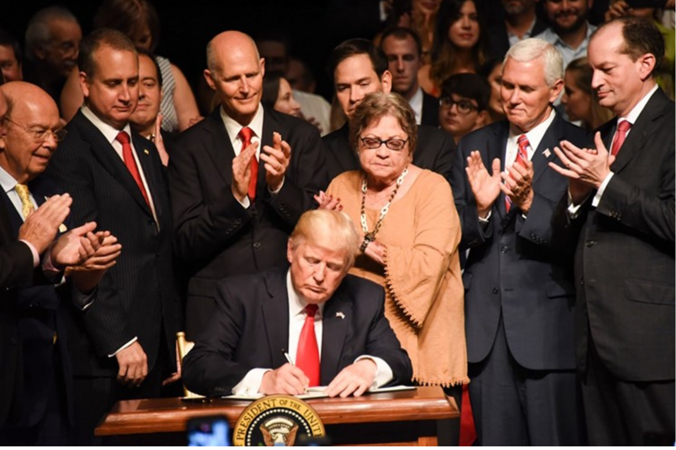
Potential Changes in U.S. Trade Policy
the Remarks by the President on the Policy of the United States Toward Cuba (delivered in Miami June 16th);
White House Background Briefing of June 15, 2017;
Department of the Treasury Office of Foreign Assets Control (OFAC) Frequently Asked Questions on President Trump’s Cuba Announcement;
National Security Presidential Memorandum on Strengthening the Policy of the United States Toward Cuba,
  New Regs to be issued September 2017

Slide 14
National Security Presidential Memorandum
Section 1 Objectives
  Encourage regimes change
  Protect national security
Section 2 Policy
  ending "economic practices that disproportionately benefit the Cuban government or its military, intelligence, or security agencies or personnel at the expense of the Cuban people”
  Tourism: "Ensure adherence to the statutory ban on tourism to Cuba” AND "Amplify efforts to support the Cuban people through the expansion of. . . lawful travel”
  (1) advancing Cuban human rights; (2) encouraging the growth of a Cuban private sector independent of government control; (3) enforcing final orders of removal against Cubans in the U.S.; (4) protecting U.S. national security and public health and safety through proper engagement on criminal cases and the return of fugitives from American justice; (5) supporting U.S. agriculture and protecting plant and animal health; (6) advancing the understanding of the U.S. regarding scientific and environmental challenges; and (7) facilitating safe civil aviation.
Section 3 Implementation
  “adjust regulations
  “identify the entities or subentities, as appropriate, that are under the control of, or act for or on behalf of, the Cuban military, intelligence, or security services or personnel (such as Grupo de Administracion Empresarial S.A. (GAESA), its affiliates, subsidiaries, and successors), publish a list of those identified . . . with which direct financial transactions would disproportionately benefit such services or personnel at the expense of the Cuban people or private enterprise in Cuba.” and prohibit direct financial transactions with those entities or subentities UNLESS a waiver is granted by SecCom.
  Travel: For education or to “support the Cuban people.”
    shall keep full and accurate records of all transactions related to authorized travel, regardless of whether or not effected pursuant to license, and such records shall be available for examination for at least 5 years after the date they occur.
  “SDN List” broadened
  Project internet and info access

Slide 15
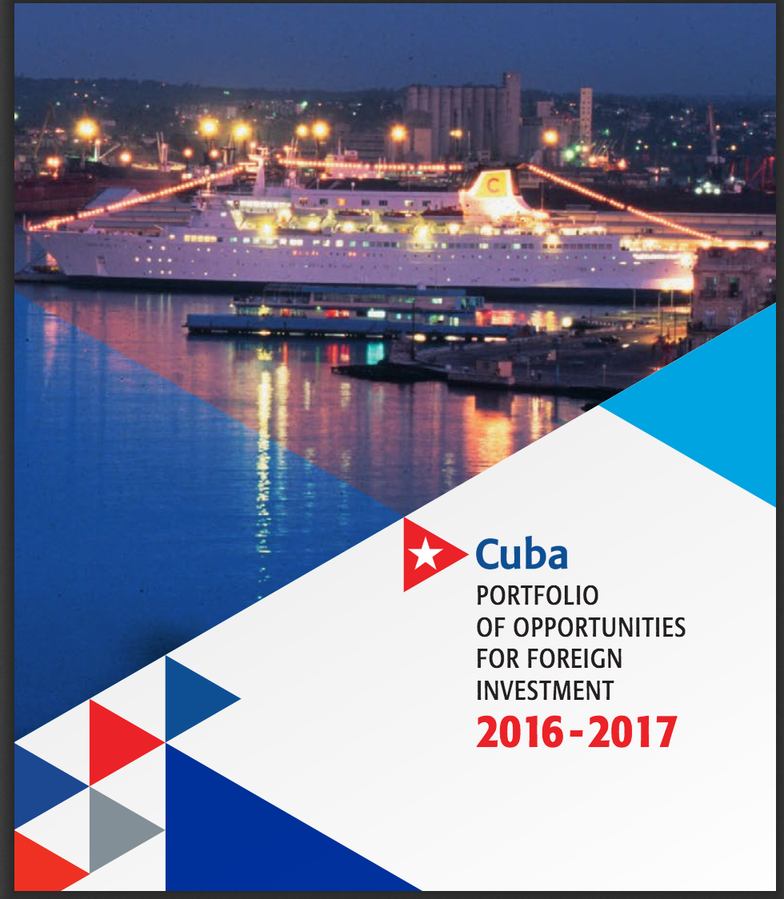
Cuba Sources
--Investment Climate; Political ideology of economic planning
--Ideological Elements
--Strategic Themes
--General Principles of Foreign Investment
--Cuba Legal Sources
--Legal Framework for Investing
--Investment Opportunities managed by the State
--The Issue of Discretion, Chilling Effects and Transaction Costs, and Corruption
--Following a Transaction
--Special Economic Zones
--The Small Transaction

Slide 16
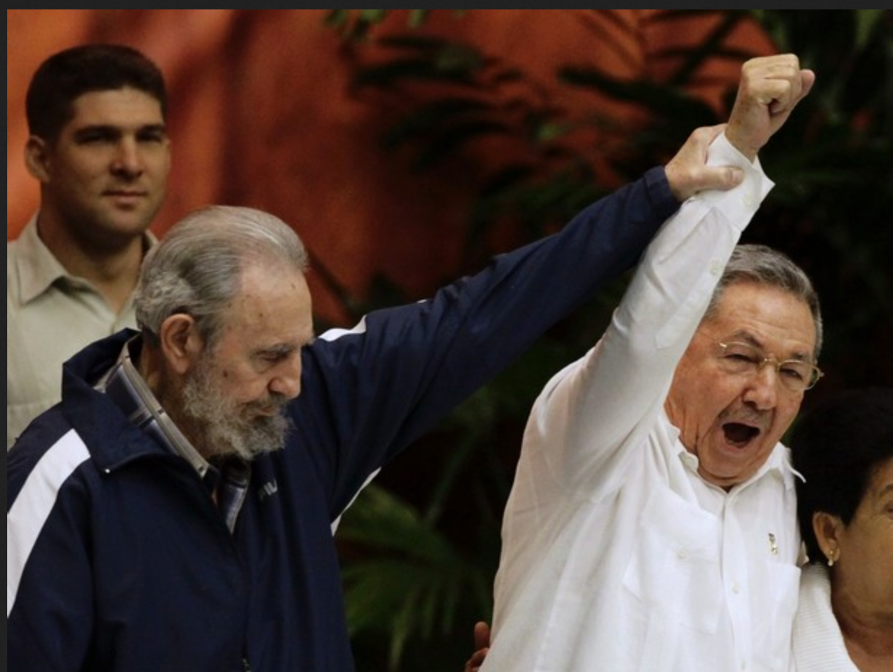
Investment Climate: Political Ideology of Economics
7th Cuban Communist Party Congress
  Conceptualización del modelo económico y social Cubano de desarrollo socialista: Plan nacional de desarrollo económico y social hasta 2030: Propuesta de vision de la nación, ejes y sectores estratégicos
    Political foundations of economic planning
    Economic plan through 2030
6th PCC Congress
    Lineamientos de la Política Económica y Social del Partido y la Revolución (2011) (Tabloide (Commentary))
      Blueprint for reform
Pix Source HERE

Slide 17
Ideological Elements
All investment must protect and develop the socialist system of Cuba under the leadership of the Communist Party
State to state and state to enterprise relations are prioritized; investments in non state sector tightly controlled
Markets and markets culture are rejected in favor of planning where the state substitutes its judgments for market
Economic development must serve to develop political and societal objectives.
El sistema de plani cación socialista continuará siendo la vía principal para la di- rección de la economía nacional, y debe transformarse en sus aspectos metodológicos, organizativos y de control. La plani cación tendrá en cuenta el mercado, in uyendo sobre el mismo y considerando sus características.
Lineamientos 2011

Slide 18
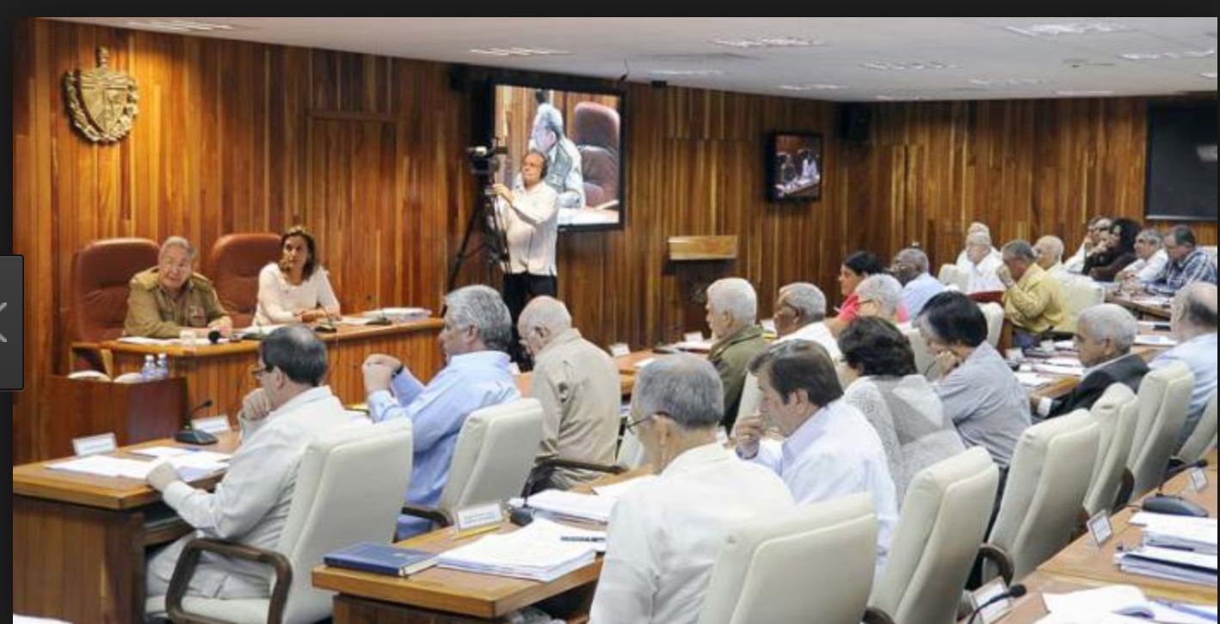
Strategic Themes Cuba Vision 2030
1) efficient and socialist government and social integration (¶¶49-77),
(2) transformation and internationalization of production (¶¶ 78-101),
(3) infrastructure development (¶¶ 102-129),
(4) developing human potential through science, technology and innovation (¶¶ 130-157),
(5) development of natural resources and environmental concerns (¶¶ 158-184), and
(6) human development, equality and justice (¶¶ 185-220).
These are meant to serve as the qualitative categories through which development will be structured (¶ 46).
Around these six strategic themes, PNDES establishes 22 general objectives and 106 specific objectives (¶ 47) that constitute the bulk of the rest of the Plan.
All of these are tied to the Lineamientos (¶ 46) and the efforts at modernization and preservation that has marked the policies of the Cuban state since the elevation of Raul Castro as First Secretary of the PCC.
Meeting Council of Ministers, Source, Havana Times, “Cuba Announces Economic Re-Adjustments” (May 2017)

Slide 19
General Principles of Foreign Investment
FDI Principles
  Guided toward export sector
  Guided toward prioritized sectors
  Utility as complements to national development
  Foster technology transfer or food security
  Market guarantees for exports of goods and services
  Cuban majority participation in certain sectors
  Infrastructure
  FDI partner to assume cost overruns
  Foreign investment may be directed selectively towards development of non-state ownership forms with juridical personality, prioritizing the cooperative sector.
  2018 Projections down:
    “Cuba’s Minister of Economy and Planning, Ricardo Cabrisas. . . referred to the need to prioritize “support for production levels and investments linked to exports, substitutes for imports, development programs and infrastructure to meet the needs of the tourism sector; food production and imports; an increase in producing building materials and agricultural supplies; and assuring education, health care, and other basic services for the Cuban people.” “Cuba Announces Economic Re-Adjustments” (May 2017)
Political Principles
  To conceive of foreign investment as a source for the country’s short, mid and long-range economic development.
  Objectives that should be proposed in order to attract foreign investment
    Access to state-of-the-art technologies,
    securing managerial methods,
    diversifying and broadening export markets,
    replacing imports, access to foreign financing,
    creating new job sources and
    securing greater incomes on the basis of production linkage with the domestic economy.
  To prioritize massive promotion for the Special Economic Development Zones starting with the work by the Special Economic development Zone of Mariel

Slide 20
Cuba Legal Sources
Legal Regime for Foreign Investment
  Law No. 118/2014: “Law of Foreign Investment”. (English version)
  Decree No. 325/2014: “Regulations of the Law of Foreign Investment” of the Council of Ministers
  Resolution No. 46/2014 and No. 47/2014 of the Banco Central de Cuba
  Resolution No. 128/2014 and No. 129/2014 of the Ministry of Foreign Commerce and Investment
  Resolution No. 16/2014 and No. 42/2014 of the Ministry of Labor and Social Security
  Resolution No. 535/2014 of the Ministry of Finance and Prices
  Resolution No. 920/2014 of the Ministry of the Economy and Planning
  Agreement No. 7567 of the Council of Ministers.
Tax Treaties
  Spain, Barbados, Italy, Russia, Portugal, Qatar, Lebanon, China, Vietnam, Austria, Ukraine, and Venezuela
BITs and TIPs
  Fifty Eight (58 states) plus 3 Treaties with Investment Provisions

Slide 21
Framework for Investment
Law No. 118
  Objectives
    Diversification and expansion of export markets, substitution of imports, development of high technology
  Health, education, and armed forces are the only sectors exempt from investment
  Modalities of investment
    Joint enterprise.
    International economic partnership agreements
      including, among others, contracts for hotel management, production or services, contracts to provide professional services, risk contracts to explore non renewable natural resources, for construction and agricultural production.
    Enterprises with 100% foreign capital:
      Natural persons acting on their own behalf;
      Juridical persons constituting a Cuban affiliate of the foreign entity which they own; or
      Juridical persons setting up a branch of a foreign entity
  Operating a business in Cuba (opening a bank account, hiring labor, sourcing production materials, registering your business with relevant authorities
  Labor must be purchased from the state (Ley 118 ¶ 30.1).
    Reglamentos Obre Régimen Laboral En La Inversión Extranjera
  No Expropriation; “unless such action is executed for reasons of public or social interest as previously stated by the Council of Ministers, in accordance with the provisions of the Constitution.” ”

Slide 22
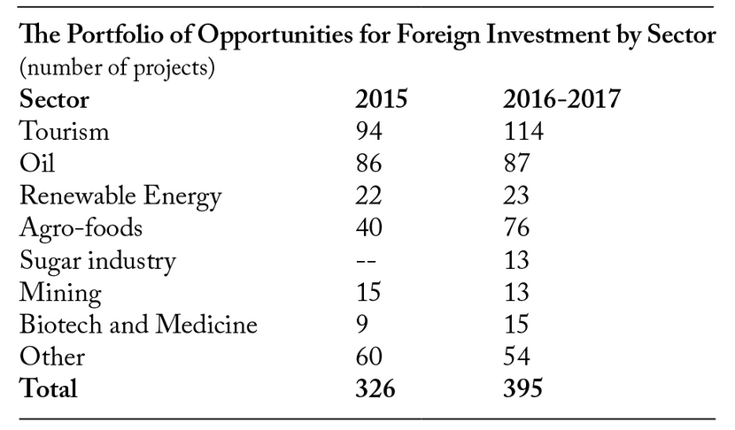
Cuba Investment Opportunities
“Portfolio of Opportunities for Foreign Investment for 2016-2017
  includes 395 business opportunities, up from 326 projects floated in 2015 and 246 projects in 2014
  Emphasis on activity in Special Economic Zones (Mariel)
Source: Feinberg, Analysis: Cuba’s Call to Foreign Investors (2017)

Slide 23
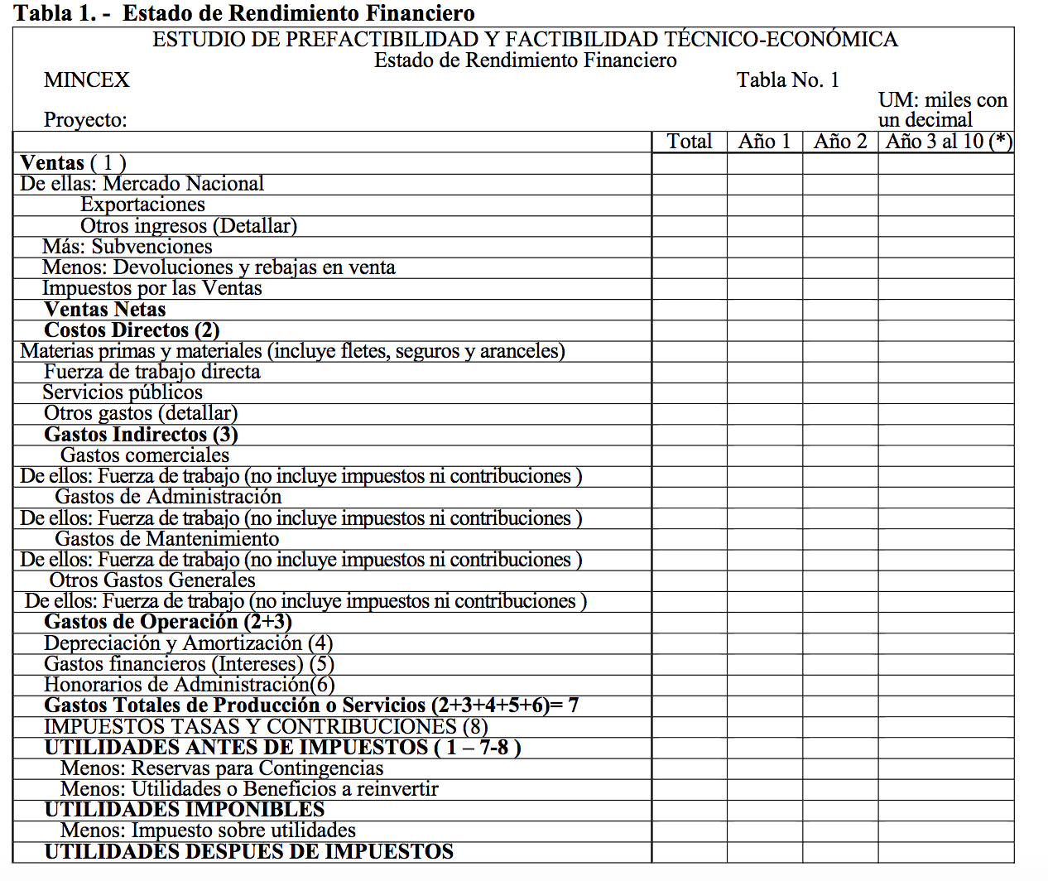
It’s All About the Application
The Foreign Investment law is effectively administered through the process of considering, negotiating, and operationalizing applications for inbound investment. Much of the administrative regulations deal with the multi-form applications and their content
Annex 2: Tablas Para La Presentación Del Estudio De Prefactibilidad Y Factibilidad Técnico-económica [Tables For Presentation Of The Study Of Pre-Feasibility And Technical-Economic Feasibility]

Slide 24
“Paperwork” for the Application
Ley 118, Resolution 129 (2014)
El Decreto Nº325 (9 April 2014) “Reglamento de la Ley de la Inversión Extranjera”
  establece el procedimiento para la presentación de solicitudes y evaluación de las propuestas de negocios con inversión extranjera en Cuba [Establishes the procedure for the submission of applications and evaluation of business proposals with foreign investment in Cuba ].
RESOLUCIÓN Nº 129 de 2014 establishes the content of the forms submitted)
  Annex 1 (Source pp. 210 et seq.) Bases Metodológicas Para La Presentación De Oportunidades De Inversión Extranjera Y La Elaboración de Estudios de Pre O Factibilidad Técnico-económica, Para Oportunidades, Propuestas De Negocios Con Inversión Extranjera Y Modificación De Negocios En Operaciones, Según Corresponda, Así Como Para La Presentación Del Informe Anual Por Las Distintas Modalidades
    Application form
    Technical pre-feasibility study
    Foundations of Economic Organization of Investing Party
      Different content for service providers
Annex 2: Tablas Para La Presentación Del Estudio De Prefactibilidad Y Factibilidad Técnico-económica [Tables For Presentation Of The Study Of Pre-Feasibility And Technical-Economic Feasibility]
  22 Tables related to investment planning
Annex 3 Annual Reporting Form

Slide 25

Los Formularios
  Application form
    General description of the project
  Technical pre-feasibility study
    A complex and quite detailed study of feasibility
    Connection between the investment and the objectives to be served in the interests of the Cuban state
    Includes the information from the 22 tables of annex 2
  Foundations of Economic Organization of Investing Party
    Detailed information about the investment vehicle

Slide 26
The Tables (Annex 2) (Original Spanish)
Tabla 1.-Estado de Rendimiento Financiero
Tabla 2.-Flujo de Caja para la Planificación Financiera [cash flow for financial planning].
Tabla 3 Flujo de Caja para el Rendimiento de la Inversión [cash flow for ROI].
Tabla 4 Estado de Situación [context]
Tabla 5. Gastos totales [total costs]
Tabla 6. Capital de Trabajo [working capital].
Tabla 7. Desglose de los Consumos Fundamentales [consumption breakdown].
Tabla 8. Inversión Inicial [initial investment]
Tabla 9. Presupuesto de Inversiones [investment budget].
Tabla 10. Cronograma de Ejecución de la Inversión [implementation schedule].
Tabla 11.Financiamientos [financing].
Tabla 12. Aportes o Aportaciones [Capital contributions].
Tabla 13. Fuerza de Trabajo [workforce].
Tabla 14. Beneficios para el país [benefit of the investment for the country].
Tabla 15. Efecto sobre las Divisas [effects on curreny].
Tabla 16. Análisis de Sensibilidad [profitability risk analysis].
Tabla 17. Movimiento de Capital Contable para prórroga.
Tabla 18. Estado de Situación pretérito para prórroga.
Tabla 19. Estado de Rendimiento Financiero pretérito para prórroga.
Tabla 20. Resumen Económico del Contrato de Asociación Económica Internacional a Riego para la exploración y producción de hidrocarburos [risk analysis hydrocarbon exploraitons].
Tabla 21. Costos y Gastos del Contrato de Asociación Económica Internacional a Riesgo de Minería [costs and expenses re mining risk].
Tabla 22. Resultados proyectados por el inversionista cubano, a partir de las operaciones del Contrato de Asociación Económica Internacional para la Administración Productiva, de Servicios y Prestación de Servicios Profesionales [Results projected by the Cuban investor, based on the operations of the International Economic Partnership Contract for the Productive Administration, Services and Provision of Professional Services].

Slide 27
From Regulation to Negotiation
The process of inbound investment can be understood as divided into roughly two stages.
First: the approval of the project
Second, the negotiation of the project investment details.
Both are filtered through the formal application and the discussions around them
For U.S. Companies that requires looking forward (to compliance with Cuban rules and standards, and negotiating details), and backwards (to the effects of Cuban needs on the ability of the U.S: enterprise to meet the BIS and OFAC licensing standards).
There are times when the incompatibility of the political agendas at the heart of two sets of rule systems might make coherent compliance difficult.

Slide 28

The Issue of Discretion, Chilling Effects and Transactions Costs , and Corruption
Discretion:
  Both the U.S. and Cuban systems are structured as ”review and approval” systems in which the exercise of administrative discretion (within the broad frameworks of law and regulation)
Chilling Effects
  Financing entities will err on the side of caution
  Approval processes can add to the costs of investment (time and money)
  In the U.S. OFAC is not bound by prior unpublished opinions or actions; great care should be taken when relying on published materials. (Source)
Corruption (e.g., here)
  Systemic (politics corrupts economics).
  Quid pro quo (economic interests corrupt politics)

Slide 29

Following a Transaction
“a) Solicitud de aprobación de la propuesta de inversión con el aval del jefe del órgano, Organismo de la Administración Central del Estado o entidad nacional patrocinadores de la inversión correspondiente, o en el supuesto de una empresa de capital totalmente extranjero, la solicitud extendida por la máxima autoridad de la rama, subrama o actividad económica en la cual se pretende realizar la inversión;
b) certificación expedida por la autoridad competente sobre la compatibilización con los intereses de la Defensa, según lo establecido en la legislación vigente;
c) valoración del Ministerio de Ciencia, Tecnología y Medio Ambiente de los aspectos relativos al medio ambiente, la tecnología, la propiedad industrial, la normalización, la metrología y la calidad;
d) propuesta de directivos cubanos que asumirán cargos en los diferentes órganos de dirección;
e) propuesta del proyecto de nomenclador de productos de importación y exportación;
f) propuesta de entidad empleadora que suministrará la fuerza de trabajo;
g) pronunciamiento escrito de la autoridad competente del órgano, organismo de la Administración Central del Estado o entidad nacional patrocinadores, avalando el estudio de factibilidad técnico-económica, así como el nivel de certidumbre de sus proyecciones; y
h) cualquier otro documento que se establezca para regular los procesos inversionistas.”
Reglamento De La Ley De La Inversión Extranjera (Decree 325 Council of Ministers) Art. 11.1, pp. 189 (On investment applications materials necessary for evaluation)

Slide 30
U.S. Process
Obtain a license from OFAC
General License
Physical Presence
31 CFR 515.573
31 CFR 501.801 (a)
31 CFR 501.801 (b)
31 CFR 515.205
Importation
31 CFR 515.535
Specific License
31 CFR 515.204
Exportation
Property
50 U.S.C. 4601- 4623
Obtain a license from BIS

Slide 31
Cuban Process (Step 1: Plan)
Start with an Idea
Diversify and expand export markets
Find a Sector
Agriculture, Forestry, and Foods
Choose Your Investment
Direct investment (investor participates as shareholder)
Decreasing dependence on imports
Increase access to advanced technology
Obtain foreign financing
Creating new sources of employment
Developing production chains
Develop renewable energy
Sugar
Industry
Tourism
Energy
Mining
Transportation
Biotechnology and Pharmaceuticals
Health
Transportation
Business
Telecom
Hydraulic Technology
Finance and Banking
Investment in equities or securities or bonds
Determine Your Contribution
Financial (“freely convertible currency”)
Machinery and equipment
Intellectual property
Property rights

Slide 32
Cuban Process (Step 2: Execute)
Joint Venture
Corporation with registered shares and shareholders
International Economic Association Agreement
No juridical persons
Negotiate with foreign investor
Totally Foreign Capital Company
Real Estate
Housing and other buildings
commercial entity with foreign capital with no involvement of any national investor
Apply for targeted sector
Approval

Slide 33
Cuban Process (Step 3: Obtain Approval)
Council of State
Council of Ministers
State Central Administration
Minister of Foreign Trade
Prospection and exploitation of non-renewable natural resources
And
Management of public services such as transportation, communications, water supply, electricity; the construction of a public work or the exploitation of a public good
Real estate developments
Totally foreign capital companies
Transfer of State ownership or other property rights over State goods
International economic associations for exploitation of natural resources
A foreign company working with public capital
Renewable energy
Business system of health and education sectors
Management of public service, construction of public work, exploitation of public good
Joint ventures, totally foreign capital company, or international economic association

Slide 34
Special Economic Zones (Source)
REULATORY FRAMEWOK
  ZED Mariel has its own regulatory framework, covered in Decree-Law 313/2013 and its complementary regulations. Decree-Law 313 grants it a group of special regimes which make up a scenario that is very attractive for investments by Cuban and for-eign companies. ZED Mariel tax incentives provide equal benefits for all the companies being established in the Zone.
APPROVAL PROCESS
  There are only 2 levels: the Director-General of the ZED Mariel Office and the Council of Ministers, for a maximum duration of 65 days from the presentation of the file.
ONE-STOP SHOP
  An efficient “One-Stop Shop” system is at work at ZED Mariel. It frees investors from bureaucratic charges and it processes all needed documents, permits, licenses and authorizations on their behalf.
DEVELOPMENT AND INFRASTRUCTURES
  Development of ZED Mariel began with Sector A, with an areaof 43.7 km², located on the western edge of the Port of Mariel. The French company Bouygues Bâtiment International was in charge of the Master Plan for the urbanization of this area, applying the best environmental quality standards and concepts.
  The Cuban government has invested over a billion USD on the development of basic and auxiliary infrastructures to ensure multi-mode connections by air, sea and land, the power supply, water supplies, sewage systems, waste treatment and info-communications, etc. which are now at the disposal of the investors.

Slide 35
The Small Transaction
From Adam J. Sulkowski, “Rodolfo’s Casa Caribe in Cuba: Business, Law, and Ethics of Investing in a Start-up in Havana,” Journal of Legal Studies Education 34(1):127-162 (2017).
  Difficulties of organizational form
    No access to corporate form (officially) (Lineamientos ¶ )
    But: “Empresas privadas de mediana, pequeña y micro escalas, según el volumen de la actividad y cantidad de trabajadores, reconocidas como personas jurídicas. ¶ 182 ”
  No direct authority to hire labor
  Difficulty of direct property ownership (as that term is used in Cuba)
  Difficulties of formalizing relationships or access to courts
  Approval process
  Are higher risk informal arrangements the norm?
  Are direct sales transactions or loans (with little collateral) the best options?
  Does the system advantage Diaspora Cubans who can work informally through family?

Slide 36
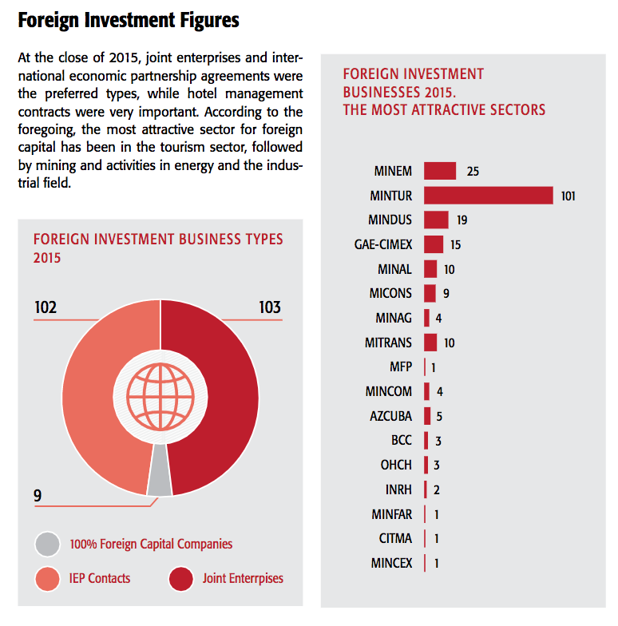
The State of Foreign Investment

Slide 37
Summary Points
“Bureaucratically, fifty-seven years after the revolution the Cuban state has become so multi-layered, so burdened with thick red tape, and so risk-averse that the decision making procedures are broken.”
  Feinberg, Analysis: Cuba’s Call to Foreign Investors (2017) noting very low rates of approval (around $200 million a year).
There are parallels in the construction of the U.S. side of investing through its licensing system tied to political efforts at regime change.
  Transaction costs of approval asserts downward push on profitability and feasibility
  Both systems consider the value of the investment to their respective states and have developed elaborate systems of governmental control of investment out of the U.S. and into Cuba.
Both the largest projects and the smallest have the greatest likelihood of moving forward
  The largest ones because they are on the radar of both the U.S: and Ciba
  The smallest ones because they can fly under the radar
Lots of traps for the unwary
  In the U.S. the interplay of control over exports, travel and finance in a fractured bureaucratic environment provides challenges
  In Cubs the complex systems of review, negotiation and approvals provide challenges.
The political overlay and bureaucracies with discretionary authority add to the transaction costs of economic activity.
  That may make the more risky or lower value added investments less attractive
Both Cuba and the United States appear still to favor commerce (trade in goods) over investment

Slide 38
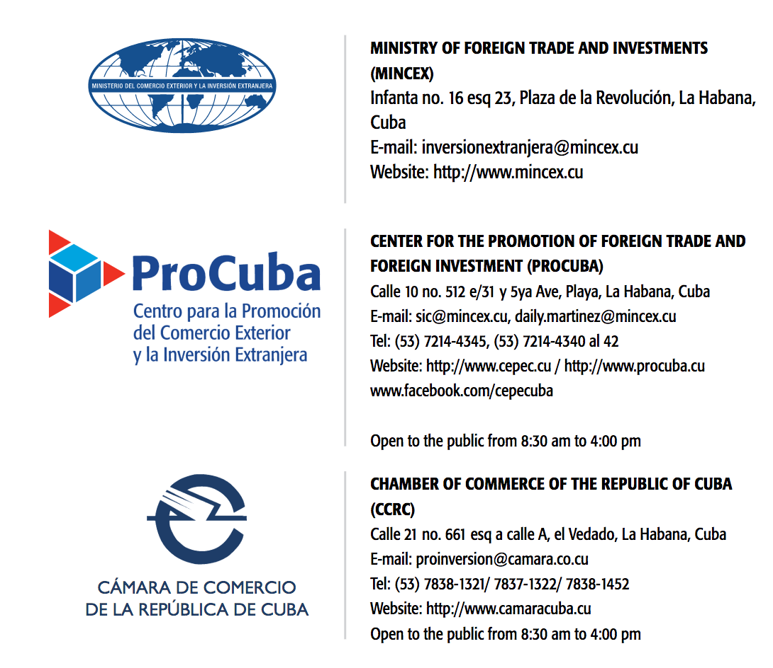
Contacts of Interest: CUBA

Slide 39
Contacts of Interest: U.S.
BIS
For additional information regarding BIS’s Cuba sanctions, please visit http://www.bis.doc.gov/cuba.
You may also call BIS’s Foreign Policy Division (202-482-4252).
OFAC
For additional information regarding OFAC’s Cuba sanctions, please visit http://www.treasury.gov/cuba.
You may also call OFAC’s toll free hotline (800-540-6322), its local hotline (202-622-2490), or the Licensing Division (202-622-2480)
Or send a message to OFAC’s email hotline account (ofac_feedback@treasury.gov).

Slide 40
Contacts of Interest: U.S.
OFAC
  Toll Free Hotline 1-800-540-6322
  ​Local Hotline ​1-202-622-2490
  OFAC Licensing Division (Direct) ​1-202-622-2480
Post Address: Office of Foreign Assets Control, U.S. Department of the Treasury, Treasury Annex, 1500 Pennsylvania Avenue, NW, Washington, DC 20220
Contact Electronically
  E-mail OFAC
  Submit in "in-process" wire transfers to the hotline
  Click here to appeal an OFAC designation or other listing
BIS
  Ask an Export Counselor Eastern Region | Western Region
  To speak with an export counselor, you may call one of the following numbers:
  (202) 482-4811 - Outreach and Educational Services Division (located in Washington, DC)
  (949) 660–0144 - Western Regional Office (located in Newport Beach, CA)
  (408) 998-8806 - Northern California branch (located in San Jose, CA)
E-mail inquiry to the Export Counseling Division of the Office of Exporter Services at: ECDOEXS@bis.doc.gov

Slide 41
Useful Additional References
Cuba
  Ministry of Foreign Commerce and Investment, Portfolio Of Opportunities For Foreign Investment 2016 – 2017 (2017).
  Law 118 Foreign Investment Law (English) (Original Spanish)
  Reglamento De La Ley De La Inversión Extranjera (Spanish; with annexes and resolutions)
  “Portfolio of Opportunities for Foreign Investment for 2016-2017
U.S.
  U.S. Treasury Dept. FAQs Related to Cuba (6 Jan 2017).
  U.S. Treasury, Treasury And Commerce Announce Further Amendments To Cuba Sanctions Regulations Oct. 2016)
  OFAC License Application Website
  Commerce Dept., BIS Cuba FAQs (Oct. 2016)

Slide 42
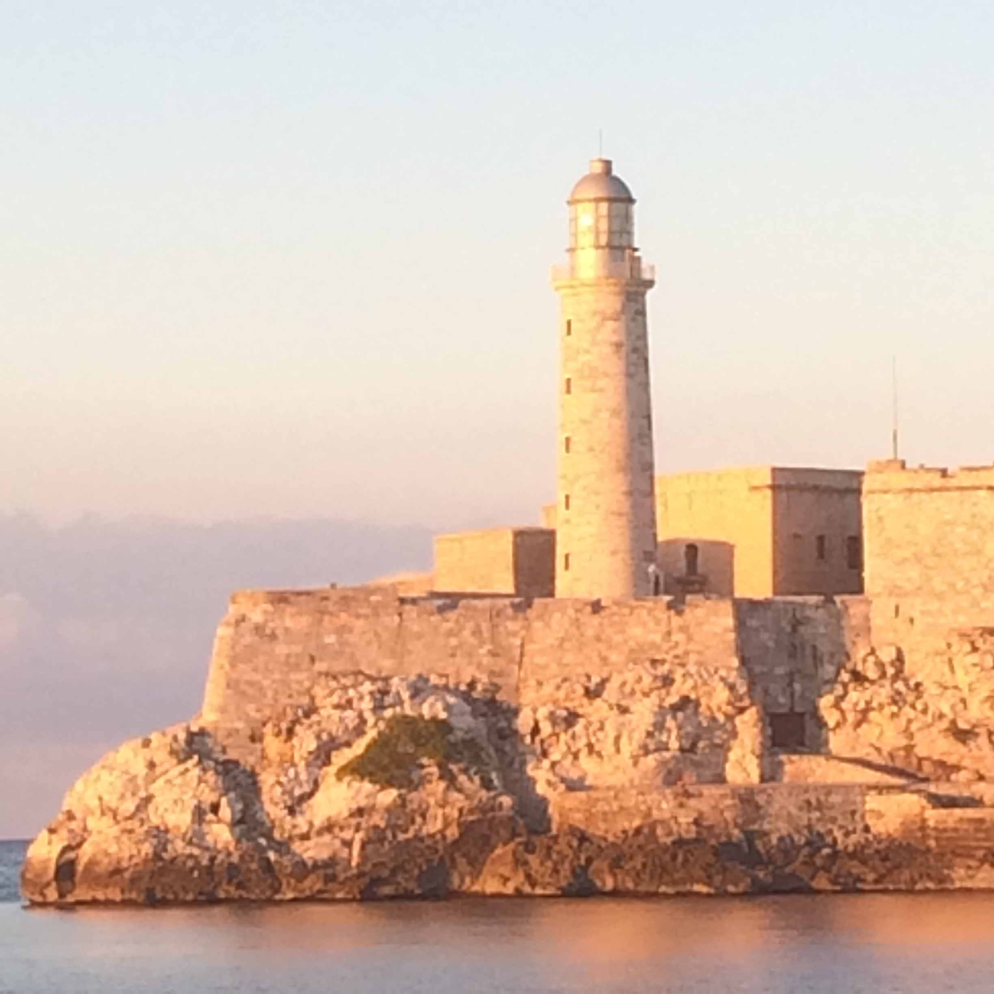
Thanks

