Slide 1
ESG Trouble From the Center to the Ends of the Silk Roads— A Comparative Problématique
Larry Catá Backer (白 轲) W. Richard and Mary Eshelman Faculty Scholar; Professor of Law and International Affairs; Pennsylvania State University | 239 Lewis Katz Building, University Park, PA 16802 || 1.814.863.3640 (direct) || lcb11@psu.edu
Prepared for the Panel on “Data Governance and the Governance of Data in China”; European China Law Studies Association Annual Conference; Helsinki, Finland 22 September 2023

Slide 2
Intersections Along Silk Roads
Social Credit
Target: Trustworthiness
Form: Lists developed from data driven measures
Basis: Data based nudging
Responsible Business Conduct
Target: Human rights & sustainability
Form: ESG Regimes developed from data driven measures
Basis: Disclosure based nudging
What happens when they meet?
What happens when Chinese Social Credit and ESG regimes meet foreign variants?
What happens when companies subject to foreign variants operate in Chia?
Pix credit here

Slide 3
Roadmap
The pathways of ESG in global public-private governance
China’s ESG policies
Are ESG policies aligned with Social Credit? Are they a species of Social Credit broadly understood?
Conflicts at the Crossroads
Inside China
Along the Silk Roads

Slide 4
ESG in Global Governance
Pix credit here

Slide 5
Brief Background: ESG
Assessing finance risk (and thus cost of capital) in private markets
Data based ratings
Advance normative agendas
Guided by the state; implemented by financial institutions
Bank Lending
Cost of capital
Availability of funds
Financial investment decisions
Norwegian Pension Fund Global Model
Operationalized through reporting, ratings
Black lists; Red lists?

Slide 6
How is it Used?
Investment and reporting
Grounded in specific objectives relevant to time, space and place
Affects availability and cost of capital
Indirect regulatory effect:
Companies conform to ESG expectations to remain in their investment universe
“According to an industry report from US SIF Foundation, investors held $17.1 trillion in assets chosen according to ESG principles in 2020, up from $12 trillion just two years earlier.1 ESG-specific mutual funds and ETFs also reached a record $400 billion in AUM in 2021, up 33% from the year before. . .” (Investopedia)
RATINGS:
“100 Best ESG Companies 2021”
Compliance based data driven regimes

Slide 7
Emerging Standards/Regulatory Frameworks
ISSB
ISSB General Requirements for Disclosure of Sustainability-related Financial Information (IFRS S1) and for Climate Related Disclosures (IFRS S2) Endorsed by IOSCO).
EU
Corporate Sustainability Reporting Directive (CSRD)
European Sustainability Reporting Standards (ESRS) (some interoperability with ISSB)
Private/Hybrid
Global Reporting Initiative (GRI)

Slide 8
From Financial Risk to Operational Impacts
A decision-making device for internal operations and choice and manner of engaging in transactions
Operational framing
Expression of prevent-mitigate-remedy (Risk) principles
Risk framing
Means of operationalizing sustainability and human rights measures in economic activity
Objectives framing
Human versus bio-diversity centered
System framing
Development versus individual centered
Stakeholder privileging framing
Compliance enhancing device
State based (Due diligence and disclosure laws)
Markets based (exchange requirements
Hybrid (SWF rules eg Norway)
Compliance framing

Slide 9
From Aspiration to Realization: Impediments and Challenges
Definitions
Methods of Assessments
Quality of data
Applications
Scalability
Comparability
Liability-consequences
Compliance networks
Coordination
).

Slide 10
Oppositions

Slide 11
Examples: Federal ESG Wars
Challenge to SEC efforts to mandate ESG disclosure in securities disclosures.
“Only Financial Criteria” strategy
US State Attorneys General sue to prevent use of ESG in making pension investment decisions
Issue is one of privileging ESG over financial objectives where legal compliance is not otherwise implicated
Biden Administration final rule : “fiduciaries are permitted to weigh “the economic effects of climate change and other ESG considerations” as long as such concerns are relevant to a risk-and-return analysis.”

Slide 12
Example: State Anti-ESG Legislation
Limit Pension Plan fiduciaries from taking into account ESG criteria.
Mississippi; Florida
No ESG criteria in fund investment or in awarding contracts
Kansas

Slide 13
China’s ESG Universe
Pix credit here

Slide 14
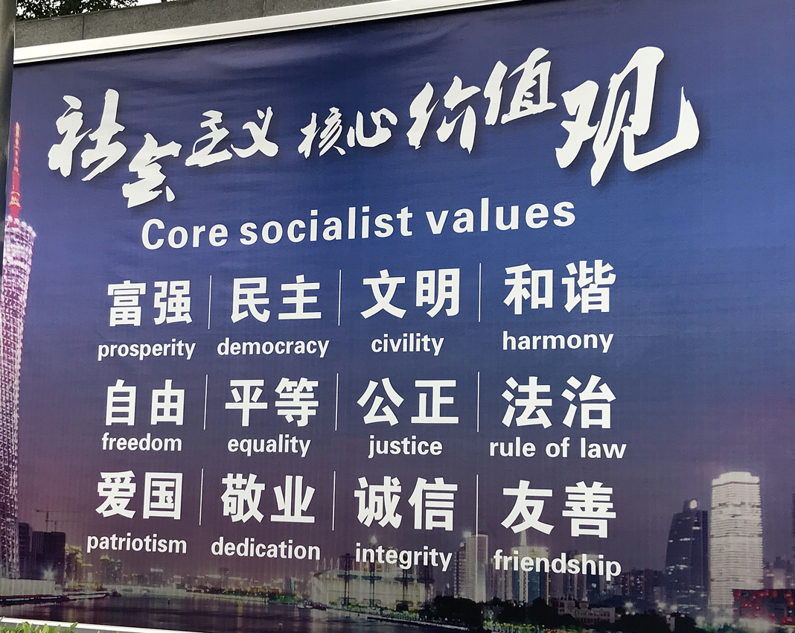
Political Foundations
From “Reform and Opening Up” to “New Era”
Ecological civilization
12 Socialist Core Values
4 Cardinal Principles
Communist path
Peoples’ democratic dictatorship
CPC Leadership
Upholding core ideology
General Contradiction:
From class struggle
To economic and cultural development
To “between unbalanced and inadequate development and the people's ever-growing needs for a better life”

Slide 15
From CSR to ESG (to Social Credit?)
2006 Companies Law
Art.5. “When conducting business operations, a company shall comply with the laws and administrative regulations, social morality, and business morality. It shall act in good faith, accept the supervision of the government and general public, and bear social responsibilities.”
China Securities Regulatory Commission (CSRC) and stock exchanges
Before 2018 gradual inclusion of ESG reporting measures
2018 CSRC added ESG to its Corporate Governance Guideline (encouraging listed entities comply with ESG requirements)
2021 (June) CSRC (a) rules on ESG reporting in the annual report of listed companies (b) reform scope of disclosure
environmental emissions,
administrative penalties for breach of environmental regulations,
measures for reducing carbon emissions,
donations or other actions that reduce poverty, and so on.
2022 (February)
CERDS (China Enterprise Reform and Development Society) led
ESG disclosure standards: the “Guidance for Enterprise ESG Disclosure” (“企业 ESG 披露指南”, the “ESG Disclosure Standards

Slide 16
A Marxist-Leninist (“Socialist”) ESG?
ESG “Trustworthiness”
Moral/Social/Political
Approach to the current general contradiciton
Data based
Ratings and Assessment driven
CSCS scoring system, based on its recent rollout in Zhejiang Province
(Lauren Yu-Hsin Lin, Curtis J. Milhaupt 2021)
Coordinating role of state apparatus
Pyramid up from local to national
Formal and informal mechanics
Entwinning
Administrative expression of New Era policies and initiatives
Private sector operationalization

Slide 17
Situating Chinese ESG in/as Social Credit

Slide 18
SCS Foundational Objectives 2014
“Raising the level of creditworthiness in commercial affairs is a key part of establishing the social credit system; it is a basic requirement for effectively upholding commercial relations, effectively lowering commercial operating costs, and effectively improving the commercial environment; it is the heart of having sustainable development for all kinds of commercial entities, and is a basic safeguard for effectively carrying out of all kinds of economic activities.” (2014 State Council White Paper)
Establishment of credit in:
Production field
Feld of circulation (markets)
Finance
Taxation
Pricing
Construction projects
Procurement
Bidding
Transport
E-commerce
Statistics (data integrity, reporting)
Intermediary services
Exhibitions and advertising
Management systems in enterprises

Slide 19
ESG Alignment with “Corporate” Social Credit System Modalities?
Ratings and Red-/Black-lists
The technologies of assessment are still embryonic but possible
Analytics of rating in place
Rewards and punishments
Cheap loans, higher import and export taxes and key personnel being prohibited from leaving China
Pix: Wang Guangy, Great Criticism (Tate Modern 1992).

Slide 20
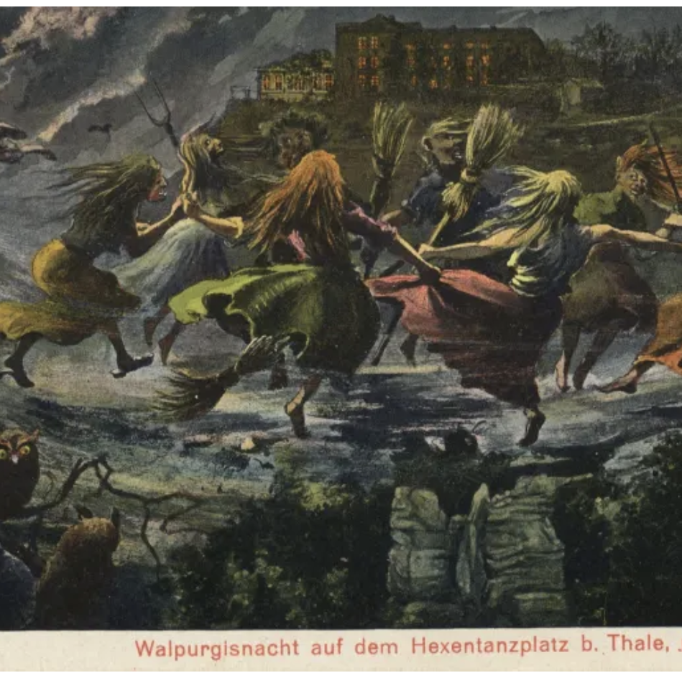
Managing the Economic Sector
Indirect management of people through enterprises
Delegated governmentalization of private sector (disciplining of private sector in Market Marxist Systems)
Coordinating markets and public public policy
Data driven punishments and rewards based on deviations from normative ideal
System of triggers based on placement in ratings with effects beyond the specific context
Social Credit!

Slide 21
Conflicts at the Crossroads
Pix credit here

Slide 22
Data/Information Protection Regimes
Information/Data
China
State Security, Counter-Espionage; Data Security Laws
EU
German Supply Chain Due Diligence Law; France, Loi de Digilance
UK/US/AUS
Modern Slavery Law disclosures; sanctions-based regimes

Slide 23
Ratings-Disclosure Based Normative Internationalism
Socialist Human Rights
Development centered
Collective
Relational
Socialist Internationalism
Global Development Initiative
Global Security Initiative
Global Civilization Initiative
Build a community with a shared future for mankind.

Slide 24
Convergences and Divergence
企业 ESG 披露是企业关于环境（Environmental）、社会（Social）和治理（Governance）的信息披 露体系。ESG 是企业可持续发展的核心框架，已成为企业非财务绩效的主流评价体系。鉴于此，为了 不断适应市场的新变化，推动企业绿色低碳战略转型，引导企业高质量发展，建立适用于我国国情的企 业 ESG 披露指南是必要的和迫切的。
《企业 ESG 披露指南》以国家相关法律法规和标准为依据，结合我国国情，从环境、社会、治理 三个维度构建企业 ESG 披露指标体系，为企业开展 ESG 披露提供基础框架，促进企业实现经济价值与社会价值的统一。
(CERDS 2022, Introduction)
Corporate ESG disclosure is the company's information disclosure system on the environment (Environmental), Society (Social) and Governance (Governance). ESG is the core framework for corporate sustainable development and has become the mainstream evaluation system for corporate non-financial performance. In view of this, in order to continuously adapt to new changes in the market, promote the green and low-carbon strategic transformation of enterprises, and guide enterprises to develop high-quality development, it is necessary and urgent to establish corporate ESG disclosure guidelines that are suitable for our country's national conditions.
The "Enterprise ESG Disclosure Guide" is based on relevant national laws, regulations and standards, combined with our country's national conditions, and constructs an enterprise ESG disclosure indicator system from the three dimensions of environment, society and governance, providing a basic framework for enterprises to carry out ESG disclosure and promoting enterprises to realize economic value. unity with social values.

Slide 25
Normative Competition Spaces along the Silk Roads
Liberal Democracy ESG normative social credit
Regional Trade Groups
International Orgs
Compliance through control of production chains
MNEs; soft/hard law
Marxist Leninist
Belt & Road Initiative
International Orgs
Compliance through control of production chains
SOEs and externalization of oversight direction (SASAC, etc., CPC)
Both use ESG/Social Credit strategically and instrumentally
Internal discipline
External

Slide 26
Mutual Blocking Legislations
China Bloc
Law
Foreign Affairs Law; Secrecy Law, etc. (with administrative approval regimes); National Security; etc.
Sanctions
Specific blocking legislation
Domestication of data
US-EU Bloc
Sanctions
National Security
Markets driven and private

Slide 27
Cross-Roads Across Systems

Slide 28
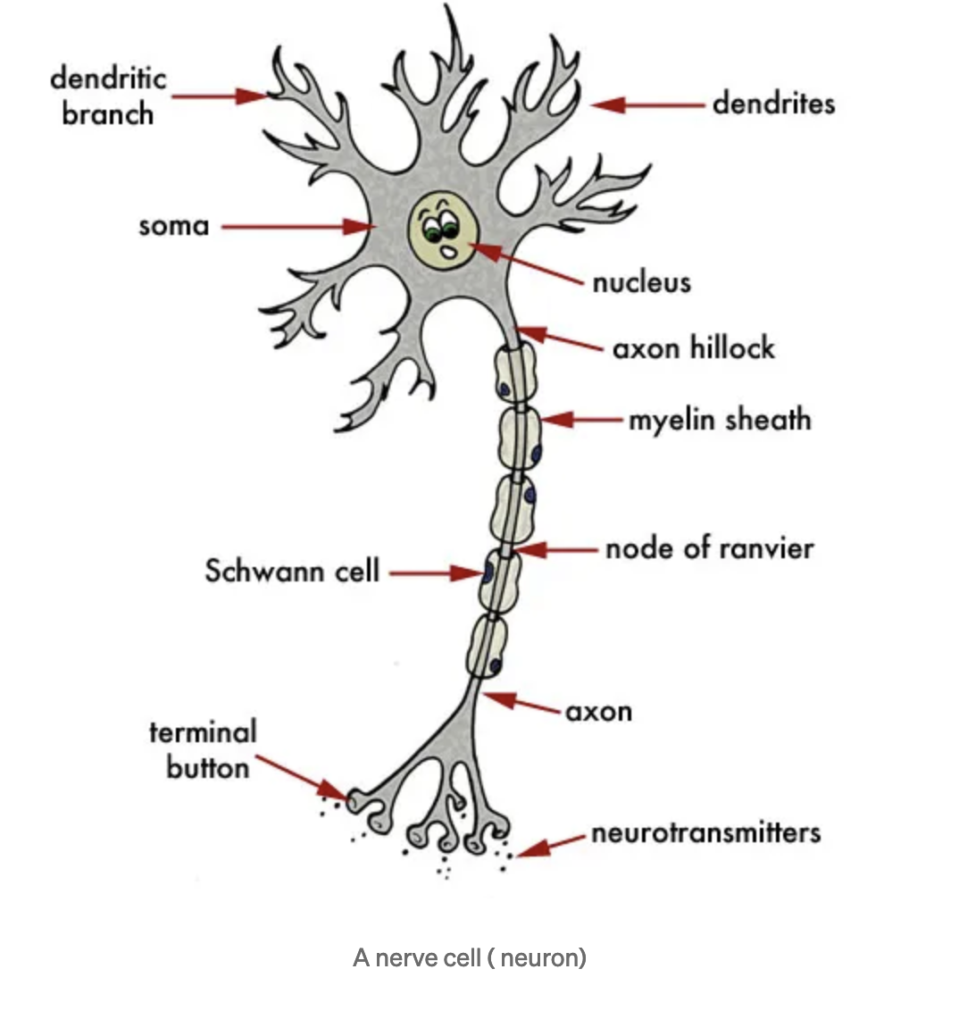
Social Credit as Pathways & Neural Networks
Punctuated by platforms
Where producers and users meet
Where interactions organized
Routing
Consequences that then loop back
Circulatory system
Between platforms
Structural coupling among functionally differentiated platforms
What sort of neural network?
Connected but diffuse—bound by technical standards
Coordinated—single or multiple coordination
Controlled—where is the control
ESG
Platform
Standardized structures of functional differentiation
Within neural networks of “trustworthiness”
Pathway and neural network
Generating disciplinary data
Structures through regulatory standards

Slide 29
Possibilities: Crossroads, Junctions, Intersections
Journey of intersecting paths
ESG are roadways going in different directions
Hostile incursions that meet at one or more points
Incompatibilities and strategic uses meeting in ESG standards
The space between places that share one or more meeting points
Normative structures, political objectives of ESG standards
To thwart, obstruct, or oppose at a point of pathway intersection
Use of ESG to block or oppose normative or operational efforts of competitors
Meeting point of passages from one place to another
Social credit and ESG as means of shaping behavior and cultures
A turning or decision point
ESG and Social Credit regimes as modalities of “just transitions”
Folklores: a portal to or a location between worlds where spirits can be contacted
Social credit generally and ESG specifically as the data driven construction of institutional folklores

Slide 30
Questions

Slide 31
Thanks

